Slide 1
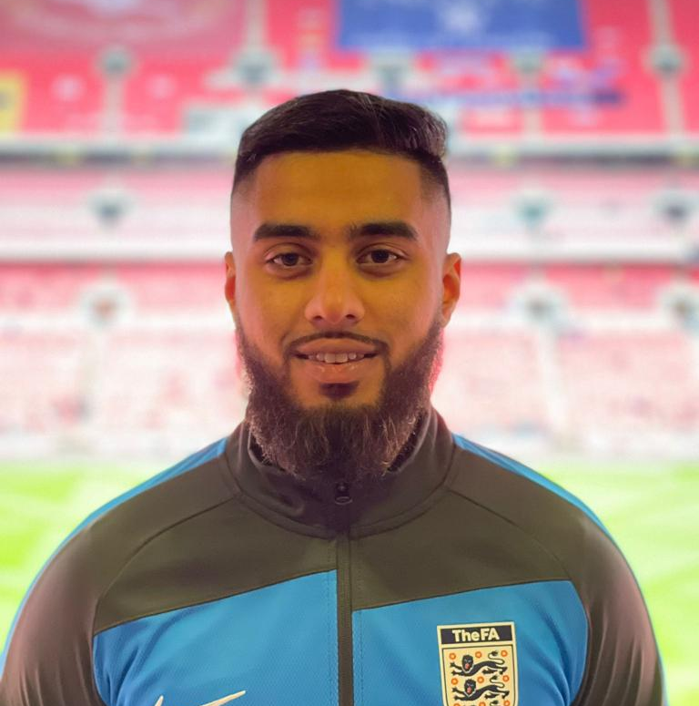
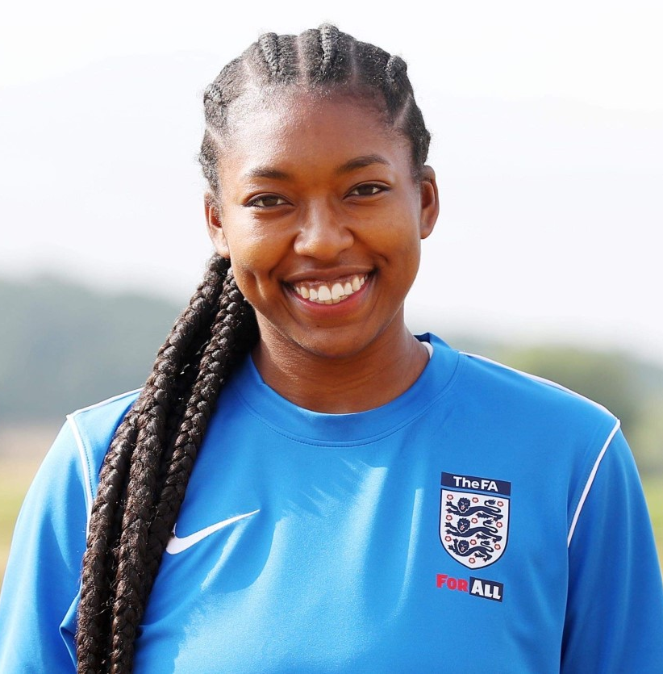
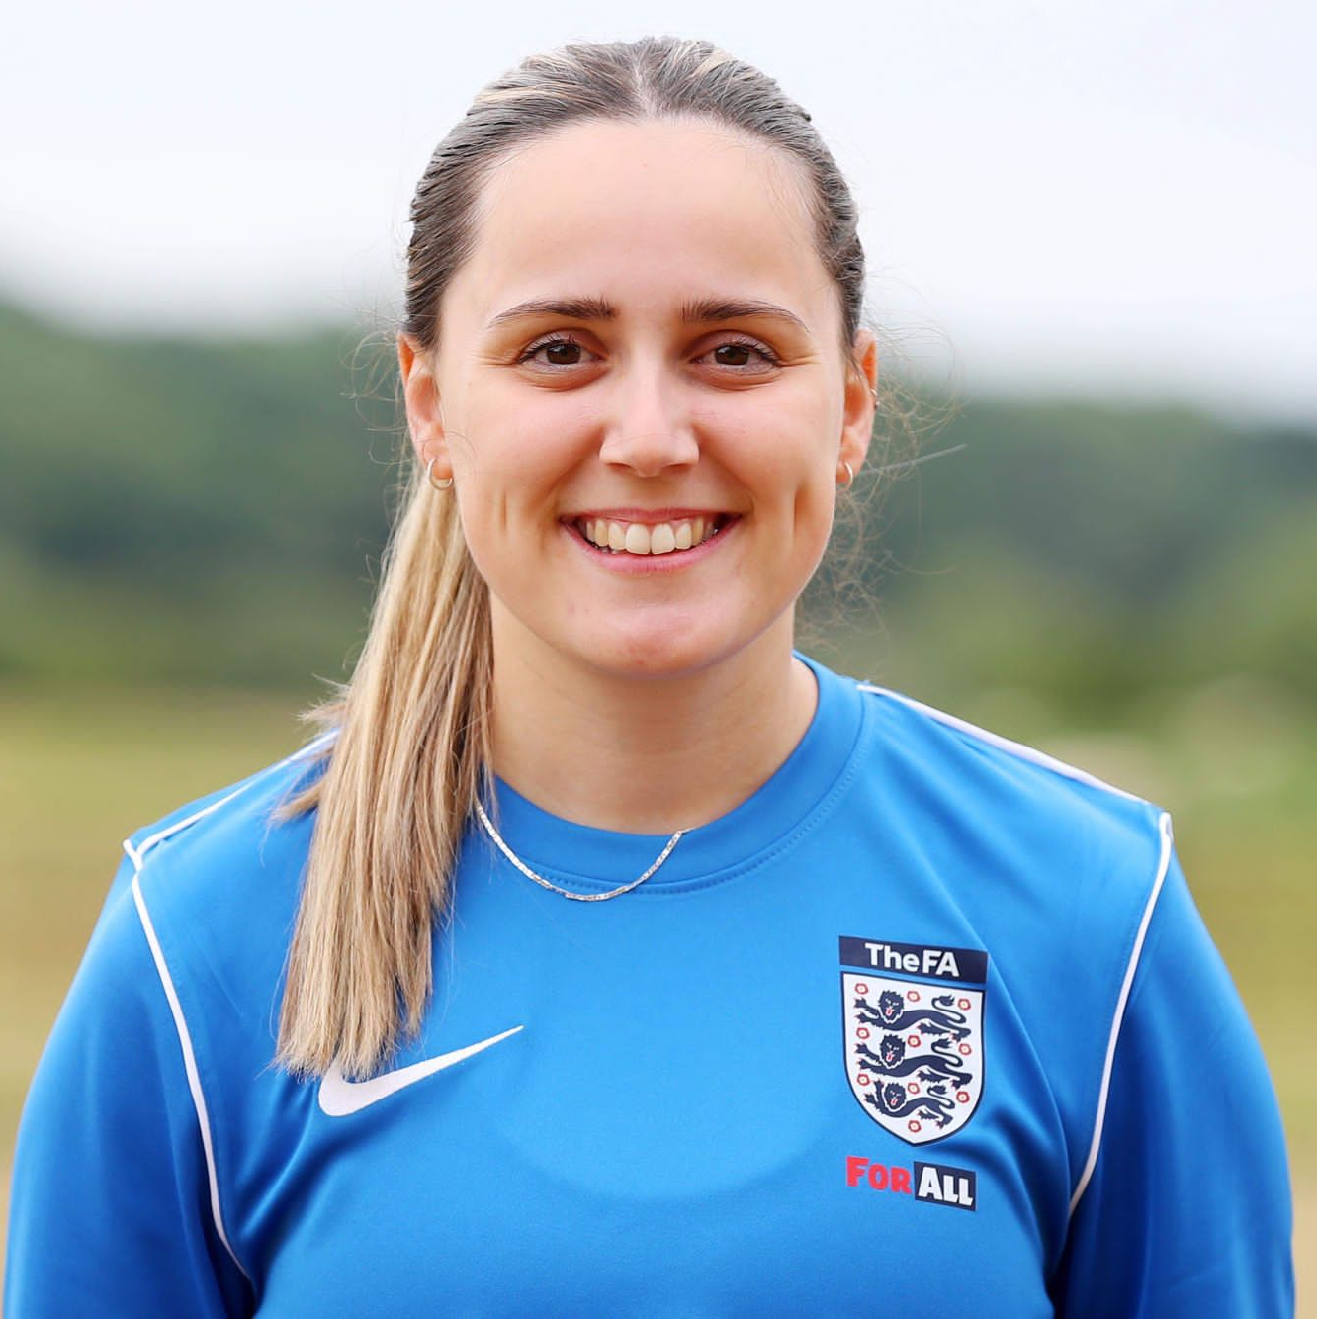
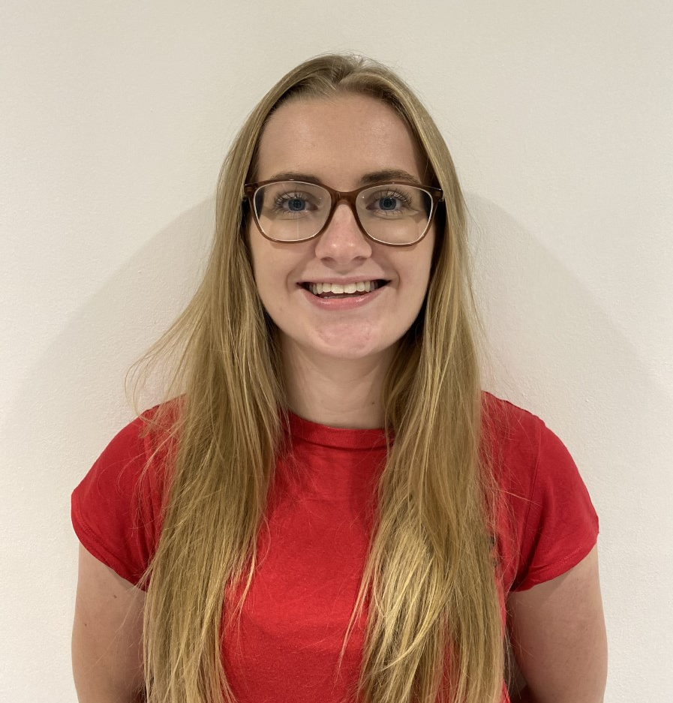
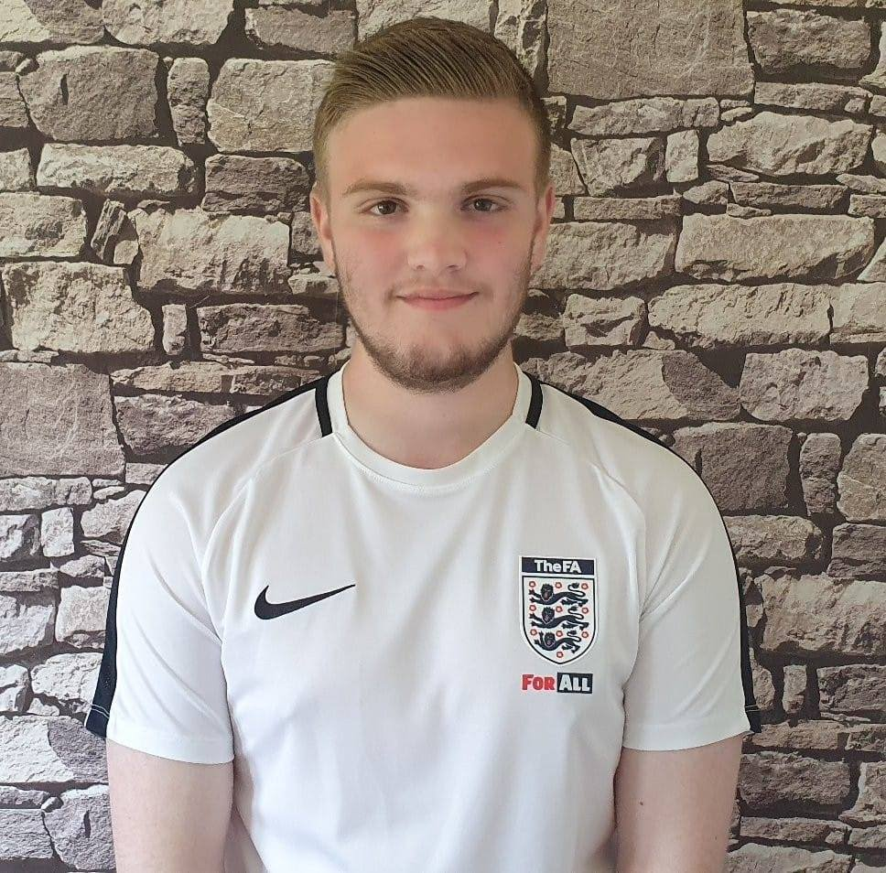
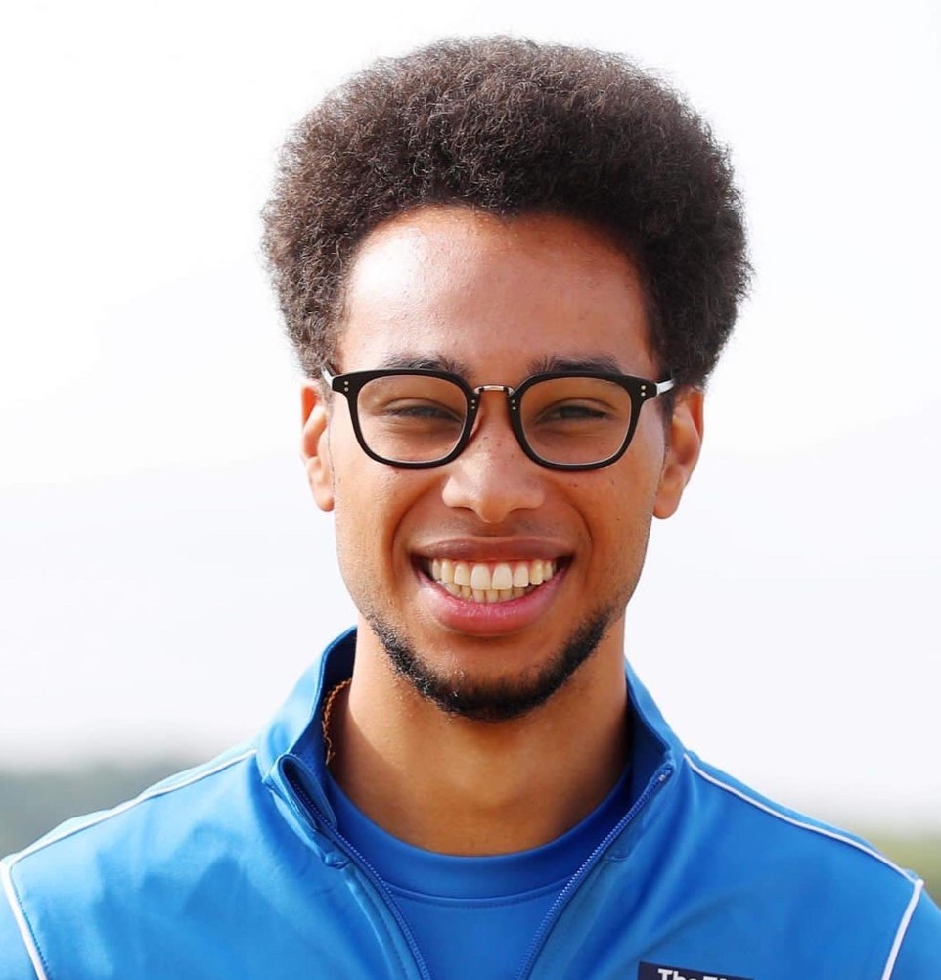
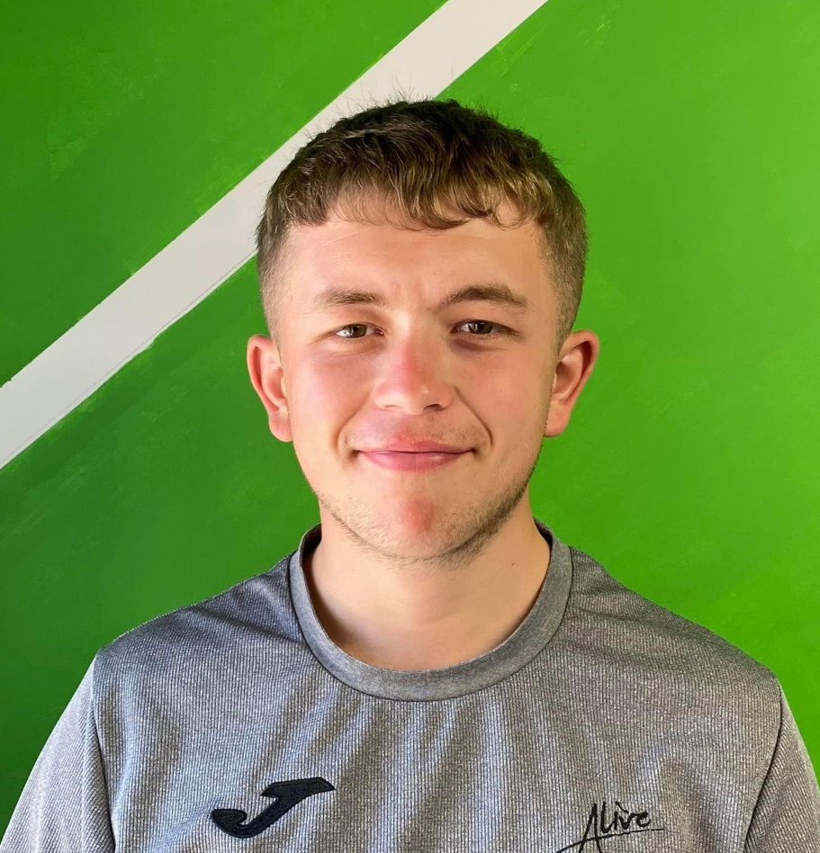
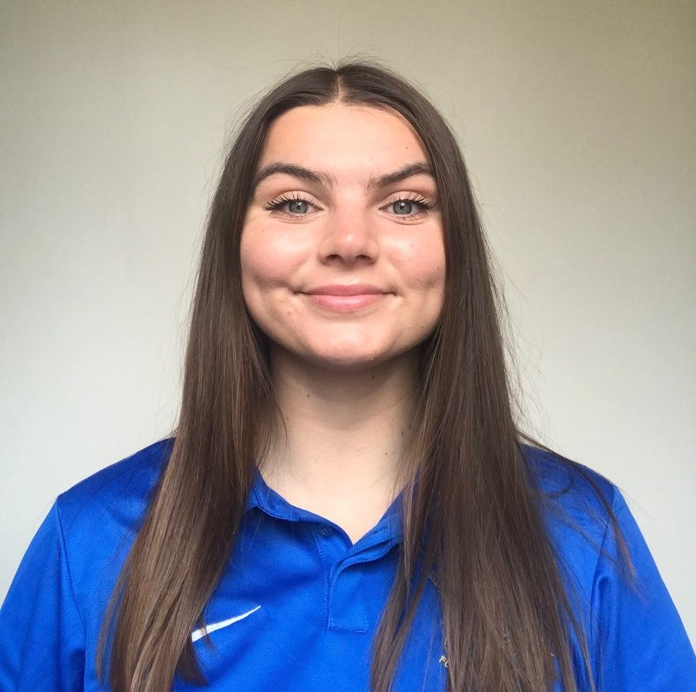
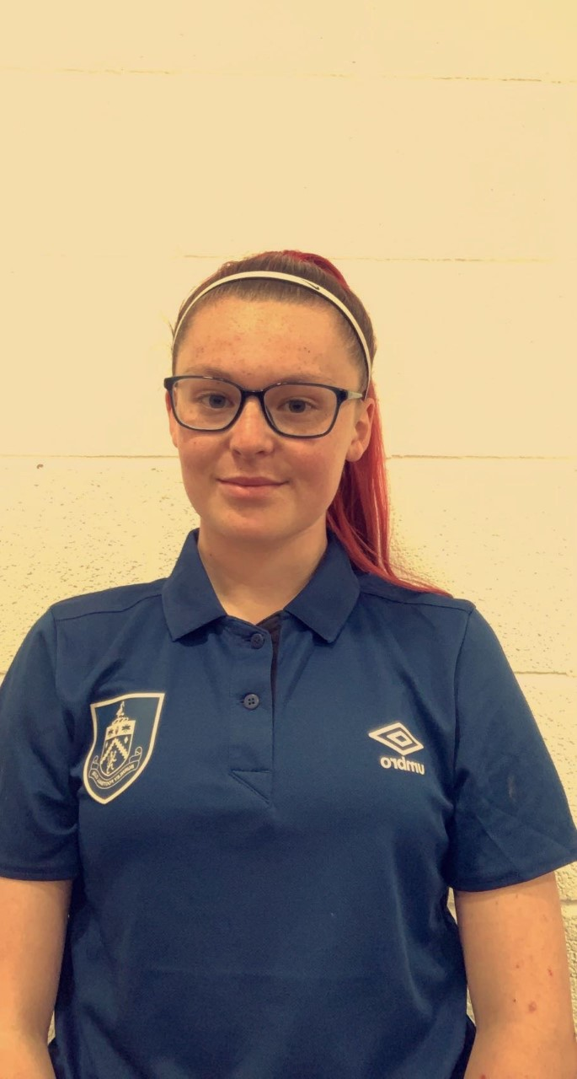
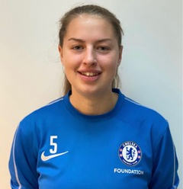
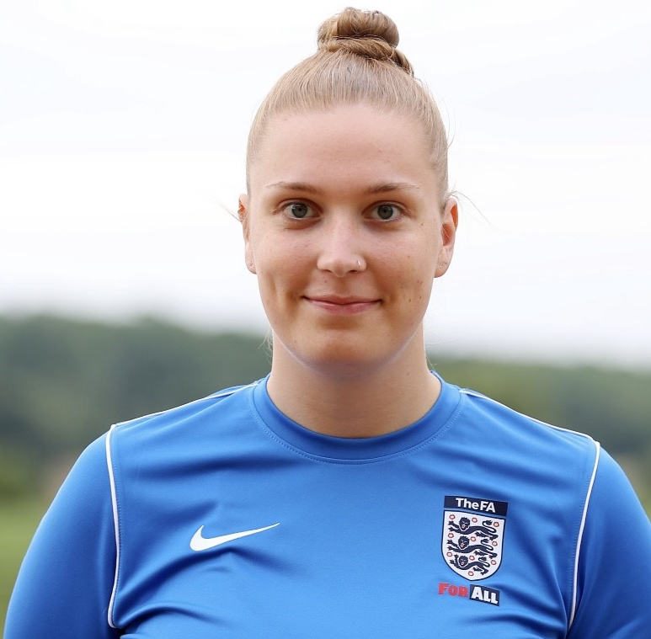
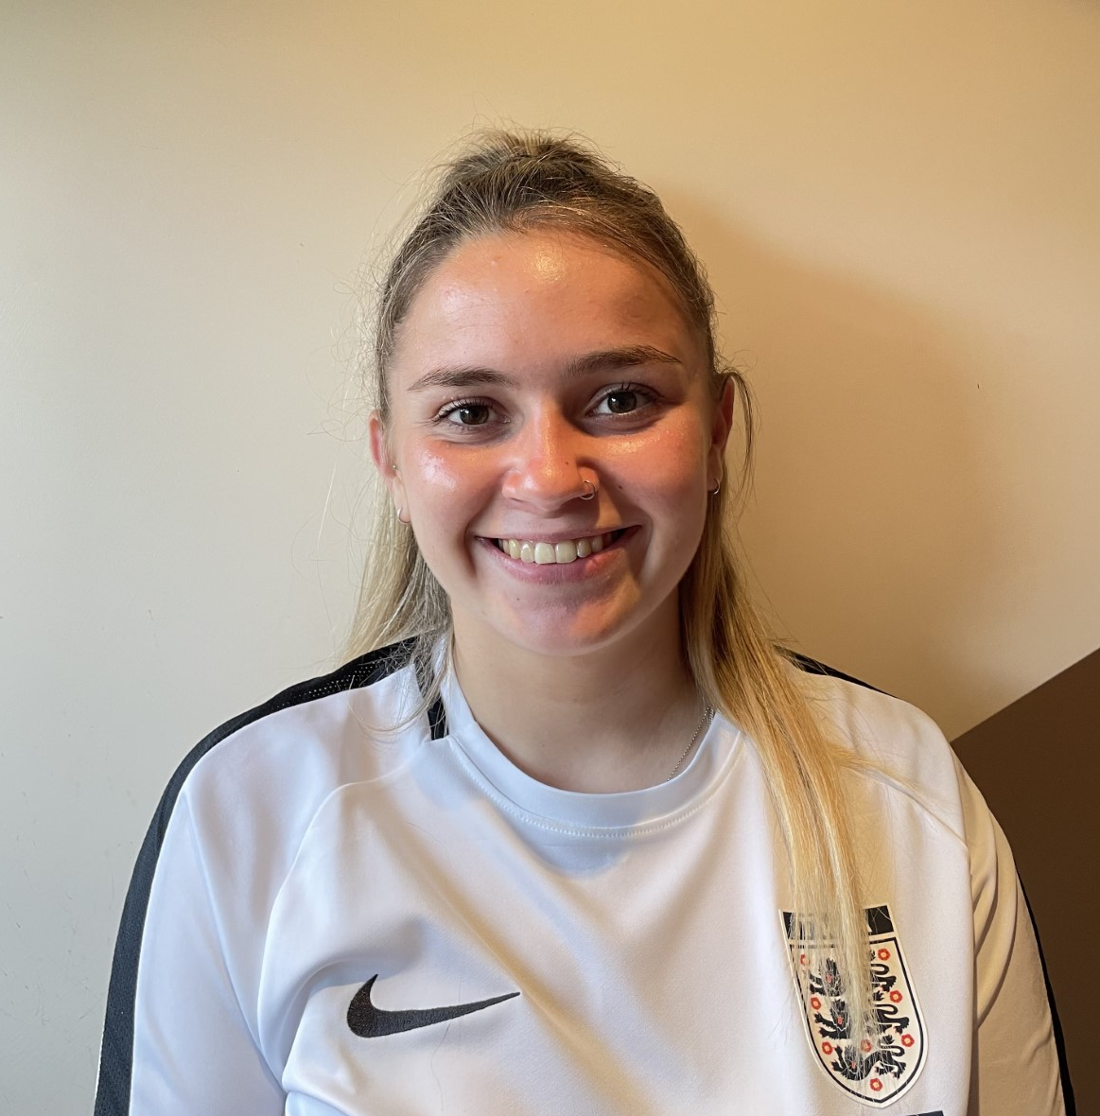

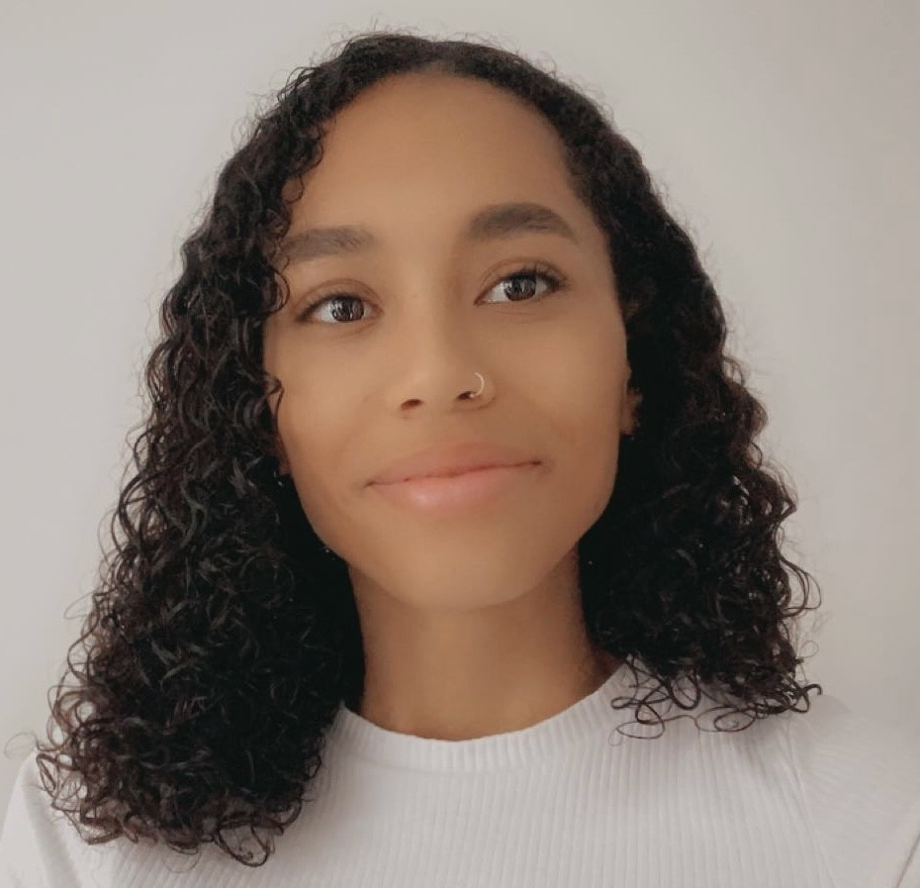
FA National Youth Council 2022/23 - Biographies
SENIOR LEADERSHIP TEAM
Nayim Ahmed - Chair
Nayim is a football coach from East London and has been coaching in the professional and grassroots game for nearly 10 years now. This is his third season on FA National Youth Council. Growing up in London, Nayim appreciates diversity amongst communities and is incredibly passionate about amplifying the voice of underrepresented groups and creating meaningful opportunities especially for males from difficult socio-economic backgrounds. Nayim has represented the London FA Youth Council and the London Legacy Development Corporation Youth Board and is also a Trustee at Wembley National Stadium Trust. He is currently running the Legacy Football League based in the London Stadium, Stratford.
Tiara Hemans – Vice-Chair
Ellie Reid – Vice-Chair
Tiara currently works as a Bid Project Manager within the Telecommunications Industry. Although football and sport is not an area that she works within at present, in her second season on FA National Youth Council, she is currently the Chair of Birmingham County FA Youth Leaders having recently been promoted from the Senior of Engagement. Alongside this, Tiara plays for Sutton Coldfield Women's Team and has recently graduated from two FA leadership programmes (FA Leadership Academy (FALA) and FA BUCS Women's Leadership Profunded gramme (FAWLP)) Though her educational and working experience varies, Tiara's interests predominately revolve around Events Management and Diversity where she aims to bridge the gap between underrepresented groups and football in ensuring that not only is football accessible to all, but football is a safe place for all.
Ellie is passionate about using sport as a tool to fulfil individual potential, and believes football is a powerful vehicle to achieve this. With a particular interest in the Women and Girl's game, she is fortunate enough to do this in her role as Women’s Participation Officer at MK Dons SET where she is working on the UEFA Women’s EURO 2022 legacy project. She has previously been Chair of Berks & Bucks FA Youth Council and completed the FA University Women’s Leadership Programme. In her second season on The FA National Youth Council, she is delighted to continue her role as Vice Chair role helping to develop a high performing team which provides meaningful opportunities for youth leaders.
COMMUNITY IMPACT TEAM
LEADERSHIP & DEVELOPMENT TEAM
RESEARCH & COMMUNICATIONS TEAM
Millie Morris – Community Engagement Lead (North & West)
Joel Dooley – Leadership & Development Lead (North)
Jordan Liburd – Research & Insight Lead
Millie is 22 years old, lives in Barnsley and has just graduated Sheffield Hallam University with a degree in Sport Business Management. This is her first season on the team. Millie’s passion for football development originated from her own experience of struggling to find sporting opportunities up North for women/girls. Millie’s life revolves around sport, her job includes inspiring and empowering women and girls to become more confident in sport and outside of work she loves playing football, running, weightlifting and walking her two cocker spaniel dogs.
Joel Dooley is 19 years old from Newcastle, who studies Sports coaching at Northumbria University. This is his second season on the team. Whilst also working as a Night receptionist in a hotel, Joel is passionate to create new opportunities for youth leadership. Joel has previously refereed and socialising through sport and playing guitar are often hobbies which Joel likes to do.
Jordan is the Research and Insight Lead on The FA National Youth Council: this is his second season. Jordan is a football coach of an U12s girls’ team, alongside being a mentor, and Football Development Officer at his club, Horsforth St. Margaret’s FC. Away from football, Jordan is a research scientist, working within structural and molecular biology.
Harry Bland – Community Engagement Lead (South & East)
Madeline Hurley – Leadership & Development Lead (Midlands)
Lois Page – Social Media & Marketing Lead
Harry is 19 years old and from Norfolk. This is his first season on the team. He is currently studying a BA Hons in Sport and Exercise Science at Sheffield Hallam University – whilst working as a sports coach back home in Norfolk. In a Football sense, Harry has previously played at a low level, whilst currently coaching and refereeing.
Madeline Hurley, aged 20. This is her first season on the team. She is currently at Sport England, working as an Investment Management Support Assistant, for her placement year within her Sport and Exercise Psychology degree at Loughborough University. She refereed football for three years and coached a Wildcats Centre for over two years. She volunteers at Hertfordshire FA and is a representative on Hertfordshire FA’s Council. She trains for sprints and enjoys a wide variety of sports. She aspires for a career where she can improve the community through sport and exercise!
Lois is 18 years old and moved down to Loughborough University from Burnley after finishing her sports science study’s at Nelson and Colne college. This is her first season on the team. She previously worked as a coach for Burnley FC in the Community whilst also volunteering with the local Wildcats set up at Burnley Belvedere FC. Her footballing journey has lead her to win the FA County league with Haslingden as well as the FA National County’s league and cup with Lancashire county team.
Lois Page – Community Engagement Lead (Clubs & Leagues)
Poppy Nicholls – Leadership & Development Lead (South)
Lydia Shale – Communications Lead
Lois is 18 years old and moved down to Loughborough University from Burnley after finishing her sports science study’s at Nelson and Colne college. This is her first season on the team. She previously worked as a coach for Burnley FC in the Community whilst also volunteering with the local Wildcats set up at Burnley Belvedere FC. Her footballing journey has lead her to win the FA County league with Haslingden as well as the FA National County’s league and cup with Lancashire county team.
Poppy is 19 years old and grew up in West Sussex. This is her first season on the team. She has played Football since the age of 5 and recently just finished a 3-year football college programme in Sussex, alongside playing she coaches for Chelsea Foundation. She’s just about to start her first year at university studying Physical Education with QTS at Brighton University. She has a passion for increasing opportunities and participation among Women and Girls.
Lydia is 19, and studies Sports Science and Physiology at the University of Leeds. This is her second season on the team. She coaches the University Women’s team, as well as leading Rehabilitation Football sessions, and teaching primary school aged children football during the week. Her main passion within football is the promotion of inclusivity, as well as improving access for Women and Girls to play.
Skye Smith – FA Youth Mentoring Programme Lead
Skye is 22 years old and works as a sports coach in Bristol. This is her second season on the youth council and is the FA Youth Mentoring Programme Lead. Skye is really passionate about Women’s Football and coaches at Gloucestershire Girls Coaching Centre and has her own u13s grassroots team.
Charlotte Akester – Equality, Diversity & Inclusion Lead
Charlotte has just completed her Sports Development and Coaching degree, and is a football coach, who has coached from wildcats right through to ladies’ football. This is her first season on the team. Charlotte has a keen interest in making football accessible and inclusive and is currently a member of the Lincolnshire FA’s Inclusion Advisory Group.

Slide 2
FA National Youth Council 2022/23 - Roles
SENIOR LEADERSHIP TEAM
Nayim Ahmed - Chair
Strategically leads The FA National Youth Council (FA NYC) throughout the season, supporting the planning and delivery of meetings and projects, whilst managing the Vice-Chairs.
Leads on representing the voice of children and young people on FA Council and other FA committees.
Leads on working closely with FA/FANYC staff as the main contact of the FANYC.
Tiara Hemans – Vice-Chair
Ellie Reid – Vice-Chair
Operationally leads The FA National Youth Council throughout the season.
Drives the planning and delivery of meetings and projects.
Manages and supports team members to achieve outcomes.
Operationally leads The FA National Youth Council throughout the season.
Drives the planning and delivery of meetings and projects.
Manages and supports team members to achieve outcomes.
COMMUNITY IMPACT TEAM
LEADERSHIP & DEVELOPMENT TEAM
RESEARCH & COMMUNICATIONS TEAM
Millie Morris – Community Engagement Lead (North & West)
Joel Dooley – Leadership & Development Lead (North)
Jordan Liburd – Research & Insight Lead
Supports and develops the network of County FA Youth Councils (and/or other young people/ youth leadership teams) in the North of England, through the County FA Youth Council Maturity Matrix to help create a national network of young people.
Supports the development of new youth leadership activities/teams in County FAs and partner organisations, WSL Academy Players Group or equivalent in the North of England.
Responsible for the planning and delivery of the FA Regional Youth Network, other new development opportunities for young people/youth leaders.
Supporting The FA Leadership Academy participants in the North in their learning and development through ensuring high engagement.
Leads on providing relevant research and insight to inform the priorities of the FANYC and drive action in line with our vision.
Leads on the tracking of The FA Leadership Academy participants progress and achievements. Leads on the logistical creation of online application processes and surveys.
Supports the FA National Youth Council team in events throughout the season.
Harry Bland – Community Engagement Lead (South & East)
Madeline Hurley – Leadership & Development Lead (Midlands)
Lois Page – Social Media & Marketing Lead
Supports and develops the network of County FA Youth Councils (and/or other young people/ youth leadership teams) in the Midlands, through the County FA Youth Council Maturity Matrix to help create a national network of young people.
Supports the development of new youth leadership activities/teams in County FAs and partner organisations, WSL Academy Players Group or equivalent in the Midlands.
Responsible for the planning and delivery of the FA Regional Youth Network, other new development opportunities for young people/youth leaders.
Supporting The FA Leadership Academy participants in the Midlands in their learning and development through ensuring high engagement.
Leads on all marketing for The FA National Youth Council across several social media and marketing platforms driving the increase in visibility of the FANYC.
Consistent and high-quality delivery and engagement of social media and webpage content and staying up to date with current topics of conversation.
Leads on the creation of FANYC brand content to for marketing, communications and events.
Lois Page – Community Engagement Lead (Clubs & Leagues)
Poppy Nicholls – Leadership & Development Lead (South)
Lydia Shale – Communications Lead
Supports and develops the network of club and league Youth Committees (and/or other youth leadership teams) in England to help create a national network of young people/youth leaders.
Supports the development of new youth leadership activities/teams in clubs and leagues. Should be engaged in youth leadership and volunteering in football.
Responsible for the planning and delivery of the FA Regional Youth Network, other new development opportunities for young people/youth leaders.
Supporting The FA Leadership Academy participants in the South in their learning and development through ensuring high engagement.
Leads and delivers regular content, updates and posting of opportunities on FA National Youth Council platform, Youth Leader Community.
Collates reports in collaboration with the Research and Insight lead that can be shared with The FA Development Team.
Collaborates with the Social Media and Marketing Lead to produce and deliver high quality content driving the increased visibility of the FA National Youth Council.
Skye Smith – FA Youth Mentoring Programme Lead
Responsible for the delivery of the new programme in its first year.
Recruiting, pairing and supporting Mentors and Youth Leaders to develop mutually beneficial mentor-mentee partnerships.
Devises tactics to provide guidance and resources to aid mentors and mentees throughout the season and to track the progress of mentees.
Charlotte Akester – Equality, Diversity & Inclusion Lead
Plans and delivers a social action plan in line with FA National Youth Council’s vision, aims and objectives.
Leads on listening, understanding, and investigating new ideas from The FA National Youth Council and other young people.
Ensures new project developments by the FANYC address and react to current situations or issues in football through the power of Youth Leadership.

