Slide 1
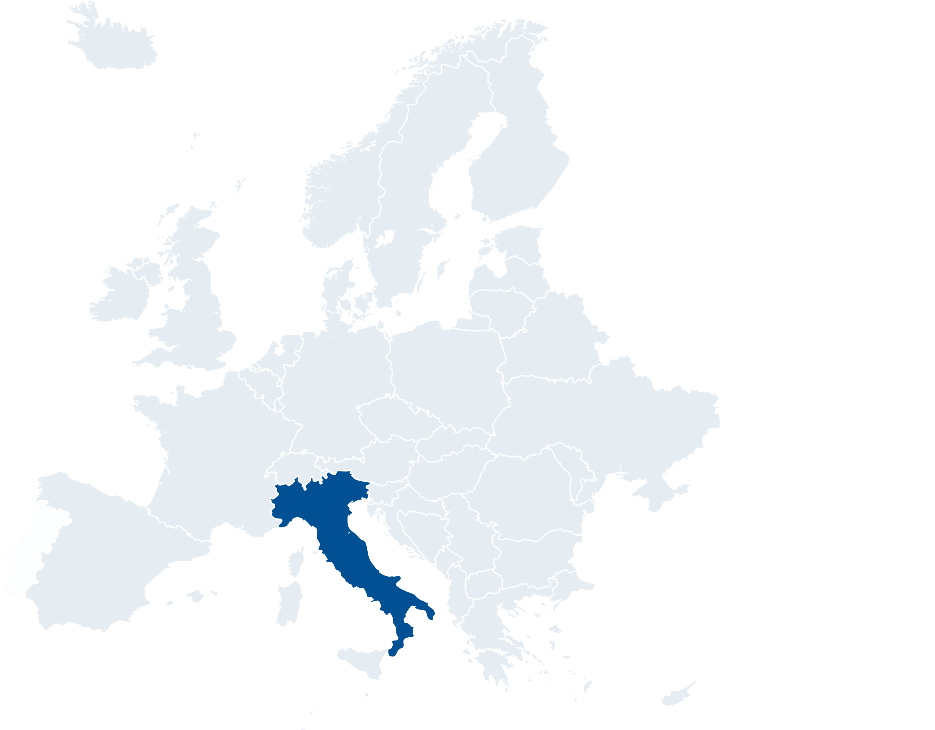



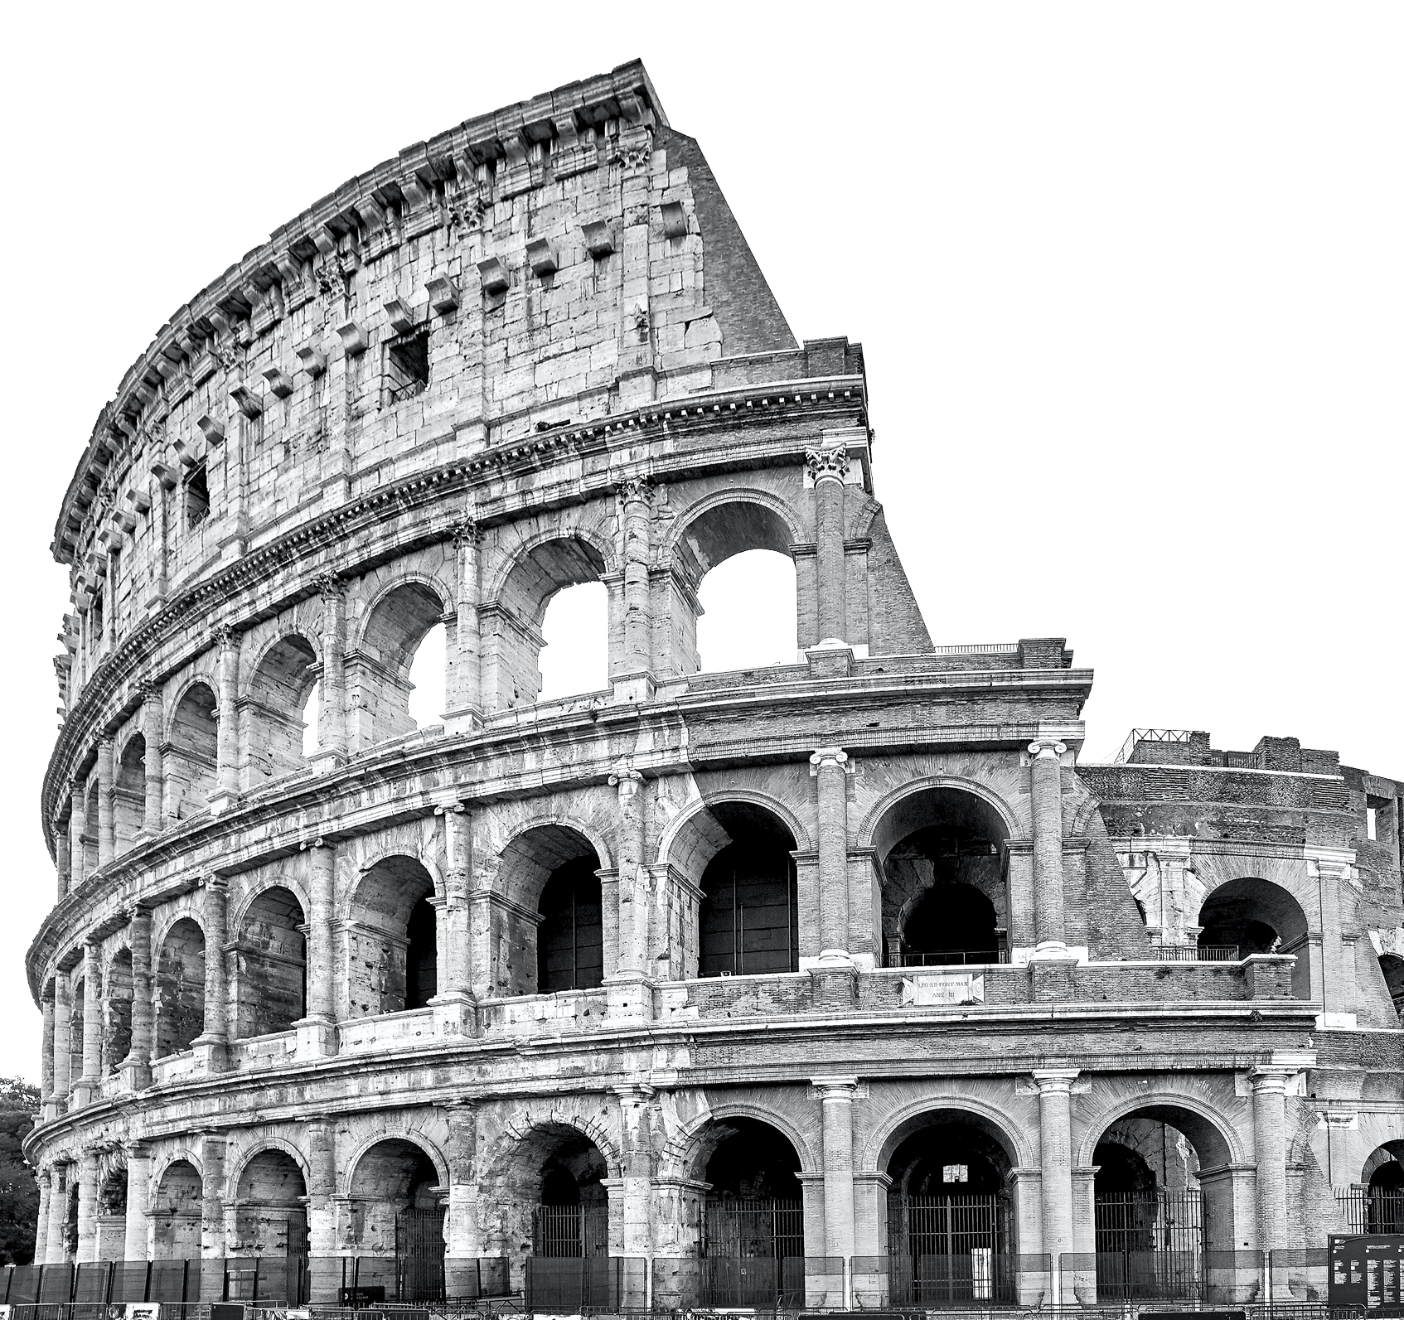





Welcome to..
ROME
Continent: Europe
Country: Italy
Capital: Rome
What country is Italy next to?
What is the official language of Italy?
The Colosseum
Notes:
Teacher Notes
Starter activity: Get students thinking about the country they are visiting.

Slide 2




WELCOME TO ROME
You’ve made your railway journey to the capital city of Italy, Rome. It is famous for its ancient architecture, amazing food and the Vatican city. It is one of the Group A hosts in UEFA EURO 2020.
What teams will be playing in this group?
Use the flags below to find out…
TURKEY
ITALY
GROUP A
WALES
Rome
SWITZERLAND
Notes:
Teacher Notes
Brief introduction to Rome as a city.
Locate Italy and then Rome on the map.
Introduction to Group A teams

Slide 3




YOUR BIG QUESTION TO ANSWER IN ROME IS:
What are a team’s chances of winning games in the tournament?
In Rome we are going to use maths skills to look at methods which we can use to predict the probability of different teams winning the UEFA EURO 2020 cup.
Lesson objectives:
To be able to predict probability over multiple events.
Using fractions, decimals and percentages.
Multiply simple pairs of proper fractions.
Notes:
Teacher Notes
The big question to answer is a key point of the lesson.

Slide 4

WHERE IS PROBABILITY USED IN FOOTBALL?
Think, pair, share
What happens at the beginning of a football match before teams begin playing?
Do any of your ideas use chance or probability?
Notes:
Teacher Notes
This question is to get students thinking of probability in a football match setting.
Students should have 30 seconds to think quietly.
The teacher should find out from the class their thoughts.
The coin toss is the idea we are looking for.

Slide 5
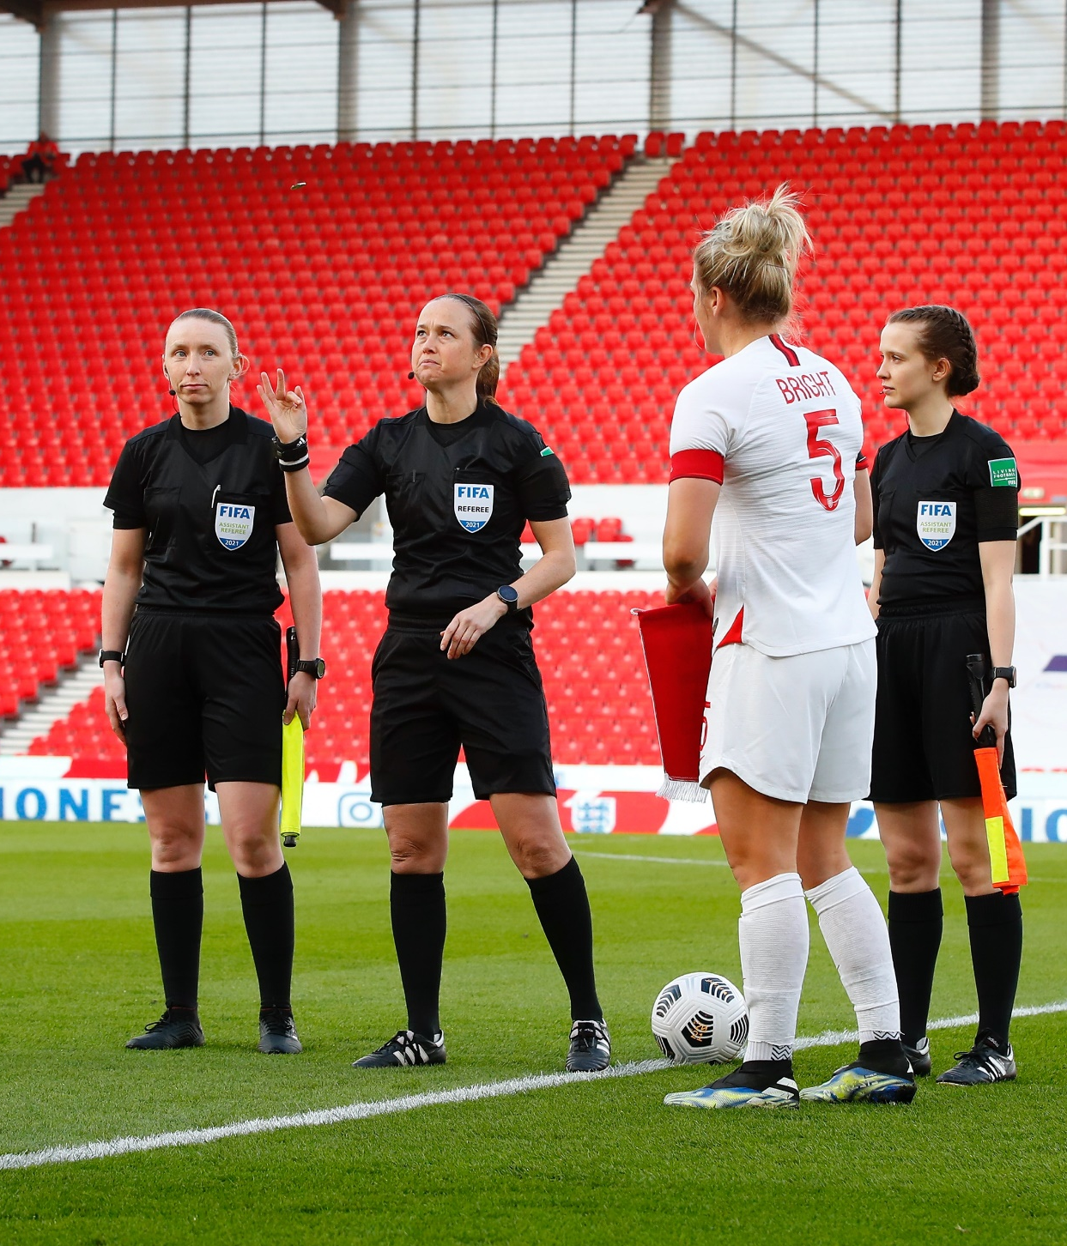
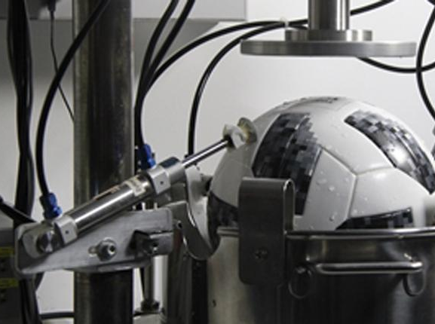
TASK: PROBABILITY OF THE COIN TOSS
At the beginning of a football game there is a coin toss. The team who wins the toss can either chose which end of the pitch to attack first, or take the kickoff.
In groups of three carry out your own coin toss.
One person is the referee, the other two are opposing teams.
Answer these questions:
How many sides are there of a coin?
What are the names of the sides?
What was the probability of getting either side?
What is that probability as a fraction, decimal and percentage?
Why is this method seen as a fair way to decide?
Notes:
Teacher Notes
Teacher to demonstrate students how to toss a coin so it is fair for both teams.
Coin must be flipped from the thumb and land on the floor.
Students to be provided with a coin each for their groups.
Students to leave main group and carry out task in their individual groups.
Once they have carried out and recorded their tasks, they have a written task to complete, answering the questions on this slide.
Answers follow on the next page.

Slide 6


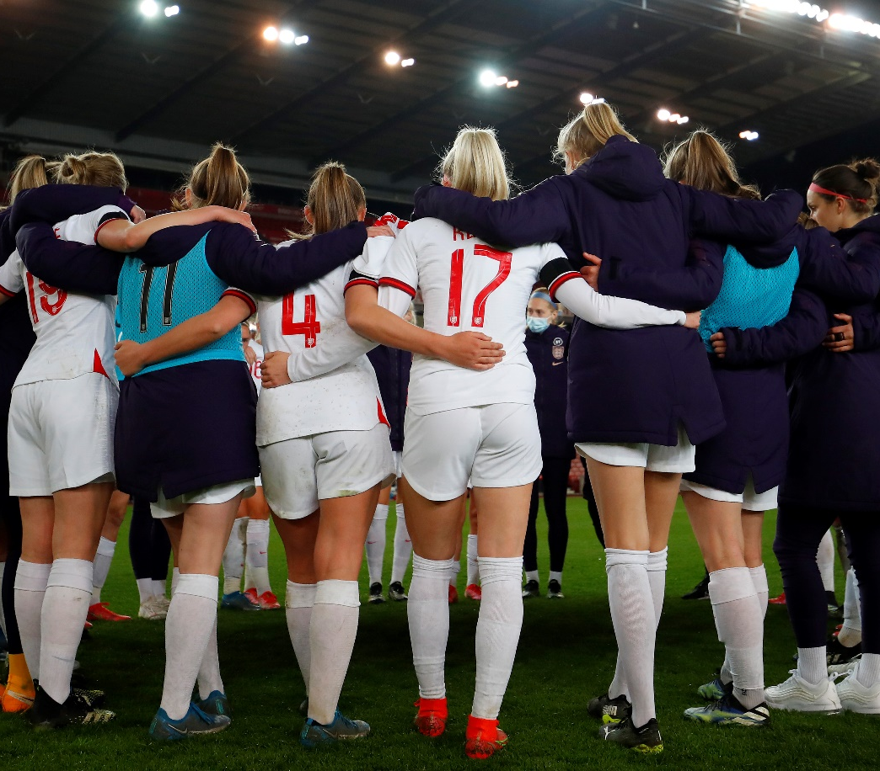
TASK: PROBABILITY OF THE COIN TOSS
Review your answers:
How many sides are there of a coin?
A = 2 sides.
What are the names of the sides?
A = Heads and tails
What was the probability of getting either side as a fraction, decimal and percentage?
A = ½, 0.5, 50%
Challenge question: Why is this method seen as a fair way to decide?
A = Because the likelihood of winning and losing is the same, so is not biased to an individual team.
Notes:
Teacher Notes
Answers to task: Can be discussed with class or used for marking following lesson.

Slide 7

ROUTE TO THE CUP!
GROUP A
GROUP B
GROUP C
GROUP D
GROUP E
GROUP F
Turkey
Italy
Wales
Switzerland
Denmark
Finland
Belgium
Russia
Netherlands
Ukraine
Austria
North Macedonia
England
Croatia
Czech Republic
Scotland
Spain
Sweden
Poland
Slovakia
Portugal
France
Germany
Hungary
Who will make it to the final?
2A
2D
26th June
Amsterdam
28th June
Copenhagen
2B
2E
3rd July
Baku
2nd July
St. Petersburg
1C
11th July
London
1F
27th June
Budapest
28th June
Budapest
3D/E/F
7th July
London
6th July
London
3A/B/C
1E
1A
29th June
Glasgow
26th June
London
3A/B/C/D
2C
3rd July
Rome
2nd July
Munich
29th June
St Petersburg
1D
1B
27th June
Seville
2F
3A/D/E/F
Notes:
Teacher Notes
Teacher to outline the structure of the tournament: Gives students background and pre-requisite knowledge to be able to complete next task.
The tournament is made up of 24 teams, in 6 groups.
16 teams will progress from the group stages.
Those 16 will play in knockout games culminating in the final.

Slide 8


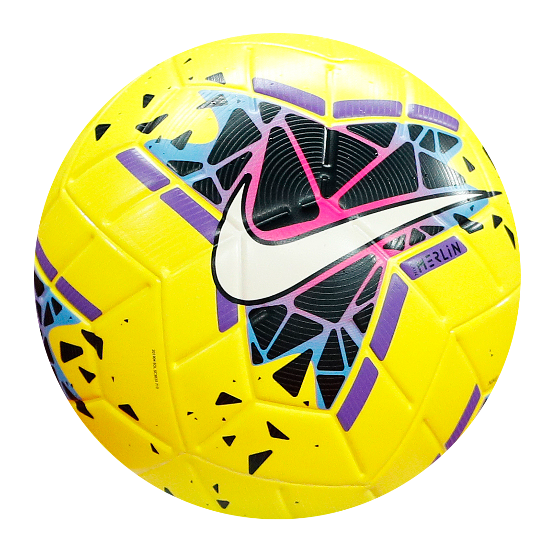
WHAT IS THE PROBABILITY OF WINNING THE CUP?
Earlier we completed a coin toss.
How many sides were there on the coin and what was the probability of getting heads or tails?
How is this similar to the outcome of a football match?
Notes:
Teacher Notes
This slide is to introduce the task of what the probability is of winning the tournament and linking it to the coin toss task.
There are two sides of a coin, there are two teams in a football match. Both have a 50:50 chance of winning if both teams are equally skilled.
The teams being equally skilled allows fraction calculations to be made at the student's level. It should be pointed out by teachers that teams are rarely evenly skilled, but without knowing how well the teams are playing before the match we cannot know. (This can be explored in the extension worksheet by adjusting the probability of teams winning).

Slide 9
WHAT IS THE PROBABILITY OF WINNING THE CUP?
There are two teams in a match, so if both teams are equally skilled the probability of winning is 0.5 as a decimal. Each team is as likely to win as lose.
However, to reach the final, the teams have to play four games after the group stages.
Notes:
Teacher Notes
This slide is to introduce the task of what the probability is of winning the tournament and linking it to the coin toss task.
There are two sides of a coin, there are two teams in a football match. Both have a 50:50 chance of winning if both teams are equally skilled.
The teams being equally skilled allows fraction calculations to be made at the student's level. It should be pointed out by teachers that teams are rarely evenly skilled, but without knowing how well the teams are playing before the match we cannot know. (This can be explored in the extension worksheet by adjusting the probability of teams winning).

Slide 10
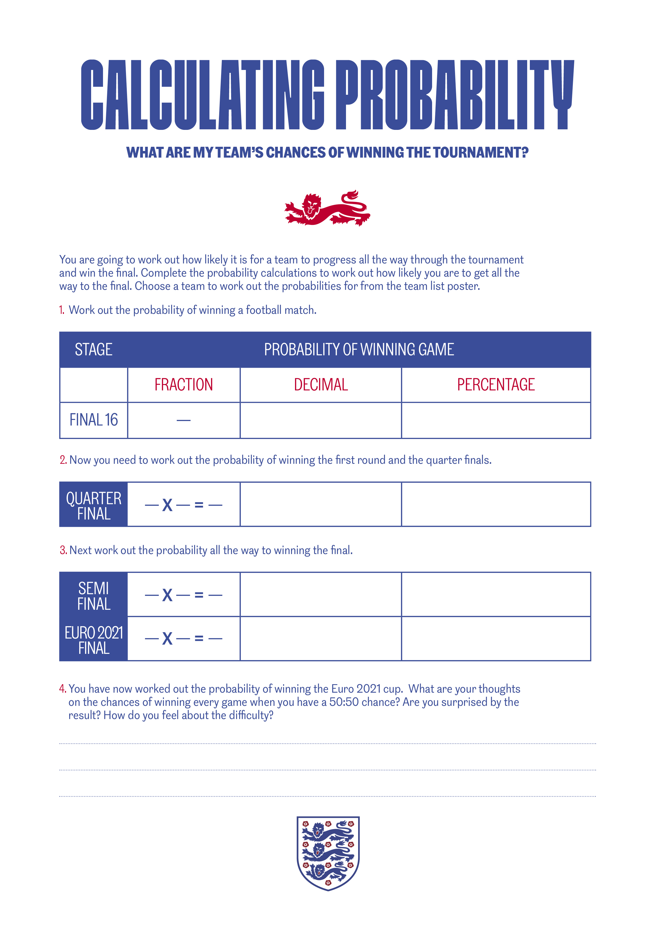
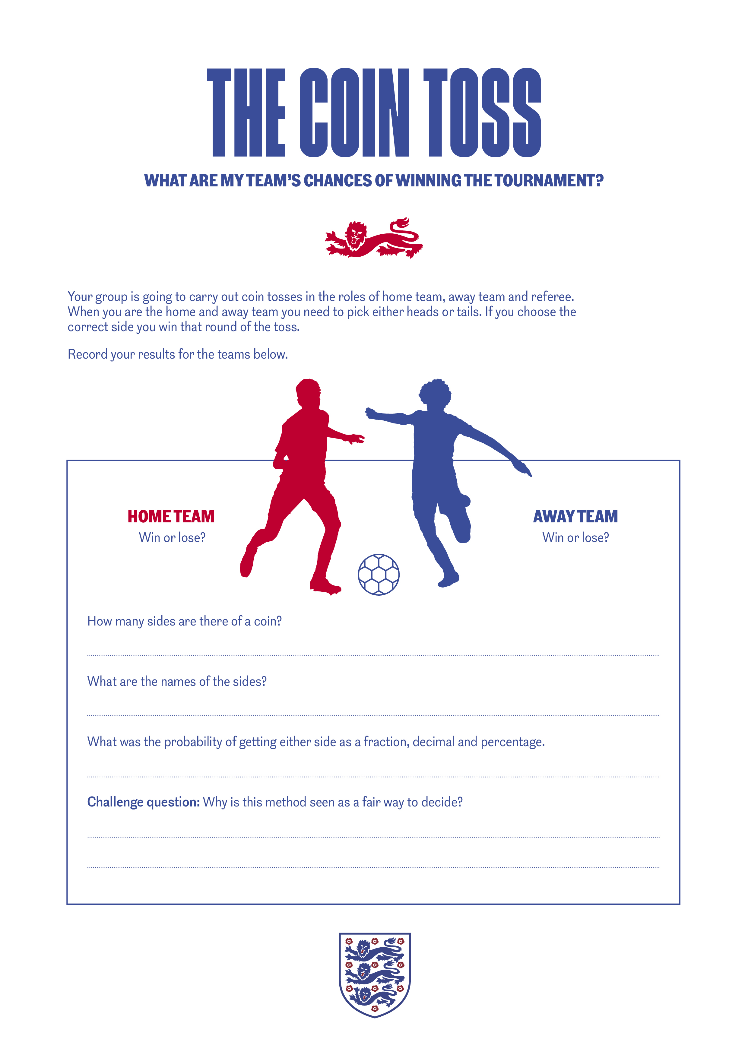
TASK:
Work out the probability of winning the cup!
Complete the worksheet using your knowledge of probability to work out what chance teams have of getting all the way to the final.
Notes:
Teacher Notes
Worksheet used to test knowledge and maths skills:
Calculating probability.
Converting probability between fraction, decimal and percentage.
Calculating final probability over multiple events. Using multiplication of fractions.

Slide 11

PROBABILITY OF WINNING THE CUP!
Class discussion:
What did your results tell you?
How likely is it to win the cup if every game is an equal chance of winning and losing?
Do you think this is actually realistic of the tournament? Why?
Notes:
Teacher Notes
Worksheet used to test knowledge and maths skills:
Calculating probability.
Converting probability between fraction, decimal and percentage.
Calculating final probability over multiple events. Using multiplication of fractions.
Follow up class discussion:
This is an opportunity to discuss with the students about the findings of their probability calculations.
Findings should be that the chance of one team winning is low.
This can lead to questioning over whether students think that it is 50:50 probability to win a football match. Are all the teams even? Does this make the tournament more exciting?

Slide 12


LET’S WRITE HOME
What are a team’s chances of winning games in the tournament?
Write a postcard home saying what you have learnt about calculating the probability of winning UEFA EURO 2020.
Can you include:
An answer to your big question.
Where probability is used in a football match.
How you calculated the chances of winning.
Where are we going next?…..
Notes:
Teacher Notes
Students to consolidate their learning within this section.
Linking back to the big question.

