Slide 1
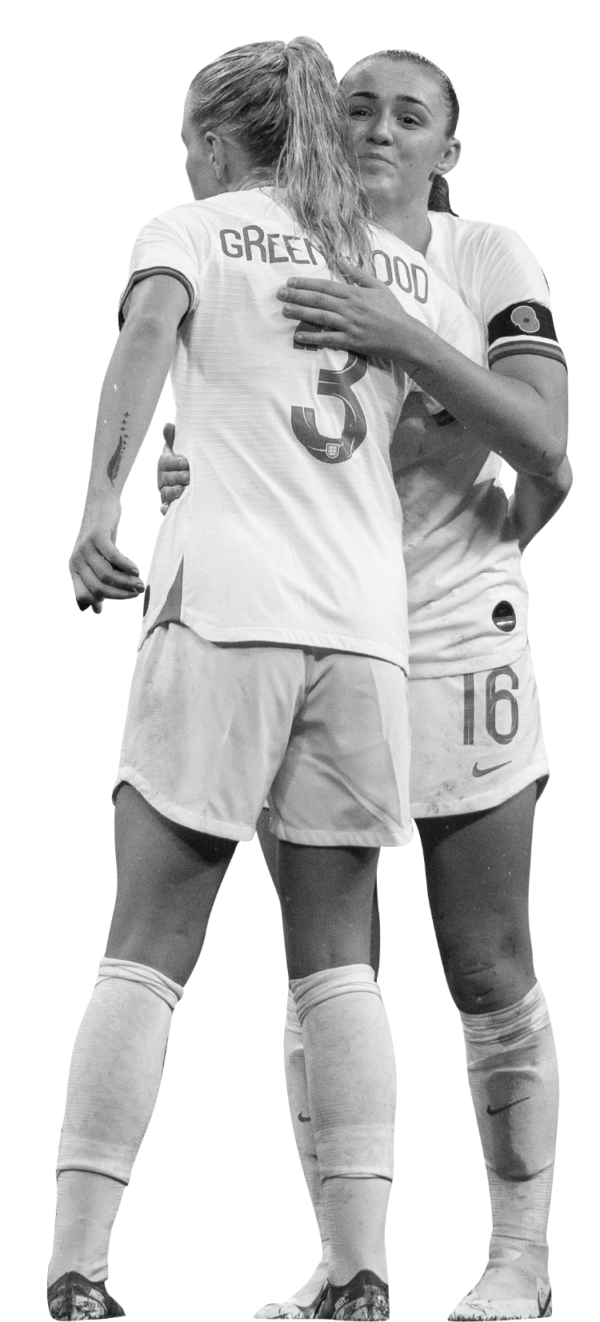
Extra time
Notes:
Teacher Notes
Starter Activity: Get students thinking about a football match, and in what scenario it would go to Extra Time. Get them to think about how players might be feeling emotionally and physically at this point in a game.
Think about what characteristics you need as a footballer/football team to be the winning team once you get to Extra Time.

Slide 2
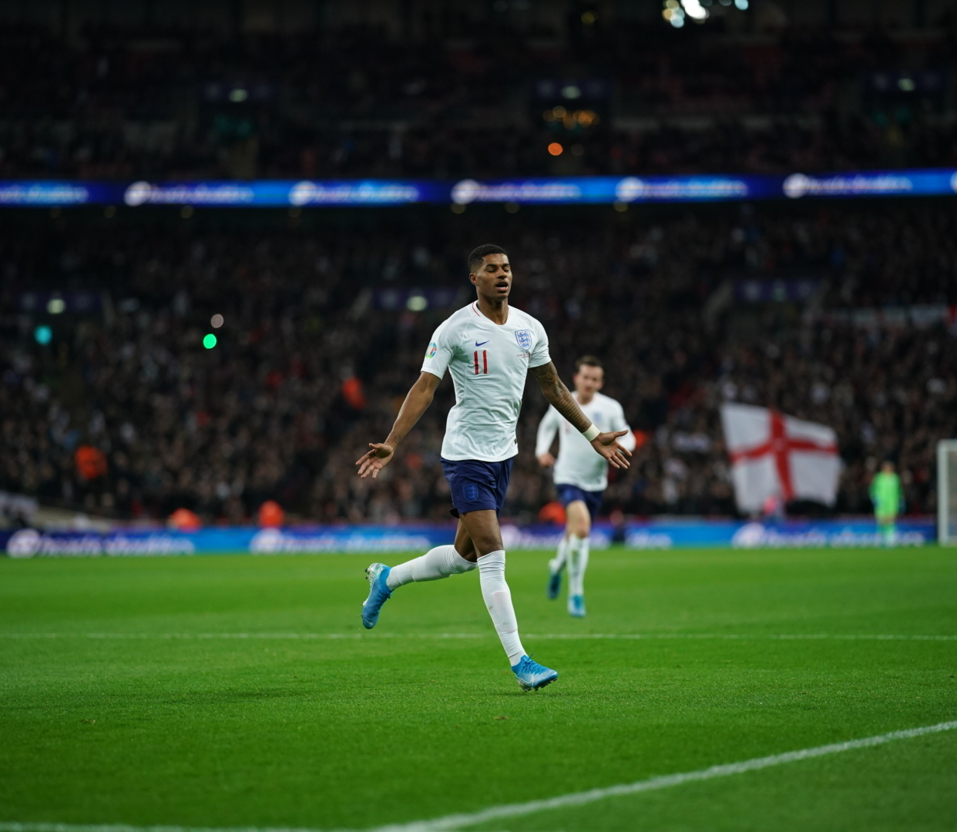
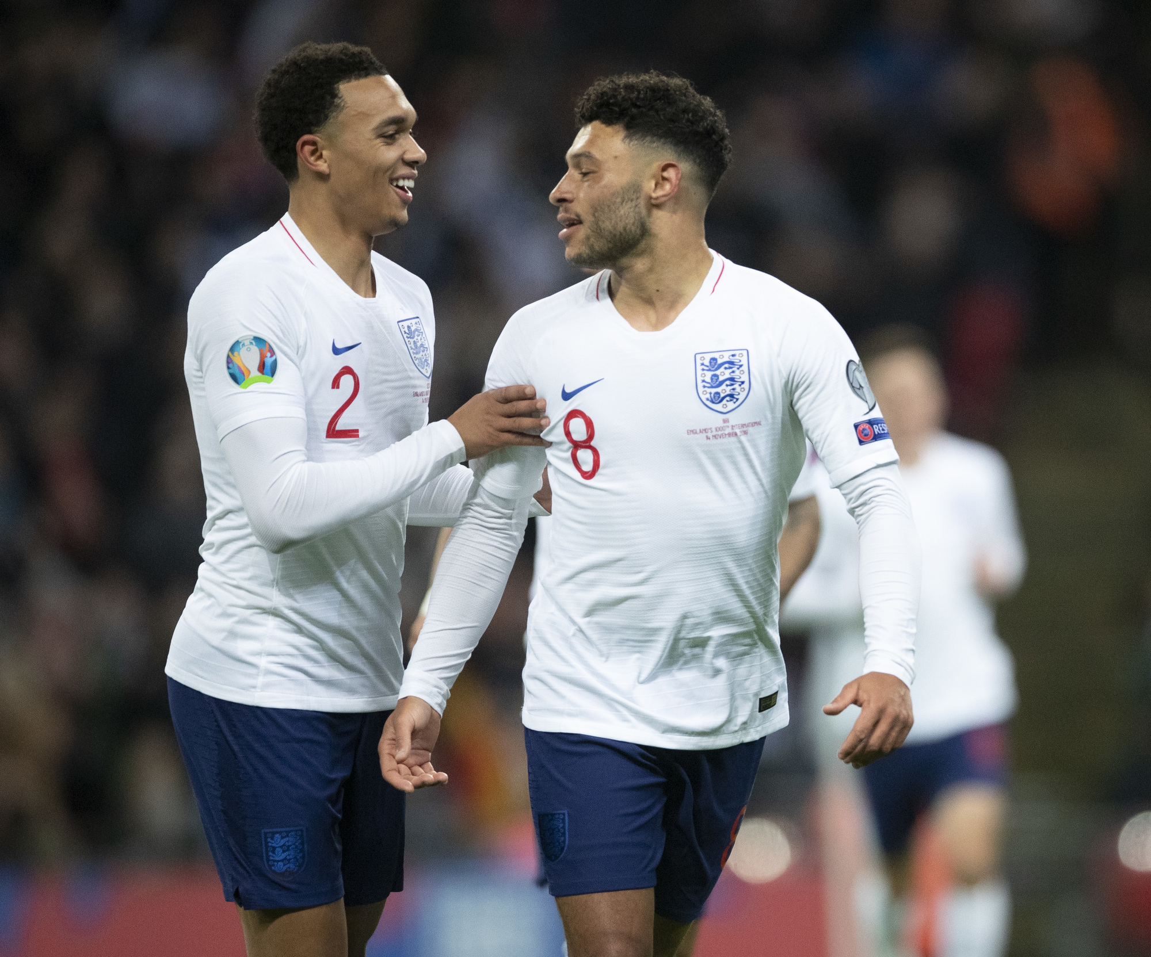
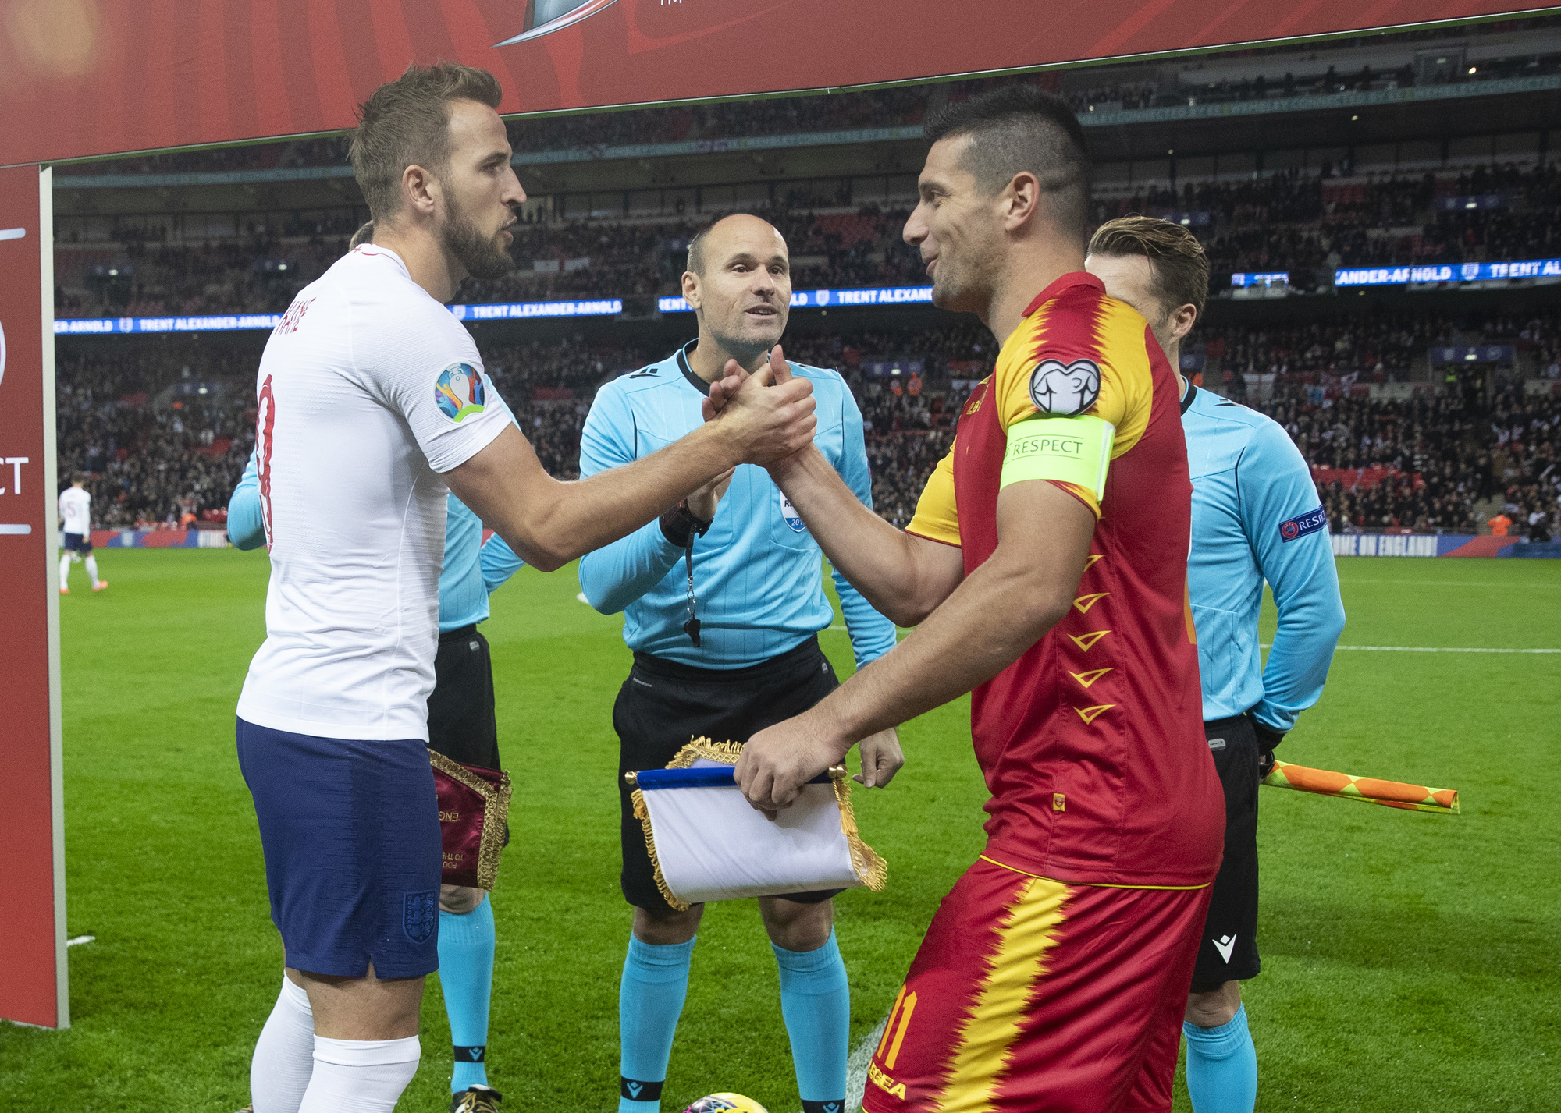
Your Extra Time
Big Question is:
What makes a footballer?
You are going to discuss the characteristics that make up a footballer and what characteristics you possess.
Lesson objectives:
Understand what characteristics are.
Have knowledge of what characteristics a footballer needs.
To be able to self assess the positive characteristics that students have.
Notes:
Teacher Notes:
- Outline of the lesson with objectives and the big question.

Slide 3
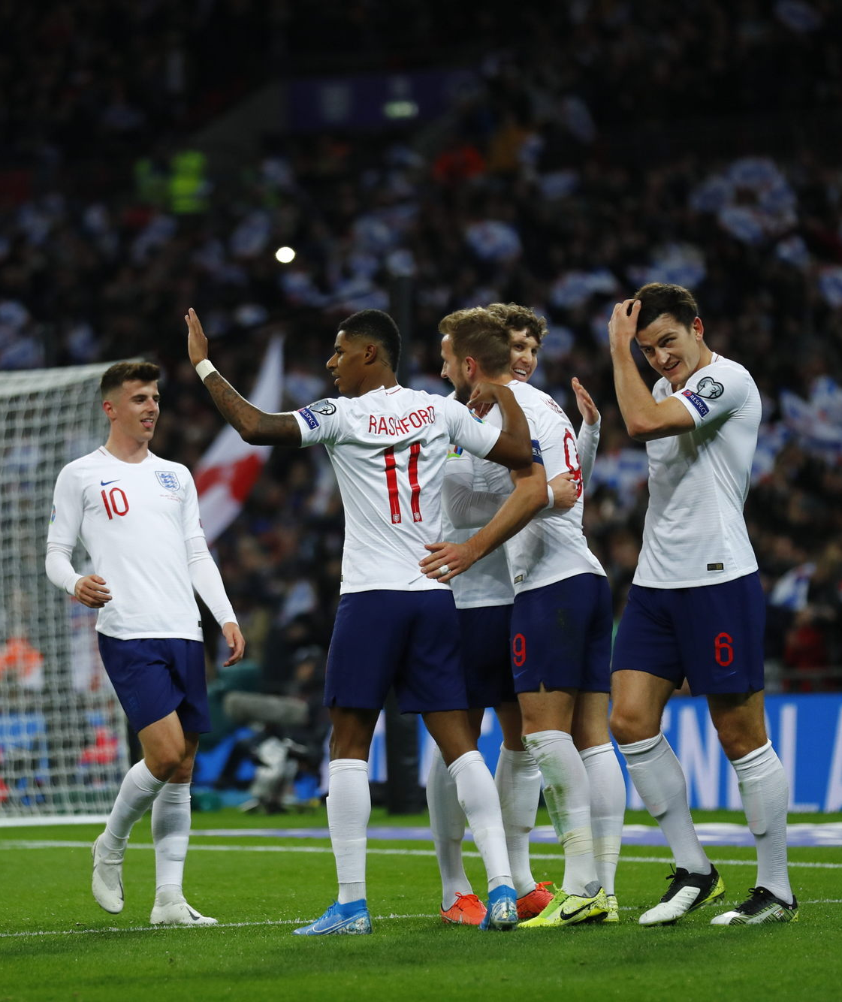
CHARACTERISTICS
Characteristics help us describe features of our personality.
Today you are going to learn about yours and footballers positive characteristics.
Positive characteristics of people include: hard working, ability to work in a team and enthusiasm.
Notes:
Teacher Notes:
Teacher should discuss with students what characteristics are.
This lesson is focusing on positive characteristics.

Slide 4
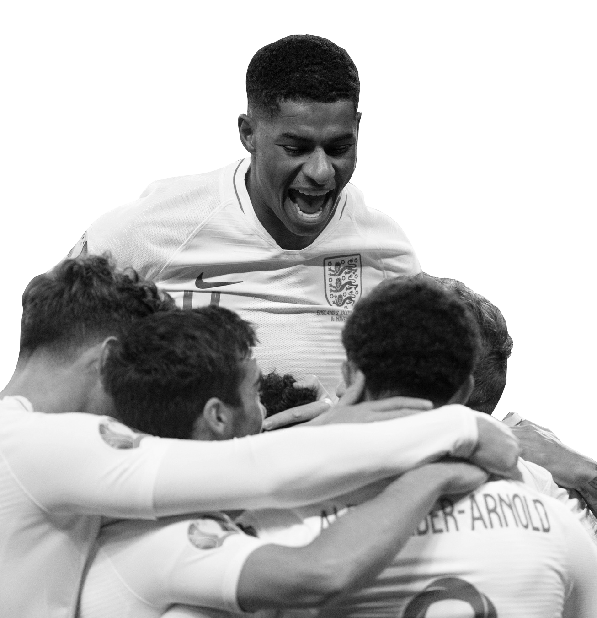
WHAT CHARACTERISTICS DO YOU HAVE?
Characteristics are how you describe what makes up your personality.
In a pair, you are going to discuss what you think your best characteristics are.
First, you are each going to describe to the other person, what you think your best characteristics are. Second, you are going to tell the other person what you think their best characteristics are. Third, you are going to tell the other person how it felt to hear what they thought your best characteristics were.
We are focusing on encouraging your classmate’s self esteem, so we are only discussing their best characteristics.
Notes:
Teacher Notes
Introduce this section describing what characteristics are.
Teacher can then give an example of what they think their best characteristics are.
Opportunity for students to discuss best characteristics of each other.
Teacher runs through the steps students will be taking.
Give students approx. 2 mins each to do each step. 1 min each person. Put timer on board or announce when change over (Could do a referee style whistle for kick off, half time and full time on each step).
Teacher to make sure this activity is kept positive and focused on best characteristics.

Slide 5
WHAT CHARACTERISTICS DO YOU THINK OF?
Characteristics:
Notes:
Teacher Notes
Now bring students back together for class discussion on what characteristics they discussed.
Teacher to write onto the board in the white box what characteristics students came up with.
(Also write down the characteristics onto a separate sheet to use later on).

Slide 6
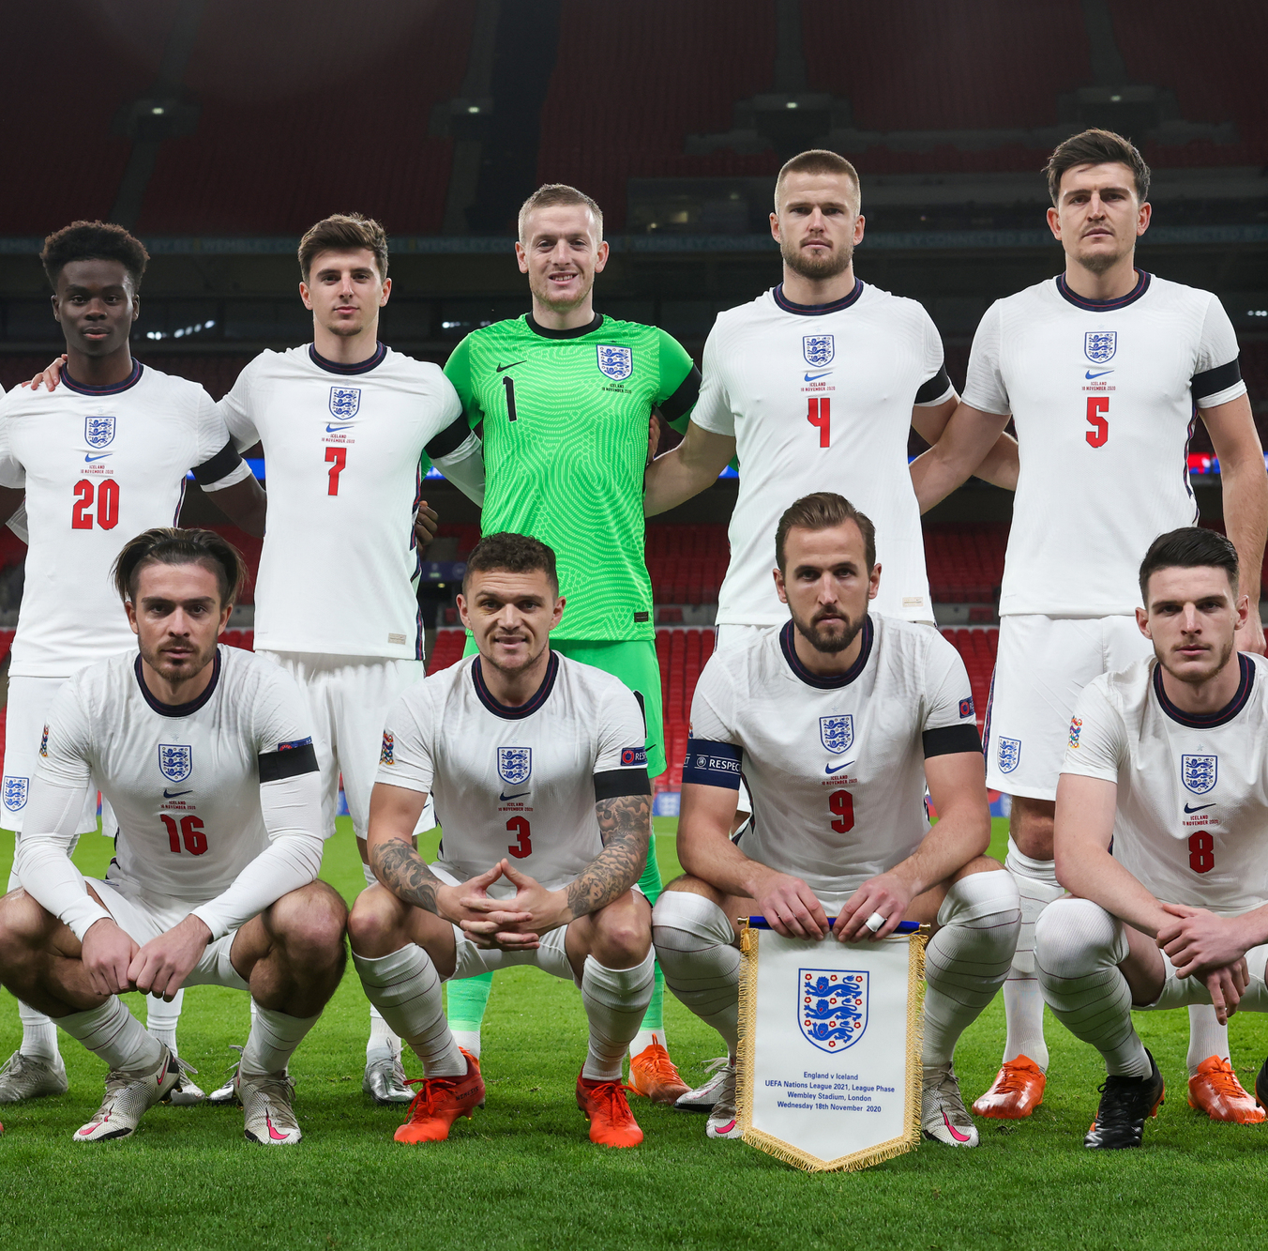
WHAT ARE THE CHARACTERISTICS OF A FOOTBALLER?
You are now going to use your knowledge of characteristics discuss how they change for different types footballers.
Notes:
Teacher Notes
Opportunity for students to talk in pairs about what the characteristics they think a footballer needs to be successful.
Should again be pointed out that we are discussing positive characteristics.
Begin by discussing in general, then group into different players positions.
Keep characteristics positive.

Slide 7
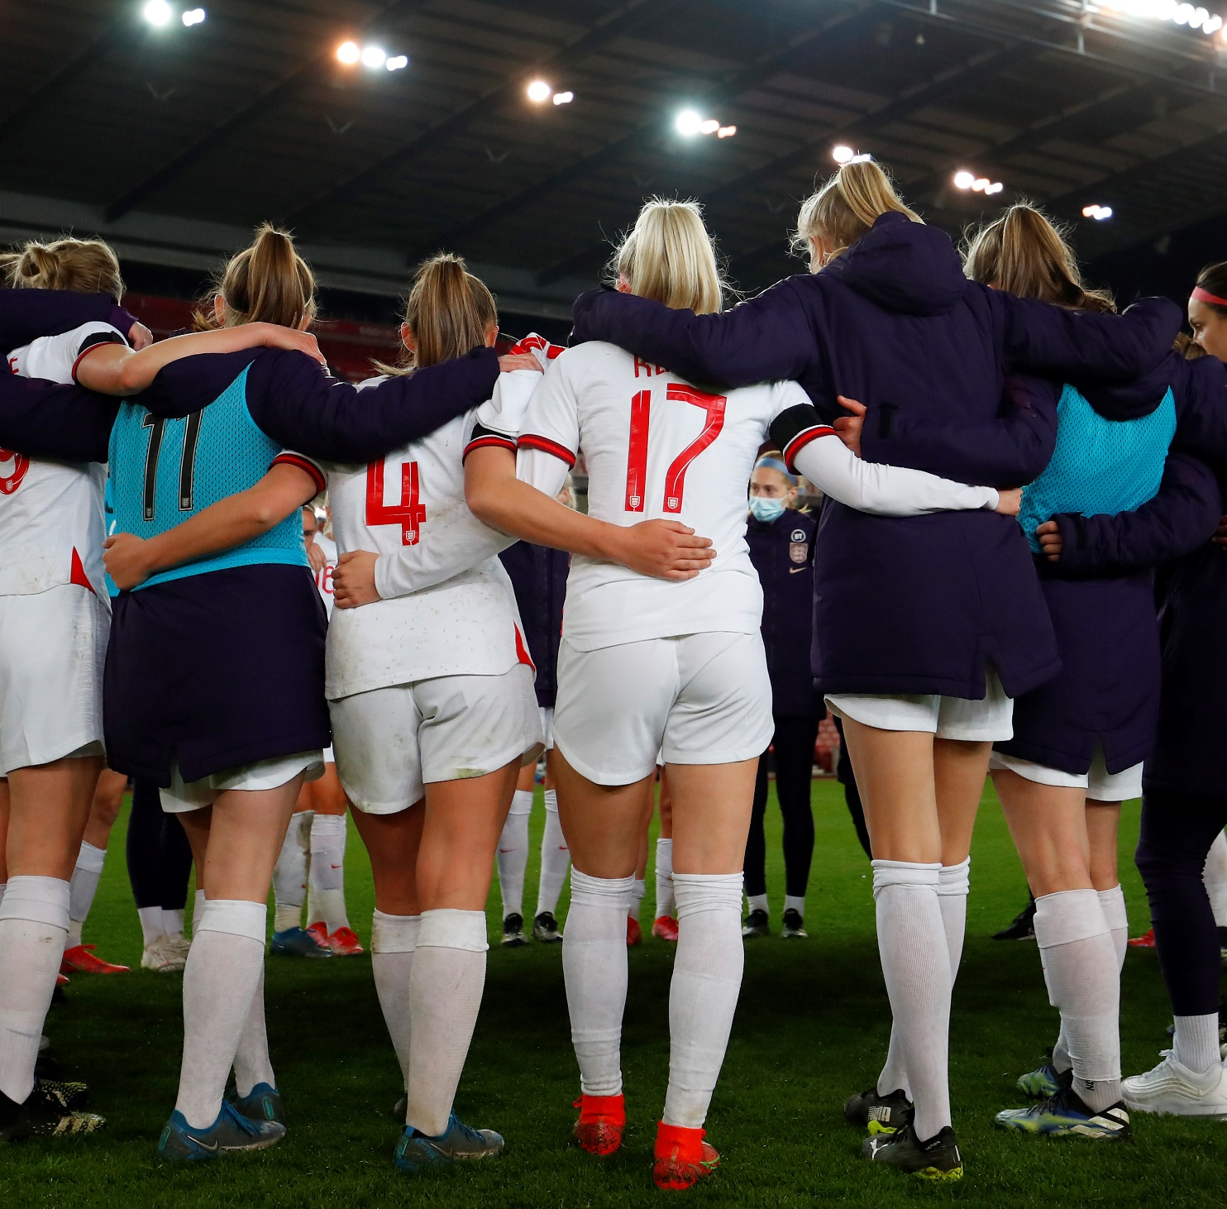
WHAT ARE THE CHARACTERISTICS OF A FOOTBALLER?
In your pairs discuss these questions.
What characteristics do footballers need in general?
Are different characteristics needed for different player positions?
Notes:
Teacher Notes
Opportunity for students to talk in pairs about what the characteristics they think a footballer needs to be successful.
These are grouped into different players positions.
Should again be pointed out that we are discussing positive characteristics.

Slide 8
Class discussion:
What characteristics do footballers need in general?
Notes:
Teacher Notes
Opportunity for students to talk in pairs about what the characteristics they think a footballer needs to be successful.
These are grouped into different players positions.
Should again be pointed out that we are discussing positive characteristics.

Slide 9
CHARACTERISTICS OF DIFFERENT PLAYERS
Different players have different characteristics depending on what their position they play.
What positions can you think of and where do they play on the field below if you were the home team?
Home goal
Away goal
Notes:
Teacher Notes:
Discussion with students about the different positions of footballers on a pitch.
Grouped into 4 major groups. Goalkeeper, midfielder, defender and attacker.

Slide 10
CHARACTERISTICS OF DIFFERENT PLAYERS
Defender
Midfielder
Attacker
Different players have different characteristics depending on what their position they play.
Goalkeeper
Home goal
Away goal
Notes:
Teacher Notes:
Discussion with students about the different positions of footballers on a pitch.
Grouped into 4 major groups. Goalkeeper, midfielder, defender and attacker.
Groups now identified on the pitch.

Slide 11
WHAT ARE THE CHARACTERISTICS OF A FOOTBALLER?
Match the characteristics to the players position.
Goalkeeper
Defender
……………………………………
……………………………………
Can be relied upon to be the last line of defence.
Can make key tackles when they need to stop attackers.
……………………………………
……………………………………
Has good confidence to believe they can score.
Has good team skills to link up different team members.
Midfielder
Attacker
Notes:
Teacher Notes
Section giving students chance to link characteristics to different positions in a team.
Discuss with and question students about what characteristics they think fit which positions.

Slide 12
WHAT ARE THE CHARACTERISTICS OF A FOOTBALLER?
Match the characteristics to the players position.
Defender
Goalkeeper
Defender
Goalkeeper
……………………………………
……………………………………
Can be relied upon to be the last line of defence.
Can make key tackles when they need to stop attackers.
Attacker
Midfielder
……………………………………
……………………………………
Has good confidence to believe they can score.
Has good team skills to link up different team members.
Midfielder
Attacker
Notes:
Teacher Notes
Section giving students chance to link characteristics to different positions in a team.
Discuss with and question students about what characteristics they think fit which positions.
Page to show students which characteristics match which position.

Slide 13
CLASS DISCUSSION:
Now think about what other characteristics different positions need to do their job well.
Goalkeeper
Defender
Midfielder
Attacker
Write your ideas in this box
Notes:
Teacher Notes
Opportunity for students to talk in pairs about what the characteristics they think a footballer needs to be successful depending on position.
Extending on from previous activity.

Slide 14
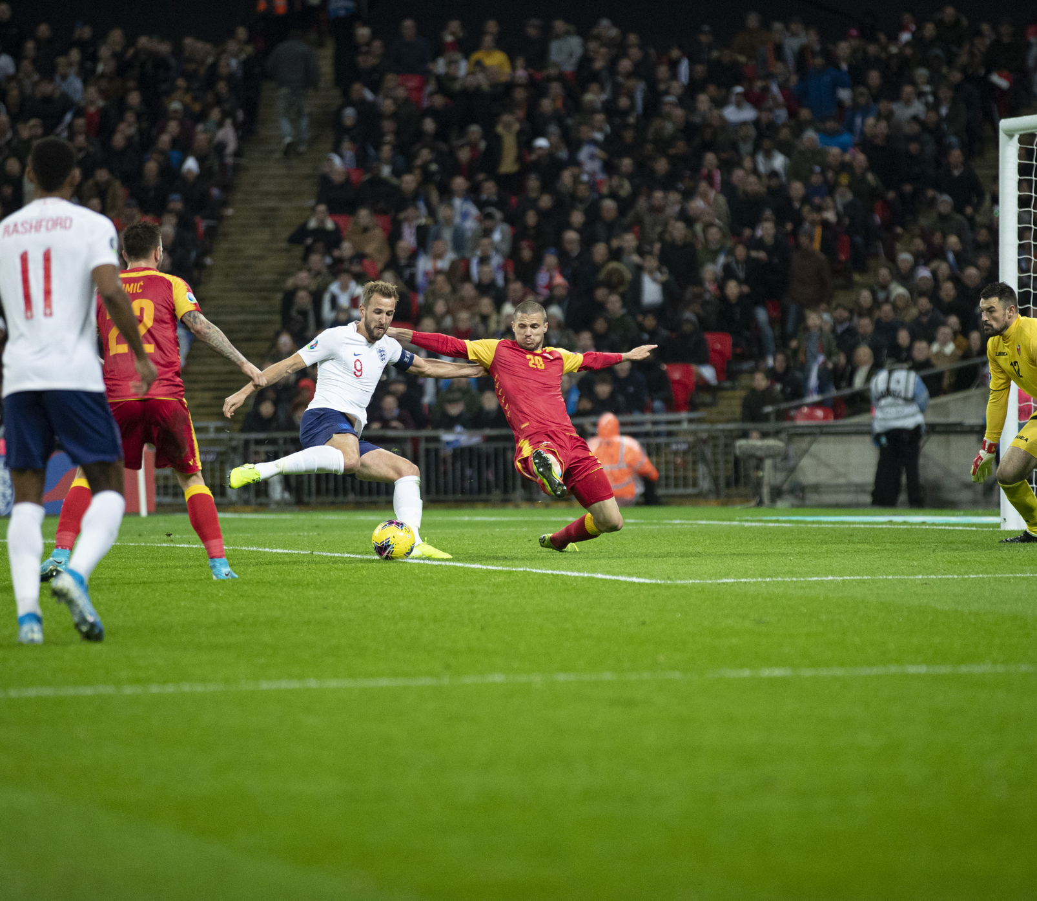
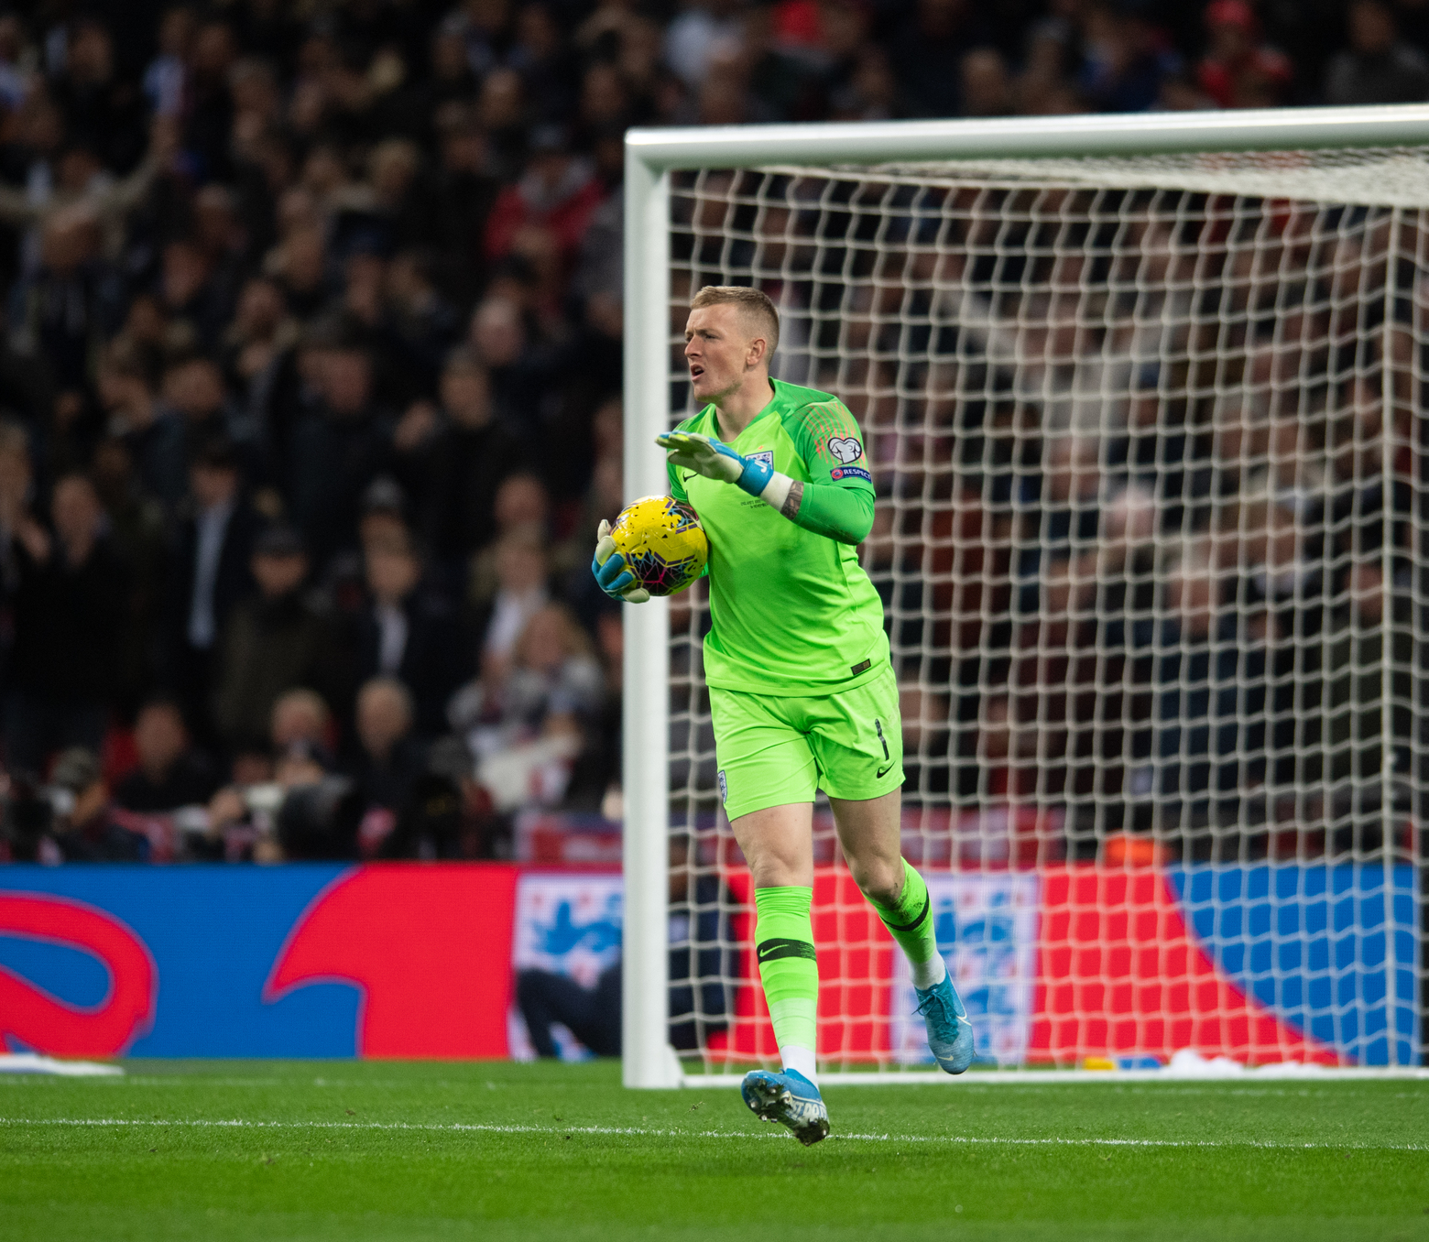
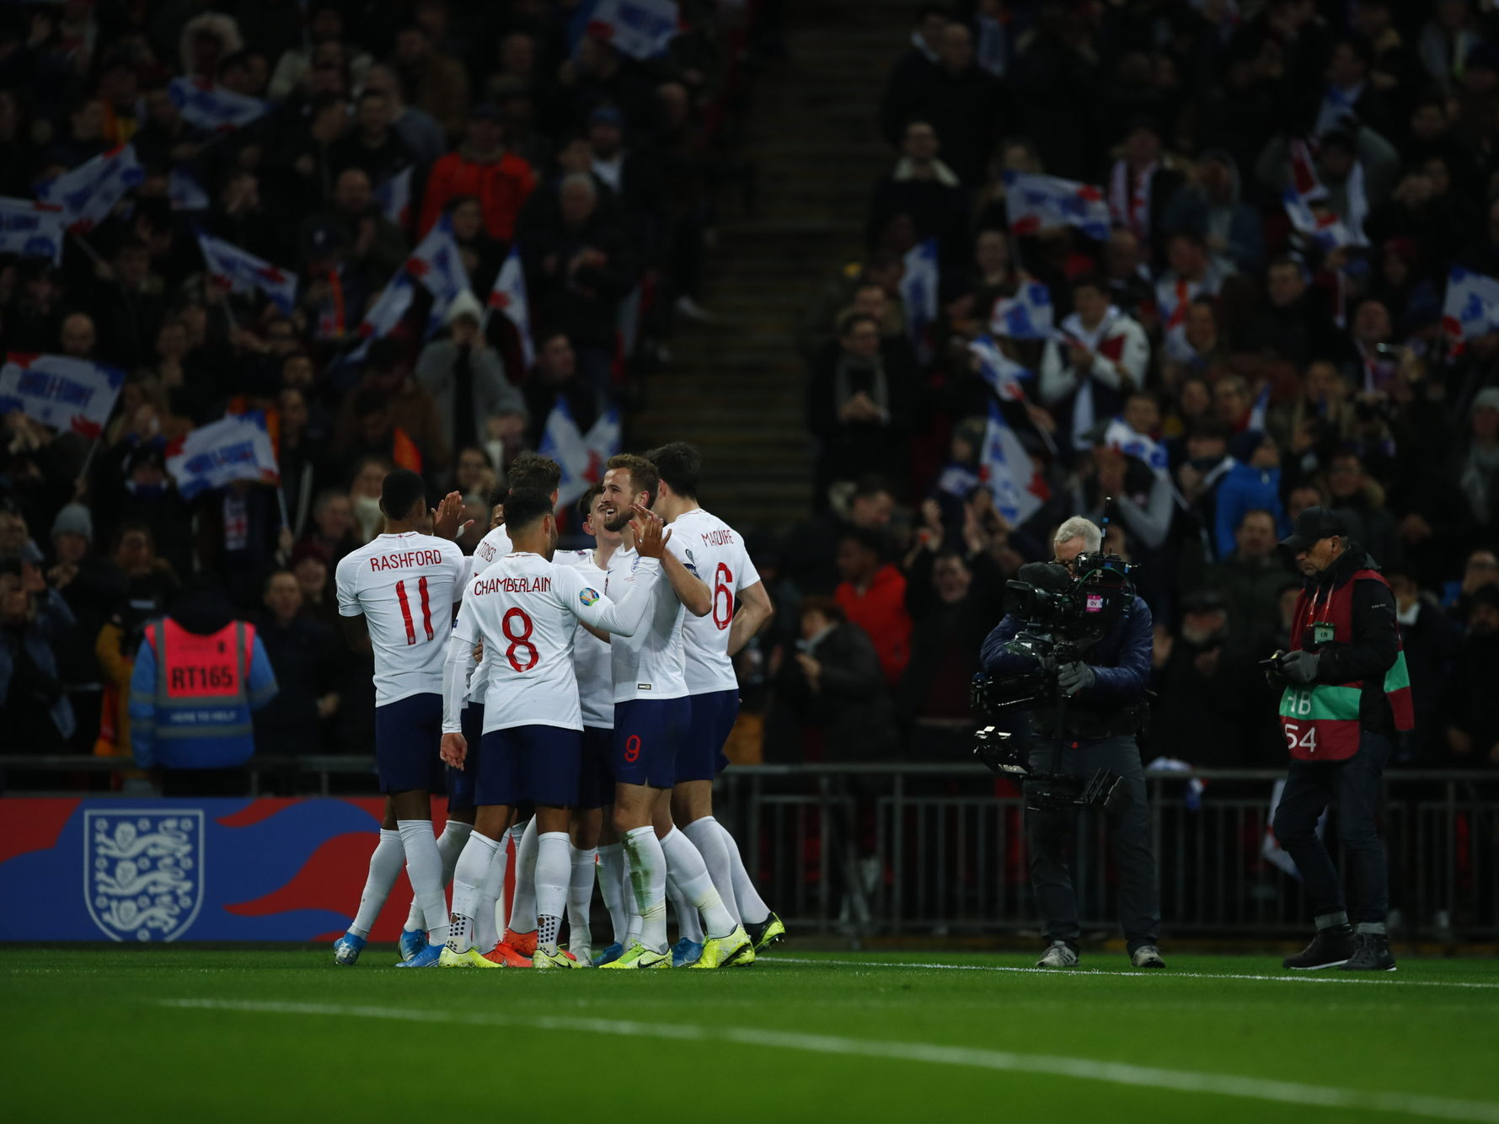
WHAT TYPE OF FOOTBALLER WOULD YOU BE?
In your pairs discuss these questions.
What characteristics do you have that would make you a good footballer?
What position would you be good at based on those characteristics and why?
Notes:
Teacher Notes
This activity aims to link students knowledge of their own characteristics to the previous activity of footballers characteristics.
Students should discuss in their pairs the questions shown.
Teachers should then follow up with questioning and discussion to members of the class.

Slide 15
LET’S WRITE HOME
What are the characteristics of football players? Write a postcard home saying what you have learnt about the characteristics of a football player and describe what you think your best characteristics are.
Can you include:
An answer to your big question.
The characteristics of a football player.
Your best characteristics.
Where are we going next?…..
Notes:
Teacher Notes
Students to consolidate their learning within this section.
Linking back to the big question.

