Slide 1

School assembly
Notes:
N/A

Slide 2

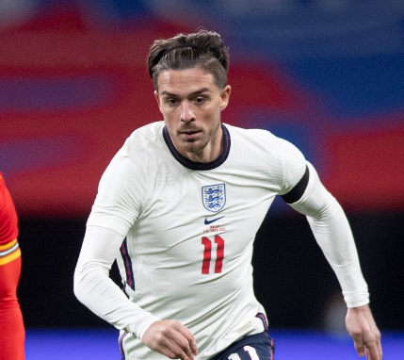

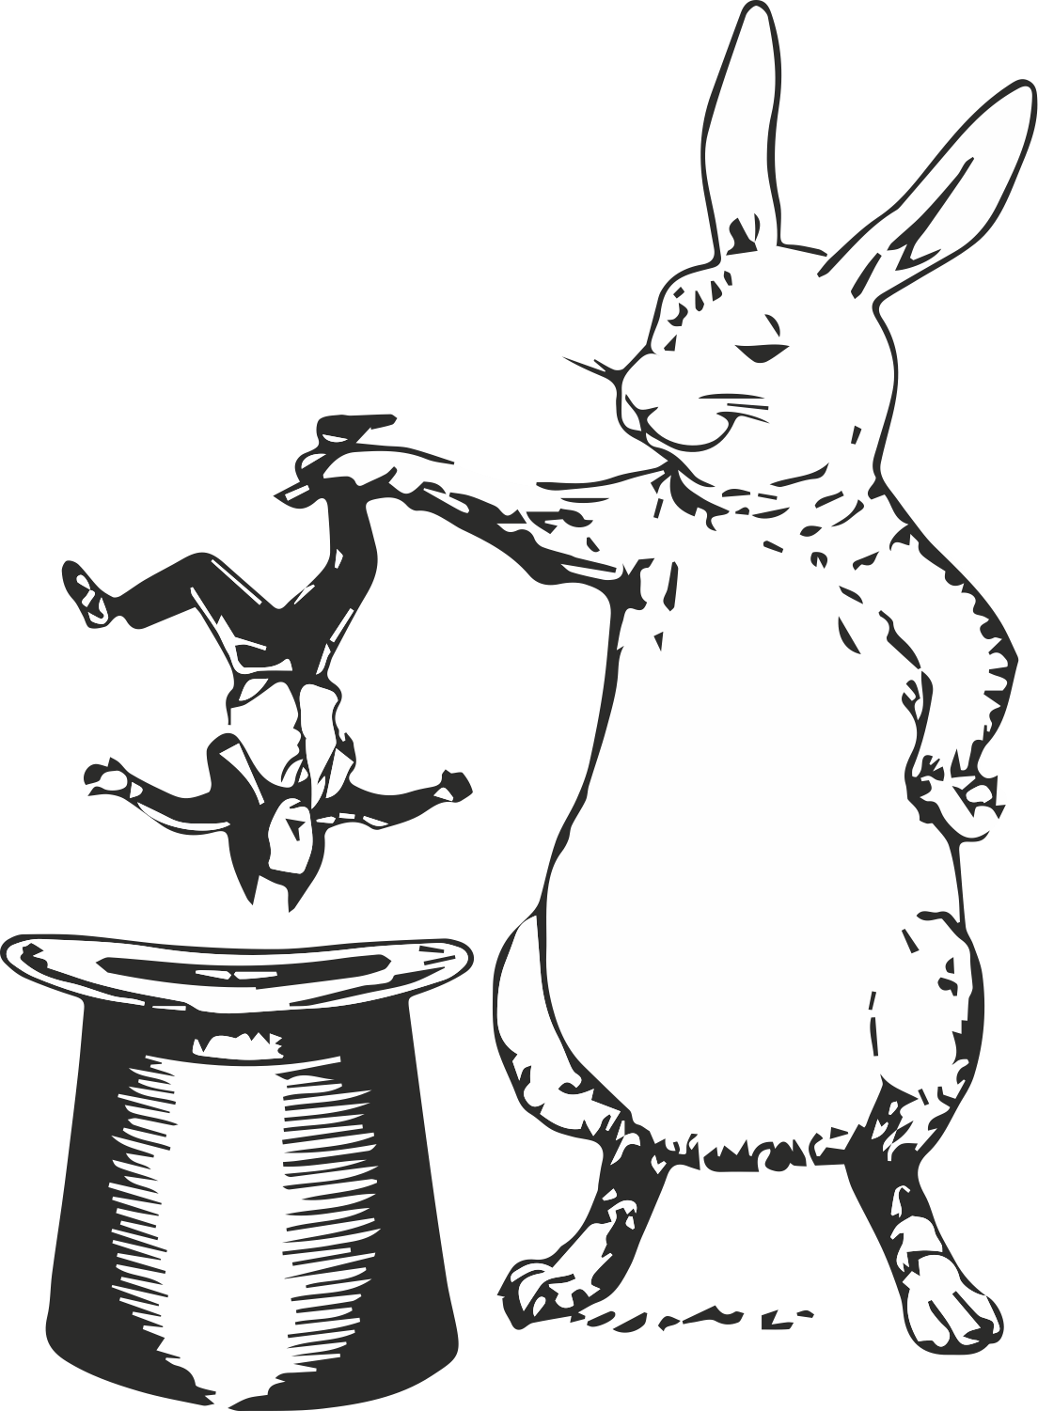
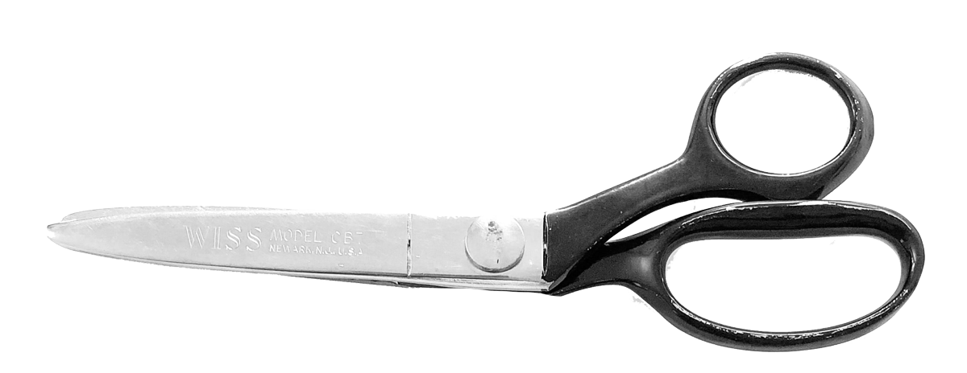
What’s in the box?
Using the items in the box, can you tell what our assembly is about?
Notes:
Teacher notes
In order to hook the children into the assembly have a box of items ready. Choose children to come up to the front and pick an item from the box. If no box available, use the pictures on the screen instead.
Items should be a mixture of STEM, PSHE and football and could include:
Red card (penalty)
Picture of Alex Scott (female footballer)
Hat with a toy bunny picture or props/toys (hat trick)
Clean white sheet (keeping a clean sheet)
Pair of scissors (scissor kick)
3 lions pictures or soft toys (England)
Newton meter
Grass cuttings
Air pump
Pull the items out one by one and children to then guess what our assembly is about.
Answer: Football

Slide 3

What does it
take to be a member
of the England
football team?
Notes:
Teacher Notes – DELETE IF NOT TAKING PART IN MINI CHALLENGES
Explain that we are going to be looking at the Big Question ‘What does it take to be a member of the England football team?’ over the course of the next few weeks/today (delete as appropriate based on how you’re delivering the challenges).
Explain we’re going to explore this in the context of an exciting football tournament…

Slide 4
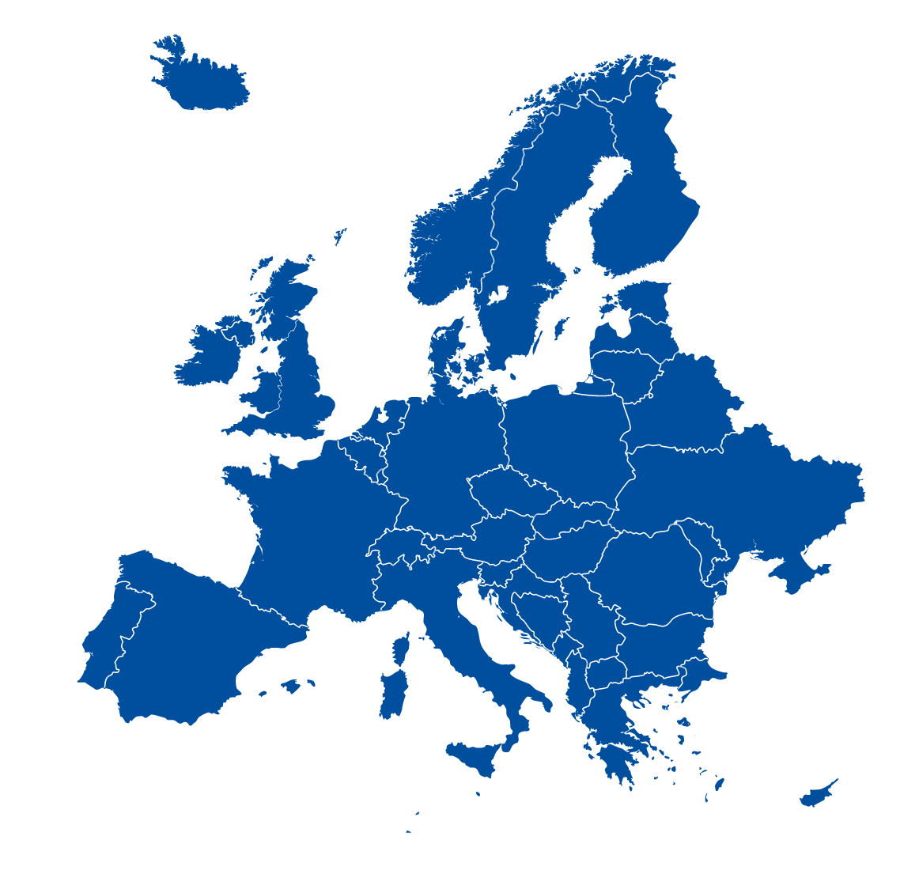
Where in the world does this map show?
Notes:
Teacher Notes
Pose the question: Where in the world does this map show?
Then ask: Does anyone know what big event is happening in and around Europe this summer? Answer: The UEFA EURO 2020

Slide 5
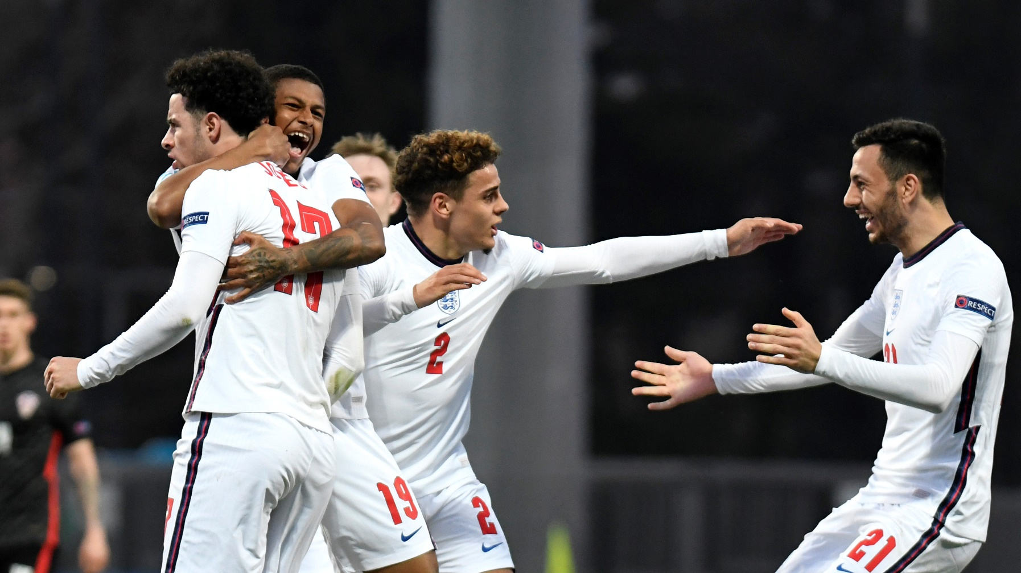
What is uefa euro 2020?
A football tournament between 24 competing nations.
Teams play in pre-selected ‘groups’ which are drawn at random.
The teams in each group play each other in a round robin. The top two teams in each group then progress to the knock out stage.
Eventually only 2 teams will be left, and they will play in a final to win the UEFA EURO 2020 cup.
Notes:
Teacher notes
Explain what the Euro’s is. Play Euro’s promotional video.

Slide 6
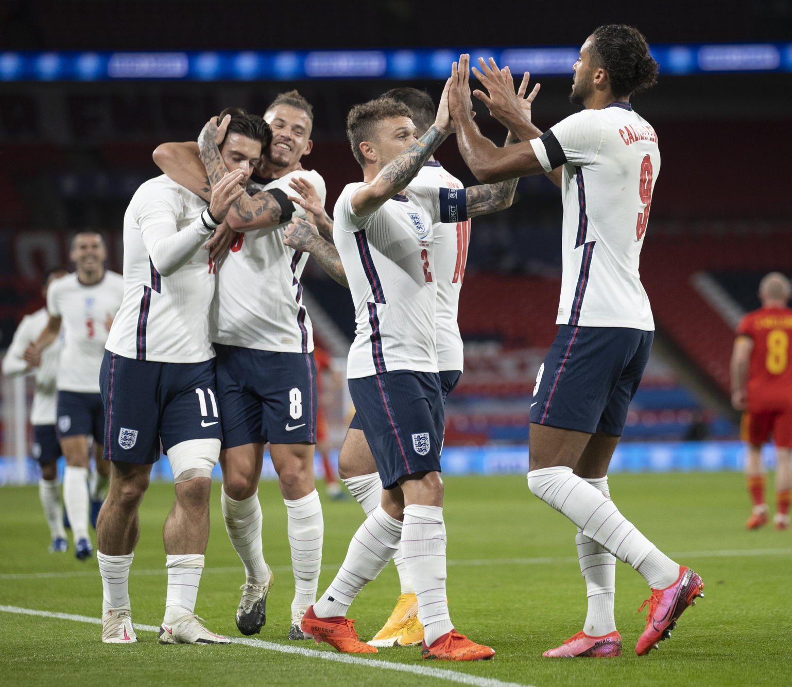
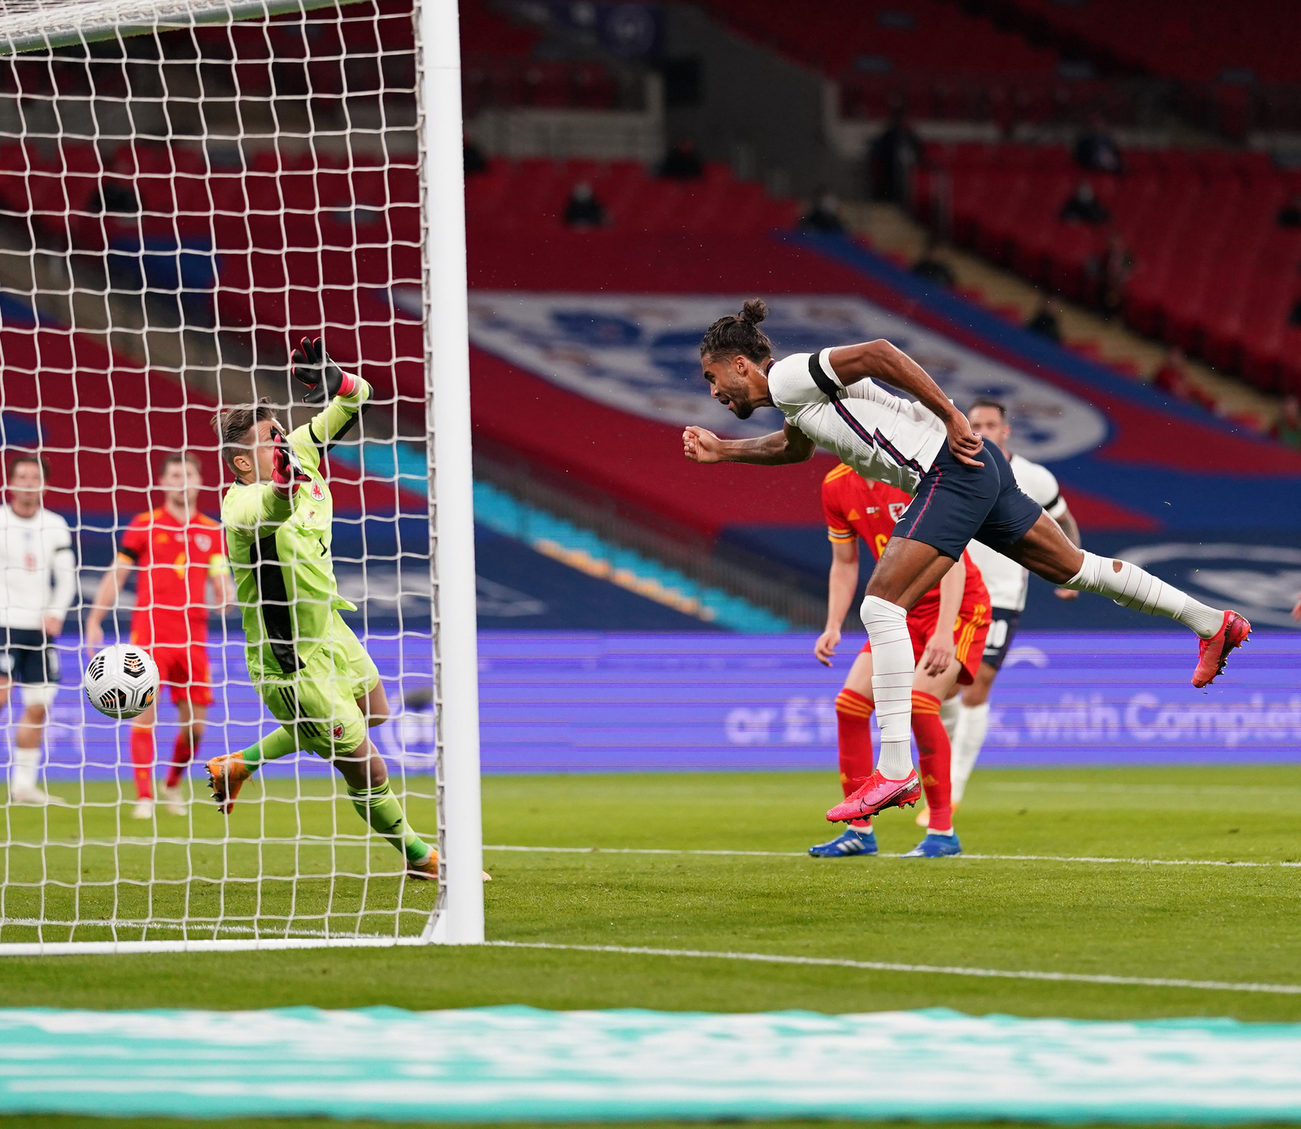
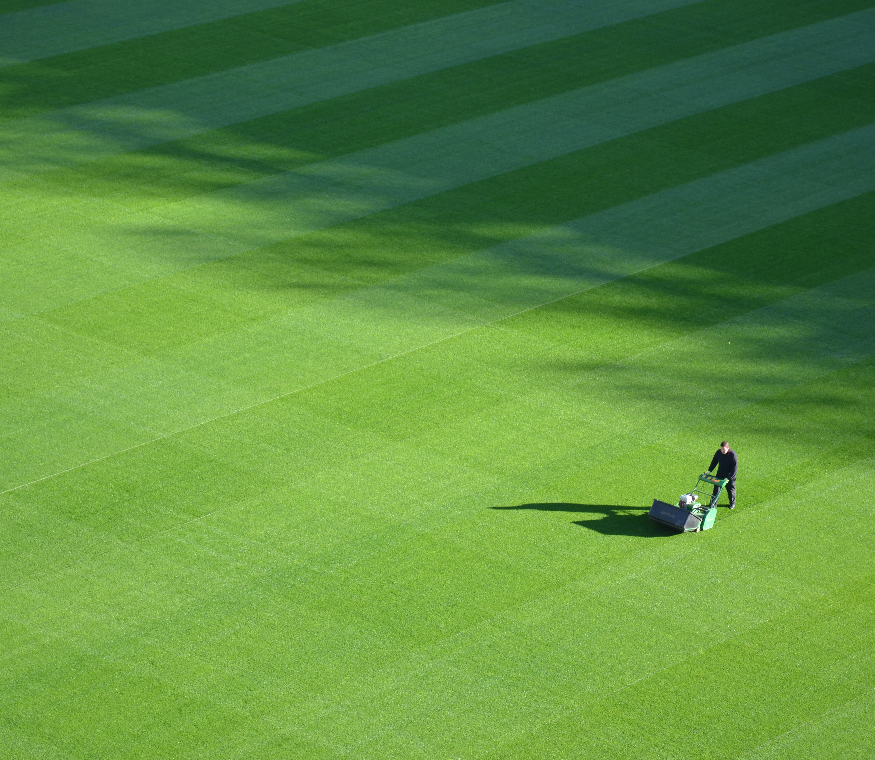
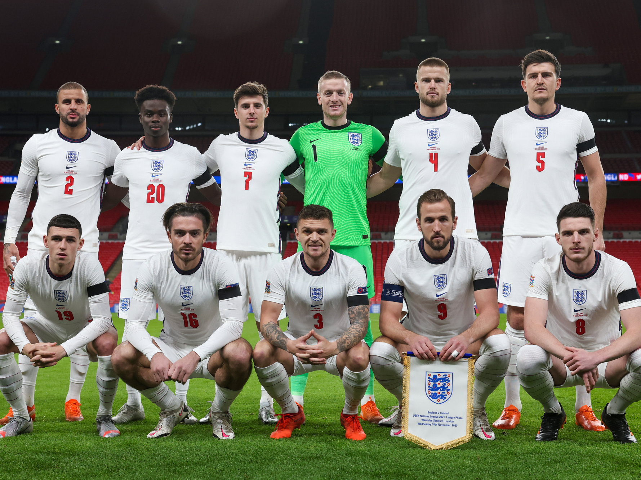
UEFA euro 2020
Matches start on 11th June 2021.
The final will be held on 11th July 2021 and will be hosted at Wembley Stadium in London.
In 2016, two billion people across the world watched the tournament.
The tournament takes place every four years and there have been 15 UEFA European Championship finals so far.
This year is the first time in the competition’s history that games are being held across different locations in Europe.
Notes:
Teacher notes
Discuss how many days there are to go until the tournament starts.

Slide 7
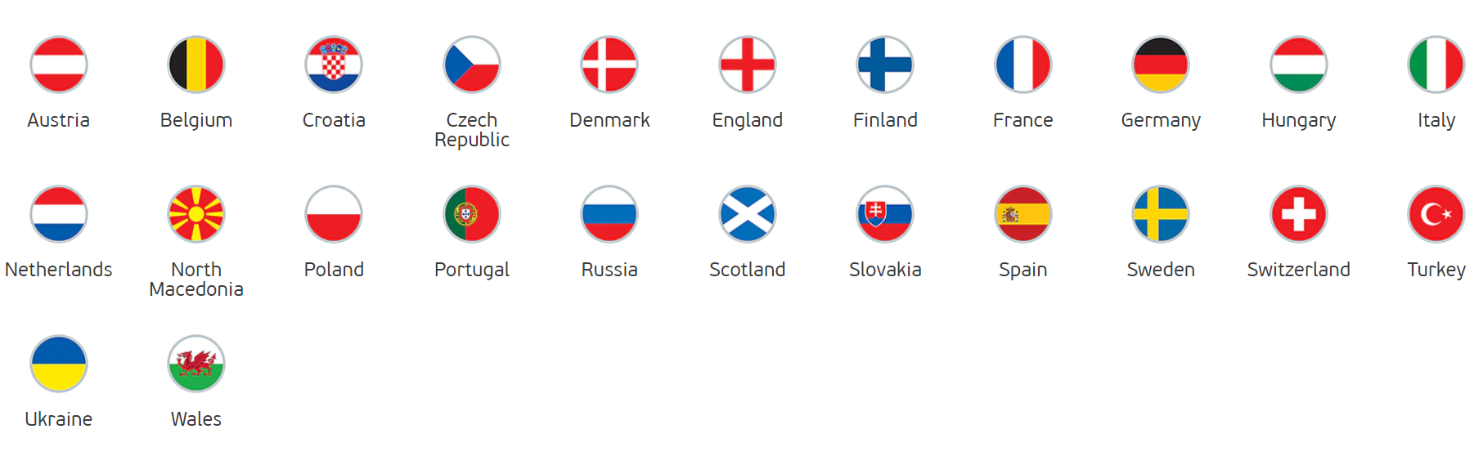
What is UEFA euro 2020?
24 Nations
11 Host Cities
To qualify for UEFA EURO 2020 teams played in the European Qualifiers from March to November 2019.
To be selected as a host for the tournament, cities must submit a bid to UEFA who then choose the best applicants.
Austria
Belgium
Croatia
Czech
Republic
Denmark
England
Finland
Sweden
Netherlands
North
Macedonia
Poland
Portugal
Russia
Scotland
Slovakia
Switzerland
Ukraine
Wales
France
Germany
Hungary
Italy
Spain
Turkey

Slide 8
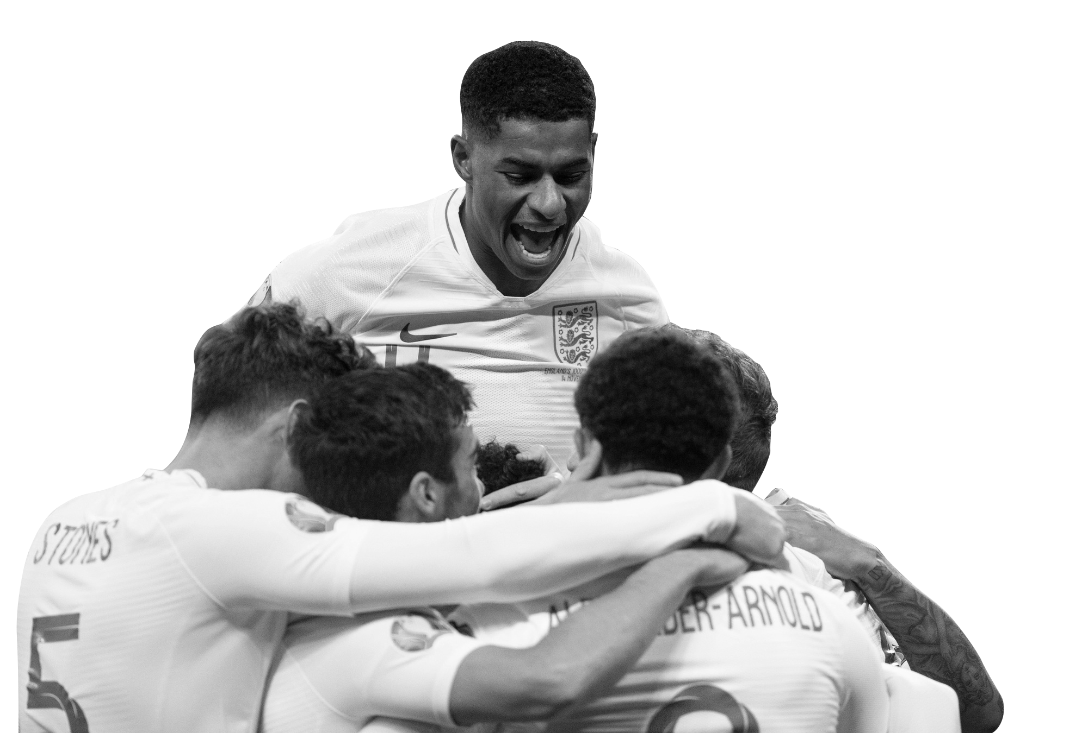
Why do we play team sports?
I feel happy
I can make new friends
I learn to work with others
I feel good about myself
I don’t worry about things as much
I learn to problem-solve
I am fit and healthy
I have a lot of fun
Notes:
Teacher notes
Teacher to pose the question to the pupils: Why do we play team sports?
Outline skills/benefits of team sports:
Problem solving
Reduces stress and anxiety
Collaboration skills
Reduces stress and anxiety
Health and fitness
Improved mental health
Social skills

Slide 9

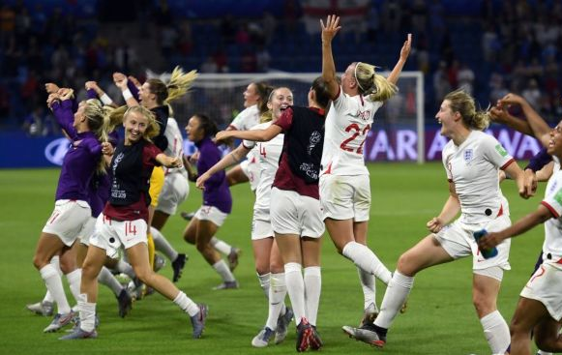
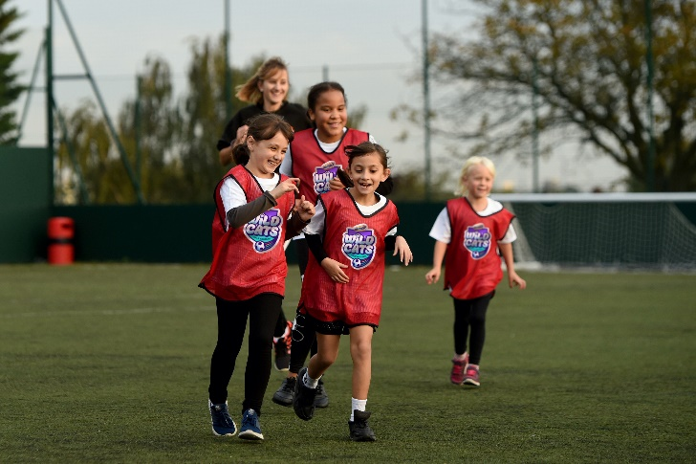
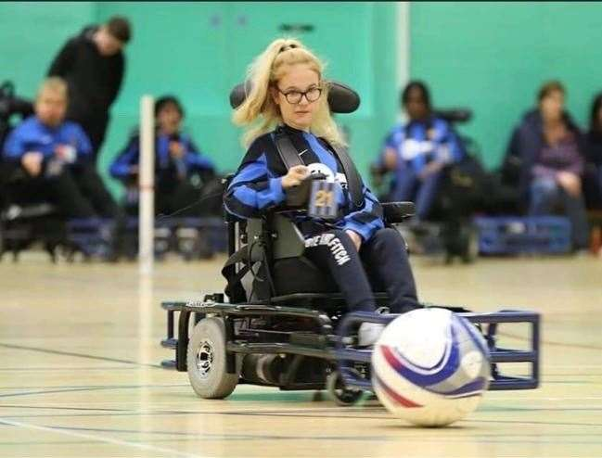
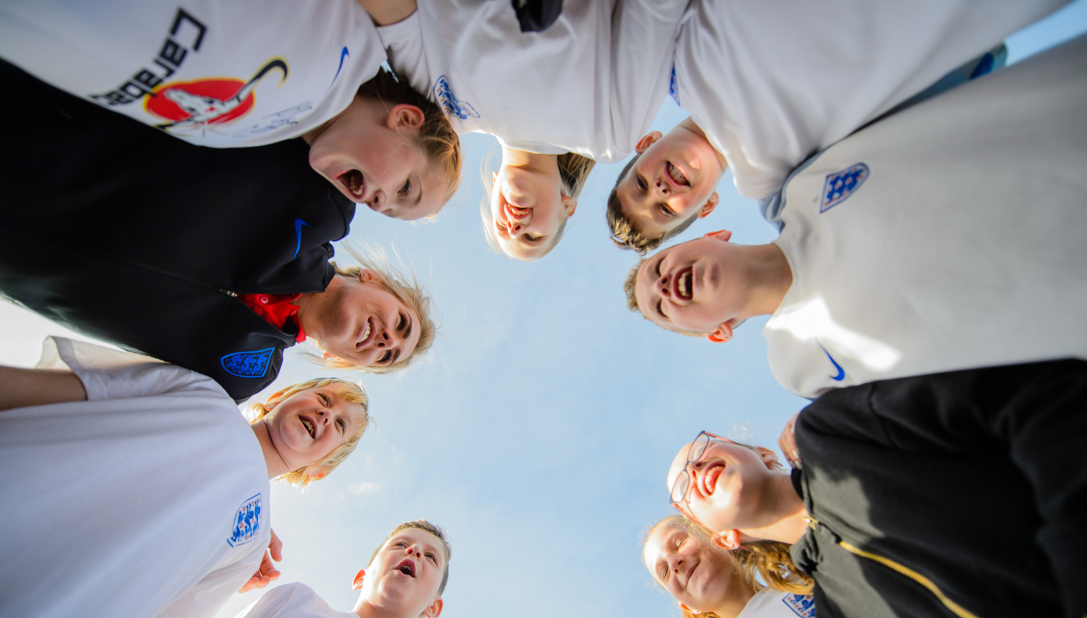
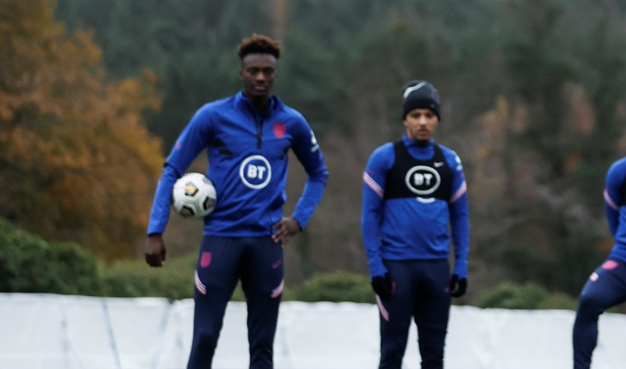
Game for all
Who plays football?
Notes:
Teacher notes
Explain to pupils that football is a game that anyone can play. UEFA EURO 2020 is a men’s tournament, but the women’s tournament is next year.

Slide 10

It’s just kicking a ball, right?
Let’s think about science and maths! How much science and maths is in football?
Materials? Fitness?
Gravity?
Speed?
Notes:
Teacher Notes
How much science is in football? Pose the question to the children. Ask them to think about their science and maths topics. Can you think of any topics in science/maths that would link to football? For example - forces. What forces may be involved in football?

Slide 11

Join us on a journey around Europe!
We are going on an ‘interrailing’ journey through Europe, visiting each of the 11 host cities.
In each host nation, we will carry out science, maths and PSHE challenges.
Notes:
Teacher Notes – CHANGE NUMBER IF YOU’RE NOT COMPLETING ALL 12 CHALLENGES

Slide 12
Where will you go?
 | City | Challenge
 | Rome | What are my team’s chances of winning the tournament?
 | Baku | How can we value others?
 | St. Petersburg | What does it take to be an international footballer?
 | Copenhagen | Why do I need a positive mindset?
 | Amsterdam | How do I get the football into the net?
 | Bucharest | How can I be my best self?
 | London | How are pitches made game-ready?
 | Glasgow | Stress - friend or foe?
 | Seville | What is a football made from and why?
 | Munich | How do you fuel an international football player?
 | Budapest | What are values and why are they important?
Notes:
Teacher notes
Go through each/some of the challenges to engage the interest of the pupils.
Please note:
These activities can be done in isolation or they can be done as a whole project-based learning programme.

Slide 13



Let’s get started
At each host city, you will answer a Big Question.
On completion of your Big Question, you will send a postcard home from that city to show what you have learned.
You will then be given your rail ticket to the next city - jump back on the train to visit your next city and complete your next Big Question!
Notes:
Teacher Notes
If you’re aiming to complete all 12 Host City Mini Challenges before the UEFA EURO 2020 final on Sunday 11 July 2021, get pupils excited about this.
If you’re running the challenges across a UEFA EURO 2020 day, explain how this will work.

Slide 14
First stop
Which host city will you travel to first?
Let’s find out and earn your first rail ticket!
Notes:
Teacher Notes – ADAPT THIS SLIDE TO SHOW WHATEVER MINI CHALLENGE YOU CHOOSE TO START WITH
Use this slide to adapt to what your children will be learning first. Remove slide if children are working in different groups on to complete the challenges.

Slide 15

Bon voyage!

