Slide 1
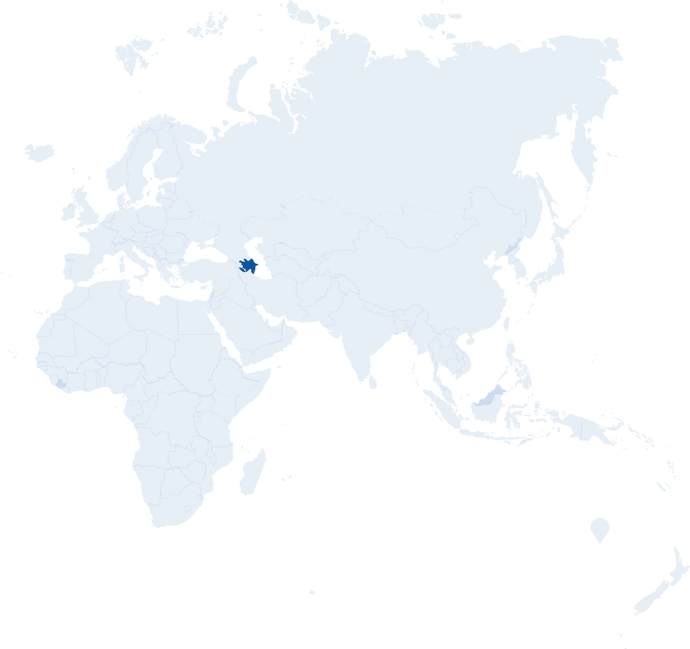





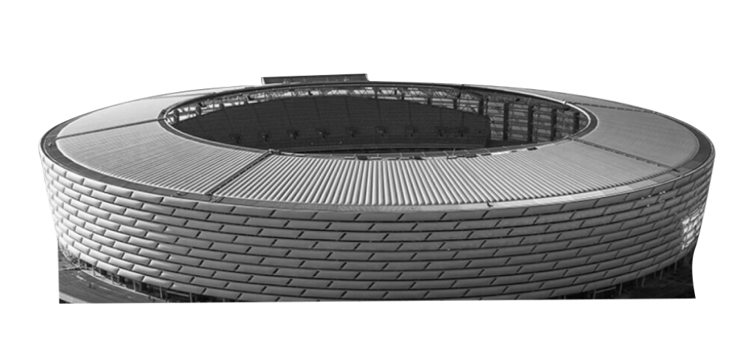

Welcome to..
baku
Continent: Europe
Country: Azerbaijan
Capital: Baku
Heydar Aliyev Centre
What country is Azerbaijan next to?
What is the official language in Azerbaijan?
Baku Olympic Stadium
Notes:
Teacher Notes
Starter activity: Get students thinking about what country they are visiting.

Slide 2





Welcome to baku
You’ve made your railway journey to the capital city of Azerbaijan. It is famous for its architecture, culture and the fact it is the lowest lying capital city in the world. It is one of the Group A hosts in UEFA EURO 2020.
What teams will be playing in this group?
Use the flags below to find out…
Baku
TURKEY
London
ITALY
GROUP A
WALES
SWITZERLAND
Notes:
Teacher Notes
Brief introduction to Baku as a city.
Locate Azerbaijan and then Baku on the map.
Use the Baku Host City Guide to discuss the country in more detail (optional).

Slide 3
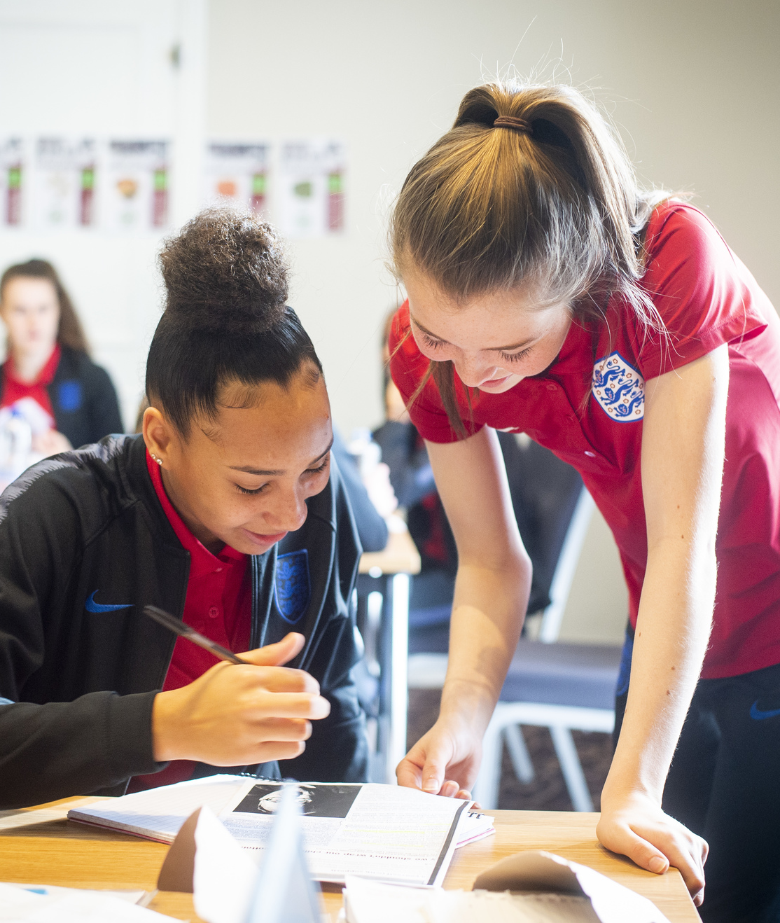
Your big question to answer in baku is:
How can we value others?
Learning objectives:
To know what it means to ‘value’ someone.
To learn to actively listen to the opinions of others and to respond appropriately.
Notes:
Teacher Notes
The big question to answer is a key point of the lesson.

Slide 4
What do all these objects have in common?
Notes:
Teacher Notes
Show students a variety of objects that are special to you.
Explain they are all special for different reasons but that you place value on them.
Value is the importance, worth or usefulness of something.

Slide 5
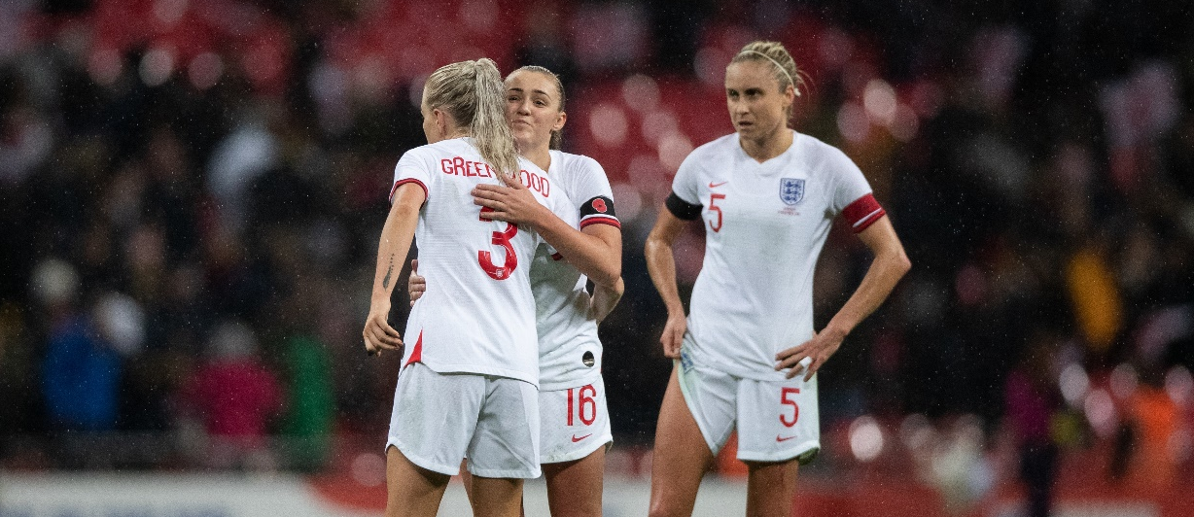
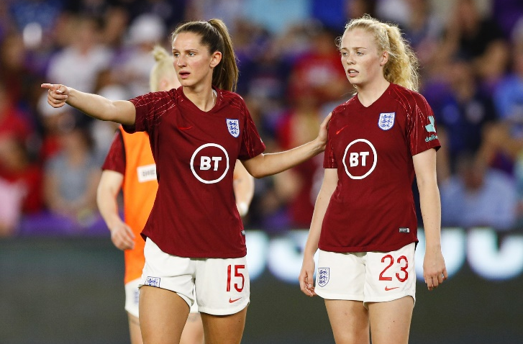
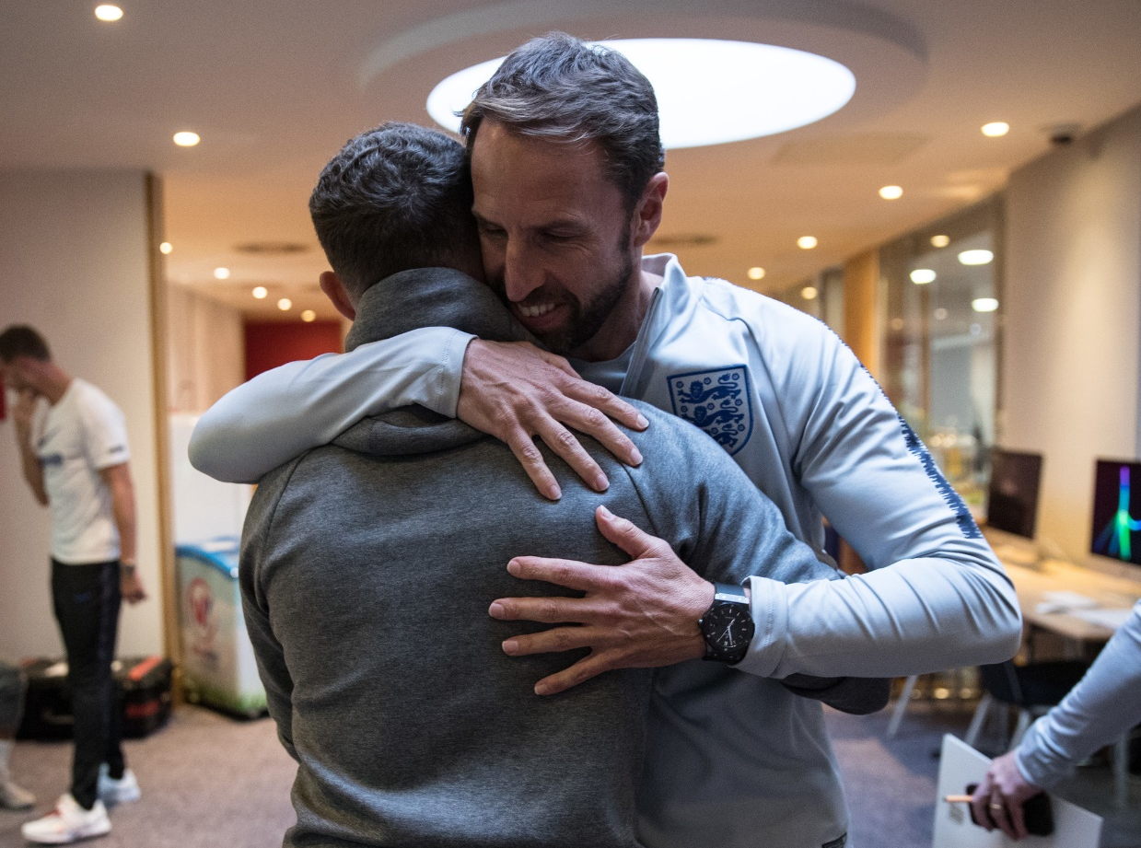
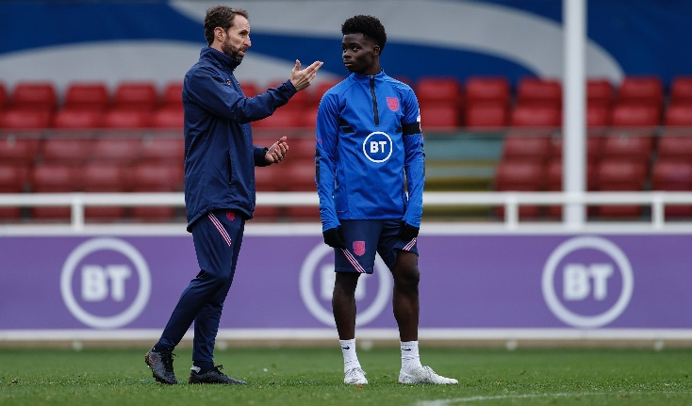
How can we demonstrate we value someone?
Notes:
Teacher Notes
Pose the question - How can we demonstrate we value someone?
Take pupils' responses, these might include:
Be interested.
Invest time in them.
Keep your promises.
Treat people equally.
Be present.
Praise achievements.
Appreciate them.
Actively listen.

Slide 6
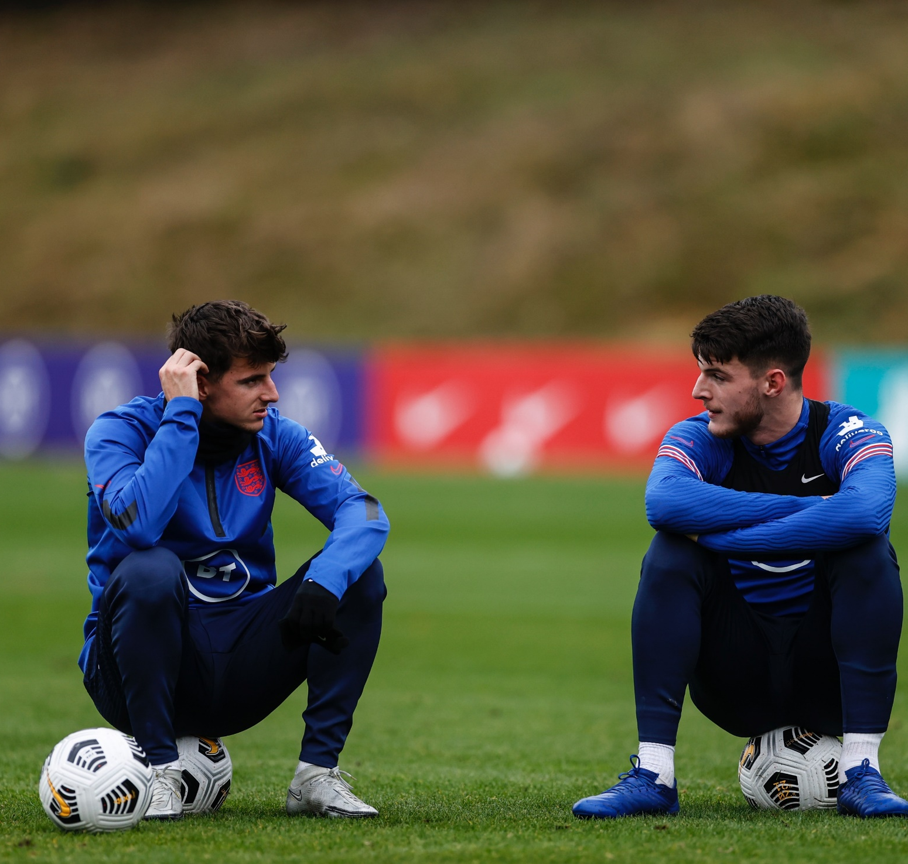
Actively listening
Respect the opinions of others.
Respond respectfully to the opinions of others.
Notes:
Teacher Notes
What does it mean to actively listen to someone?
Explain that a large part of demonstrating value towards another person is to listen and respect their points of view and opinions.
We are going to practice the skills of voicing our opinions, listening to the opinions of others and responding to them respectfully.

Slide 7

Let’s debate!
We are going to practice the skills of voicing our opinions, listening to the opinions of others and responding to them respectfully.
debate!
debate!
Notes:
Teacher Notes
Introduce the activity to pupils and get ready to hand out Debate Cards (see Activity Sheet).

Slide 8
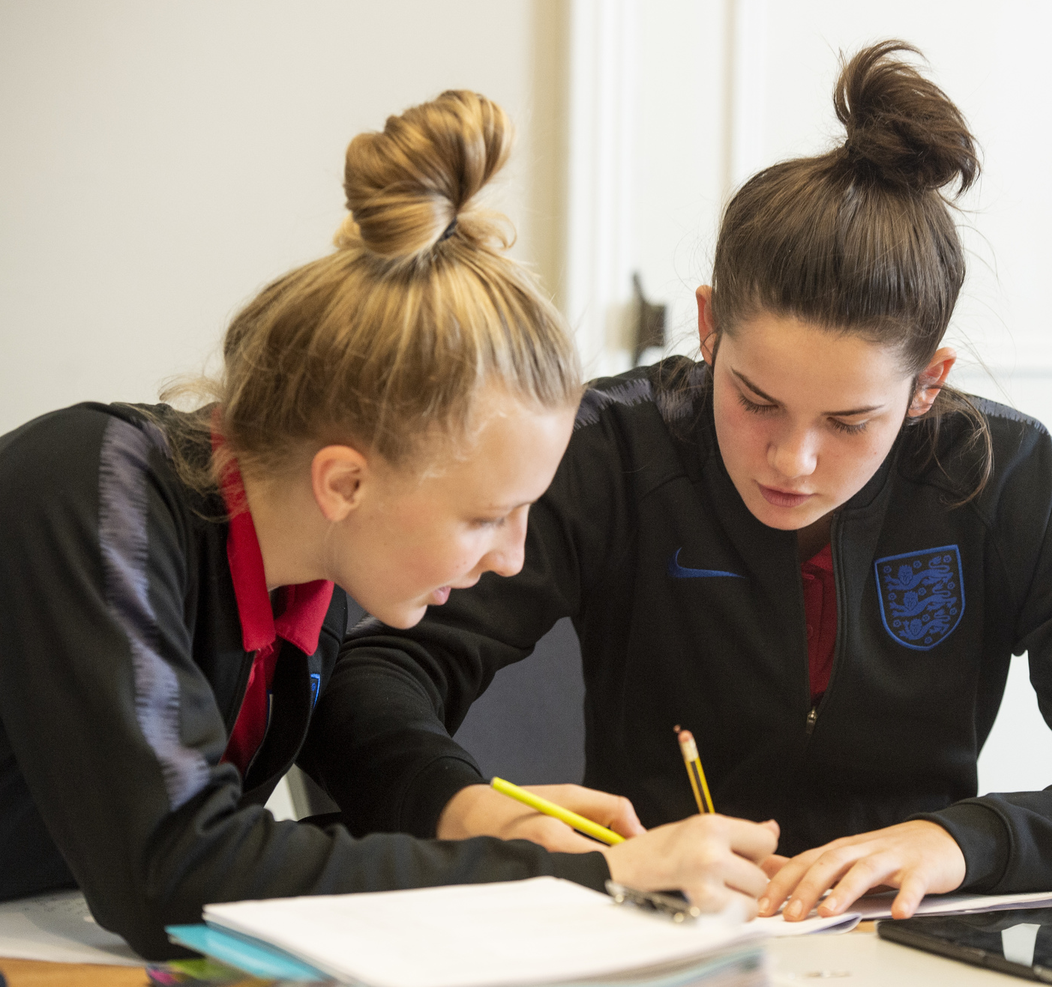
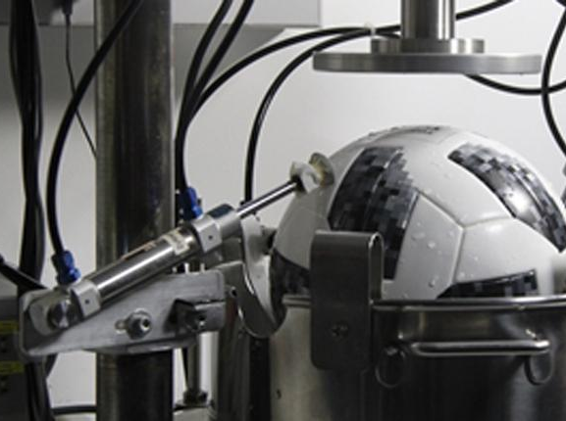
How to play
Choose a card.
Read out the statement on your card to your partner.
Decide if you agree or disagree.
Give reasons for your decision.
e.g.
I agree with this statement because…
I disagree with this statement because…
Notes:
Teacher Notes
Explain the activity to the pupils.
Working in pairs or small groups of up to four, pupils each choose a Debate Card from the pile. If preferred, the teacher can allocate a card for each group to debate. Each card contains a statement that pupils will need to decide if the agree or disagree with. They must then give reasons for their decision.
Debate example: Only boys can play football
- I agree with this statement because…
- I disagree with this statement because…

Slide 9

Let’s debate!
Competitive sport should not be played in schools.
In football, the captain is always right.
School uniform should be gender neutral.
Teachers should wear uniform.
Girls are not as good as boys at playing sports.
School uniform should be abolished.
An hour of sport every day should be compulsory in schools.
SATS exams should be banned in Year 6.
Penalty shoot-outs are an unfair way to win a match.
VAR (video assistant referee) is bad for football.
Women’s football isn’t as competitive as men’s football.
Football matches should be free to watch on TV.
Notes:
Teacher Notes
Share all of the topics being debated with the class.

Slide 10


Let’s write home
Write a postcard home saying what you have learnt about how to show value.
Can you include:
How we can show we value others.
How you show you value your classmates.
Where are we going next?…..
Notes:
Teacher Notes
Students to consolidate their learning within this section.
Linking back to the big question.

