Slide 1
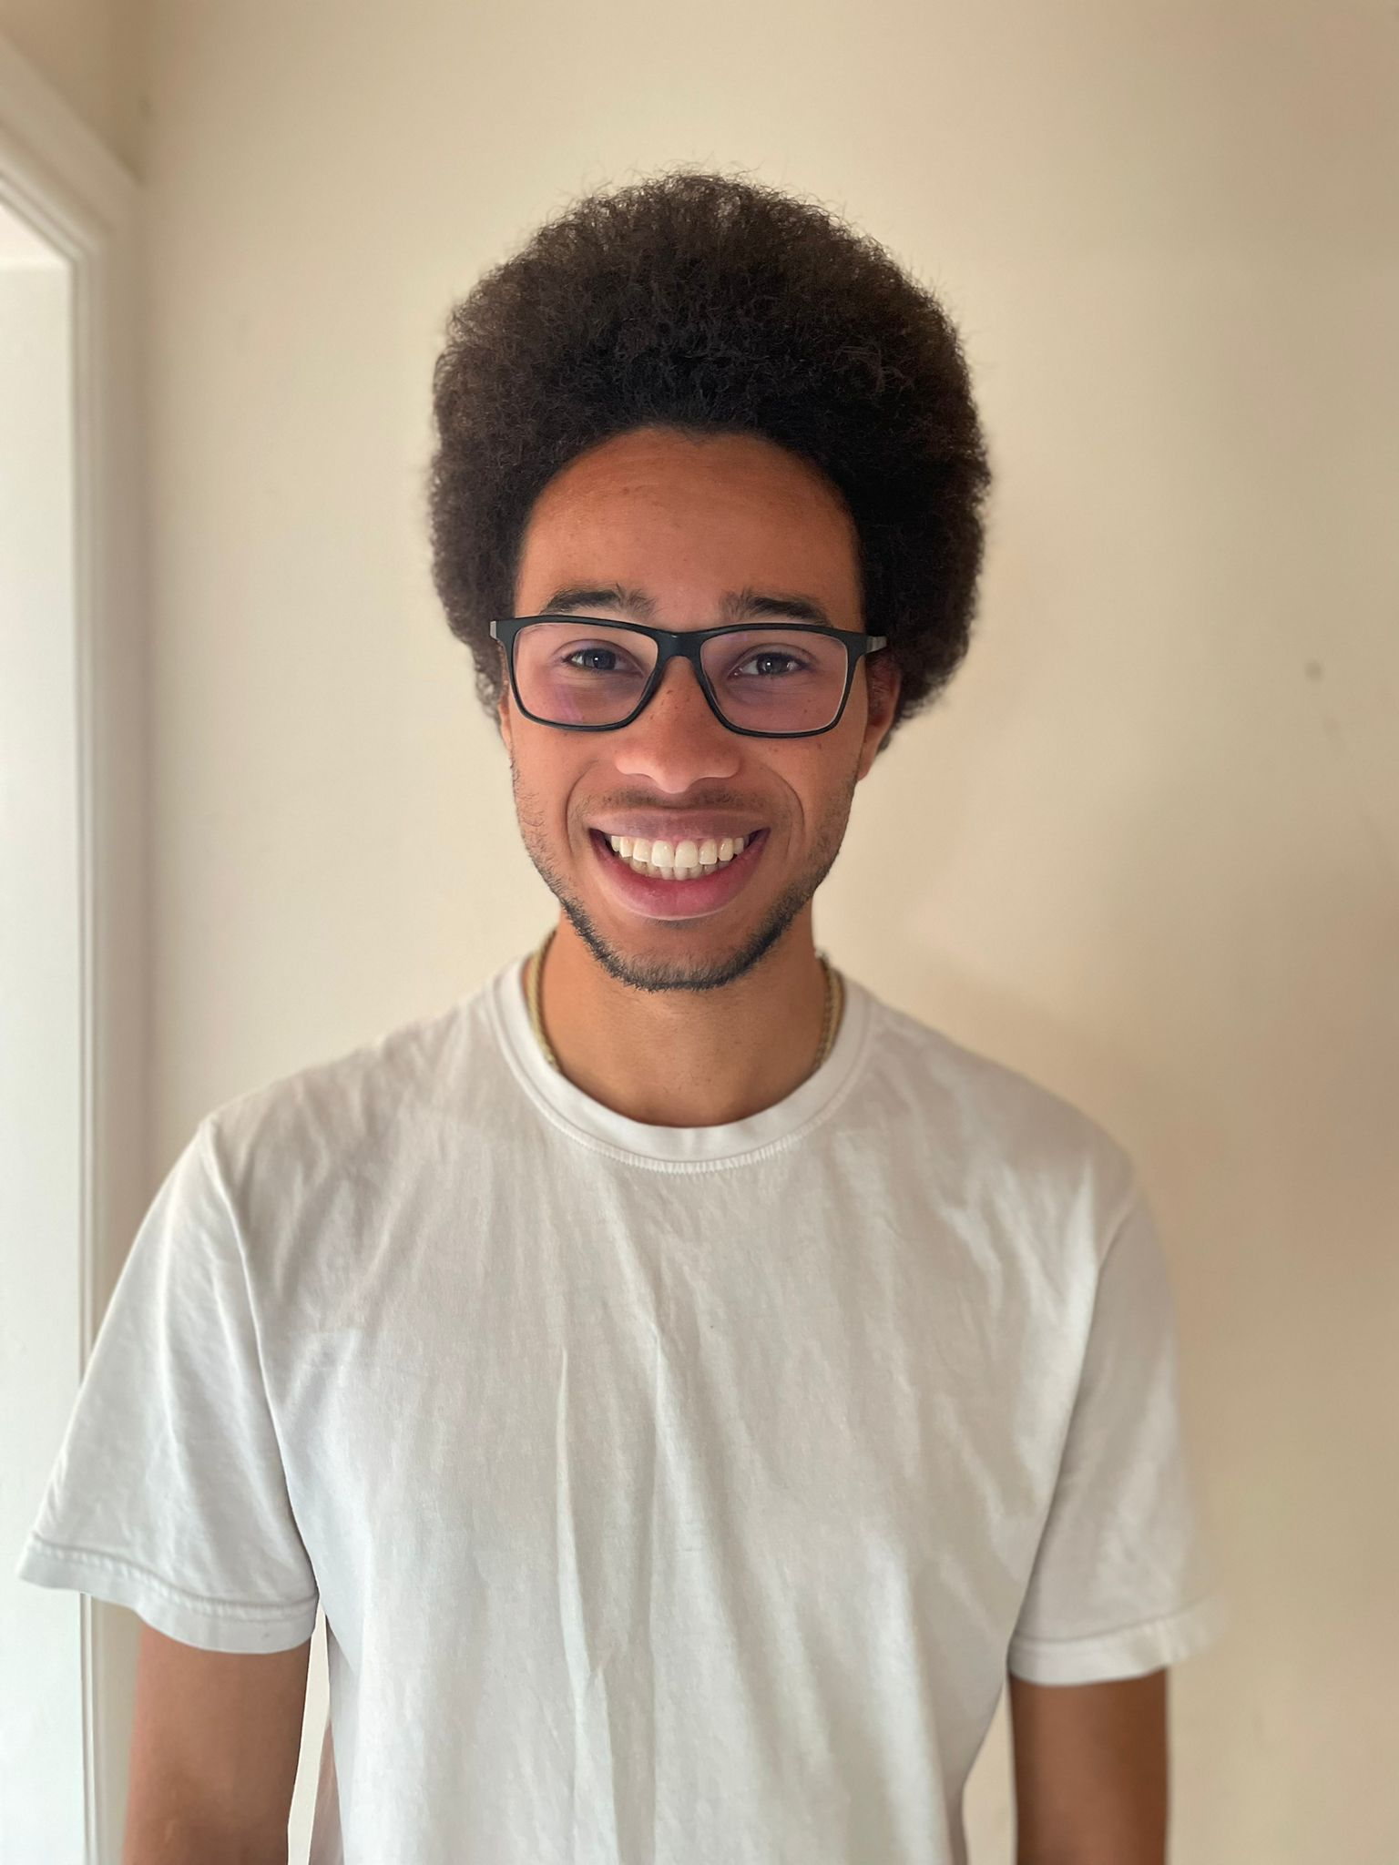
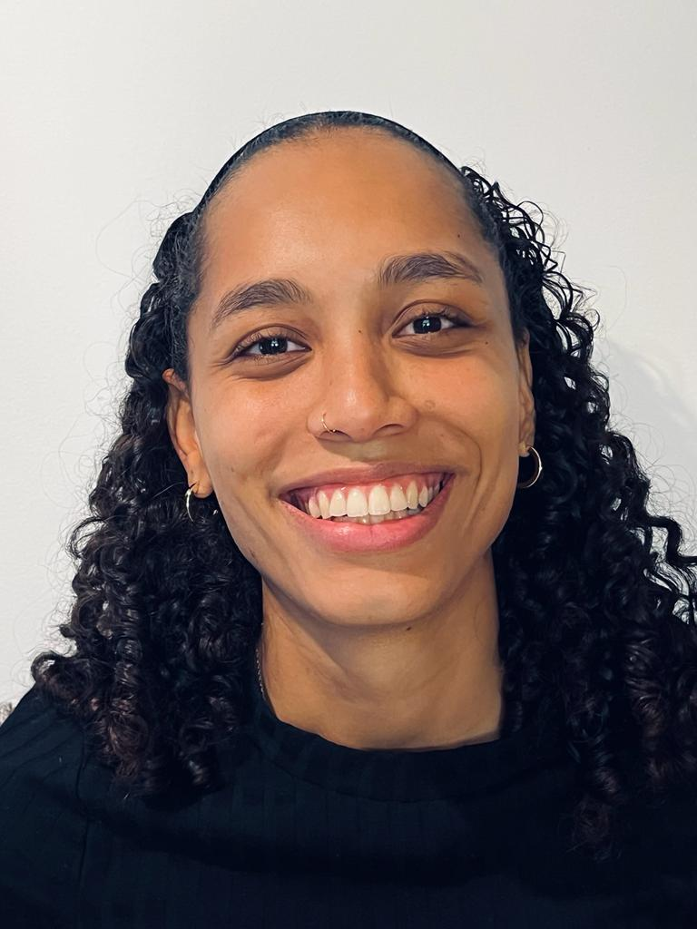
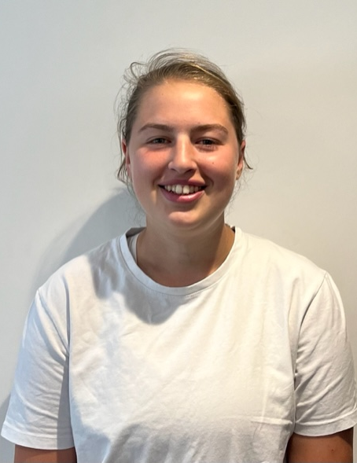
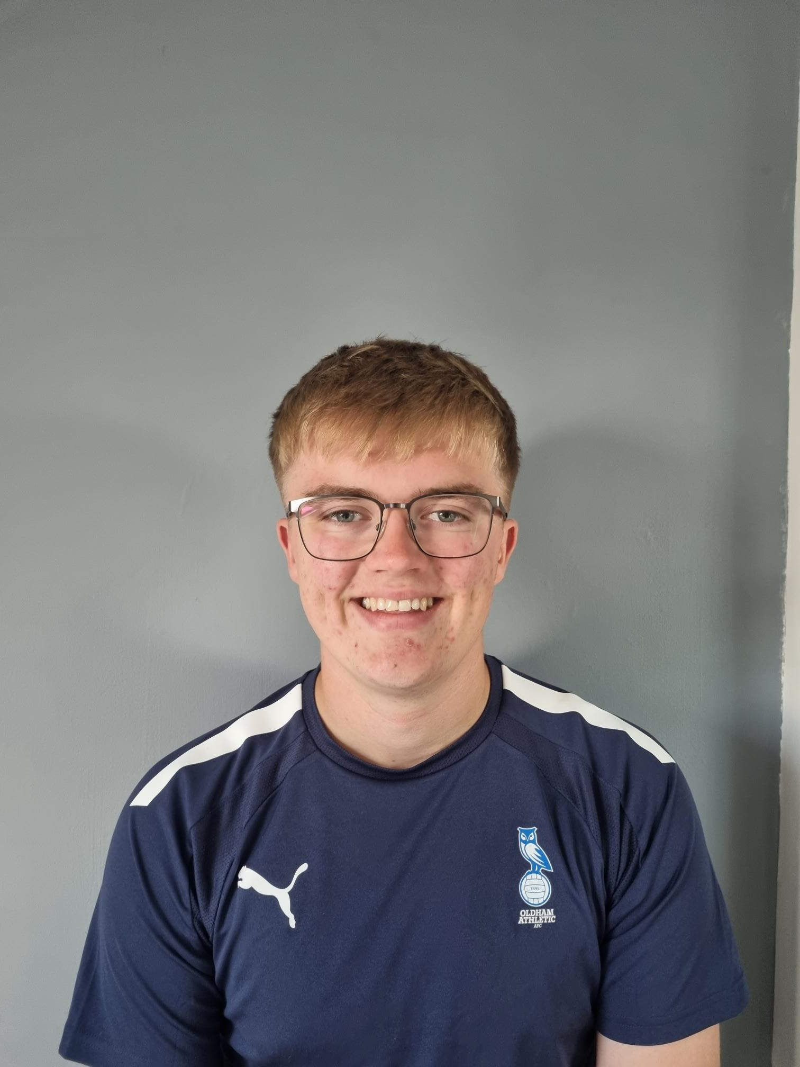
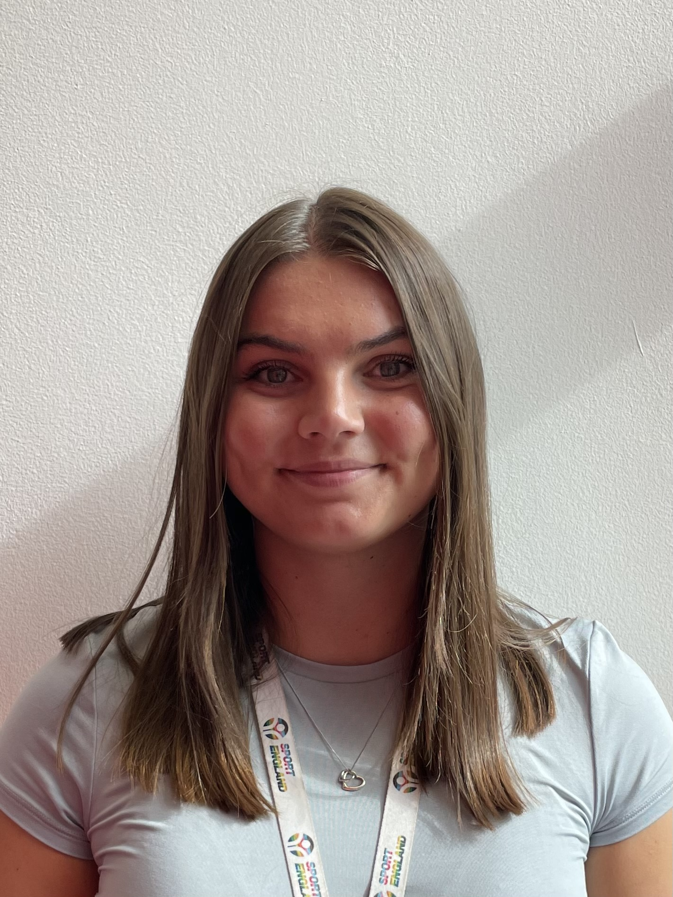
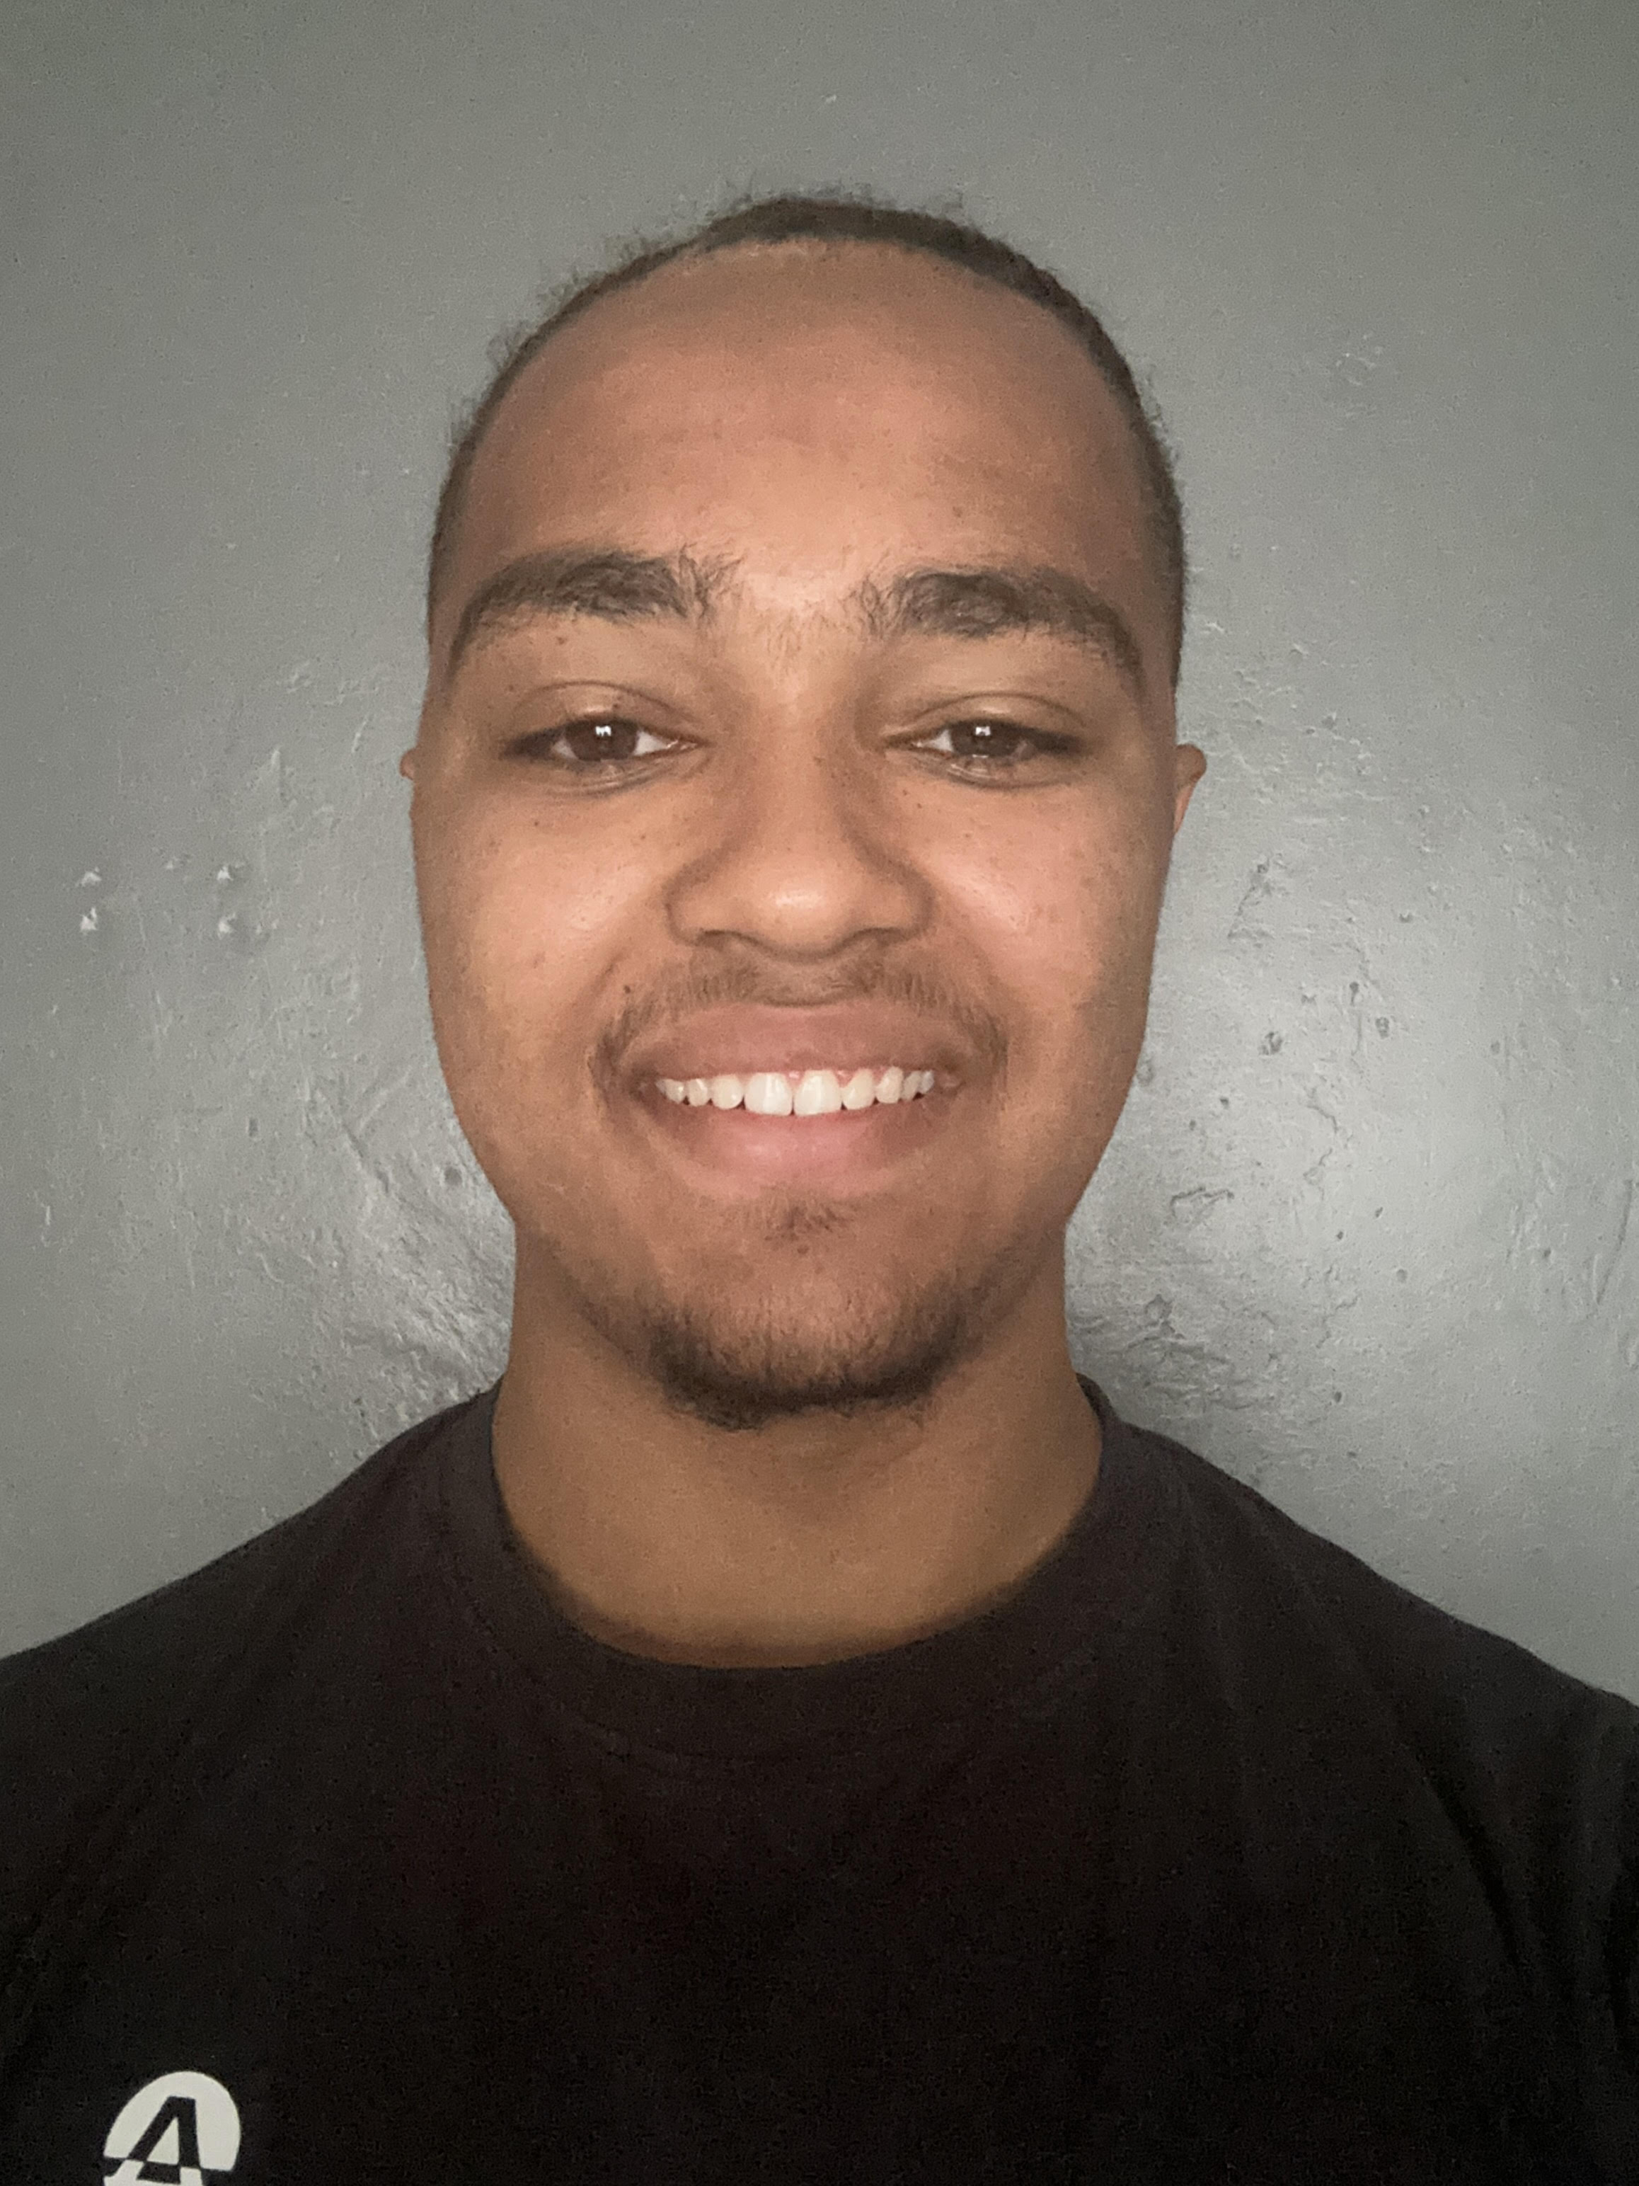
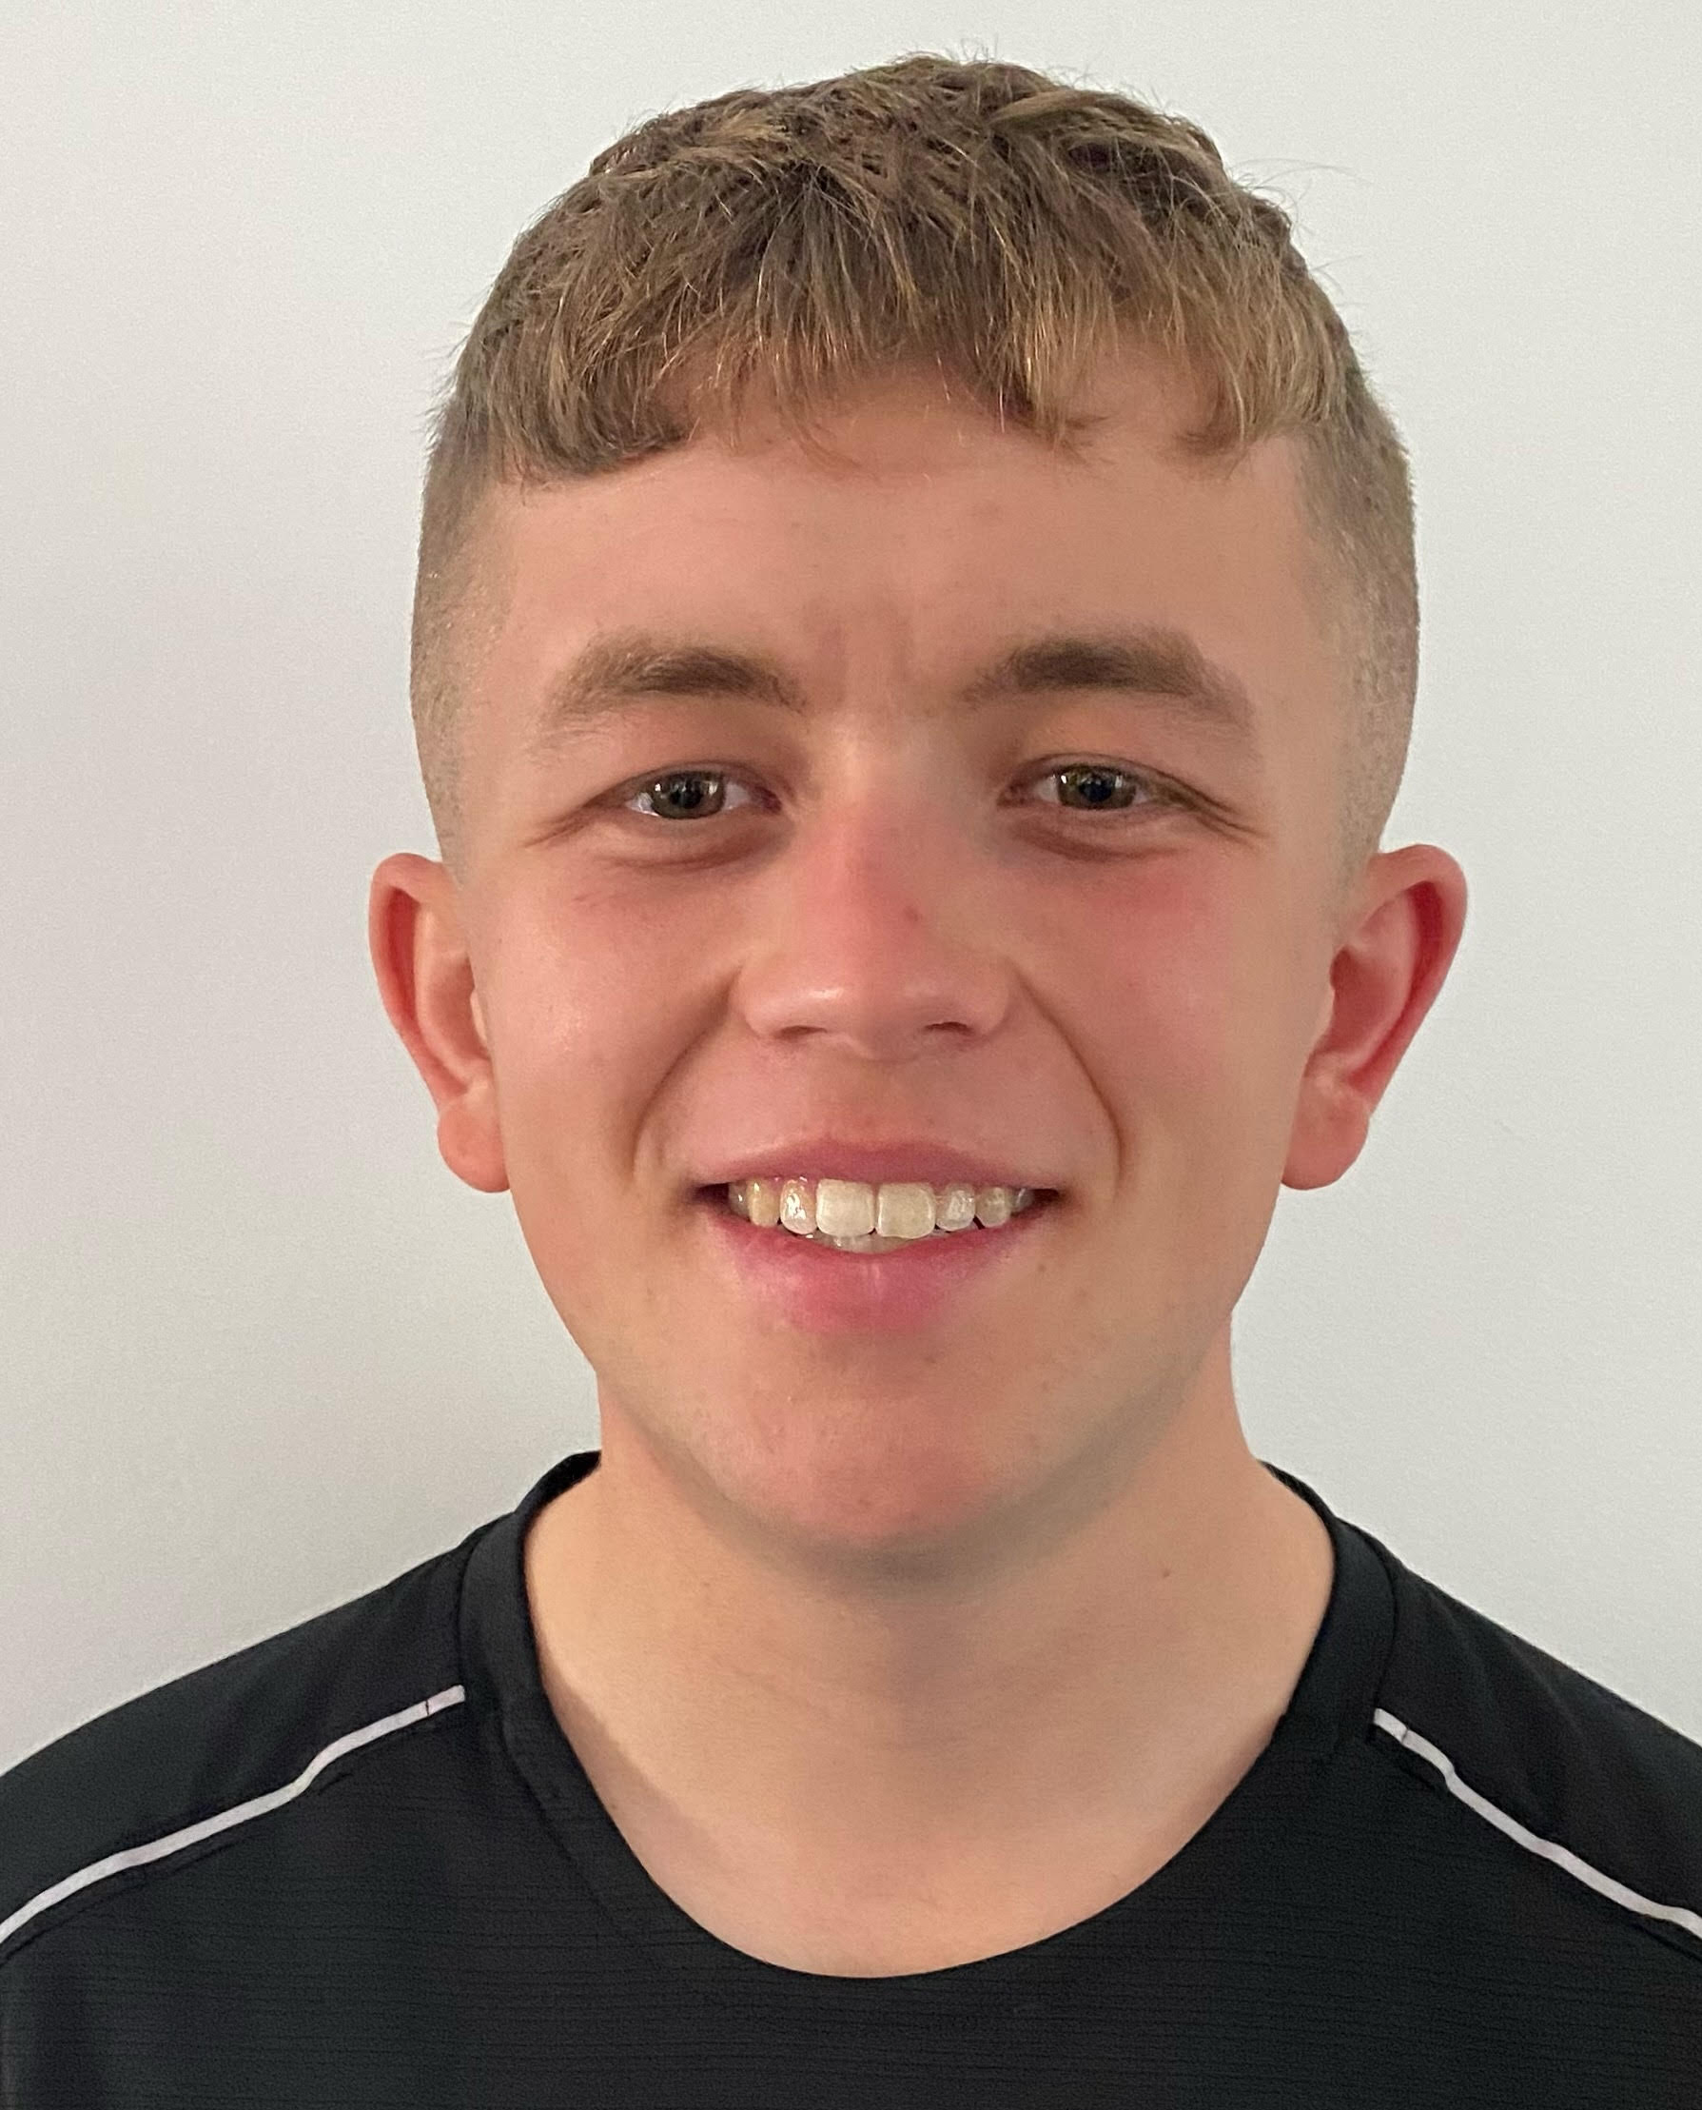
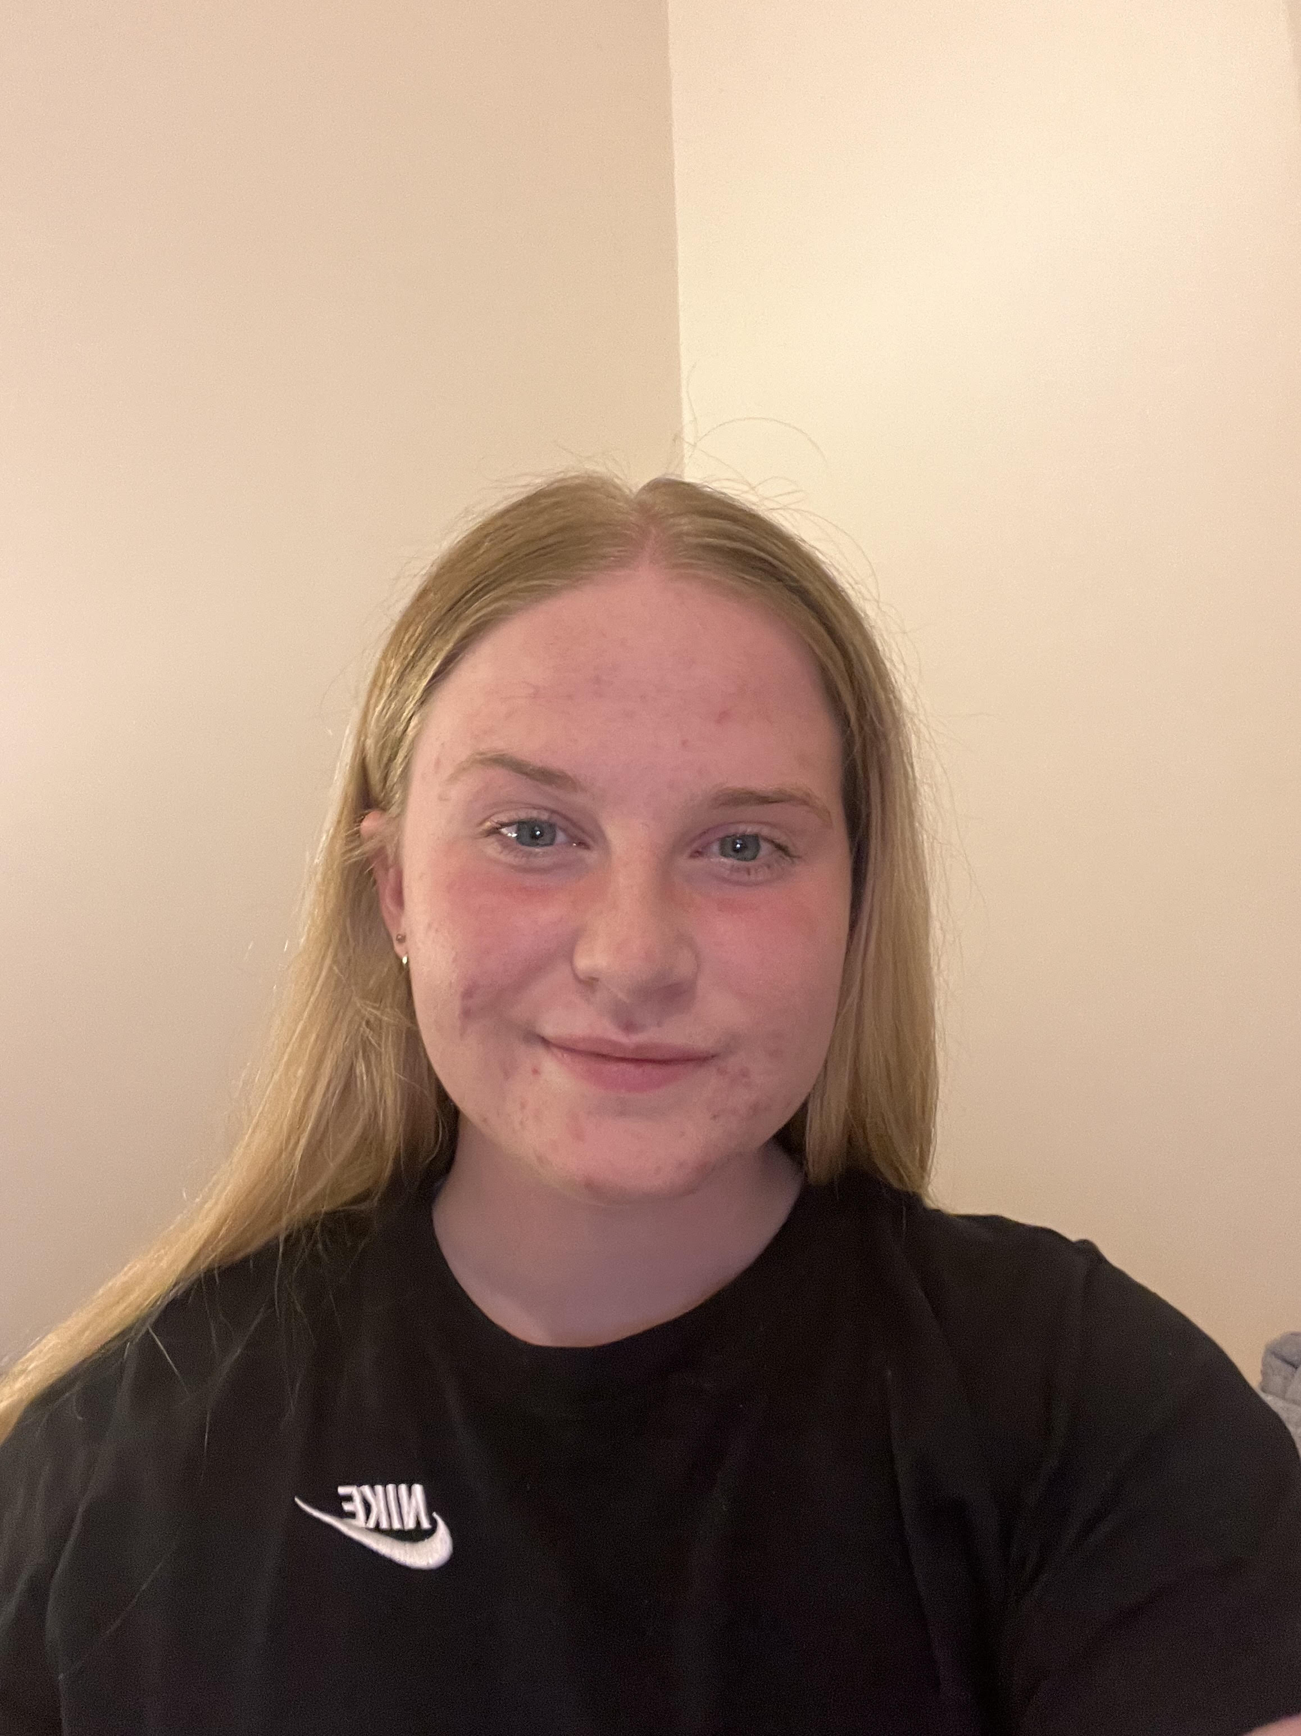
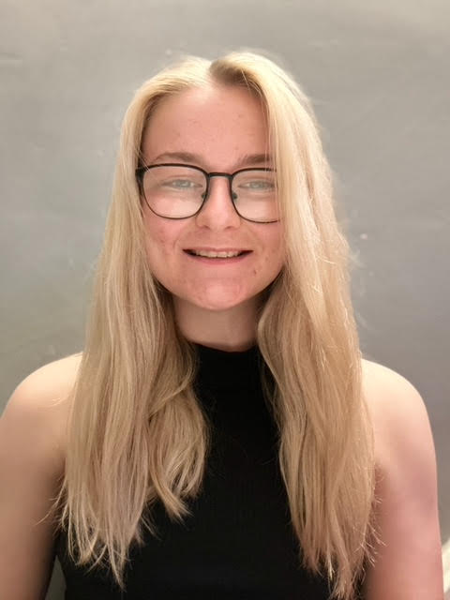
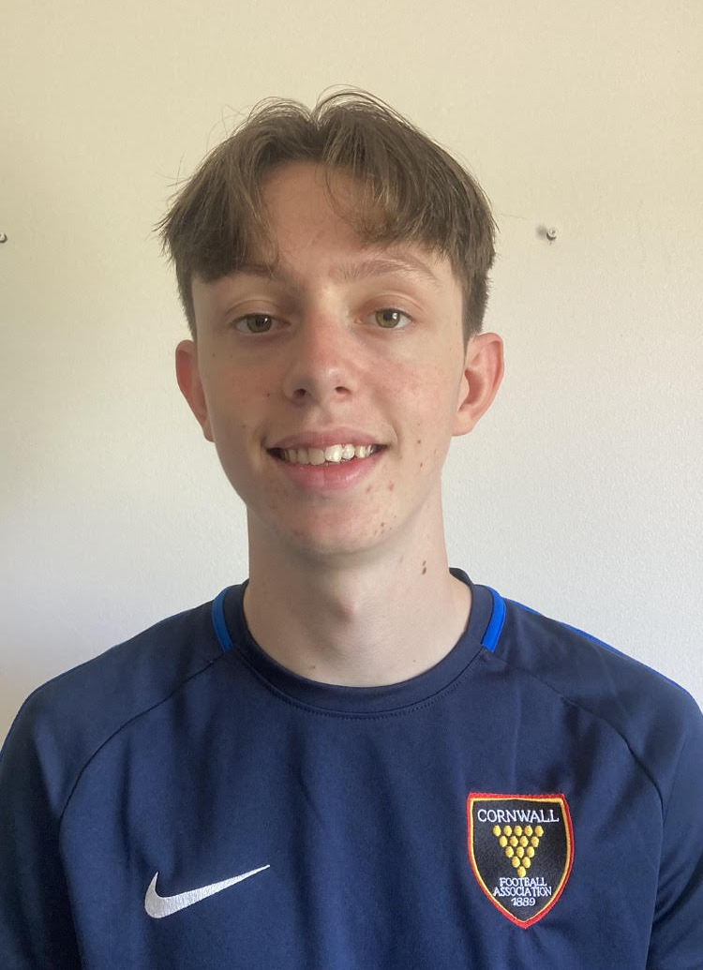
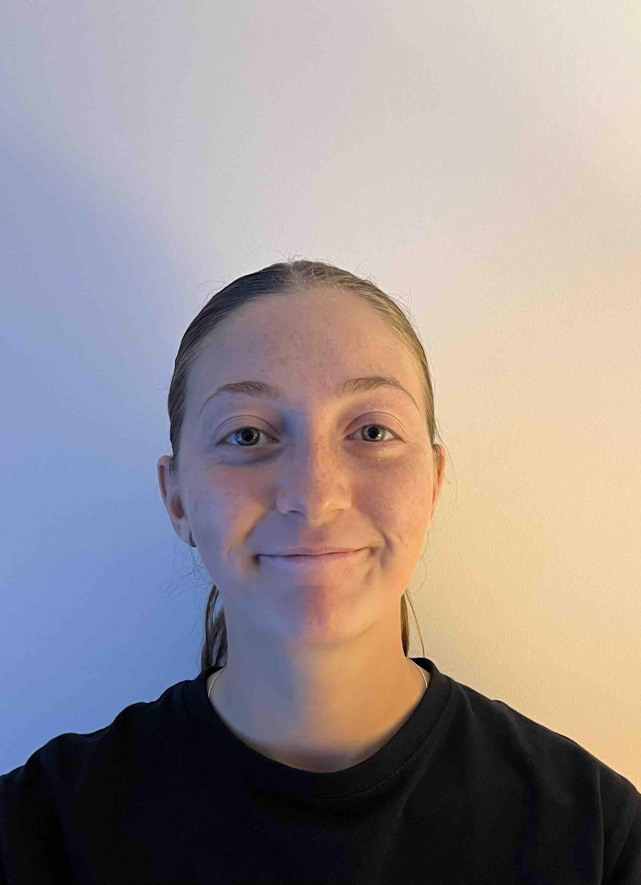
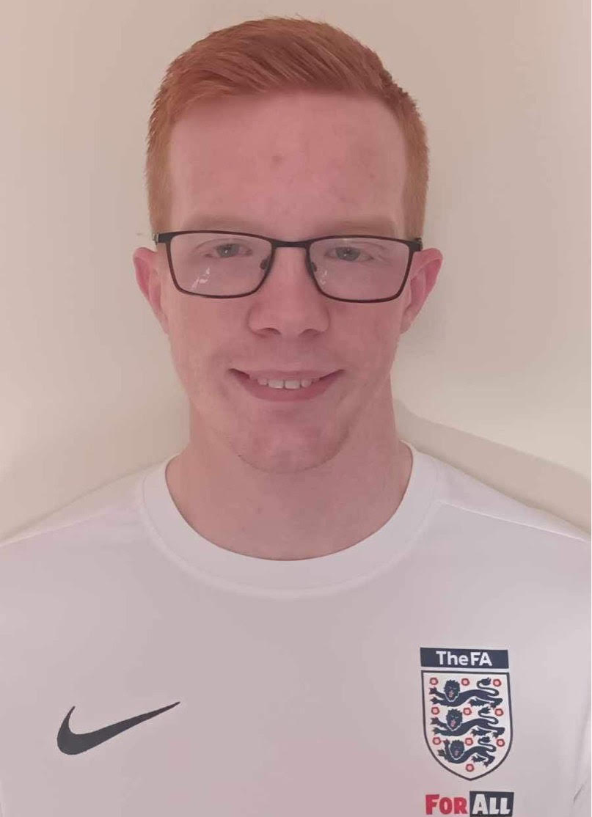
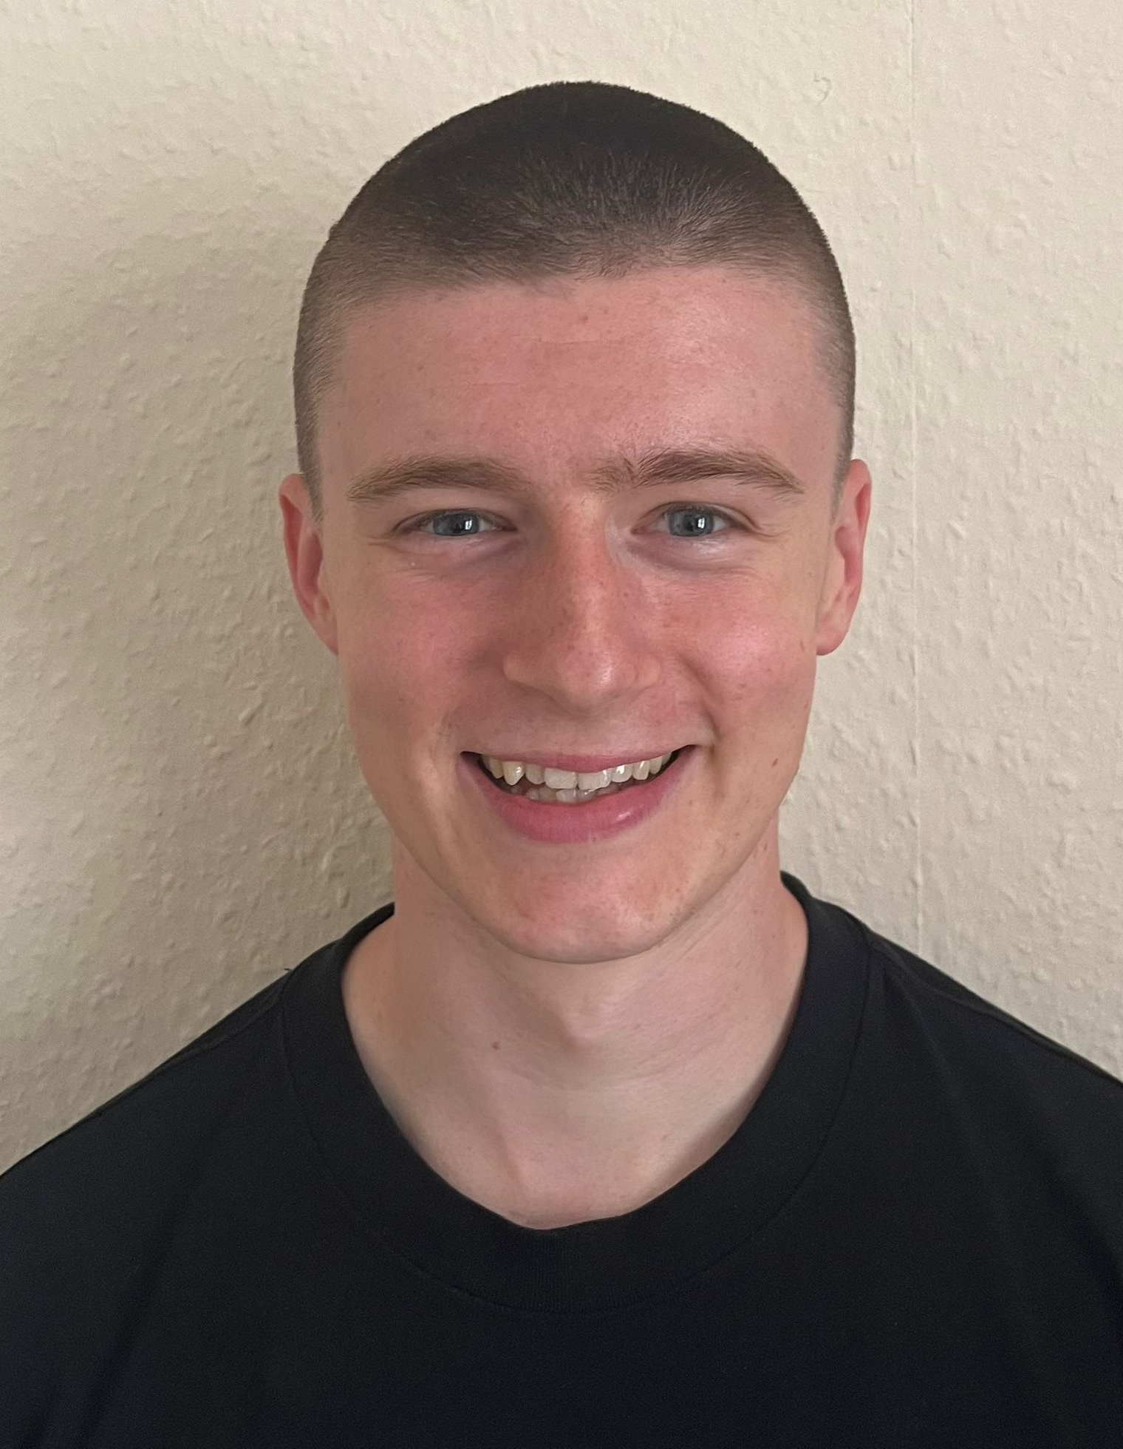
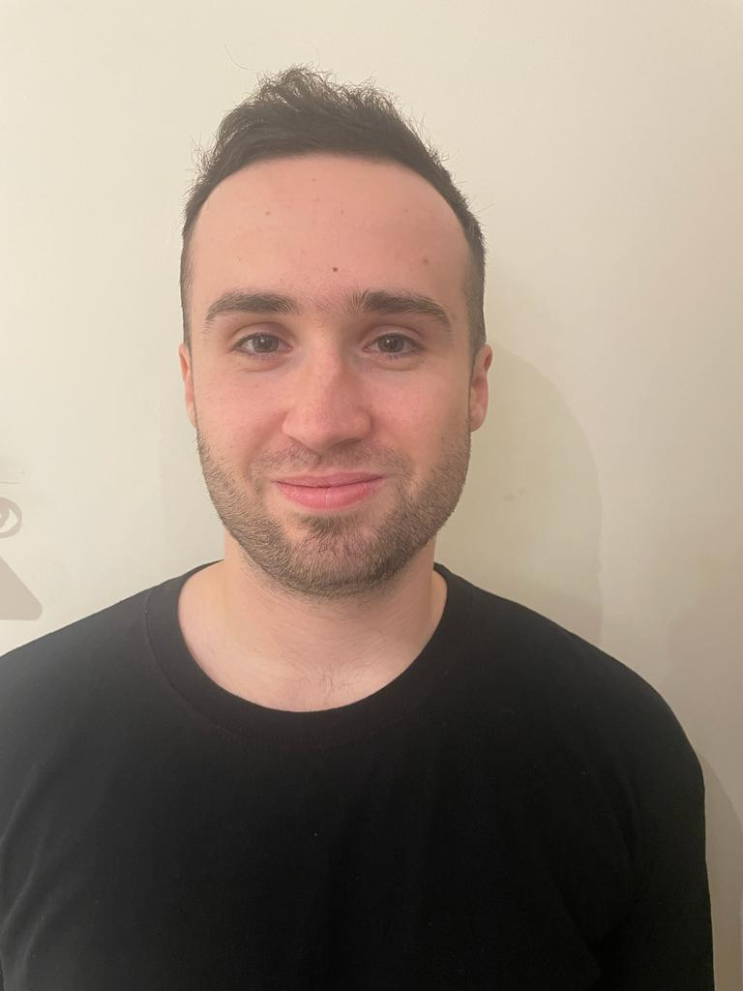
FA National Youth Council 2023/24 - Bios
SENIOR LEADERSHIP TEAM
Jordan Liburd- Chair
Jordan is in his third season on the FA National Youth Council, he is the Chair. Jordan is a passionate grassroots coach and is the football development officer at his club. Jordan mentors' young people and runs a Youth Leadership programme at a company where he works. Jordan is a research scientist, working in structural and molecular biology at the University of Leeds
Charlotte Akester– Vice-Chair
Poppy Nicholls– Vice-Chair
Charlotte is an Equality, Diversity and Inclusion Coordinator, with an undergraduate degree in Sport Development and Coaching. Charlotte is driven to ensure opportunities in football are inclusive and accessible for all and currently sits on the Lincolnshire FA Inclusion Advisory Group. This is Charlotte’s Seconds season on the team. Charlotte is a Level 2 football Coach currently coaching both adult women’s and Under 13s Girls football.
Poppy is going into her 2nd year at the University of Brighton, training to become a PE Teacher. She is a passionate football coach who has coached since the age of 15. This is her 2nd year on the team and she is passionate about making football accessible for all..
COMMUNITY ENGAGEMENT TEAM
LEADERSHIP & DEVELOPMENT TEAM
INSIGHT, INCLUSION & COMMUNICATION TEAM
Cameron Fletcher– Community Engagement Lead (North)
Madeline Hurley- Regional Youth Network Lead
Gregory Stevens- Equality, Diversity & Inclusion Lead
Cameron works full-time as a Women’s Football Development Officer at Calderdale College and is a football coach working within multiple environments from Wildcats to Academy football. Furthermore, he is also a Level 5 Referee. Through his positive experiences in his current roles Cameron is keen to encourage a new diverse audience of coaches and referees in the North of England
Maddy is in her final year at Loughborough University, studying Sport and Exercise Psychology. She has just completed her placement at Sport England, working as an Investment Management Support Assistant. She is also chair of Hertfordshire FA Youth Council.
Greg is currently a second-year university student studying Football Business and Marketing, and is also a coach and player himself at county level. Greg has a strong passion for inclusivity in football and aims to create greater opportunities for everyone using football as a source. This is Greg’s first season on the team
Harry Bland – Community Engagement Lead (South)
Katana Gould – Regional Youth Network Lead
Sarah-Jayne Smith– Social Media Lead
Harry is currently undertaking an Undergraduate Sport and Exercise BSc at Sheffield Hallam, and is a football coach, who has coached from grassroots right through to men’s professional football. This is his second season on the team. Harry has a keen interest on ensuring everyone’s voice is heard around any role he undertakes, like his role as Chairperson on the Norfolk FA Youth Council last season.
Kat is 20 years old, is currently based in Preston, and beginning her Sports Business Management degree this year. Kat is returning to the team after studying and playing football in America for the past 2 years. Kat is passionate about increasing participation and opportunities for Women and Girls.
Sarah has recently completed her Community Football Coaching degree and is heading back to study her Masters in Sport and Exercise Science in September. Sarah is football coach, and referee. This is her first season on the team. Sarah is passionate about creating opportunities in football for women and girls outside of playing and is part of the FA Women’s Emerging Talent Programme for referees.
Jack Masters– Community Engagement Lead (West)
Siân Hillis– Programmes Lead
Ethan Freestone – Research & Insight Lead
Jack is 18 years old, from Cornwall and is starting his first year at Marjon University studying Football Coaching and Development. Aside from this, Jack coaches his local u18s and at the Cornwall FA Girls Emerging Talent Centre. This is Jack’s first season on the team although he is also part of the Cornwall FA Youth Council and the Regional Youth Network. Jack’s main passion is creating and providing opportunities for everyone to stay in the game.
Sian has recently completed a degree in Sports Business and Coaching. She currently coaches within girls’ academy football, and has experience working with a range of ages, in different football formats. At present Sian is the Chairperson of Essex FA’s Youth Forum and 2023/24 will be her first season on the FA NYC
Ethan is 18 and based in Lincoln, where he is a civil servant. Outside of work Ethan is usually either at the gym or refereeing, he is currently a level 6 referee, with 4 years’ experience. He started refereeing when he was 14 and has refereed from youth football right through to open age. This is his first season on the team. Ethan has a keen interest in providing more support for youth referees and is currently a member on Lincolnshire FA’s Youth Council, and the Regional Youth Network for the East.
Joel Moore– Community Engagement Lead (East)
Kelvin Newell– Programmes Lead
Vacant Marketing & Communications Lead
Joel is currently in his placement year at Loughborough University as Men’s Football Operations Coordinator for Loughborough Students FC. He is excited about his first season on the team and believes that football can positively influence people’s lives and wants to make sure as many people as possible can access football!
Kelvin currently works for the Kent FA as a Football Development Assistant which involves being a co-lead on the Kent FA Youth Council. He is also a Level 2 Football Coach who also works part time for the Chelsea FC Foundation. This is his first season on the team and has a keen interest on developing young individuals to reach their potential in all parts of the amazing game.

Slide 2
FA National Youth Council 2023/24 – Roles
SENIOR LEADERSHIP TEAM
Jordan Liburd- Chair
Strategically leads The FA National Youth Council (FA NYC) throughout the season, supporting the planning and delivery of meetings and projects, whilst managing the Vice-Chairs.
Leads on representing the voice of children and young people on FA Council and other FA committees.
Leads on working closely with FA/FANYC staff as the main contact of the FANYC.
Charlotte Akester– Vice-Chair
Poppy Nicholls– Vice-Chair
Operationally leads The FA National Youth Council throughout the season.
Drives the planning and delivery of meetings and projects.
Manages and supports team members to achieve outcomes.
Operationally leads The FA National Youth Council throughout the season.
Drives the planning and delivery of meetings and projects.
Manages and supports team members to achieve outcomes.
COMMUNITY ENGAGEMENT TEAM
LEADERSHIP & DEVELOPMENT TEAM
INSIGHT, INCLUSION & COMMUNICATION TEAM
Cameron Fletcher– Community Engagement Lead (North)
Madeline Hurley- Regional Youth Network Lead
Gregory Stevens- Equality, Diversity & Inclusion Lead
Supports and develops the network of County FA Youth Councils (and/or other young people/ youth leadership teams) in the North of England, through the County FA Youth Council Maturity Matrix to help create a national network of young people.
Supports the development of new youth leadership activities/teams in County FAs and partner organisations e.g., AoC & BUCS, Clubs and leagues and equivalent in the North of England.
Run the Regional Youth Network (RYN); plan and deliver online meetings - 4 per year (October, December, February, and April). Oversee RYN-led projects and consultations throughout the season.
Develop relationships with everyone on RYN to provide them with meaningful development opportunities. Create and share opportunities with the appropriate RYN members and provide relevant support throughout the season.
Lead on listening, understanding, and investigating new ideas from the FANYC and other young people. Ensure new project developments by the FANYC address and react to current situations or issues in football through the power of Youth Leadership. Collaborate with the FANYC on any new and upcoming projects. Ensuring that all content, projects & events are inclusive and accessible.
Harry Bland – Community Engagement Lead (South)
Katana Gould – Regional Youth Network Lead
Sarah-Jayne Smith– Social Media Lead
Supports and develops the network of County FA Youth Councils (and/or other young people/ youth leadership teams) in the South of England, through the County FA Youth Council Maturity Matrix to help create a national network of young people.
Supports the development of new youth leadership activities/teams in County FAs and partner organisations e.g., AoC & BUCS, Clubs and leagues and equivalent in the South of England.
Run the Regional Youth Network (RYN); plan and deliver online meetings - 4 per year (October, December, February, and April). Oversee RYN-led projects and consultations throughout the season.
Develop relationships with everyone on RYN to provide them with meaningful development opportunities. Create and share opportunities with the appropriate RYN members and provide relevant support throughout the season.
Lead on boosting FANYC's visibility across social media platforms by generating consistent, high-quality content. Collaboratively work with the Marketing and Communication Lead to formulate a comprehensive social media strategy for the season, ensuring a uniform and high-quality FANYC brand across all marketing and communication efforts. Working with the EDI Lead to create content for EDI-related occasions and take the lead in recognizing and celebrating young individuals on FANYC's social media channels.
Jack Masters– Community Engagement Lead (West)
Siân Hillis– Programmes Lead
Ethan Freestone – Research & Insight Lead
Supports and develops the network of County FA Youth Councils (and/or other young people/ youth leadership teams) in the West of England, through the County FA Youth Council Maturity Matrix to help create a national network of young people.
Supports the development of new youth leadership activities/teams in County FAs and partner organisations e.g., AoC & BUCS, Clubs and leagues and equivalent in the West of England.
Support the delivery of key FANYC programmes throughout the season. This includes supporting the FALA23 participants in delivering their project throughout the course of the season and supporting their learning and development by maintaining regular contact with them, sending out and reviewing their FALA tasks, and providing support on an individual basis to help ensure the success of FALA23 participants.
Facilitate the delivery of the FA Youth Mentoring Programme (FA YMP).
Lead on providing relevant research and insight to inform the priorities of the FANYC, and drive action in line with the FANYC vision. Gather and analyse data from a variety of sources. Create and present reports on key FANYC projects/programmes. Lead on the logistical creation of online application processes and surveys. Support the FA National Youth Council team in events throughout the season. Collaborate with FANYC team members to monitor and evaluate projects throughout the season.
Joel Moore– Community Engagement Lead (East)
Kelvin Newell– Programmes Lead
Vacant Marketing & Communications Lead
Supports and develops the network of County FA Youth Councils (and/or other young people/ youth leadership teams) in the East of England, through the County FA Youth Council Maturity Matrix to help create a national network of young people.
Supports the development of new youth leadership activities/teams in County FAs and partner organisations e.g., AoC & BUCS, Clubs and leagues and equivalent in the East of England.
Support the delivery of key FANYC programmes throughout the season. This includes supporting the FALA23 participants in delivering their project throughout the course of the season and supporting their learning and development by maintaining regular contact with them, sending out and reviewing their FALA tasks, and providing support on an individual basis to help ensure the success of FALA23 participants.
Facilitate the delivery of the FA Youth Mentoring Programme (FA YMP).
The Marketing and Communication Lead's primary responsibilities involve establishing a consistent FANYC brand across public-facing content, creating a team-wide branding checklist, overseeing the FA National Youth Council platform and Youth Leader Community with regular content updates, developing an engaging online environment, and collaborating on reports with the FANYC team. Additionally, this role works closely with the Social Media Lead to enhance the visibility of the FA National Youth Council through high-quality content.

