Slide 1
FA Para Football Talent Pathway
England Talent Days 2023 / 24 season
Liam Drake
Talent Inclusion Lead
liam.drake@theFA.com
Tel: 07816 354045

Slide 2
England Talent Days 2023/24
Lead Talent Hub / County FA | COMMUNITY BASED EVENT Date, Venue etc… | SCHOOLS BASED EVENT Date, Venue etc…
Albion in the Community (Brighton) | TBC | TBC
Argyle Community Trust (Plymouth) | Sun 11th Feb 2024 (1.30-4.30pm) Manadon Sports Hub, St Peter’s Rd, PL5 3FD | TBC
Bristol Rovers Community Trust | Fri 12th April 2024 (12-4pm) Lockleaze Sports Centre, BS7 9XF | TBC
Cambridgeshire FA / Peterborough | Fri 23rd Feb 2024 (10.30am – 2pm) Focus Centre, Chestnut Ave, PE1 4PE | TBC
Durham County FA / Sunderland AFC | Sat 27th April 2024 (10.30am – 1.30pm) East Durham College, Peterlee Campus, SR8 2RN | Wed 13th March 2024 Temple Park Leisure Centre, South Shields
Fulham FC Foundation | TBC | TBC
Lincoln City Foundation | TBC | TBC
Manchester Utd Foundation | Fri 23rd Feb 2024 (9am – 12noon) Platt Lane Complex, Yew Tree Rd, M14 7UU | Mon 11th March 2024 (Sec – AM / Prim – PM) The Cliff, Lower Broughton Rd, Salford, M7 2HU
Norwich City Community Sports Foundation | New date in 2024 TBC | TBC
Watford FC CSE Trust | TBC | TBC
West Midlands (Staffordshire FA) | TBC | TBC
Plus…
Sat 02/12/2023 | National Football Centre, St George’s Park (led Nationally by the FA Para Football Dept) Newborough Road, Needwood, Staffordshire, DE13 9PD (10.30am – 1.30pm)
Thurs 04/04/2024 | National Football Centre, St George’s Park (led Nationally by the FA Para Football Dept) Newborough Road, Needwood, Staffordshire, DE13 9PD (10.30am – 1.30pm)

Slide 3
Event Details
FA England Talent Days are utilised as a player's first engagement with the Para Football Pathway and as the first selective environment in the player pathway.
The programme will identify and signpost players to the ‘right’ environment at that point in time and seeks to feed the subsequent Regional and National levels of the pathway.
The Para Football player pathway runs ALONG SIDE any football that players already participate in, so does not compromise or replace any current involvement in the game.
England Talent Days run on a yearly basis to ensure that players can be re-assessed and kept in the Talent System.
ETDs will not be viewed as player development environments.
ETDs are underpinned with the development of local Para Football Recruitment Networks responsible for driving player identification and recruitment.
The impairment groups included in England Talent Day activities are:
Players who are deaf
Players who have cerebral palsy (and are ambulant)
Players who are partially sighted
The two St George’s Park events (2nd Dec ‘23 & 4th April ’24) will also have provision for players who are blind, plus an opportunity for mainstream / non-impaired goalkeepers to be identified for the blind & partially sighted formats of the game.
Age Range: 7 – 16yrs (with flexibility on this with regards to GKs at the SGP events)

Slide 4
Event Details cont.
Timings of events may vary, so please make note of your specific event for start / finish times once they are confirmed
Players should come dressed ready to play football (including appropriate clothing, footwear and shin pads)
Surfaces, venues & weather(!) may vary, so please come prepared to be adaptable to both indoor (sportshall) and outdoor (3G or grass)
Please bring suitable hydration (no fizzy drinks!) as you may be playing for up to 2 hours
Signposting to further Para Football Pathway opportunities for players will take place AFTER the event. No communication regarding this will be done on the day apart from to perhaps highlight local playing opportunities available to all.
NB: Eligibility criteria for the Para Football is set internationally and evidence of this will be required prior to a player's engagement at Regional or National level.
Please be prepared to produce and share this medical evidence of the qualifying condition, should you be asked to do so either at your chosen ETD or via communications after the event.
Further details around player eligibility are available on the next page of this document.
Player Registration Link: https://forms.office.com/e/6hiHsSgVNJ or scan the QR code on the back page of this information pack.

Slide 5
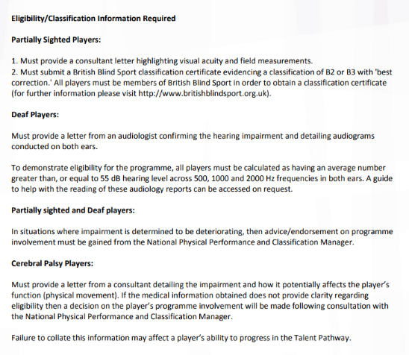
Para Football Eligibility Information

Slide 6
2nd Dec & 4th April @ St George’s Park
In addition to the local Talent Hub led England Talent Days, there will be two nationally led events at St George’s Park on Sat 2nd Dec 2023 & Thurs 4th April 2024.
In addition to following a similar format as all of the other ETDs taking place, these events will have an additional focus around 2 specific areas of the game…
Blind Football
As we look to develop the B1 pathway, including the female game, the SGP event will have a particular focus around looking to identify & engage both male and female blind players in a specific coaching session, before signposting them to further playing opportunities that are available or may arise as part of the development of this particular player pathway.
Goalkeepers
The SGP events will also have a specific session to engage goalkeepers, both male and female across all of the Para Football formats…
Deaf Male and Female goalkeepers
Male & Female GKs with cerebral palsy
Non-impaired* male & female GKs interested in being involved in our Blind Football (male & female) & Partially Sighted (male) pathways
*Non-impaired = no physical or sensory impairment required to be a GK in these formats of Para Football
NB: The 7-16 age range does NOT apply to GKs at this event. This is an open age opportunity.

Slide 7
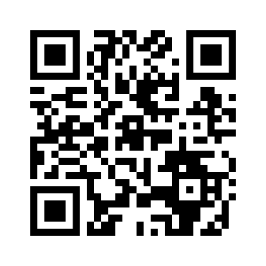
Scan the QR code to register for a Para Football England Talent Day!

