Slide 1


Staffordshire FA in partnership with the
Grounds Management Association
Pitch Maintenance Q&A – Monday 22 February 2021
Good evening!
The session will start at 7.30pm – please feel free to grab a brew.
We will mute everyone at 7.30pm – in the meantime please feel free to say hello!
We will be inviting questions during the evening via the chat box function, or via email if you would prefer. If time allows, we’ll also invite attendees to raise their hands and ask questions verbally should you wish to.

Slide 2

Embracing technology to keep in touch…
Welcome to Microsoft Teams.
We will record the workshop.
Approximately 60-90 minutes.
Microphones will be muted.
Cameras are optional.

Slide 3
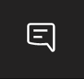
If you have a question tonight…
Type your question into the chat box on here:
Or if you’d prefer to email:
gareth.thomas@staffordshirefa.com

Slide 4
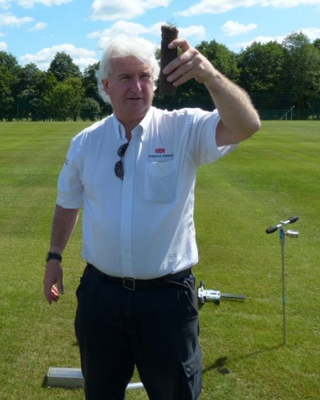
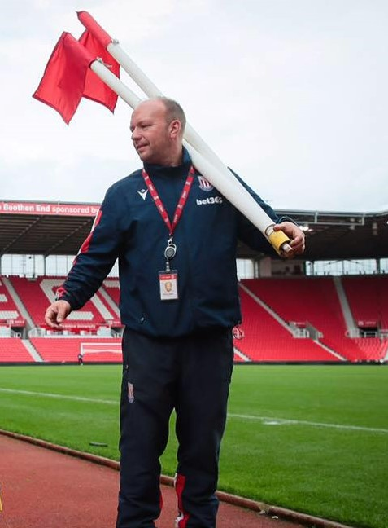
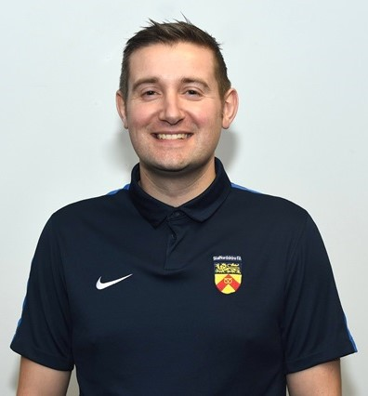
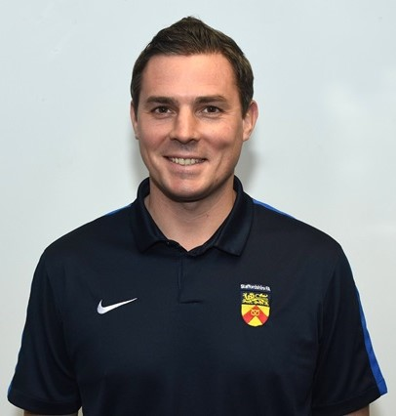
This evening’s panel...
Kevin Duffill Regional Pitch Advisor
Grounds Management Association
Andy Jackson Grounds Manager
Stoke City Football Club
Kevin Staples Head of Delivery
Staffordshire FA
Gareth Thomas Partnerships & Communications Officer
Staffordshire FA

Slide 5



Staffordshire FA Partners on hand…
John Campey, Director, Campey Turf Care
john@campeyturfcare.com
Glen Howard, Technical Sales Manager, Rigby Taylor
Glen.Howard@rigbytaylor.com

Slide 6
Grass Pitch Improvement Strategy…
2012 = year Staffordshire FA launched its programme
2 = number of pitch advisors (Kevin Duffill and Andy Jackson)
116 = number of clubs / sites visited
184 = total number of visits & reports
326 = total number of pitches visited / impacted by the programme
1138 = total number of football pitches across Staffordshire:
Education Sector = 487
Local Authority = 278
Clubs = 167
Other = 206

Slide 7
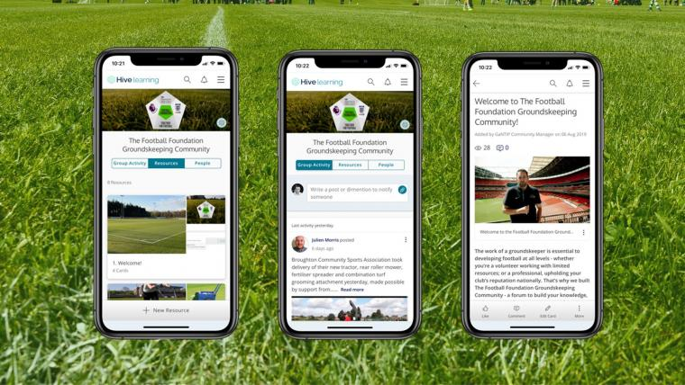
Additional online support...
GMA Football Grounds Maintenance Toolkit:
https://resources.thegma.org.uk/football/football-groundsmanship
GMA Online Football Grounds Maintenance Courses: https://portal.thegma.org.uk/education/course/379868
Football Foundation Groundskeeping Community:
https://footballfoundation.hivelearning.com/join
Football Foundation Pitch Power App:
https://footballfoundation.org.uk/pitchpower/how-it-works

Slide 8
Important messages...
Please ensure you always follow the latest government guidelines when maintaining your pitches, either as lone workers or as part of a team. www.gov.uk/coronavirus
Check GMA Covid-19 page for latest updates: https://www.thegma.or.uk/covid.19.0
Adhere to all relevant health and safety.
Always follow government guidelines.
Working alone – be aware.
Who is responsible/accountable?

Slide 9
Question time…
Type your question into the chat box on here:
Or if you’d prefer to email: gareth.thomas@staffordshirefa.com
If time allows we’ll also invite attendees to raise their hands and ask questions verbally should you wish to.
Attendees were invited to submit any questions ahead of tonight too, so we’ll cover those pre-asked questions first.

Slide 10
Questions received in advance… (1/2)
On our pitch we have one area that gets boggy and waterlogged very easily, but not the whole pitch. Are there any suggestions on how to improve this one area with little or no budget?
With the potential of grassroots football possibly returning soon – what can we potentially be doing before then? Can we seed now or is it too early? Can we fertilise, and if so, what mix is recommended?
We have invested in a second-hand slitter – I’ve never used one before so when is best to slit? And how often and do we sand after slitting, every time? Should we mow the pitches before or after slitting? Also, our goal areas need some work – when is it best to do repairs?
When is the best time to sow seed to help patchy pitches that we currently rent off Walsall Council?
What should we be doing if grassroots football restarts in March and extends through to May or June? What happens in terms of renovation plans?
What advice can you provide to venues with multi-sports on site, e.g. football and cricket?

Slide 11
Questions received in advance… (2/2)
Is funding still available for clubs to invest in pitch maintenance machinery, and if so, what % is available?
We understand that additional pitch maintenance funding is potentially available to clubs who maintain their own pitches – can you provide a summary of the criteria required for that funding?
If we only have enough funding to deep-aerate our site once a year, what time of year would you recommended that operation takes place?
If we can afford to deep aerate our site twice a year – do you recommended a verti-drain in the spring renovation, and a shockwave in the autumn?
With no football played on our pitches for the last three months, in addition the very wet weather, our pitches look and feel like they require rolling, as the playing surface feels uneven now. After advice of not to roll which compacts the surface, what would the advice be as a first activity to carry out, as I should be able to get the lighter machinery back on to do some carry maintenance shortly?

Slide 12

Questions received tonight...
Questions received so far during tonight’s workshop, via the chat box or email.
Please feel free to submit further questions via the chat box or email.
If time allows we’ll also invite attendees to raise their hands and ask questions verbally should you wish to.

Slide 13
Summary / final thoughts...
Follow government guidance.
Embrace the GMA and Football Foundation resources.
Will email tonight’s slides and recording of the meeting.
Keep in touch and keep networking, e.g. Groundskeeping Community on Hive.
Potential development of regular online Q&A sessions.
Fingers crossed for practical, face-to-face workshops again soon.
Any questions post-workshop please get in touch.
Feedback always welcomed.
Thank you.

Slide 14
Staffordshire FA contact details...
Email: support@StaffordshireFA.com
Website: www.staffordshirefa.com
Kevin Staples (Head of Delivery)
kevin.staples@staffordshirefa.com
07969 294084
Gareth Thomas (Partnerships & Communications & Officer)
gareth.thomas@staffordshirefa.com
07815 295223

