Slide 1



Staffordshire FA in partnership with the
Grounds Management Association
INTERIM WORKS AND FIT FOR PLAY WORKSHOP
Good evening!
You will be automatically muted but don’t worry
The workshop will start at 7.30pm
In the meantime grab a brew and enjoy the commentary from a vintage England performance back in 2001!

Slide 2

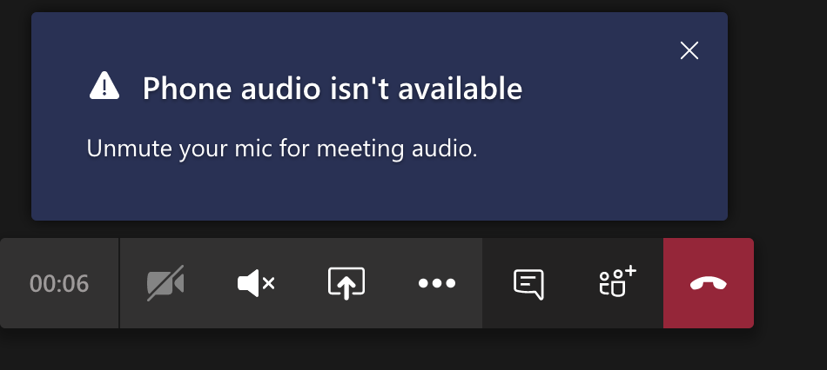
Embracing technology to keep in touch…
Welcome to Microsoft Teams
We will record the workshop
Approximately one hour
Mute microphone and turn off video
Type your questions in the chat box

Slide 3
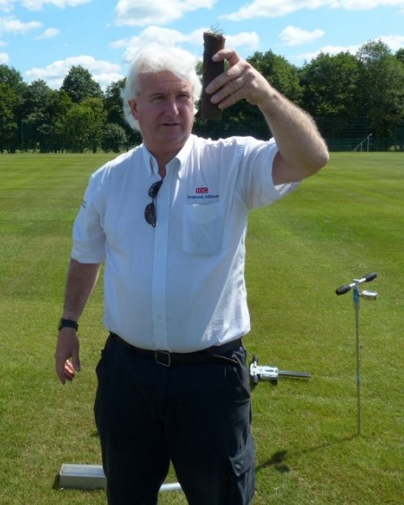
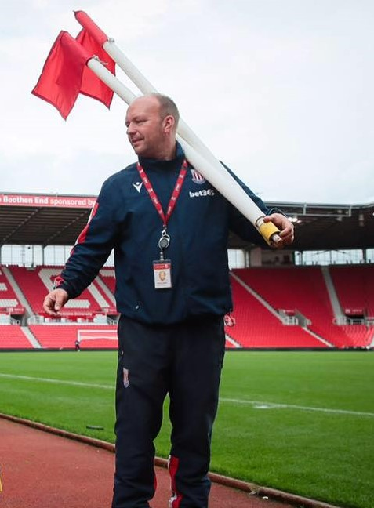
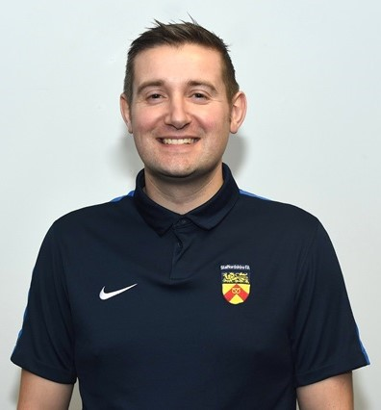
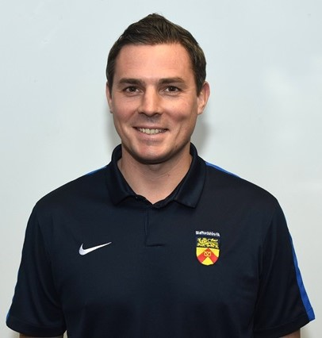
This evening’s presenters...
Kevin Duffill Regional Pitch Advisor
Grounds Management Association
Andy Jackson Grounds Manager
Stoke City Football Club
Kevin Staples Head of Strategy & Investment
Staffordshire FA
Gareth Thomas Communications & Relationships Officer
Staffordshire FA

Slide 4
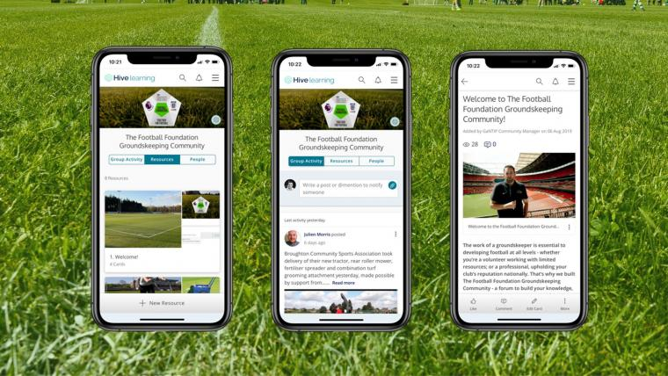
Guidance and support...
Unprecedented times for everyone.
Health and wellbeing is the main priority.
Important to take care of your physical and mental health.
Keep in touch and keep networking with other groundskeepers.
GMA: https://thegma.org.uk/guidance-your-health-and-wellbeing
The FA: http://www.thefa.com/about-football-association/heads-up
Groundskeeping Community: https://thefa.hivelearning.com/groundskeeping/
Over 1,500 members, group activity 24/7, Q&A.
Guidance, tips, resources, good practice, networking.

Slide 5
Questions received prior to tonight...
1. We have a Trimax roller mower as recommended a few years ago by the FA. Due to the weight of the mower with its rollers, are we at risk of undoing some of the good work that we achieve when shock-waving and slitting? Are we better to limit the use of this or if possible cut with a lighter non-roller mower?
Can I order the bags of seed – are deliveries available at the moment?
How many bags of seed would you recommend for the pitches (11v11)?
4. What would be the ideal height to allow the new plants to grow to before starting to mow them?
Would the pitches be best fertilised, before or after the seeding process?
If I have planned to apply top-dressing to my pitches, when is the best time to undertake this, e.g. weather conditions?
With a reduced budget this year, in which order would you prioritise the following operations: scarifying, verti-draining, seeding?

Slide 6
If you have a question tonight...
Type your question into the chat box on here
Or email: gareth.thomas@staffordshirefa.com

Slide 7
Staffs FA Pitch Improvement Programme…
2012 = year Staffordshire FA launched its programme
2 = no. of pitch advisors (Kevin Duffill and Andy Jackson)
110 = number of clubs / sites visited since then
173 = total number of PIP visits and reports
320 = total number of pitches visited and impacted by the programme
1138 = total no. of football pitches across Staffordshire:
Education = 487
Local Authority = 278
Clubs = 167
Other = 206

Slide 8
Football Foundation funding…
Pitch maintenance equipment and storage:
Up to 75% funding available, maximum £25,000 funding per application.
Pitch Improvement Programme visit must have taken place and machinery agreed.
Two like-for-like quotes required.
Decision within 14 days of application.
Pitch maintenance works and products:
£2,500 for 11v11 pitch | £2,100 for 9v9 pitch | £1,700 for 7v7/5v5 pitch.
Pitch Improvement Programme visit must have taken place prior to application.
Pitch must meet funding criteria and agree work with Regional Pitch Advisor.
CFA can support with details of contractors & suppliers.
Decision within 14 days of application.

Slide 9

FF investment into Staffordshire pitches...
Pitch maintenance equipment and storage (2016-2020):
No. of projects supported = 13
Funding provided = £117,104
Pitch maintenance works and products (2020 to date):
No. of projects supported = 14
No. of pitches impacted = 78
Funding provided = £694,600
New Goalposts (2015-2020)
Funding provided = £18,706

Slide 10

Interim works and fit for play guidance...
Guidance produced by the Grounds Management Association (formerly IOG)
Kevin Duffill Regional Pitch Advisor
Grounds Management Association
Andy Jackson Grounds Manager
Stoke City Football Club

Slide 11
Important messages...
Please ensure you always follow government guidelines www.gov.uk/coronavirus should you be permitted to work outdoors either as lone workers or as part of a team.
Please access and read the document below for further information
https://www.thegma.org.uk/covid-19-0
The above information is valid on the date of this presentation 27th April 2020.

Slide 12
Workshop discussions – next few slides...
Mowing, thatch, aeration, fertilising, weeds, repairs, seeding, irrigation.
What may happen to football playing surfaces and the soils beneath should they be left alone for a lengthy period?
What maintenance is recommended to consider undertaking at this time of year?
What works can/should be carried out should play resume?
Questions received.

Slide 13
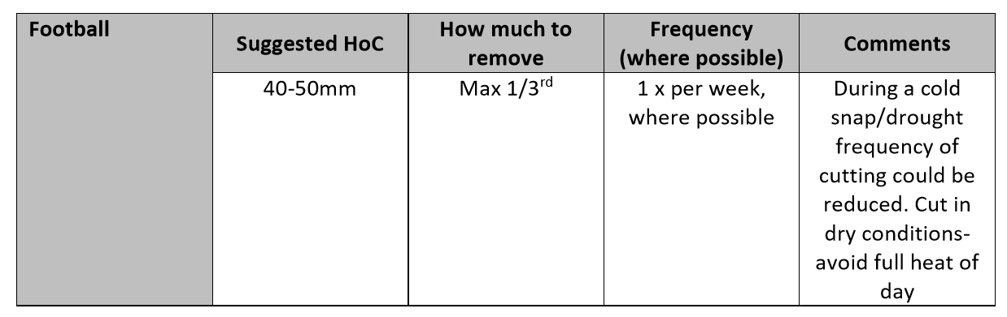
Mowing...
What may happen if I do not cut the grass at all?
The grass will grow very tall, the surface will become very thin, it will try to set seed, and this will result in an even thinner surface. It will be a challenge to get the surface back into a suitable playing surface when we can start playing sport again.

Slide 14
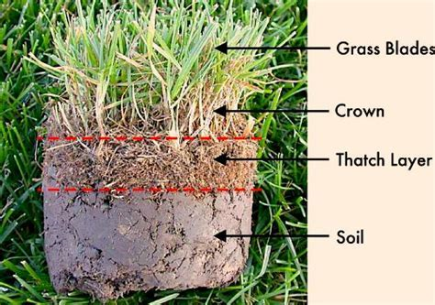
Control or removal of thatch...
Why should I do this if play is not taking place?
Grass leaves and sheaths do die off on a regular basis and these will build-up at the base of the plant.
Surface grooming using chain harrow or tractor mounted rake, can help keep the surface clean and prevent build up.
Where scarification is concerned be cautious when the weather is hot and dry.

Slide 15
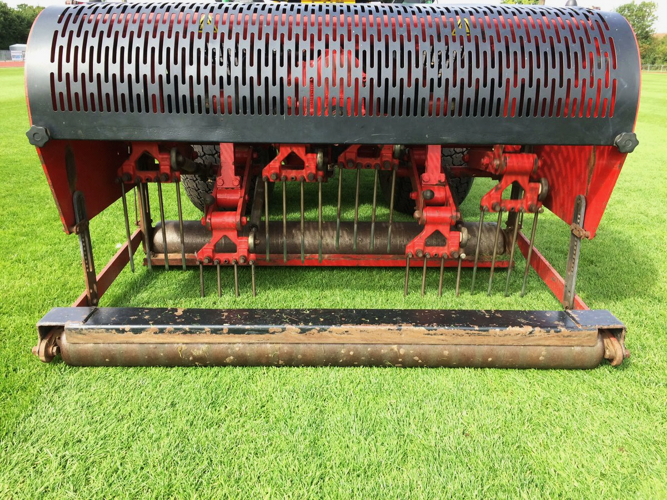
Aeration...
Should I do this at all if no play is taking place?
Aeration or decompaction works, will help the surface but only if ground conditions are suitable.
Increased aeration will encourage grass growth.
Improves the soil with gaseous exchange, infiltration of water, nutrient uptake, deeper rooting and drought stress tolerance.

Slide 16
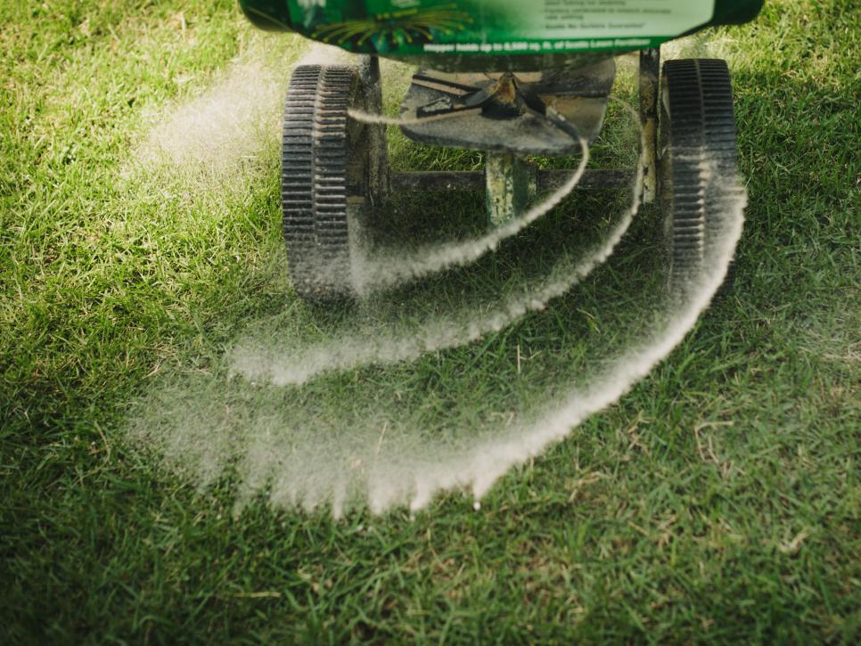
Fertilising...
Should I do this at all if no play is taking place?
In many cases there will not be a need to apply a fertiliser as the grass will be growing naturally.
It will not need to recover from wear and tear, and we don’t want it too fast growing or dense.
Application will increase maintenance requirements.
Once mowing is under control, assess the need for treatments and action accordingly.

Slide 17
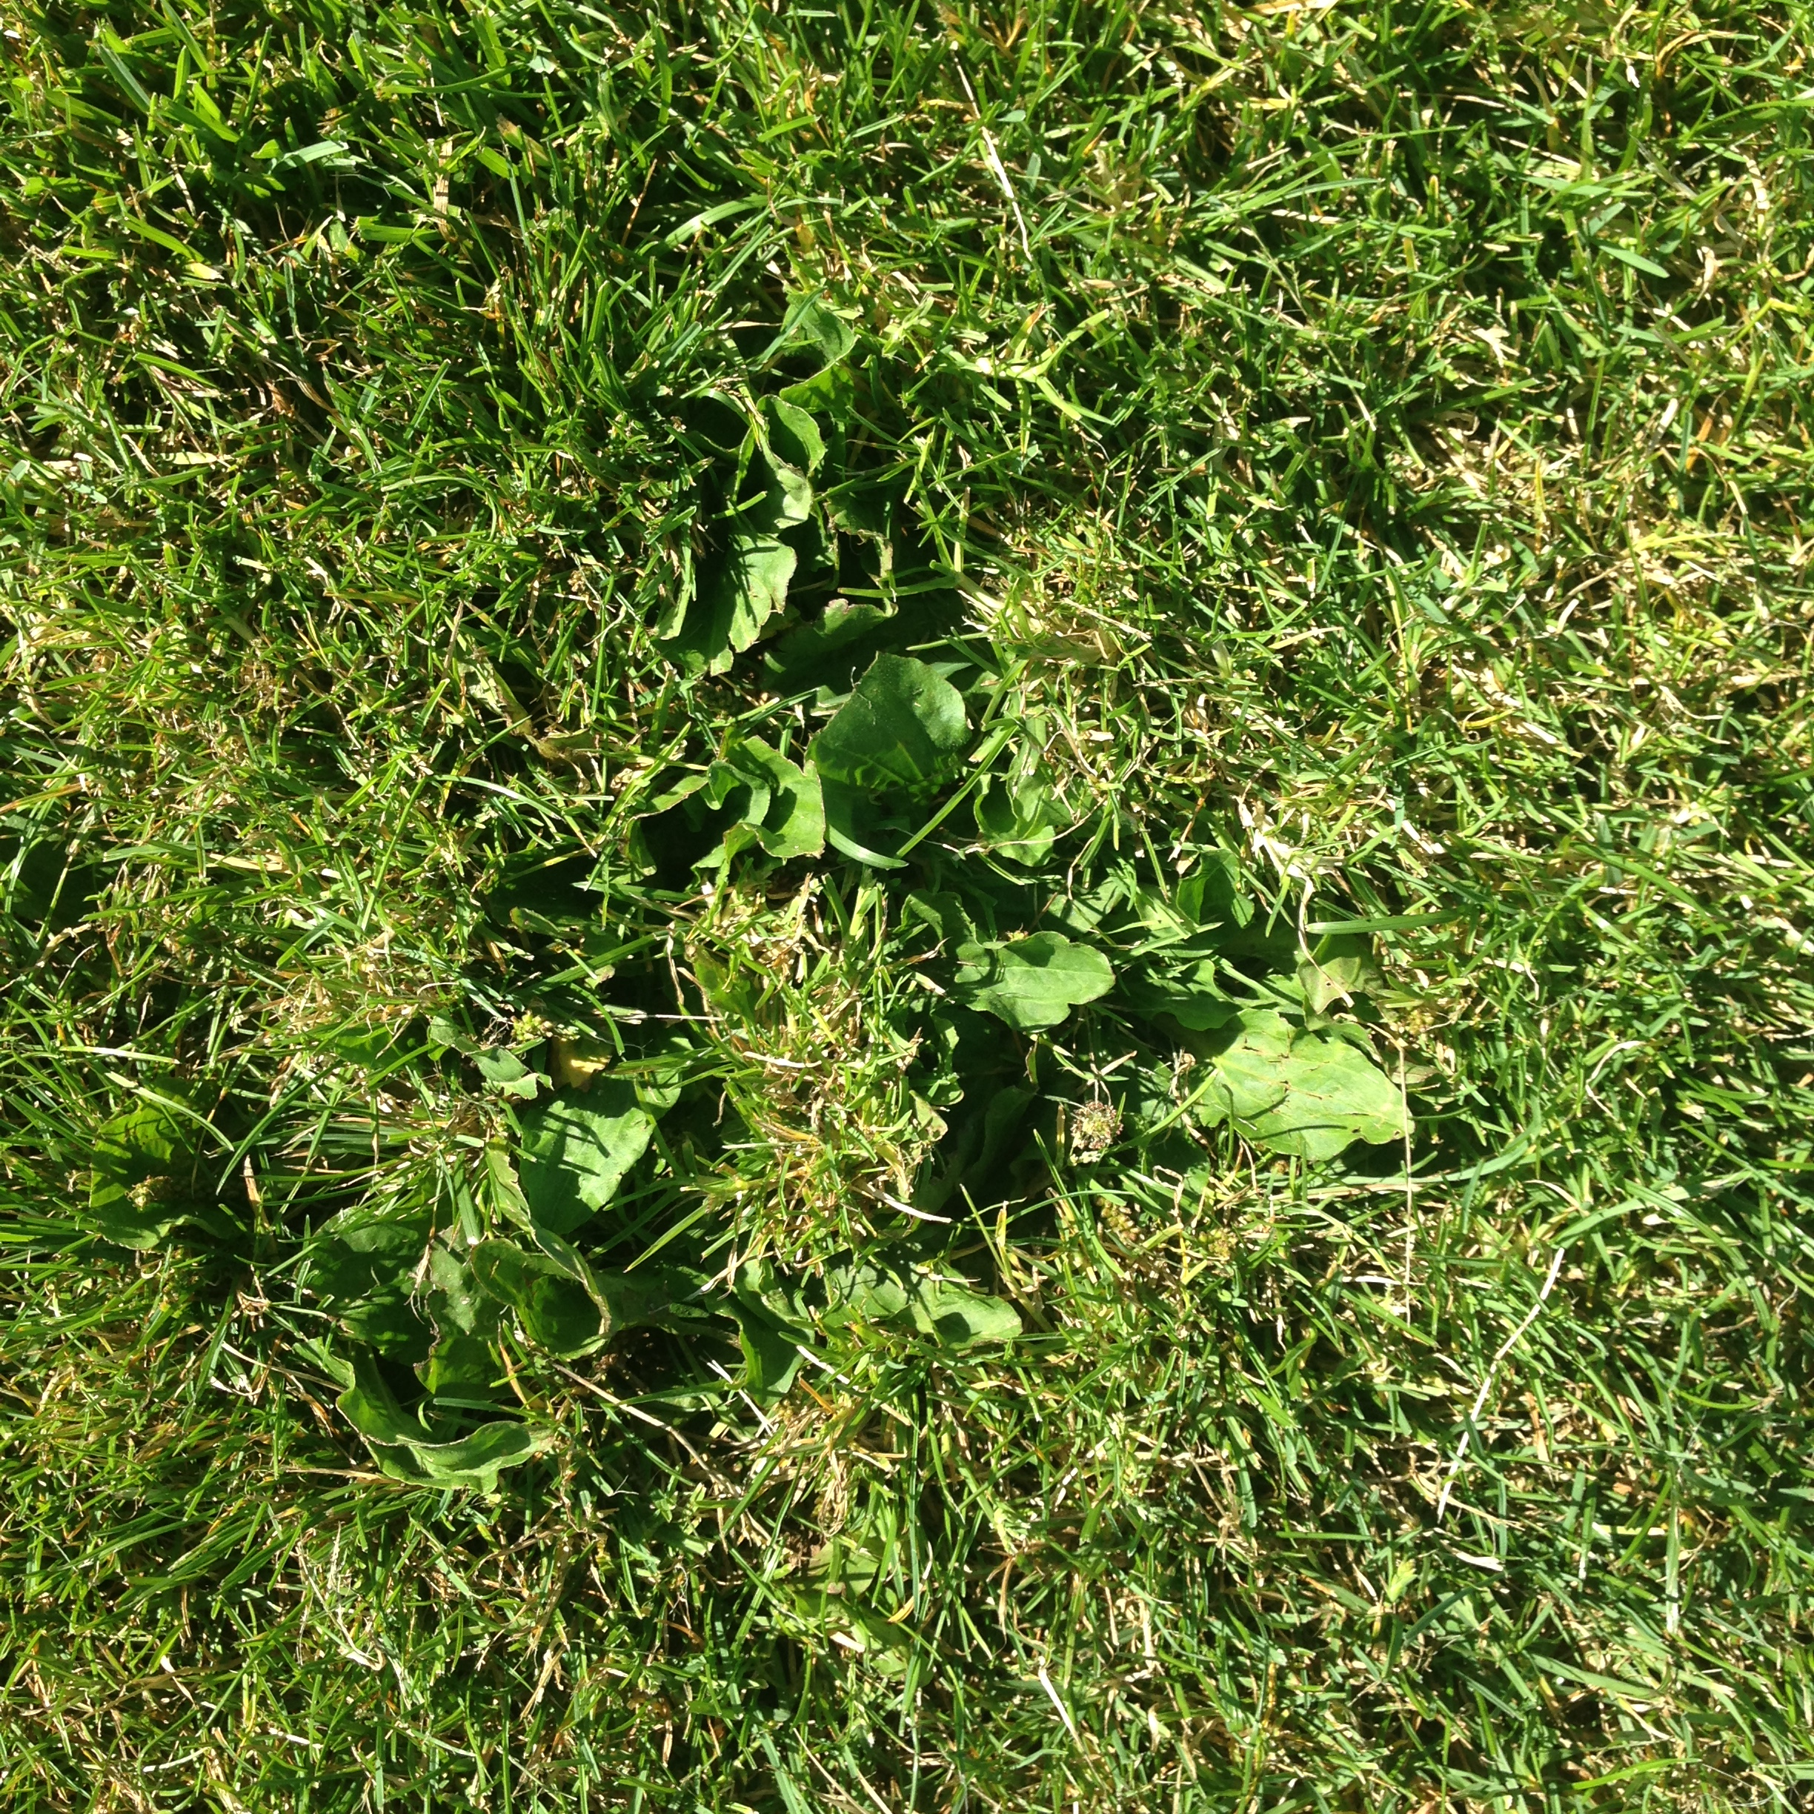
Weeds...
Minimise bare patches and brush off worm casts quickly to slow down weed invasion.
If a significant problem, an application of selective herbicide can be applied by a suitably qualified person – typically done between May-Sept.
As with all operations, consider whether this is an essential practice during this period of restricted movement.

Slide 18
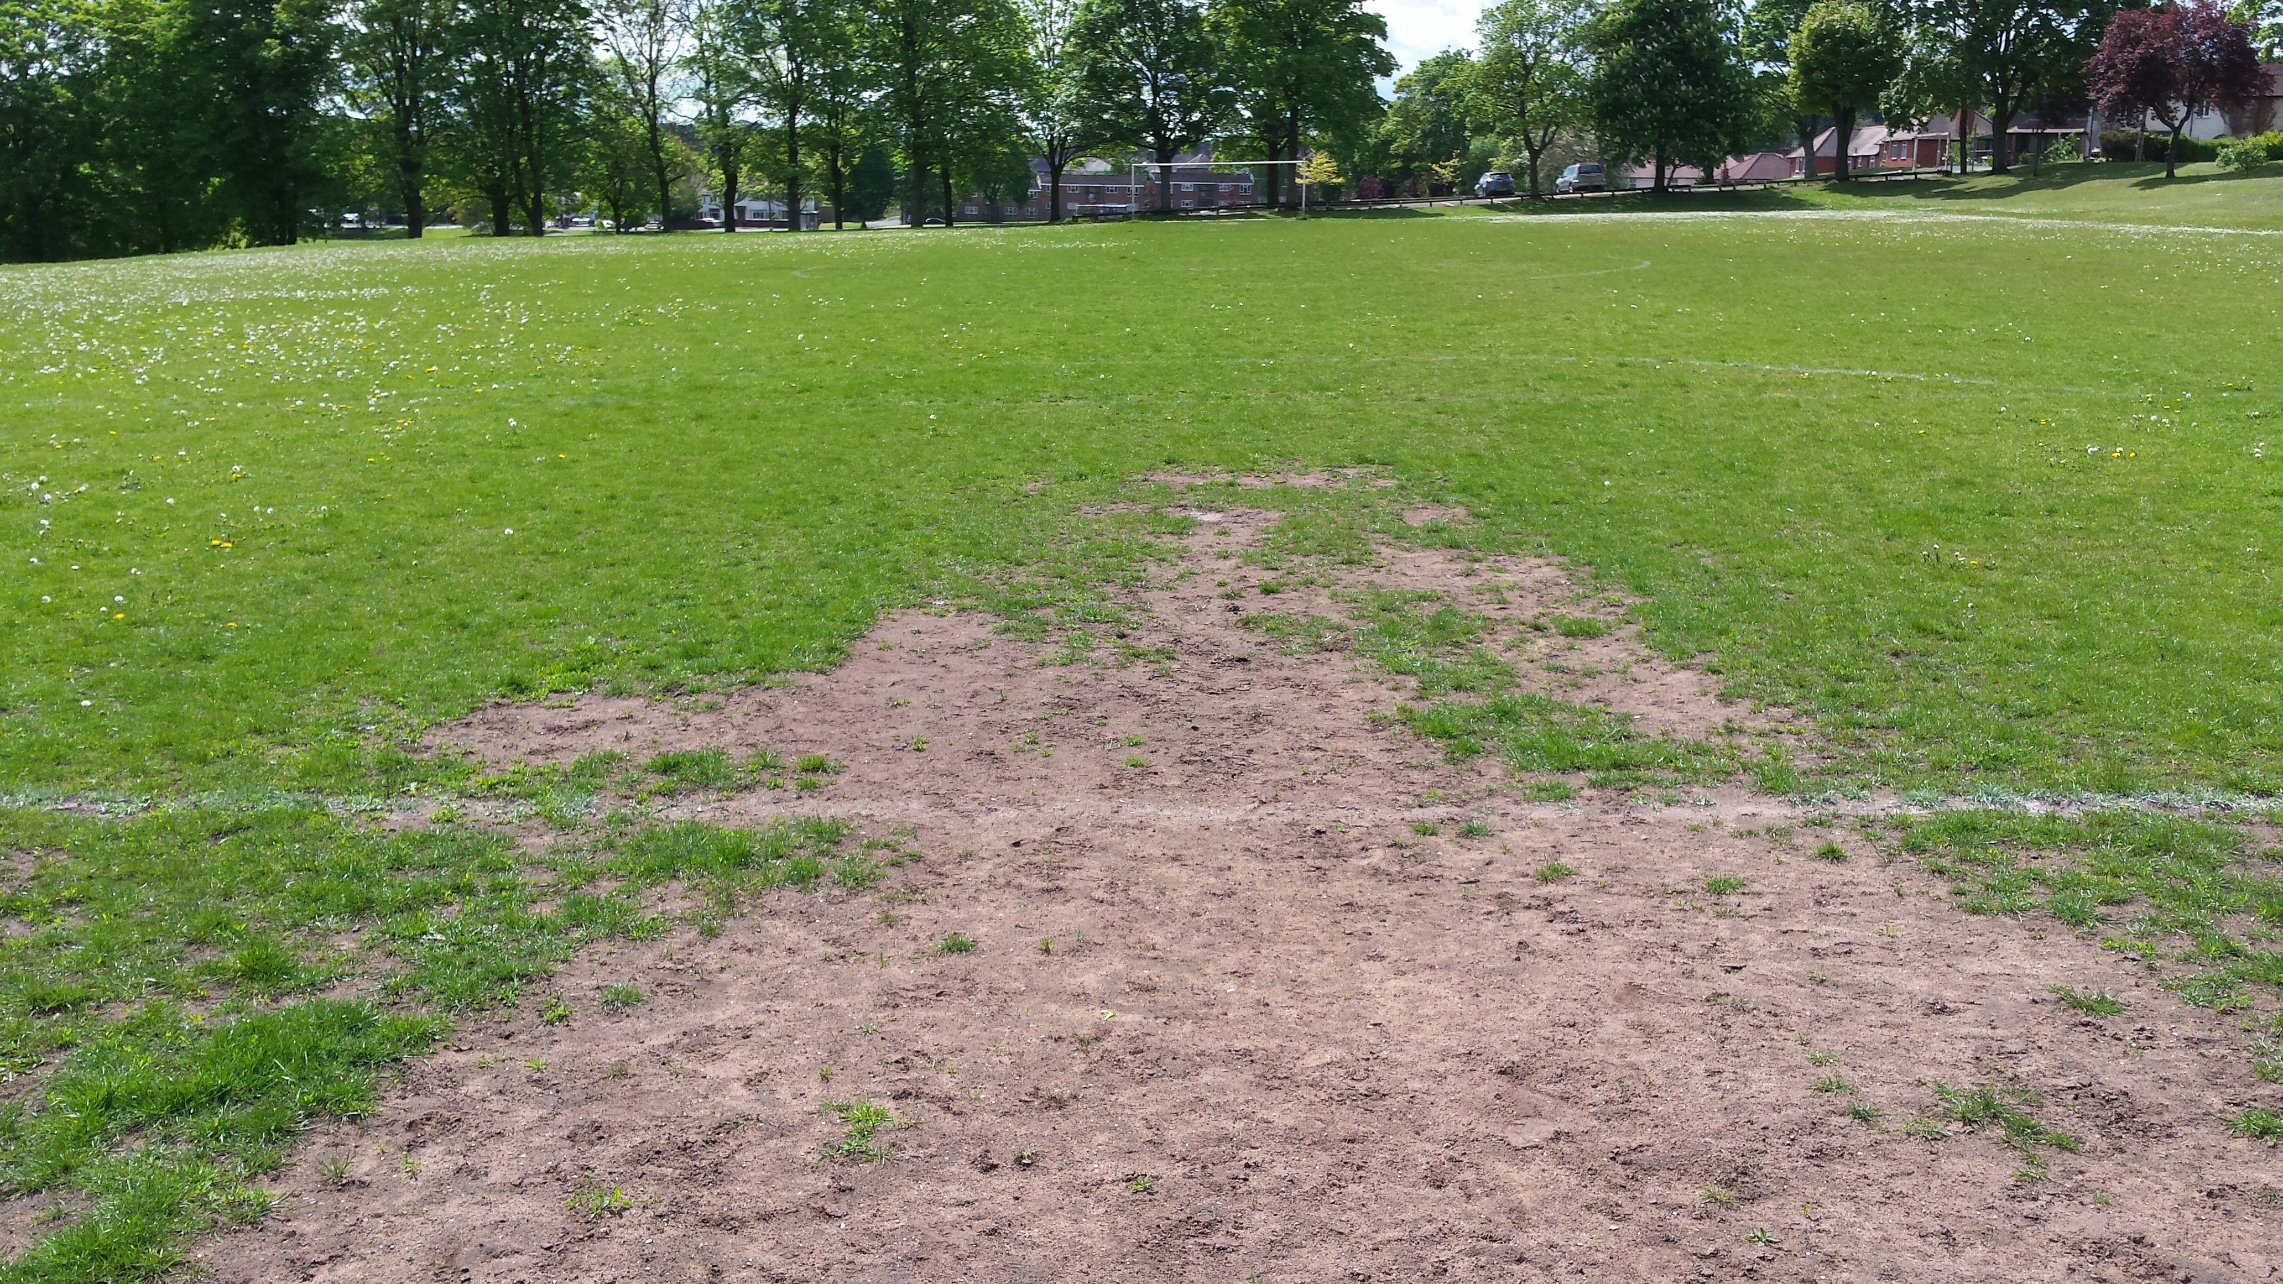
Local repairs to the surface...
Where possible, and where resources permit take time to repair those areas that have always caused issues.
This would typically be light renovations by hand forking (or machine if a large area), a light fertiliser application, over-seeding and light top-dressing of thin areas, followed up with regular watering to aid germination and establishment.
Re-turfing of areas may also be considered.

Slide 19
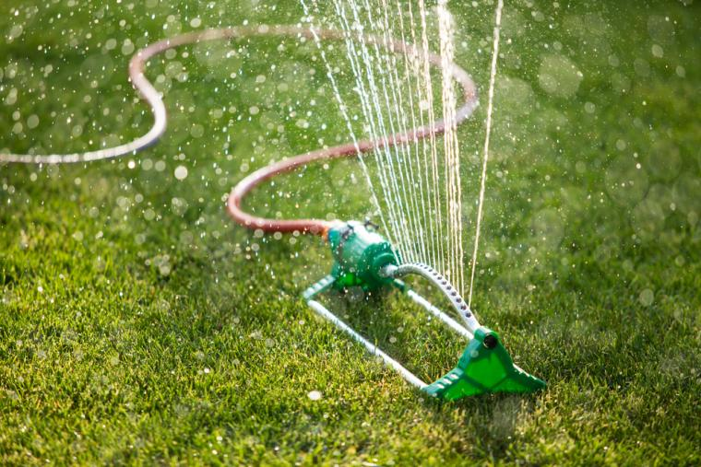
Irrigation...
Should I do this at all if no play is taking place?
Irrigation should be carried out as and when needed as indicated by weather conditions.
Do not over irrigate. Too much water will affect the turfgrass growth and may also affect the soil conditions to the extent that compaction occurs with subsequent maintenance operations.
If your ability to irrigate is limited, focus on those areas with the weakest turfgrass growth or newly sown grass.

Slide 20
When play resumes...
How can I get my surface back to a ‘fit for play’ condition when football resumes?
If grass length is too long, scarify or flail mow, remove some thatch, surface debris and unwanted grasses. Arisings should be collected where possible.
Chain harrow with rough side down to level and create seed bed.
Application of selective herbicide via qualified contractor.
Introduce a regular mowing regime.
If required: over-seed using a perennial ryegrass mix of at least 3 cultivars. Apply with a drill seeder at a rate of 30-40 grams per square metre minimum of 3 directions.
Fertiliser may need to be considered.

Slide 21
Recap – important guidance...
Please ensure you always follow government guidelines (www.gov.uk/coronavirus) should you be permitted to work outdoors either as lone workers or as part of a team.
Please access and read the document below for further information:
https://www.iog.org/sites/default/files/images/inline-images/interim_works_-_football_-_1_april_2020.pdf

Slide 22
Questions received prior to tonight...
1. We have a Trimax roller mower as recommended a few years ago by the FA. Due to the weight of the mower with its rollers, are we at risk of undoing some of the good work that we achieve when shock-waving and slitting? Are we better to limit the use of this or if possible cut with a lighter non-roller mower?
Can I order the bags of seed – are deliveries available at the moment?
How many bags of seed would you recommend for the pitches (11v11)?
4. What would be the ideal height to allow the new plants to grow to before starting to mow them?
Would the pitches be best fertilised, before or after the seeding process?
If I have planned to apply top-dressing to my pitches, when is the best time to undertake this, e.g. weather conditions?
With a reduced budget this year, in which order would you prioritise the following operations: scarifying, verti-draining, seeding?

Slide 23

Questions received tonight...
Questions received during tonight’s workshop via the chat box or email.

Slide 24
Summary / final thoughts...
Follow government guidance.
Embrace the GMA guidance document.
Will email that guidance along with tonight’s slides and recording.
Keep in touch and keep networking, e.g. Groundskeeping Community on Hive.
Get in touch with Staffs FA for further info on PIP visits and funding.
GMA course (1-day) to be delivered in Staffs in the future.
Any questions post-workshop please get in touch.
Feedback always welcomed!

Slide 25
On a separate note before we close...
Staffordshire FA Groundsman of the Year Awards 2019/20 (Step 7 and below)
Congratulations to all of the above and a huge THANK YOU to ALL groundsmen across Staffordshire for your ongoing hard work and dedication.
Thank you all for your time this evening.
Place | Groundsman | Club / Organisation
First | Dave Lunt | Silverdale Athletic FC
Second | Andy Salt | Trubshaw Cross Ladsandads
Third | Stuart Cresswell | Eccleshall Eagles FC
Highly Commended | Wayne Smith & Brian Finney | Audley FC
Highly Commended | Danny Robinson | Redgate Clayton FC

Slide 26
Staffordshire FA contact details...
Email: support@StaffordshireFA.com
Website: www.staffordshirefa.com
Kevin Staples (Head of Strategy & Investment)
kevin.staples@StaffordshireFA.com
07969 294084
Gareth Thomas (Communications & Relationships Officer)
gareth.thomas@StaffordshireFA.com
07815 295223

