Slide 1

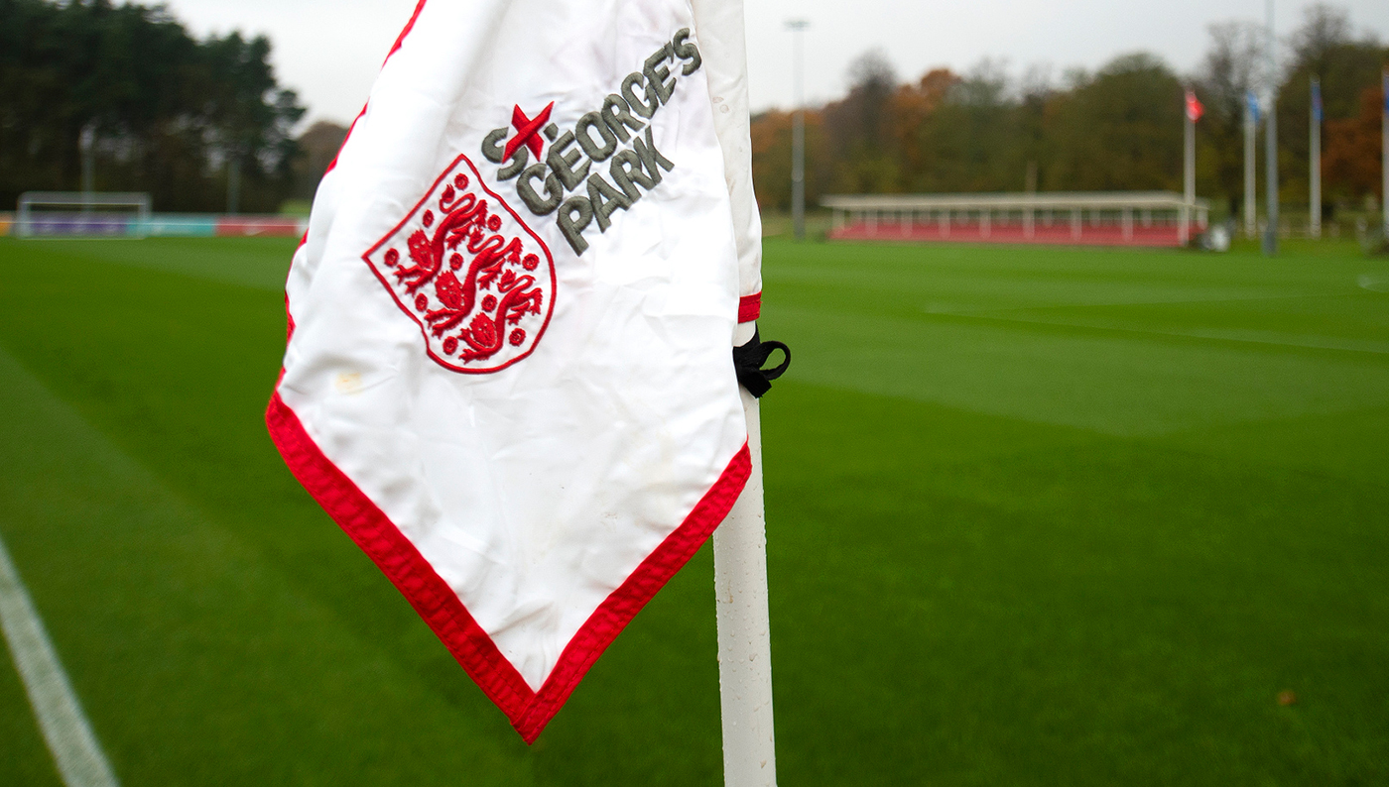
Pitch Maintenance Workshop Monday 2 December 2019 6.30pm – 9.00pm

Slide 2
Workshop Itinerary
18.00 – 18.30pm Arrival | Tea & Coffee
18.30 – 19.15pm Staffordshire FA Pitch Improvement Programme
Staffordshire FA Deep Aeration Initiative
National FA updates – ‘Grass Pitch Revolution’
19.15 – 20.00pm Practical Machinery Demonstration & Discussions
(Compact Tractor, Roller Mower, Quadraplay)
20.00 – 20.15pm Tea & Coffee Break | Opportunity to Network
20.15 – 20.30pm Pitch Maintenance Products Discussions
20.30 – 20.45pm St. George’s Park Pitch Usage & Maintenance
20.45 – 21.00pm Q&A | Open Forum
21.00pm Depart | Opportunity to Network

Slide 3
Welcome & Introductions
Scott Brooks (Head of Grounds & Estates, SGP)
Andy Jackson (Grounds Manager, Stoke City FC)
Kevin Duffill (Regional Pitch Advisor, IOG)
John Campey (Director, Campey Turf Care Systems)
Glen Howard (Technical Sales Representative, Rigby Taylor)
Kevin Staples (Head of Strategy & Investment, Staffs FA)

Slide 4
Workshop Objectives
Provide an update on the Staffordshire FA Pitch Improvement Programme.
Discuss in-season renovations in more detail – specifically overseeding.
Understand the benefits of wetting agents and their use.
Ask questions of the pitch advisors and other local groundsmen.
Provide feedback on the Staffs FA PIP innovation idea.
Network with groundsmen from other local grassroots clubs.
Ask lots of questions! Interaction is encouraged throughout.

Slide 5
Staffordshire FA Pitch Improvement Programme (PIP)
PIP numbers / impact to date:
2012 = year Staffordshire FA launched the programme
84 = number of clubs / sites visited since then
129 = total number of PIP visits
228 = total number of pitches visited and impacted by the programme
1022 = total no. of football pitches across Staffordshire

Slide 6
Total no. of LA/Private/NLS grass pitches in Staffordshire
Local Authority | Adult 11v11 | Youth 11v11 & 9v9 | Mini Soccer 7v7 & 5v5
Cannock | 23 | 14 | 24
East Staffs | 34 | 16 | 13
Lichfield | 19 | 12 | 10
Newcastle u Lyme | 42 | 12 | 18
South Staffs | 29 | 16 | 11
Stafford | 16 | 5 | 4
Staffs Moorlands | 30 | 8 | 17
Stoke on Trent | 53 | 27 | 20
Walsall | 38 | 23 | 14
Total | 284 | 133 | 131
Overall Total | 548

Slide 7
Total no. of School grass pitches in Staffordshire
Local Authority | Adult 11v11 | Youth 11v11 & 9v9 | Mini Soccer 7v7 & 5v5
Cannock | 12 | 15 | 24
East Staffs | 18 | 16 | 32
Lichfield | 12 | 12 | 25
Newcastle u Lyme | 14 | 17 | 33
South Staffs | 18 | 19 | 12
Stafford | 23 | 19 | 21
Staffs Moorlands | 11 | 12 | 14
Stoke on Trent | 13 | 8 | 5
Walsall | 30 | 20 | 19
Total | 151 | 138 | 185
Overall Total | 474

Slide 8
Total no. of grass pitches in Staffordshire
Facility | Adult 11v11 | Youth 11v11 & 9v9 | Mini Soccer 7v7 & 5v5
Traditional | 284 | 133 | 131
Education | 151 | 138 | 185
Total | 435 | 271 | 316
Overall Total | 1,022

Slide 9
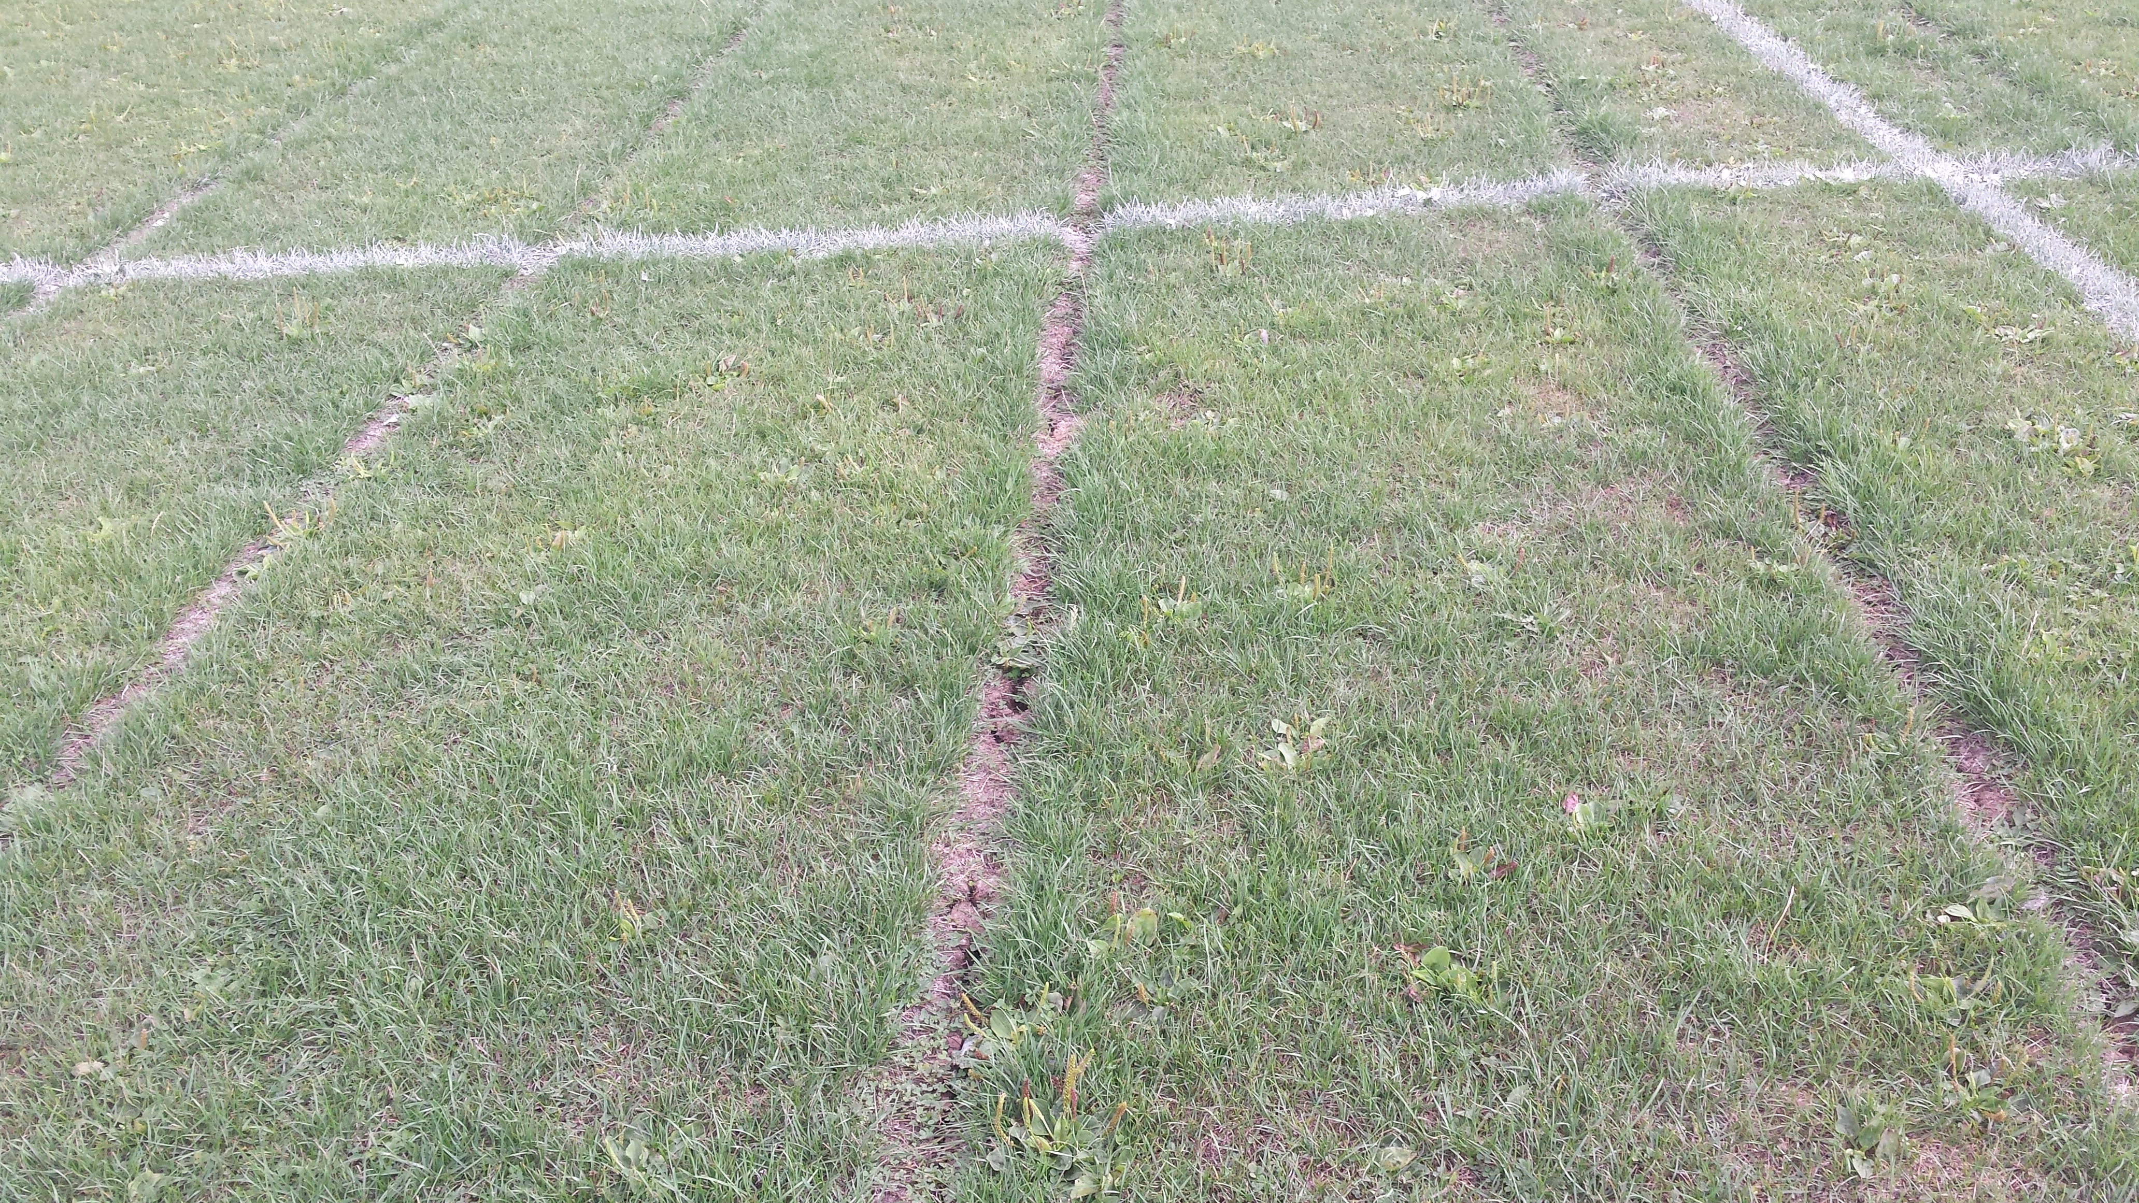
What has been your biggest challenge in recent weeks?

Slide 10
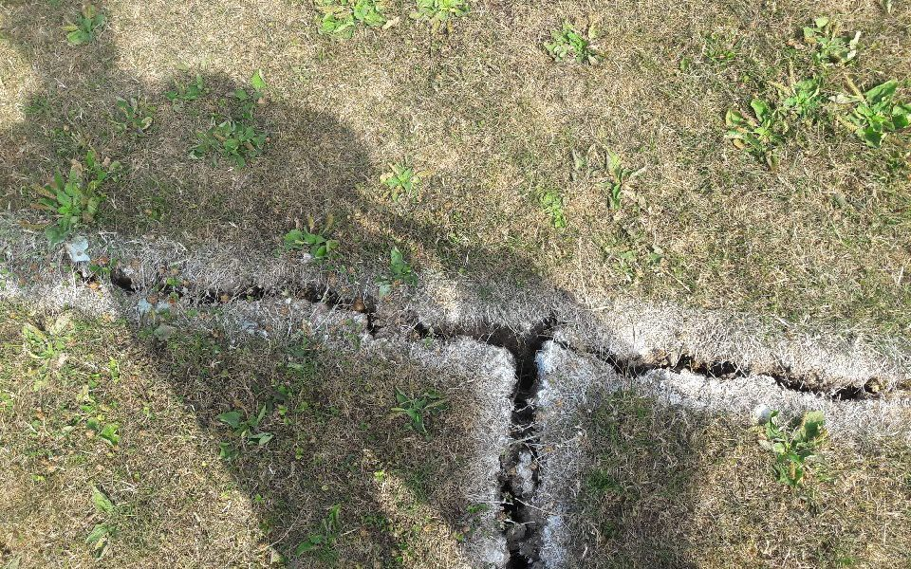
What has been your biggest challenge in recent weeks?

Slide 11


Slide 12
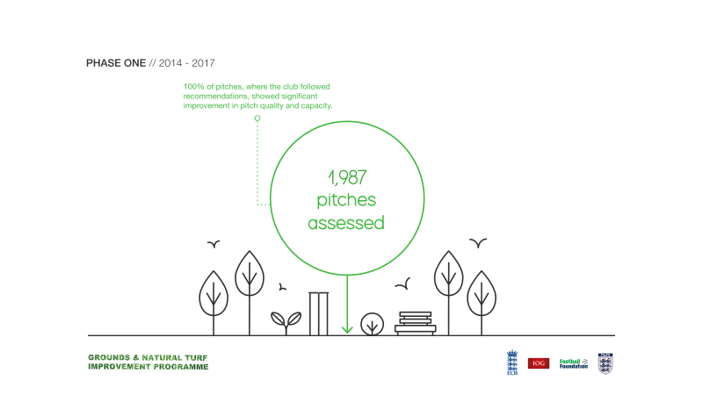

Slide 13
IOG Pitch Grading Framework

Slide 16
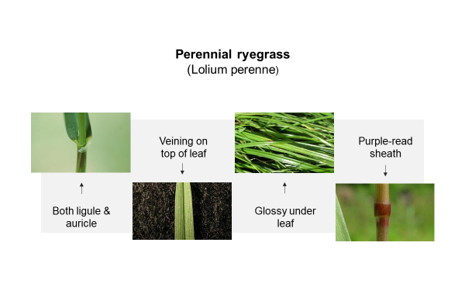
Overseeding – Desirable Grasses

Slide 17
Overseeding – When?

Slide 18
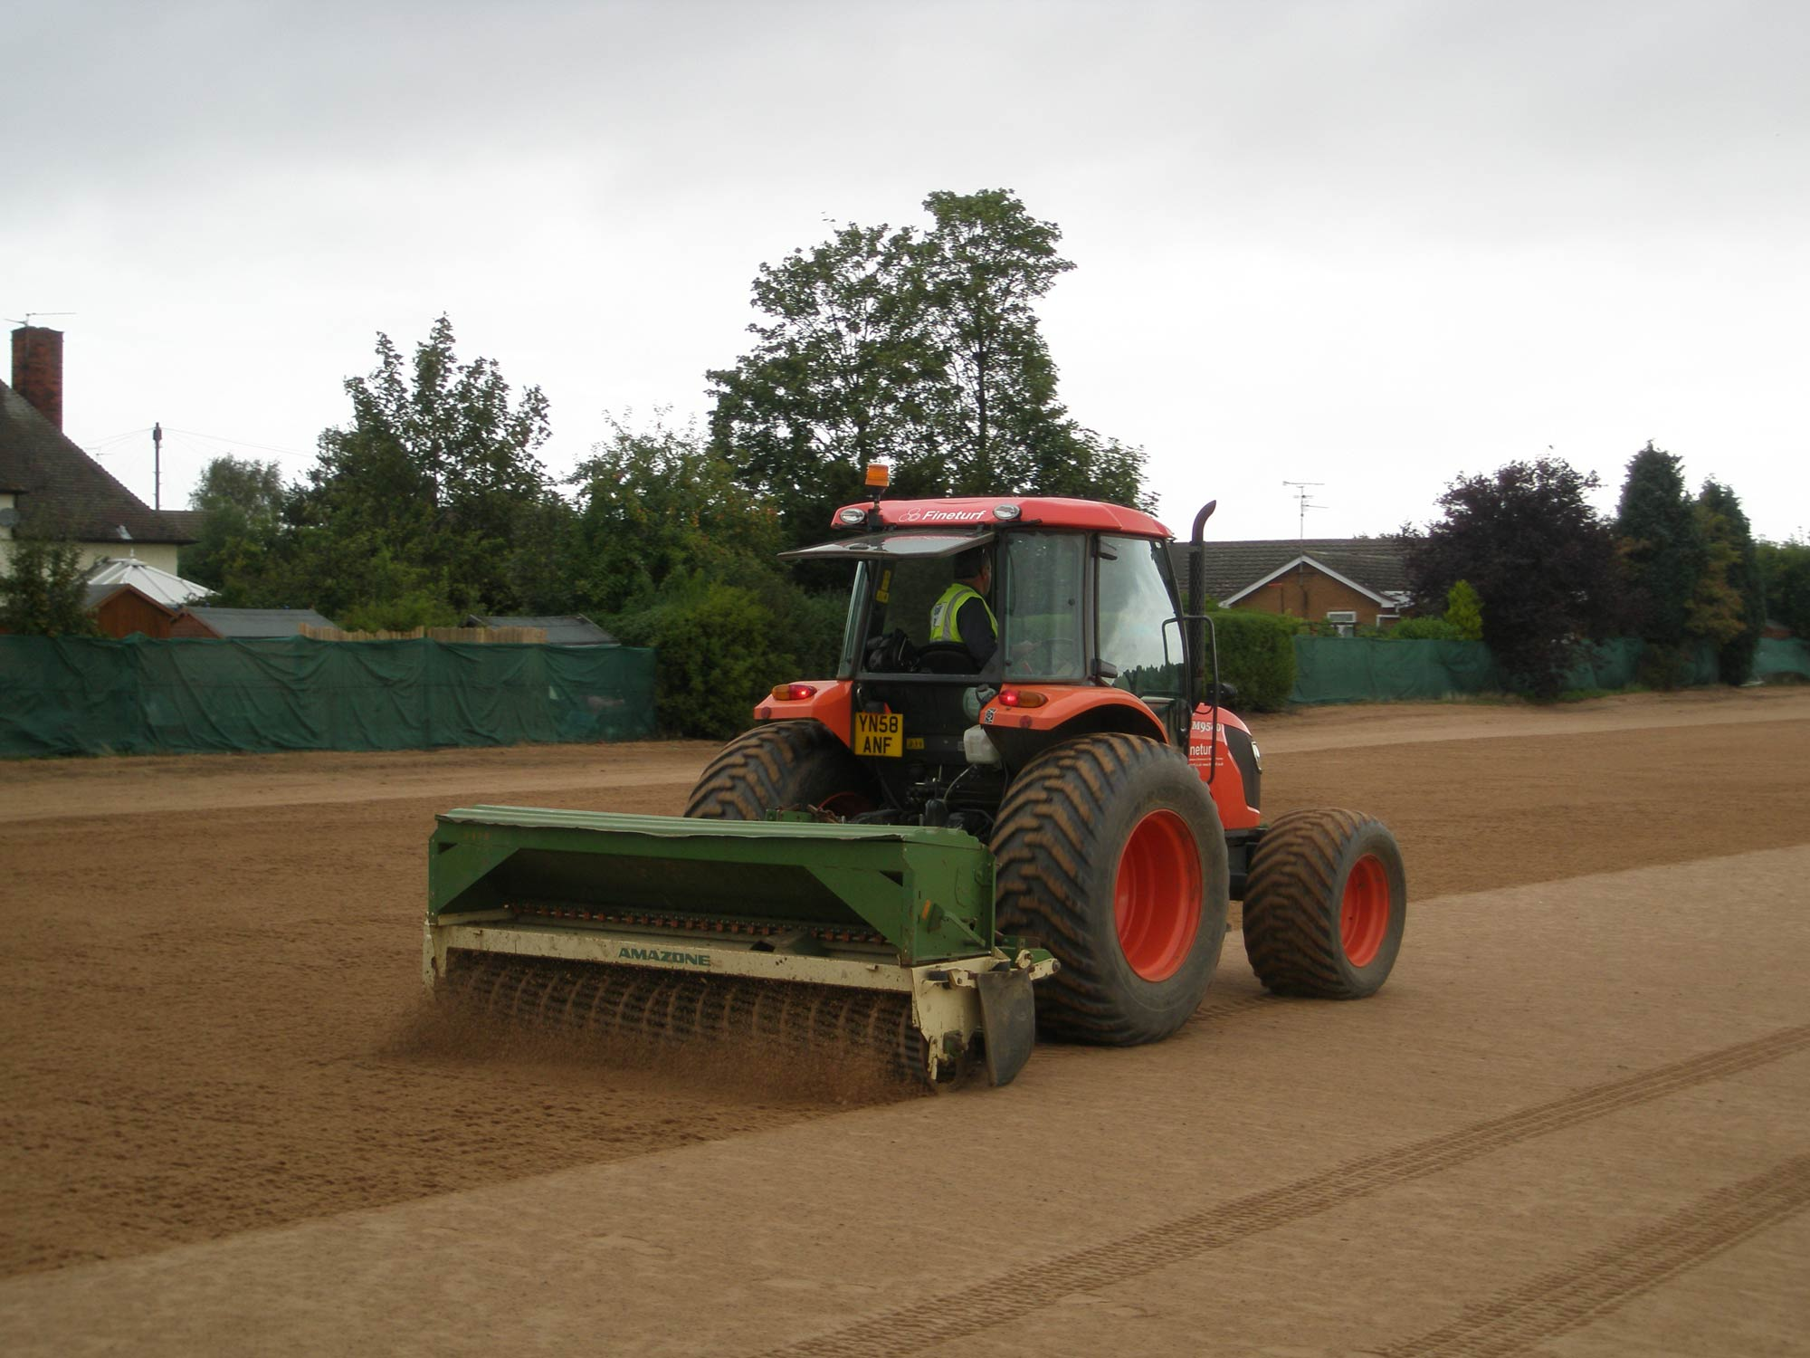
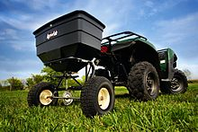
Overseeding – How – Broadcast?

Slide 19
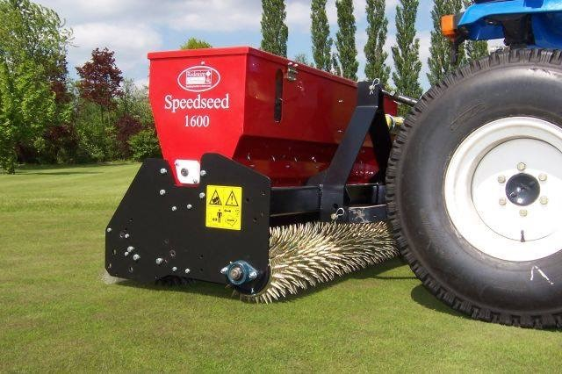
Overseeding – How – Dimple?

Slide 20
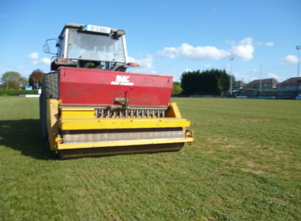
Overseeding – How – Drill?

Slide 21
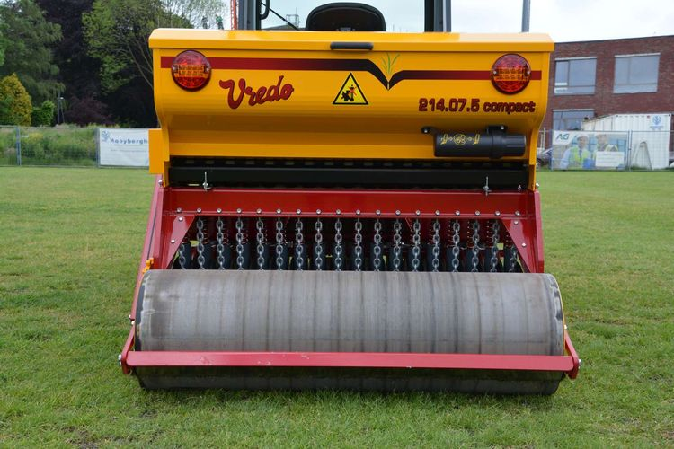
Overseeding – How – Disc?

Slide 22
Overseeding – is grass type important?

Slide 23

Overseeding – What seed do I use?

Slide 24
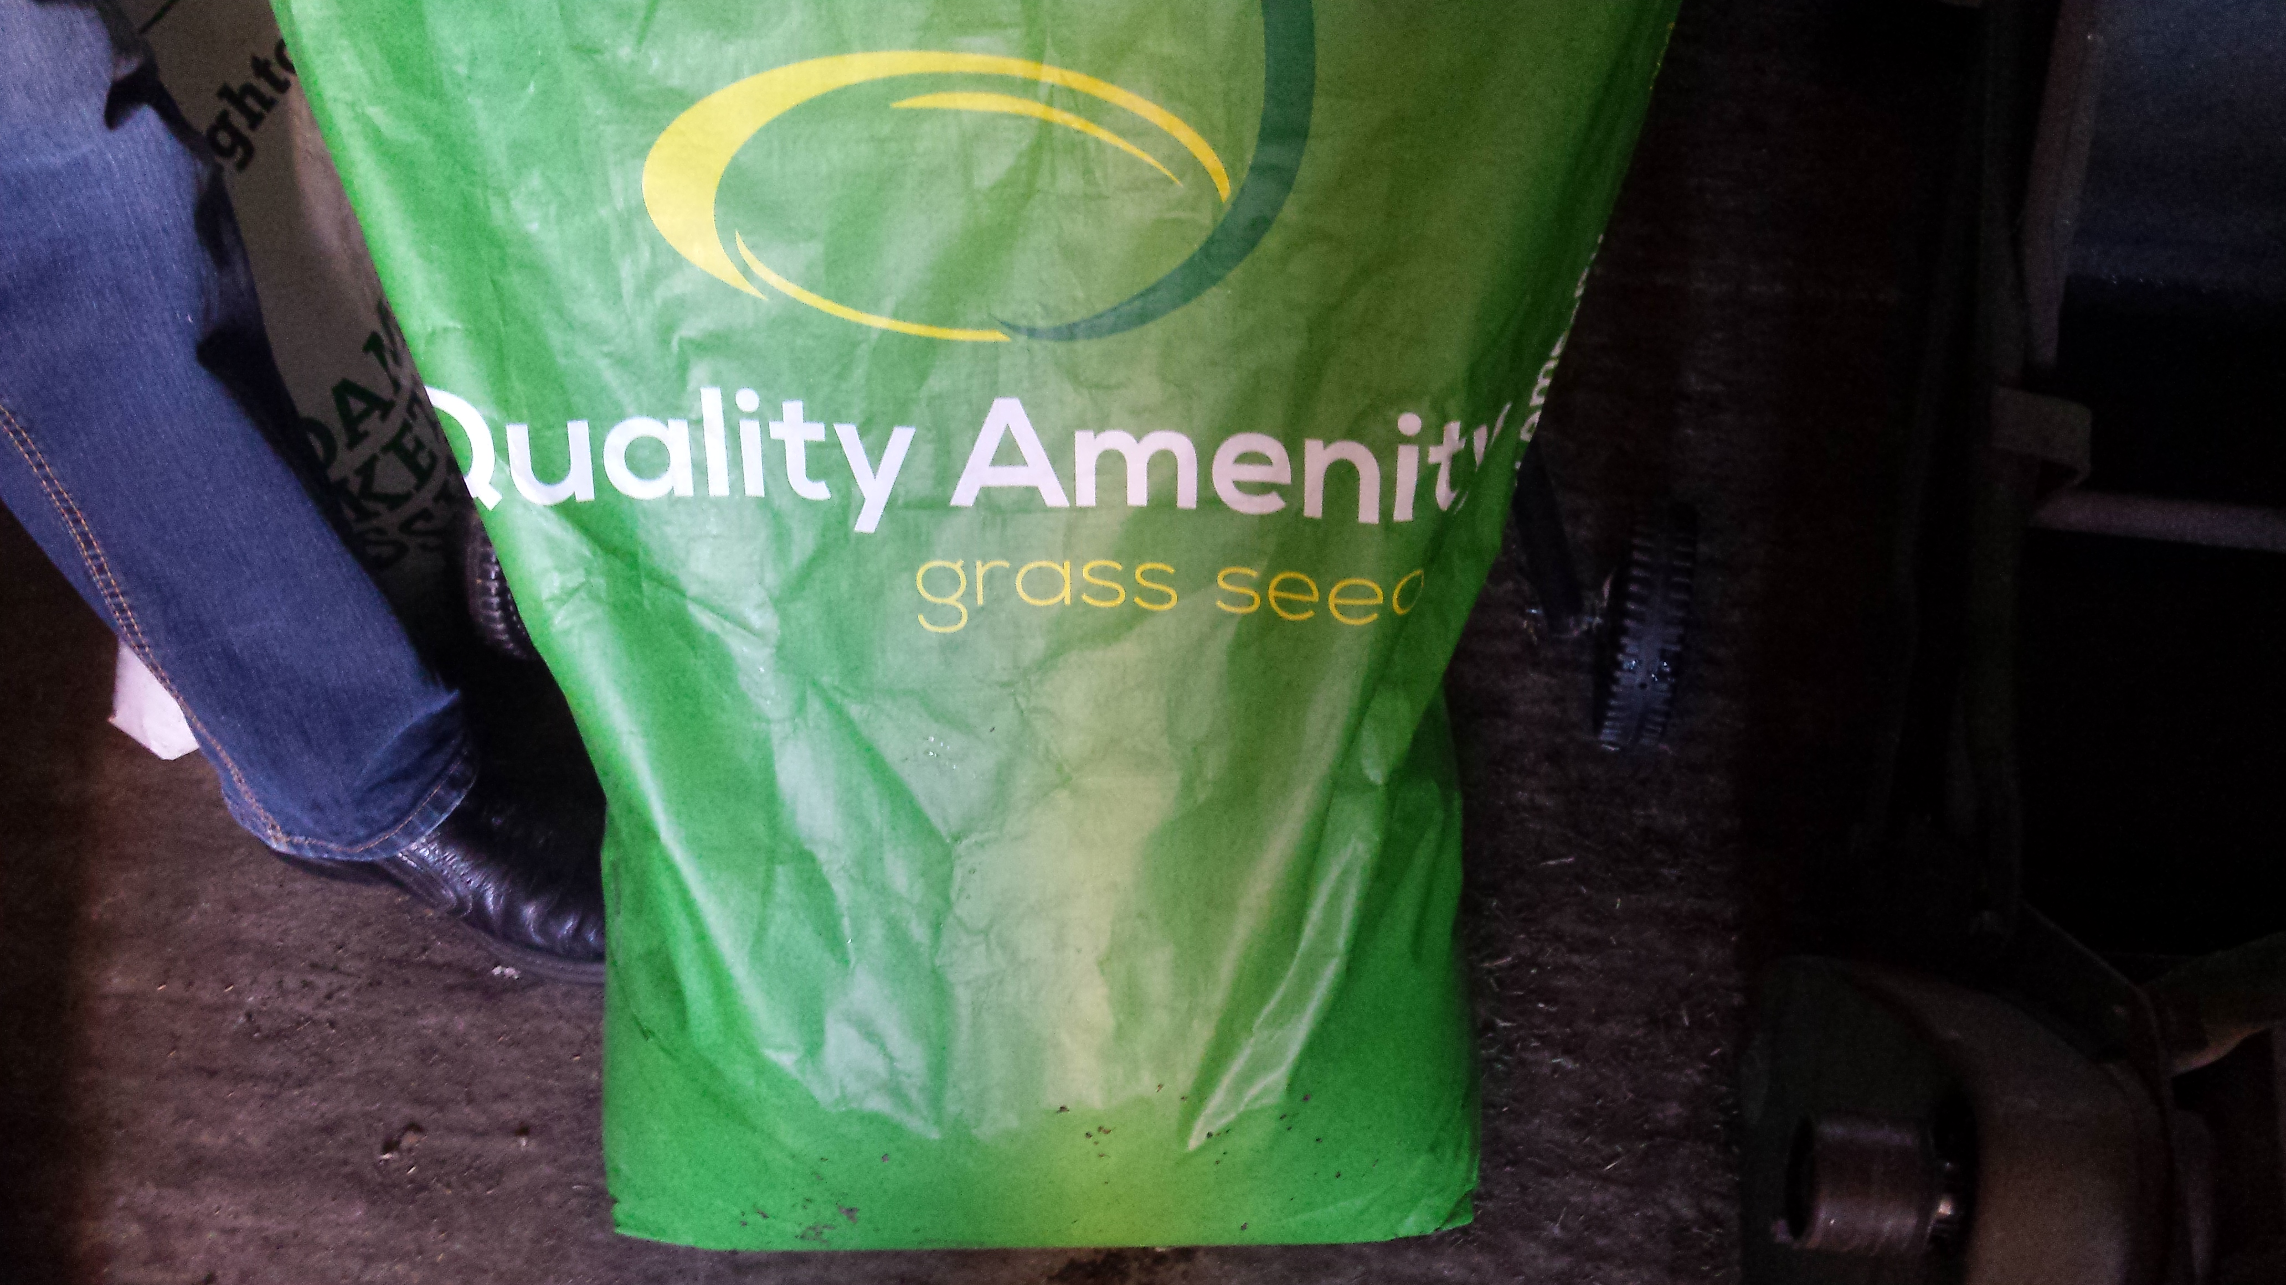
Overseeding – Understand your seed – is this okay?

Slide 25
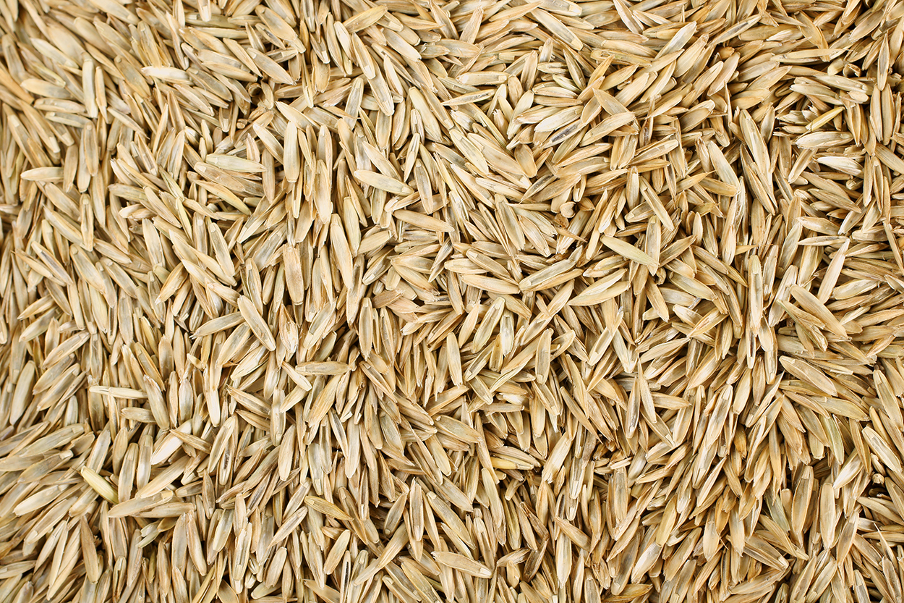
Appropriate
seed selection
Very fast establishment
Superior wear tolerance and recovery
Low temperature germination
Fast establishment for end of season renovation
Excellent early spring growth
High shoot density
Seeds
Image showing Perennial
ryegrass seed
Notes:
The main grass seed will typically be Perennial ryegrass, which has characteristics such as:
Very fast establishment
Look for fine leaved varieties
Superior wear tolerance and recovery
Fast establishment for end of season renovation
Excellent early spring growth
High shoot density
Superior aesthetics

Slide 26
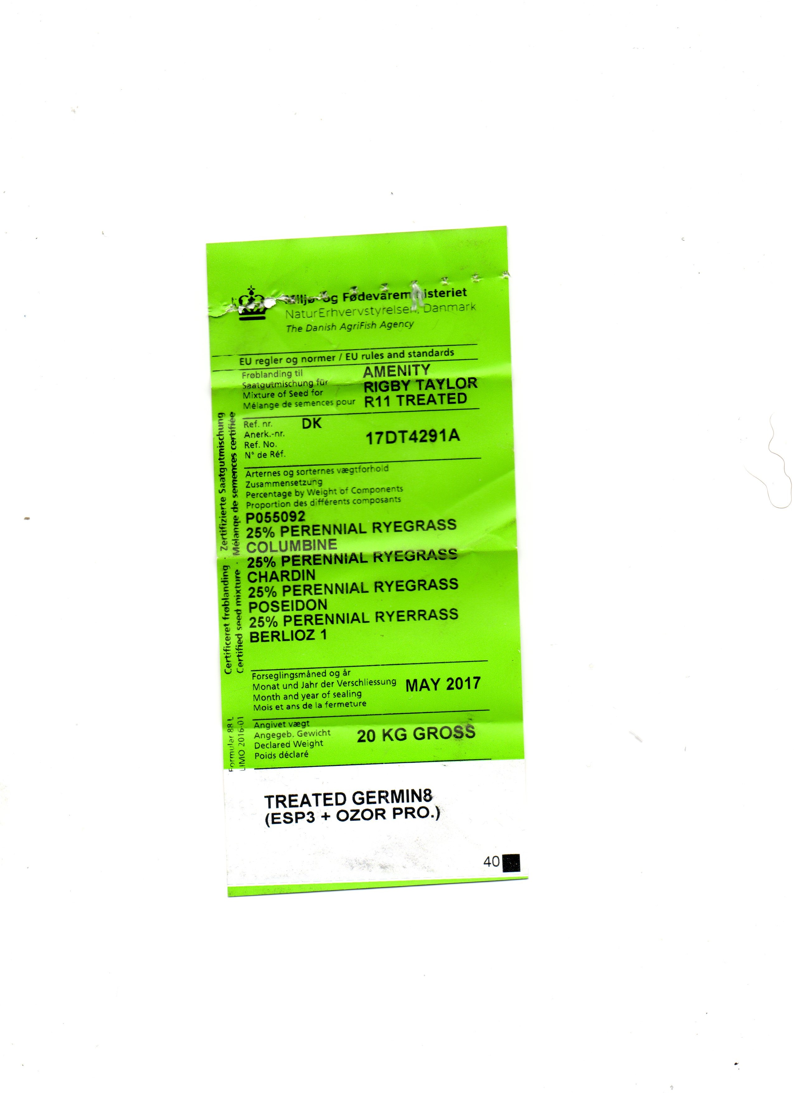
Overseeding – Understand your seed – why is this important?

Slide 27
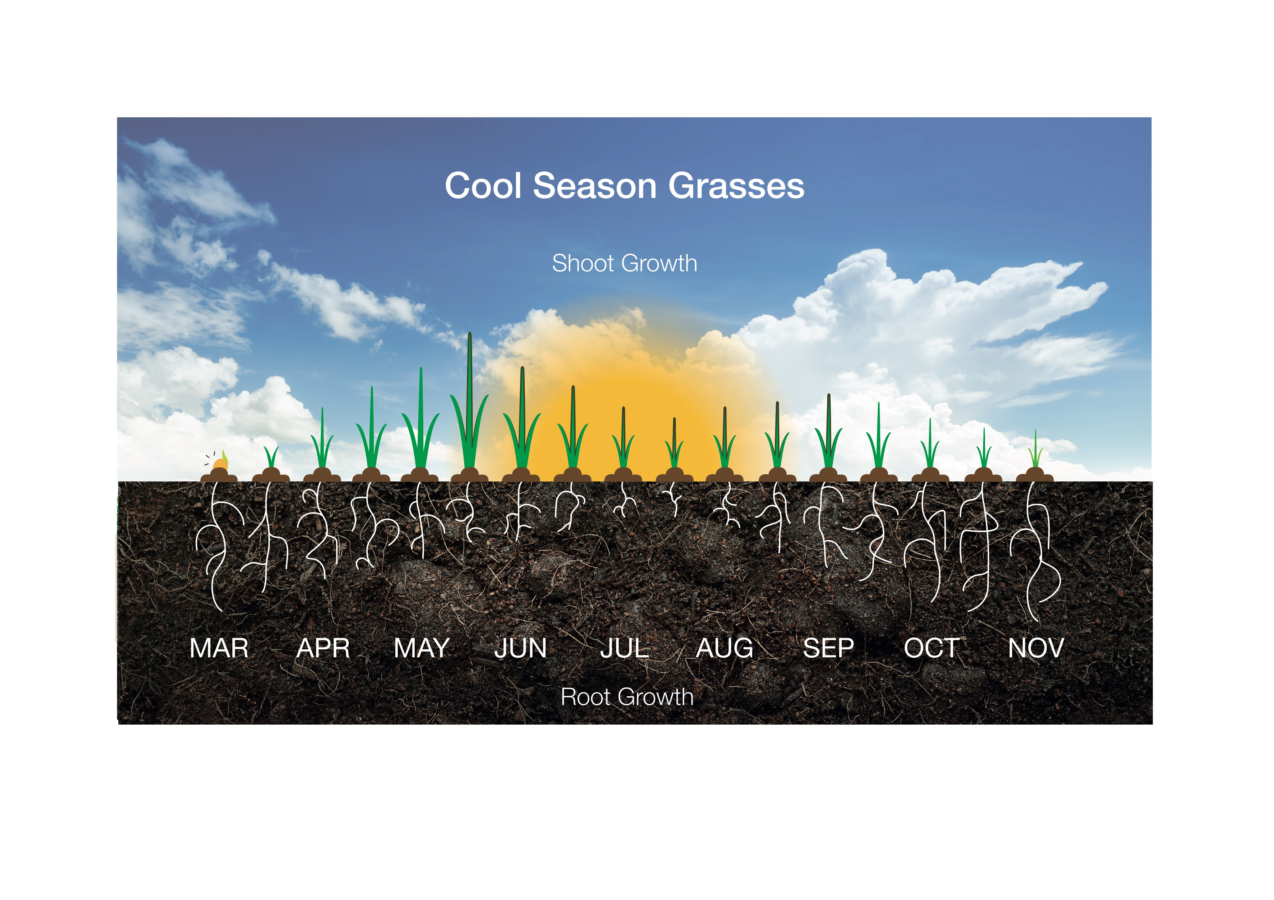
Overseeding – Understanding the grass plant cycle

Slide 28
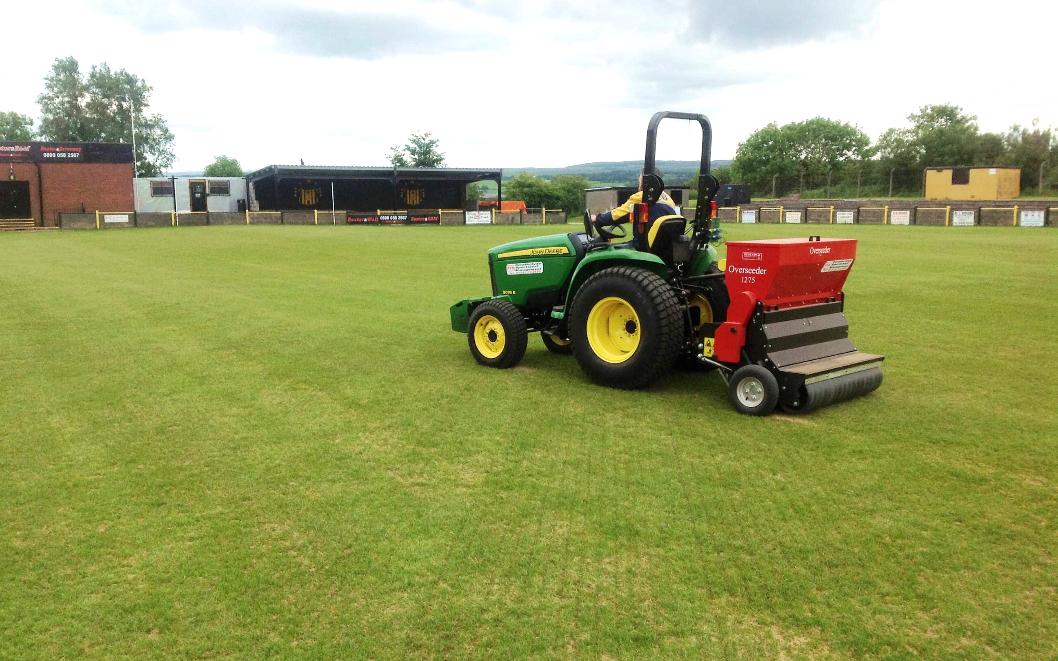
Seeding
Most effective when undertaken using a disc/drill seeder.
Optimum planting depth approximately 4mm but some cultivars can be planted deeper.
Recommended application rate 35g/m2 in three directions.
Notes:
What seed?
A three way rye seed mix is recommended for football pitches to be disc/drill seeded in three directions, similar to a Union Jack style.
Application rate is a guide, there may be some situations where a more aggressive overseed is required, particularly in heavy wear areas.
Be sure not to apply an amount of seed that would inhibit suitable grass establishment.
Methods of overseeding
Disc/drill seeding is the most effective method to maximise the chance of suitable grass establishment, however the depth of planting and soil conditions must be considered.
For pitches that suffer with heavy clay, a dimple seeder may be a better option if the surface is soft enough for the machine to lightly penetrate the surface and create a suitable seed bed.
If neither of these machines are available then results can be achieved through using a broadcast spreader to spin out the seed and then using a light chain harrow to create a tilth bed.
Protect the pitch
Once the renovation has finished it will be important to protect the pitch in anyway you can. This may be in the form of roping off immediate goalmouths to protect from the public or by using germination sheets if available.

Slide 29
Live Overseeding Demonstration (Dave Rhodes, local contractor)

Slide 30
General discussion around the benefits of Wetting Agents / Fertilizers
https://www.youtube.com/embed/0KEfcwPGV5Y

Slide 31
Staffs FA PIP Innovation Idea – Discussion & Consultation
Are these example figures realistic to grassroots clubs
– of all shapes, sizes & budgets?
Example aeration ‘packages’:
Package 1: £250 = 1 x deep aeration
Package 2: £450 = 2 x deep aeration
Package 3: £650 = 2 x deep aeration + 2 x slitting
Package 4: £850 = 2 x deep aeration + 4 x slitting

Slide 32


Q&A | AOB
Andy Jackson Kevin Duffill
Stoke City FC Grounds Manager IOG Regional Pitch Advisor
Staffordshire FA Pitch Advisor Staffordshire FA Pitch Advisor

Slide 33
Closing Summary
Support is available.
The Staffordshire FA Pitch Improvement Programme – along with events such as these and the network of partners – will hopefully result in creating a network of people and organisations who can support grassroots football clubs in maintaining their natural turf pitches to the best possible standard.
Thank you for your time and input this evening.
Have a safe journey home.

