Slide 1

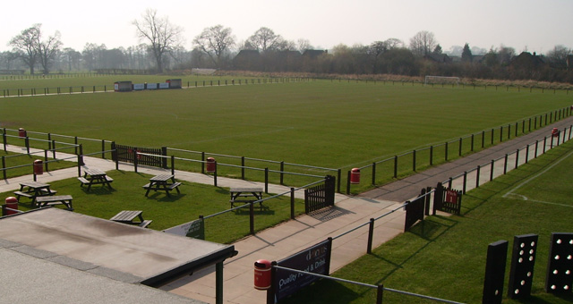
End of Season
Pitch Renovation Workshop
Saturday 21 May 2016 @ Stone Dominoes FC

Slide 2
Workshop Itinerary
09.30 – 09.45am Arrival | Tea & Coffee
09.45 – 10.00am Welcome | Overview | Introductions
10.00 – 11.30am Practical Demonstrations & Discussions
11.30 – 12.00pm De-brief | Q&A | Distribution of Literature
12.00pm Networking I Depart

Slide 3




FA Pitch Advisors / PIP Partners
Andy Jackson Jeremy Vincent
FA Pitch Advisor Charterhouse Turf Machinery
SCFC Head Groundsman
Kevin Duffill Glen Howard
FA Pitch Advisor Rigby Taylor
IOG Regional Pitch Advisor

Slide 4
Workshop Objectives
Provide an update on the FA Pitch Improvement Programme
Introduce key partners who can offer further guidance and support
Observe pitch maintenance demonstrations and machinery
Think about forward planning to improve your pitch
Ask questions of the pitch maintenance specialists in attendance
Network with groundsmen from other local grassroots clubs
Leave with a clearer idea of what support is available to you

Slide 5
Pitch Improvement Programme
Programme started in Staffordshire in November 2012 – since then our two
FA Pitch Advisors have visited 58 clubs/sites across the county – with many
of those clubs/sites investing in follow-up visits (84 PIP visits in total).
Process:
1. Expression of Interest form to County FA
2. CFA organise visit with Pitch Advisor and Club
3. Pitch Advisor and CFA visit site
4. Club receive a report with recommendations
5. Club action those recommendations, supported by the CFA

Slide 6
PIP Report / Recommendations
The Pitch Improvement Programme reports and recommendations will be unique to each club/site based on the resources available – budget, machinery, personnel, time, priorities, etc.
In many of the reports we have done previously, clubs have requested short-term recommendations based on their immediate priorities and budget available, then longer-term recommendations which the whole club can work towards achieving.
We recommend that clubs invest in a second visit approximately 6 months after their first visit to ensure that the recommendations provided in the reports have maximum impact.

Slide 7
Feedback
Andy / Kevin / Gareth,
I would like to take this opportunity to drop you a line and thank you and for the invaluable assistance and advice that you have given us over the last 18 months – without this I am quite sure that we would have gone down many blind alleys and spent money that we could ill afford to waste.
As you know we took over a new playing surface that was, quite frankly, not fit for purpose, but by following the maintenance programme you have provided us with, we now have a playing surface we can all be proud of.
Once again many thanks.
Marko Djukic
Chairman, Silverdale Athletic Football Club

Slide 8
Example (for guidance only*)
* Priorities / budgets will vary from pitch to pitch
Example annual maintenance programme for an 11v11 pitch
Example Priority Order GUIDE ONLY | Maintenance Item | Responsibility | Frequency (time of year) GUIDE ONLY (conditions would dictate) | No. of times per year | Cost Per Visit GUIDE ONLY | Annual Cost GUIDE ONLY
1 | Grass Cutting | Groundsman | Weekly | 20 | £0 - £50 | £0 - £1000
2 | Line Marking | Groundsman | Weekly | 20 | £0 - £25 | £0 - £500
3 | Vertidraining / Earthquaking | Specialist contractor | Annually (October) | 1 | £350 - £500 | £350 - £500
4 | Application of Fertiliser | Specialist contractor | Annually (October & May) | 2 | £250 - £400 | £500 - £800
5 | Application of Worm Control | Specialist contractor | Annually (October) | 2 | £150 - £250 | £300 - £500
6 | Application of Weedkiller | Specialist contractor | Annually (May) | 1 | £150 - £250 | £150 - £250
7 | Slitting | Specialist contractor | Annually | 4 | £150 - £200 | £600 - £800
8 | Scarification | Specialist contractor | Annually (May) | 1 | £350 - £500 | £350 - £500
9 | Topdressing | Specialist contractor | Annually (May) | 1 | £1300 - £2000 | £1300 - £2000
10 | Overseeding | Specialist contractor | Annually (May) | 1 | £400 - £1200 | £400 - £1200
 |  |  |  |  | Total cost | £3950 - £8050

Slide 9
Clubs Working Together
Investing in Specialist Contractors
If you are looking to invest in a local contractor to carry out any maintenance work – e.g. earthquaking, vertidraining, slitting, application of worm control, etc. – it may be worth liaising with other clubs in your local area to see if they are potentially looking to invest in similar maintenance work.
It may work out more cost-effective for clubs local to each other to work together when investing in specialist contractors.
The FA Pitch Advisors and the County FA can provide information on local contractors who have supported the Pitch Improvement Programme.

Slide 10

Potential Funding
The Football Foundation have two funding schemes which can support the purchasing of pitch maintenance equipment (supported by a PIP report):
            Football Stadia Improvement Fund
            National League System Clubs (Steps 1-7)
            £20,000+ (dependant on step in NLS)
            Can fund 50-70% (dependant on step in NLS)
            Small Grants Scheme
            Clubs outside National League System
            £10,000
            Can fund 50%

Slide 11
Q&A / Open Forum
Andy Jackson FA Pitch Advisor (Stoke City FC)
Kevin Duffill FA Pitch Advisor (IOG)
Jeremy Vincent Charterhouse Turf Machinery (FA PIP Machinery Partner)
Glen Howard Rigby Taylor (FA PIP Products Partner)
Peter Jones P2 Services / Local Contractor
Dave Rhodes Stone Dominoes FC Groundsman / Local Contractor
Gareth Thomas Staffordshire FA

Slide 12
Summary
Support is available.
The FA Pitch Improvement Programme – along with events such as these and the network of partners – will hopefully result in creating a network of people and organisations who can support grassroots clubs in maintaining their natural turf pitches to the best possible standard.
Please use this morning as an opportunity to continue building that network of people who can support you in maintaining your pitch

