Slide 1

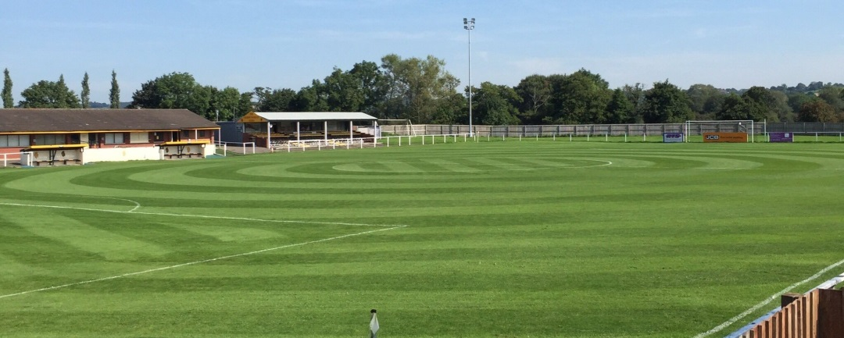
Pitch Improvement Workshop Monday 14 November 2016 @ Rocester FC
Staffordshire FA Pitch Improvement Programme (PIP)

Slide 2
Workshop Itinerary
18.00 – 18.30pm Arrival | Tea & Coffee
18.30 – 18.45pm Welcome| Introductions | Overview
18.45 – 19.30pm Presentation from Staffordshire FA Pitch Advisors 19.30 – 19.45pm PIP Case Study – Rocester FC
19.45 – 20.15pm FA PIP Partner – Charterhouse Turf Machinery
20.15 – 20.45pm FA PIP Partner – Rigby Taylor
20.45 – 21.00pm De-brief | Q&A
21.00pm Depart

Slide 3




FA Pitch Advisors / PIP Partners
Andy Jackson Curtis Allen
SCFC Head Groundsman Charterhouse Turf Machinery
FA Pitch Advisor FA PIP Partner
Kevin Duffill Phil Dewhurst
IOG Regional Pitch Advisor Rigby Taylor
FA Pitch Advisor FA PIP Partner

Slide 4
Workshop Objectives
Provide an update on the FA Pitch Improvement Programme
Introduce key partners who can offer further guidance and support
Hear about local case studies – positive and negative
Think about forward planning to improve your pitch
Ask questions of the pitch maintenance specialists in attendance
Network with groundsmen from other local grassroots clubs
Leave with a clearer idea of what support is available to you

Slide 5
Pitch Improvement Programme (Staffordshire)
Programme started in Staffordshire in November 2012. Since then our two
FA Pitch Advisors have visited 66 clubs/sites across the county – with many
of those clubs/sites investing in follow-up visits (92 PIP visits in total to date).
Process:
1. Expression of Interest form to County FA
2. County FA organise visit with Pitch Advisor and Club
3. Pitch Advisor and County FA visit club/site
4. Club receive a detailed report with recommendations
5. Club action those recommendations, supported by County FA

Slide 6
PIP Report / Recommendations
The Pitch Improvement Programme (PIP) reports and recommendations will be unique to each club/site based on the resources available – budget, machinery, personnel, time, priorities, etc.
In many of the reports we have done previously, clubs have requested short-term recommendations based on their immediate priorities and budget available, then longer-term recommendations which the whole club can work towards achieving.
We strongly recommend that clubs invest in a second visit approximately 6 months after their first visit to ensure that the recommendations provided in the reports have maximum impact.

Slide 7

PIP Case Study – Rocester RC
Summer Renovation:
05 May 2016 FA Pitch Improvement Visit FA Pitch Advisor
16 May 2016 Deep Aeration (Earth-quaking) Local Contractor
16 May 2016 Disc Seeding Local Contractor
16 May 2016 Application of Fertilizer Local Contractor
15 June 2016 Application of Liquid Fertilizer Local Contractor
Ongoing Maintenance:
Lessons Leaned (application of selective weed killer)
Mowing/Aeration (local support!)
Future Plans (renovations / new machinery)

Slide 8
Q&A
Andy Jackson Curtis Allen
FA Pitch Advisor Charterhouse Turf Machinery
SCFC Head Groundsman
Kevin Duffill Phil Dewhurst
FA Pitch Advisor Rigby Taylor
IOG Regional Pitch Advisor

Slide 9
Summary
Support is available.
The FA Pitch Improvement Programme – along with events such as these and the network of partners – will hopefully result in creating a network of people and organisations who can support grassroots clubs in maintaining their natural turf pitches to the best possible standard.
Please use the Pitch Improvement Programme as an opportunity to build the network of people who can support you with your pitch maintenance.

