Slide 1

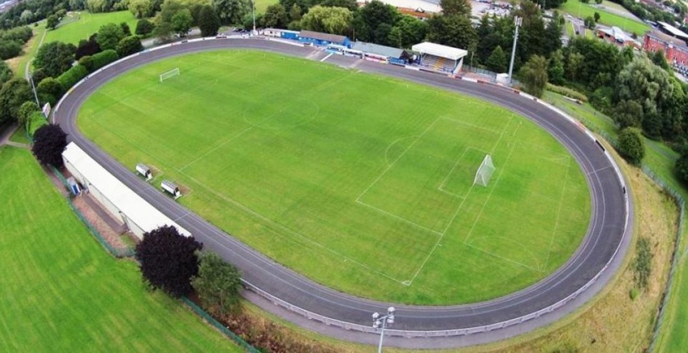
Staffordshire FA Groundsman Workshop Wednesday 8 May 2019 @ Newcastle Town Football Club

Slide 2
Workshop Itinerary
18.00 – 18.30pm Arrival | Refreshments | Networking
18.30pm Welcome | Introductions
18.30 – 19.15pm Newcastle Town pitch renovation – demo & discussions
19.15 – 19.45pm Demonstrations of renovation techniques for clubs with smaller budgets
19.45 – 20.30pm Demonstrations, observations and discussions of machinery suitable for grassroots clubs
(Compact Tractor, Roller Mower, Quadraplay, Pedestrian Mower, Dragmat)
20.30 – 21.00pm Summary discussions in the clubhouse (if time allows)
21.00pm Opportunity to network / depart at your leisure

Slide 3


Staffordshire FA Pitch Advisors
Andy Jackson Kevin Duffill
Stoke City FC Grounds Manager IOG Regional Pitch Advisor
Staffordshire FA Pitch Advisor Staffordshire FA Pitch Advisor

Slide 4
Summary | Q&A
Andy Jackson Kevin Duffill
Stoke City FC Grounds Manager IOG Regional Pitch Advisor
Staffordshire FA Pitch Advisor Staffordshire FA Pitch Advisor

Slide 5
Closing Summary
Support is available.
The Staffordshire FA Pitch Improvement Programme – along with events such as these and the network of partners – will hopefully result in creating a network of people and organisations who can support grassroots football clubs in maintaining their natural turf pitches to the best possible standard.
Thank you for your time and input this evening.
Have a safe journey home.

