Slide 1






Grass Pitch Improvement Workshop
Wednesday 6 October 2021 @ Brocton Football Club
Tonight’s workshop is being delivered in partnership with Staffordshire FA’s grass pitch improvement strategy key partners:

Slide 2
Welcome/Introductions...
Kevin Duffill Grounds Management Association, Regional Pitch Advisor
Andy Jackson Stoke City Football Club, and Staffordshire FA Support Pitch Advisor
John Campey Campey Turf Care
Lee Morgado Campey Turf Care
Ben Lloyd SISIS
Glen Howard Rigby Taylor

Slide 3
Setting the scene for this evening…
Original workshop plan has been tweaked slightly!
Currently lots going on in the world of grass pitch improvement, with lots of support available – both locally and nationally. Too much to squeeze into 2.5 hours!
Tonight’s workshop will predominantly focus on equipment demonstrations and discussions from three of Staffordshire FA’s key partners.
An additional online workshop will be taking place in November (date TBC), which will focus more on Football Foundation funding, additional online support networks, GMA courses and toolkits, ‘Pitch Power’, and best practice tips for the winter months.

Slide 4
Focus for tonight’s workshop…
Demonstrations of equipment and techniques suitable for grassroots football clubs.
All clubs who receive a ‘Pitch Power’ report, will have sections in that report which recommends the following:
- Maintenance operations which can be carried out by contractors.
- Recommended equipment for the club to invest in.
- Investment in products which can improve the quality of pitches.
All of the above can be funded by Football Foundation grant schemes.
We will touch upon the above tonight, and cover in more detail in November’s online workshop.

Slide 5
Itinerary for this evening…
Approx. | Content
6.30 - 6.50 | Welcome, introductions, and setting the scene.
 | Head outside for demos & discussions
7.00 - 7.10 | Campey - Compact Tractor and Roller Mower
7.10 - 7.20 | Campey - Shockwave (deep aeration)
7.20 - 7.30 | Campey - Rotoknife
7.30 - 7.40 | SISIS - Quadraplay (combination tool)
7.40 - 7.50 | SISIS - Multislit
7.50 - 8.00 | SISIS - Multitiner
8.00 - 8.10 | Rigby Taylor - Line Marker
8.10 - 8.20 | Rigby Taylor - Robot Line Marker
 | Head inside back inside
8.30 - 8.40 | Rigby Taylor - Seed & Fertilizer
8.40 - 9.00 | GMA Toolkit, GMA Courses, Groundskeeping Community, SALTEX
 | Staffs FA Website - Grass Pitch Improvement Section (in progress)
 | Staffs FA Support Pitch Advisor Service
 | Q&A, close/depart

Slide 6
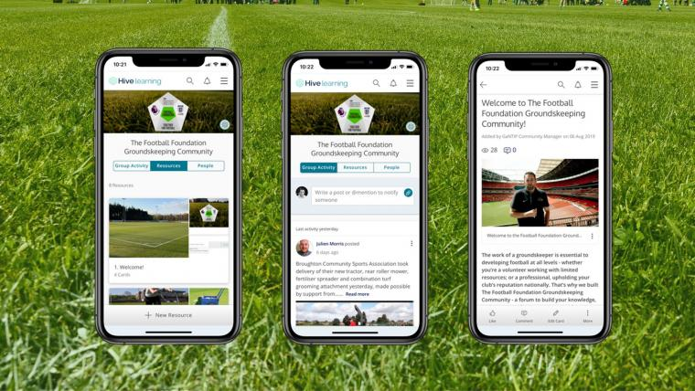
Additional online support...
GMA Football Grounds Maintenance Toolkit:
https://resources.thegma.org.uk/football/football-groundsmanship
GMA Online Football Grounds Maintenance Courses: https://portal.thegma.org.uk/education/course/379868
Football Foundation Groundskeeping Community:
https://footballfoundation.hivelearning.com/join

Slide 7
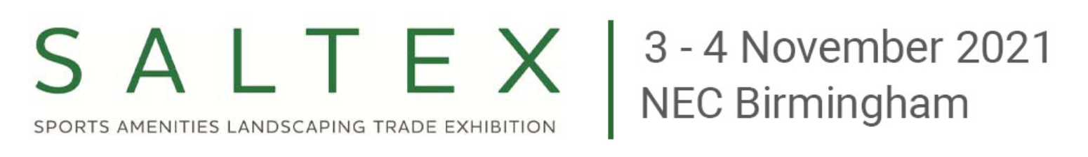


Visiting saltex is free of charge
Online registration is now open - gmasaltex.co.uk/visitor-registration/

Slide 8
Staffordshire FA key contact details...
Email: support@StaffordshireFA.com
Website: www.staffordshirefa.com
Kevin Staples (Head of Delivery)
kevin.staples@staffordshirefa.com
07969 294084
Gareth Thomas (Partnerships & Communications & Officer)
gareth.thomas@staffordshirefa.com
07815 295223

Slide 9
Many thanks to everyone for your attendance and ongoing efforts, as we collectively work together to improve as many natural turf pitches across Staffordshire as we can.
Many thanks to Brocton FC for hosting the workshop this evening.
Safe journeys home.

