Slide 1

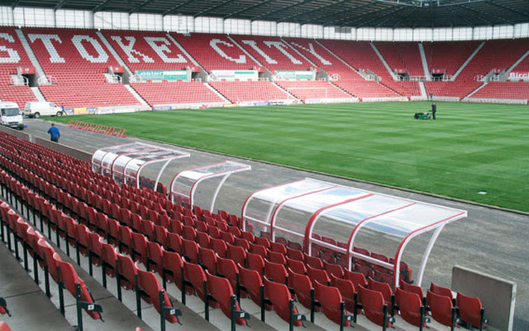
Pitch Improvement Workshop
Thursday 6 April 2017, 6.30pm – 9.00pm
1863 Lounge, bet365 Stadium, Stoke City Football Club

Slide 2
Workshop Itinerary
18.00 – 18.30pm Arrival Time | Tea & Coffee
18.30 – 18.45pm Welcome | Introductions | Overview
18.45 – 19.30pm Case Study 1: Professional football club (PL)
19.30 – 19.45pm Case Study 2: Non-league football club (Step 4)
19.45 – 20.00pm Case Study 3: Non-league football club (Step 7)
20.00 – 20.15pm Tea & Coffee Break| Networking
20.15 – 20.30pm Case Study 4: Sunday football club (adult 11v11)
20.30 – 20.45pm Case Study 5: Large multi-pitch site (all formats)
20.45 – 21.00pm De-brief | Q&A
21.00pm Networking | Depart

Slide 3


Staffordshire FA Pitch Advisors
Andy Jackson Kevin Duffill
Stoke City FC Head Groundsman IOG Regional Pitch Advisor
Staffordshire FA Pitch Advisor Staffordshire FA Pitch Advisor

Slide 4
Workshop Objectives
Provide an update on the Staffordshire FA Pitch Improvement Programme
Discuss the ‘Pitch Maintenance Summary Document’ in more detail
Listen to local case studies from all level of the football pyramid
Ask questions of the pitch advisors and other local groundsmen
Makes notes to support your club and groundsman with future planning
Network with groundsmen from other local grassroots clubs
Interaction is encouraged throughout – ask lots of questions!

Slide 5
Staffordshire FA
Pitch Improvement Programme
(PIP)
PIP numbers / impact to date:
2012 = year Staffordshire FA launched the programme
77 = number of clubs / sites visited since then
109 = total number of PIP visits
187 = total number of pitches visited and impacted by the programme

Slide 6
Pitch Maintenance
Summary Document

Slide 7
Pitch Maintenance
Summary Document
(refer back to throughout the workshop)
Guidance – simple document to support clubs and groundsmen with the planning of pitch maintenance items throughout the season.
Budgets – not all of the items will be achievable – individual budgets will dictate what is and isn’t possible.
Prioritising – which items are going to have the biggest impact to your pitch – based on the budget and resources available to you?
Recommendations – the pitch advisor’s report & recommendations can support you with this process.

Slide 8
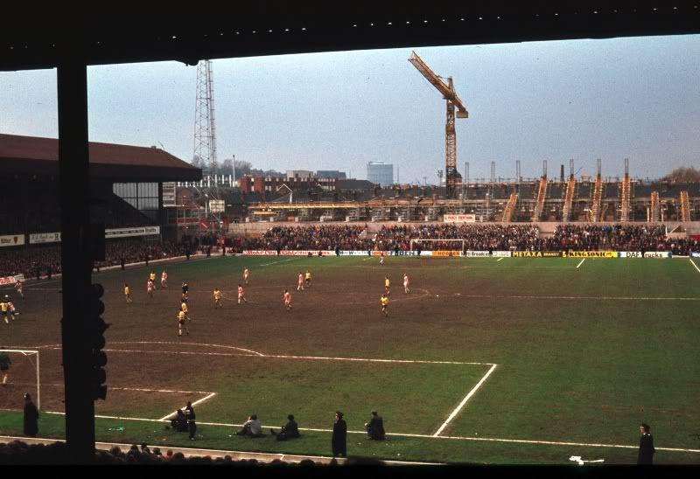
Case Study 1:
Stoke City FC (Premier League)
From this…

Slide 9
Case Study 1:
Stoke City FC (Premier League)
To this!

Slide 10
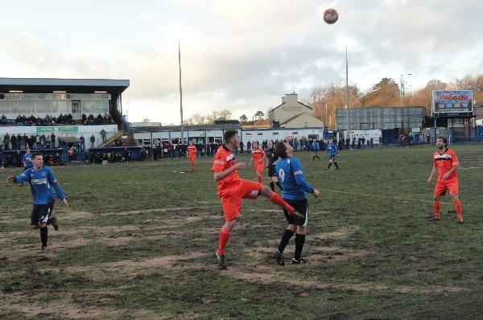
Case Study 2:
Leek Town FC (NLS Step 4)

Slide 11
Case Study 2:
Leek Town FC (NLS Step 4)
CHALLENGES FACED:
1. Obtaining grants – major pitch construction was required
2. Learning how pitches and drainage work together
3. Challenges with dealing with contractors
4. Being aware that once contractors have completed, pitch will settle and additional works will need to be carried out – this is ongoing.
5. Learning to care for your new pitch – old pitch & ways don't work with new.
6. Damn weather!

Slide 12
Case Study 2:
Leek Town FC (NLS Step 4)
ACTION:
1. Once grant was accessed, choosing contractors.
2.Summer maintenance by outside contractors.
3. Being aware that in year two/three extra drainage and filling low spots as the new pitch settles.
4. Ongoing maintenance e.g. verti-draining, weed control, etc.
(PIP Report recommendations – feedback from Andy and Kevin)

Slide 13
Case Study 2:
Leek Town FC (NLS Step 4)
RESULT:
1. Majorly improved playing surface, but also a far better looking stadium.
2. A total of 58 games played on Harrison Park so far.
- First Team
- Ladies First Team
- Stoke City U23
- Academy
- UEFA International Matches
3. Less games lost to flooding and frost.
4. Increased revenue for the club.

Slide 14
Case Study 2:
Leek Town FC (NLS Step 4)
BEFORE

Slide 15
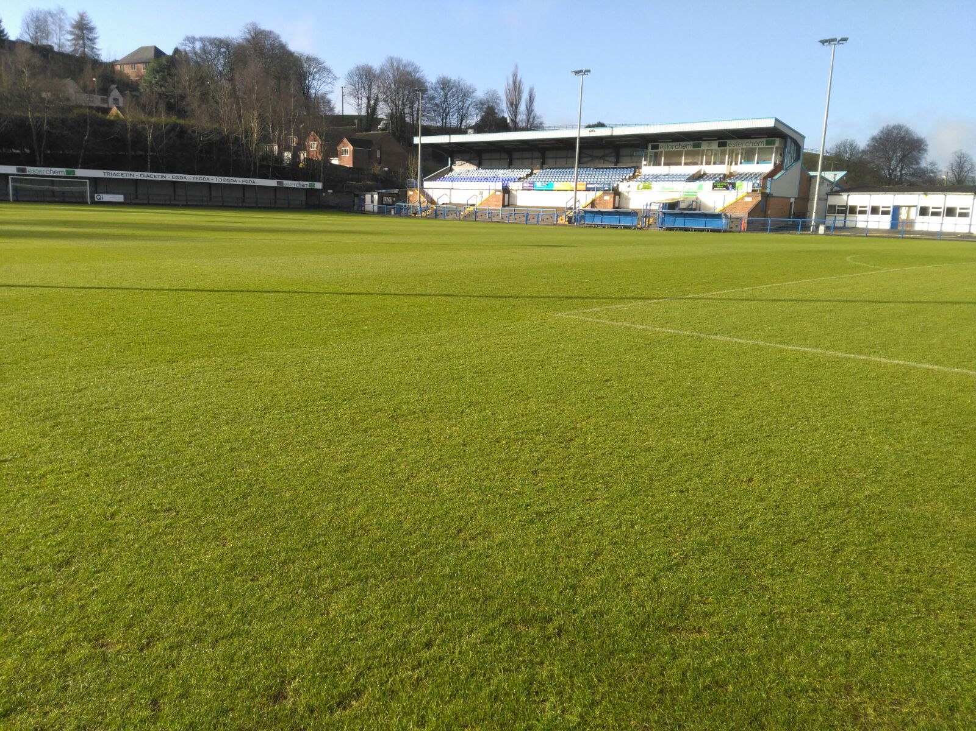
Case Study 2:
Leek Town FC (NLS Step 4)
AFTER

Slide 16
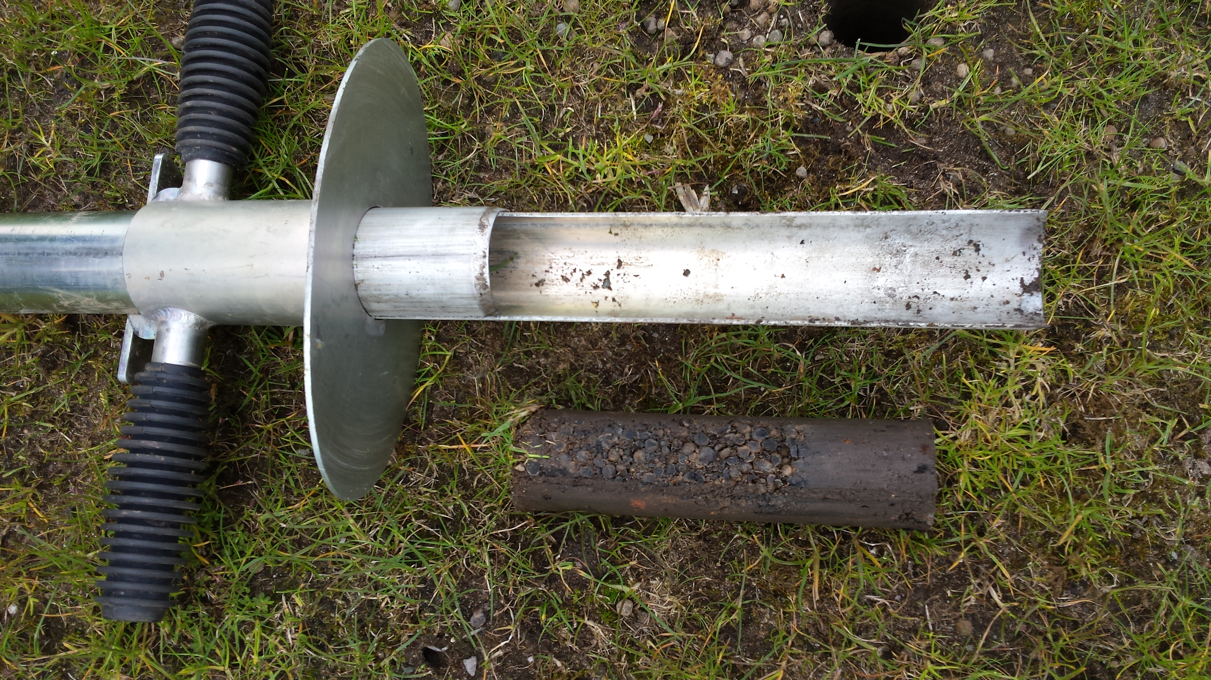
Case Study 3:
Silverdale Athletic FC (NLS Step 7)

Slide 17
Case Study 3:
Silverdale Athletic FC (NLS Step 7)
CHALLENGES FACED:
Time – finding the time to organise and often complete the work within the timescales set.
Funding – raising the capital required to pay for the materials, equipment and contractors.
(Andy and Kevin to add some technical detail around the challenges the club faced when they inherited the pitch from the Local Authority)

Slide 18
Case Study 3:
Silverdale Athletic FC (NLS Step 7)
ACTION:
Attended the first Staffordshire FA pitch improvement workshop and invested in advice from the two pitch advisors Andy & Kevin
Followed their recommendations as close as we could within our financial restraints.
Kept in close contact with Staffs FA and the pitch advisors to overcome any problems we came across while the work was being undertaken.
(PIP Report recommendations – feedback from Andy and Kevin)

Slide 19
Case Study 3:
Silverdale Athletic FC (NLS Step 7)
RESULT:
After our first pre-season treatment, the pitch improved dramatically in root strength and in top growth. With following the pitch advisors advice in the 2nd and 3rd seasons, the pitch has gone from strength to strength.
After the first pre-season large financial commitment, we have been able to reduce our annual expenditure by over 50%, we also now have the ability to budget for the works and fundraise accordingly.

Slide 20
Case Study 3:
Silverdale Athletic FC (NLS Step 7)
BEFORE

Slide 21
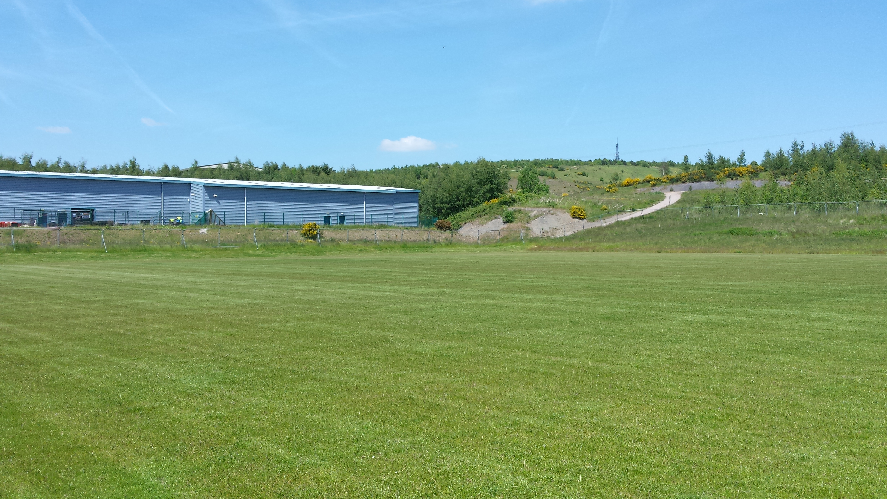
Case Study 3:
Silverdale Athletic FC (NLS Step 7)
AFTER

Slide 22

8.00pm – 8.15pm

Slide 23
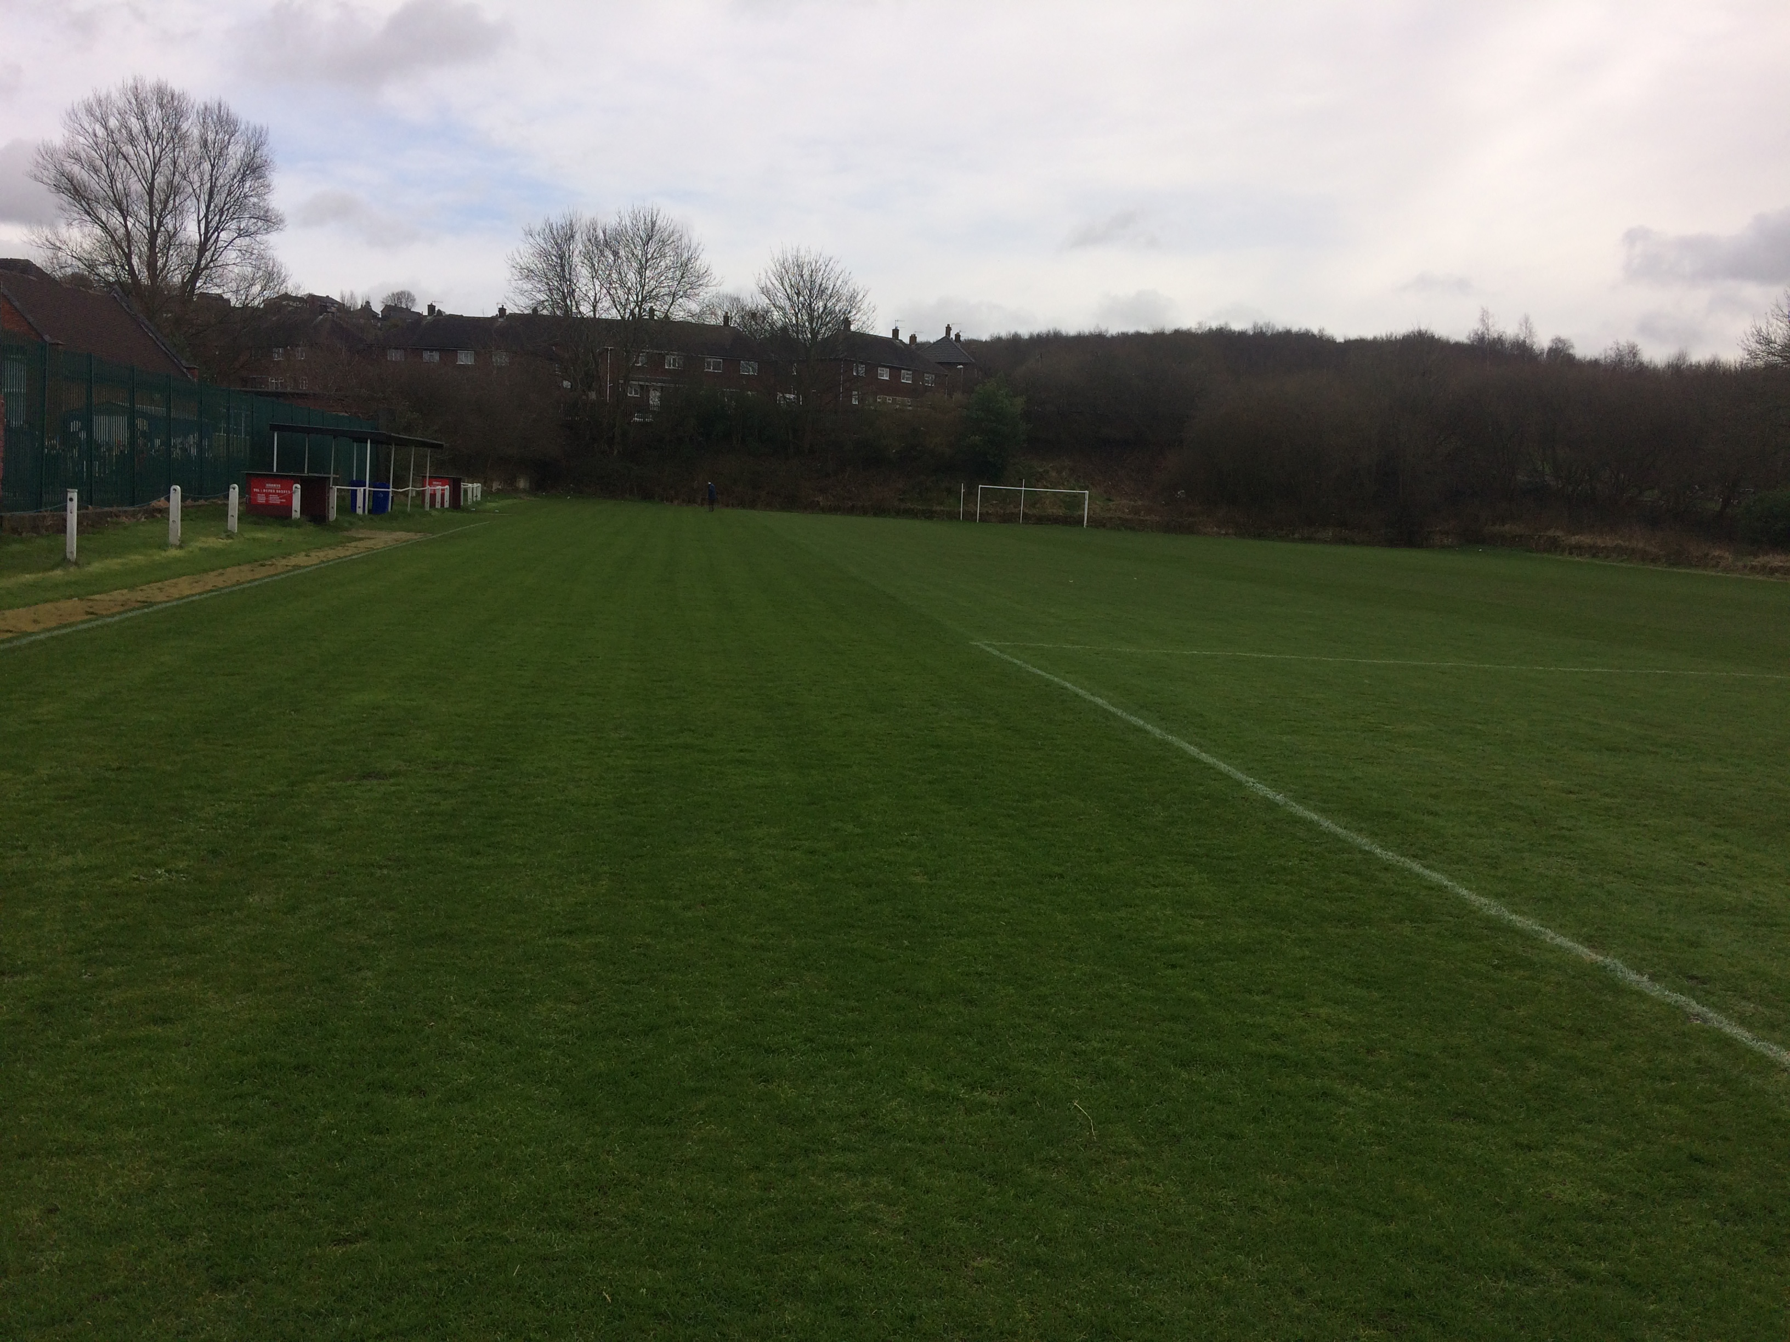
Case Study 4:
AC Milton (Sunday 11v11 team)
Presentation from Roger Ibbs,
AC Milton Groundsman

Slide 24
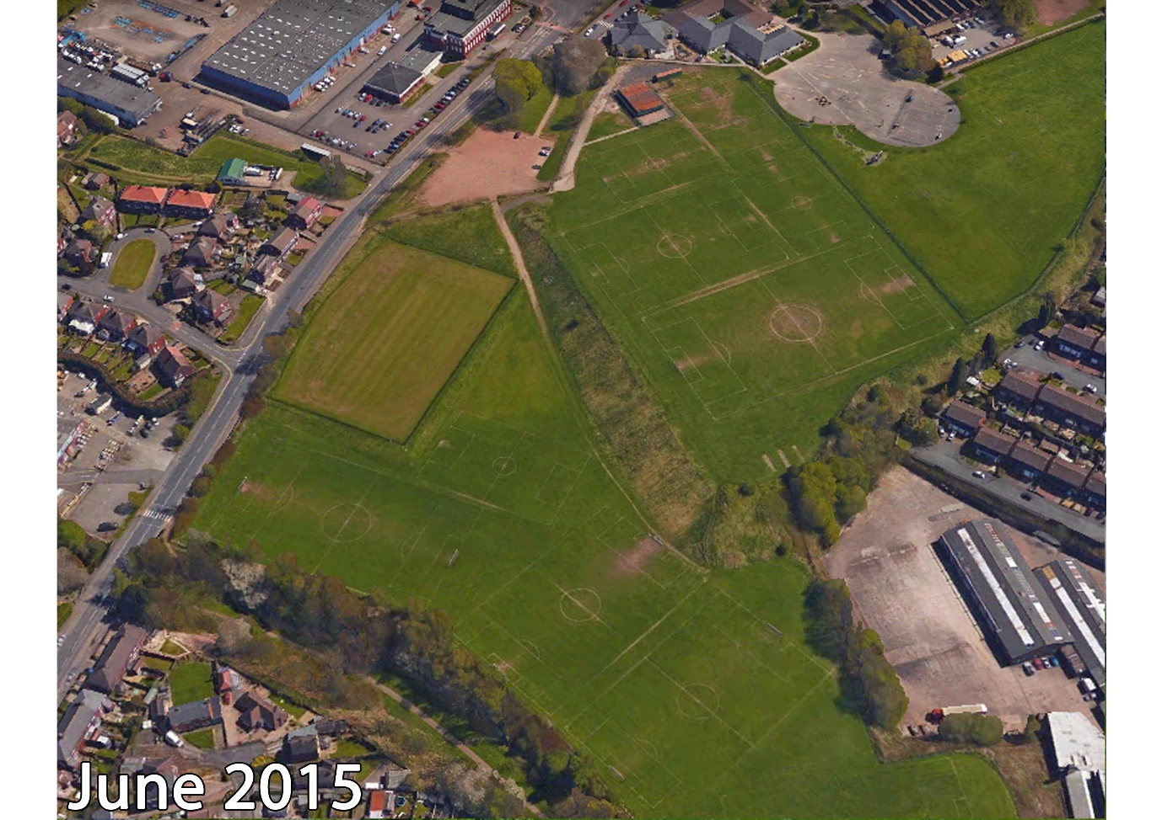
Case Study 5:
Trubshaw Cross (multi-pitch site)

Slide 25
Case Study 5:
Trubshaw Cross (multi-pitch site)
CHALLENGES FACED:
Knowledge – completely out of our depth – not having a clue as to what on earth we were doing! Having 11 pitches (12.5 acres) to look after and our sum total of knowledge was grass is green. Oh and the initial budget of £500!
In the last 6 months, the latest challenge we had to overcome was machinery breakdown and realising our plan B wasn’t good enough.
We now know we should have had a plan A, B, C and D.

Slide 26
Case Study 5:
Trubshaw Cross (multi-pitch site)
ACTION:
Heavily invested in machinery and gained as much knowledge as possible. Learnt from mistakes we make – we’ve made plenty. Kept a log of all work completed and the effects it has – weekly/monthly/annually. This has meant we learnt that different areas of the site react to different maintenance.
(PIP Report recommendations – feedback from Andy and Kevin)

Slide 27
Case Study 5:
Trubshaw Cross (multi-pitch site)
RESULT:
We now have pitches that have been able to host more games throughout the season. The appearance and grass coverage improves each season.
We are continually learning how our site works/reacts to different weather conditions, which means we can update/tweak our development plans to continue to improve the pitches.

Slide 28
Case Study 5:
Trubshaw Cross (multi-pitch site)

Slide 29
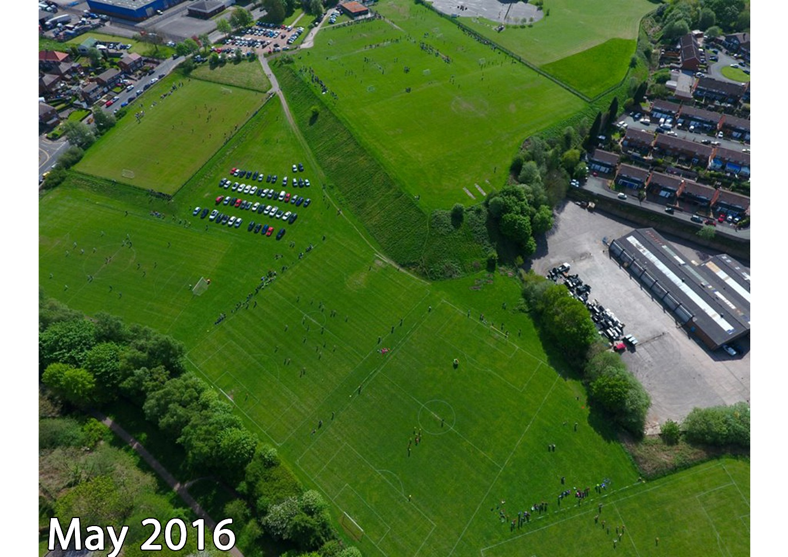
Case Study 5:
Trubshaw Cross (multi-pitch site)

Slide 30
De-brief / Q&A
Andy Jackson Kevin Duffill
Stoke City FC Head Groundsman IOG Regional Pitch Advisor
Staffordshire FA Pitch Advisor Staffordshire FA Pitch Advisor

Slide 31

Funding Opportunities
The Football Foundation have two funding schemes which can support the purchasing of pitch maintenance equipment (supported by a PIP report):
Small Grants Scheme
Up to £10,000
Can fund 50%
For Clubs outside of the National League System
Football Stadia Improvement Fund
For National League System Clubs
£20,000+ (dependant on NLS Step)
Can fund 50-70% (dependant on NLS Step)

Slide 32
Staffordshire FA
Groundsman of the Year ‘16/17
(Step 7 and below)
Groundsmen at this level of the game are nearly all volunteers who give up countless hours of their time to provide the best pitches possible with limited resources, equipment and budgets.
The Groundsmen of the Year Awards is a great opportunity for these volunteer be recognised locally, with the top three Groundsmen is Staffordshire receiving awards at the County FA awards event in the summer.

Slide 33
Closing Summary
Support is available.
The Staffordshire FA Pitch Improvement Programme – along with events such as these and the network of partners – will hopefully result in creating a network of people and organisations who can support grassroots football clubs in maintaining their natural turf pitches to the best possible standard.
Thank you for your time and input this evening.
Have a safe journey home!

