Slide 1

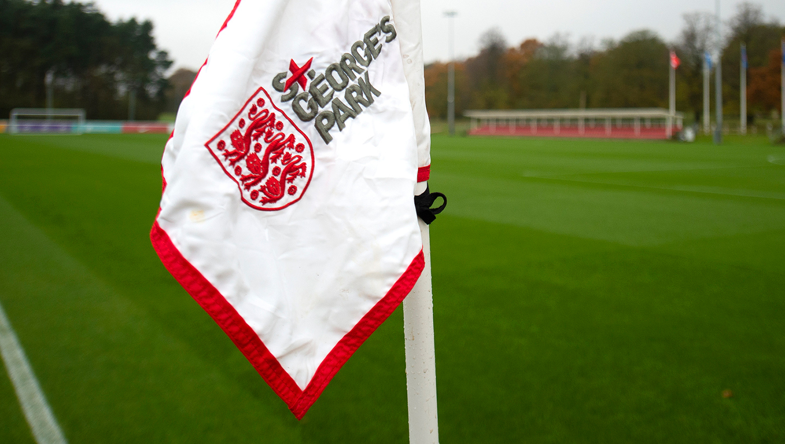
Pitch Maintenance Workshop Monday 2 December 2019 6.30pm – 9.00pm

Slide 2
Welcome & Introductions
Scott Brooks (Head of Grounds & Estates, SGP)
Andy Jackson (Grounds Manager, Stoke City FC)
Kevin Duffill (Regional Pitch Advisor, IOG)
John Campey (Director, Campey Turf Care Systems)
Glen Howard (Technical Sales Representative, Rigby Taylor)
Kevin Staples (Head of Strategy & Investment, Staffs FA)

Slide 3
Staffordshire FA Pitch Improvement Programme (PIP)
PIP numbers / impact to date (Nov 2019):
2012 = year Staffordshire FA launched the programme
101 = number of clubs / sites visited since then
165 = total number of PIP visits
305 = total number of pitches visited and impacted by the programme
1022 = total no. of football pitches across Staffordshire

Slide 4
Staffordshire FA Deep Aeration Pitch De-compaction Offer
(refer to handout for additional details)
The general costs to deep aerate (linear) a full-size 11v11 football pitch are usually around £350+ for one operation, £700+ for two operations.
Staffordshire FA are offering this service at a subsidised cost of £500 for two operations (a saving of £200+). The above cost is based on an 11v11 pitch, however this service is available to all clubs and the price will be calculated accordingly dependant on the size of the area.

Slide 5
‘Grass Pitch Revolution’ New funding from the Football Foundation to improve grassroots football pitches…
Cuts in local authority funding of sport have led to a decline in the quality of grass pitches in England.
Only 1 in 8 grassroots clubs are satisfied with the quality of their grass pitches.
Only 1 in 3 grassroots pitches meet basic standards.
150,000 matches were called off last season due to poor facilities.
Source: Grassroots Football Survey 2018

Slide 6
What funding is available?
Commitment to a 10-year plan to improve your pitch/pitches.
Up to £2,500 for each of your pitches in the first two years.
- 100% funding in years 1-2
- 66% funding in years 3-4
- 33% funding in years 5-6
Grants available for contractors, materials and equipment.

Slide 7
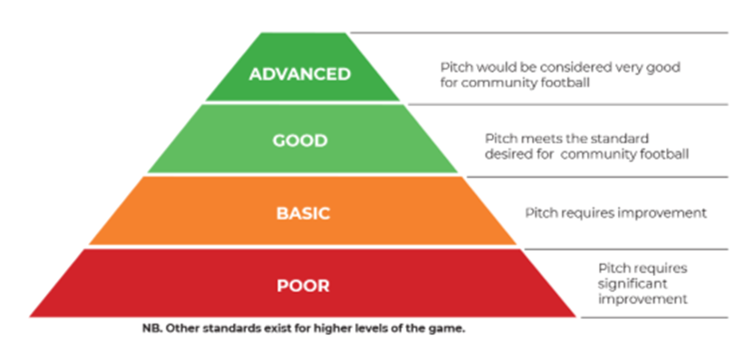
Which pitches are eligible?
*Determined by Regional Pitch Advisor

Slide 8
What support will it help pay for?
Clubs can receive a grant to pay for a pitch maintenance contractor to help you improve your grass pitches.
A 10-year maintenance plan determined by the Institute of Groundsmanship (IOG) based on your pitch assessment.
Football Foundation will award 66% of the total cost for the first 6 years of your maintenance plan.
Grass pitch maintenance includes:
Slitting | Fertiliser | Selective Herbicide
Scarification | Aeration | Overseeding

Slide 9
What materials will it help pay for?
If you want to do it yourself, you can receive grants to support the cost of materials.
A Regional Pitch Adviser from the IOG will recommend the appropriate quantities and product type required.
You can receive grants for the following:
- Grass Seed
- Selective Herbicide
- Fertiliser
Must have qualified personnel (IOG Level 1 or equivalent) to carry out the works.
Equipment is eligible for funding.
Storage container is eligible for funding.

Slide 10
What machinery will it help pay for?
You can receive up to 75% of the total cost of any machinery required to improve your pitches. Maximum grant of £25,000.
Machinery and equipment requirements will be determined by a Regional Pitch Adviser from the IOG.
Second hand machinery is eligible.
Storage container eligible for funding.
Insurance & secure storage condition of award.

Slide 11
Connecting through ‘The Hive’ (see Groundskeeping Community flyer)
The FA/IOG/Football Foundation have created an online community for volunteer groundskeepers.
Volunteer groundskeepers can access ongoing advice and education about pitch maintenance.
The resource is live and you can sign up now…

Slide 12


Key reasons to sign up…
Over 1,000 users have signed up the majority are grassroots volunteers like yourselves.
Group forum, IOG Regional Pitch Advisor commitment to come back to you within 48 hours.
Pitch maintenance diary.
Task specific advice.
Easy to find guidelines on pitch sizes and requirements.
Network to find local support in your area.
Soon to set up county specific groups.
First sight of any new initiatives, funding streams and latest news.
Notes:
So finally,

Slide 13
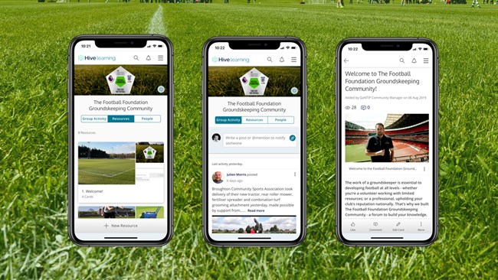
Football Foundation Groundskeeping Community
Notes:
So finally,

Slide 14
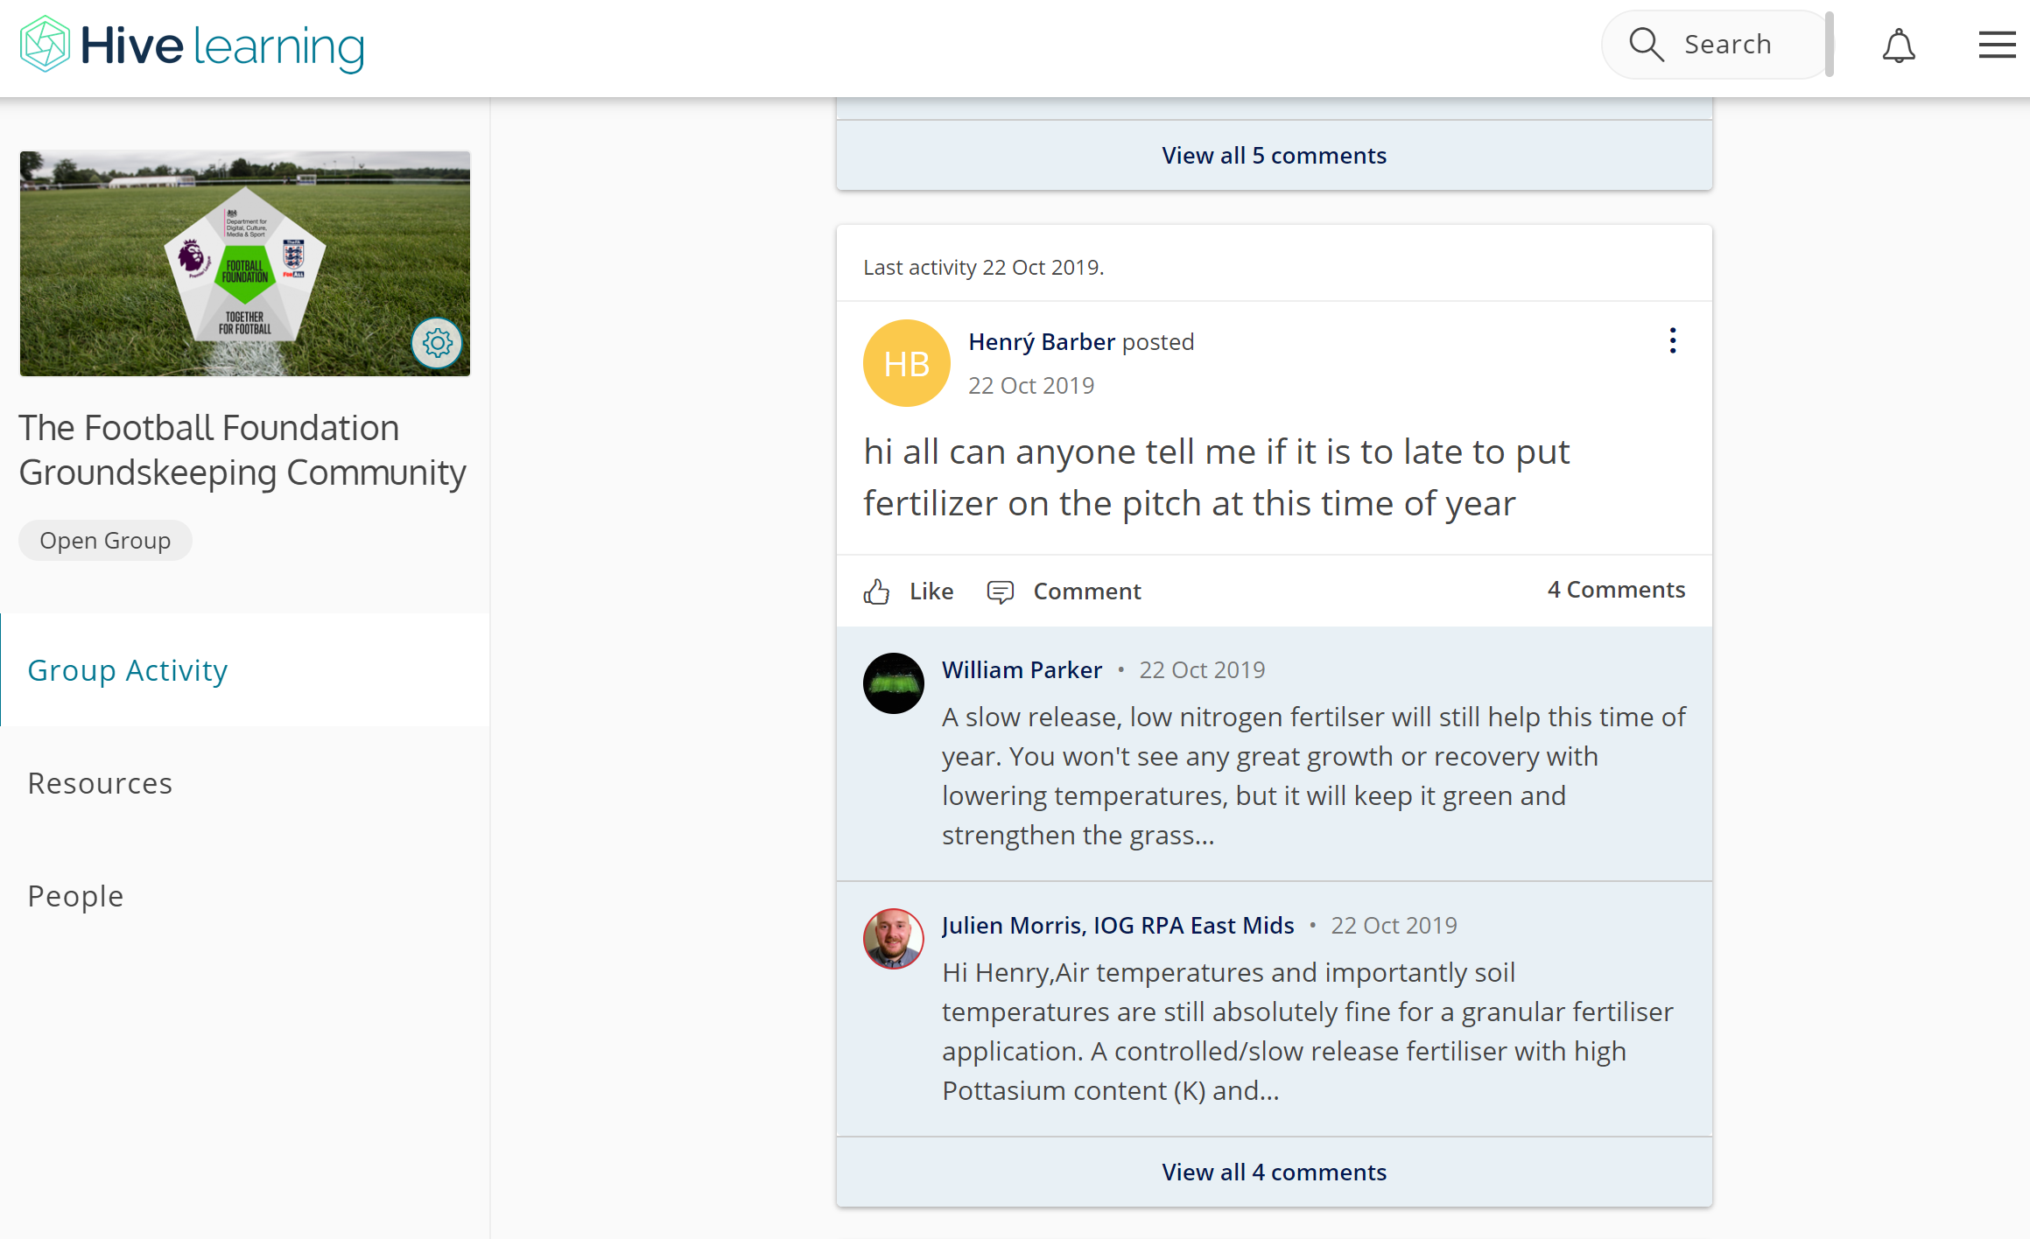
Group activity forum
Notes:
So finally,

Slide 15
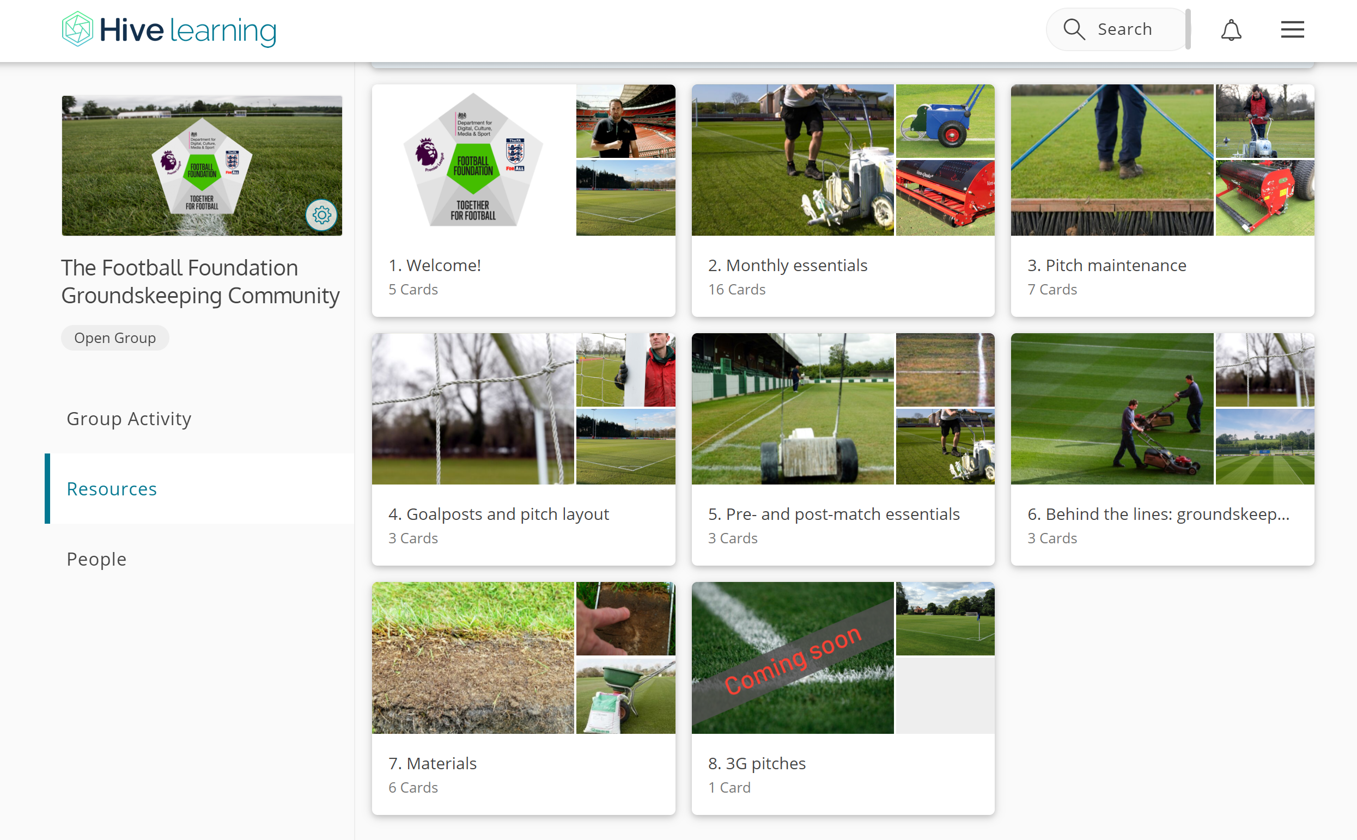
Resources page
Notes:
So finally,

Slide 16

Welcome page
Notes:
So finally,

Slide 17
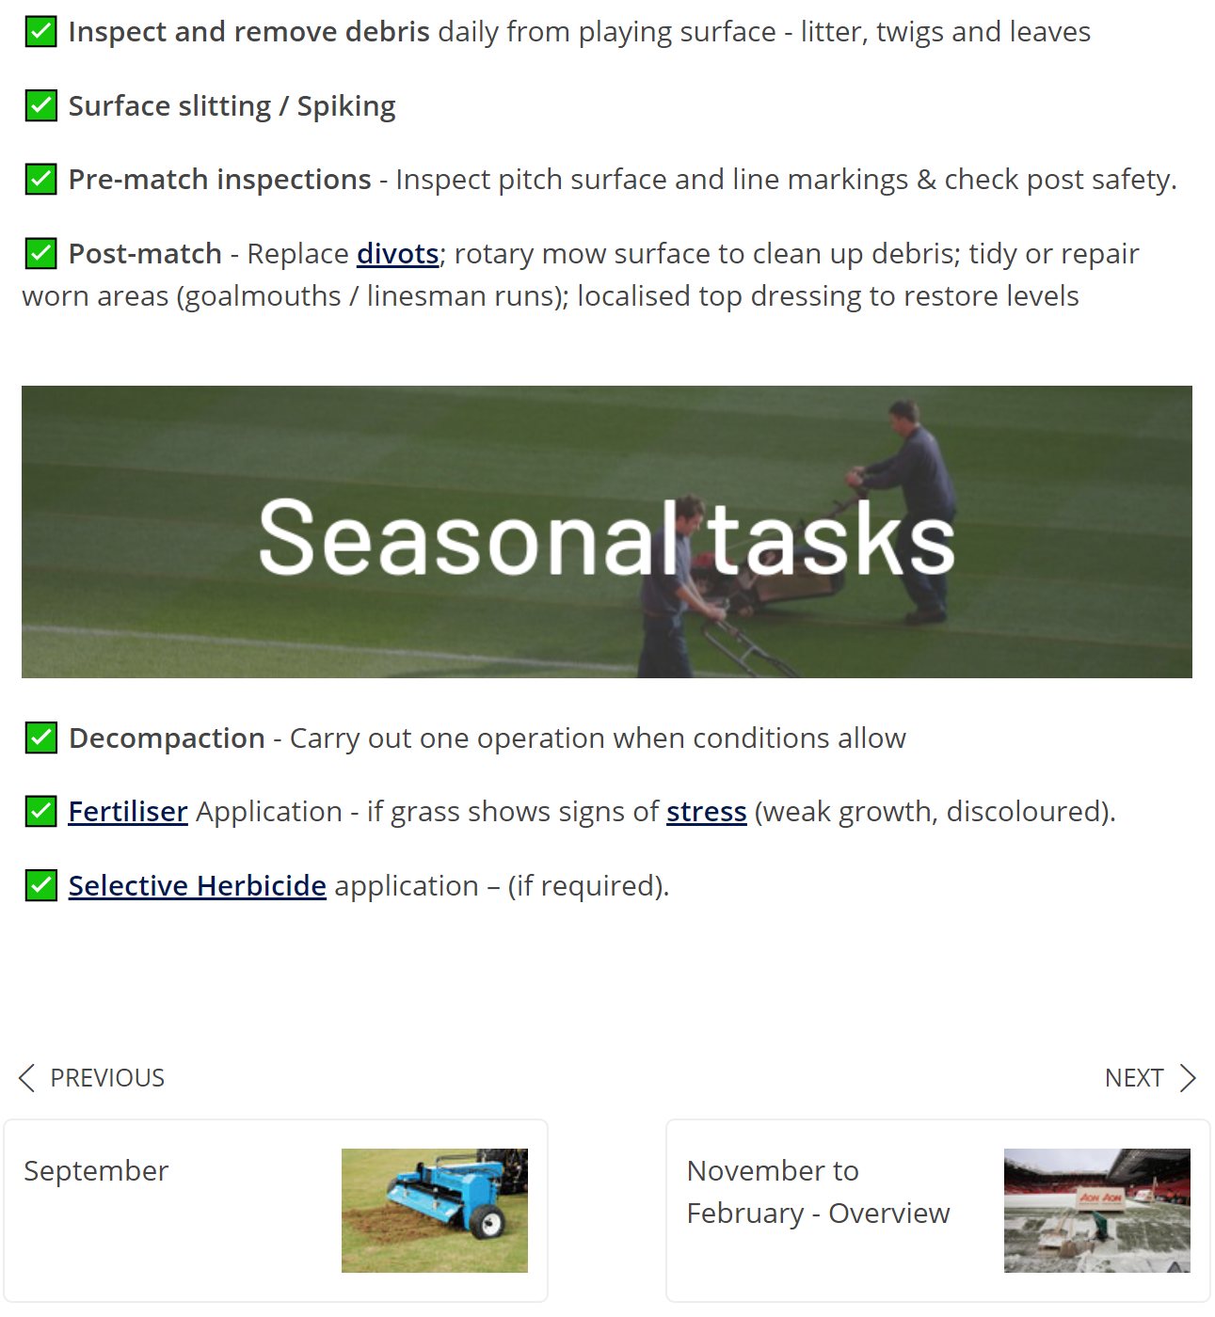
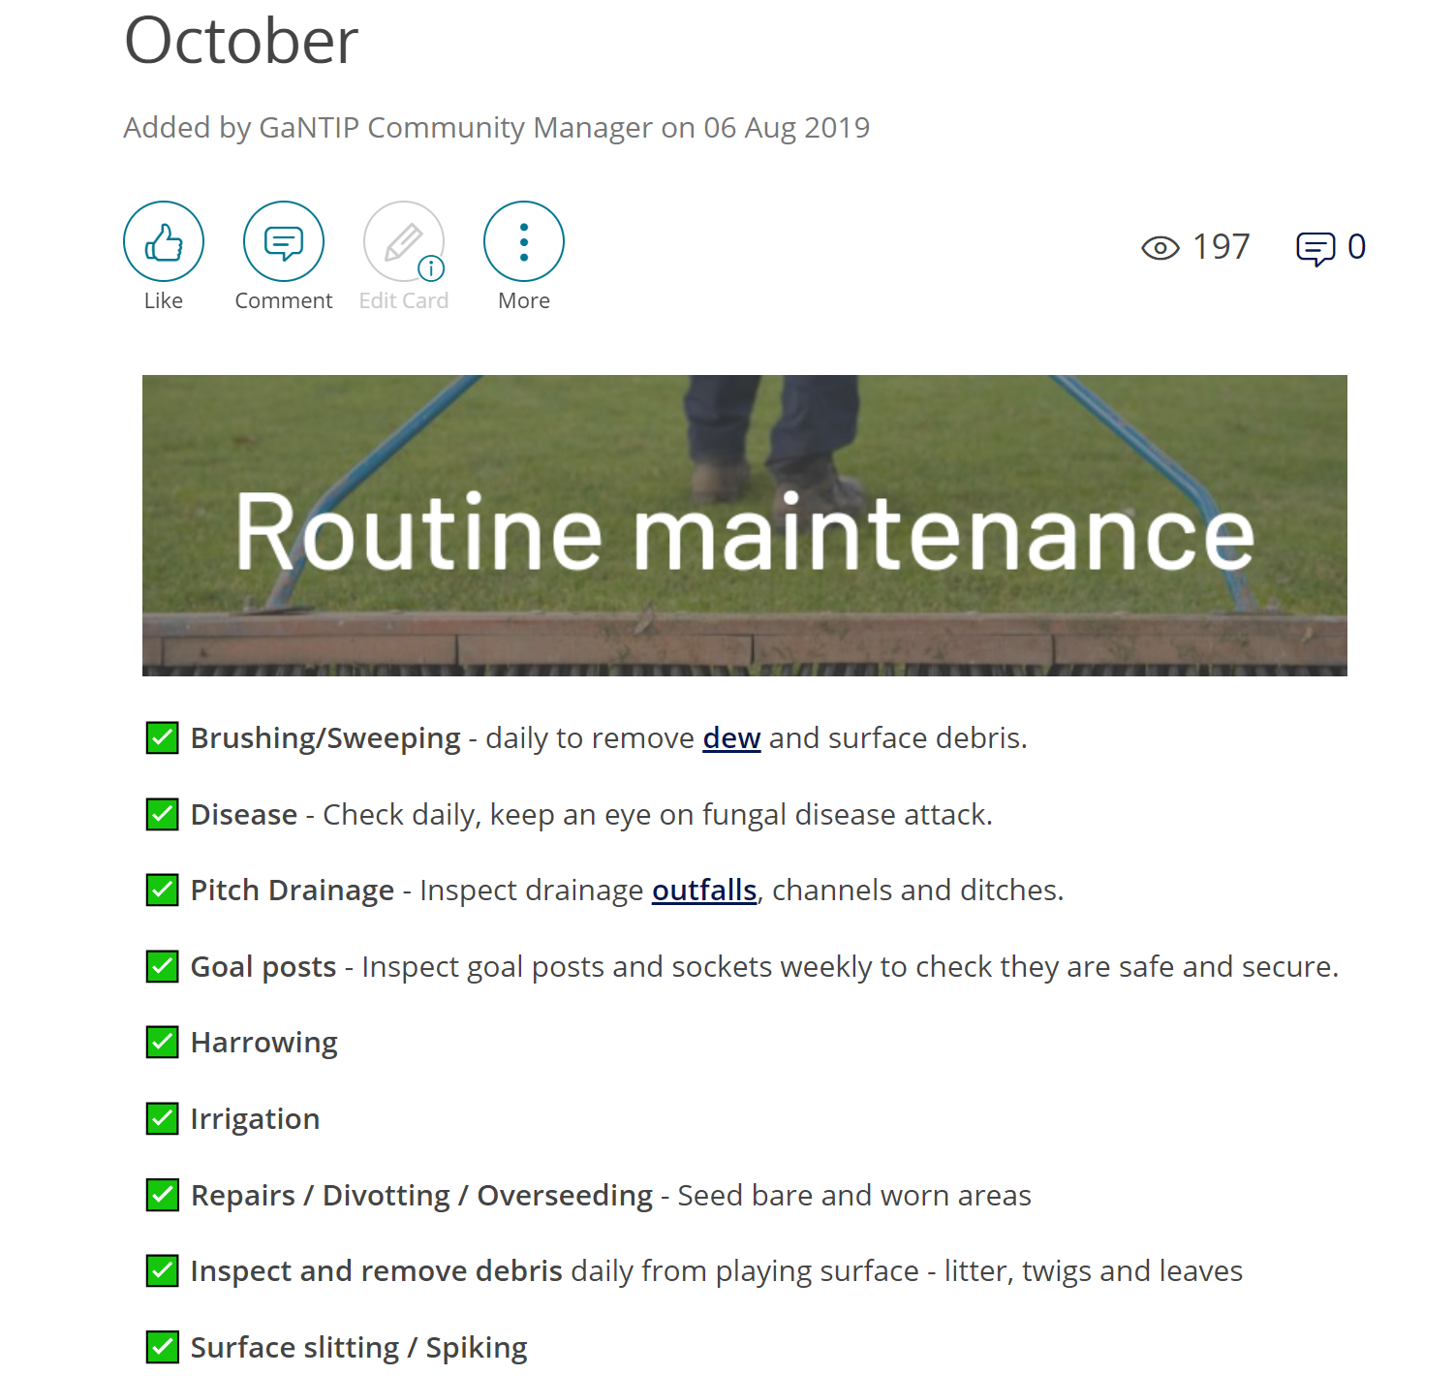
Monthly essentials
Notes:
So finally,

Slide 18
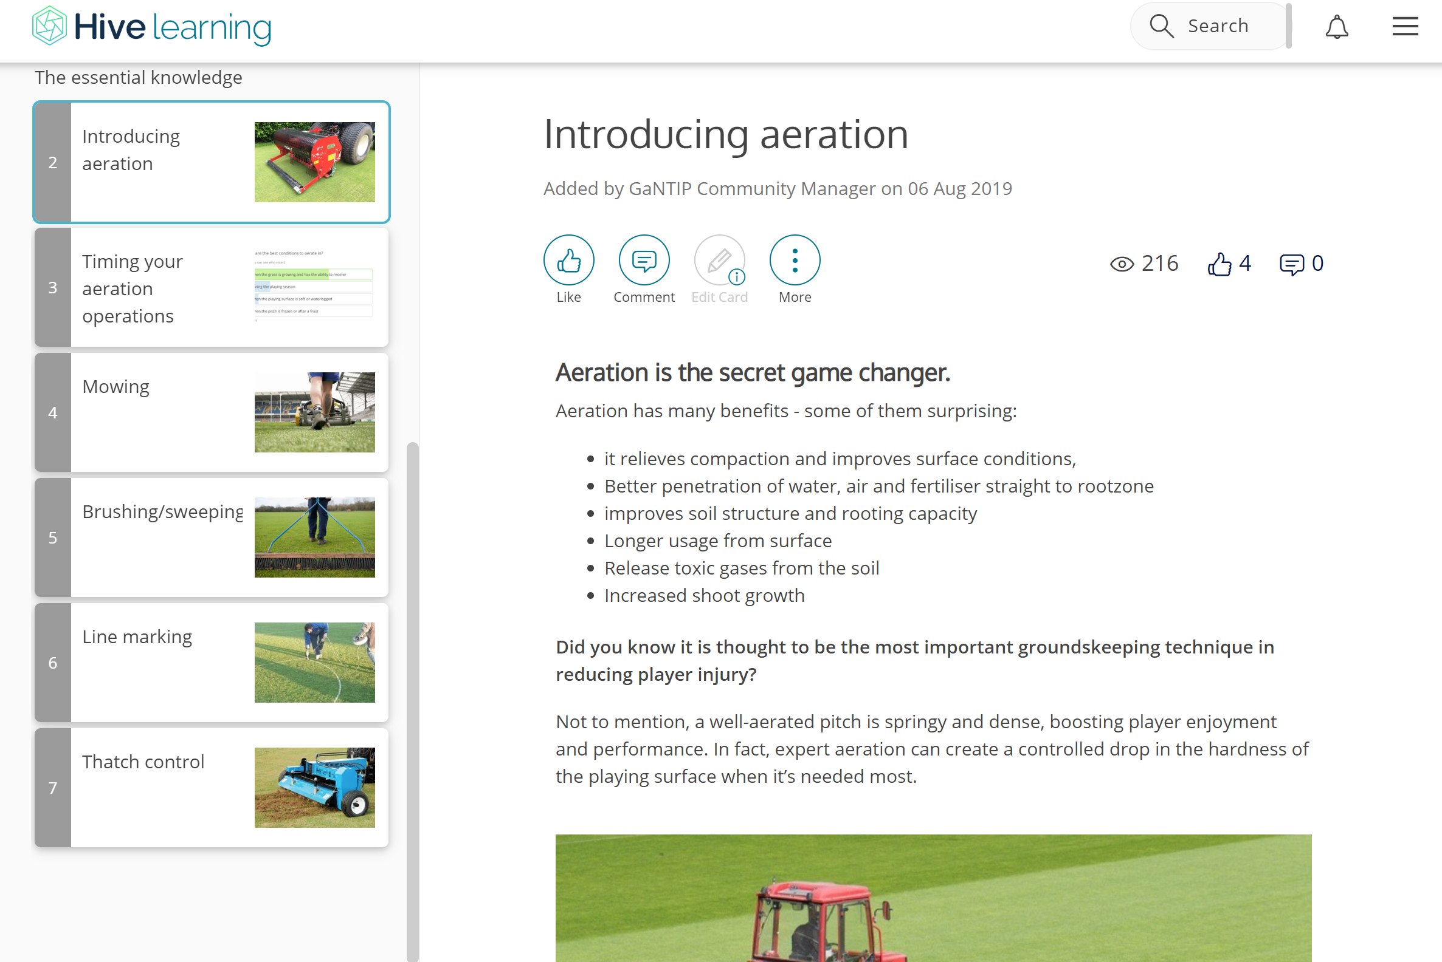
Pitch maintenance
Notes:
So finally,

Slide 19
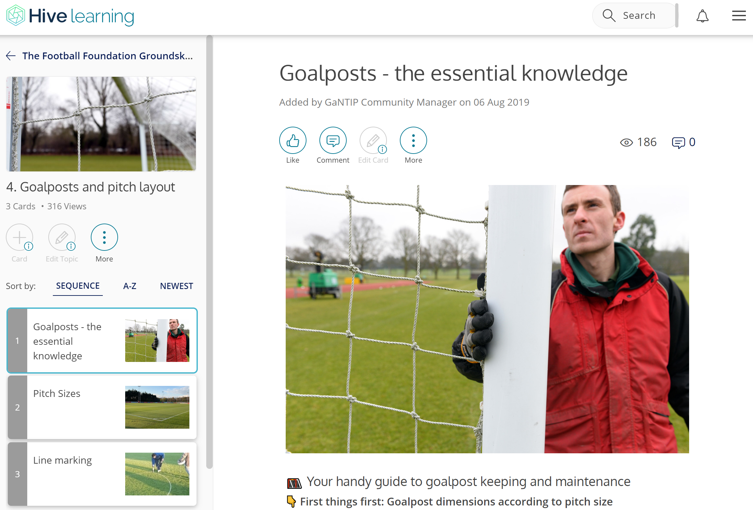
Goalposts and pitch layout
Notes:
So finally,

Slide 20
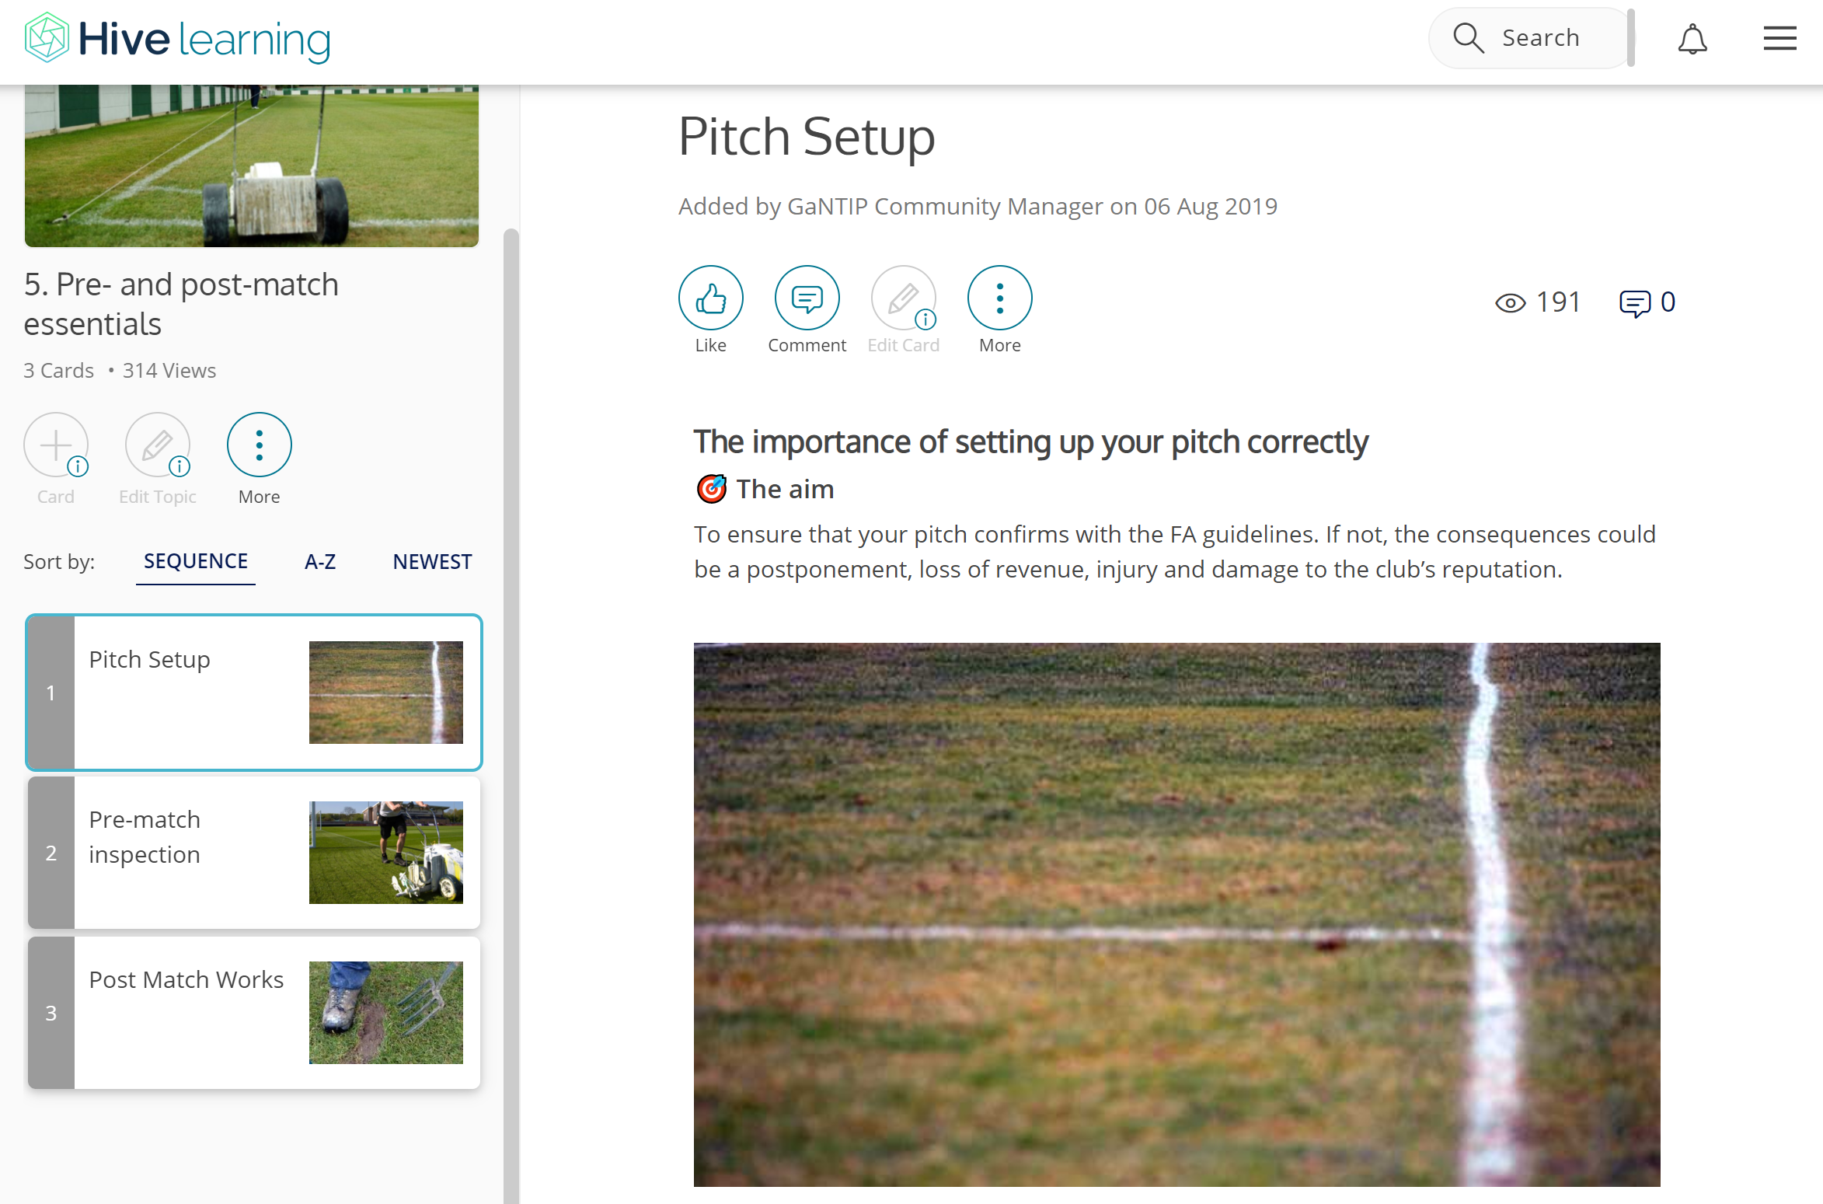
Pre and post match essentials
Notes:
So finally,

Slide 21
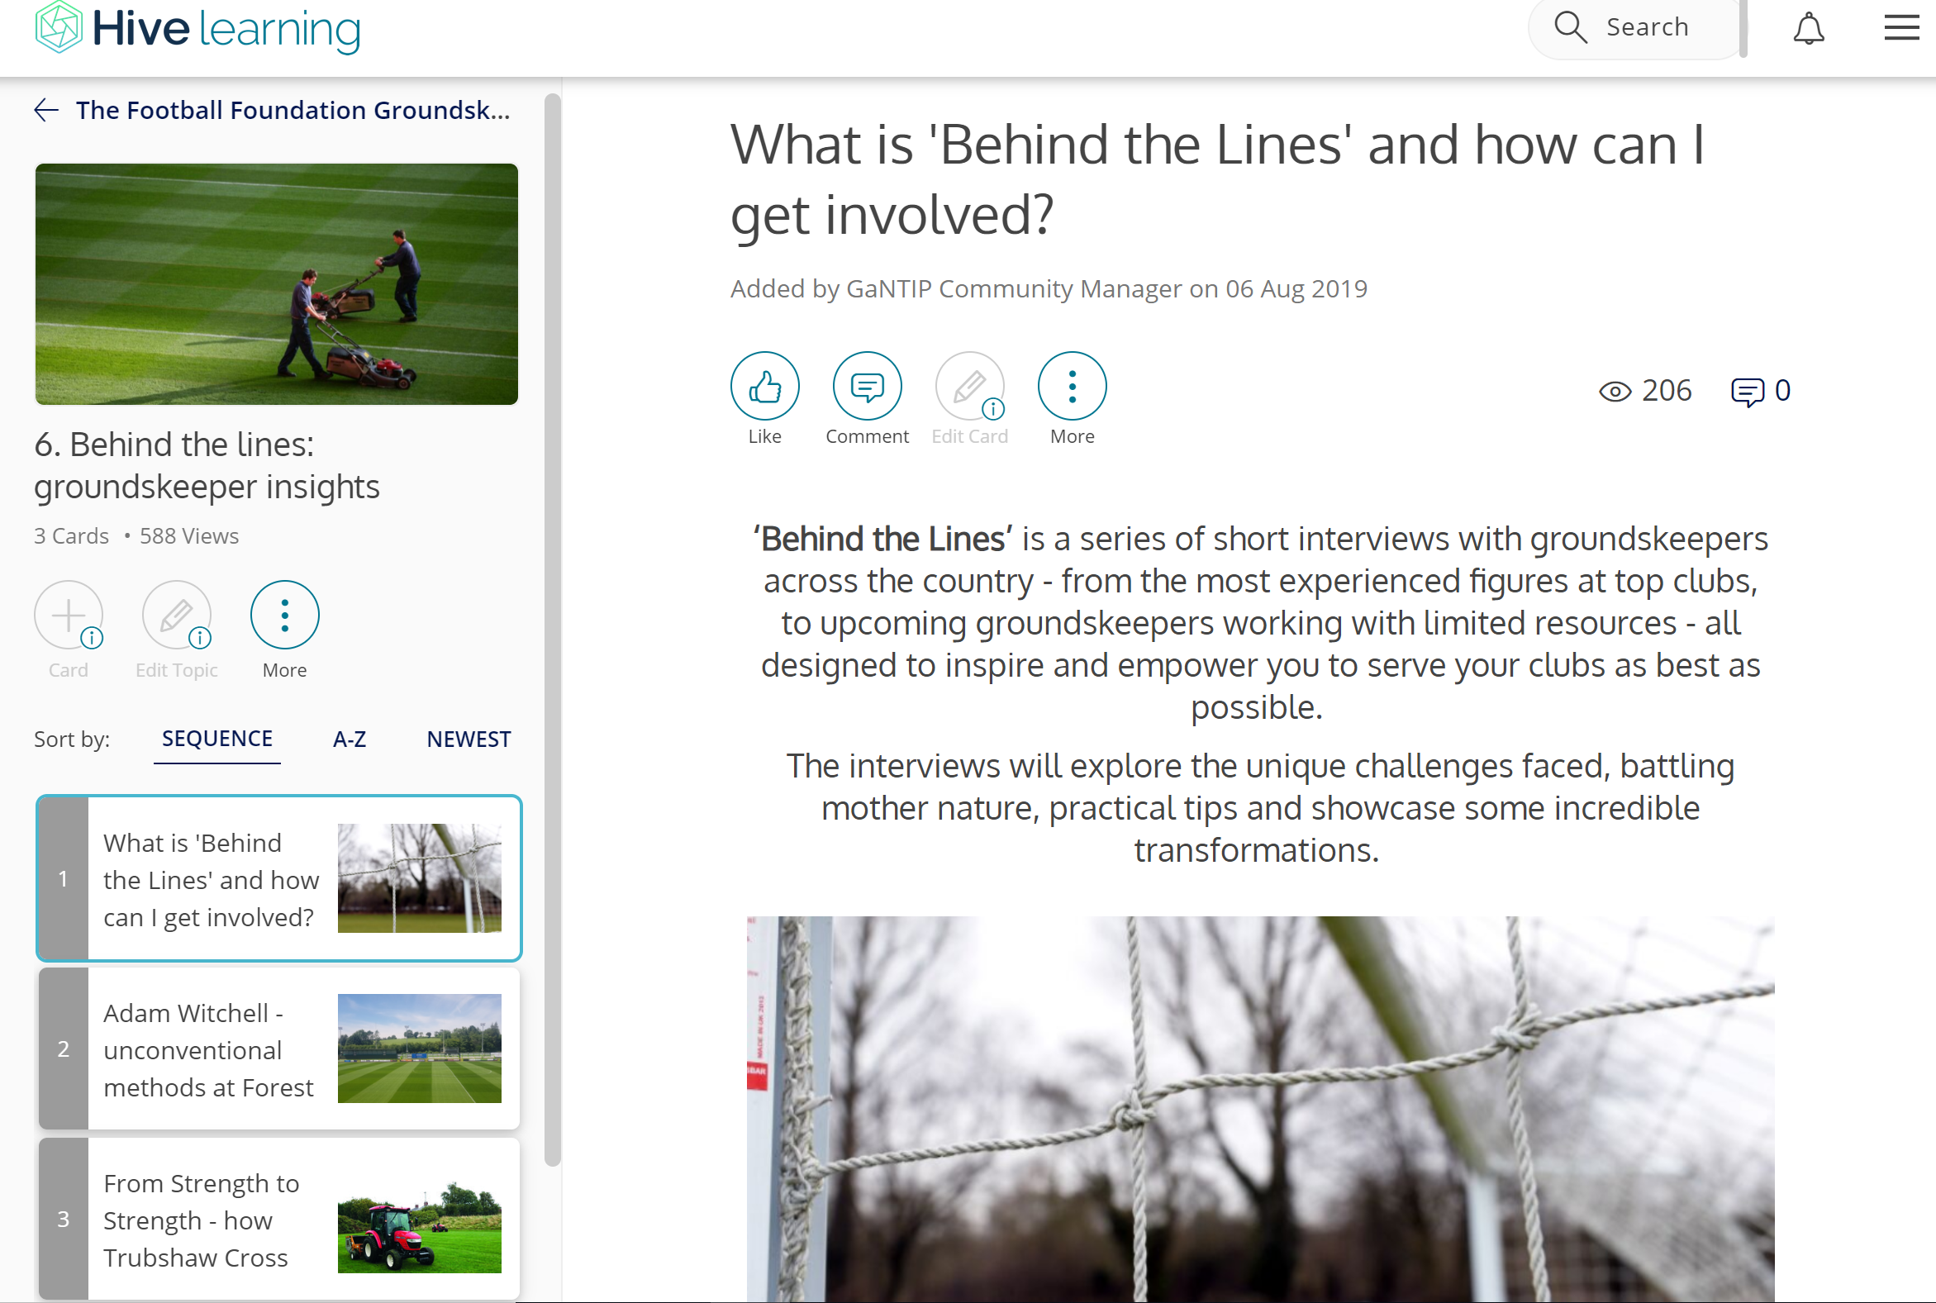
Behind the lines
Notes:
So finally,

Slide 22
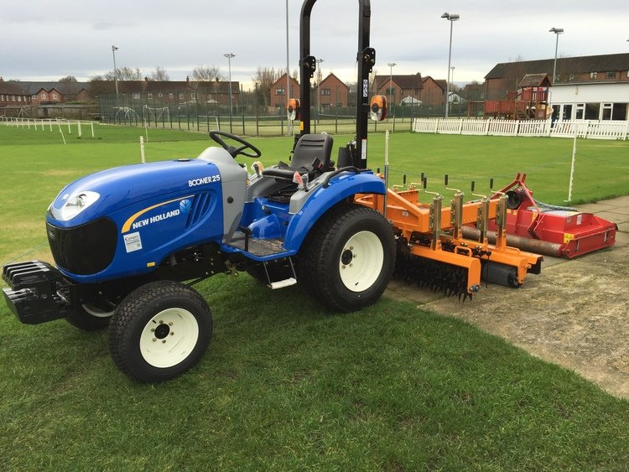
75% Funding for Machinery example…
Compact Tractor + Roller Mower + Quadraplay = £22,000*
*figure is for example purposes only
75% Funding = £16,500
25% Club contribution = £5,500
Is that potentially achievable for
grassroots football clubs?

Slide 23
Outside for Machinery Demonstrations & Discussions…
Compact Tractor + Roller Mower + Quadraplay

Slide 24

8.00pm

Slide 25

Pitch Maintenance Products suitable for Grassroots Football
Glen Howard (Technical Sales Representative, Rigby Taylor)

Slide 26
Maintaining & Managing the pitches at St. George’s Park
Scott Brooks (Head of Grounds & Estates, SGP)

Slide 27
Q&A | Open Forum
Scott Brooks (Head of Grounds & Estates, SGP)
Andy Jackson (Grounds Manager, Stoke City FC)
Kevin Duffill (Regional Pitch Advisor, IOG)
John Campey (Director, Campey Turf Care Systems)
Glen Howard (Technical Sales Representative, Rigby Taylor)
Kevin Staples (Head of Strategy & Investment, Staffs FA)

Slide 28
Closing Summary
Support is available.
The Staffordshire FA pitch improvement programme – along with events such as these and the network of partners – is hopefully creating a network of people and organisations who can support grassroots football clubs in maintaining your natural turf pitches to the best possible standard.
Thank you for your time and input this evening.
Have a safe journey home.

