Slide 1
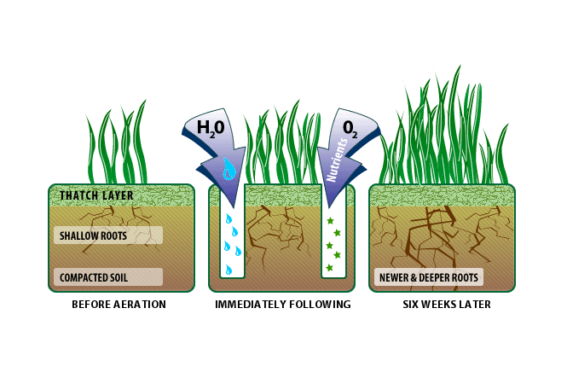
Pitch Improvement Workshop Thursday 13 March 2018, 6.30pm – 9.00pm @ Staffordshire FA

Slide 2
Workshop Itinerary
18.30 – 18.45pm Arrival Time | Tea & Coffee
18.45 – 19.00pm Welcome | Introductions | Overview
19.00 – 20.00pm Example End of Season Renovations
20.00 – 20.15pm Tea & Coffee Break| Networking
20.15 – 20.45pm End of Season Renovations – Budgets & Priorities
20.45 – 21.00pm De-brief | Q&A
21.00pm Networking | Depart

Slide 3
Staffordshire FA Pitch Advisors
Andy Jackson Kevin Duffill
Stoke City FC Grounds Manager IOG Regional Pitch Advisor
Staffordshire FA Pitch Advisor Staffordshire FA Pitch Advisor

Slide 4
Workshop Objectives
Provide an update on the Staffordshire FA Pitch Improvement Programme.
Discuss end of season renovations in more detail.
Review your own club’s budget and priorities.
Ask questions of the pitch advisors and other local groundsmen.
Makes notes to support future planning.
Network with groundsmen from other local grassroots clubs.
Ask lots of questions! Interaction is encouraged throughout.

Slide 5
Staffordshire FA Pitch Improvement Programme (PIP)
PIP numbers / impact to date:
2012 = year Staffordshire FA launched the programme
120 = number of PIP visits since then
81 = number of clubs / sites visited
207 = total number of pitches visited and impacted by the programme
83 = number of pitches visited twice or more

Slide 6
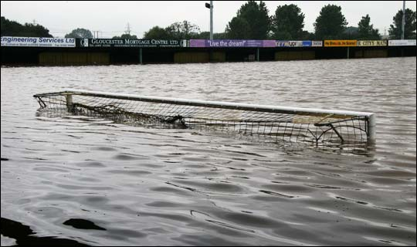
What has been your biggest challenge in recent weeks?

Slide 7
End of season renovations - example renovation (9 steps)
Application of selective weed killer
Mow grass to 15-20mm before scarification
Scarify/rake in multiple directions
Collect debris
Restore levels in priority areas
Deep aeration
Disc seed
Application of fertilizer
Allow grass to grow to 50mm, then mow to 35mm

Slide 8
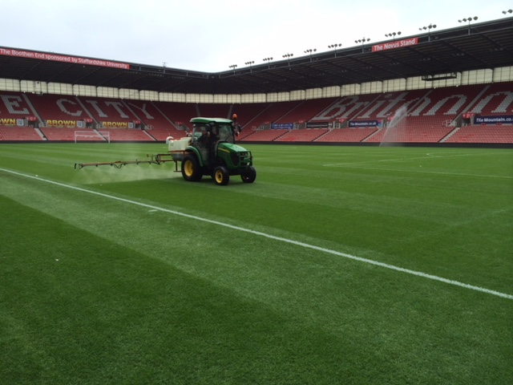
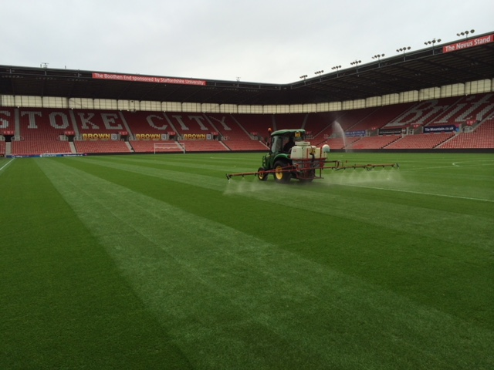
1. Application of weed killer
https://www.youtube.com/watch?v=xo-jT6hKQLQ
(example video clip taken from YouTube)

Slide 9
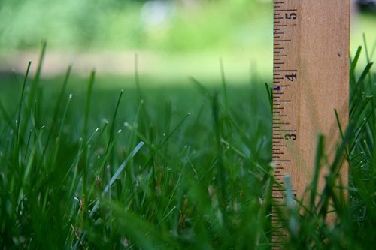
2. Mow grass to 15-20mm before scarification

Slide 10
3. Scarify in multiple directions
https://www.youtube.com/watch?v=XEhG8ROMsUA
(example video clip taken from YouTube)

Slide 11
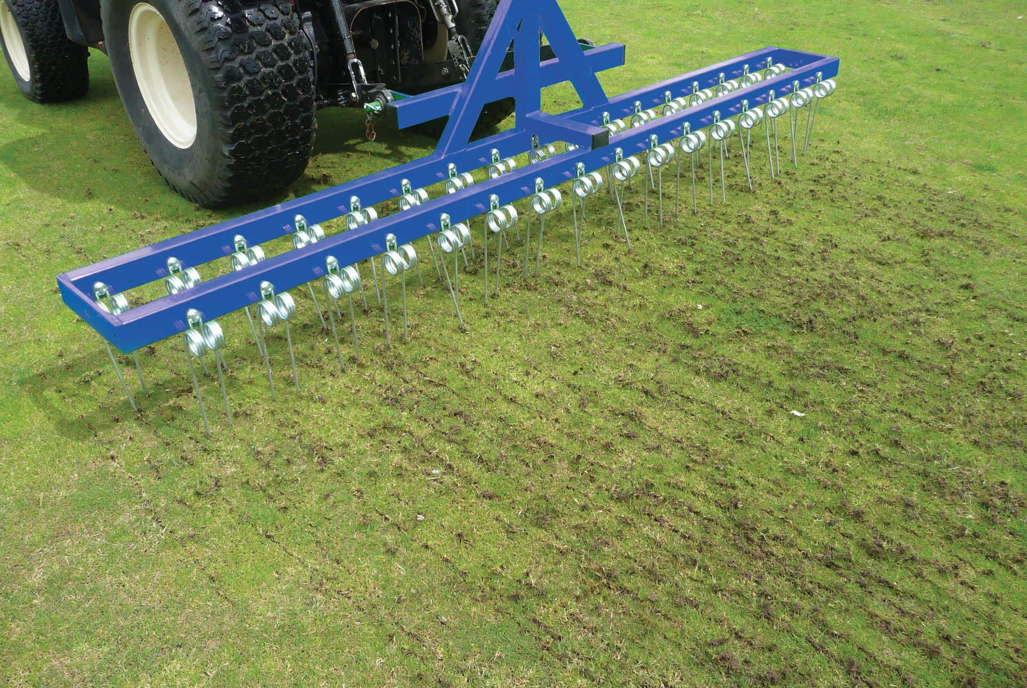
4. Collect debris
Discussion around the options available to grassroots football clubs with limited budgets to collect debris post-scarification.

Slide 12
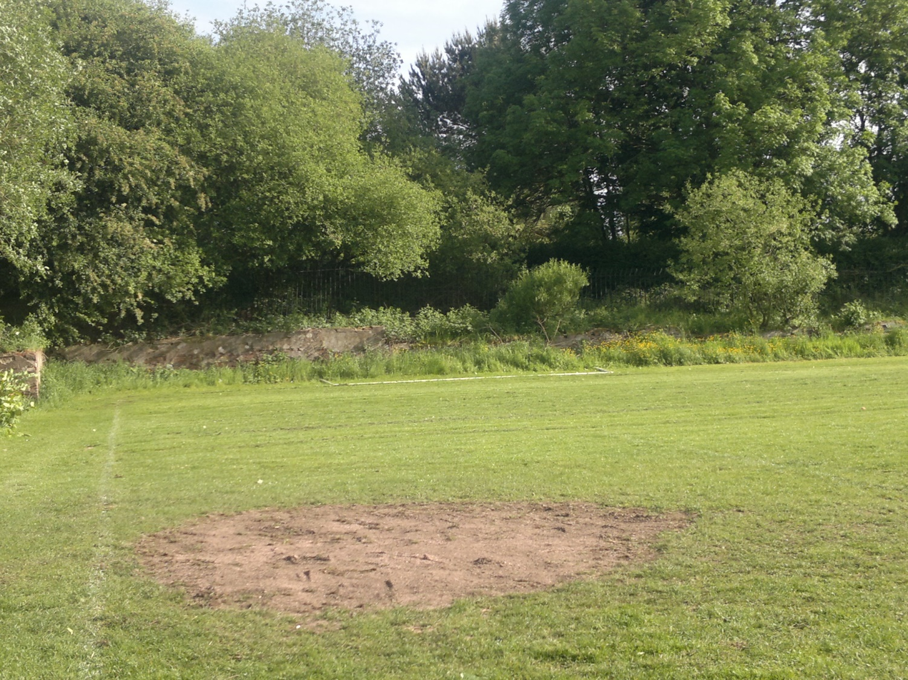
5. Restore levels in priority areas

Slide 13
6. Deep aeration (2 examples)
https://www.youtube.com/watch?v=wZaw-f0wp7U
(Shockwave)
https://www.youtube.com/watch?v=xcwCOxzEPEc
(Verti-Drain)
(example video clips taken from YouTube)

Slide 14
7. Disc seed
https://www.youtube.com/watch?v=ZvtjS7gdzXE
(example video clip taken from YouTube)

Slide 15
8. Application of fertilizer
https://youtu.be/d4mPyyq7YLs
(example video clip taken from YouTube)

Slide 16
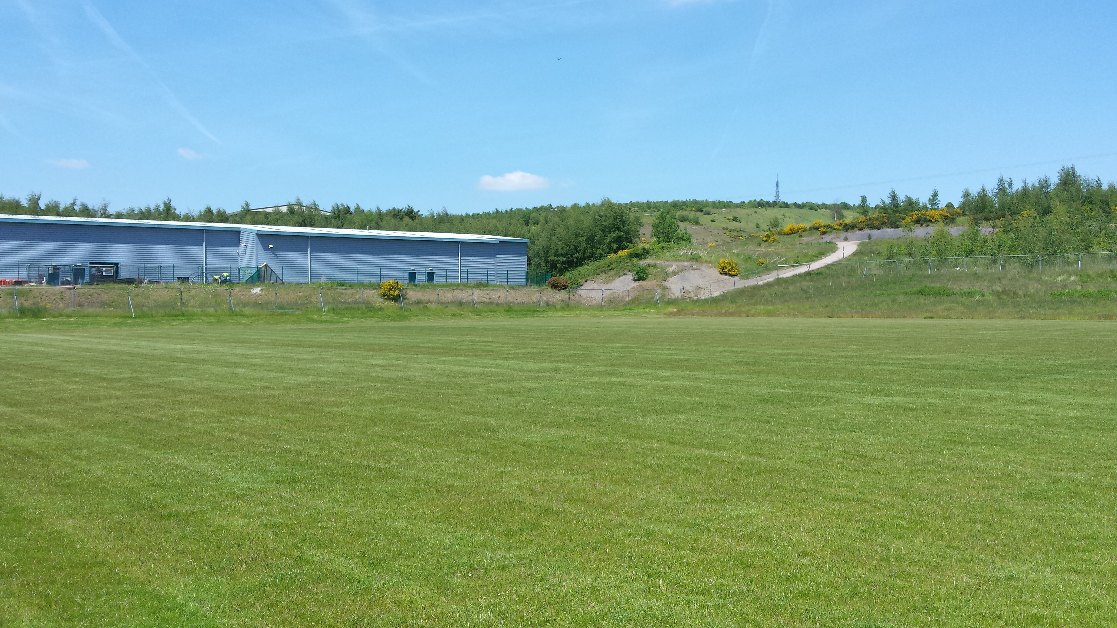
9. Allow grass to grow to 50mm, then mow to 35mm

Slide 17
8.00pm – 8.15pm

Slide 18
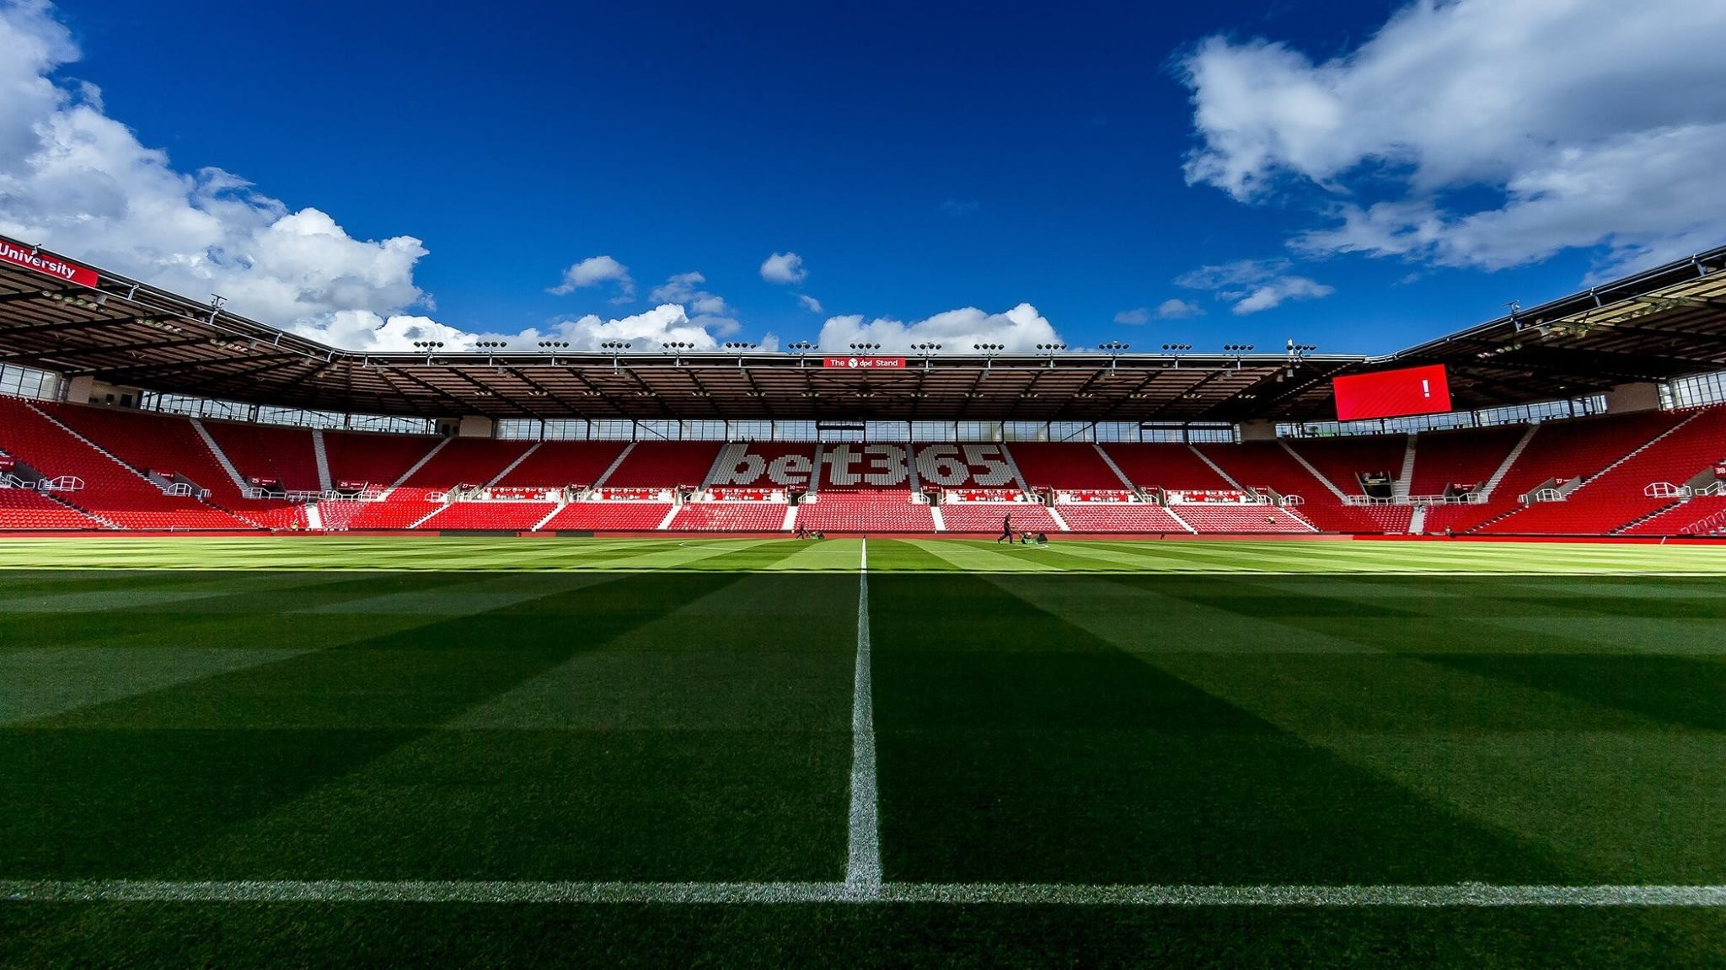
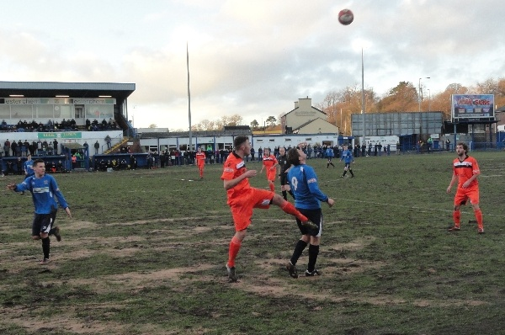
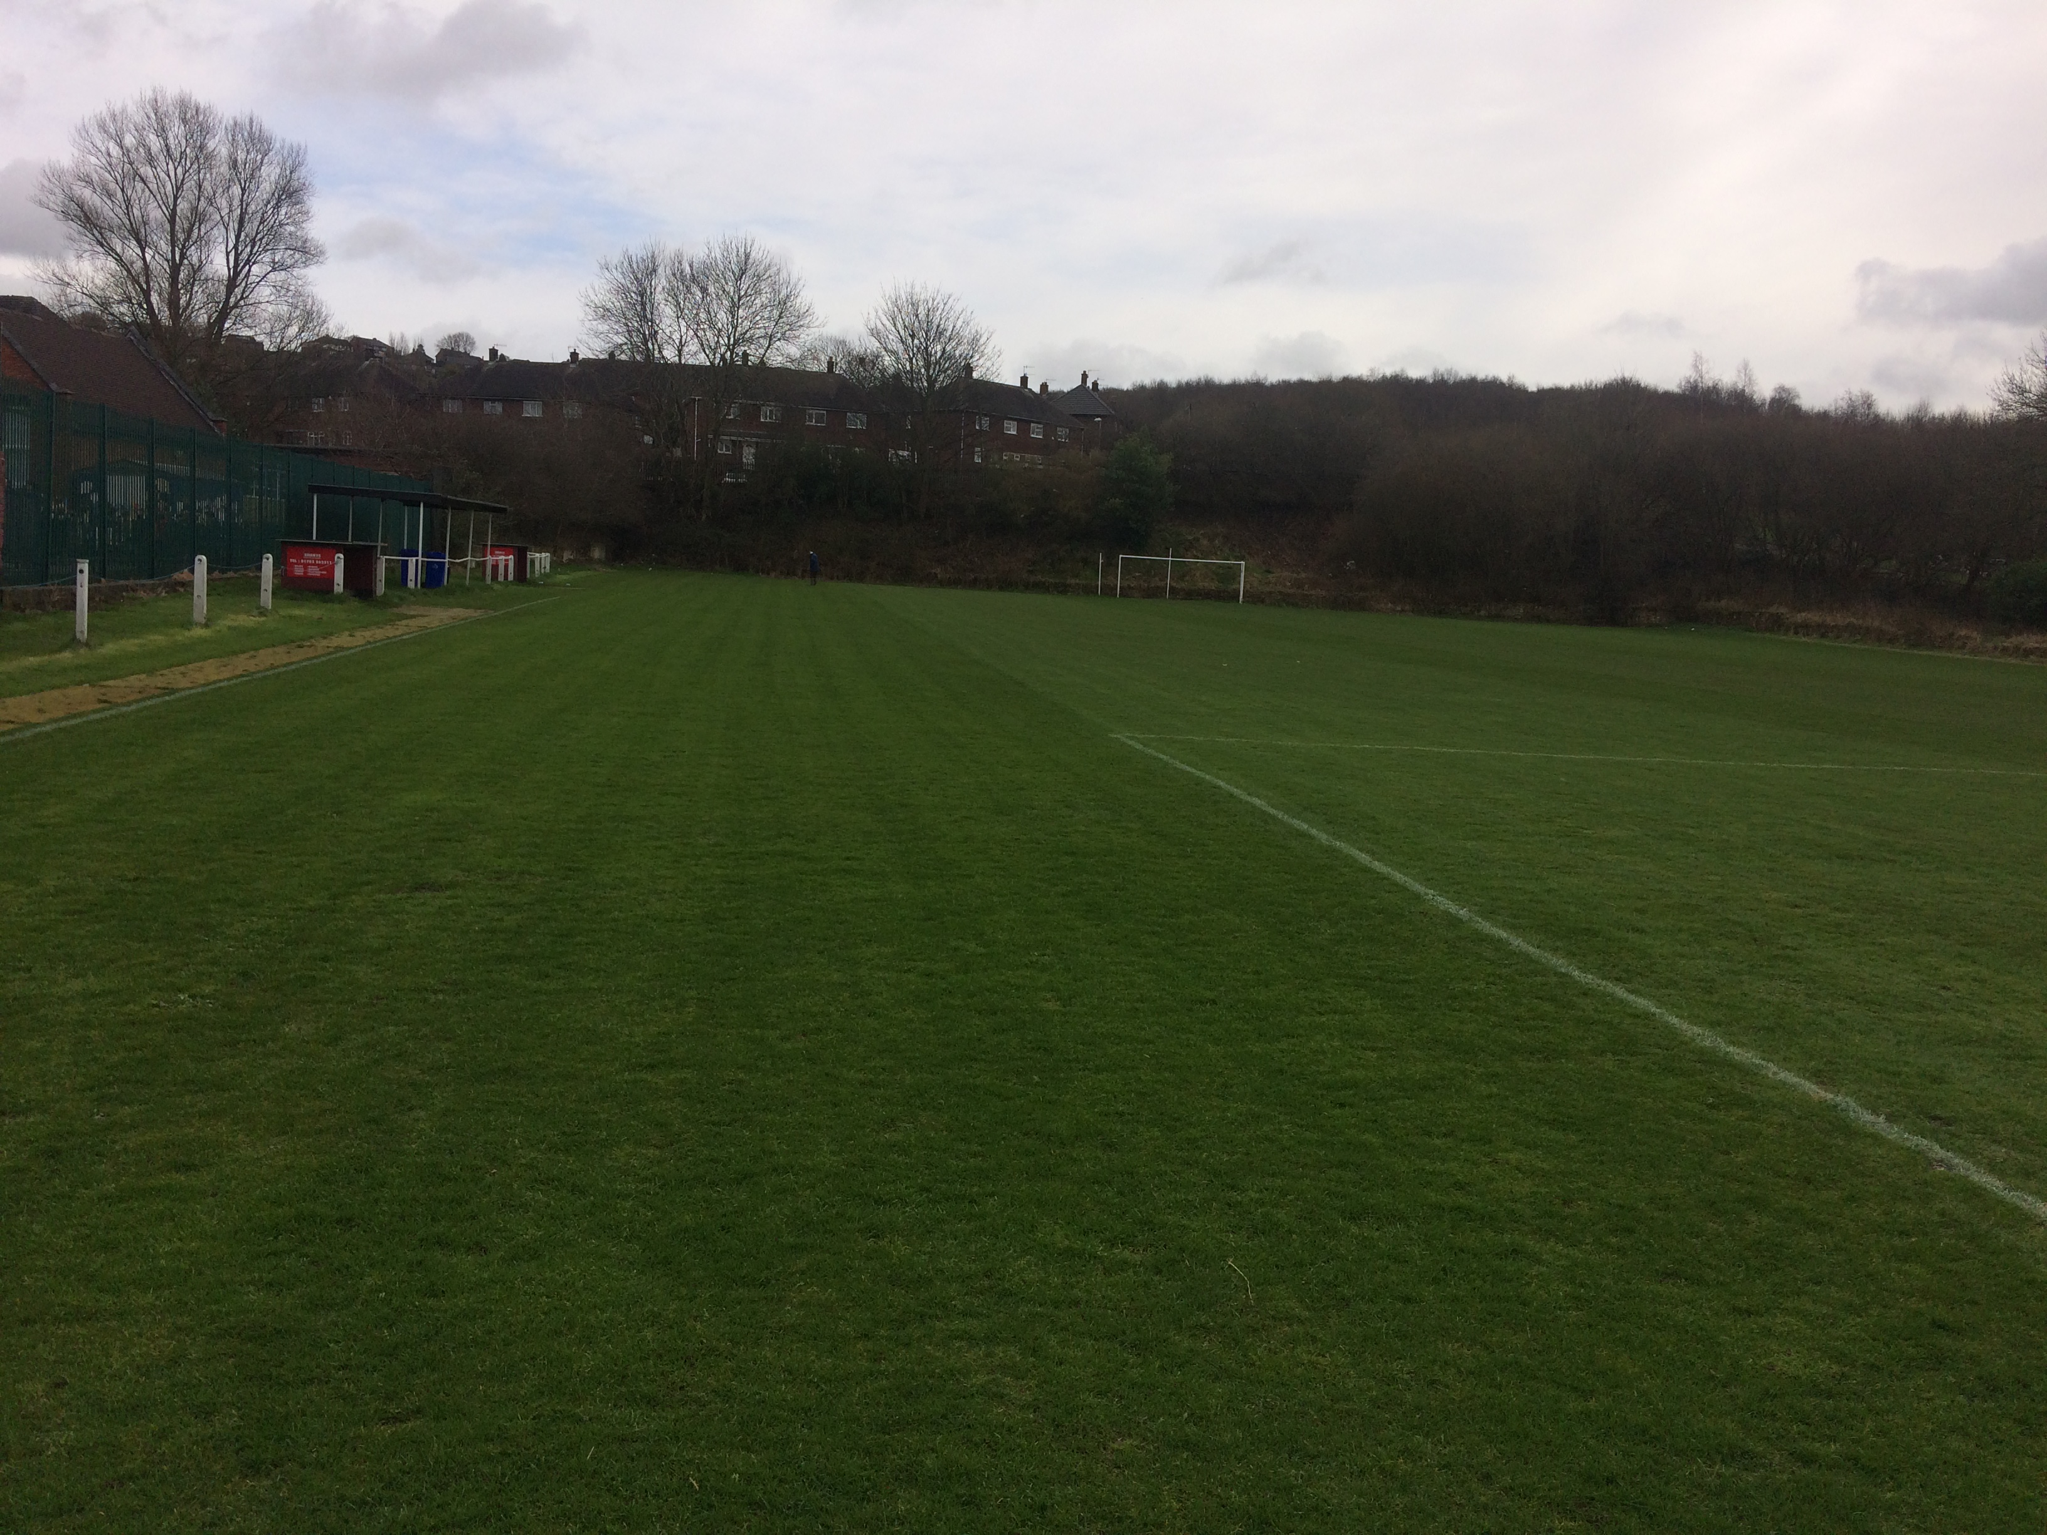
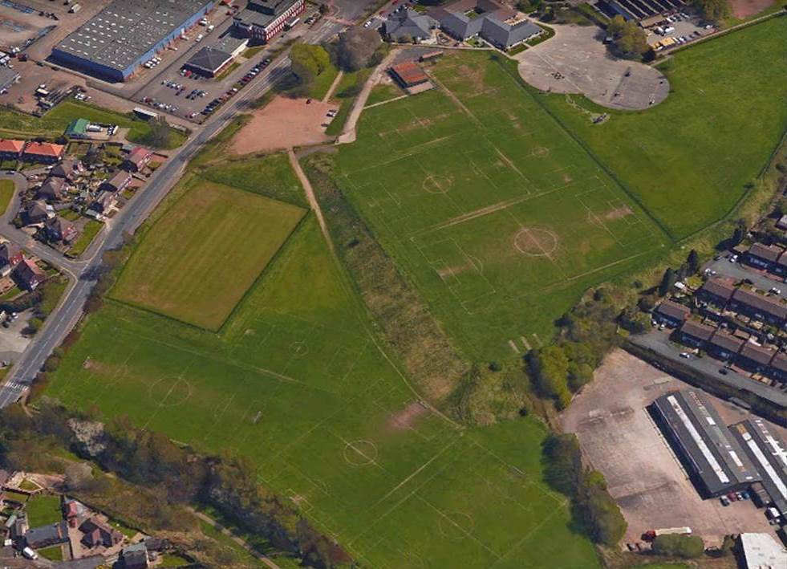
End of season renovations - budgets & priorities

Slide 19
Ongoing pitch maintenance - summary document * priority order will differ from club to club

Slide 20
Pitch maintenance - summary document
Guidance – simple document to support clubs and groundsmen with the planning of pitch maintenance items throughout the season.
Budgets – not all of the items will be achievable – individual budgets will dictate what is and isn’t possible.
Prioritising – which items are going to have the biggest impact to your pitch – based on the budget and resources available to you?
Recommendations – the pitch advisor’s report & recommendations can support you with this process.

Slide 21
De-brief / Q&A
Andy Jackson Kevin Duffill
Stoke City FC Grounds Manager IOG Regional Pitch Advisor
Staffordshire FA Pitch Advisor Staffordshire FA Pitch Advisor

Slide 22
Closing Summary
Support is available.
The Staffordshire FA Pitch Improvement Programme – along with events such as these and the network of partners – will hopefully result in creating a network of people and organisations who can support grassroots football clubs in maintaining their natural turf pitches to the best possible standard.
Thank you for your time and input this evening.
Have a safe journey home

