Slide 1
CLUB’S NAME GOES HERE
YYYY - YYYY

Slide 2
ADD CLUB’S NAME HERE
The Leagues and Clubs YouTube Hub.

Slide 3
Use this planner to set goals and tasks you need to complete. These may focus on tasks to form the club identity, create a successful structure, ensure you have the right people in the right roles, develop effective financial planning, and to identify and secure the required facilities for your club.
Top Tips: Visit our England Football League and Club Hub on YouTube for helpful ideas and insights.
Visit our England Football Learning website for ideas to help you develop your football philosophy.
Also, take a look at our Club Structures Guide created in partnership with Muckle LLP.

Slide 10
CLUB STRUCTURE
CHAIRPERSON
Add Name Here
TREASURER
SECRETARY
WELFARE OFFICER
Add Name Here
Add Name Here
Add Name Here
INSERT CLUB ROLE
INSERT CLUB ROLE
INSERT CLUB ROLE
Add Name Here
Add Name Here
Add Name Here

Slide 15
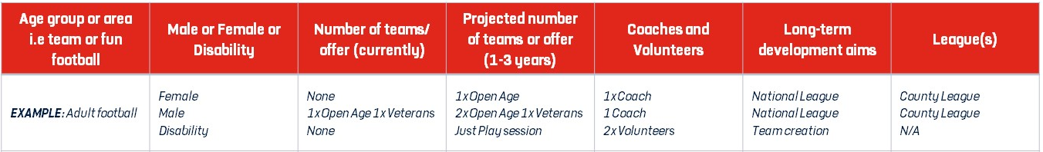

Slide 16
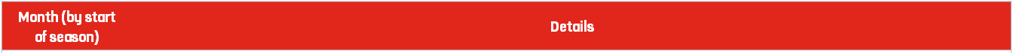
ADD IN SEASON HERE
September
October
November
December
January
February
March
April
May

Slide 18
Total Projected Income
Total Projected Expenditure
Annual Balance

Slide 19
Annual Accounts Sheet | Cost (£)
Club
Year
Income |  | Expenditure
Sponsorship |  | Affiliation
Subs |  | Pitch Hire
Donations |  | Training Hire
Grants |  | Referee Fees
Trips |  | Washing
 |  | Fines
Total Income |  | Total Expenditure
Opening Balance
+ Surplus / Deficit
Total / Closing Balance

Slide 20
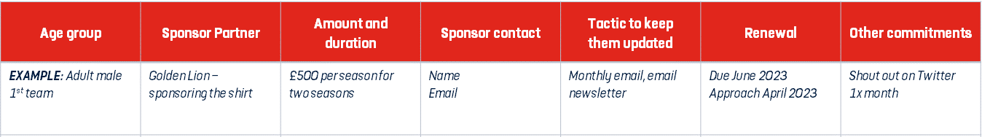

Slide 22
Club contact details
Club Name
Club Address |  | Postcode
Telephone
Access routes
For Ambulance
From Pitch to Ambulance
First Aider / Helper Information
Name |  | Mobile number
For queries about this EAP
See relevant coach for First Aider on day of match
Other Information
Nearest A&E / Trauma Hospital
Fastest Route to A&E / Trauma Hospital
Distance and Journey time
Nearest Walk-in Centre
Alternative Trauma Hospital
First Aid Equipment and Facilities
Item | Location
Defibrillator
Stretcher
First Aid Room

Slide 23
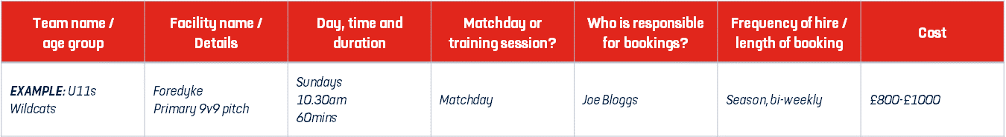

Slide 27
England Football Resources
England Football – Leagues & Clubs
England Football Accreditation
Club Learning Opportunities
YouTube - The League and Club Hub
England Football Learning
Club Resources
Club Structures Guide
Contact details for County FAs
Other Grassroots Support
Football Foundation
Football Foundation – Local Plans
Sport England
Sport England – Funding

