Slide 1
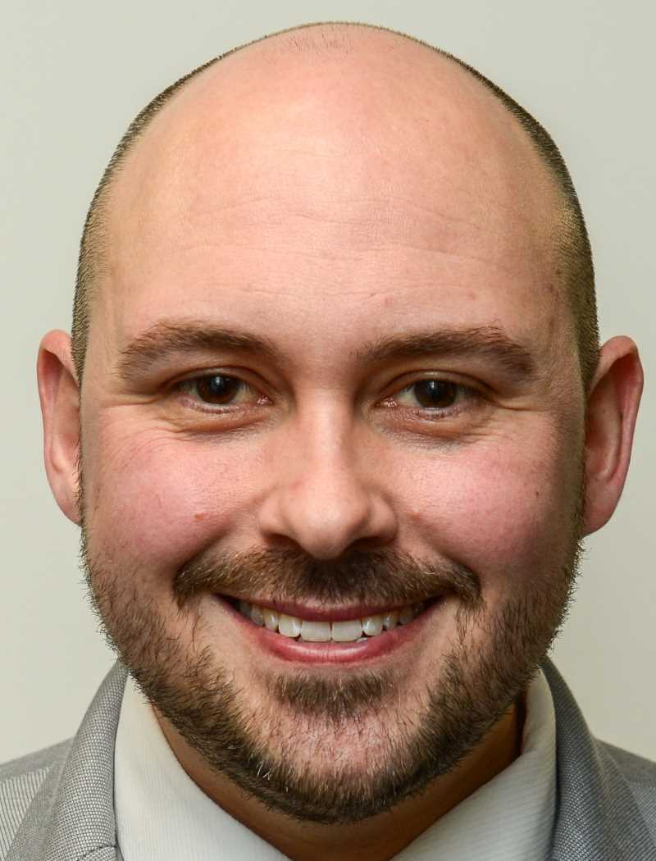
Introduction
Steve Swinyard Experience:
Newcastle United Football Club - Head of Safeguarding & Welfare (7 years in post)
- Board Member at NFA (Safeguarding Lead)
- Former Safeguarding tutor for NFA & Newcastle City Council - Lead investigator and discipline office in several safeguarding cases including high profile cases
- Member of the PL SAG group
Qualifications:
- FA Safeguarding Children Workshop
- FA Welfare Officer Workshop
- Newcastle City Council Safeguarding Children Level 3
- ACAS trained in leading investigations
- 15 years football experience
- Coach, Football Development Officer, Safeguarding Professional

Slide 2
Session Aims…
To support Welfare Officers to be able to lead competent safeguarding investigations…
Key focus points:
Appropriate investigations
Effective investigations
Supporting correct outcomes
Why?
Feedback from CWO’s
Evidence of poor investigations resulting in poor outcomes
Evidence of skill variance across the game
FA Safeguarding Policy requirements places an expectation on CWO’s but does little to support any upskill required.

Slide 3
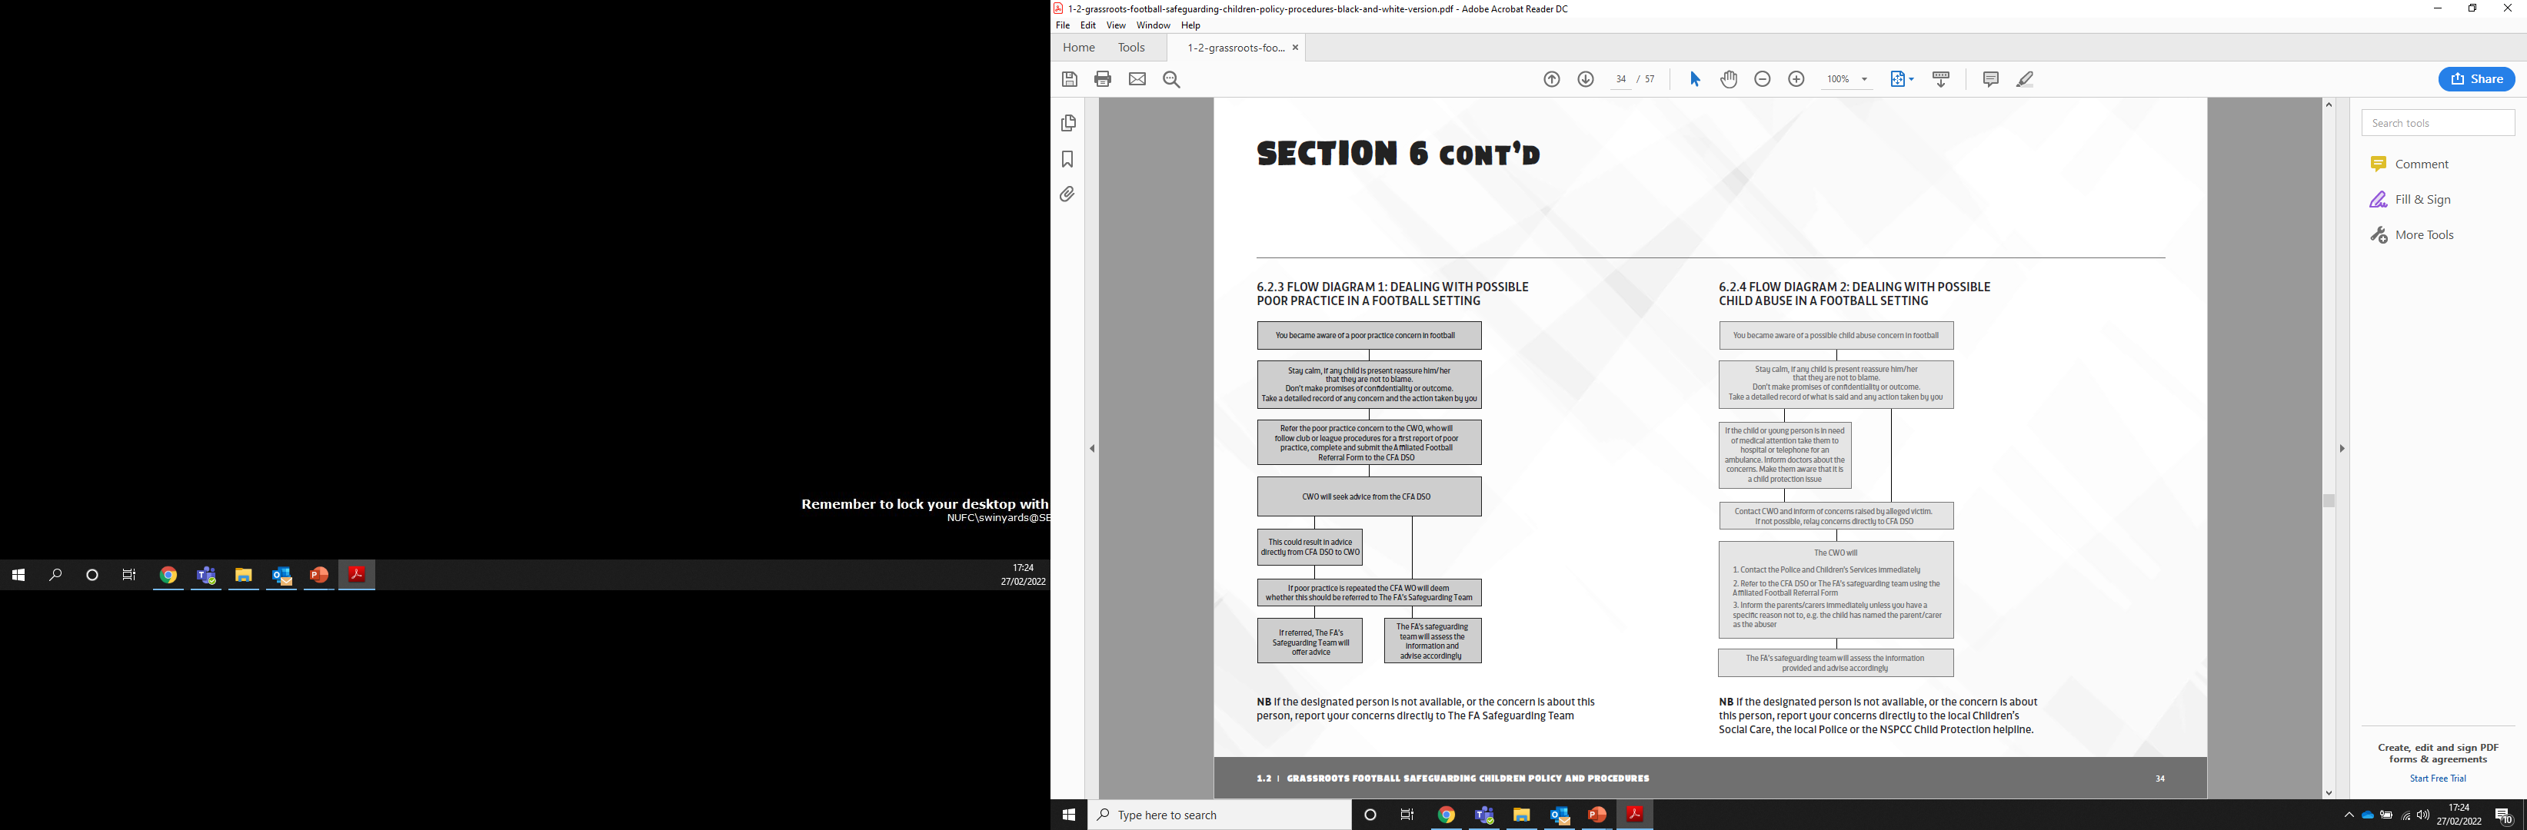
FA Policy

Slide 4
County Procedure
Notes
Identification of the correct course of action is dependent on a good knowledge of the issues involved.
e.g Poor Practice v Abuse
NFA will provide a Triage service to support CWO’s. This supports FA expectations and provide assurance to the League. This service follows simply guidance.. something happens, CWO contacts CFA DSO and CFA DSO provides advice.
NFA will record open cases and support with process.
Dual reporting may be required where offences are breach of league rules – NFA happy to advice on this as part of triage.
It is assumed any outcome will follow clear proceudres
Issue arises
NFA Triage
Safeguarding
Discipline
Abuse
Poor Practice
Match Related
Non-match related
Referral to 3rd party
FA
Police
CSC
Club investigate
Referral to County
Club investigate
Outcomes and relevant appeal/review processes, where appropriate

Slide 5
Appropriate Investigations…
Q: What is an appropriate investigation?
T: Using breakout rooms, discuss this for 5 minutes and feedback.

Slide 6
Appropriate Investigations…
Appropriateness might be considered in terms of undertaking an investigation in the correct manner/way.
Another way to think about it is for the investigation to be considered ethically or morally correct.
Key points to note:
Take time to plan the process
Is there a precedent you can consider – i.e. have the club investigated things before and might they be useful to guide you or lesson learnt?
Will the appropriateness of your investigation stand up to challenge? This is likely to be the first thing to be challenged by an appeal.
Investigation
Fair
Consistent
Transparent
Balanced
Confidentiality
Anonymity
Consent
Relevant components
Auditable
Timely

Slide 7
Effective Investigations…
Q: What is an effective investigation?
T: Using breakout rooms, discuss this for 5 minutes and feedback.

Slide 8

Effective Investigations…
Effective investigations are able to deliver all the potential outcomes they need to.
Fundamental to this is the concept of ‘Standards of Proof’, which considers the test that will be applied when deciding the outcome of any issue arising.
Generally, there are 2 widely accepted standards of proof.
Balance of probabilities
Beyond all reasonable doubt
‘Balance of probabilities’
A court is satisfied that an event occurred if, on the consideration of evidence, the occurrence of the event was more likely than not
‘Beyond all reasonable doubt’
On consideration of evidence a court is as certain as possible, under any given circumstances, that an event has occurred

Slide 9
Effective Investigations…
Relevance…
Both are legal tests but are applied differently. ‘Beyond all reasonable doubt’ is the standard of proof required for common law criminal convictions. ‘Balance of probabilities’ is used more commonly in civil law cases.
As a result of it’s use in civil law cases, and specifically employment law, ‘balance of probabilities’ is the standard of proof applied in across wider settings such as football.
All FA and NFA procedures will apply ‘balance of probabilities’ when making safeguarding and discipline decisions or hearing appeals/reviews.
NFA advice clubs to adopt the same standard of proof to any decision making that falls with the club so to ensure the appropriateness of the outcome is upheld.
As a result, whilst there is no pressure to find information that proves beyond doubt, your investigation does need to be broad enough that a ‘probability decision can be made’
Consider what a probability decision is…

Slide 10
Supporting Correct Outcomes…
Having an understanding of the correct outcomes is also an important consideration for any investigation.
It is important to know that the investigation will be used correctly. Club’s must be prepared to sanction correctly if an investigation finds reason to.
A good investigation will protect you personally from criticism in the event the Club sanctions inappropriately.
Any sanctioning process should be appropriate and effective, in the same way investigations should be. The framework included later will support Club’s with this.
Words of advice
Education
Warning
Suspension
Removal/Dismissal

Slide 11
Achieving Success…
Framework to follow:
Structure
Application
Presentation

Slide 12
Structure
Identify Key Personnel
  Alleged offender
  Witnesses
  Investigator(s)
  Discipline Officer/Decision maker
  Appeals/review officer
  Outline Roles & Responsibilities
    Who will undertake the interviews – who will keep notes?
    Who will be interviewed? How will you ensure consistency?
    How will information be recorded and verified as accurate?
Logistics
  How will information be gathered? Online v in person
  How many interviews (potentially?)
  Appeals/review officer
  Are there any additional needs to consider?
  Plan for the unexpected
    Are you prepared to be challenged? Do you know which policies apply and what people’s rights are – what might they challenge you about?
    Are you flexible enough/prepared for your investigation to go in another direction? Might the parameters change?
    Are there any other potential curve ball’s you can plan for?

Slide 13

Appropriate, effective and supports outcomes…
Structure
    This approach helps to ensure:
    Consistency and fairness in approach
    Transparency and credibility through a layered approach to process
    Relevant components are targeted correctly
    Conflicts of interest or bias are identified and avoided from the outset
    The size of the job at hand is scoped and remains realistic
    Curve balls are avoided as far as possible – after all you only know what you know
    Things run smoothly in the application phase

Slide 14
Application
Interview techniques
  Open v closed questions
  Consistency in approach – set questions as a basic framework then be information led
  Think about tone and delivery. If it is serious to the Club it should feel serious to those involved.
  Administration
    What format will notes be in? Verbatim v summarised account…
    How will you ensure consistency in all administration – are there templates to follow?
    How will notes be verified? Will you ask people to sign them as accurate?
    What happens with them afterwards?
Wider Communication
  What other communication might be needed – e.g. Informing people of their rights at the start of interviews? Wider policy considerations that apply being communicated at the start of interviews etc.
  Any communication needs to consider?
  Support
    What impact will the process have on all those involved? How are the club supporting them?
    How are you getting support?
    Will the Club need wider support? Either now or in the future (post decision)
    Child centred focus – ultimately are children being affected and how can the Club stop that?

Slide 15
Appropriate, effective and supports outcomes…
Application
    This approach helps to ensure:
    The investigation runs smoothly
    Issues around confidentiality, anonymity and consent are dealt with early.
    The investigation gets the respect it deserves
    The impact of the investigation on those involved is managed and potentially credit received if done well
    Wider fall out for the Club etc is limited/planned for.

Slide 16
Presentation
Findings & recommendations
  Present findings and recommendations not decisions. What has the information told you not whether you think someone is guilty?
  Be balanced in your findings & recommendations.
  Remember the standard of proof.
  Report Writing
    Try to be concise yet thorough and detailed.
    Always give wider context and scope. Frame the report - Why did you investigate, what did you do & ultimately what did you find?
    Try to support findings with evidence – reference interviews etc.
    Remember your recommendation is whether the discipline officer needs to hear the case.
Language
  Be careful about the language used. Try to avoid personal opinion or judgement where you can, other than in your recommendations.
  Be concise and use plain English.
  Are there any other needs to consider? ENFL?
  Fall-out and further considerations
    Is the Club prepared for the fall-out?
    GDPR – data retention to be considered. Security? Where stored etc?
    Have any 3rd party thresholds been reached as a result of the investigation (or mid-investigation)
    Will the Club need wider support? Either now or in the future (post decision)

Slide 17
Appropriate, effective and supports outcomes…
Presentation
    This approach helps to ensure:
    Auditable and defensible
    Consistency for future investigations.
    Tangible evidence to support a disciplinary procedure is available.
    A fair sanctioning process. Standard of proof test remains central ‘test’ around which outcomes are made,
    The Club is supported at any appeal/review
    Any 3rd party involvement is supported
    Wider fall out for the Club etc is limited/planned for.

Slide 18

Take away messages…
    Understanding the County procedure for reporting incidents is key. First port of call is NFA triage. Abuse v Poor Practice?
    If advised to undertake an internal investigation, apply the framework to help you plan the process.
    Ensure roles and responsibilities are shared out appropriately. Shared the burden as well as making the process more credible
    Your job as an investigator is to gather information in relation to what may or may not have happened. Findings will be tested against the ‘balance of probabilities’ meaning your investigation must support such decisions to be made.
    Do the best you can on the resources you have, including time. You are volunteers giving valuable time to keeping children safe. A key judgment of investigations is proportionality, amongst other things!

