Slide 1
Benefits of Futsal for Football:
Developing a Winter Training Programme
Bruce Vause & Alan Evans

Slide 2
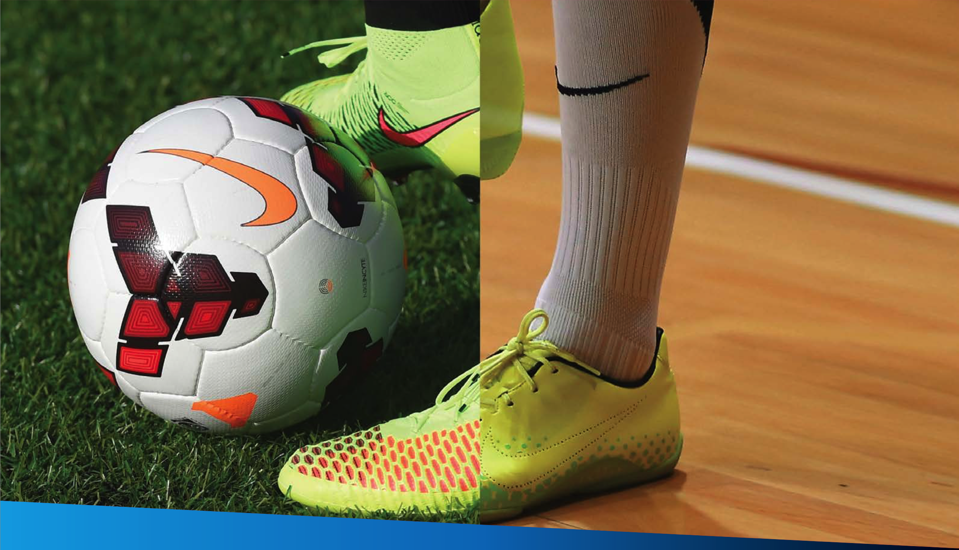
Benefits of Futsal for Football:
Developing a Winter Training Programme
(Alan Evans & Bruce Vause)
The Football Association

Slide 3
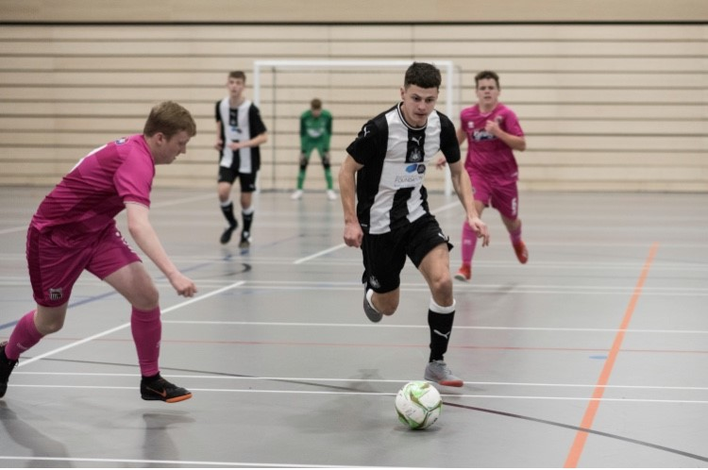
What are we going to do ?
The Football Association
Explore benefits of training indoors
Understand the benefits of playing futsal
Identify the Non-Negotiables of futsal
See simple practical ideas to use with players

Slide 4
The Football Association
Why train indoors?
Creating the environment
No rain, no wind, no freezing conditions (Players/Parents/Coaches).
Increase contact time with players (Training/Games not called off).
Improve planning: ability to plan for the season.
Improve player engagement and motivation.
Enhanced learning experience: discuss, share and reflect on ideas in small groups.
Opportunity for grassroots football coaches to give young players the opportunities to play futsal.
Ultimately create an environment which is conducive to learning and not merely an easy/comfortable training environment.
Notes:
1- Improve conditions.
2- No lost training time, Maintain momentum.
3- No need to adapt at the last minute due to weather conditions.
4- Music can be used for arrival activities/warm ups, visual aids such as whiteboards/tactics boards, session objectives on a poster on the wall.
5- Training indoors provides ideal opportunity to experiment with futsal.

Slide 5
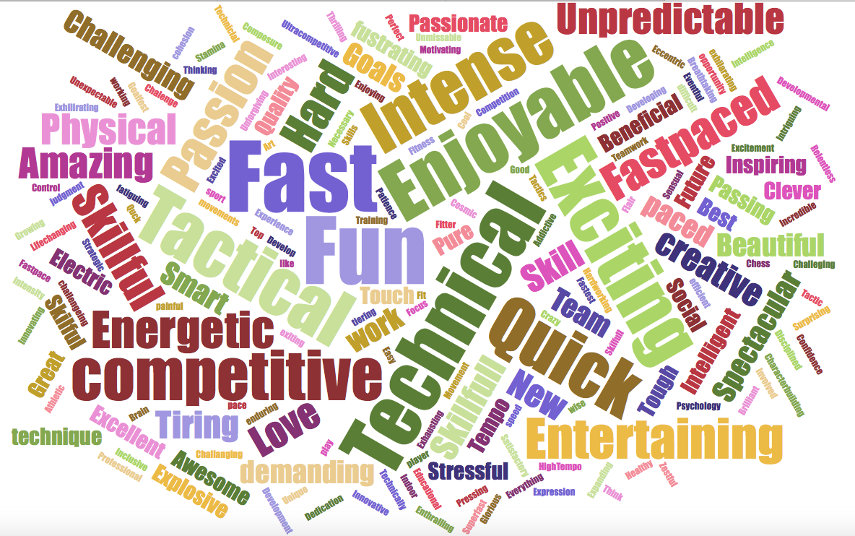
Why Futsal? Ask the people who have played it…
“You just get more everything, touches, shots, goals, saves. Movement has to be better, you have to be creative. It's massively helped in my 11-a-side games.’’ Futsal National League player
“During my childhood in Portugal, all we played was Futsal. The small playing area helped me improve my close control, and whenever I played Futsal I felt free. If it wasn't for Futsal, I wouldn't be the player I am today." Cristiano Ronaldo
Question to 303 National League Futsal Players ‘Describe Futsal in 3 words
“As a little boy in Argentina, I played futsal on the streets and for my club. It was tremendous fun, and it really helped me become who I am today." Lionel Messi
“Football & Futsal have a lot in common ... There are different tactics & moves, but there is the same essence of mastering the ball, combining & making quick decisions.” Andres Iniesta

Slide 6
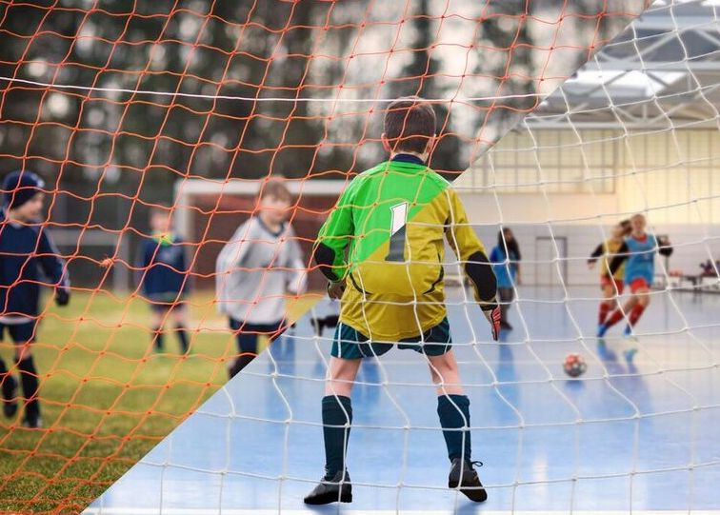
Reasons why grassroots coaches should take their players indoors to play futsal this winter.
Twin-Tracking
The Football Association

Slide 7
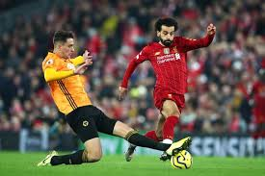
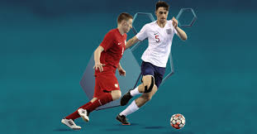
The Football Association
Twin-Tracking
Twin-Tracking= Players exposed to football and futsal alongside each other.
Aim of making the sport a natural part of children’s football development, boys/girls can play futsal as a part of their overall experience of the game.
Futsal is integral to the progression of football standards across the country.
The game places a huge emphasis on technical ability, decision making and reaction time and as a result it can result in more technically confident players.
Notes:
Max Kilman- current PL player at Wolves, twin-tracked as a player until signed pro contract, England futsal international.

Slide 8
The Football Association
Reasons why grassroots coaches should take their players indoors to play futsal this winter.
TECHNICAL/TACTICAL
Natural constraints of the game can help players develop their ability to play in tight situations, pass more accurately, become better at quick decision-making and understand tactics.
Confidence on the ball, receiving a pass under pressure, decision-making in 1v1 situations, and ball retention are all important fundamental skills that we look to develop in young football players that are practiced regularly within a game environment in Futsal.
Regular one-on-one situations with their opponent, encouraging players into quick decision making as to how they overcome these scenarios; this could be through beating the opponent with a skill, or through clever passing to a team-mate.
Teaches the value of ball retention with the constant looming threat of an immediate counter-attack.
Notes:
It helps your players to improve.
Evidence about the role futsal has played in the development of many of the world’s top players - Marcelo, De Bruyne, Neymar and Ronaldo are just a few.
Research is telling us that the constraints futsal puts on players is the reason why players get better.
If you strip futsal back to its component parts, it’s harder to play than 5-a-side football. In futsal you can’t just stand at the back and pass it and not worry about anything else. Similarly, in futsal you can’t take the easy option and play off the wall and get it back.

Slide 9
The Football Association
Reasons why grassroots coaches should take their players indoors to play futsal this winter.
PHYSICAL
Agility: Change of direction and change of pace
Balance: Receiving under pressure under a physical challenge
Coordination: Receiving the ball and holding off physical pressure
Speed: To get away from defenders quickly
Strength: Use upper body to hold up the ball
Fundamental movements: Travelling and stopping
Futsal functional movements: Quick accelerations and decelerations.
PSYCHOLOGICAL
Commitment: understand the technical detail and know your job
Confidence: show willing to get on the ball under pressure
Control: remain patient, do not panic in tight areas
Communication: body shape of the receiving players sets the next pass
Concentration: focus on the task, pay attention to passing detail.
Notes:
Confidence, Resilience, Commitment, Effective Decisions, Identify Strengths and Weaknesses (Self/Opponent), Compete, Evaluate.

Slide 10
The Football Association
Reasons why grassroots coaches should take their players indoors to play futsal this winter.
SOCIAL
Team work: Working in 2's and 3’s, as a group of five.
Sharing roles and responsibilities: Trusting each other.
Cooperation: To work together to undertake different roles within a team.
Collaboration: Listen to teammates in order to implement team strategies and solve problems.
Leadership: motivate and inspire others, show creativity and innovation within a team.
Organisation: players are constantly involved in the game, regular substitutions.
Notes:
It has social benefits.
Due to the quick nature and high intensity of the game the five players on court regularly swap with those on the bench.
Young players can be challenged to organise this process themselves which can have a positive social benefit.
Additionally, when they are on the side they’re looking, learning and developing their understanding of the game.
Don’t think that the resting players aren’t involved - if the intensity of the practice is right the players will need the rolling substitutions.

Slide 11
Futsal Non-Negotiables
The Football Association
Its harder to score
Futsal
Identity
Futsal Goals
Futsal Ball
Playing to Lines
Futsal
Laws of the Game
Hard Surface
Tactics = Pressure
4 v 4 Research
Easier to control but travels faster
Harder – Have to keep it on the island
Travels faster so have to think quicker!
Notes:
It includes challenging constraints
If you want to give your players a new and challenging experience, it's important that you stay true to the principles and constraints of futsal – otherwise you’re not going to get anything different for the kids than going indoors and playing 5 a-side.
LINES: Play to lines, even if the courts are small and not off the walls
GOALS: Use futsal sized goals (3m x 2m) – if you only have letterbox sized goals put cones inside the goals to make the goals smaller
BALLS: Use the appropriate size of futsal ball: size three for U12s and size four for above
LAWS: Stick to the laws of the game such as the number of players on court (5v5 rolling subs)
SURFACE: Play on a hard, flat surface.

Slide 12
Factors effecting the game
The Football Association
Ball Size and bounce
Goal post size and shape
Playing to a boundary
Pitch size
Playing on a hard surface
All in / out the penalty area
Kick ins
Score Line
Time clock (stopped clock)
No height restriction
No off side
4 second rule
GK Back pass restriction
Accumulated fouls
Rolling Subs (squad of 14)
Time outs
Fly GK rule
Notes:
What are the consequences of the above constraints?

Slide 13
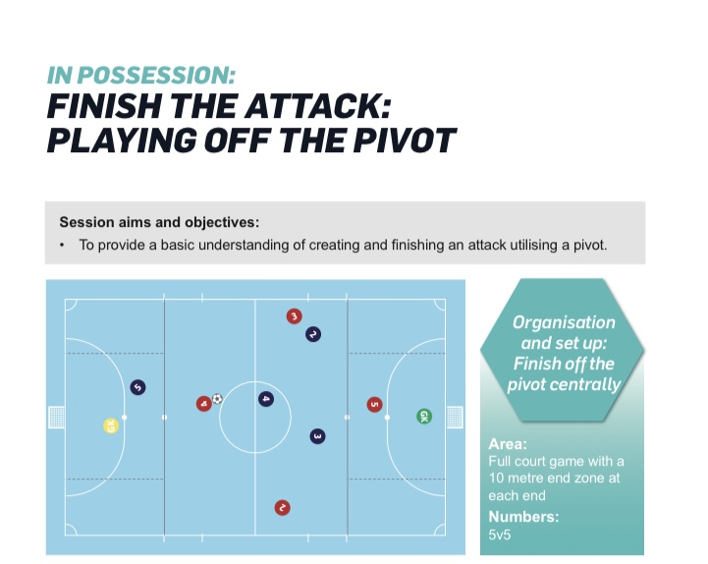

Slide 14
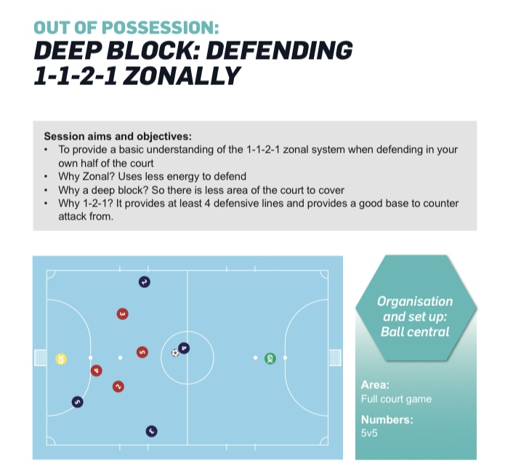

Slide 15
