Slide 1
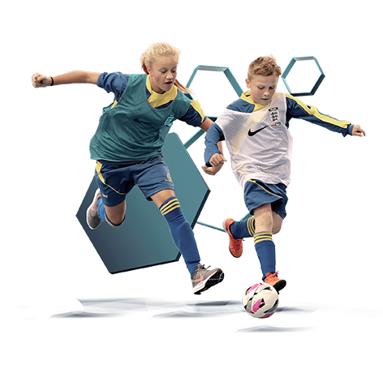
FUTSAL FOR SCHOOLS Developing Futsal in Secondary Schools (Alan Evans & Bruce Vause)
The Football Association

Slide 2
What are we going to do ?
The Football Association
What is futsal? Identify key components, Basic Laws, Core Techniques.
Why futsal? Understand the benefits of futsal to students and schools.
How to get started- practical ideas to use with students.
Signpost to additional resources.

Slide 3
The Football Association
What is futsal?
Futsal is a small-sided invasion game. The fast moving, skilful version of football originated in South America, and is now a key part of the football culture in many countries around the world.
The key components of futsal are:
What is Futsal?
Smaller, Narrower Goals
3m x 2m
Smaller Ball with reduced bounce
Small Court
(15 x 30m)
Playing to Lines
5 v 5 with
Futsal Laws of the Game
Hard, Flat Surface

Slide 4
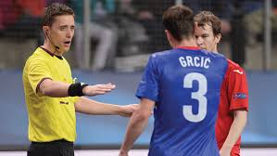
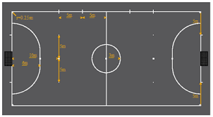
The Football Association
The Basic Laws of the Game
The Pitch
Head Height
Substitutions
Kick In
Four Second Rule
Duration
Timeouts
Match Officials
The 5m Rule
Goalkeeper
Back Passes
Red Cards
Accumulated Fouls
Notes:
The Pitch: Futsal is played on a marked pitch and the ball can go out of play.
Head Height: There are no height restrictions.
Substitutions: Up to 14 players can be used in one match and there is no limit on how long a player must stay on or off the pitch. Players must enter and leave the field of play from in the substitution gates.
Kick In: In order to restart the game after a ball has gone out of play the ball is kicked back into play from the touchline and from corners. The ball must be placed stationary on the touchline and the feet of the player taking the kick-in must not cross the line.
The Four Second Rule: For kick-ins, free kicks, goal clearances and corner kicks the player in possession of the ball has 4 seconds to restart play which the referee will count with their fingers in the air. If play isn’t restarted within four seconds possession is surrendered to the opposing team. The goalkeeper is not allowed to control the ball for more than 4 seconds in his/her own half.
Duration: Matches are played with a stopping clock (real time) whereby the clock will be stopped whenever the ball goes out of play or when there is a stoppage in the game. Depending on competition rules, rolling clock will be adequate for Schools’ Futsal competition. Futsal games consist of 2 halves of 20 minutes.
Timeouts: Each team is permitted one timeout of 60 seconds each half.
Match Officials: At international level there are 2 referees, a third official and a timekeeper. Depending on competition rules, for Schools’ Futsal competition, one referee is the minimum standard.
The Five Meter Rule; Players are required to keep 5m from the player in possession of the ball on free kicks, corners, goal clearances, kick-ins and penalties.
Goalkeepers: Goalkeepers are allowed to come out of and players are allowed to go into the penalty area. A restart from the goalkeeper must be thrown out, but the goalkeeper can use their feet to distribute the ball from open play.
Back Passes: Once the goalkeeper has played the ball he/she cannot touch the ball again. Unless an opposition player has touched the ball or if the goalkeeper receives the ball in the opponent’s half.
Red Cards: If a player is sent off then the team to which the player belongs must remain with 4 players until two minutes have passed, or the opposition have scored a goal.
Accumulated Fouls: Each team will be allowed to give away 5 direct free kicks in each half of the game, then on the sixth foul and every foul thereafter, a direct kick will be awarded to the opposing team and the defending team is not

Slide 5
The Football Association
Core Techniques
Control • It is easiest to control and manipulate the ball if players use the sole of the foot.
Traveling with the ball • The sole of the foot is often used when travelling with the ball to keep the ball close, to allow shorter stride patterns and to enable a quicker change of direction.
Passing • The most common passes in futsal are the 1-2 or wall pass around a defender, diagonal passes between players and little lifted passes over the defender’s feet (it is often called a ‘parallel pass’ if a winger lifts the ball down the line for a deeper player to run on to).
Finishing • It is common in futsal that a lot of goals are scored as a first time finish, or with a toe poke and a lot of goals in futsal are finishes at the second/far post.
Playing, moving and feinting • Players are frequently marked tightly and need to be creative with movement to create space as an individual and as a team.
Defending • 1v1 defending is very important, so players must stay low in order to change direction more easily and follow the attacker. Team defending is very important, so players should try to cover their mates.
Notes:
Control: It is easiest to control and manipulate the ball if players use the sole of the foot
• It is also important that the players are able to shield the ball to keep it away from the defender. This requires the player to keep their body between the defender and the ball and keep the ball at the furthest foot from the defender.
Finishing:
Players often toe-poke the ball in futsal because it creates lots of power with very little back-lift of the shooting leg. In such a quick game this is sometimes the best way to catch defenders and goalkeepers unaware. It is common in futsal that a lot of goals are scored as a first time finish (a shot is taken without controlling the ball first)
• Also, a lot of goals in futsal are finishes at the second/ far post so players are often encouraged to fill these positions on attacks.
Playing, moving and feinting • Because players are frequently marked tightly it is difficult to create space as an individual and as a team. Therefore players often move once they have passed the ball to create space for a team mate to fill. Combinations of movements like this may be called a ‘rotation’
• A common way for players to find space if they are being marked and want to receive the ball is to run away so the defender follows them and then ‘check’ back in to the original space to receive the ball.

Slide 6
Benefits of futsal for students
The Football Association
A hard surface means the ball travels faster and players can change direction quicker and more often.
Also, due to the increased speed of the game, players develop their fitness levels quickly and have to control their emotions in challenging situations.
Futsal teams operate in smaller spaces which ensure players are more involved and engaged because they have more touches of the ball, take more shots and are closer to the ball to make more defensive actions. Furthermore, players have more decisions to make.

Slide 7
Benefits of futsal for students
The Football Association
Playing to lines also ensures players have to be in control of the ball at all times to stop it going out of play.
The futsal ball doesn’t bounce as high as a football so it spends more time on the floor and is therefore easier to control which leads to a higher number of short passes in games.
The smaller, narrower goals make it harder to score which challenges the attackers more.

Slide 8
The Football Association
TECHNICAL/TACTICAL
Core Techniques:
Control (Using the Sole)
Passing (Wall/Paralell)
Finishing (Toe Shot)
Playing/Moving/Feinting
Traveling with the ball
Defending
Desire/ability to retain ball
1 v 1 attacking situations
1 v 1 defensive situations
Decision making
Understanding Set Plays
Understanding Role
PHYSICAL
Agility
Balance
Coordination
Speed
Strength
Mobility
Flexibility
Reactions
Fundamental movements: Travelling & stopping
Futsal functional movements: Quick accelerations and decelerations.
PSYCHOLOGICAL
Commitment: understand technical detail & know your job
Confidence: show willing to get on the ball under pressure
Control (Emotional): remain patient, do not panic in tight areas
Communication: body shape of the receiving players sets the next pass
Concentration: focus on the task, pay attention to detail.
SOCIAL
Team work: Working in 2’s/3’s within a 5.
Sharing roles and responsibilities: Trusting each other.
Cooperation Collaboration
Independence
Accountability
Responsibility
Relationships
Leadership: motivate and inspire others, show creativity and innovation within a team.

Slide 9
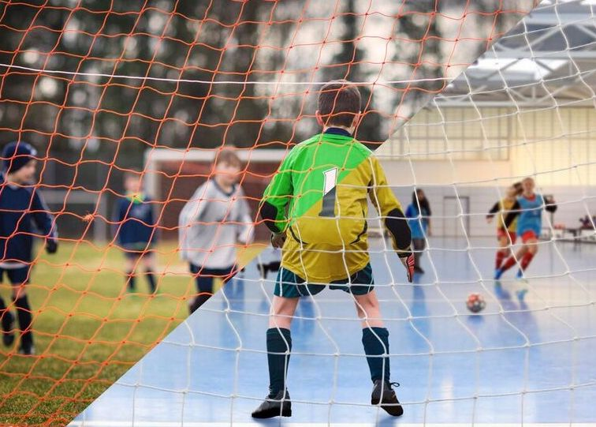
The Football Association
Benefits of futsal for schools
Student Engagement
Facilities
Equipment
Personal Development
School Sport Calendar
PE National Curriculum Outcomes
DfE Approved Activity
Notes:
Student Engagement- popular/inclusive football activity. Supports football development (Twin Tracking).
Facilities- most schools have sports hall/MUGA, most schools have hockey, handball/futsal goals.
Equipment- relatively cheap to begin. Balls/Goals initial outlay.
Personal Development- provide opportunities to develop social/cultural capital (New Ofsted Framework) E.G: School Trips, Visits to Local University, Residential, Cultures.
School Sport Calendar- traditional school football season breaks over the winter, ideal time to introduce futsal.
PE National Curriculum Outcomes- KS3 and KS4 outcomes are spread across the four corners of the FA LTPD model.
DfE Approved Activity- In September 2019 the Department for Education added Futsal to an approved activity list for GCSE, AS and A-Level PE.

Slide 10
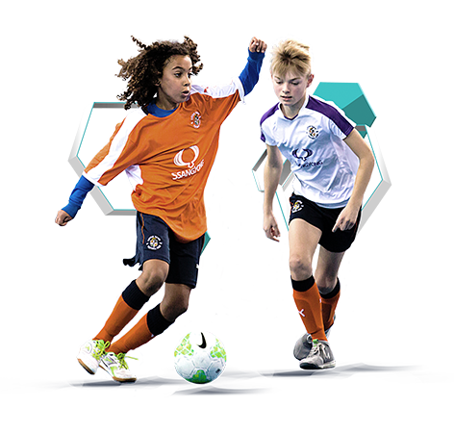
The Football Association
Where to start?
1- Introduce as an Extra-Curricular Activity.
2- Develop Intra-School Competitions
(House/Inter-Form)
3- Explore opportunities to play Inter-School fixtures.
4- Enter Schools Association/ County Schools Association Competition.
5- Add to the PE Curriculum at KS3 and KS4.

Slide 11
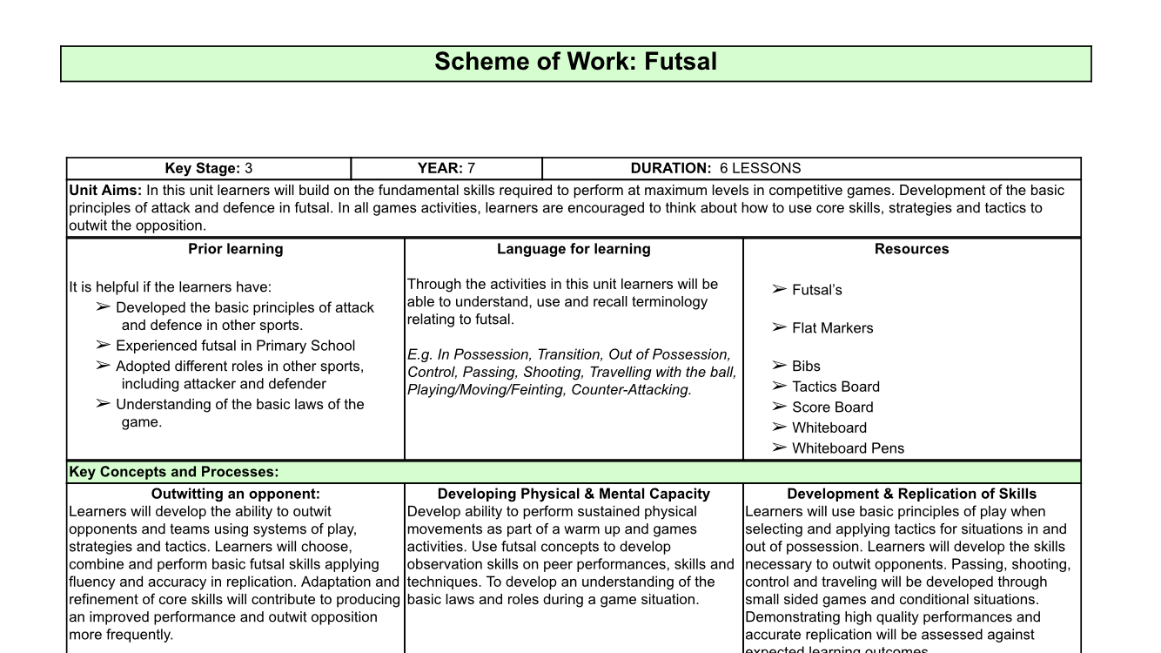
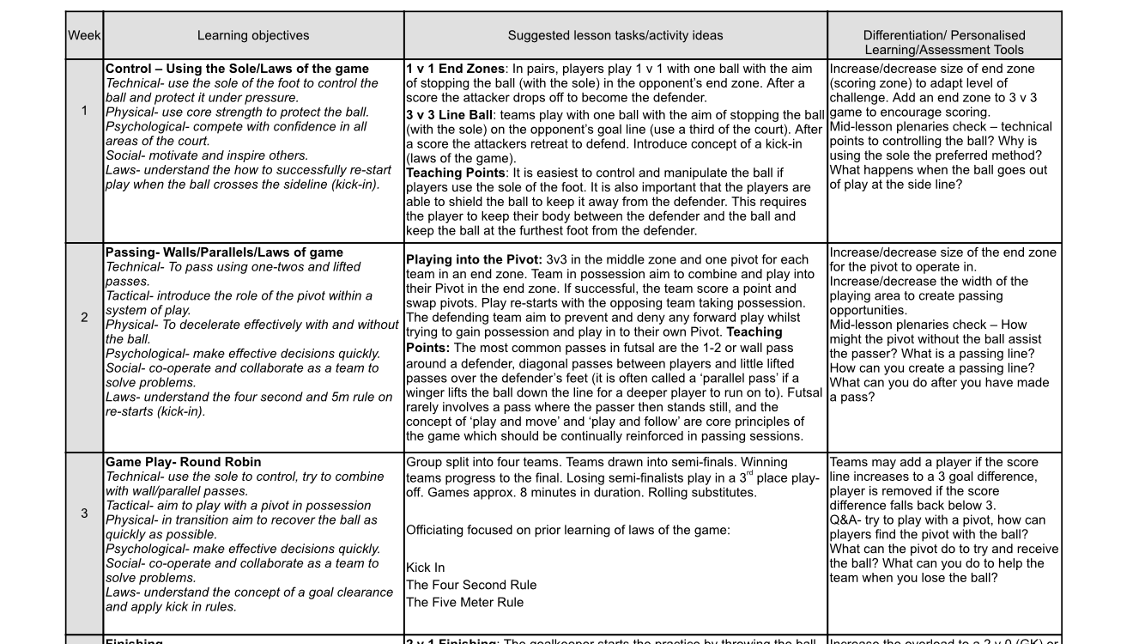
The Football Association

Slide 12
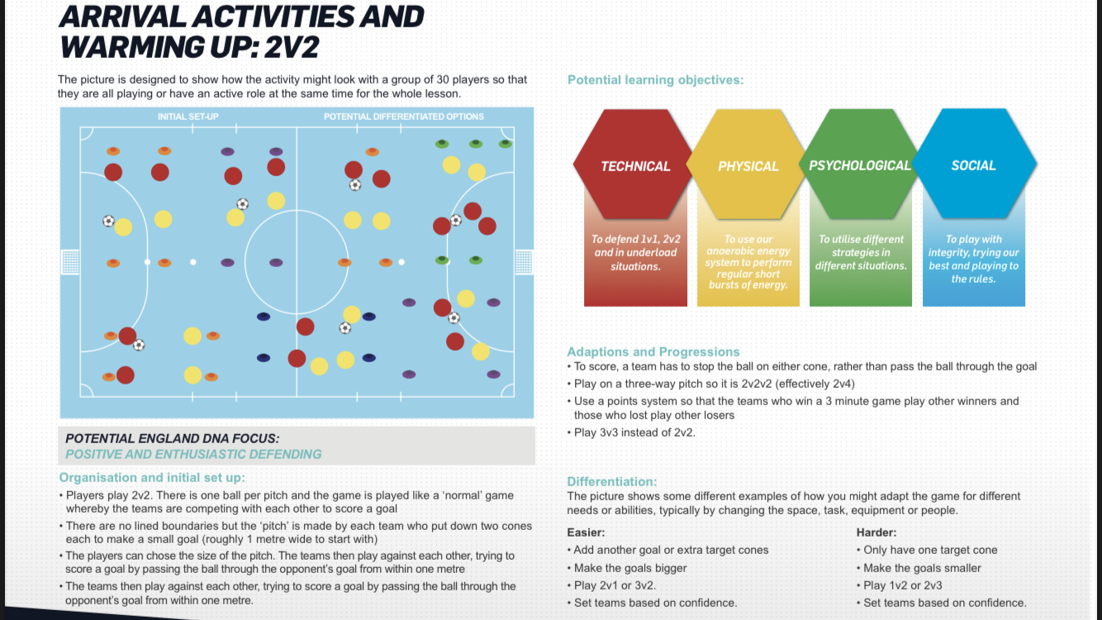
The Football Association

Slide 13
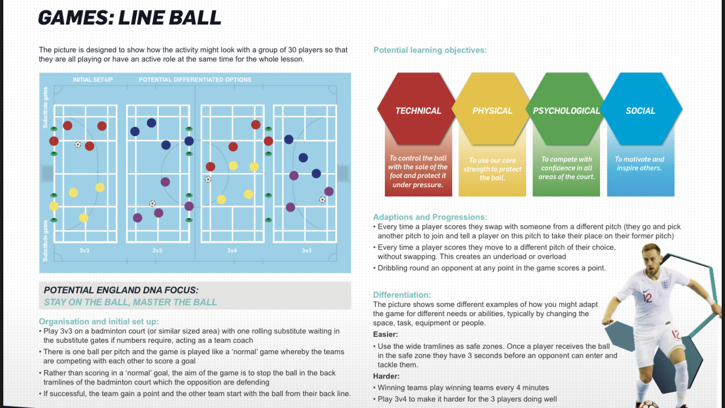
The Football Association

Slide 14
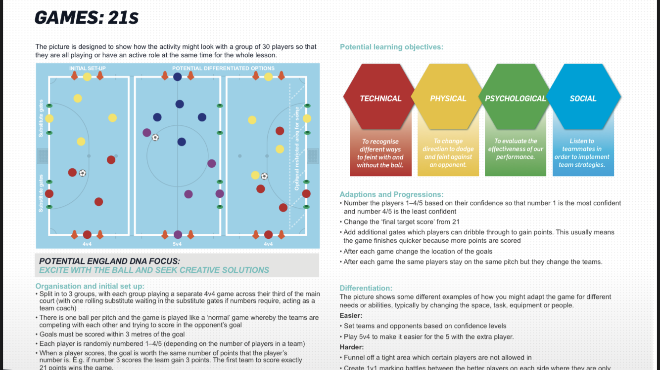
The Football Association

Slide 15
The Football Association
Developing School Sport
Gateshead Schools FA
2019-20 Futsal Cups
280 students from 8 member schools.
Durham County Schools FA
2020 Finals Day
225 students, 25 schools, 5 districts.

Slide 16
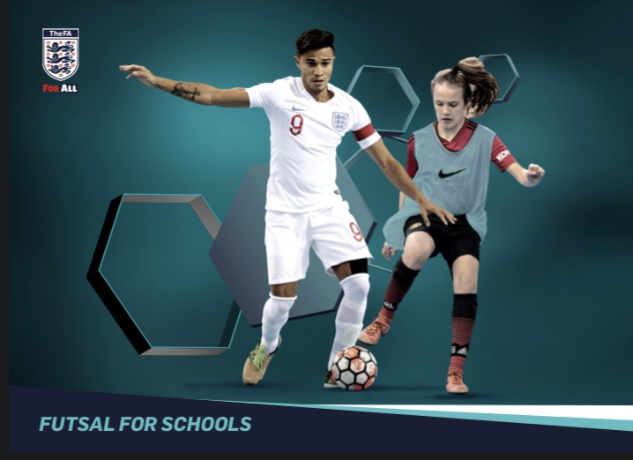
Resources
thefa.com
Futsal For Schools
Youth Futsal Handbook
Benefits of Futsal
Playing Guide- Getting Started
Futsal Facilities Guide
The Football Association

Slide 17
The Football Association

Slide 18
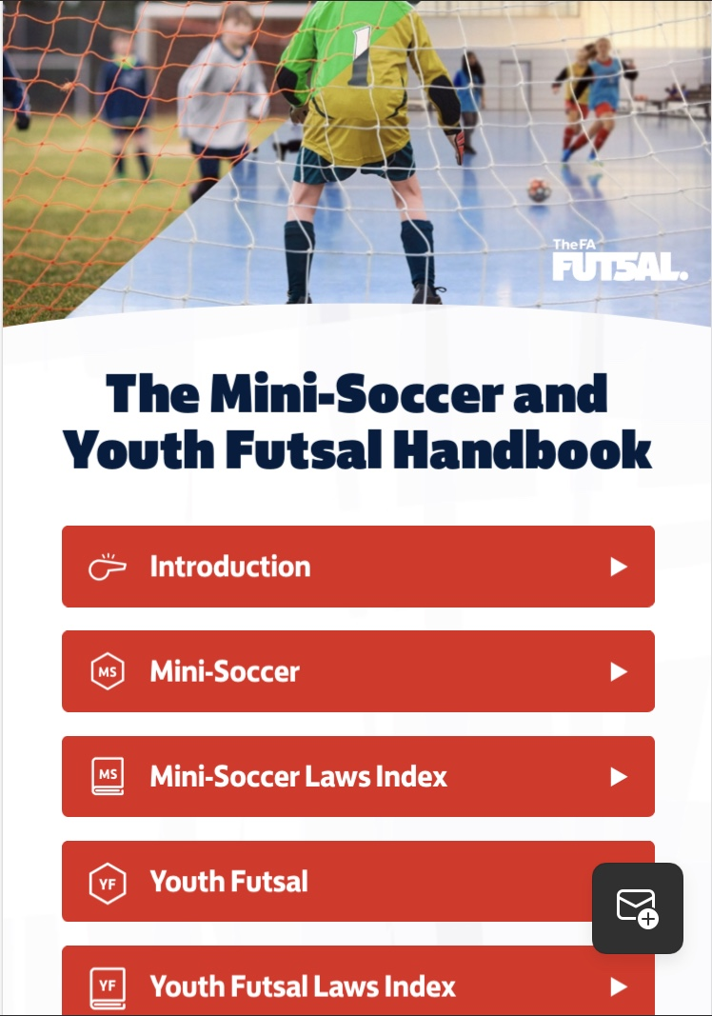
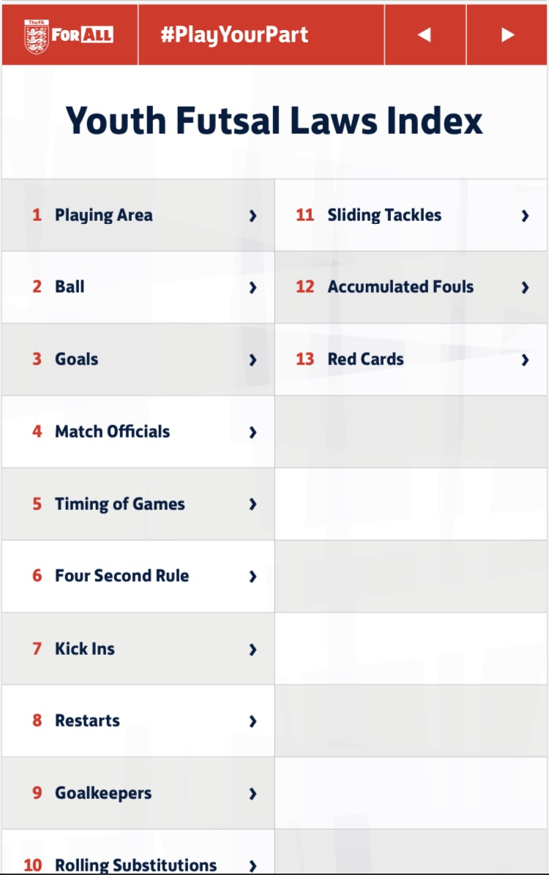
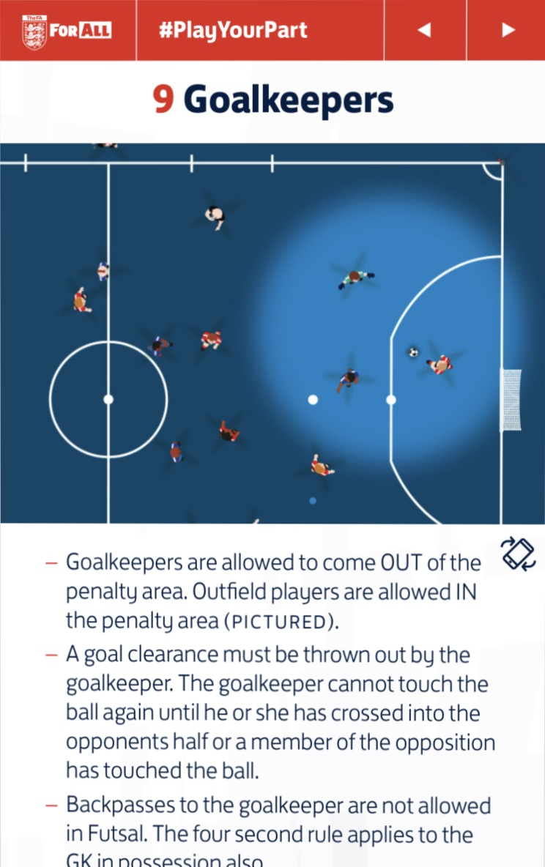
The Football Association

Slide 19
Questions?
The Football Association

