Slide 1
GRASSROOTS REFEREE EVENING: NOVEMBER 2022
North Riding County FA Referee Department

Slide 2
Main Aims of the Evening
Provide Referee Development Updates
Reporting & Dealing with Misconduct Recap
Heading in Football Update
FA Refereeing Progression Pathway
LOTG Development
Refereeing within Grassroots Football Technical Session
Open Forum And Q&A

Slide 3
North Riding FA In Numbers..
452 Referees Registered for 2022/23 Including Trainees
101 New Referees Trained since August 2022

Slide 4

Who’s who?

Slide 5

Who’s who?

Slide 6

Who’s who?

Slide 7
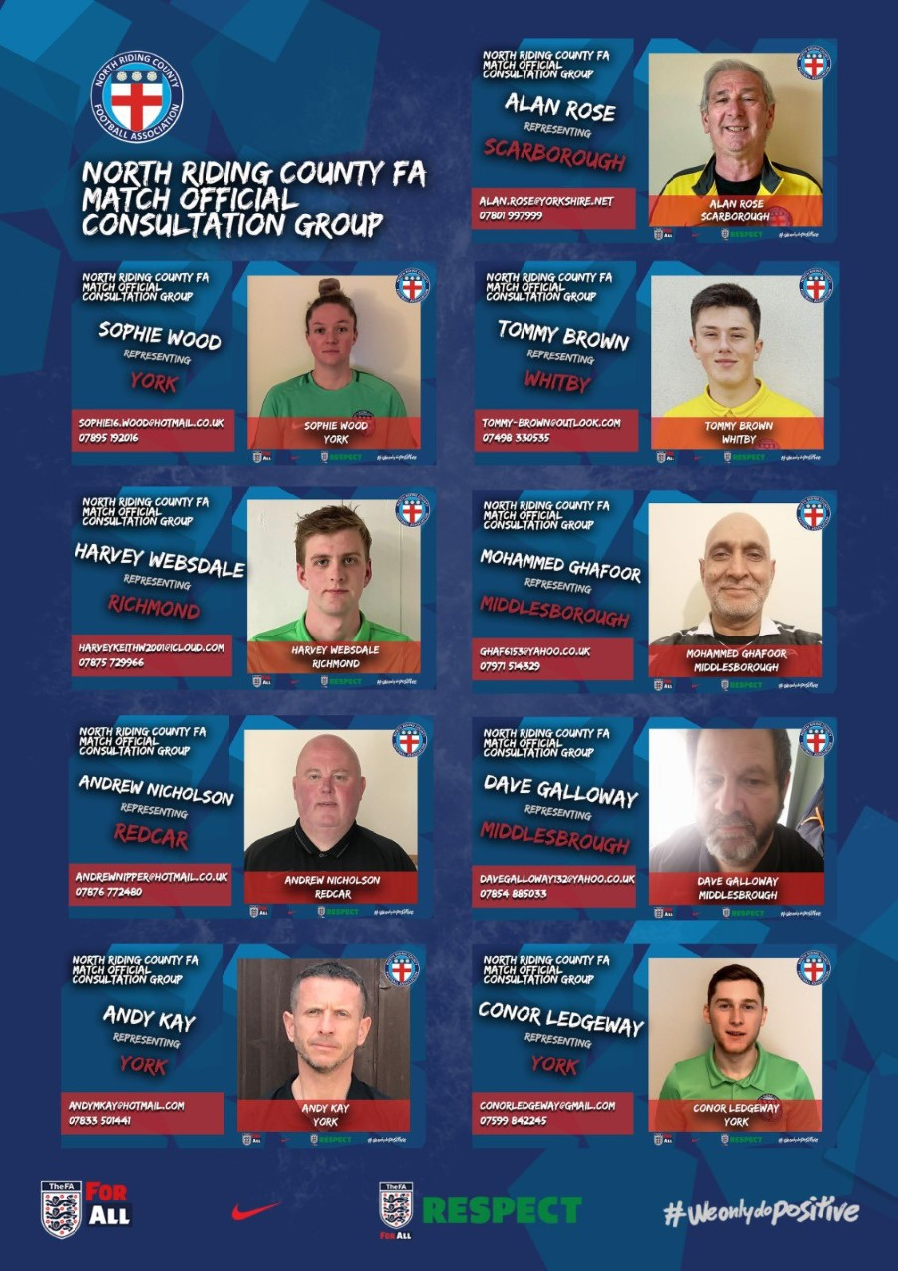
Who’s who?

Slide 8
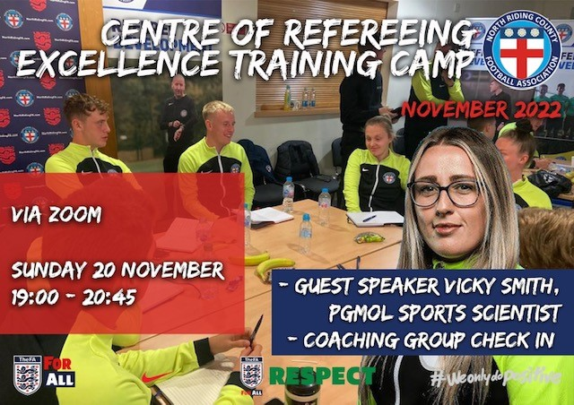
Who’s who?

Slide 9
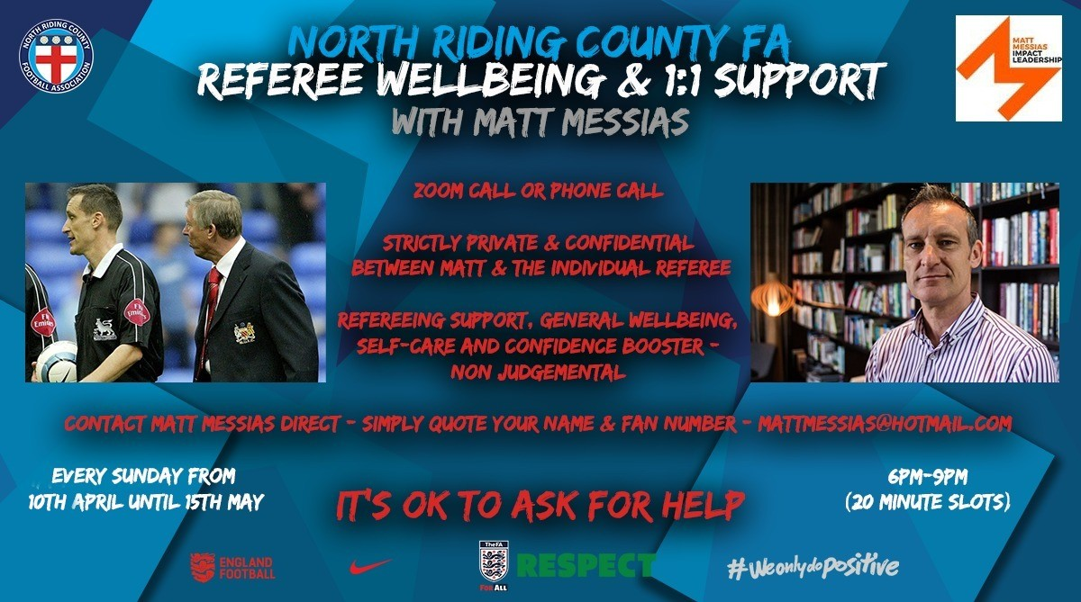
Who’s who?

Slide 10




Who’s who?

Slide 11
Who’s who?

Slide 12
Who’s who?

Slide 13
Who’s who?

Slide 14
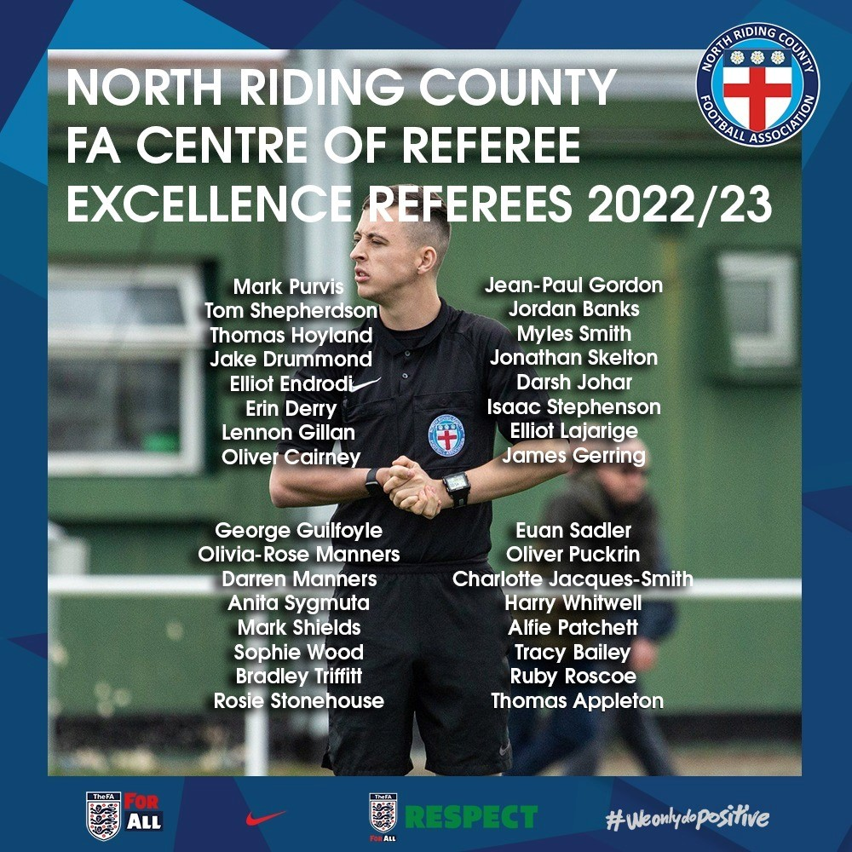
Who’s who?

Slide 15
Dealing with Misconduct & Practical Guidance Recap: November 2022
North Riding County FA Referee Department

Slide 16
Main Session Aims
To identify who team officials are
To identify when team officials have committed misconduct
To identify and how to effectively deal with spectator misconduct
To know what disciplinary action to take
To know how to manage these incidents effectively

Slide 17
Who’s who?

Slide 18
Task – Can you identify who’s who?
Touchline Team Occupants:
Others on the Touchline:
…
…
…
…
…
…
…
…

Slide 19
Task – Can you identify who’s who?
Touchline Team Occupants:
Others on the touchline:
Manager
Coach
Physio
Subs
Substituted players
Parents
Family members
Spectators
We can only take formal disciplinary action against those on the left!

Slide 20
A Question of Sport Law

Slide 21
Question 1
A manager enters the field of play at half time in a respectful and non confrontational manner. What action if any do you take?
Warn the manager
Caution the manager (yellow card)
Send off the manager (red card)
A. Warn the manager

Slide 22
Question 2
A coach sarcastically claps one of your decisions showing a clear lack of respect toward you. What action do you take?
Sin bin the coach
Caution the coach (yellow card)
Send off the coach (red card)
B. Caution the coach (yellow card)

Slide 23
Question 3
The manager is gesturing and acting in a inflammatory manner on the touchline towards you. What action do you take?
Warn the manager
Caution the manager (yellow card)
Send off the manager (red card)
B. Caution the manager (yellow card)

Slide 24
Question 4
The coach uses insulting, abusive and/or offensive language towards you following a penalty award in the 24th minute. What action do you take?
Send off the coach (red card)
Ask the coach to just leave the touchline
Caution the coach (yellow card)
A. Send off the coach (red card)

Slide 25
Question 5
At full-time the home team manager enters the field of play to confront you regarding your decision making during the game. This makes you feel intimidated and uncomfortable. What action do you take?
Ask the manager to move away
Caution the manager (yellow card)
Send off the manager (red card)
C. Send off the manager (red card)

Slide 26
Disciplinary Action for Team Officials
IFAB Laws of the Game – Law 12

Slide 27
Warnings for Team Officials
The following offences should usually result in a warning; repeated or blatant offences should result in a caution or sending-off:
entering the field of play in a respectful/non-confrontational manner
failing to cooperate with a match official e.g., ignoring an instruction/request from a match official
minor/low-level disagreement (by word or action) with a decision
occasionally leaving the confines of the technical area without committing another offence

Slide 28
Caution Offences for Team Officials
clearly/persistently not respecting the confines of their team’s technical area
delaying the restart of play by their team
deliberately entering the technical area of the opposing team (non-confrontational)
dissent by word or action including:
  throwing/kicking drinks bottles or other objects
  gestures which show a clear lack of respect for the match official(s) e.g., sarcastic clapping
excessively/persistently gesturing for a red or yellow card
gesturing or acting in a provocative or inflammatory manner
persistent unacceptable behaviour (including repeated warning offences)
showing a lack of respect for the game

Slide 29
Sending Off Offences for Team Officials
delaying the restart of play by the opposing team e.g., holding onto the ball, kicking the ball away, obstructing the movement of a player
deliberately leaving the technical area to:
  show dissent towards, or remonstrate with, a match official
  act in a provocative or inflammatory manner
entering the opposing technical area in an aggressive or confrontational manner
deliberately throwing/kicking an object onto the field of play
entering the field of play to:
  confront a match official (including at half-time and full-time)
  interfere with play, an opposing player or a match official

Slide 30
Sending Off Offences for Team Officials
physical or aggressive behaviour (including spitting or biting) towards an opposing player, substitute, team official, match official, spectator or any other person (e.g., ball boy/girl, security or competition official etc.)
receiving a second caution in the same match
using offensive, insulting or abusive language and/or gestures
violent conduct

Slide 31
How do we manage these incidents?

Slide 32
Managing the incident…
Dealing with these incidents can at first be daunting
These incidents & individuals can often be heated and irate
However,…
Have confidence in your own ability
Take your time
Utilise the framework of the LOTG to support you
Remain calm & composed
Stay strong
Take the appropriate action using the correct procedure

Slide 33
Referee Department
Practical Guidance for Dealing with Misconduct

Slide 34
Practical Guidance for dealing with Grassroot Misconduct
Aims & Reasons of Guidance
Provides a uniformed approach, with practical guidance to our Match Officials & Clubs on how Misconduct will be dealt with
Help deal with behaviour / conduct that oversteps the mark, and ensure it is appropriately addressed and reported
Help support the retention of Match Officials, as well as the enjoyment for our Match Officials
Provides Clubs the opportunity to take responsibility, and take positive action against spectators who make irresponsible comments or behaviour unacceptably
Promote positive behaviour, and enjoyment for ALL within the grassroots game

Slide 35
Practical Guidance for dealing with ‘NON PARTICIPANTS’ Misconduct
Stage 1 (Warning)
If Referees receive any irresponsible comments, they should stop the game at the next appropriate stoppage and have a public word with the individual concerned that their conduct is not acceptable, and any further repeat will result in formal disciplinary action.
This Stage 1 Warning DOES NOT need to be reported to County FA via Whole Game System, as it forms part of a referee's management of the game. (Manager / Coach / Physio)
Stage 2 (Disciplinary Sanction)
Any further breach, and formal disciplinary action NEEDS be issued to the individual concerned (Yellow or Red Card) as per the LOTG for ‘Non participants’ and reported via Whole Game System. Match Officials need to take the appropriate action as detailed within the LOTG framework.

Slide 36
Practical Guidance for dealing with ‘SPECTATOR’ Misconduct
Stage 1 (Warning)
If Referees receive any irresponsible or low-level comments, they should stop the game at the next appropriate stoppage in play and speak with the responsible club representative (Home or Away), and make them aware that the conduct is unacceptable, and ask them to address it with the spectator / spectators identified, as any further repeat will result in a formal Misconduct Report been submitted to the County FA.
This Stage 1 warning DOES NOT need to be reported to the County FA, via Whole Game System, if the club representative positively deals with it, and no further issues arise, as it forms part of a referee's management of the game.
If it does need to be escalated, and reported to the County FA, because of continued conduct, reference should be made in the below (Stage 2) Misconduct Report to the County FA, of earlier positive actions made to try and address the matter and allow the club to take positive actions to avoid a formal misconduct report been submitted as below.

Slide 37
Practical Guidance for dealing with ‘SPECTATOR’ Misconduct
Stage 2 (Misconduct Report to County FA)
If after offering the club representative the opportunity to deal with earlier conduct it continues, a Misconduct Report should be submitted, detailing the earlier Stage 1 management (warning) and full details of what occurred.
Furthermore, if the Misconduct or behaviour of spectators requires more than just a Stage 1 warning, then a misconduct report should be submitted via Whole Game System and the club representative made aware of this. If a spectator or spectators are abusive or threatening, the referee should ask the club representative to ask the identified individual and or individuals, to leave the vicinity of the field of play. In extreme circumstances, should the spectator / spectators fail to comply with the request of their club representative, and the referee continues to receive further comments, or fears for their personal safety, the referee should warn the club representative that the game could be abandoned. We are asking clubs to take responsibility and help support proactively, our referees with regards to spectator misconduct.

Slide 38
Temporary Dismissal Guidance (SIN BIN)
MATCHDAY PROCESS
In order to ensure that you have a full understanding as to how the Sin Bin process will be implemented during a game, please refer to the below information:-
Who?
Applies only to active players only (those on the field of play)
Does not apply to substitutes and coaching staff
How?
The referee will take the name of the offending player
A yellow card will be issued and shown
Referee to point to the touchline where the player must go (there will be no specific Sin Bin area)
Time
Sin Bin to last for 10 minutes in matches of a 90-minute duration
Sin bin to last for 8 minutes in all other matches
The Sin Bin period only commences when the referee restarts play
Referee will include any lost time (i.e., injury delay)
Referee is the sole arbitrator of time and as to when the player can return (permission can be given when the ball is in play)
Offending Player
Cannot be substituted until the Sin Bin period has expired
Can take part in a penalty shootout – even if the Sin Bin period has not expired (i.e., end of extra time)
Must be in the Sin Bin for active playing time (i.e., Sin Bin to continue into 2nd half if required)
Defined as being in the Sin Bin from the moment they are cautioned for Dissent (even if play has not yet restarted)
Any player who has been Temporarily Dismissed and commits a further yellow or red card offence whilst in the Sin Bin cannot take any further part in the game and cannot be substituted

Slide 39
If a temporary dismissed player:
Commits another Yellow Card offence or Red Card offence during the sin bin period, they cannot take any further part in the game and cannot be substituted
Commits a non-dissent caution at any time on the field of play in addition to the sin bin period will continue to play
Commits a 2nd Dissent caution (and no other offences) will receive a 2nd period in the sin bin. At the end of that period, the player can take no further part in the game but can be substituted (providing that the team concerned has not used all of their permitted substitutes)
Commits a 2nd dissent offence and has already had a non-dissent caution will take no further part in the game and cannot be substituted

Slide 40
Caution Offence 1 | Caution Offence 2 | Caution Offence 3 | On Field Sanction
Dissent | - | - | Sin Bin
Dissent | Non Dissent | - | Sin Bin, caution recorded (no send off)
Dissent | Non Dissent Caution | Non Dissent Caution | Sin Bin, send off for S7 (second caution)
Dissent | Dissent | - | Sin Bin x2, unable to re-join, but CAN be substituted after 2nd Sin Bin if not all subs used
Dissent | Non Dissent Caution | Dissent | Sin Bin, caution recorded, Sin Bin, unable to re-join and CANNOT be substituted
Non Dissent Caution | Dissent | - | Caution recorded, Sin Bin
Non Dissent Caution | Dissent | Non Dissent Caution | Caution recorded, Sin Bin, send off for S7 (second caution)
Non Dissent Caution | Dissent | Dissent | Caution recorded, Sin Bin, Sin Bin - unable to re-join and CANNOT be substituted after 2nd Sin Bin

Slide 41
FA Discriminatory Guidance
“This protocol applies specifically where incidents are heard or witnessed by players, managers or match officials on the pitch. It aims to ensure that any discriminatory abuse directed at players, managers or match officials is effectively addressed and that Participants feel protected.”

Slide 42
Key Guidance
The incident should in the first instance be brought to the attention of the match referee during a break in play.
The match referee should report the incident to a relevant responsible club representative. The identity of that club representative will vary game to game and the match official will determine the best person from the club to assume this responsibility and is likely to be the Secretary, Manager or other Club Official.
The club representative should seek to identify the person/people responsible and take appropriate action while the match continues in order to stop the abuse.
If, within an amount of time agreed by the match referee to the club representative, the problem continues, the referee may remove the players from the field and suspend the match, allowing the club representative a further opportunity to deal with the problem.
If in the opinion of the match referee the matter cannot be dealt with satisfactorily and the welfare of any participants, in terms of the threat of continued abuse, remains at risk, the match referee should consider abandoning the match.
Any decision to suspend or abandon a match should be taken solely by the match referee after full consultation were deemed appropriate with both team managers and captains.

Slide 43
Examples of Good Misconduct Reporting

Slide 44
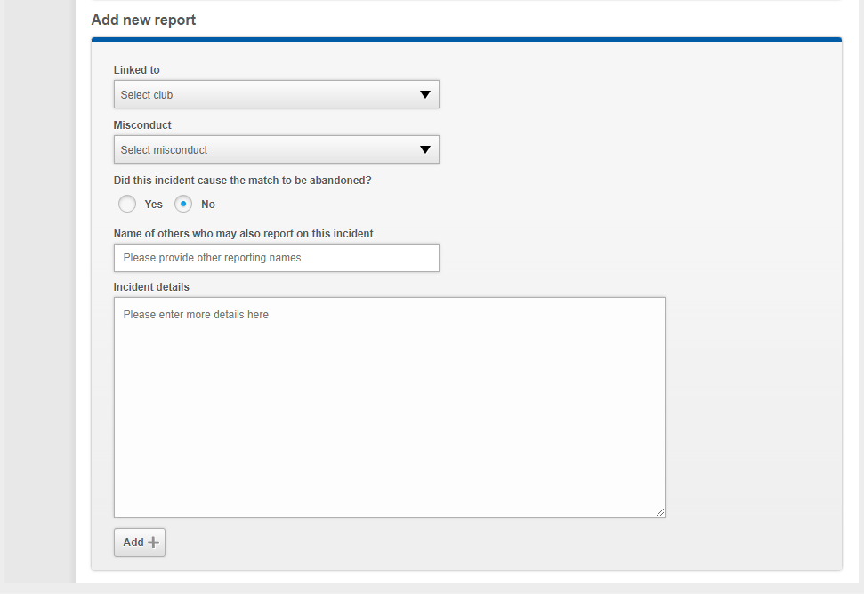
Example 1
Blue Rovers FC
Yes
In or around the 28th minute of this fixture, a spectator connected with Blue Rovers FC made some unacceptable comments towards me, following an award of a penalty kick to Red Rovers FC.
I immediately went across and spoke with the Blue Rovers FC team representative (Wayne Smith) and advised him that these comments were unacceptable, and requested that he spoke with the individual concerned, as any further repeat would result in a misconduct report been submitted to the County FA.
I can confirm that Wayne Smith spoke to the individual identified asking him to refrain from making such comments.
Furthermore, in or around the 50th minute, I received further comments from the individual earlier identified as part of Blue Rovers FC, which included “you are a fucking cheat” & “you fucking prick referee”.
I immediately stopped play at the next stoppage and advised Wayne Smith that this act of misconduct would be reported to the County FA and requested that he asked the individual to leave the vicinity of the field of play and return to the car park. I can confirm that the individual complied with the request from Wayne Smith and no further incidents took place.

Slide 45
Example 2
Blue Rovers FC
Yes
In or around the 28th minute of this fixture, a spectator connected with Blue Rovers FC, made some unacceptable comments towards me, following an award of a penalty kick to Red Rovers FC.
I immediately went across and spoke with the Blue Rovers FC team representative (Wayne Smith) and advised him that these comments were unacceptable, and requested that he spoke with the individual concerned, as any further comments of this nature would result in a misconduct report been submitted to the County FA and that I was an U18 referee signified by the fact that I was wearing my U18 yellow armband.
I can confirm that Wayne Smith spoke to the individual identified asking him to refrain from making such comments.
Furthermore, in or around the 50th minute, I received further comments from the individual earlier identified as part of Blue Rovers FC, which included “you are a fucking cheat” & “you fucking prick referee”.
I immediately stopped play at the next stoppage and advised Wayne Smith that this act of misconduct would be reported to the County FA and requested that he ask the individual to leave the vicinity of the field of play and return to the car park. I can confirm that the individual complied with the request from Wayne Smith and no further incidents took place.
I can confirm, as detailed above, that I was wearing my U18 yellow referee armband to signify that I am under the age of 18 and found the conduct of the spectator to be intimidating and completely unacceptable.

Slide 46
Example 3
Blue Rovers FC
Yes
In or around the 60th minute of this game, I was approached by the manager of Red Rovers FC (Matthew Jones) to say one of his players was called a “Fucking black twat” by Blue Rovers FC #5.
I can confirm that I did not hear this alleged comment and I immediately went across to Matthew Jones and spoke with him and his player (Jack Baker, Red Rovers FC #9) who was allegedly subjected to this comment.
I asked Jack Baker what had been said and he confirmed that Blue Rovers FC #5 (Paul Wilson) had called him a “Fucking black twat”. I explained to Jack that as I had not personally heard this comment, I could not take any action at this time, however, I reassured him that I would be reporting this alleged comment to the County FA who would then investigate.
I asked Jack if he was ok and he confirmed that he was, however, I could see that he was visibly upset, but he was happy to continue.
I then went and spoke with Blue Rovers FC manager (Wayne Smith) and his player Paul Wilson and informed them that I had received an allegation of a racist comment, allegedly made by Paul. I further explained that as I had not heard the alleged comment, I would simply be submitting a report to the County FA post-match.
Paul responded by saying “it’s a load of bollocks” and “I did not say anything”. I explained to Paul that I would simply be reporting this allegation to the County FA as I had not heard these comments.
I can confirm that the game continued without any further incident and I informed both parties and Ross Joyce, Referee Development Manager by telephone post-game that this would be reported.

Slide 47
Example 4
Blue Rovers FC
Yes
In or around the 55th minute of this game, following a reckless challenge by Red Rovers #4 who was subsequently cautioned for his actions, several players became involved in a confrontation with each other. I estimate it was around five players from each team with pushing and shoving taking place. I did also see one punch thrown by a Blue Rovers FC player, but I could not identify him due to the number of players in my view.
Furthermore, several spectators entered the field of play without permission and started shouting comments such as “fuck off you pricks”, “fucking wankers” & “Come on then let’s sort this out wankers”. I can confirm that the spectators came from both Blue Rovers FC & Red Rovers FC and clearly inflamed the situation with verbal exchanges taking place.
During this incident, I also observed Blue Rovers FC manager, Wayne Smith, violently push an opposition player from Red Rovers FC and call him a “fucking wanker” so I immediately showed him a red card as a ‘nonparticipant’ – please see separate report submitted.
Once this incident was concluded, I advised both teams that the actions would be reported to the County FA for their consideration and due to the seriousness of the incident, I decided I would not be resuming the game and therefore, I abandoned it due to the misconduct of both teams, who I believe are equally to blame.

Slide 48
Procedure
Name
Offence
Time
Eye contact
Issue Card
Report

Slide 49


Slide 50


Slide 51
Summary & Key Learning
The importance of knowing who’s who on a match day!
A firm understanding of Law will assist and support you with what action to take
Take the appropriate action, we need to protect ourselves, others and the game
Courage, composure and calmness will help us effectively manage and deal with the issues we are faced with on the touchline

Slide 52
Thank You & Well Done
It is vital that you continue to invest time into your development as a referee to continue to grow and develop
We hope to see you again at a future session

