Slide 1
WHAT WE STAND FOR
This webinar will give you the confidence to develop your own vision and values, with the help of trailblazing Lewes FC and their Chairman Stuart Fuller
Time:
Date:
20:00 – 21:00
3rd February 2020

Slide 2


Notes:
Danielle

Slide 3
FORMAT & HOUSEKEEPING
To help with recording quality, please mute sound until the discussion
The webinar will be recorded and available to view again
Slides will be emailed to all participants who signed up
Any questions you have through the presentation jot them down on a piece of paper or in the chat and we will open up the floor for discussions at the end.
Notes:
Danielle

Slide 4
WHAT WE’LL COVER TODAY
Unpicking the terminology
Why bother with vision and values
How to develop and use them effectively
What we do: Stuart Fuller, Lewes FC
Questions/Open discussion
Notes:
Danielle
Purpose of slide: to run through the content of the webinar
Add that there will be an opportunity for a question and answer session at the end of the presentation etc

Slide 5
WHY HAVE A VISION STATEMENT AND
SET OF VALUES?
Provides the club with a sense of identity and purpose
Helps guide decision making and can be used to drive positive change
Underpins the club’s business and activities
A ‘rallying call’ for existing club members – they know what they’re contributing to
A ‘sales pitch’ to potential members – helps the club stand out from the crowd
Makes it clear to funders and other partners/stakeholders what you want to achieve
Notes:
Purpose of slide: to explain the various benefits of having a clear vision and set of values
Provides the club with a sense of identity and purpose: this is particularly valuable if the club hasn’t ever clearly expressed what it wants to achieve
Helps guide decision making and can be used to drive positive change: a clear vision can prevent ‘mission creep’, or attempts to blow the club off course; equally, it can used to support the introduction of new projects, programmes or activities
A ‘rallying call’ for existing club members: the vision can rejuvenate existing members’ pride in the club and even encourage them to ‘put something back’, e.g. volunteering, coaching, fundraising
Underpins the club’s business and activities: provides a clear line of sight between what the club says it wants to achieve and how it actually goes about achieving it through day to day operational delivery
A ‘sales pitch’ to potential members: attracting new members is essential to the lifeblood of a club and having a clear vision can help the club stand out from the crowd
Makes it clear to funders and other partners/stakeholders what you want to achieve: particularly important if you want to attract significant investment into the club, e.g. facility development, purchase of new equipment

Slide 6
UNPICKING THE TERMINOLOGY
Vision: the world we’d like to see
Purpose: the reason you exist
Mission: how you will get there
Aims or Goals: quantified ambitions to realise the vision and mission
Objectives: targeted and measurable intentions to fulfil our aims/goals
Values: describe our core ethics and principles
Notes:
James
Purpose of slide: to introduce the concept of visioning, and to set it in context
All organisations should be able to ask themselves - and answer - the four questions shown here. Having a vision statement will provide a strong basis for being able to answer the four questions.
Often a club’s vision can be contained within a mission statement, or within its aims and objectives. It is worth explaining the difference between these concepts:
Vision: a statement that describes how the future will look if the organisation achieves its ultimate aims
Purpose: should inspire your volunteers/staff team etc to deliver
Mission: a roadmap for how you get there. A statement of the overall purpose of the organisation. It describes what you do, for whom you do it and the benefit
Aims or Goals: broad, long-term aims that define accomplishment of the mission
Objectives: specific quantifiable, realistic targets that measure the accomplishment of a goal over a specified period of time
Values: culture
Don’t get too hung up on the differences – the important thing is that the club can clearly express what it is trying to achieve

Slide 7

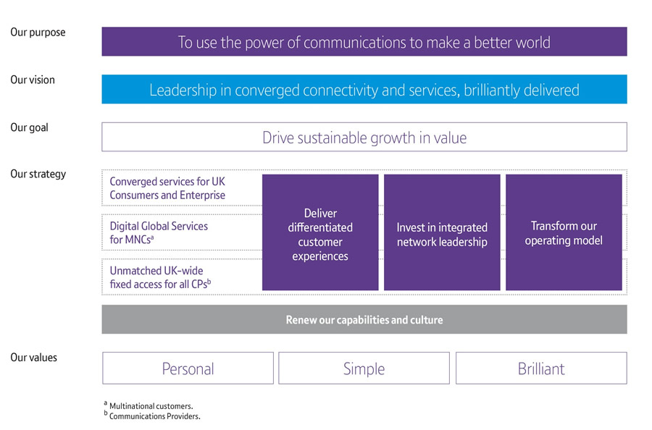
Notes:
James

Slide 8
WHAT DOES A GOOD VISION STATEMENT LOOK LIKE?
  It should be clear and unambiguous
  It should give a sense of going forward
  It should have an element that points to the club’s values
  It should be concise, ideally a sentence or two
  Club members should be able to remember it – and understand it!
  Be clear about where the vision statement will appear and what role it will serve
Notes:
Purpose of slide: to highlight the characteristics of a well researched and well written vision statement
Clear and unambiguous: it should be easily understood by all
Sense of going forward: aspirational, and builds on club’s success to date
Points to club’s values: thereby linking with the club’s overall culture
Concise: you can create a longer version, but it should not be the one that is broadcast to the world
Memorable and understandable: it’s not a test of memory, but the key message should be easily understood and be explainable by all

Slide 9

Unite the Game
Inspire the Nation
Notes:
Danielle

Slide 10

Notes:
Warnes

Slide 11


Our Vision
A nation enjoying thriving sporting places, open to, and led by their local community.”
Our Mission
Drive the continued development of a relevant, resilient and impactful Community Sports Sector”
Our Vision
We won’t give up until everyone experiencing a mental health problem gets both support and respect.
Our Mission
We provide advice and support to empower anyone experiencing a mental health problem. We campaign to improve services, raise awareness and promote understanding.
Notes:
Purpose of slide: difference between vision & mission and words used
Drive – we do more than support the sector we push it forward through the work we do at a sector level; the funds are a great example of this in the sport sector and the first for an NGB
Continued development – there’s always more we can do to keep the sector moving forward
Relevant – organisations need to be relevant to their local communities to survive and thrive; this links to the work we do to make organisations more connected to the communities and deliver services they need. It’s the opposite of an inward focused members club.
Resilient – encompasses the financial resilience and organisational resilience; key offers of our day-to-day work with grassroots clubs
Impactful – we aim to help individual and sector organisations to deliver greater impact / or continue to do impactful activity sustainably
Community Sports Sector – we are not about elite sport

Slide 12

CLUB CASE STUDY
Bradwell Bay United shall provide a fun and safe environment for its members to learn to play football. We hope to gradually create more teams for different ages and inspire children.
Our values were really quite important to us. When creating our club we spoke lots and we all knew we wanted to be a fully transparent club so have worked hard to do this. We wanted to be welcoming not just to the players but their families too and we wanted them to be armed with all the relevant and appropriate information they may need. We always want to ensure our club is for our members (players and their families) and we often speak with them all to see if there is anything extra we can do to help them and improve the club.
Top tip from one club to another
Really think about what you want to achieve and what would make a club stand out to you. How can you achieve this? Who can help you? Don’t give up!

Slide 13
WHAT DOES A GOOD SET OF VALUES LOOK LIKE?
  Make sure they truly represent your club and what is important to you
  Develop them together with time to reflect
  Think about what they mean and how they could be interpreted
  Can they guide your decision making
  Are they memorable? Try to keep them short and don’t have too many
  How can you bring them to life at your club
Notes:
Purpose of slide: to highlight the characteristics of a well researched and well written vision statement
Clear and unambiguous: it should be easily understood by all
Sense of going forward: aspirational, and builds on club’s success to date
Points to club’s values: thereby linking with the club’s overall culture
Concise: you can create a longer version, but it should not be the one that is broadcast to the world
Memorable and understandable: it’s not a test of memory, but the key message should be easily understood and be explainable by all

Slide 14
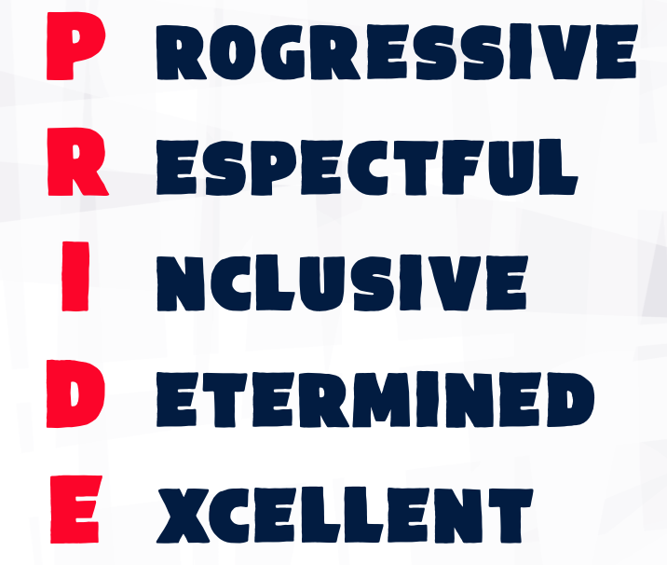
Notes:
Purpose of slide: to introduce the FA’s vision and values
Provides the audience with clear statement of the FA’s own vision and values, thereby further setting the context for the rest of the webinar.
The audience could be asked to reflect on whether they think the vision and values are effective and accurately represent the organisation.
FA Values
We believe that the best chance of achieving these objectives is with a healthy culture. At The FA, we live our PRIDE values in everything that we do:
Progressive - We embrace new thinking in the pursuit of continuous improvement
Respectful - We set the standards for respectful behaviour across the game
Inclusive - We champion and ensure that football is and will remain a game for everyone
Determined - We are tenacious and accountable to each other in serving the whole game and doing the right thing
Excellent - The very best outcome can only be achieved by sustained excellence in performance

Slide 15


Notes:
Purpose of slide: to introduce the FA’s vision and values
Provides the audience with clear statement of the FA’s own vision and values, thereby further setting the context for the rest of the webinar.
The audience could be asked to reflect on whether they think the vision and values are effective and accurately represent the organisation.

Slide 16
ENSURING THE VISION AND VALUES MATCH THE AMBITION OF YOUR CLUB
Does the club have a vision and values already and how long have they had them for?
If not a vision, does it have charitable objects or a statement of purpose?
Does the club have a business plan and how long does it cover?
What time period should it cover?
How long has the club been in its current set up? E.g. long standing, traditional, same premises and steady as she goes offer vs new, constantly innovating, keen to grow quickly
Are there ‘clubs within clubs’? Is everyone included
Notes:
James
Purpose of slide: issues to consider when forming early thoughts around what the vision and values might say
If the club has a vision and values already, are they still fit for purpose, or is there an appetite to update them?
If the club has objects or a statement of purpose, the vision will need to mirror them
Again, if the club has a business plan with life left in it the vision should reflect its core themes; alternatively, if the business plan is out of date this would be the perfect time to revisit the vision
Vision statements tend to be medium to long term, so a period of between 5-10 years should be considered
Getting a sense of these indicators should help shape how ambitious the vision statement needs to be

Slide 17
PRACTICAL IDEAS TO DEVELOP YOUR VISION AND VALUES
Adapting what you might have: Informed by existing formal documents such as your club rules or charitable objects your purpose can be adapted by elected officials or trustees of the club into a vision statement
Surveys: ask the club’s membership what they think the vision and values should include, and then asking them to vote for shortlisted options drafted from their responses
Vision workshop: either developed and delivered by the club or facilitated professionally
Theory of change: a detailed process of clarifying an organisation’s priorities by defining its goals and the path to reach them – the vision and values are then summarised from this
Notes:
James
Purpose of slide: to introduce the three main ways in which a club can develop a vision statement and set of values
Visioning workshop: we will go on to talk in more detail about how such a workshop can be developed and delivered
Theory of Change: a theory of change shows how you expect outcomes to occur over the short, medium and longer term as a result of your work. It can be represented in a visual diagram, as a narrative, or both. Often facilitated by experts, but there are some good ’self help’ materials on line
Constitution or charitable objects: the formal structure of a club will often require it to have a statement of its purpose, particularly if it is incorporated. These statements can usually be readily adapted into vision statements, thereby providing end users with concise and clear explanation of what the organisation does
Alternatively, the vision and values can be developed in a more informal way by working directly with the club’s membership
Whatever the method, testing the draft vision statement with the club’s wider membership, partners and stakeholders is good practice, as that way it feels more like a democratic exercise and gives people more of sense of ownership of the final agreed version.

Slide 18
RUNNING A VISION/VALUES WORKSHOP
Decide who you want to invite?
  Board/Trustees
  Committee members
  Those holding key delivery roles e.g. a coach, volunteer coordinator
  Volunteers and other members with relevant professional skills and knowledge
  Representatives across all parts of a club
How long do you run the workshop for? Some areas to consider:
  Are the club starting from fresh?
  Do attendees know each other well?
  Is there a sense of common endeavour?
  What time of day is best?
  Will there be a further chance to work on it? Who would lead that?
Notes:
James
Purpose of slide: to help the club identify the key people who should attend the session
Committee members: preferably with the Chair present, and other leading roles e.g. treasurer
Key delivery roles: important to have representation from the those involved in the direct delivery of sports activities
Facility manager and bar staff: and other staff/volunteers involved in generating income, social activities etc
Others with relevant skills and experience: could be members or friends/relatives of members invited to join the session (e.g. someone with day to day experience of marketing & communications, business development etc)

Slide 19
RUNNING A VISION/VALUES WORKSHOP
3. Look to cover the following areas in your workshop;
  Introduction (20 minutes)
    What is a vision? Why is having one important? What sits below the vision? How do we deliver against it?
  The club’s vision for the future (40 minutes)
    What may the club look in 3 years’ time; how would new members describe the club in three years’ time?
  Discuss the key issues moving forward (40 minutes)
    Think about success factors and possible barriers as well as new initiatives which would help deliver the emerging vision
  Conclusion and next steps (25 minutes)
    Have we agreed a vision? A short list of key words? Have we formed ideas about how the vision can be delivered? (Goals and Objectives) What are the key next steps and who for, such as members, funders, volunteers?
Notes:
James
Purpose of slide: to help the club identify the key people who should attend the session
Committee members: preferably with the Chair present, and other leading roles e.g. treasurer
Key delivery roles: important to have representation from the those involved in the direct delivery of sports activities
Facility manager and bar staff: and other staff/volunteers involved in generating income, social activities etc
Others with relevant skills and experience: could be members or friends/relatives of members invited to join the session (e.g. someone with day to day experience of marketing & communications, business development etc)

Slide 20
RUNNING A VISION/VALUES WORKSHOP
4. Summarise the workshop
  Write up all notes, flipchart, post it note
  Write up the vision as the group have agreed it, or (more likely) draft up to three vision statements based on the outcomes of the workshop
  Create a ‘word cloud’ based on notes – this can be useful when drafting a vision statement
  Note any action points
  Test the vision statement(s) with members
Share the vision and values to the club’s members, partners and stakeholders
  Traditional media - news story, newsletter, annual report
  Digital media – Facebook update, tweets, emails, website, YouTube video
  Branding – posters, headers, sports kit and merchandise
Notes:
James
Purpose of slide: to help the club identify the key people who should attend the session
Committee members: preferably with the Chair present, and other leading roles e.g. treasurer
Key delivery roles: important to have representation from the those involved in the direct delivery of sports activities
Facility manager and bar staff: and other staff/volunteers involved in generating income, social activities etc
Others with relevant skills and experience: could be members or friends/relatives of members invited to join the session (e.g. someone with day to day experience of marketing & communications, business development etc)

Slide 21
RUNNING A VISION/VALUES WORKSHOP
6. Use the new vision and values as an opportunity to:
  Launch a drive to recruit new members
  Develop and deliver new activities and programmes
  Celebrate a notable club anniversary
  Invite the wider community to visit the club and try out its activities for free
  Target under-represented groups within the community
  Attract new investment and sponsorship
Notes:
James
Purpose of slide: to help the club identify the key people who should attend the session
Committee members: preferably with the Chair present, and other leading roles e.g. treasurer
Key delivery roles: important to have representation from the those involved in the direct delivery of sports activities
Facility manager and bar staff: and other staff/volunteers involved in generating income, social activities etc
Others with relevant skills and experience: could be members or friends/relatives of members invited to join the session (e.g. someone with day to day experience of marketing & communications, business development etc)

Slide 22

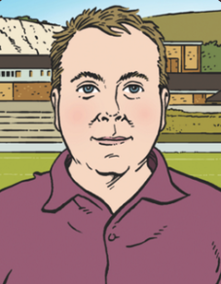
CLUB CASE STUDY
Stuart Fuller: Chair, Lewes FC

Slide 23
OUR STORY

Slide 24

“The biggest problem you have is that you know nothing
about football…”

Slide 26
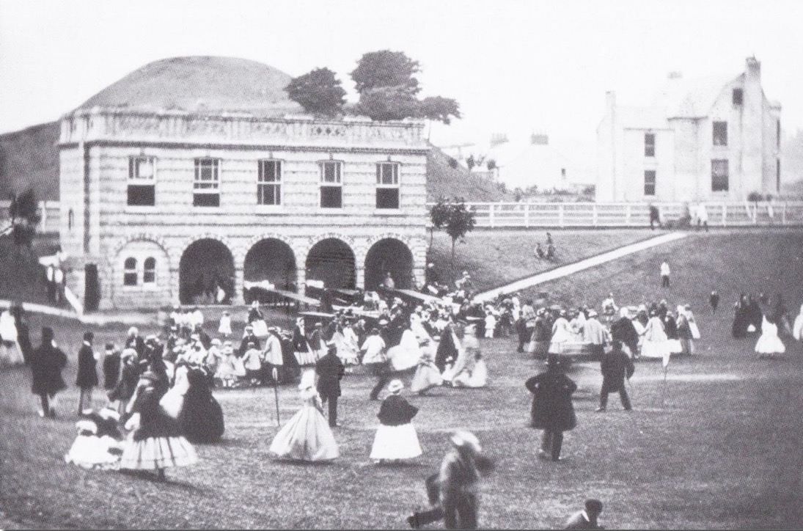
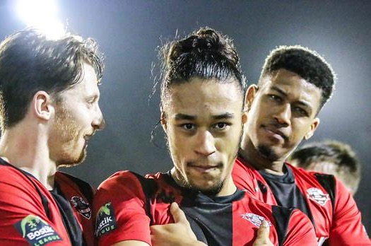
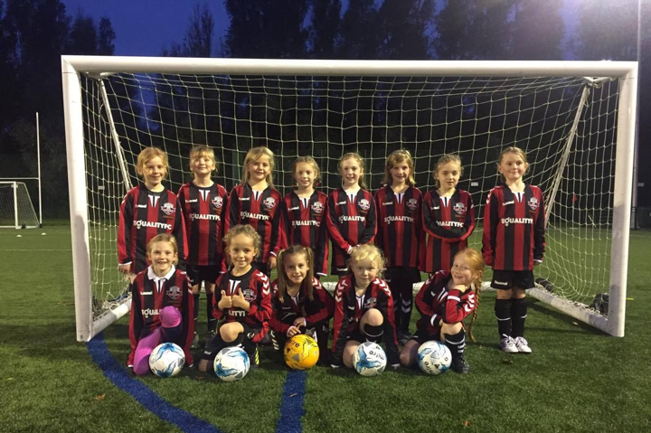
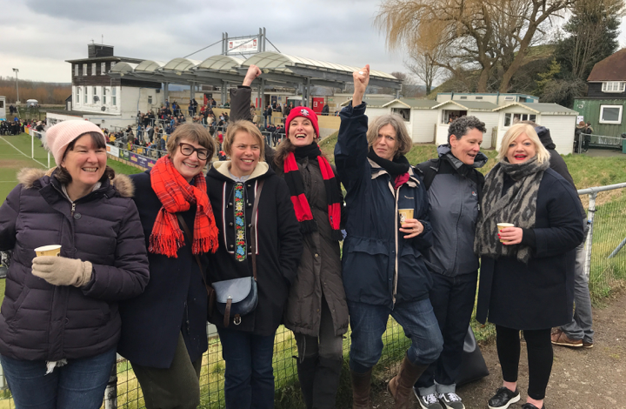
Football has been played at the Dripping Pan since 1885, making it one of the oldest constantly used grounds in the world.
In 2010, Lewes FC became a 100% community-owned, non-profit entity.
We have around 1,500 equal owners across 26 countries.
Each owner can own only one share, thereby lowering our risk of becoming too dependent or overly influenced by one or two single rich individuals.
Our board is elected from among the owners. This means that we not only serve our community, we are our community.
LEWES FC - OUR STORY
Lewes FC

Slide 27
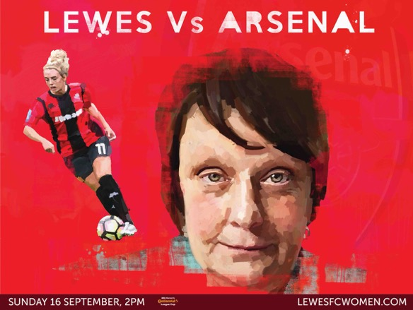





Slide 28


Slide 29
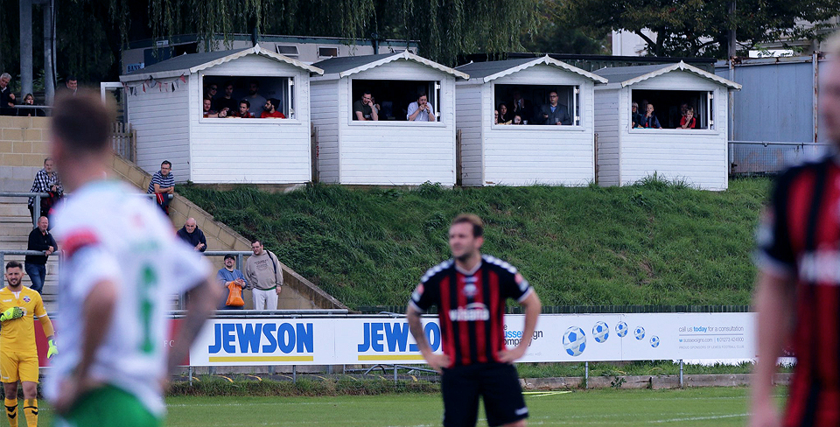

Slide 30
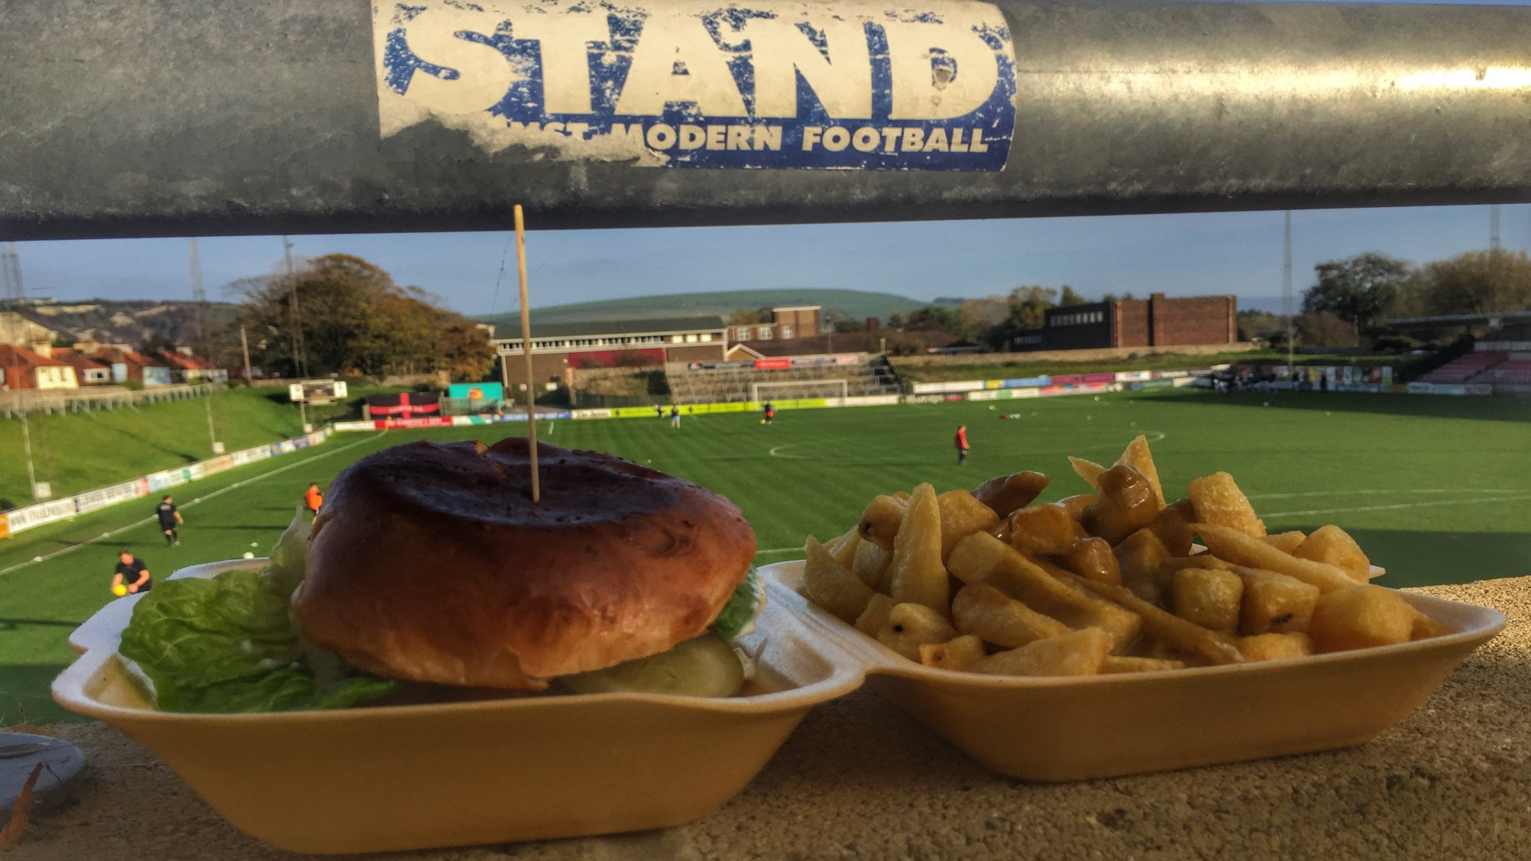

Slide 31
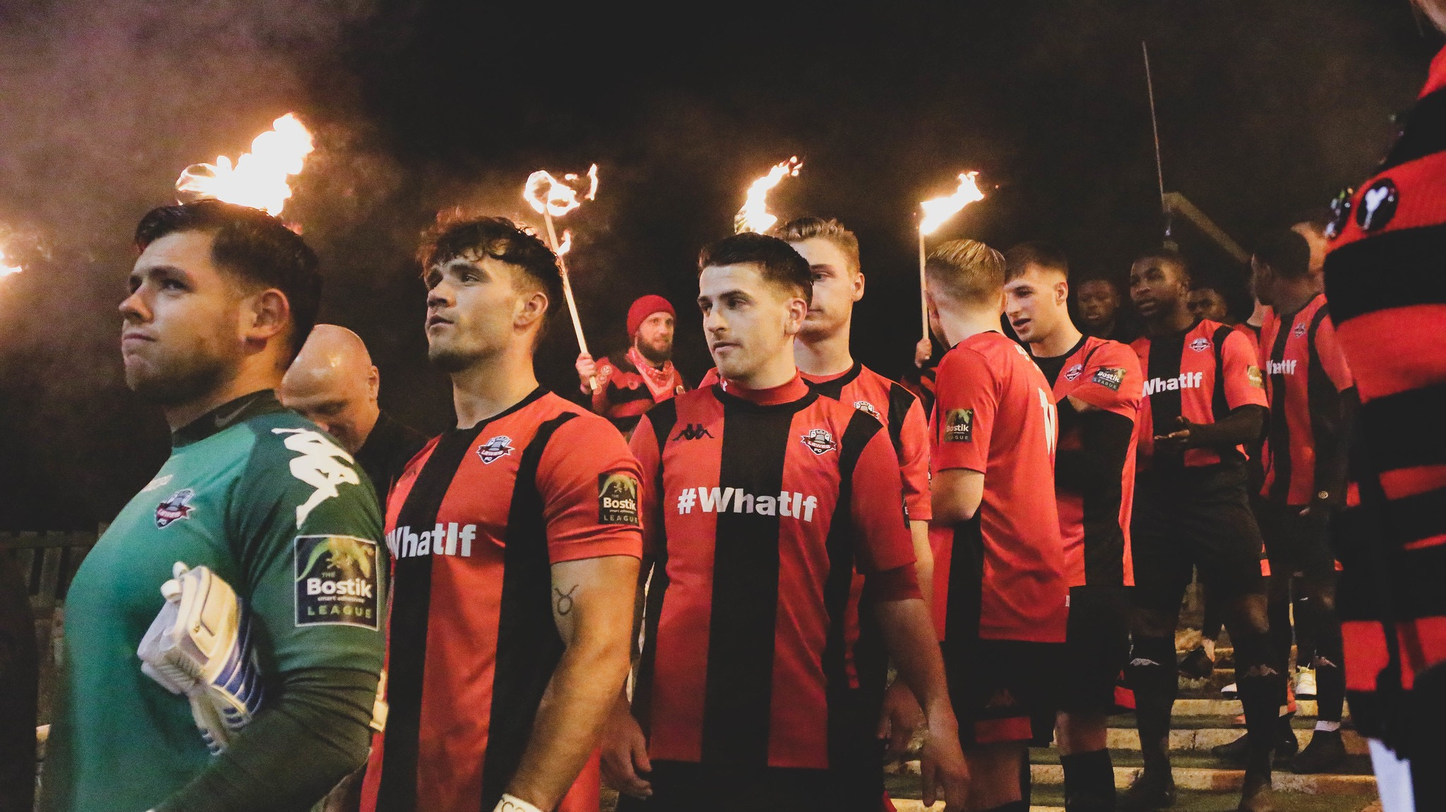

Slide 32
In 2017, Lewes FC become the first club in the world to have equal playing and marketing budgets for women and men.
We allocate all club resources equally by gender.
LEWES FC - OUR STORY
Lewes FC

Slide 33



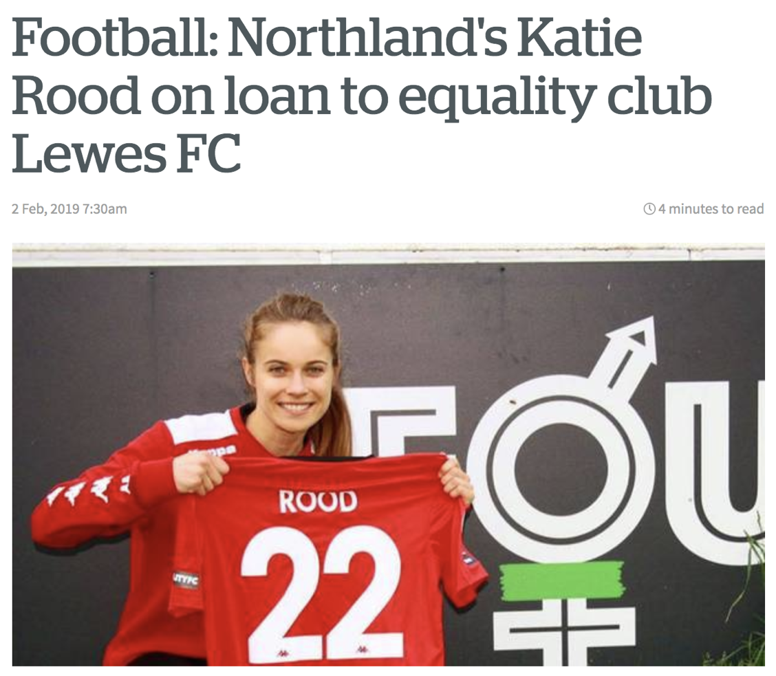
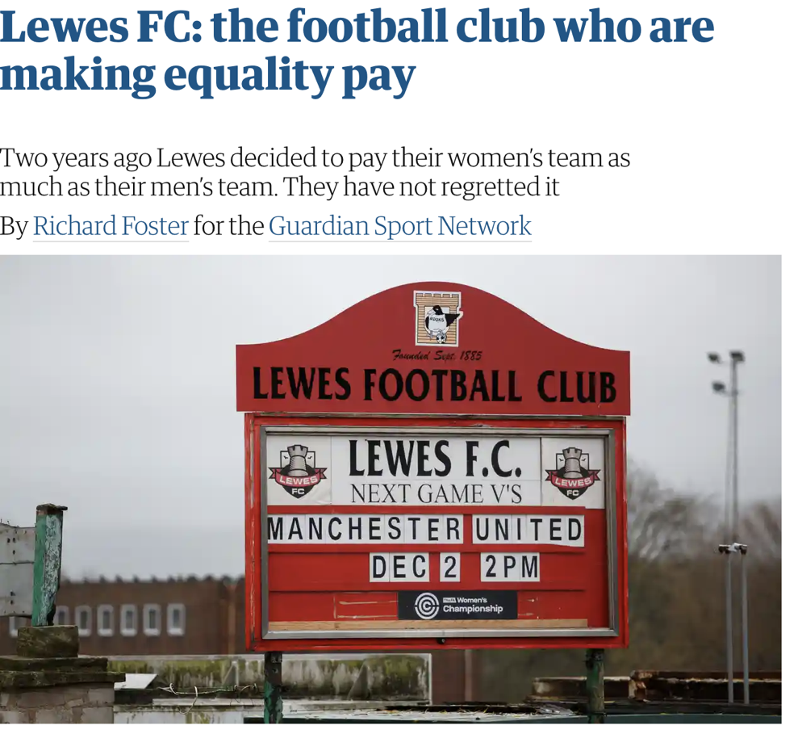
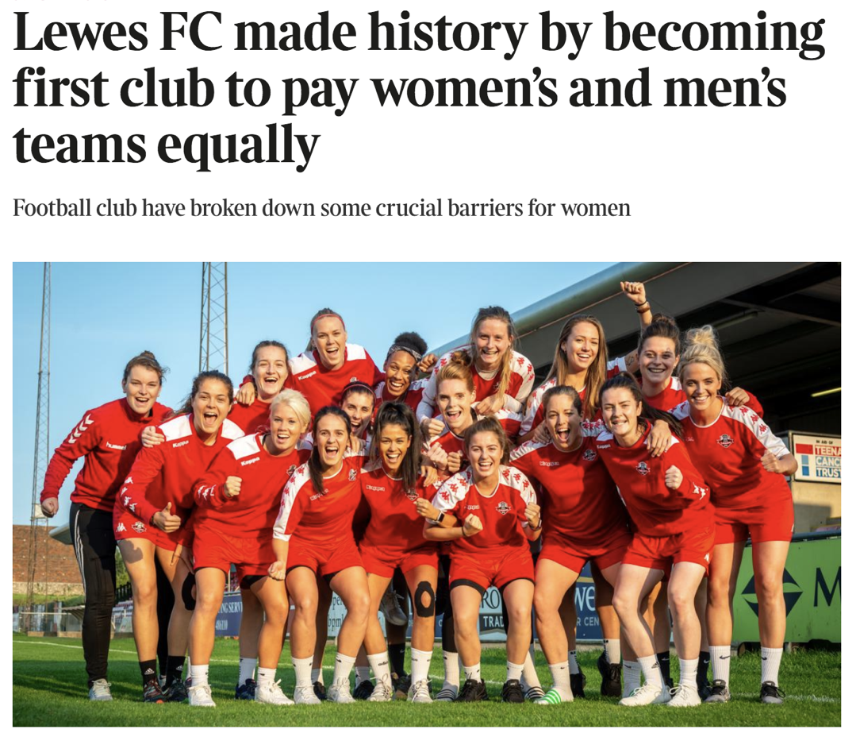
Our equality principles have generated many media stories and a global attention
LEWES FC - OUR STORY
Lewes FC

Slide 34

The first (and only) club world in the world to allocate resources equally by gender.
Our players, Directors and Staff frequently speak to the media and in forums about our values, our principles and our stance on equality.
We use our pitch hoardings and our front of shirt to promote powerful messages promoting social good.
Sponsors must be aligned with the club’s principles and values. We have declined lucrative sponsorship opportunities in the past where we have felt our values may be compromised.
LEWES FC - OUR PRINCIPLES
Lewes FC

Slide 35

UN Women UK HeForShe Award 2019
On September 4 2019, Lewes FC was awarded the Inspiration Award for an outstanding contribution to advancing gender equality in the UK
LEWES FC - UN AWARD
Lewes FC

Slide 36
IMPACT

Slide 37
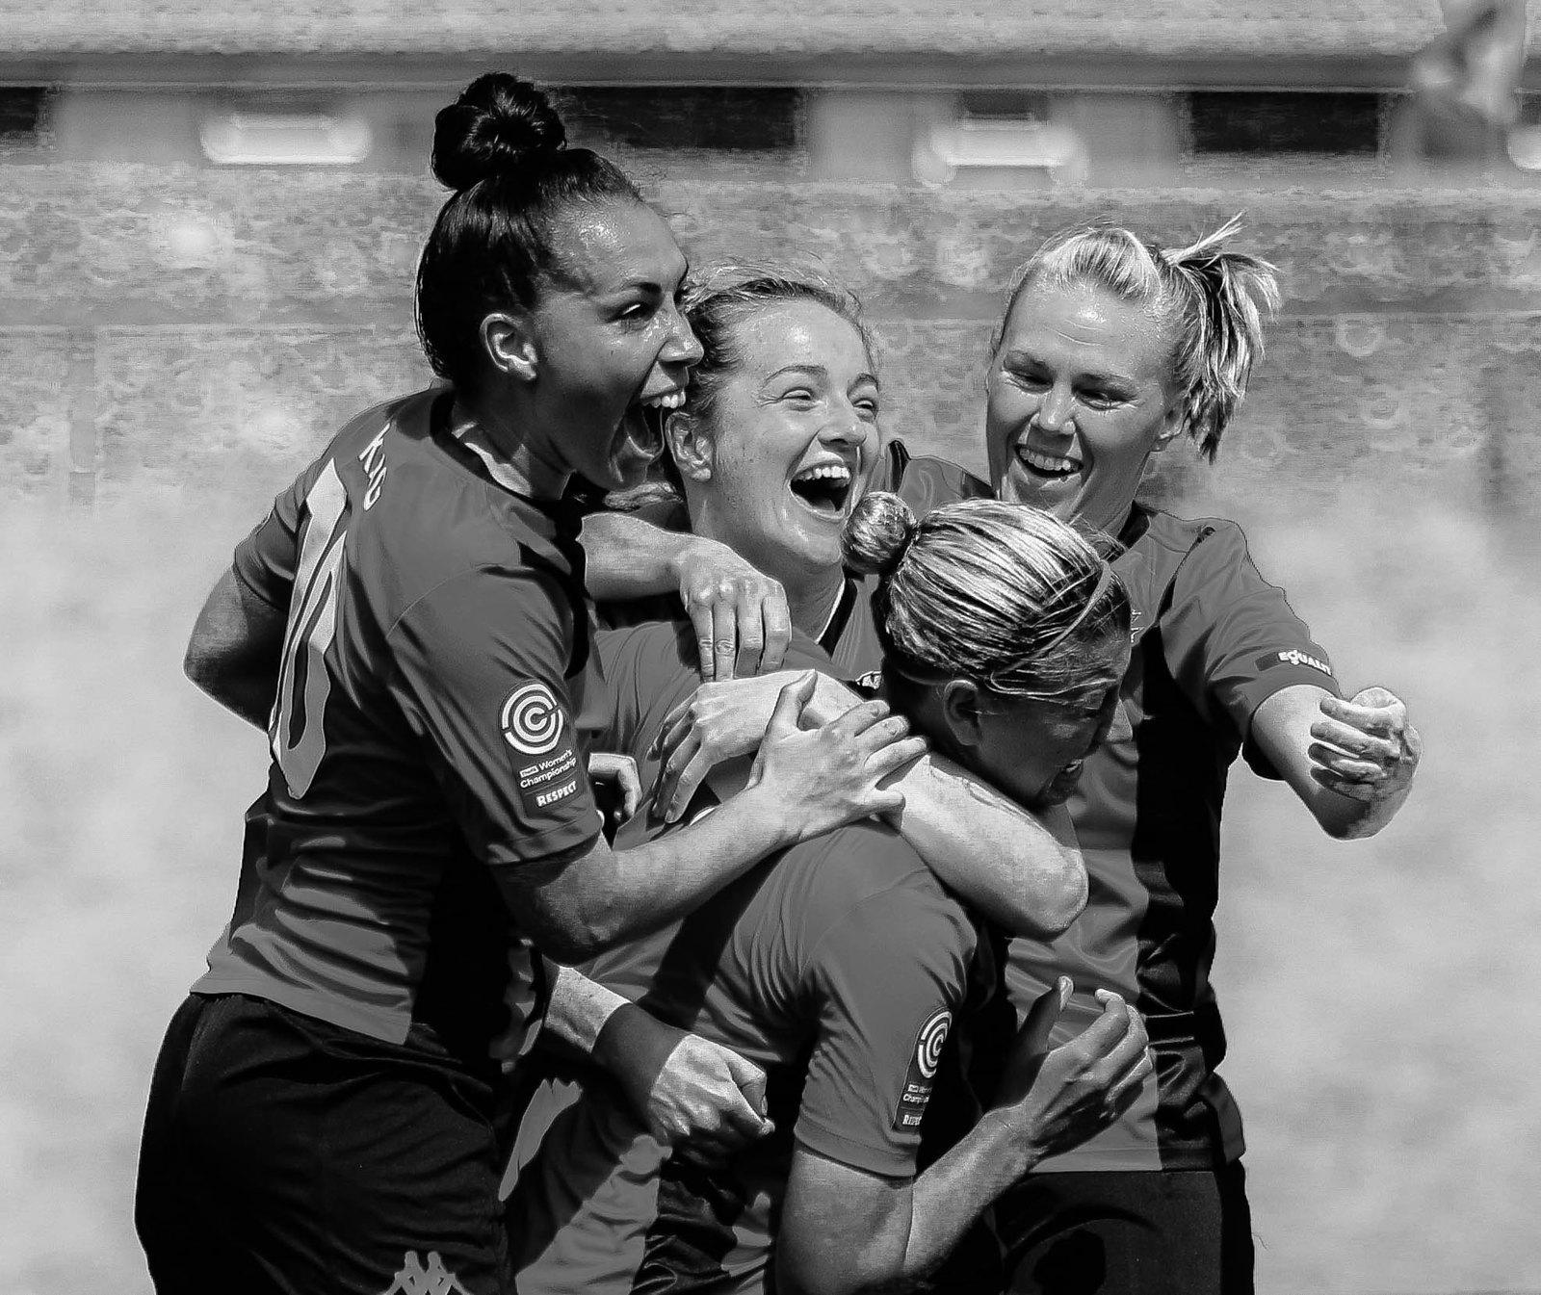
LEWES FC - IMPACT ON THE PITCH
Approx 100 women and girls play football across our elite talent pathway (from U14s to the first team)
We punch above our weight alongside household names. In our first game of the 2019-2020 season, we beat Blackburn Rovers 5-1.
The men’s team were promoted, the first year after introducing pay parity and junior team (U18s) champions of Sussex for past two seasons
The women’s team have six players who play international football at senior level for Wales, Scotland and Cyprus.
Lewes FC

Slide 38

LEWES FC - IMPACT IN THE COMMUNITY
100% community owned.
100+ volunteers dedicate their time and skills.
200 boys and girls play for Lewes Juniors
“Football Therapy” sessions promote mental well-being across the community with trained support workers.
Walking Football established for women over the age of 40
Competitive “Vets football” for men and women aged 35+.
Lewes FC

Slide 39
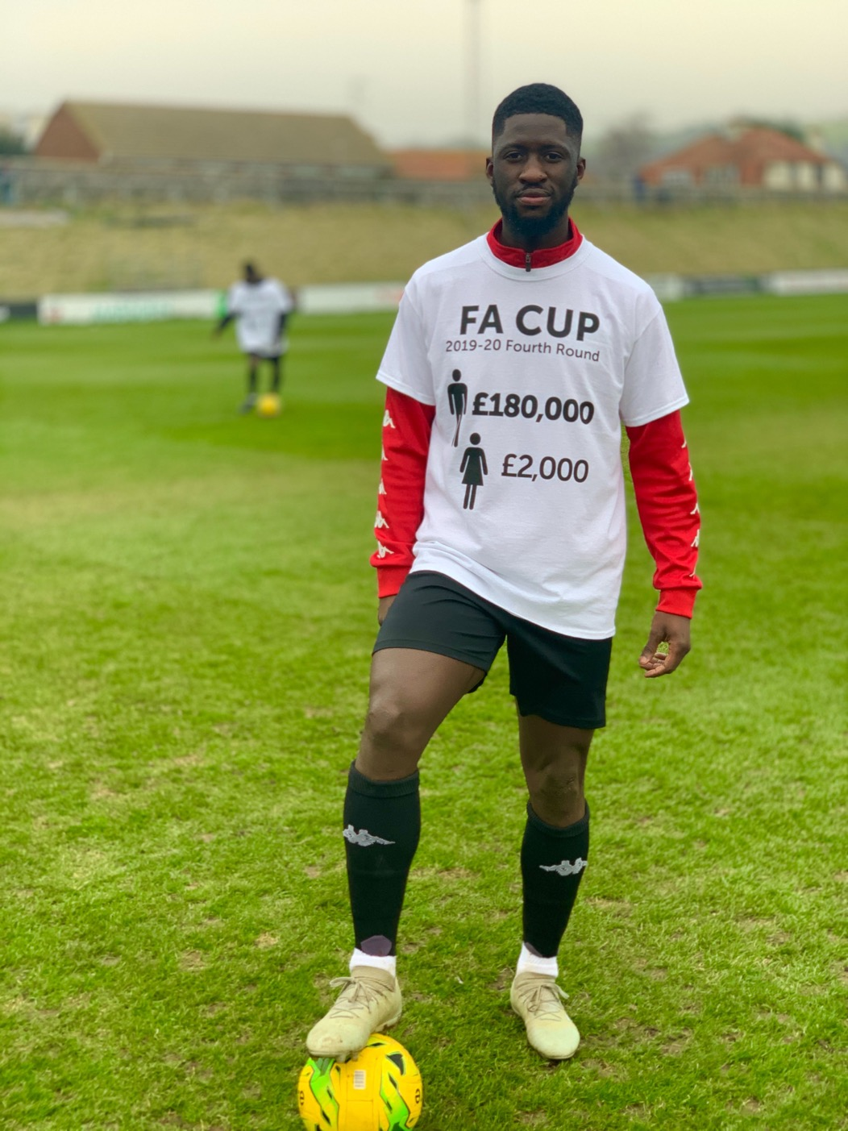
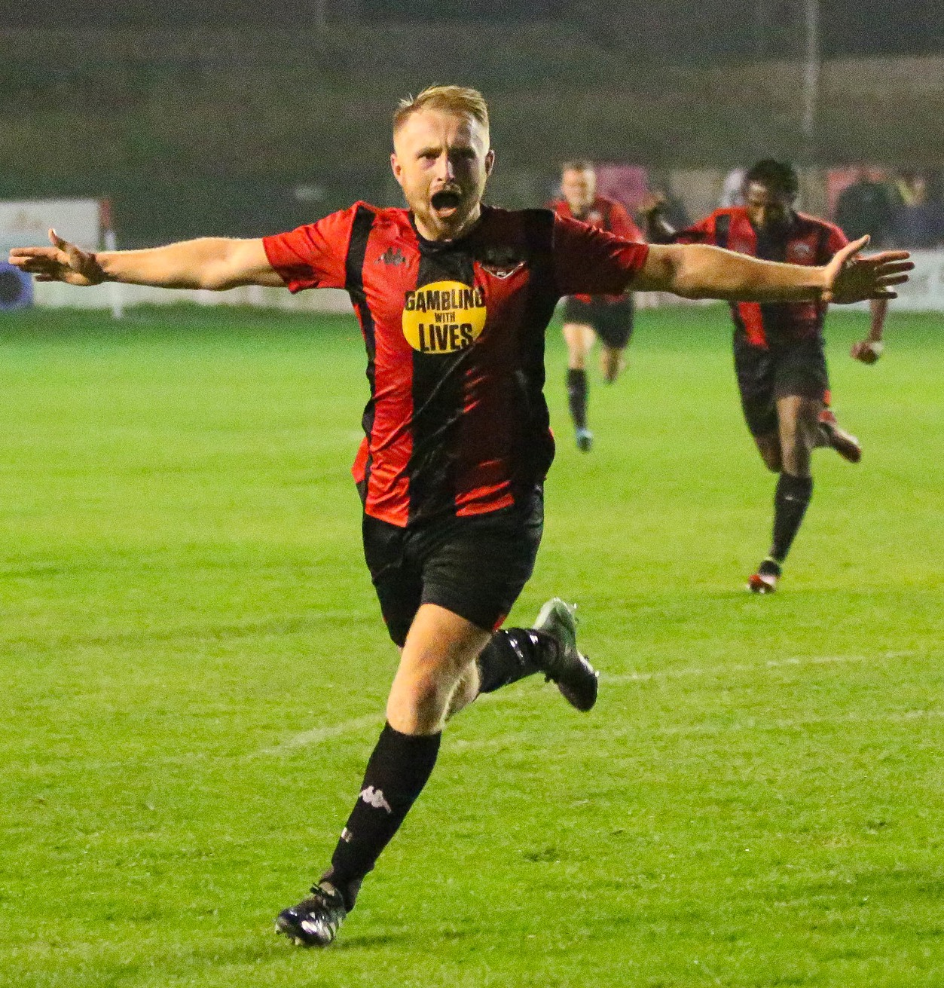
LEWES FC - IMPACT IN THE COUNTRY
The first football club in the UK to install solar-panels.
The first football club to erect “Football v Homophobia” pitch barriers.
A vocal club, that campaigned for equal prize money in the FA Cup, generating debate in the UK Parliament.
First football club to have an Anti-Gambling Charity on the front of our Men’s shirts despite playing in a league sponsored by a gambling company
Lewes FC

Slide 40
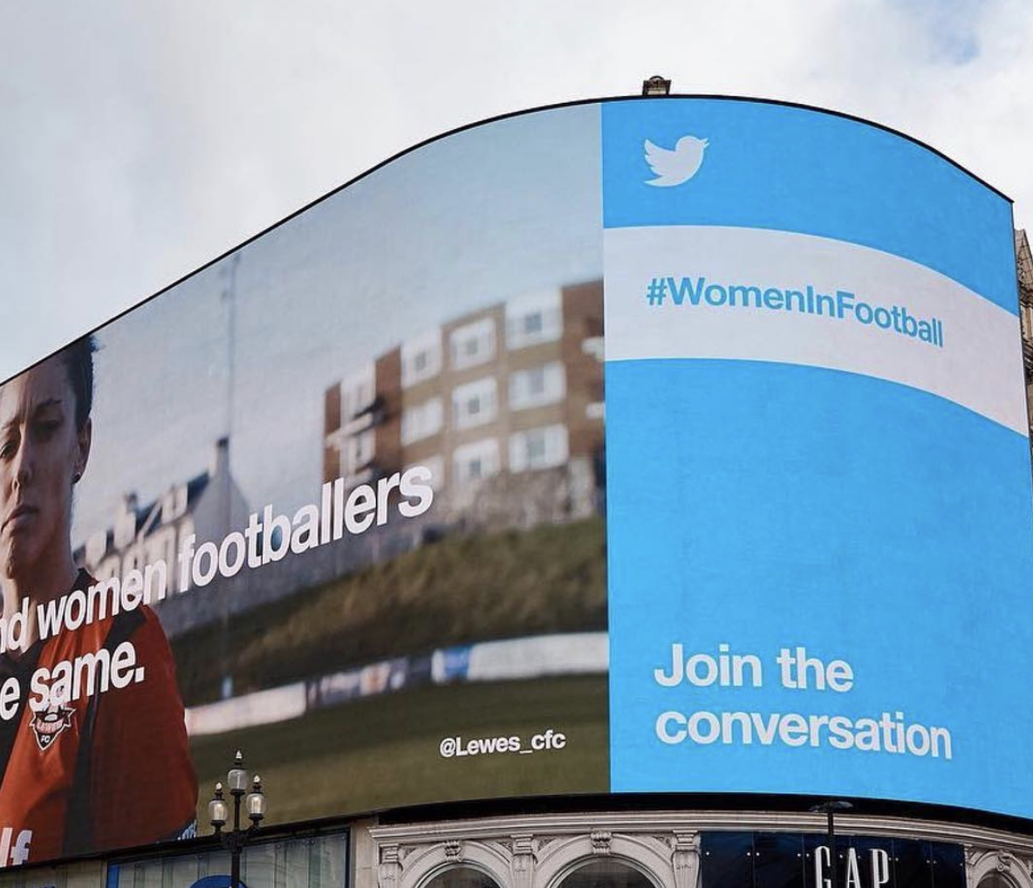
LEWES FC - IMPACT IN THE WORLD
Owners across 25 countries, bought in to the principles and values of Lewes FC.
Won the prestigous UN #HeforShe prize in 2019 for leadership in driving forward gender equality in actions, not words.
Our “Rooks TV” generates approx 60k views per season.
Global relationships with leaders, clubs and organisations promoting gender equality in sport across the world.
Lewes FC

Slide 41
GET BIG, GET NICHE OR GET OUT…
There are these two young fish swimming along, and they happen to meet an older fish swimming the other way, who nods at them and says, “Morning, boys, how’s the water?” And the two young fish swim on for a bit, and then eventually one of them looks over at the other and goes, “What the hell is water?”
We are the only football team in the world to pay men and women the same amounts for performing the same work. Ask why not rather than why
= Big and Niche

Slide 42
OUR PEOPLE

Slide 43
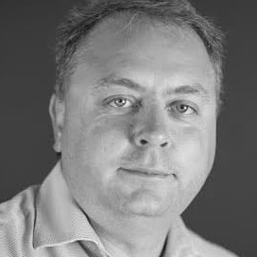
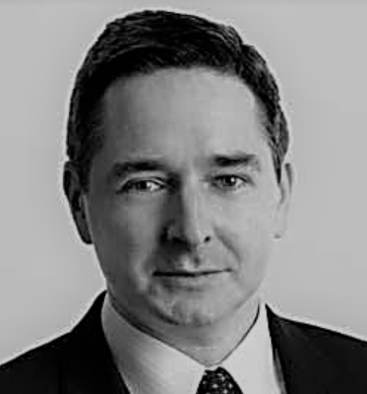
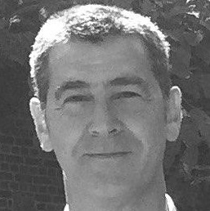
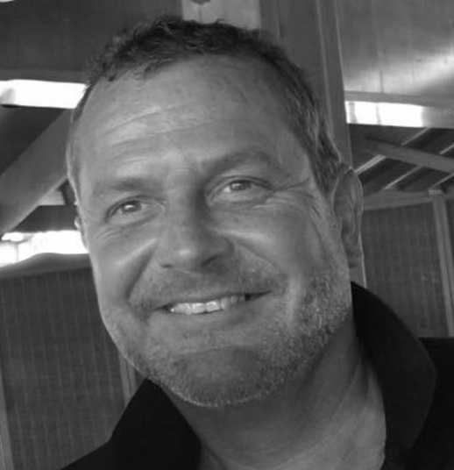
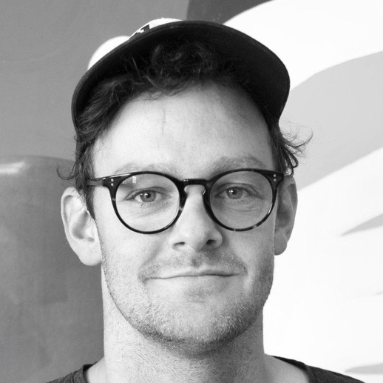
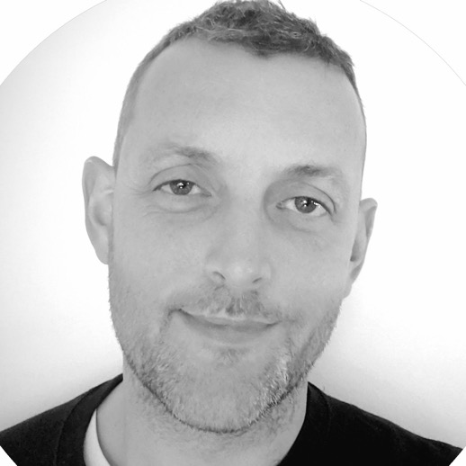
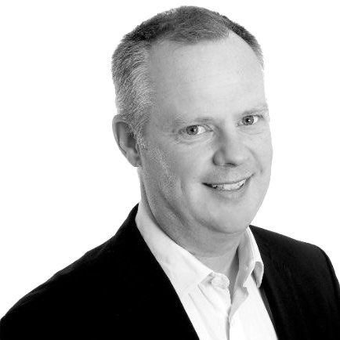
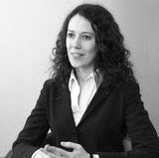
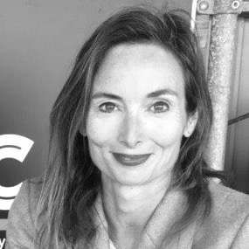
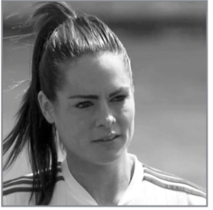
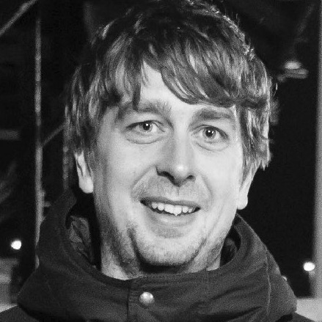

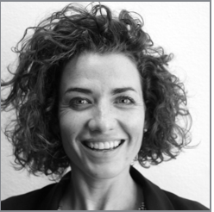
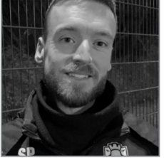
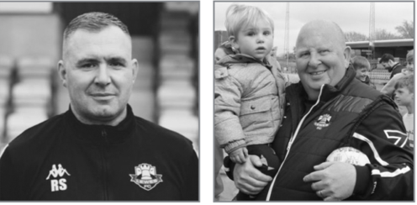
LEWES FC – OUR FIRST TEAM SQUAD
Lewes FC

Slide 44
THANK YOU

Slide 45

OPEN DISCUSSION/QUESTIONS
Ask Questions
Share your own experiences
Share your current challenges
Solutions
If you’d like to contribute, either
Please type your name and club/org. into the chat box so we can effectively bring you into discussion or
Please type a question/comment which one of the presenters will raise

Slide 46
HOW DO WE KNOW WE HAVE MADE IT?
Next webinar;
Defining success at your club

Slide 47

THE FA CLUB
FOOTBALL FORUM
FREE WEBINAR
THANK YOU

