Slide 1
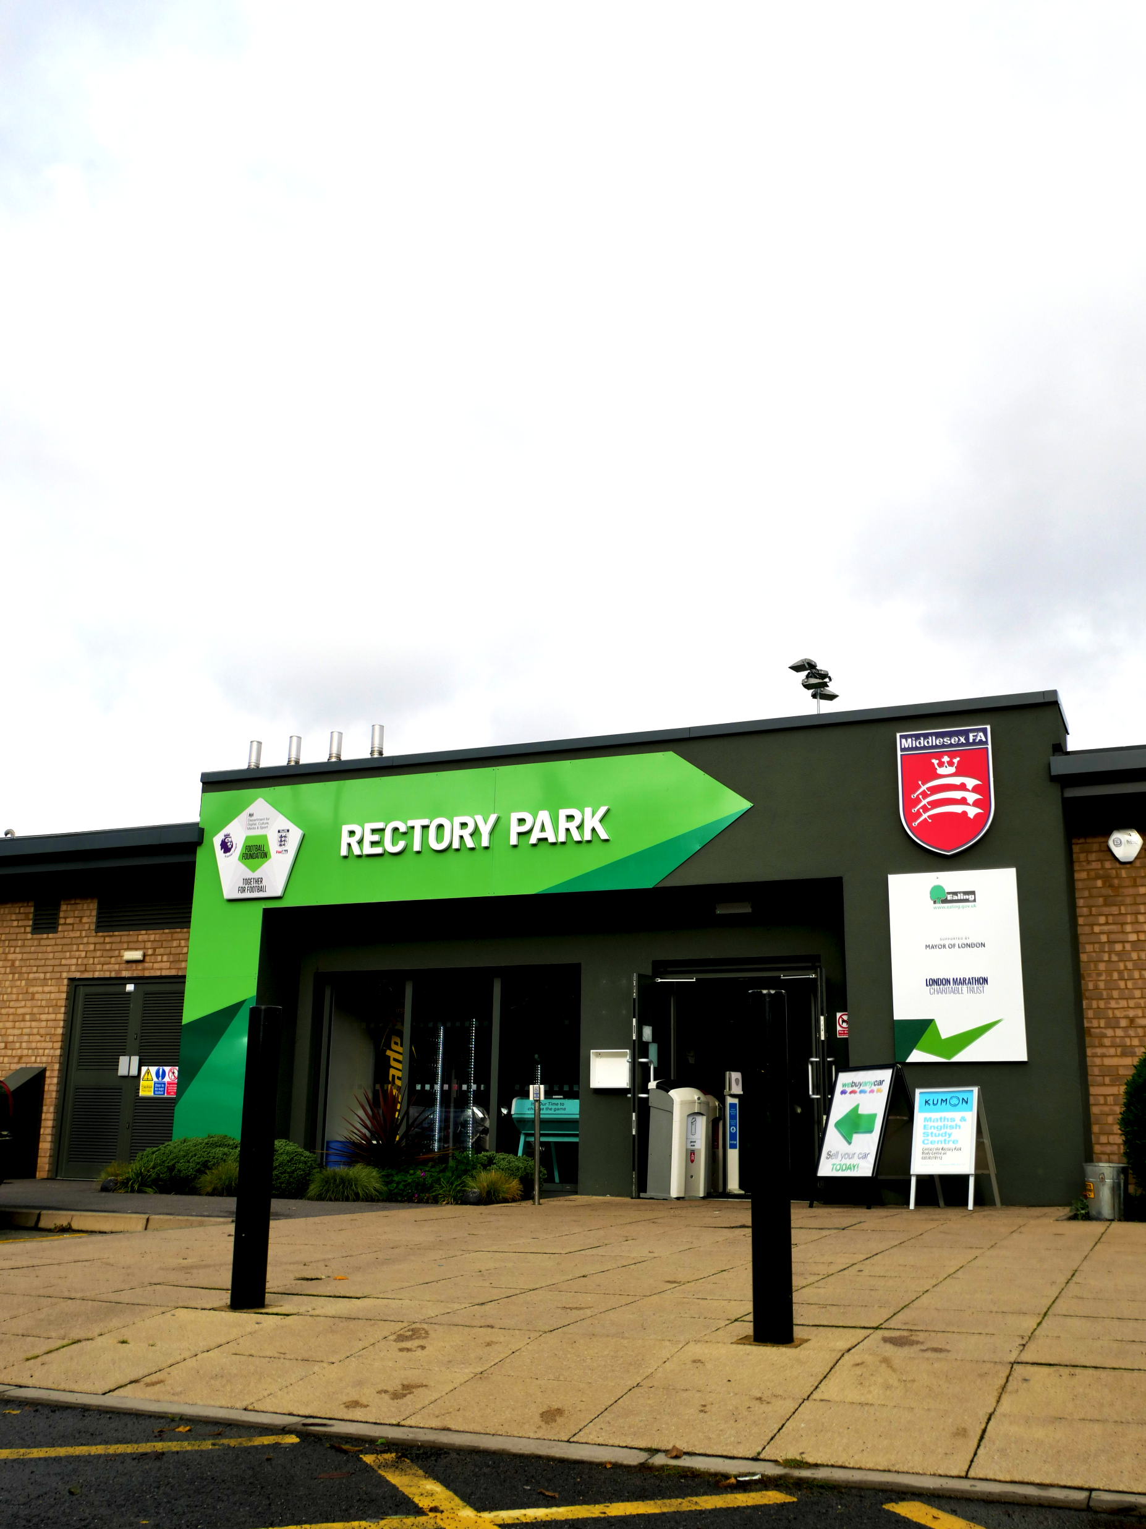
MIDDLESEX FA EVENTS CALENDAR 2022/23

Slide 2
DECEMBER 2022
DATE | CAMPAIGN OR EVENT | MFA CONTACT
20TH Nov – 18th Dec | World Cup | N/A
Nov – Apr 2023 | England Football Accreditation Renewal Window | Paul Sharpe development@middlesexfa.com
Nov – 16th Jan 2023 | Introduction to Coaching Football Fully Funded Places Application Window | Paul Sharpe coaching@middlesexfa.com
21ST Nov – 18th Dec | Rainbow Laces | Daniel Perkins development@middlesexfa.com
3rd December | International Day of People with Disabilities | Daniel Perkins development@middlesexfa.com
4th December | PAN Disability League Fixtures | Daniel Perkins development@middlesexfa.com
8th December | Council Meeting | N/A
9th December | NWL Mental Health League | Daniel Perkins development@middlesexfa.com
14th December | Youth Council Meeting | N/A
23rd Dec – 3rd Jan | Office/Rectory Closed | N/A
18th – 26th Dec | Chanukah | N/A
25th Dec | Christmas | DP – Lead JB – Support

Slide 3
JANUARY 2023
DATE | CAMPAIGN OR EVENT | MFA CONTACT
January | Application Window opens for Squad & Weetabix Wildcats Providers | Andrew Perren development@middlesexfa.com
January | Referee Mid-Season Promotions | Sophie Dennington Referee@middlesexfa.com
January | Female Referee CPD Session | Sophie Dennington Referee@middlesexfa.com
1st January | New Year | N/A
23rd Dec – 3rd Jan | Office/Rectory Closed | N/A
Nov – 16th Jan | Introduction to Coaching Football Fully Funded Places Application Window | Paul Sharpe coaching@middlesexfa.com
Nov – Apr | England Football Accreditation Renewal Window | Paul Sharpe development@middlesexfa.com
5th January | Female Only Referee Course | Sophie Dennington referee@middlesexfa.com
20th January | Birthday of Guru Gobind Singh | N/A
22nd January | Lunar/Chinese New Year | N/A

Slide 4
FEBRUARY 2023
DATE | CAMPAIGN OR EVENT | MFA CONTACT
Nov – Apr | England Football Accreditation Renewal Window | Paul Sharpe development@middlesexfa.com
February | LGBT History Month | Daniel Perkins development@middlesexfa.com
February | Welfare Officer CPD Session | Rebecca Chapman safeguarding@middlesexfa.com
5th Feb | PAN Disability League | Daniel Perkins development@middlesexfa.com
6th – 10th Feb | Internet Safety Week | Rebecca Chapman safeguarding@middlesexfa.com
7th Feb | Safer Internet Day | Rebecca Chapman safeguarding@middlesexfa.com
7th – 13th Feb | Sexual Abuse & Sexual Violence Awareness Week | Rebecca Chapman safeguarding@middlesexfa.com
9th Feb | Hendon Referee Course | Sophie Dennington referee@middlesexfa.com
10th Feb | NWL Mental Health League | Daniel Perkins development@middlesexfa.com
14th February | Valentines Day, Healthy Relationships | Rebecca Chapman safeguarding@middlesexfa.com
25th-26th Feb | Silent Support Weekend 2.0 | Rebecca Chapman safeguarding@middlesexfa.com

Slide 5
MARCH 2023
DATE | CAMPAIGN OR EVENT | MFA CONTACT
Nov – Apr | England Football Accreditation Renewal Window | Paul Sharpe development@middlesexfa.com
1st March | Zero Discrimination Day | Daniel Perkins development@midlesexfa.com
3rd March | International Wheelchair Day | Daniel Perkins development@middlesexfa.com
5th March | PAN Disability League Fixtures | Daniel Perkins development@middlesexfa.com
6th March | The Match Day Experience CPD Event | Paul Sharpe coaching@middlesexfa.com
8th March | International Women’s Day | Daniel Perkins development@middlesexfa.com
10th March | NWL Mental Health League Fixtures | Daniel Perkins development@middlesexfa.com
16th March | Jeff Ritson Senior Youth Cup Final | countycups@middlesexfa.com
18th March | Child Sexual Exploitation Day | Rebecca Chapman safeguarding@middlesexfa.com
19th March | Veterans Cup Final | countycups@middlesexfa.com
22nd March | Ramadan due to begin | Daniel Perkins development@middlesexfa.com
25th March | Non-League Day | N/A
25th & 26th Mar | Middlesex FA Charity Weekend | info@middlesexfa.com
26th March | Sunday Premier Cup Final | countycups@middlesexfa.com
29th March | Junior Trophy Final | countycups@middlesexfa.com
30th March | Graham Rigby U16 Cup Final | countycups@middlesexfa.com
 | Pitch Power Submissions Deadline | Lawrence Picking development@middlesexfa.com

Slide 6
APRIL 2023
DATE | CAMPAIGN OR EVENT | MFA CONTACT
Nov – Apr | England Football Accreditation Renewal Window | Paul Sharpe development@middlesexfa.com
2nd April | World Autism Day | Daniel Perkins development@middlesexfa.com
2nd April | Final PAN Disability League Fixtures | Daniel Perkins development@middlesexfa.com
2nd April | Sunday Junior Cup Final | countycups@middlesexfa.com
5th April | Premier Cup Final | countycups@middlesexfa.com
12th April | Junior Cup Final | countycups@middlesexfa.com
13th April | U18 Girls Cup Final | countycups@middlesexfa.com
14th April | NWL Mental Health League Fixtures | Daniel Perkins development@middlesexfa.com
16th April | Sunday Intermediate Cup Final | countycups@middlesexfa.com
18th April | Developing on the Pitch CPD Event | Paul Sharpe development@middlesexfa.com
19th April | Senior Challenge Cup Final | countycups@middlesexfa.com
20th April | EPL Grieg U18 Cup Final | countycups@middlesexfa.com
21st April | Ramadan Due to End | Daniel Perkins development@middlesexfa.com
23rd April | Sunday Junior Trophy Final | countycups@middlesexfa.com
26th April | Intermediate Cup Final | countycups@middlesexfa.com
29th April | U12, U14, U16 Girls Cup Finals | countycups@middlesexfa.com
30th April | Jimmy Dyson U15 Cup Final | countycups@middlesexfa.com
30th April | FA Sunday Cup Final | N/A

Slide 7
MAY 2023
DATE | CAMPAIGN OR EVENT | MFA CONTACT
3rd May | Senior Charity Cup Final | countycups@middlesexfa.com
6th May | Kings Coronation | N/A
14th May | JN Smith U14, Sam Dunn U13, Dudley Harper U12 Cup Finals | countycups@middlesexfa.com
14th May | Vitality Women’s FA Cup Final | N/A
15th May | Supporting Players Through Game Formats CPD Event | Paul Sharpe coaching@middlesexfa.com
21st May | Ron Plunkett U14, Richard Styles U13, Jim Taylor U12 Trophy Finals | countycups@middlesexfa.com
21st May | Non League Finals Day (Wembley Stadium) | N/A
TBC | Club Welfare Officer End of Season De-Brief | Rebecca Chapman safeguarding@middlesexfa.com
TBC | Club Affiliation Workshop | Daniel May info@middlesexfa.com

Slide 8
JUNE 2023
DATE | CAMPAIGN OR EVENT | MFA CONTACT
1st June | Affiliation Window Opens | info@middlesexfa.com
1st June | Referee Affiliation Window Opens | referee@middlesexfa.com
5th June | Middlesex FA AGM | Management@middlesexfa.com
18th June | Walking Football County Cup | Andrew Perren Development@middlesexfa.com
Tbc | New Referee CPD Session | Sophie Dennington referee@middlesexfa.com

