Slide 1


London FA – Weetabix Wildcats Centre Support Pack

Slide 2

Weetabix Wildcats Overview
Weetabix Wildcats is an offer for girls aged 5-11 to
try football for the first time in a fun, safe
environment.
All Weetabix Wildcats sessions are delivered by FA qualified coaches, providing a safe place for girls to try football for the first time and develop key skills.

Slide 3
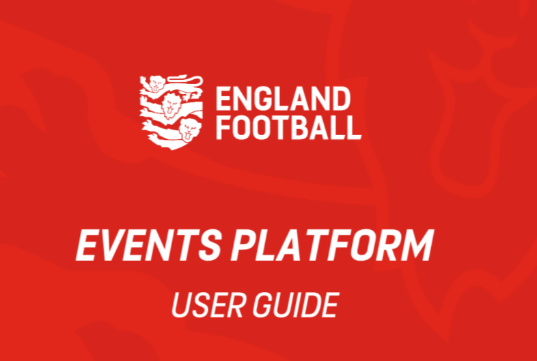
Events Platform
In order to deliver Weetabix Wildcats programme, you need to register your sessions on the FA Events Platform.
User guide, including videos, on how to register your sessions and utilise the Events platform can be found here.
For further support, you can contact the FA team at wildcats@thefa.com.

Slide 4

Key questions to consider?
Are you using appropriate Weetabix Wildcats branding to promote your sessions?
Remember if you need additional resources, let us know.
Are you using social media to promote your sessions? Use the FA Events platform to attract more girls to your sessions.
Engagement with Primary schools as they have access to participants.
Have you spoken with your local FA Girls School Partnership?
As a reminder, you will receive two lots of funding. There is also the opportunity to claim additional equipment from London FA to help support your sessions

Slide 5



Benefits
Access to FA Coach Mentors & Community Champions who can help you
CPD events for coaches and volunteers
Weetabix Wildcats Coffee Club
Reward & Recognition
Part of a national centre network with opportunities to share best practice

Slide 6





Tips to retaining players
Long-term involvement- look to develop links with schools and other coaching providers
Creating fun and engaging sessions
Developing a clear pathway from rec to affiliated football
Positive member experience and atmosphere
The first welcome

Slide 7

Key considerations for sustainability
Support from the London FA and FA on how to engage with young girls in your local area. Contact Shannon Hyner at shannon.hyner@londonfa.com.
Offer cheaper sessions which are fun and engaging. Participants are more likely to return if they have a positive experience.
Support for new members: make sure every effort is made to retain them. Support should be available for new member should they require it. The first session can be daunting, especially if girls have not played football before.
Good customer service: this is key to members buying into the Weetabix Wildcats lifestyle. Making sure your staff and committee are familiar with the girls (knowing members names) and ongoing staff training will be vital to ensuring members feel welcome and wanted.
Talk to your members: good communication is key, updating club notice boards, emailing members, social media channels, customer feedback survey for current members and visitors, ideas from members for other clubs – share the results of surveys with members with steps to addressing problems.

Slide 8






Marketing tools
Partner with local organisations and schools. Look at Girls School Partnerships
Promote through own website
Targeted social media advertising
Use existing social media accounts
Advertise in local newspaper
Engage parents in promotion. Use FA Playmaker as incentive

Slide 9

100FC
Using the 100 FC database to get coaches at your Centre. It’s a great way of engaging female parents to volunteer at the sessions.
The 100FC programme for females (16+) across London, support females with their first steps into coaching.
You can find more information here.

