Slide 1

LONDON FA FC
2022 - 2023

Slide 3
LONDON FA FC

Slide 5
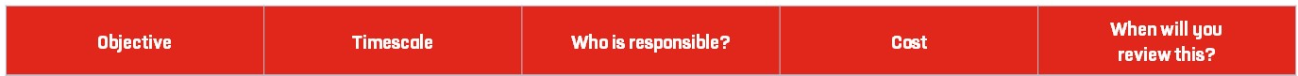
Use this planner to set goals and create tasks to complete which will
help you understand your clubs vision, and what its purpose is.
Tip: Visit our England Football League and Club Hub on YouTube
for ideas and insights to help you develop a vision and mission for your club.
To provide the opportunity for all to participate in grassroots football | 2021-2022 Season | The club committee | Annual club running costs | Quarterly
To allow the local community to socialise via football | 2021-2022 Season | The club committee | None | Weekly
To keep players fit and healthy | 2021-2022 Season | The club committee | None | Monthly
To improve the mental health of our players through exercise | 2021-2022 Season | The club committee | None | Weekly
To offer equal opportunities to play football to all male, female, non-binary and disability groups. | 2021-2022 Season | The club committee | None | Weekly
To assist our coaches and players in gaining FA coaching, medical, safeguarding or refereeing qualifications. | 2021-2022 Season | The club committee | Professional Development budget of £1000 | Monthly

Slide 6
Club of the Year 2000
London FA Cup Winners 2002
Started in 1991
Joined xx League in 2000
Purchased venue in 2005
Secured a Club House
Grown to 10 teams
Purchased new goals
Received funding grant from FA
We would like to grow a high quality and sustainable male, female and disability pathway in full and achieve 3 star accreditation.

Slide 7
The vision is to grow the full male, female and disability pathway. We would like to offer every team a qualified coach and the opportunity to play in a league regularly.
Our club currently represents adult males and females. We would like to grow our youth and disability teams this season.
Our club likes to play fast paced football with lots of passes. We prefer to attack and succeed in our counter attacking but require more training on our defensive approach.
Gain 20 new members
Grow 1 youth team
Qualify 1 new coach
Secure a funding grant

Slide 9
2021-2022
Use this planner to set the goals and tasks you need to complete for a positive season on and off the pitch. Think about what needs to happen both monthly and weekly.
Tip: Visit our England Football League and Club Hub on YouTube for ideas and insights to help you plan ahead for a successful season.
Complete all planning for season ahead e.g. pitch bookings, coach hiring, squad membership fee etc. | 2 months | The club committee | £2000 | Annually
Affiliate with the London FA and complete our player registration. | 2 weeks | The club committee | £100 | Annually
Create a coaching syllabus for the season and update weekly if required. | Full season | The club committee | £0 | Weekly
Create monthly social calendar for players and parents/ other half's. | Full season | The club committee | £0 | Monthly
Book all courses in Safeguarding, Coaching and Medical that are required or due to expire. | Full season | The club committee | £100 – £300 | Annually and Monthly
Begin advertising the club for the season ahead. | Full season | The club committee | £50 -100 on paid promotion via social media | Weekly and Daily if necessary

Slide 10
2021-2022
September | Complete all Affiliation and Player Registration
October | Begin fixtures
November | Enter Cups and Competitions
December | Club Christmas Party and Winter Break
January | Provide FA courses for club members
February | Continue with fixtures
March | Begin preliminary planning for next season e.g. booking pitches
April | Complete all fixtures in all competitions
May | Club AGM, End of season awards

Slide 13

11v11
5x5
11v11
Club House
7v7
7v7
Car
Park
5x5

Slide 14
Club contact details
Club Name | LONDON FA FC
Club Address | Unit 11, Hurlingham Business Park, Sulivan Rd, London | Postcode | SW6 3DU
Telephone | 07500600700
Access routes
For Ambulance | Via large gate
From Pitch to Ambulance | Yes
Other Information
Nearest A&E / Trauma Hospital | Chelsea & Westminster Hospital
Fastest Route to A&E / Trauma Hospital | Via ambulance
Distance and Journey time | 9 minutes, 1.9 miles
Nearest Walk-in Centre | Chelsea & Westminster Hospital
Alternative Trauma Hospital | Charing Cross Hospital
First Aider / Helper Information
Name | Niamh Coyle | Mobile number | 07500600700
For queries about this EAP | Email Niamh.coyle@londonfa.com
See relevant coach for First Aider on day of match | Niamh Coyle
First Aid Equipment and Facilities
Item | Location
Defibrillator | Yes
Stretcher | Yes
First Aid Room | Yes

Slide 16

11v11
11v11
Club House
5x5
Car
Park
5x5
7v7
7v7

Slide 19
2021-2022
Use this planner to set the goals and tasks you need to complete for a clear plan for your club budget and finances.
Tip: Visit our England Football League and Club Hub on YouTube for ideas and insights to help you with your club finances.
Buy new kit for all teams | 1 season | The club committee | £3000 | Yearly
Pay all coaches | 1 season | The club committee | £4000 | Monthly
Ensure all coaches have access to club funding for qualifications. | 1 season | The club committee | £1000 | Quarterly
Hire new upgraded facility | 1 season | The club committee | £2000 | Weekly

Slide 20
Total Projected Income | £11,000
Total Projected Expenditure | £10,000
Annual Balance | £1,000

Slide 21
Weekly Club | Cost (£)
Club | LONDON FA FC
Team | All teams
Income |  | Expenditure
Subs | £500 | Pitch Hire | £500
Membership | £500 | Referee Fees | £500
Sponsorship | £500 | Washing Kit | £100
Donations | £150 | Coaches | £500
Total Income | £1650 | Total Expenditure | £1600

Slide 22
Annual Accounts Sheet | Cost (£)
Club | LONDON FA FC
Year | 2021-2022
Income |  | Expenditure
Sponsorship | £2000 | Affiliation | £500
Subs | £2000 | Pitch Hire | £2500
Donations | £2000 | Coaches | £2000
Grants | £2000 | Referee Fees | £2000
Trips | £2000 | Washing | £1000
 |  | Fines | £1000
Total Income | £10,000 | Total Expenditure | £9000
Opening Balance | £10,000
+ Surplus / Deficit | £1000
Total / Closing Balance | £1000

Slide 23
Adult female 1st team | Starbucks – sponsoring shirt | £1000 per season for 5 seasons | John Doe John.doe@starbucks.com | Monthly meeting | Due August 2027 | Photos on social media each week

Slide 24
We need funding in order to grow and expand our club.
We estimate that 25 people will benefit from the project
The project involves starting a new youth team for the club
The community will have more access to a youth team
Players, Parents and Coaches
£500. The funds will be spent on advertising, coach requirement/wages, pitch hire, league fees, kit and referees.
We have had many enquires about starting a youth club, particularly from our adult team players with children.
All spending decisions will be approved by the entire club committee prior to spending.
The club committee

Slide 27
Use this planner to set goals and the tasks you need to complete to build your volunteer team. It can also be used to identify key responsibilities for those who are already playing their part in your club.
Tip: Visit our England Football League and Club Hub on YouTube for ideas and insights to help you make the most of the people at your club.
Complete all planning for season ahead e.g. pitch bookings, coach hiring, squad membership fee etc. | 2 months | The club committee | £2000 | Annually
Affiliate with the London FA and complete our player registration. | 2 weeks | Club secretary | £100 | Annually
Create a coaching syllabus for the season and update weekly if required. | Full season | Coaches | £0 | Weekly
Create monthly social calendar for players and parents/ other half's. | Full season | Club social secretary | £0 | Monthly
Book all courses in Safeguarding, Coaching and Medical that are required or due to expire. | Check | Club Development Officer | £100 – £300 | Annually and Monthly
Begin advertising the club for the season ahead. | Start in August 2021 | The club committee | £50 -100 on paid promotion via social media | Weekly and Daily if necessary

Slide 28
Paul Bickerton
Roya Taslimi
Neil Fowkes
Lewis Warren
Neil Twitchett
Aquila Burgess
Amanda Lewis

Slide 29
TREASURER
Overall oversight, chairs board meeting, chief club representative, bank payment authorisation
Responsible for bank accounts, budgeting, debt collection, preparation of annual accounts
TEAM MANAGER
Club contact, arranges fixtures, head of administrative tasks, Pitch Organisation
Squad Selection, Team Selection, Football direction, Footballing Strategy, Runs training, Match-day discipline
SPONSORSHIP MANAGER
To promote a safeguarding children policy, anti-bullying policy and equality policy, responsible for recruitment processes including the taking up of references and submitting FA CRB checks (getting the right people into the game).
Responsible for Sponsorship procurement, Kit design/production, Social Media, Brand development, Match Videos, Coordinate PR with Secretary

Slide 30
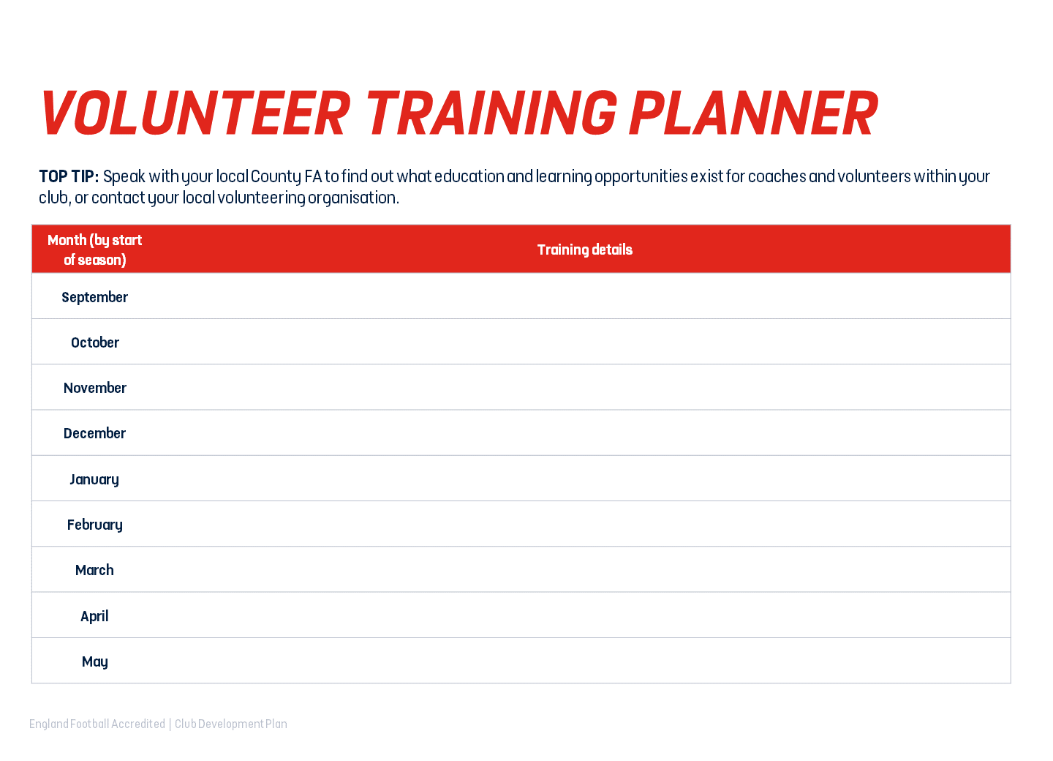
2021-2022
September | Recruit volunteers via London FA website and Social Media
October | Begin interviews for position
November | Ensure volunteer has completed all FA Safeguarding qualifications and receives full training on club operations
December | Refresh training with weekly sessions
January | Ongoing support
February | Ongoing support
March | Ongoing support
April | Attend LFA Club Webinar
May | Offer opportunity to continue for another season if performance is adequate.

Slide 31
Club Development Officer
To develop the club
5
The CDP will make changes and add value to the club by developing all relevant areas such as finance, operations, marketing and recruitment.
- Experience of grassroots football
Tasks include regularly audits of policies and procedures, identifying areas of growth in the club, liaising with coaches and players to understand wants and needs.

Slide 33
Use this planner to set goals and the tasks you need to complete to understand your market, and the methods you will use to listen to and communicate with them.
Tip: Visit our England Football League and Club Hub for ideas and insights into how to market your club and communicate effectively. Think about placement opportunities with local education providers, or give players within your club the opportunity to manage your online presence and social media content.
Open Instagram account | 1 day | The Club development officer | £0 | Monthly
Boost posts through paid advertisements | 1 season | The Club development officer | £50-100 | Monthly
Contact local newspapers for exposure | 1 season | The Club development officer | £0 | Monthly
Enter all LFA./Football competitions | Ongoing | The Club development officer | £0 | Monthly

Slide 34
Well established, long standing club with excellent sportsmanship and friendly coaches/volunteers
They want to feel appreciated and supported, We want everyone to enjoy their time with LONDON FA FC.
We would like to be treated with fairness and kindness, on and off the pitch.

Slide 37
General club information such as training times, match information, scores, club achievements etc.
3 times a week.
Players, Parents, Coaches, Sponsors and outward football community.
Professional

Slide 38
General club information such as training times, match information, scores, club achievements etc.
3 times a week.
Players, Parents, Coaches, Sponsors and outward football community.
Professional

Slide 39
General club information such as training times, match information, scores, club achievements etc.
3 times a week.
Players, Parents, Coaches, Sponsors and outward football community.
Professional

Slide 41
For information
Varied
Subject
Targeted audience
Emails, message, teams calls and Social media

Slide 42
Priority
Varied
Subject
Players
Emails, message, teams calls and Social media

Slide 43
For action
Varied
Subject
Players
Emails, message, teams calls and Social media

Slide 44
For information
Varied
Subject
Players
Social media

Slide 45
Required information
Varied
Varied
Players
Emails, message and Social media

Slide 46
Action required
Varied
Varied
Players
Email

Slide 48
England Football Resources
England Football – Leagues & Clubs
England Football Accreditation
Club Learning Opportunities
YouTube - The League and Club Hub
The Grassroots Football Hub Events
England Football Learning Bootroom
Club Resources
Club Structures Guide
Contact details for County FAs
Other Grassroots Support
Football Foundation
Football Foundation – Local Plans
Sport England
Sport England – Funding

