Slide 1
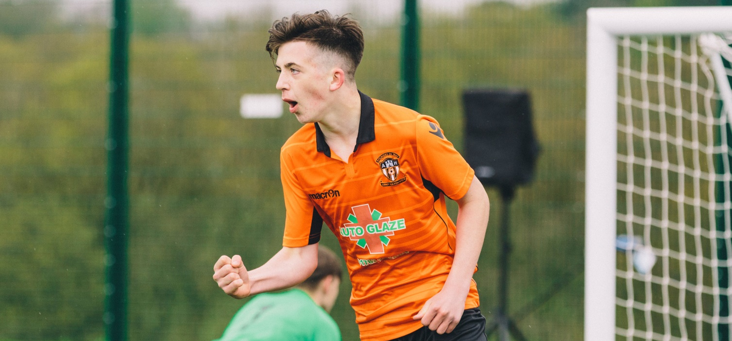



TEMPORARY DISMISSALS
Notes:
Introduce yourself, your position in the County FA and how you will deliver the session, taking questions throughout and thanking the League for inviting you to their meeting.
Emphasise the importance of their participation and to challenge and ask questions.

Slide 2
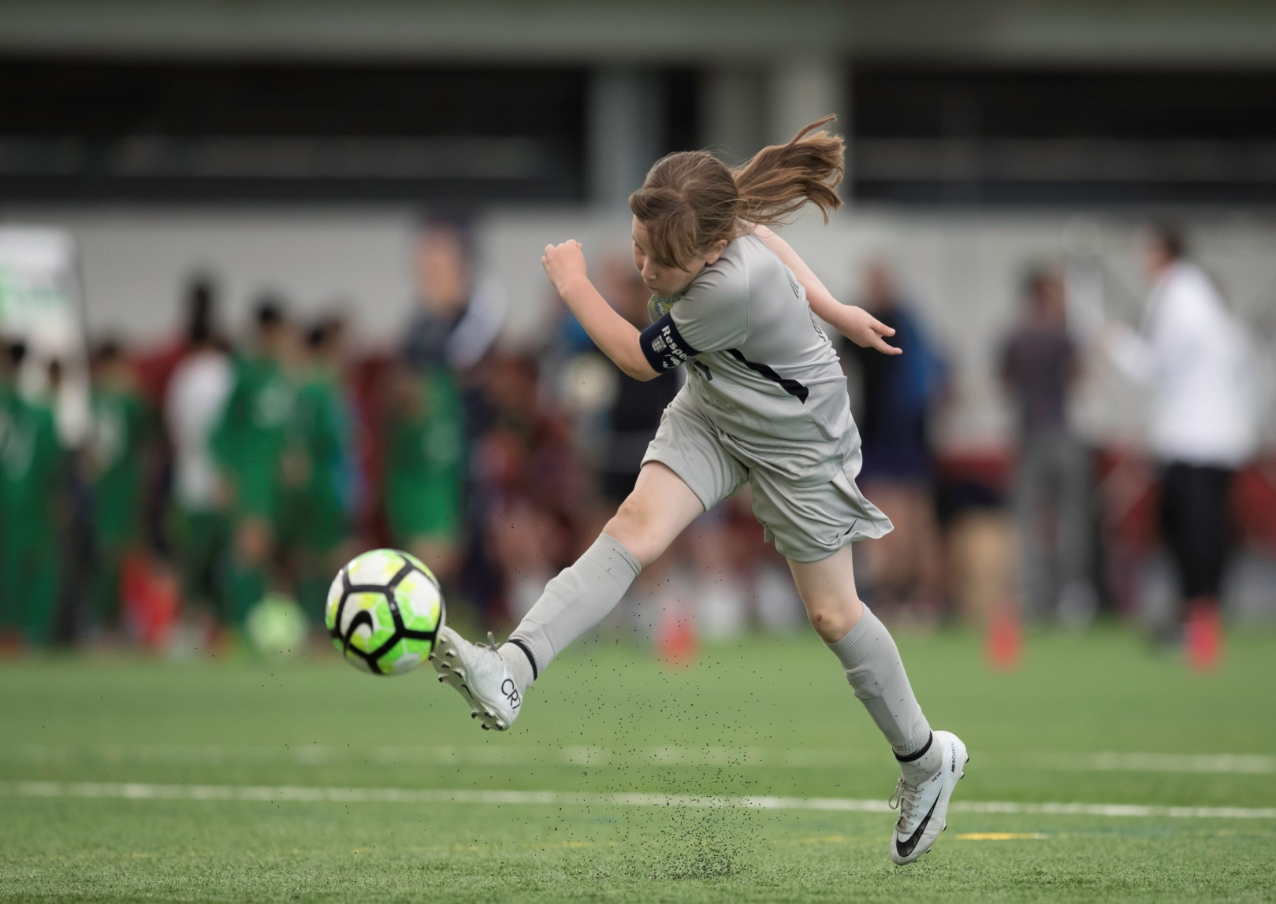
AGENDA
The Authority
The Pilot and Results
The Law
The Next Steps
Sin Bins in Operation
Open Forum
Notes:
Simply outline the Agenda at this stage to confirm the purpose is so everyone has the full story
The session will be explaining the authority of sin bins and that they have been in operation for Two years and the results that we have received following the pilot so far. Moving to the future what the next steps are and how they will operate

Slide 3
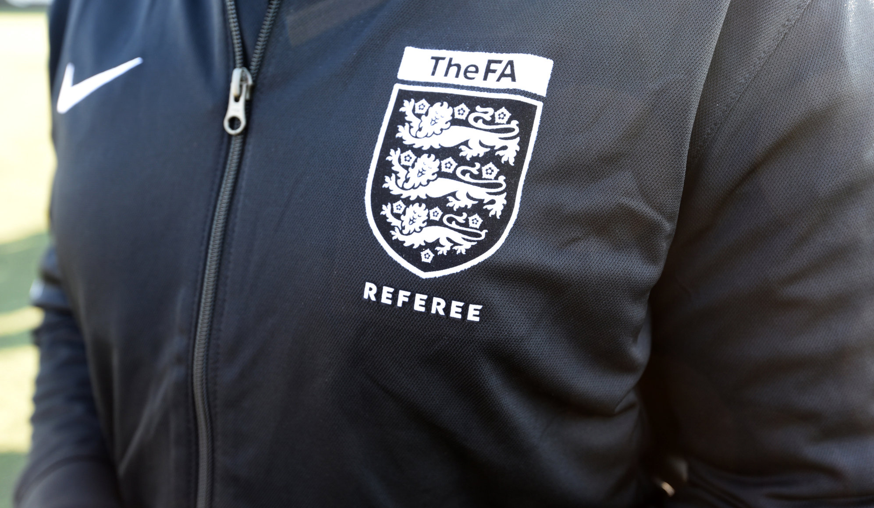
THE AUTHORITY
Notes:
The authority of allowing is IFAB and National Associations have some discretion
IFAB are rule makes WORLDWIDE and approved ability to utilise Sin bins and was for National Association to decide what for.
Ask to be open minded and positive about the process and how it will work. Will be teething problems but the pilot suggests few and far between.
IFAB have been encouraging in their approach to trying new things to improve the game

Slide 4
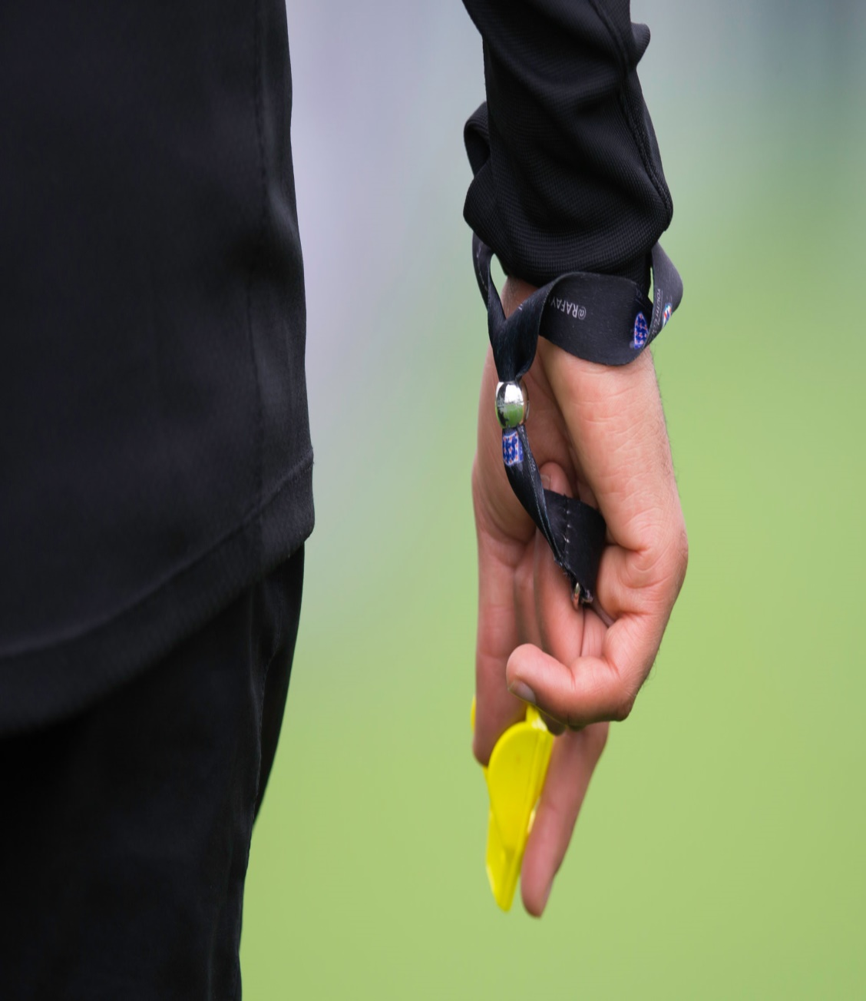
FA PILOT
IFAB approved in March 2017 discretion for National Associations to use system for either:
All Cautions
Selected Cautions
FA Approved Pilot
Pilot for Dissent only
Some areas of IFAB approval are different than current practices – we have responsibility to try new practices
31 Leagues Selected
Notes:
Approach to using a Pilot was so we should know the impact rather than just believing we would know.
Better to try and find it doesn’t work than simply not try
31 Leagues used across all types of the game (Sat/Sun, Male/Female, Adult/Youth) all at Step 7 or below.

Slide 5
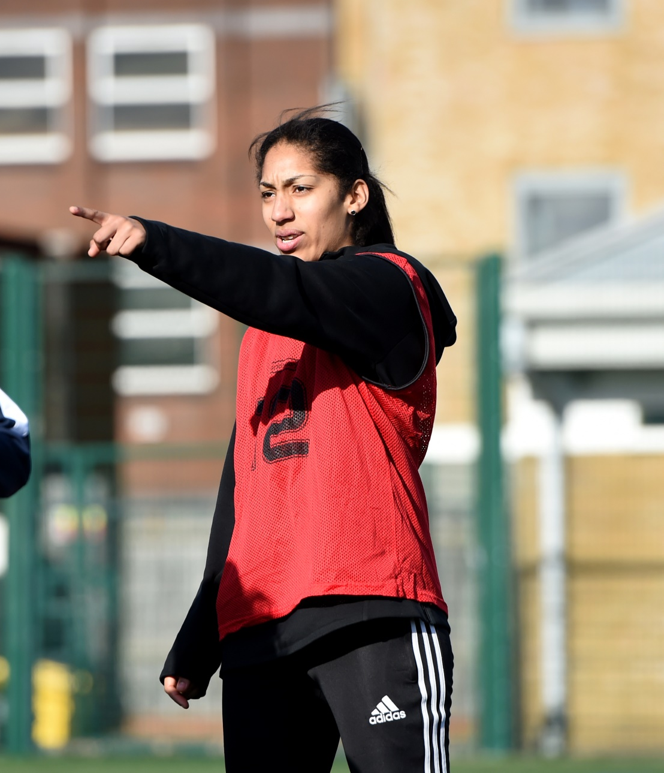
WHY DISSENT?
Support the RESPECT programme
73.5k cautions for Dissent in 2016/17
25% of all Cautions
Aim is to decrease Dissent and improve match experience
Notes:
Supporting RESPECT and explain the stats were not good and wanting to improve participation for all and the match experience something had to be done.
Explain almost ¾ of a million pound being paid by clubs/players due to Dissent.
Also Dissent is a behavioural matter as opposed to a football matter
Reduce Dissent then we improve retention of referees and improve image of the game

Slide 6
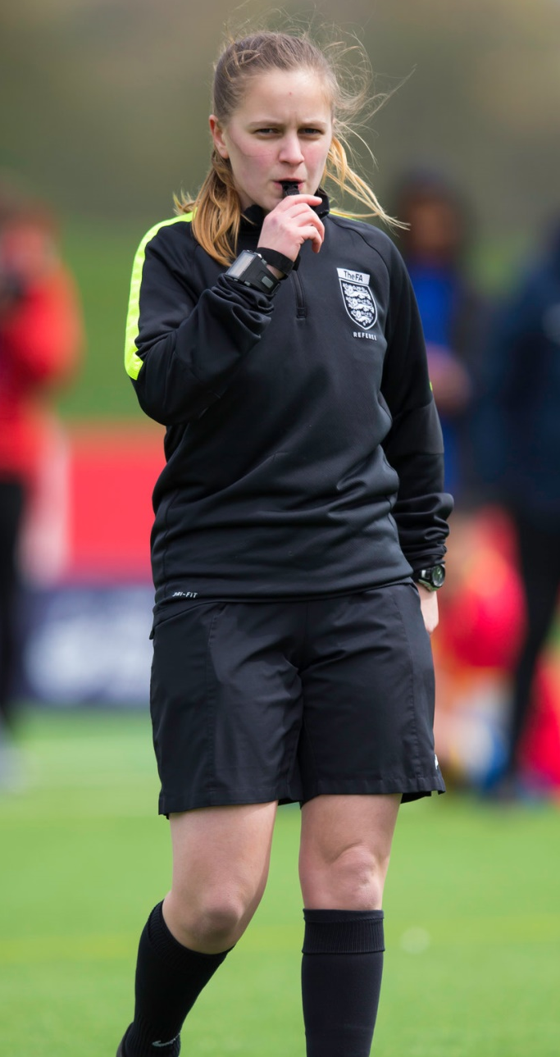
INITIAL CONCERN FROM REFEREES
WHY DISSENT?
Likely numbers in Sin Bin at any one time
Research over 135,000 matches
Average Dissent Caution count - 0.46/Game
Caution in every 2.16 matches
Where Dissent exists – 1.356/game
<1% of matches have more than 3 cautions for Dissent
Chances of those in the same 10 minute period remote
Notes:
Referees had concern that too many would be in the sin bin and not be able to manage the timing for all players, especially when they have multiple individuals. The stats however disprove that as a “common practice”
Explain the chances of having multiple people in Sin Bin at same time was low by stepping through the Stats.

Slide 7
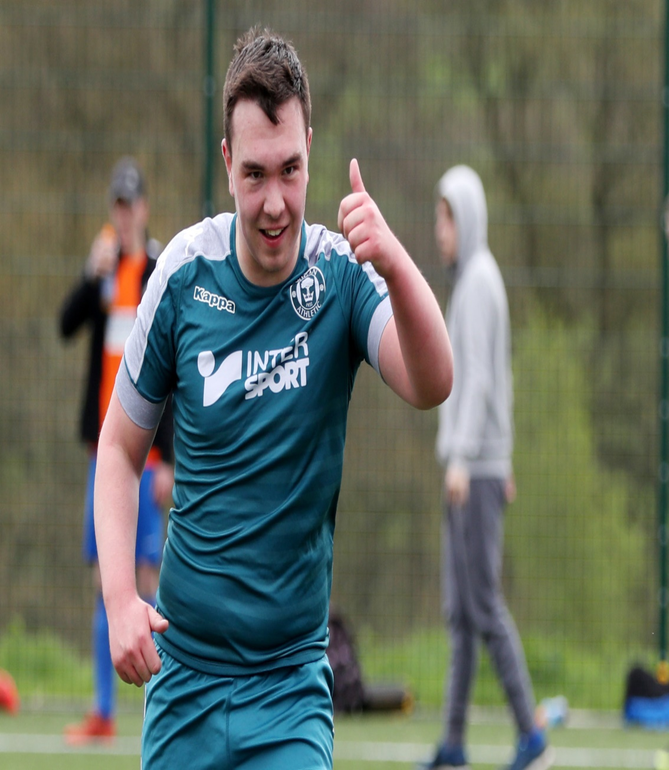
INITIAL CONCERN FROM CLUBS
Just another Money Making machine
No £10 Admin Fee for C2(Sin Bin)
This is not Rugby
Notes:
This is implemented to improve the game and does not result in more money being received from CFA’s.
Not a financial issue I in fact costing The FA £¾million but a good investment if improves behaviour and match experience
CFA’s and FA Council have given full backing to the process even knowing that the money is decreased.
Also learning from other sports is sensible

Slide 8
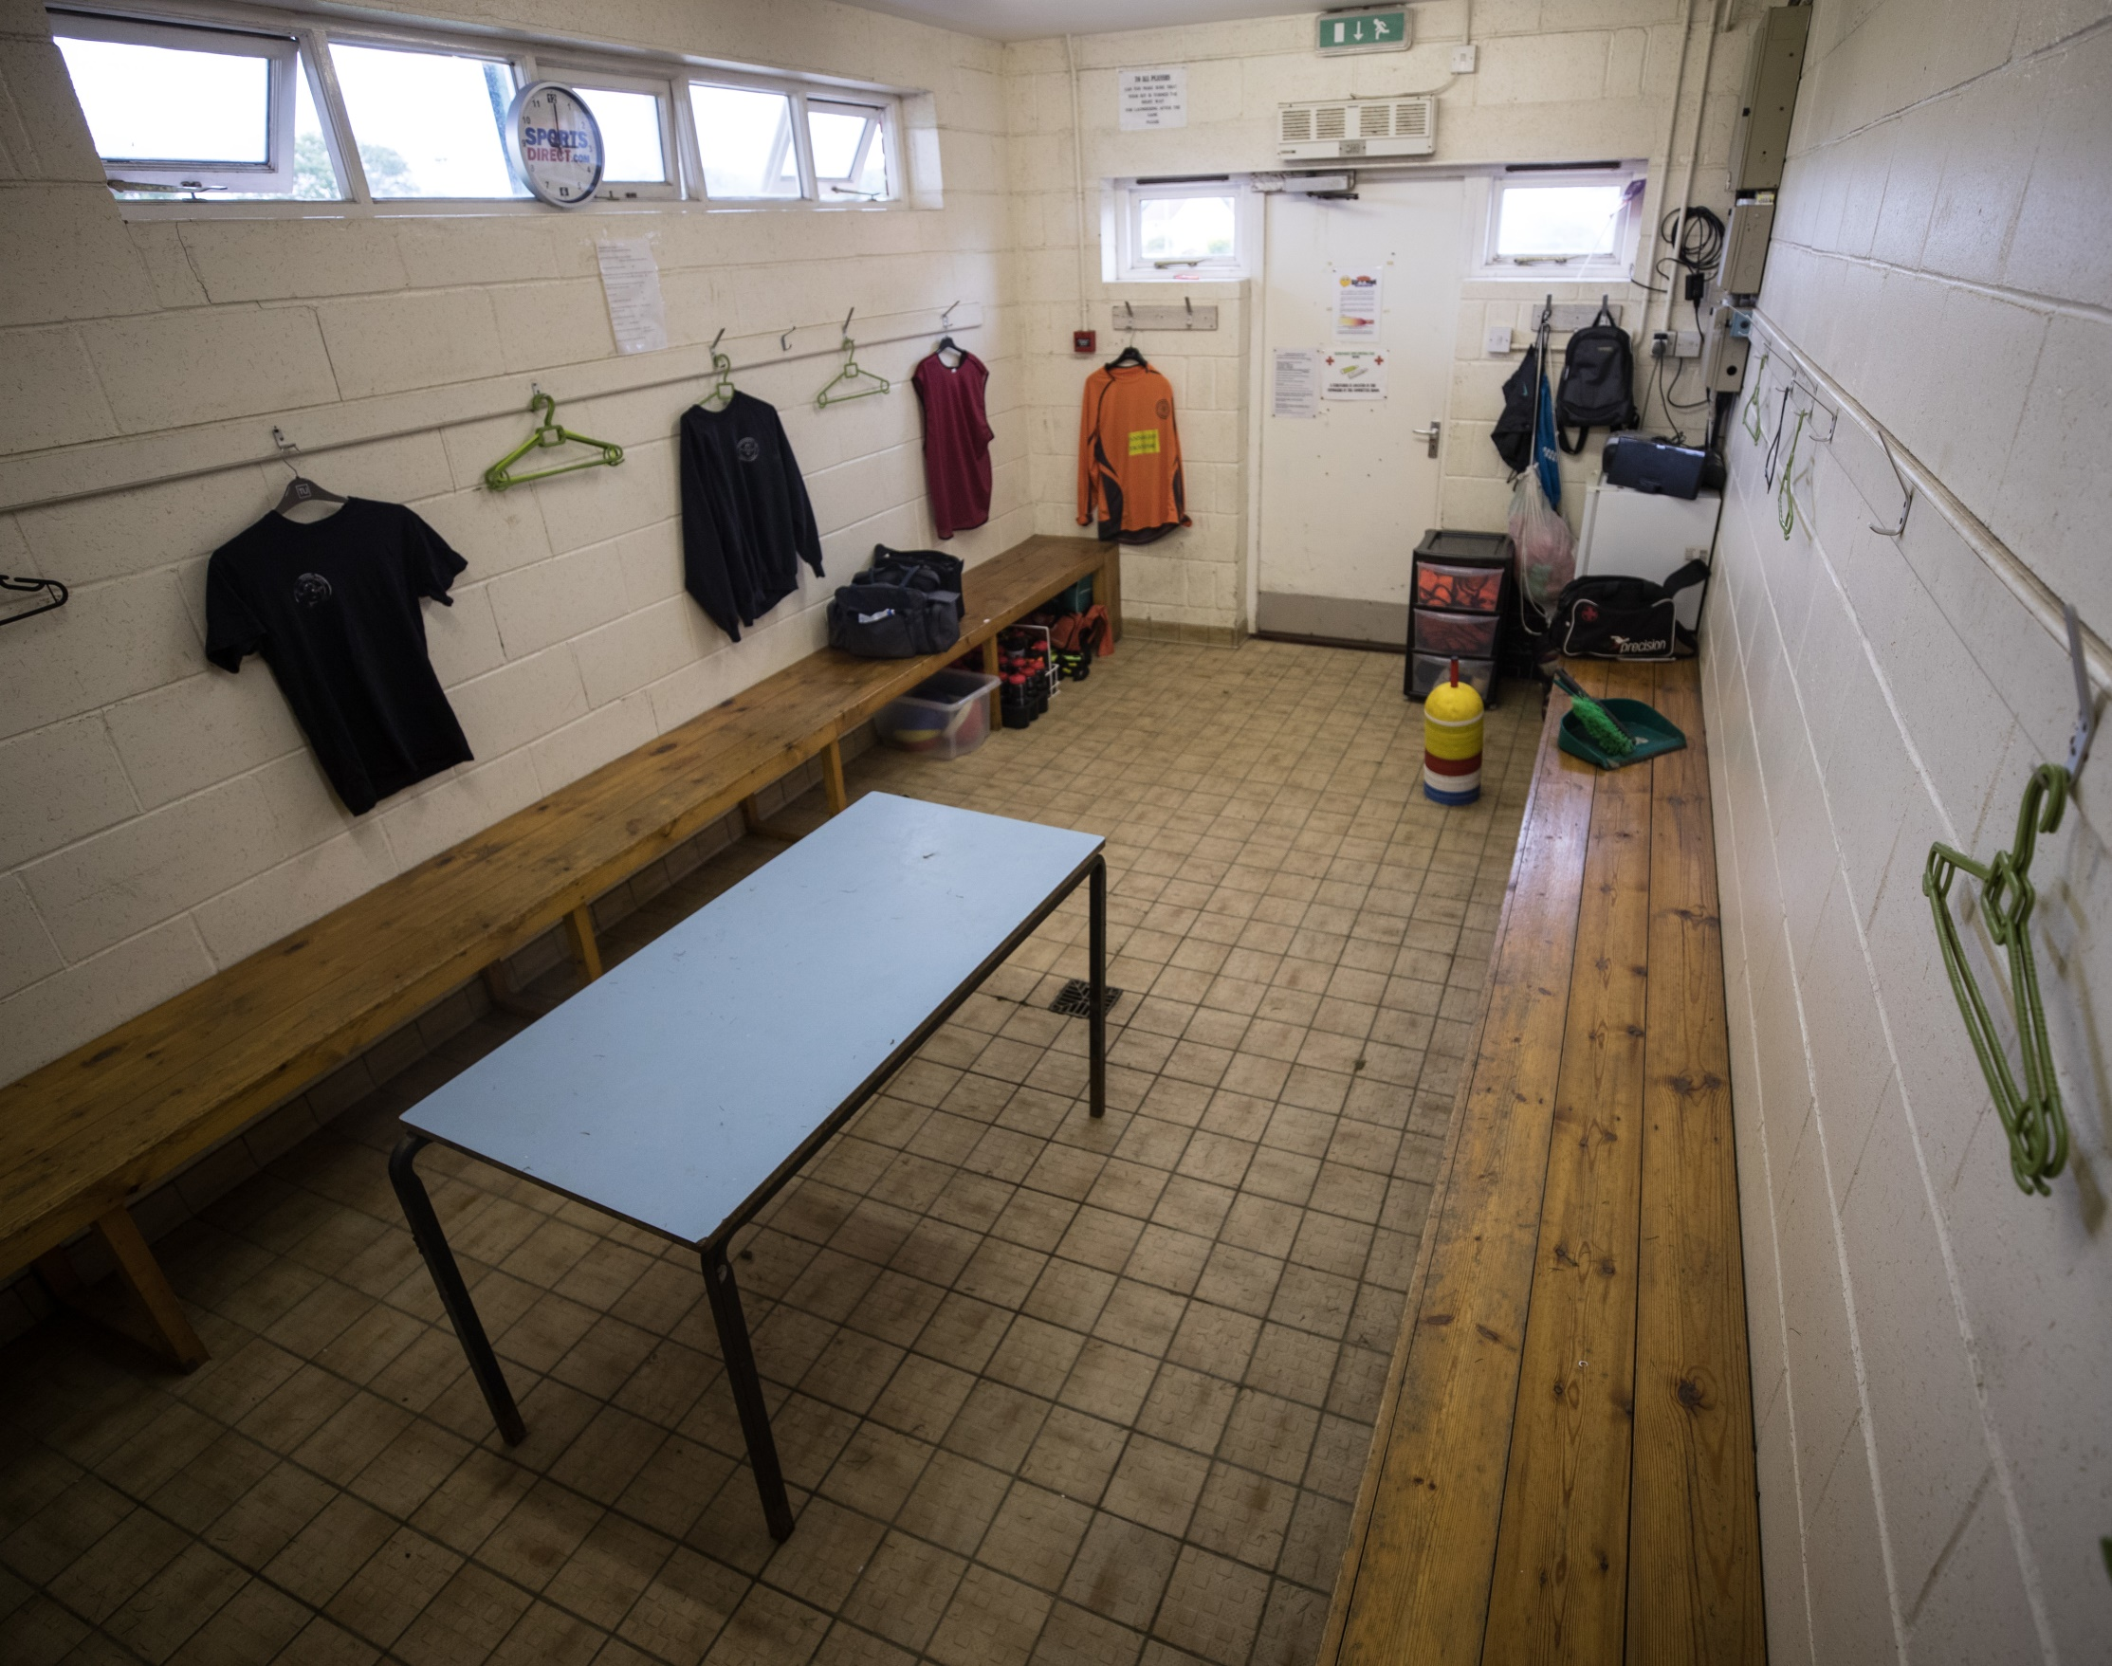
THE PILOT
AND THE RESULTS
Notes:
Results following the pilot of the leagues throughout 2017/18 Season

Slide 9
PILOT SCHEME RESULTS
38% Reduction in Dissent across all Leagues
Also showed a reduction on dismissals for receiving a 2nd caution in a game and Abusive Language
Survey carried out to obtain feedback from users (1400 users)
72% of Players wanted to continue with Sin Bins
77% Managers/Coaches wanted to continue with Sin Bins
84% Referees wanted to continue with Sin Bins
SKY Survey showed Referees requested the 1 major change to be bought in was to be Sin Bins
Current use has shown that Players self police Dissent as they wish to
play with a full squad
Notes:
Stats are self explanatory, ultimately though it works and has been a positive impact in grassroots football.

Slide 10

THE LAW
OF DISSENT
Notes:
The pilot through up a misunderstanding in the Law for Dissent by some parties

Slide 11
DISSENT
Has shown a lack of understanding amongst some Players and Managers as to what is Dissent.
Covered under Law 12 and is in the opinion of the Referee
A player is cautioned if guilty of dissent by word or action
Kicking the Ball away could be either Dissent or Delaying the restart – depending on context
Using offensive, insulting or abusive Language or Gestures is not dissent and is a send off offence
Responsibility of Clubs to control their players
The use of the Sin Bin gives the Management team the opportunity to calm the players down
Notes:
Explain the difference in Kicking ball away
Dissent is not swearing
Anecdotally Players police the behaviour as they wish to play with all 11 players

Slide 12
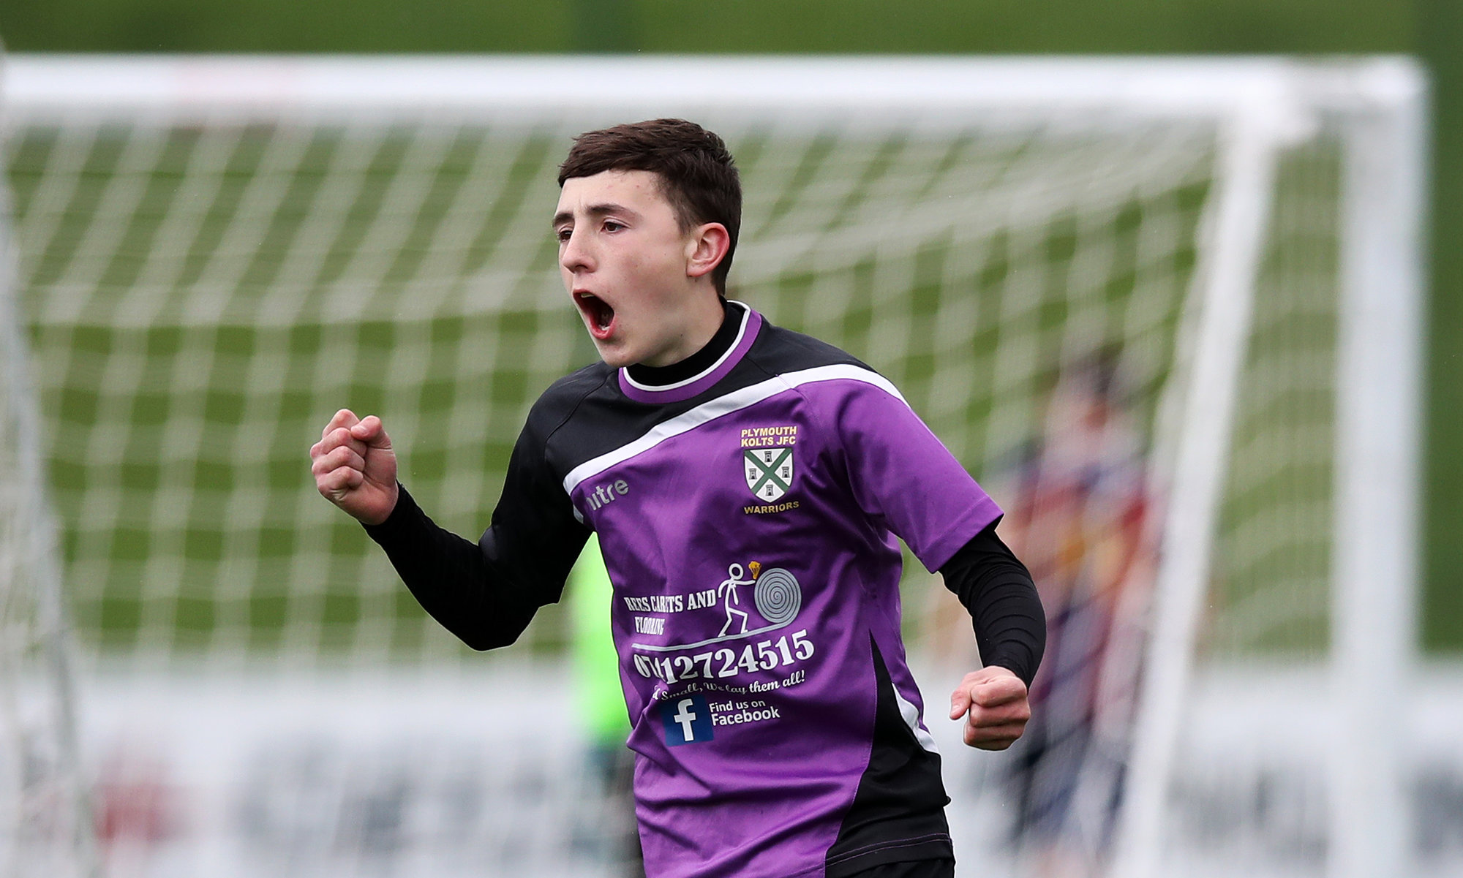
THE NEXT STEPS
Notes:
Looking forward to the future and how this will impact yourselves and football in general

Slide 13
NEXT STEPS
2018/19 Season
31 Leagues on Pilot to continue
CFA’s may nominate Leagues at Step 7 and below to be considered early
CFA’s may elect to use Sin Bins in County Cups
60+ Extra Leagues selected
Repeat Offenders in a game to get 1 match ban and £25 fine with immediate effect
2019/20 Season
All Leagues at Grassroots level, including youth, to use Temporary Dismissals for Dissent - mandatory
Notes:
Current situation for the season, how many leagues are operating and their choice to join this season.
FA Council approved decision for it to be mandatory during 2019/20 season for all Clubs at step 7 and below based upon IFAB/FIFA stating it can be for grassroots football only.
FA since consider Step 5 and below as grassroots following consultation at Step 5 & 6.

Slide 14
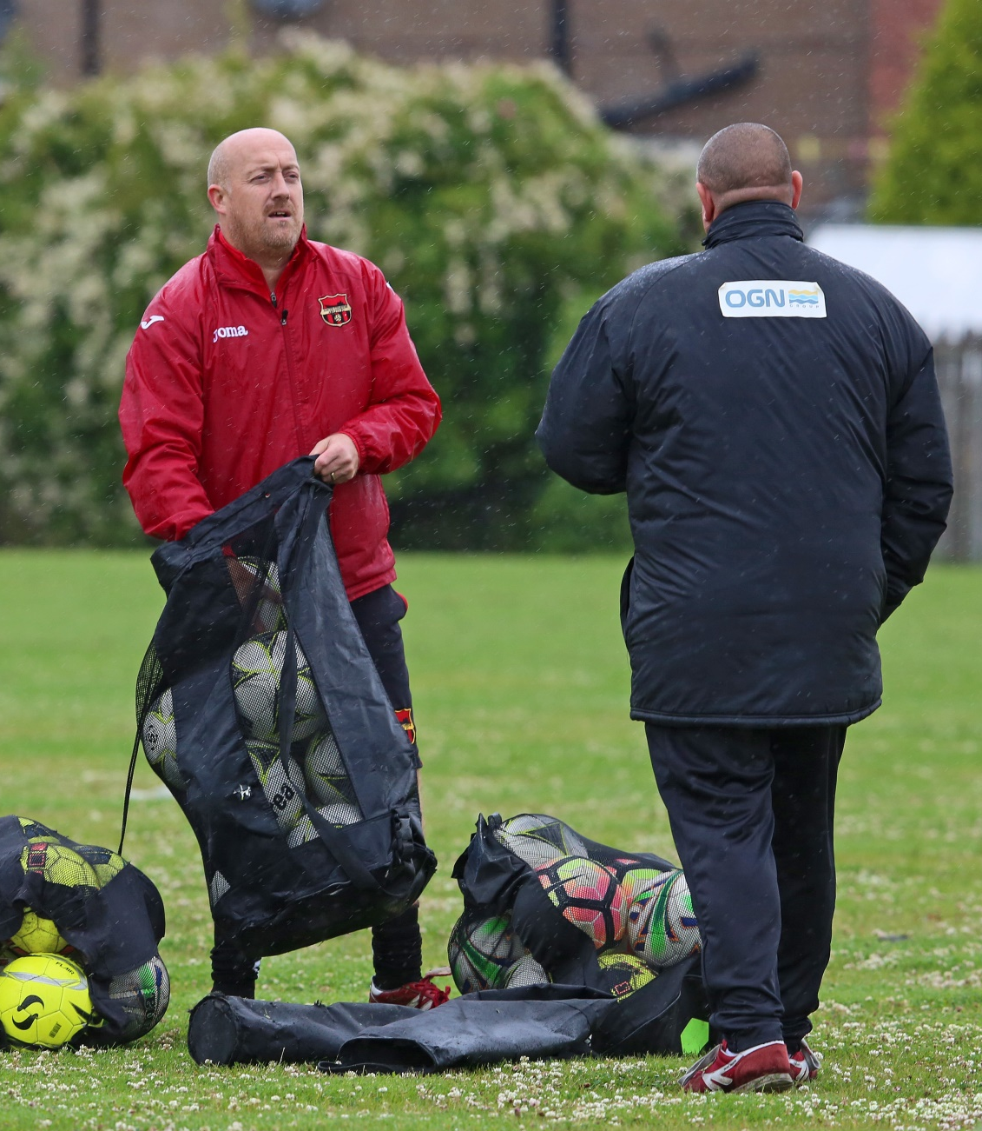
NEXT STEPS
CUP COMPETITIONS
Includes all Cup Competitions in Leagues at Grassroots level.
All County Cups or External Cup Competitions where there are no teams whose Clubs play in National League or above.
The Following FA Competitions:
FA Vase
FA Sunday Cup
FA County Youth Cup
FA Inter-League Cup
Notes:
Explain Competitions to be used for Sin Bins
Any Competition that has a Club at Step 1 or above (not Team) cannot use Sin Bins as Discipline is dealt with by FA and not considered Grassroots

Slide 15
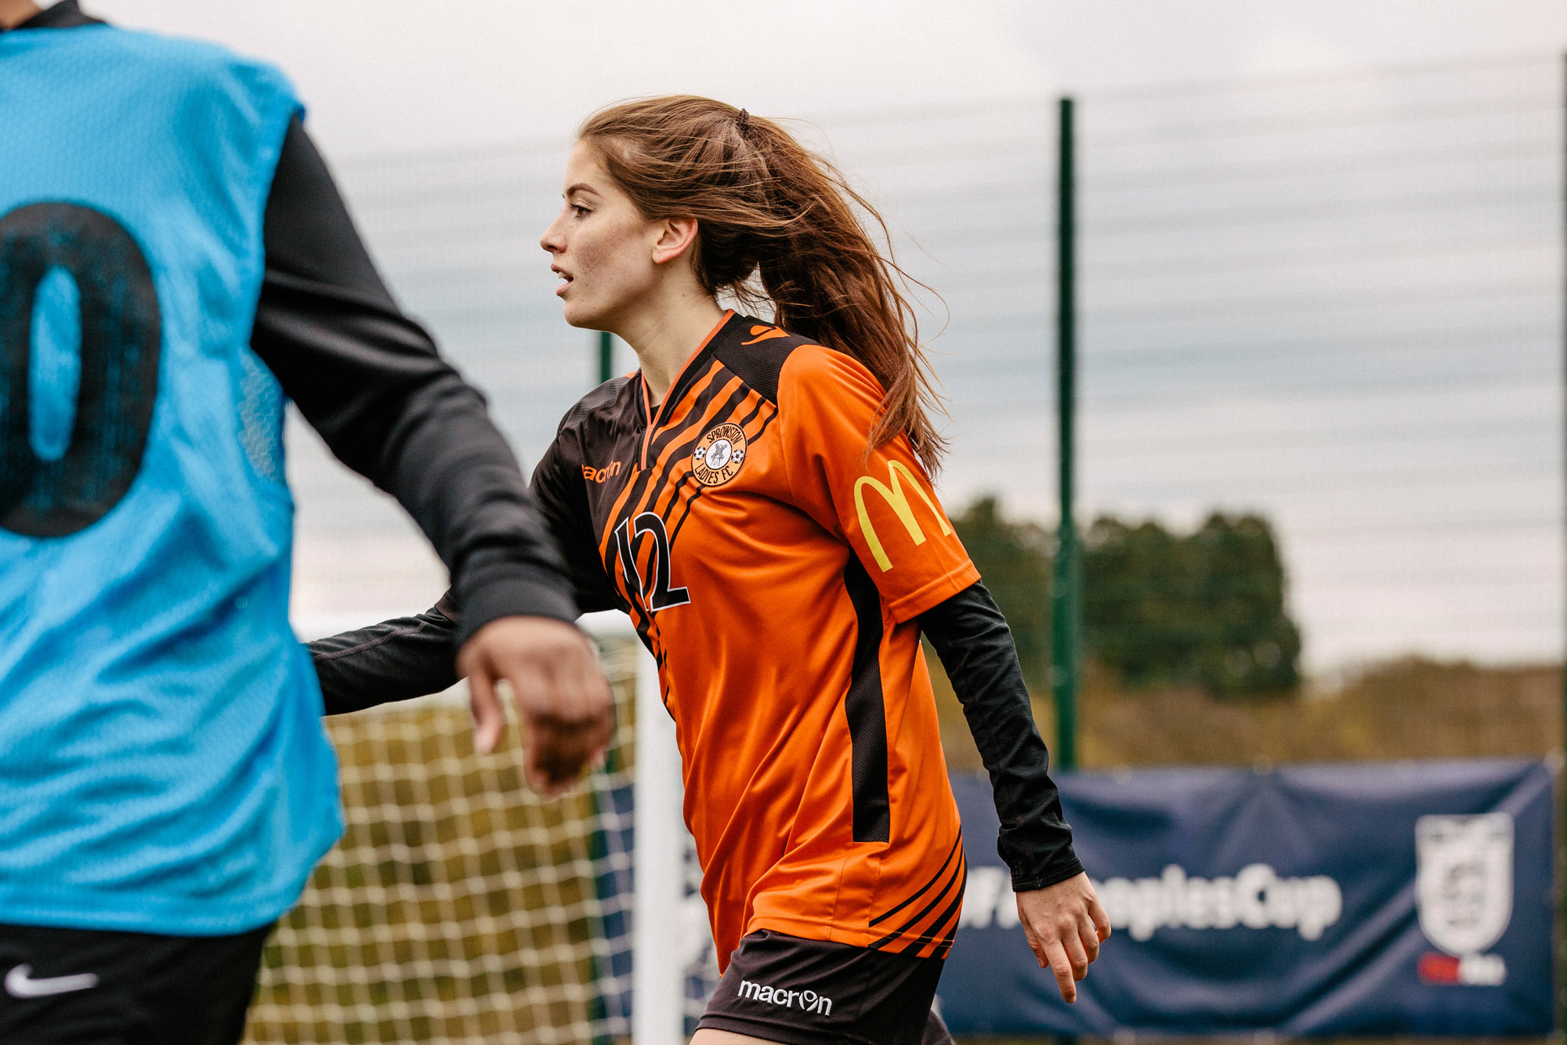
THE KEY PRINCIPLE
Notes:
Remind the purpose of Temporary dismissals and why – Reduce Dissent, and for behaviour to be dealt with on the day.

Slide 16
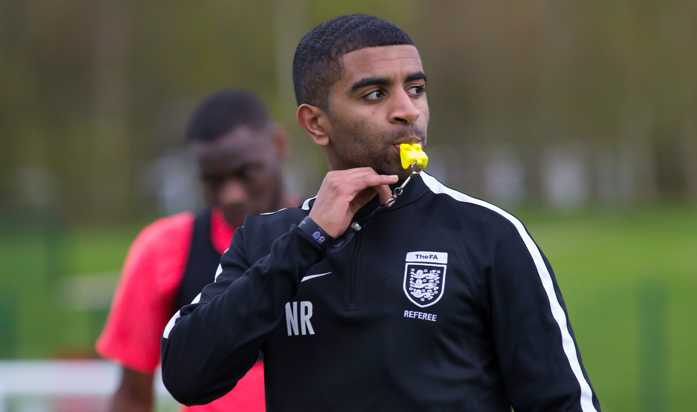
MATCHDAY PROCESS
Notes:
What actually happens in practice on a match day

Slide 17
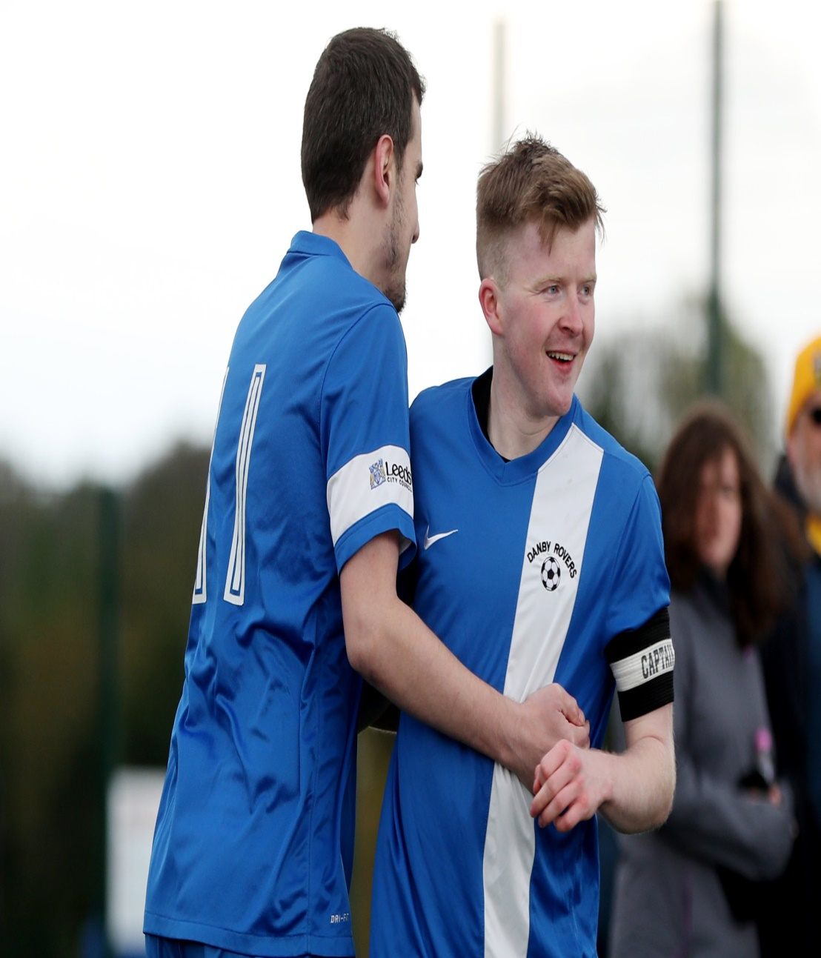
MATCH DAY PROCESS
Principle is for misconduct to be dealt with on the day
Will still be reported by referee as:
Used to monitor impact
Used for continual misconduct
No Admin fee will be charged
Notes:
Punishment to be served on the day and impact player/team to prevent it from happening again.
Match Referees will report in normal manner and WGS Portal has been developed to allow sin bins to be registered.
No admin fee charged for any caution when the player is directed to the sin bin.

Slide 18
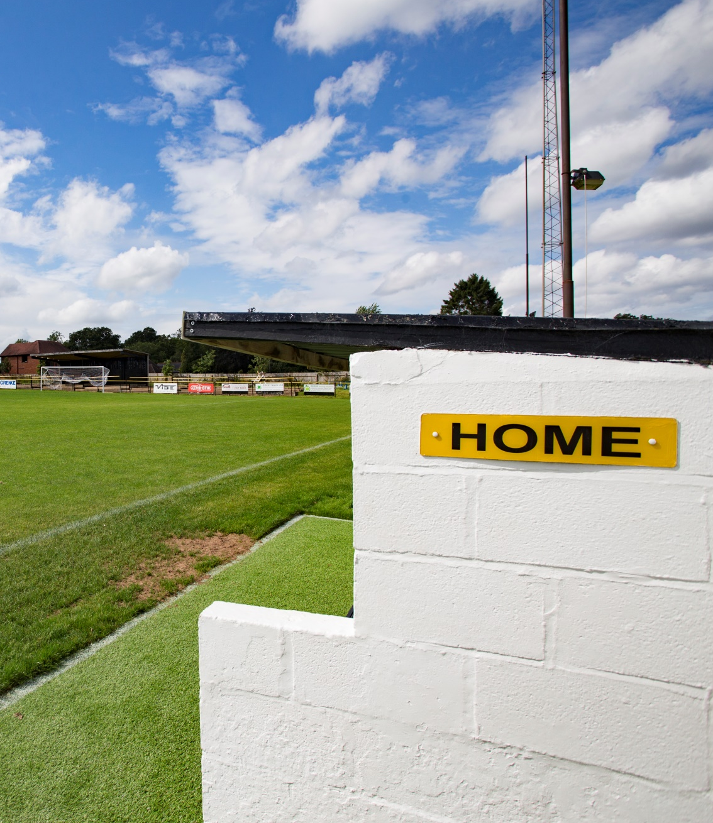
MATCH DAY PROCESS
All Cautions for Dissent must be dealt with by the Sin Bin Process
Applies to Players only and not Substitutes or Coaching Staff
Referee Signals by issuing a Yellow card in the normal way and pointing to the touchline where the player must go. (not a defined Sin Bin area)
Notes:
Can only be administered to active players who are participating, all other individuals dealt with as per previous misconduct and subject to an administration fee.
Suggestion of a Blue card has been raised with IFAB however at this stage not supported and not within FA remit to introduce.
Emphasise importance of Referee following Caution procedure :
Isolate player
Warn being cautioned for Dissent (at that point they are technically in the Sin Bin)
Ask Name
Note Number
Record Time
Show Yellow card and point to side.

Slide 19
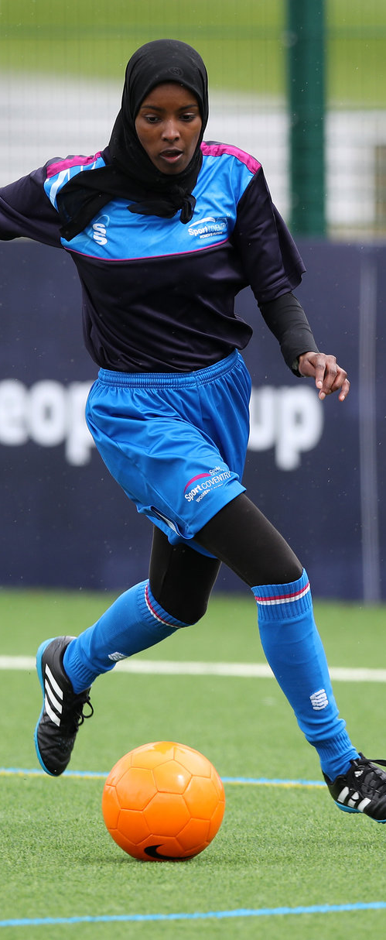
MATCH DAY PROCESS
Period in Sin Bin is:
10 Minutes for all matches of 90 minutes
8 Minutes for all other matches
Remember - No designated area: just back with management and subs
Period starts when play restarts
Referee includes any lost time
Where neutral Assistants are appointed they assist with
timing
Notes:
Timings for the Sin Bin – simple to follow
Match Referee is sole arbitrator of the time
Emphasise player in Sin Bin moment told he is cautioned for dissent.

Slide 20
MATCH DAY PROCESS
Referee has final decision on when the player can return to play.
Does not need to be in a stoppage in play – Referee will only allow player to return away from current action.
A Player in the Sin Bin cannot be substituted until the period has expired and not at all if all substitutes have been used
If the period has not expired at the end of the 1st half, it continues during the 2nd half (or Extra Time)
If it has not expired at the end of Extra Time and there are kicks from the penalty mark – the player can participate
Notes:
Providing further details on the process and requirements of a match referee. Explain to all in a clear and concise manner
Safe refereeing on when they allow player back on
Explain how the break in play is accounted for
Sin Bin finishes aftwr final whistle and not included in Kicks from the Penalty Mark

Slide 21
MATCH DAY PROCESS
Repeat Offenders (this will be a different approach than expected)
If a temporary dismissed player :
commits another YC Offence or RC offence during the sin bin period cannot take any further part in the game and cannot be substituted
Commits a non-dissent caution at any time on the field of play in addition to the sin bin period will continue to play.
Commits a 2nd Dissent caution (and no other offences) will receive a 2nd period in the sin bin. At the end of that period, the player can take no further part in the game but can be substituted.
Commits a 2nd dissent action and has already had a non Dissent caution will take no further part in the game and cannot be substituted
All other Laws of the Game remain unaffected (i.e. 2 Non-Dissent Yellow cards)
Notes:
Emphasis importance to keep an open mind – Will feel different but not wrong - just different
Take your time and go through each one checking with the audience to ensure they follow the process
Go through the example of player shows dissent after being told cautioned but before leaving field of play – comes under committing an offence whilst in Sin Bin

Slide 22
Caution Offence 1 | Caution Offence 2 | Caution Offence 3 | On field Sanction
Dissent | - | - | Sin Bin
Dissent | Non Dissent | - | Sin Bin, Caution Recorded (No Send Off)
Dissent | Non Dissent Caution | Non Dissent Caution | Sin Bin, Send Off for S7
Dissent | Dissent | - | Sin Bin x2, unable to rejoin, but can be substituted after 2nd Sin Bin if not all Substitutes used
Dissent | Non Dissent Caution | Dissent | Sin Bin, Caution Recorded, Sin Bin, unable to rejoin and CANNOT be substituted
Non Dissent Caution | Dissent | - | Caution Recorded, Sin Bin
Non Dissent Caution | Dissent | Non Dissent Caution | Caution Recorded, Sin Bin, Send Off for S7
Non Dissent Caution | Dissent | Dissent | Caution Recorded, Sin Bin, Sin Bin - unable to rejoin, and CANNOT be substituted after 2nd Sin Bin
Notes:
Key grid that should be circulated to all players, Managers, Clubs and Leagues.
Some match officials print out and keep in pocket
Ask Clubs to display in Dressing Rooms

Slide 23
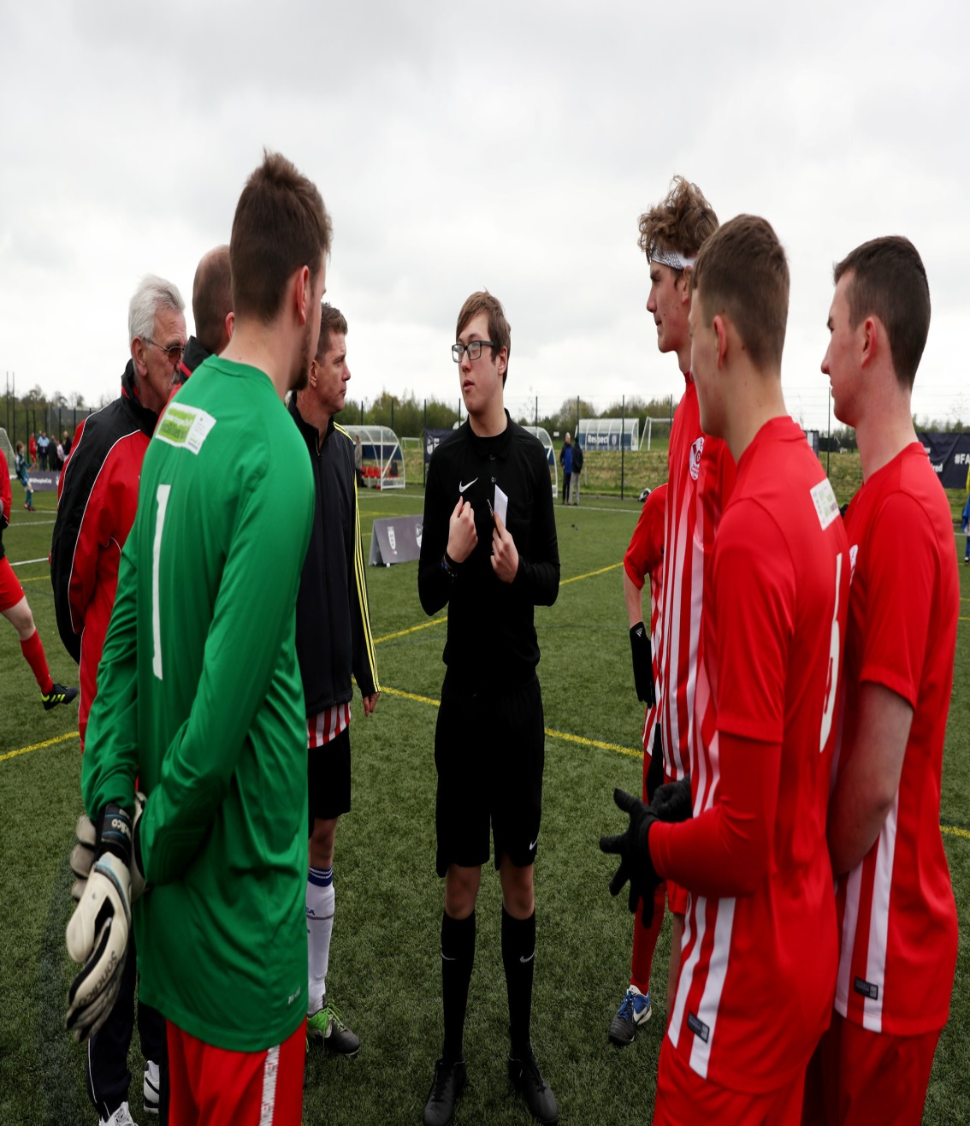
FAQS
Q: Will the Referee working on their own be able to control the Sin Bin Period?
A:Yes if they follow the correct Procedure
Notes:
Go back to the stats and likelihood of several being in the sin bin at the same time – it will happen but few and far between
Importance of Referee applying procedure correctly
Go through on how to control time. (i.e. If they follow process correctly – only need to remember time when next person can come on as it is recorded in notebook)

Slide 24
FAQS
Q: Can a Temporary Dismissed player warm up?
A: Yes – Want to avoid injury and the purpose of the Sin Bin is to remove from play
Notes:
They are only temporarily dismissed and have not been sent off. We don’t want any injuries being sustained so they can warm up but must keep away from the pitch and not interfere with play, otherwise be subject to further disciplinary action from the Referee

Slide 25
FAQS
Q: What happens if the Team go down to less than 7 players as a result of a Temporary Dismissal?
A: If it is the players second sin bin and not permitted to return - the game will be abandoned
Notes:
Statistics show this is extremely unlikely to happen, however, if it does the game must be abandoned. Ask them the question when was the last time they played or watched a game being abandoned due to the above.

Slide 26
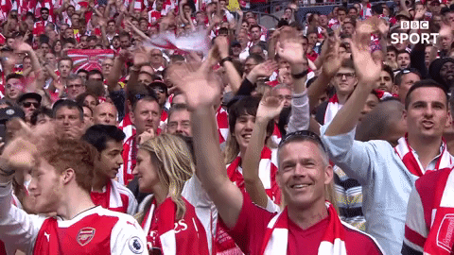
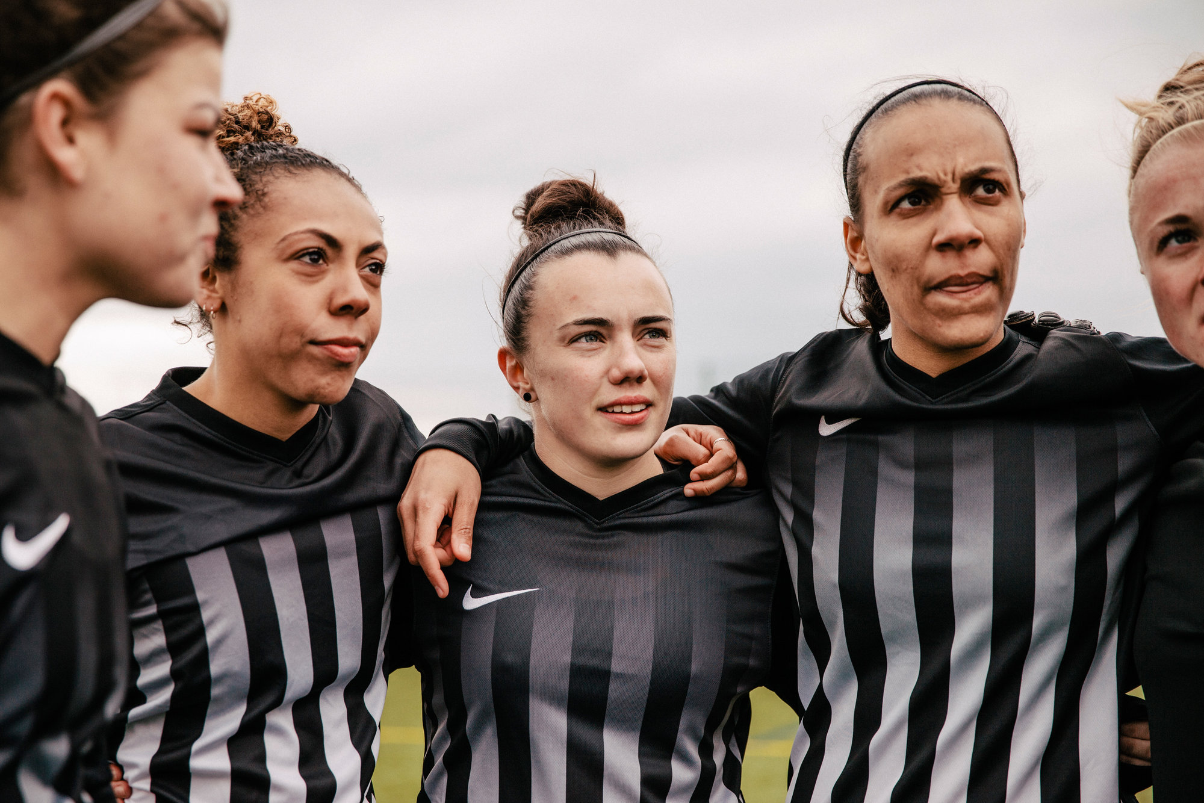
ANY QUESTIONS?
Notes:
Thank them for attending and for them all to be open minded for what is being implemented. Evidence shows it does work and it is here to stay. We will be reviewing throughout the season and encourage all feedback in the first instance to the County FA who will then in turn submit to the Association as appropriate

