Slide 1
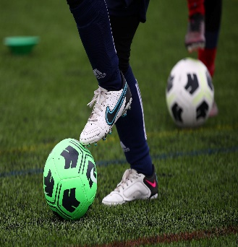
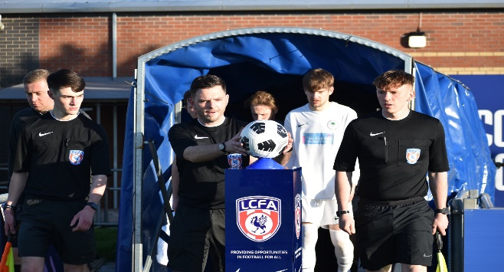

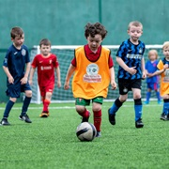
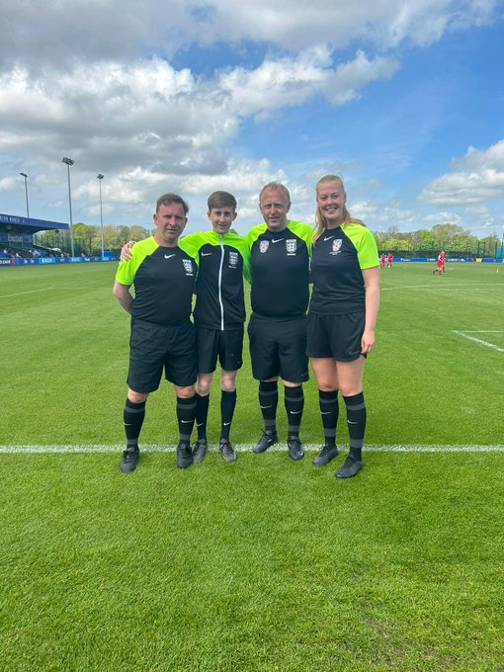
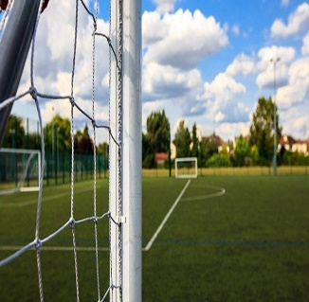
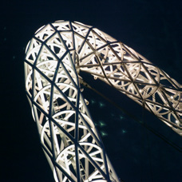

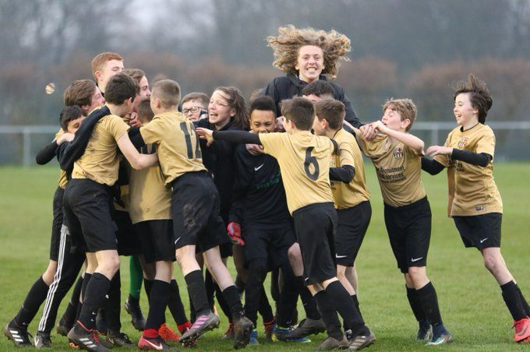
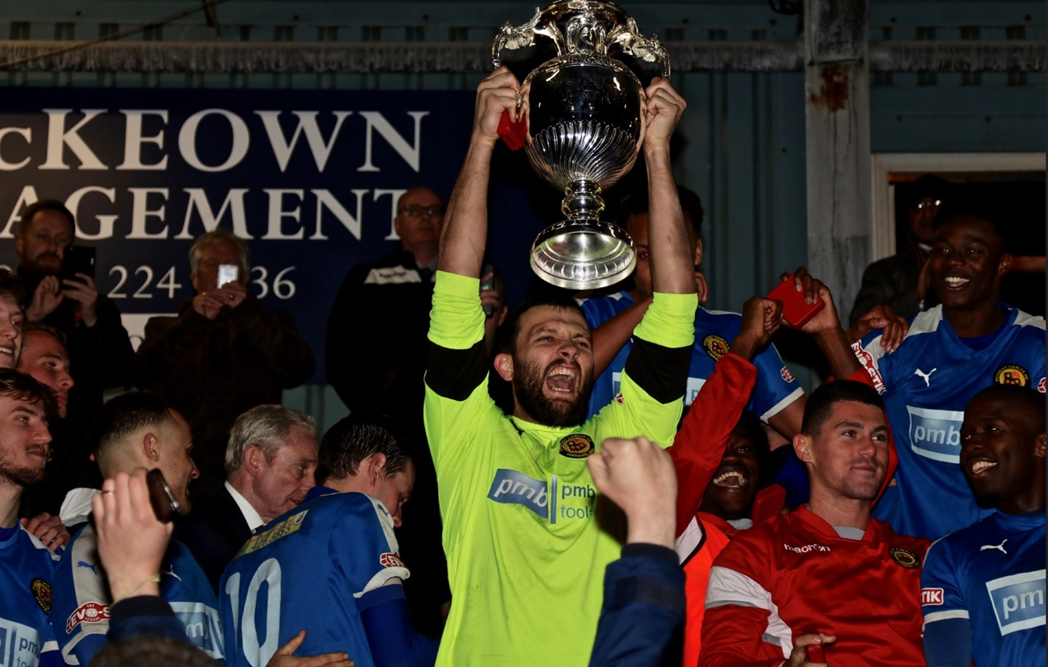
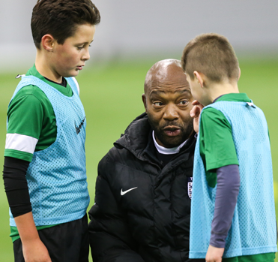
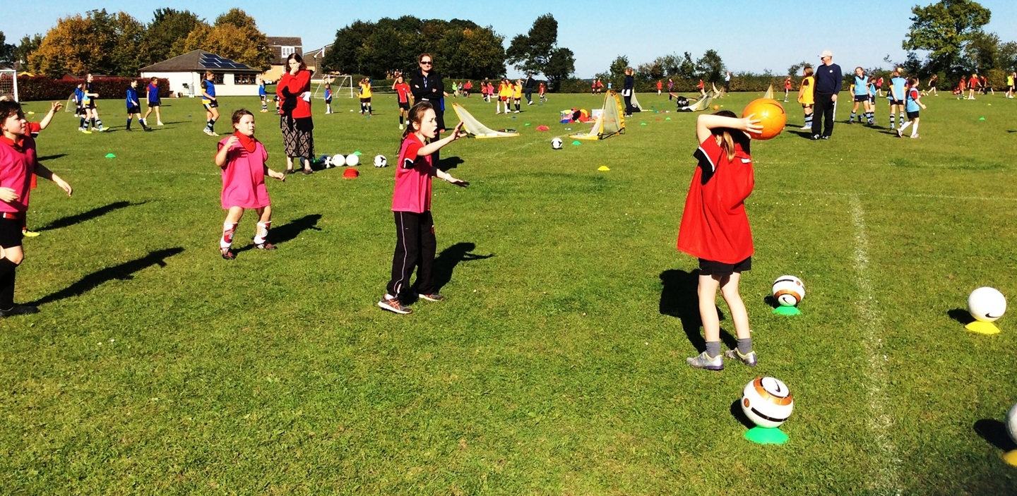

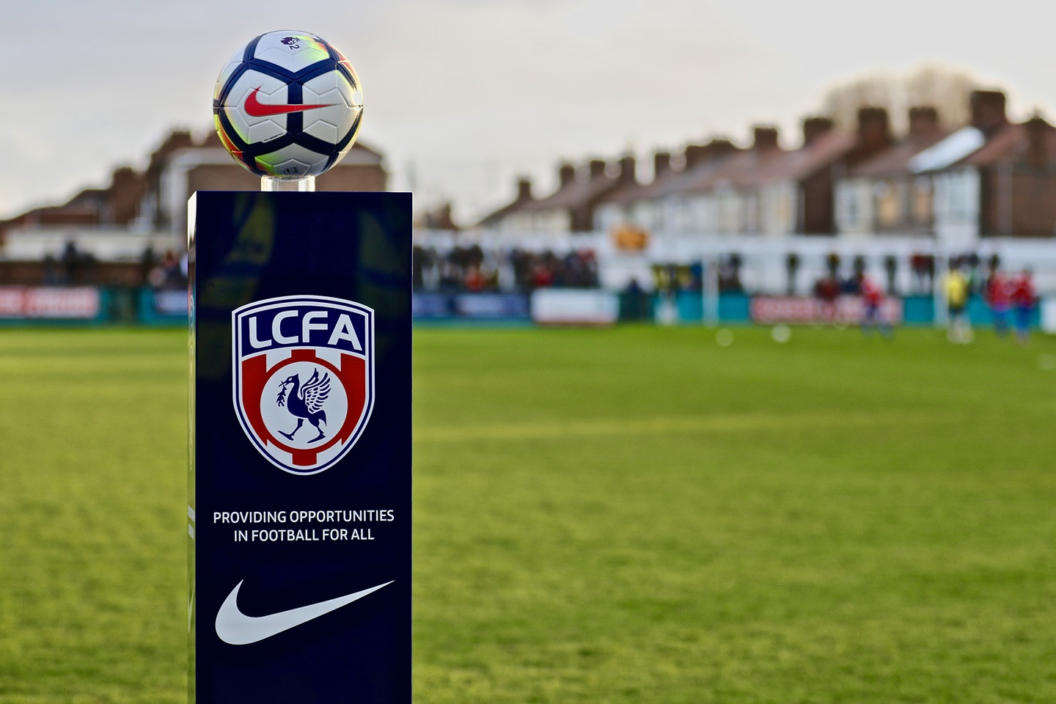

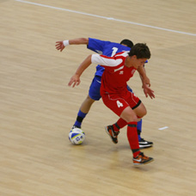


???? FC
Football Development Plan
Seasons 20?? - 20??
Insert Club Logo

Slide 2
Our Vision
Our vision is to build a Club that provides first class football training facilities and playing opportunities for current and future generations in the ????? and surrounding areas.
To provide Quality and Safe opportunities for young people of all ages in our community
To provide a Safe and Positive alternative place to go other than playing on the streets.
To help people realise their potential, develop personal skills and confidence as well as promoting respect.
To introduce people to football regardless of Age, Ability, Sex, Religion and Ethnic background
To improve the performance of Players, Coaches and Volunteers within the Club through Coaching, Training and Mentoring.

Slide 3
Our History – The Club was formed in ??? and achieved The England Football Club Accreditation status in ???. Season 20??/?? sees the Club affiliate ?? Teams with Liverpool FA
Our Philosophy - ????? follows the FA England DNA playing philosophy which outlines an overarching vision for the English game.
We endeavor to put in place Specialist age-appropriate Coaches for each Team who concentrate on Development, Fun Friends and Family and promote respect and the Club values in everything we aim to achieve and do.
We promote equal playing time with a proviso that every player in a Team will get 50% game time over the course of a season to allow everyone to develop.
????? have a Coaching philosophy document available to everyone in the Club which is attached to this application and available to view on the Club website.
Notes:
It’s a positive move for a club to have a philosophy (identity) which runs through the club and adopted by all teams within the club. This philosophy should be how the club believes children should develop, the environment which the children play, how the children should play (for example is it win at all costs long ball from back to front as quickly as possible or is it the players are children and should play in an environment free from pressure of making mistakes, mistakes will happen and learning will take place in a fun enjoyable environment) the philosophy will be clear to all and shared with everyone within the club. What is success??? Is it winning the league or maintaining a group of players that would normally have left the game??

Slide 4

Our Achievements
Club Growth!
  We have increased our numbers in mini soccer to now have multiple teams in ages U7s to U12s.
  We are working closely with Liverpool FA to start or increase (delete as applicable) women's and girls Teams
  We have increased teams numbers in last two seasons from ?? to ?? teams currently playing in the Club.
The People Factor!
  Talent, enthusiastic and qualified volunteer workforce
  Stable and progressive Executive Committee
  Investment in young people to become Coaches and Referees

Slide 5
Our Achievements
Facilities
  We currently Provide our members with first class training facilities which include 3G pitches at ?????.
  We also have plans in place to secure land for multiple pitches and build a clubhouse with financial backing, fundraising ourselves and grants from various sources.
Recognition
  We have The FA England Football Club Accreditation and retain this yearly via an Annual Validation process.
  Our Club is now being recognised and rewarded with increased numbers and a lot more applications to join us.
Notes:
Recognition is not just trophies but awards for the good work carried out by the club and it’s volunteers, these can be from the County FA, The FA, Local Authority etc.

Slide 6
Club Development Table (Example… Make it realistic in how your club will grow year by year)
Current |  |  | 20??/?? |  |  | 20??/20?? |  |  | 20??/20?? |  |  | 20??/20?? |  |  | 20??/20??
Number of Teams = ?? M=Male FM= Female Dis= Disability |  |  | ?? |  |  | ?? |  |  | ?? |  |  | ?? |  |  | ??
M | F | Dis | M | F | Dis | M | F | Dis | M | F | Dis | M | F | Dis | M | F | Dis
??xU8 ??xU9 ??x10 ??xU11 ??xU12 ??xU13 ??xU14 ??xU15 ??xU16 ??xU17 | 0 | 0 | ??xU6 ??xU7 ??xU8 ??xU9 ??x10 ??xU11 ??xU12 ??xU13 ??xU14 ??xU15 ??xU16 ??xU17 | ?? | ?? | ??xU6 ??xU7 ??xU8 ??xU9 ??x10 ??xU11 ??xU12 ??xU13 ??xU14 ??xU15 ??xU16 ??xU17 | 1xU9 | ?? | 2xU7 2xU8 1xU9 1x10 3xU11 2xU12 2xU13 3xU14 1xU15 2xU16 1xU17 1xU18 1xU19 | ?? | ?? | 2xU7 2xU8 2xU9 1x10 1xU11 3xU12 2xU13 2xU14 2xU15 2xU16 1xU17 1xU18 1xU19 1xU23 | ?? | ?? | 2xU7 2xU8 2xU9 2Ux10 1xU11 1xU12 2xU13 2xU14 2xU15 2xU16 1xU17 1xU18 1xU19 1xU23 Adult | ?? | ??
Notes:
Things to consider:………. Clearly state the current ages groups you have, if you have multiple teams in 1 age group state them too, if a club has U18’s can they develop them to U21’s & U23s?? This will help the transition from youth to senior football for many players who are physically not ready for senior football.

Slide 7
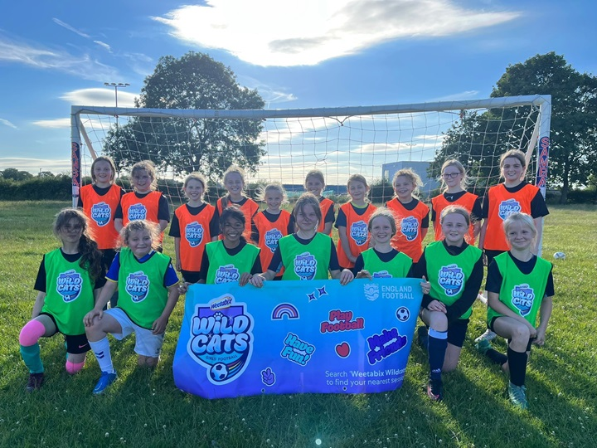

Player Pathways

Slide 8
Player Pathways
Aim | To provide opportunities for people of all ages and abilities to play football
Objective | Achievement targets | Timescale | Responsibility | Cost
1. Retain all existing teams, maintain a good level of support to existing Teams, Including Quarterly Team Manager and Coaches meetings to include a review of squad numbers. | All existing Teams retained. | Year ? and annually after that. | Club Committee. Head coach. Team Managers. | Normal running costs associated with those teams already in place.
2. Develop weekly introductory Coaching Sessions for 4-7 year old. Players to participate in Fun Days/Festivals/Club Kick-a-bouts. Create ? New Teams from players attending these sessions. U6’s to participate in the New U6 Development Football Programme. New Coaches to be identified from parents attending. | ?? Kids attending 4-6 age group. ?? Kids attending 6-7 age group. ?? Of U6 Teams created. | Next season and annually each season thereafter. | Club Committee. Head coach. Team Managers. | Players pay £?? Per session
3. Back fill with ? new U7 Teams each year through recruiting new Players, Coaches and Managers. | ? new U 7s Teams each year. | Next season and annually each season | Club Committee. Head coach. Team Managers. | £?? per team
4. Develop close links with Schools in the local area. Work with ? focus primary Schools to recruit new Players to squads where appropriate. | Coaching sessions in the Schools to promote the club. | Year ? and annually . | Head coach. | Free
a) Develop ?? Teams in each age group for mini soccer b) Develop an Under 15s & 16s Team so we have opportunities in every age group. | U15s Boys Team. U16s boys Team . | Year ? and annual retention . | Club Committee. Head coach. Team Managers. (Appointment of a head of girls football). | £500 per team
Notes:
Things to consider:………. Think a head to what teams you plan to set up over the duration of the plan, are you “back filling” each year and setting up at the younger age group or are there gaps in the age groups which you plan to fill? It’s important to add which age groups you plan to create and what format they will play. Also how you will go about setting the teams up, where will the players/volunteers come from? Are you using any schools? Etc.

Slide 9
Player Pathways
Aim | To provide opportunities for people of all ages and abilities to play football
Objective | Achievement targets | Timescale | Responsibility | Cost
6. Ensure all youth Players have a realistic pathway to continue playing open age football. Develop a new Senior Men’s Team and retain each year. (U19’s, U21’s, U23’s &/or Senior) Develop a new Senior Women’s Team and retain each Year. | Multiple adults Teams either in 11 aside or 5-a-side football. | Year ? | Club Committee Head coach Team Managers | £? for senior women's team
7. Develop a men's over 35s Team to allow senior Players to stay in the sport. Encourage Parents, Coaches & ex Players to participate . | Over 35s Team. | Year ? | Club Committee Head coach Team Managers | £? for seniors team
8. To provide first class playing and social facilities to accommodate all the new members including children, adults, women's football and disability football. | Home ground with multiple pitches and Club house facilities with social areas. | Year ? | Club Committee Head coach Team Managers
9. Set up a junior disability Teams through making links with local disability organisations and schools. Develop a new U??s disability Team and retain each year. | ? Junior disability Teams. | Year ? | Club Committee Head coach Team Managers | £? for kit and equipment
10. Set up an adult disability Team through making links with local disability organisations and support from the DFA Disability Development Officer to develop new adult disability Team and retain each year. | ? Adult disability Teams. | Year ? | Club Committee Head coach Team Managers | £? for kit and equipment
Notes:
Things to consider:………. Think a head to what teams you plan to set up over the duration of the plan, are you “back filling” each year and setting up at the younger age group or are there gaps in the age groups which you plan to fill? It’s important to add which age groups you plan to create and what format they will play. Also how you will go about setting the teams up, where will the players/volunteers come from? Are you using any schools? Etc.

Slide 10
Player Pathways
Aim | To provide opportunities for people of all ages and abilities to play football
Objective | Achievement targets | Timescale | Responsibility | Cost
11. Utilise FA Initiatives to recruit new Players. For example the ‘Wild Cats’ programme aimed at recruit female Players. | Programme delivered. ? number of new Players/Teams join the Clubs. | Year ? | Club Committee Head coach Team Managers | ?
12. Work with County FA Women’s & Girls Development Officer to develop a new girls and women's football teams each season targeting age ranges U8s to U18s in first two years. Aim to create a Full Player Pathway for Female Football U8’s – Open Age. | A new girls/women’s football Team each season as a minimum. | Each season and annually there after. | Club Committee Head coach Team Managers (Appointment of a head of girls football) | £? per team
13. Offer recreational playing opportunities for members. Female sessions for Players mums. Male sessions for Players dads. Walking Football sessions for Players grand parents. | Sessions available for parents to participate in whilst their child trains. | Year ? | Club Committee Head coach Team Managers | attendees pay £?? Per session
? | ? | ? | ?
? | ? | ? | ?
Notes:
Things to consider:………. Think a head to what teams you plan to set up over the duration of the plan, are you “back filling” each year and setting up at the younger age group or are there gaps in the age groups which you plan to fill? It’s important to add which age groups you plan to create and what format they will play. Also how you will go about setting the teams up, where will the players/volunteers come from? Are you using any schools? Etc.

Slide 11
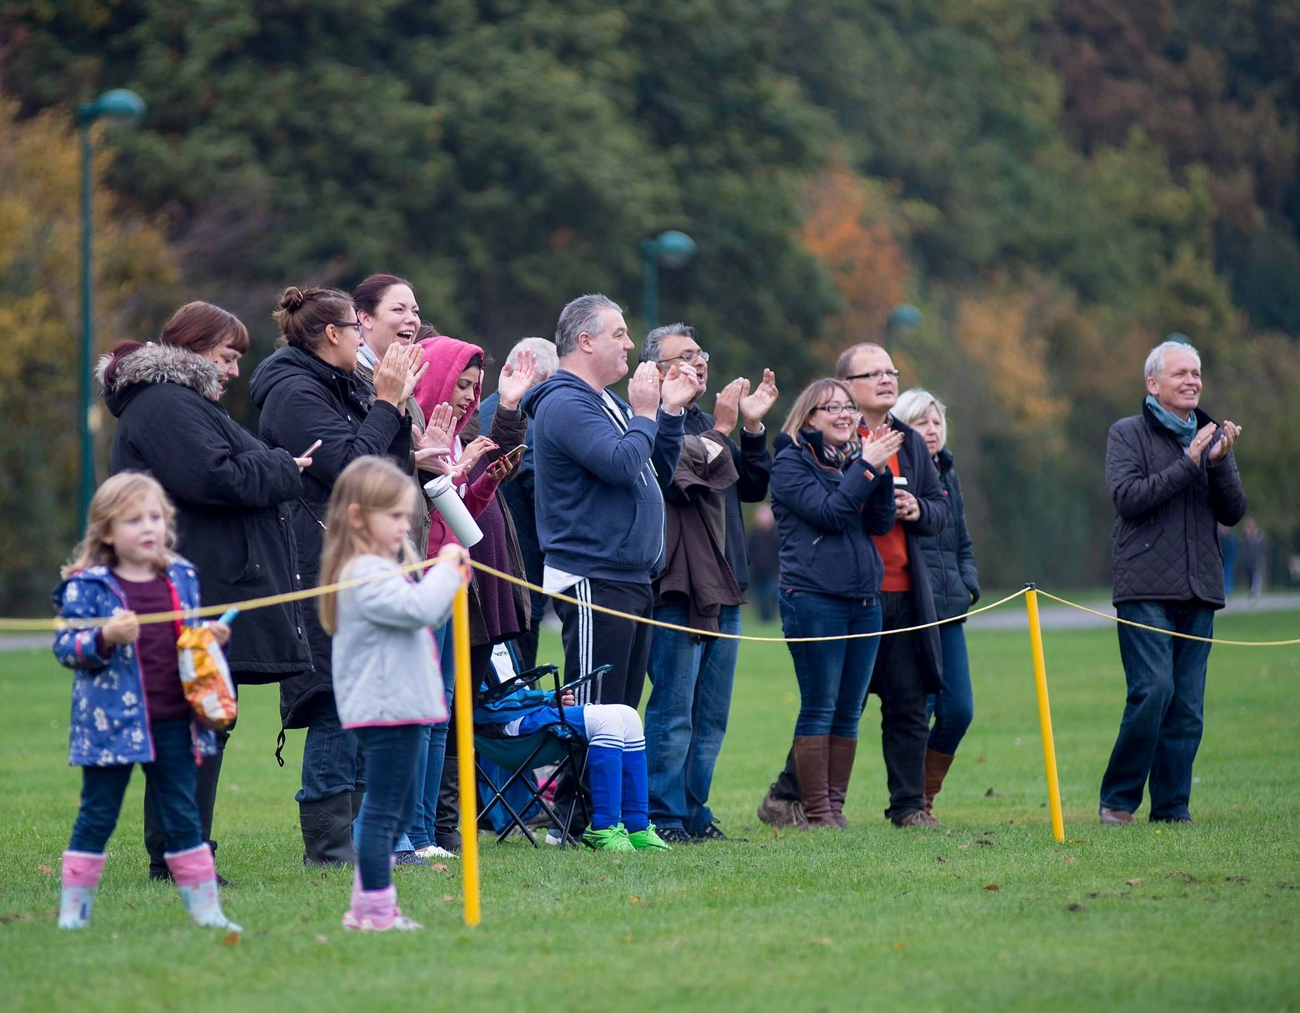

Positive Environments

Slide 12
Positive Environments
Aim | To ensure that all people can play football in a high quality, safe environment that is free from abuse
Objective | Achievement targets | Timescale | Responsibility | Cost
1. To Retain and achieve the FA ?*/**/*** Club Accreditation and retain each year by completing the Annual Validation process. | */**/*** Club Accreditation achieved/retained. | Year ? and annually | Secretary | ?
2. To follow all FA guidelines and procedures regarding Club Welfare and work with the county FA to ensure Club Welfare Officer receives up to date training and support. | All FA guidelines and procedures followed. | Year ? and annually thereafter | Club Welfare officer. | ?
3. To work with County FA to ensure Club Welfare Officers receive up to date training and support Club Welfare Officer to attend Welfare Officers workshop. | Workshop attended. | Year ? | Club Welfare officers | ?
4. Fully support the FA RESPECT PROGRAMME through briefings and visibility of the respect logos and promotional material. | Regular agenda item on meetings. All Teams to have respect captains armbands and logos on the sleeves. Respect barriers and posters to be used around the pitches and Club house when built. | Year ? and annually thereafter | Secretary Club Welfare officers Team Managers | ?
Notes:
Things to consider:………. How does your club plan to tackle poor standards and behaviour both on the pitch and touchline?? What ideas do you have to change the mindset of the adults?? Everyone involved in the game is entitled to an enjoyable environment free from abuse and intimidation, especially the young children.

Slide 13
Positive Environments
Aim | To ensure that all people can play football in a high quality, safe environment that is free from abuse
Objective | Achievement targets | Timescale | Responsibility | Cost
6. Fully support the FA RESPECT programme through all the Players and members . Every Player, Parent and Coach to sign the ‘Code of Conduct’ and display latest versions in Clubhouse Zero tolerance of abuse towards referees Work with County FA. | Reduce number of incidents of abuse towards referees and deal with all matters firmly and in line with FA recommended sanctions. | Year ? and annually | Club committee Team managers Parents Introduce respect Marshalls by year 2 | Nil
7. Organise a Volunteer and Player awards evening Set up an organising committee. Seek recognition for hard work of all Volunteers. | Annual Volunteer and player awards evening 1 awards application per season. | Year ? and annually | Club Committee | £?
8. Organise a pre-season briefing for Players and Parents/Carers at the start of each season detailing acceptable standards of behaviour. | One pre season meeting per year. | Year ? and annually | Club Committee | Nil
Notes:
Things to consider:………. How does your club plan to tackle poor standards and behaviour both on the pitch and touchline?? What ideas do you have to change the mindset of the adults?? Everyone involved in the game is entitled to an enjoyable environment free from abuse and intimidation, especially the young children.

Slide 14
Positive Environments
Aim | To ensure that all people can play football in a high quality, safe environment that is free from abuse
Objective | Achievement targets | Timescale | Responsibility | Cost
9. Club Committee Members regularly visit training and games to ensure those involved are the correct Club Volunteers who have the necessary accreditations in place. | ? Visits per month | Year ? and annually | ? | ?
10. Club will set up a committee to deal with in house issues involving Parents & Coaches. | In house issues dealt with internally by Club Committee. | Year ? and annually | ? | ?
11. Managers & Coaches will be responsible for the behaviour of Parents & Spectators involved with their Team. | Managers & Coaches to promote good behaviour inline with Clubs Codes of Conducts at training and matches throughout the season. | Year ? and annually | ? | ?
? | ? | ? | ? | ?
? | ? | ? | ? | ?
? | ? | ? | ? | ?
Notes:
Things to consider:………. How does your club plan to tackle poor standards and behaviour both on the pitch and touchline?? What ideas do you have to change the mindset of the adults?? Everyone involved in the game is entitled to an enjoyable environment free from abuse and intimidation, especially the young children.

Slide 15
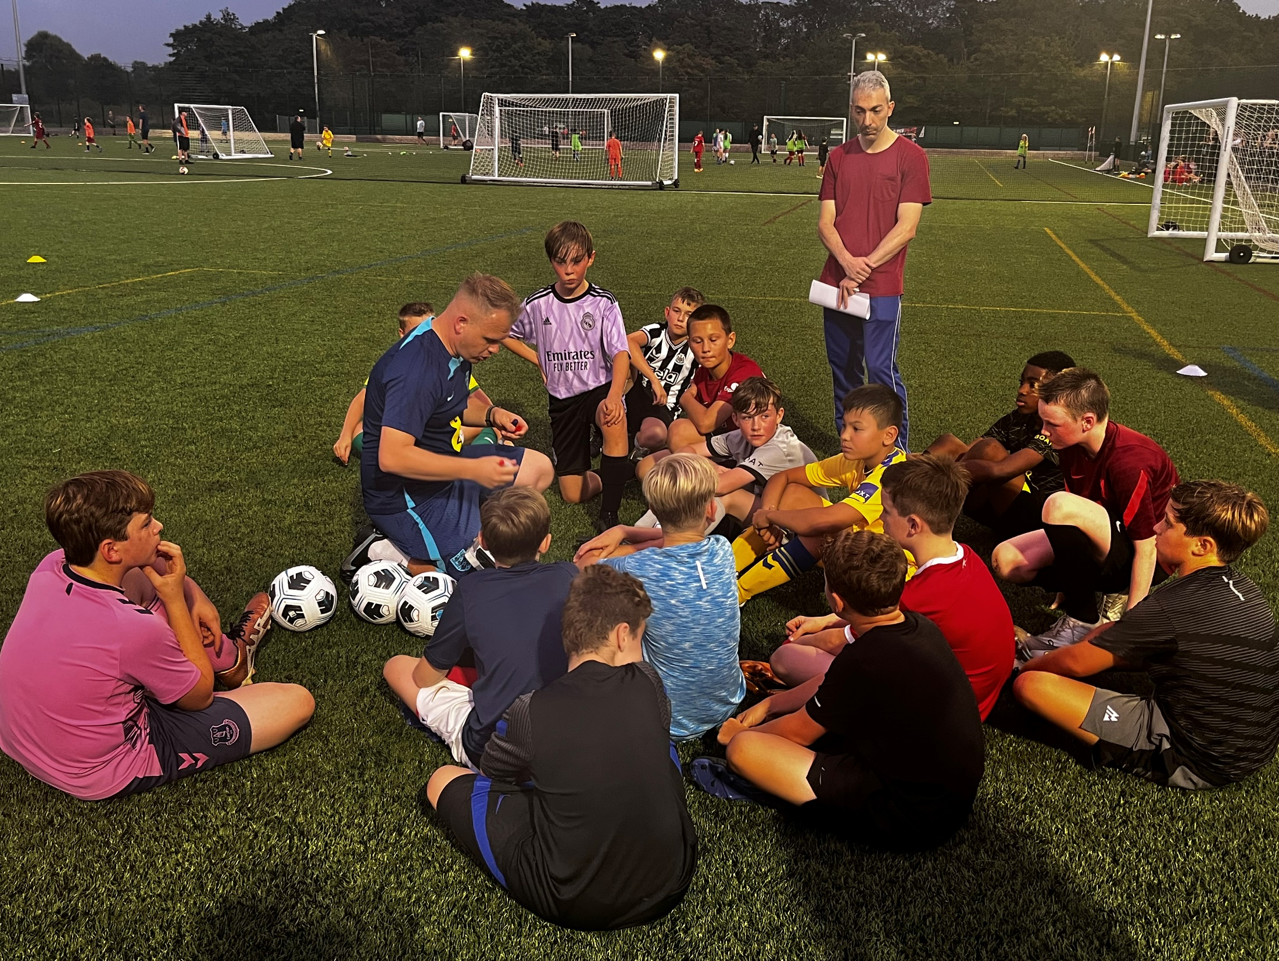
Player Development
Notes:
15

Slide 16
Player Development
Aim | To raise the standards of Players within the Club To support the Development of Coaches to create better Players
Objective | Achievement targets | Timescale | Responsibility | Cost
1. To identify older players in the Club from U17s up over as future young leaders. Also to sign post interested volunteers aged 14+ to the Liverpool FA Young leaders programme via the DFA. | Two per year. | Year ? and annually. | Head coach Committee Team Managers | £? per year
2. Run holiday coaching courses for 4-11s. Run Fun Days/Festivals/Club Kick-a-bouts during School Holiday/Half Terms for 4-7s. | 5-11s engaged in holiday coaching Sessions. Over 7s also engaged in separate session. | Year ? and annually. | Head coach | n/a
3. Coaches to promote basics skill development training and Coaching exercises to the Parents/Carers of Players to increase practice time at home. | 2 meetings per year with parents. | Year ? then maintained annually. | Team managers Head of Football | N/A
Notes:
Things to consider:………. What methods/ideas do you have in mind to improve the players? E.g. club has a coach coordinator who spends a period of time with each age group and passes on new ideas to the coaches? If the club has multiple teams at 1 age group do they train together from time to time? Or for example does the U11’s spend a few weeks training with the U12’s?

Slide 17
Player Development
Aim | To raise the standards of Players within the Club To support the Development of Coaches to create better Players
Objective | Achievement targets | Timescale | Responsibility | Cost
5. Run a transition festival in May/June each year to give Players moving from 7 a side to 9/11 a side the experience of the wider format of the game. | 1 transition festival run in May each year for new U9s and U11s. | Year ? and annually. | Head coach Committee | Nil
6. Run 5 a side and 7 aside festivals across all age groups 12 - 17s to promote the benefits of small sided play supporting skill development at the end of each season. | 5 a side and 7 aside festivals to be organised for all age groups. | Year ? and annually. | Head coach Committee | Nil
7. To have multiple Teams in each group which allows Players the opportunity to play for a Team that matches and pushes his/her ability and skill levels up. | Multiple Teams in place from U7 to Under 12. Build from bottom up to continue this. | By the end of year ? to have multiple teams from U7 to U 18s plus adult first and reserve Teams. | Committee Head coach | Nil
Notes:
Things to consider:………. What methods/ideas do you have in mind to improve the players? E.g. club has a coach coordinator who spends a period of time with each age group and passes on new ideas to the coaches? If the club has multiple teams at 1 age group do they train together from time to time? Or for example does the U11’s spend a few weeks training with the U12’s?

Slide 18
Player Development
Aim | To raise the standards of Players within the Club To support the Development of Coaches to create better Players
Objective | Achievement targets | Timescale | Responsibility | Cost
8. To identify older Players in the Club from U17s up over as future Young Leaders and attain the FA Certificate. Also to sign post interested volunteers aged 14+ to the Liverpool FA Young Leaders Programme. | ? Players identified per year | Year ? and annually | Head coach Committee Team Managers | £?
? | ? | ? | ? | ?
? | ? | ? | ? | ?
? | ? | ? | ? | ?
Notes:
Things to consider:………. What methods/ideas do you have in mind to improve the players? E.g. club has a coach coordinator who spends a period of time with each age group and passes on new ideas to the coaches? If the club has multiple teams at 1 age group do they train together from time to time? Or for example does the U11’s spend a few weeks training with the U12’s?

Slide 19

Club Administration

Slide 20
Club Administration
Aim | To ensure the Club is managed and run effectively in accordance with FA guidelines To provide structure, management and leadership to successfully deliver a Football Development Plan
Objective | Achievement targets | Timescale | Responsibility | Cost
1. Form a Football Development Committee to manage, monitor and deliver the Football Development Plan. | Committee formed and meets on a regular basis. Committee formed from representatives of junior, seniors, women and girls, disability and Coaches as each section is developed. | Year ? and annually | Secretary, Chairperson and Head Coach | ?
2. All Teams affiliated with CFA by 1st July every year and entered into the appropriate Leagues. Secretary to submit paper work to CFA. | All Teams affiliated | Year ? an annually | Secretary | Affiliation costs only.
3. Keep all football records up to date with the County FA using the FA Club Portal. | All records up to date | Year ? and ongoing process | Secretary | ?
4. Set up a Coaches support group to offer help and guidance, Invite all Coaches and Team Managers to a network meeting to discuss issues such as Coaching methods and squad Team numbers. | Group established | Year ? and ? Per season meetings thereafter | Football Development Committee, Secretary and Head Coach. | ?
Notes:
Things to consider:………. What administration methods does the club plan to use to improve the running of the club? What’s the communication like between the teams. How easy is it to communicate with all the coaches? Etc.

Slide 21
Club Administration
Aim | To ensure the club is managed and run effectively in accordance with FA guidelines To provide structure, management and leadership to successfully deliver a football development plan
Objective | Achievement targets | Timescale | Responsibility | Cost
5. Improve communications between Club and its team Managers/Coaches by having volunteers register including tel no and email address. | Managers/Coaches register established and issued to all Committee Members. | Year ? and annually | Secretary, | ?
6. Improve communication between Club and its members and parents with a fully updated contact list including telephone and email addresses. | Club Register established | Year ? an annually | Secretary | ?
7. To provide all new Managers with guidance and support when joining the Club in terms of Coaching and admin. | All new Managers supported by Head Coach for Coaching and Secretary for admin. Guidance documents given out. | Year ? and ongoing process | Secretary & Head Coach | ?
8. To make all Club documents easily available for all members to assist in the smooth running of the Club and have clear guidance on how the Club is run. | All documents are available on the Club website for download or reading. | Year ? and quarterly meetings thereafter | Football Development Committee, Secretary and Head Coach. | ?
9. To maintain regular Executive Committee/ Managers and parents meetings within the club. | Regular meetings held and documented | Year ? and annually | Secretary | ?
10. Create an Emergency Reserve Fund which will cover 6-12 Months of running costs in the event of unforeseen circumstances (i.e. COVID-19) Club to set aside % of annual income over ? of months/years. | ?% of annual income to be set aside to ensure committed outgoings such as facility hire contracts can be honoured. | By year ? | Club Committee & Treasurer | ?
Notes:
Things to consider:………. What administration methods does the club plan to use to improve the running of the club? What’s the communication like between the teams. How easy is it to communicate with all the coaches? Etc.

Slide 22
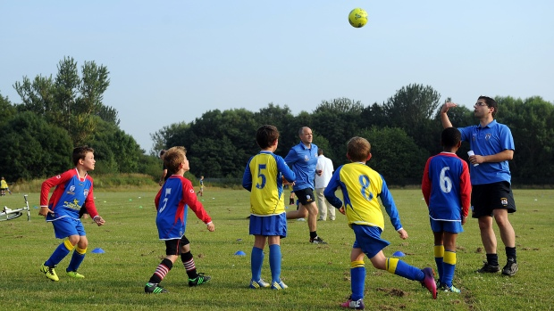
Safeguarding

Slide 23
Safeguarding
Aim | Ensure Club provide safe environment for all members Club have processes in place effectively safeguard children and young people
Objective | Achievement targets | Timescale | Responsibility | Cost
1. Any Volunteer wishing to join the Club (To work with children) must be interviewed by the CWO and have an FA DBS check carried out by the FA and can not carry out any activity with the Team until this has returned from the FA as accepted. | All club volunteers who need an FA DBS Check have in date accepted FA DBS Check on their FAN record at all times | Year ? and annually | Secretary / Club Welfare Officer | £10 per check
2. Ensure all coaches and assistant coaches have in date FA Safeguarding Children course. | All coaches and assistant coaches hold an in date FA Safeguarding Children course on their FAN Record (every 2 years) | Year ? and annually | Club Committee | £30 per initial FA Safeguarding Children course
3. All members are aware of how to raise concerns and are aware of the clubs complaints policy and procedures. | All members have access to clubs complaint policy and procedures and are aware of how to raise concerns. | Year ? and annually | Club Committee | ?
4. To increase the number of Welfare Officers the Club has as Teams and members increase. | 1 fully trained Welfare Officer to every 10 teams | Year ? and annually Year ? and being maintained Year ? and annually Year ? and annually | Committee members | £30 per Welfare Officer Workshop £30 per FA Safeguarding Children Course £10 per FA DBS Check

Slide 24
Safeguarding
Aim | Ensure Club provide safe environment for all members Club have processes in place effectively safeguard children and young people
Objective | Achievement targets | Timescale | Responsibility | Cost
5. Club have and adhere to a ‘Safer Recruitment’ policy to ensure all club volunteers are recruited consistently and supported | All volunteers recruited have gone through the process and supported in their deployment | Year ? and annually | Club Committee | ?
6. Ensure Club Portal records are up to date and accurate at all times | All Coaches and Assistant Coaches are listed against the relevant teams at all times | Year ? and annually | Club Committee | Free
7. Seek feedback from children and young people on how the club have support them. | Establish process to gain feedback from children and young people and utilise this feedback to affect club decision making. | Year ? and annually | Club Committee | ?
? | ? | Year ? and annually |  | ?
? | ? | Year ? and annually |  | ?
Notes:
Things to consider:………. ?

Slide 25
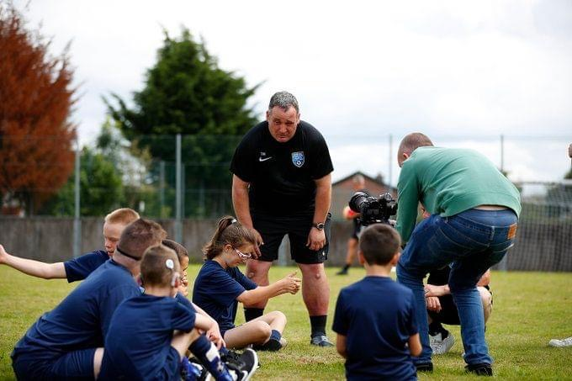
Volunteer Development

Slide 26
Workforce Development
Aim | To create, develop and support an effective volunteer workforce within the club
Objective | Achievement targets | Timescale | Responsibility | Cost
1. Have a key contact person to support the recruitment and development of volunteers. Recruit and select a Volunteer Coordinator. | Role currently carried out by Club Welfare Officer but as we grow new role to be created. | Year ? | Management Committee | ?
2. All Club Coaches to hold a minimum of FA Level 1 or Introduction to Coaching and FA DBS check. Volunteer Coordinator to maintain an up to date list and book new Coaches onto County FA courses. | All coaches either level 1 qualified or on booked courses. New Coaches to be Introduction to Coaching qualified within first 12 months. | Year ? and annually | Secretary, Welfare Officer and Volunteer Coordinator (when appointed) | Course cost per Coach. And DBS check £10
3. The Club uses The FA Football Workforce resource so that all Coaches and Volunteers have job descriptions with clear roles and responsibilities. | All Volunteers have job descriptions within the Club. | Year ? and annually | Secretary, Welfare Officer and Volunteer Coordinator. | ?
4. Increase the number of Level 2 Coaches (UEFA C) Encourage enthusiastic Level 1 Coaches to progress. | ?? already level 2 (UEFA C) qualified, ? further each year to be identified. | Year ? and annually | Head coach | UEFA C cost
5. Recruit new Volunteers for all roles within Teams and Clubs, Find out Parents backgrounds if possible and utilise their Skills within the Club. | ?? Volunteers . | Year ? and annually | Welfare Officer, Secretary, Chairperson and Volunteer Coordinator (when appointed) | Dependant on role.
Notes:
Things to consider:………. Apart from coaches attending Level 1 and Level 2 courses, what other development do you have in mind for the coaches to continually development themselves in order to give the children the best possible experience and environment. Does the club host a Liverpool FA Coaches CPD event which is free? Does the club have a buddy system for new coaches? Etc. What training/development is offered for those who carry out roles other than Coaching?

Slide 27
Workforce Development
Aim | To create, develop and support an effective volunteer workforce within the club
Objective | Achievement targets | Timescale | Responsibility | Cost
6. Ensure all existing Coaches and appropriate Volunteers have valid FA Introduction to First Aid, FA Safeguarding Children qualifications and FA DBS Check. Identify expiry dates of existing Coaches and Volunteers’ qualifications | All Coaches and Volunteers qualifications up to date or booked on courses. | Year ? and annually | Welfare officer, Secretary, Chairperson and Volunteer Coordinator | Dependant on qualification.
7. All Coaches to participate in Liverpool FA Coach Development Programmes/Events | All Coaches either members or in process of applying. | Year ? and annually | Secretary, Welfare Officer and Volunteer Coordinator (when appointed) | ?
8. Increase the number of qualified female Coaches | ?? Female Coaches qualified each season. | Year ? and annually | Secretary, Welfare Officer, Head Coach and Volunteer Coordinator. | Level 1 cost x UEFA C annually
9. Develop new Referees as Club grows from older Teams. | ?? Referees | Year ? And annually | Secretary, Welfare Officer, Head Coach and Volunteer Coordinator. | Referee course cost
10. Hold Coach Development events in the Club for its Coaches in line with Liverpool FA and Coaches Development Programme. | Improved levels of Coaching for all Coaches. ?? Of in house events per season. | Year 3 and annually | Secretary | ?
Notes:
Things to consider:………. Apart from coaches attending Level 1 and Level 2 courses, what other development do you have in mind for the coaches to continually development themselves in order to give the children the best possible experience and environment. Does the club host a Liverpool FA Coaches CPD event which is free? Does the club have a buddy system for new coaches? Etc. What training/development is offered for those who carry out roles other than Coaching?

Slide 28
Workforce Development
Aim | To create, develop and support an effective volunteer workforce within the club
Objective | Achievement targets | Timescale | Responsibility | Cost
11. Implement a Coaching/Player Development Plan. All Club Coaches to be involved and consulted in the creation of the Plan. | Development Plan and Philosophy in place for all Coaches/Managers to follow. | Year ? and annually | ?? | ?
12. Create a Succession Plan to identify suitable new Committee Members and future applicants for key roles. | Clear Role Descriptions in place. Progression route in place. Designated person in place to identify suitable new candidates. | Year ? and annually | ? | ?
? | ? | ? | ? | ?
? | ? | ? | ? | ?
Notes:
Things to consider:………. Apart from coaches attending Level 1 and Level 2 courses, what other development do you have in mind for the coaches to continually development themselves in order to give the children the best possible experience and environment. Does the club host a Liverpool FA Coaches CPD event which is free? Does the club have a buddy system for new coaches? Etc. What training/development is offered for those who carry out roles other than Coaching?

Slide 29
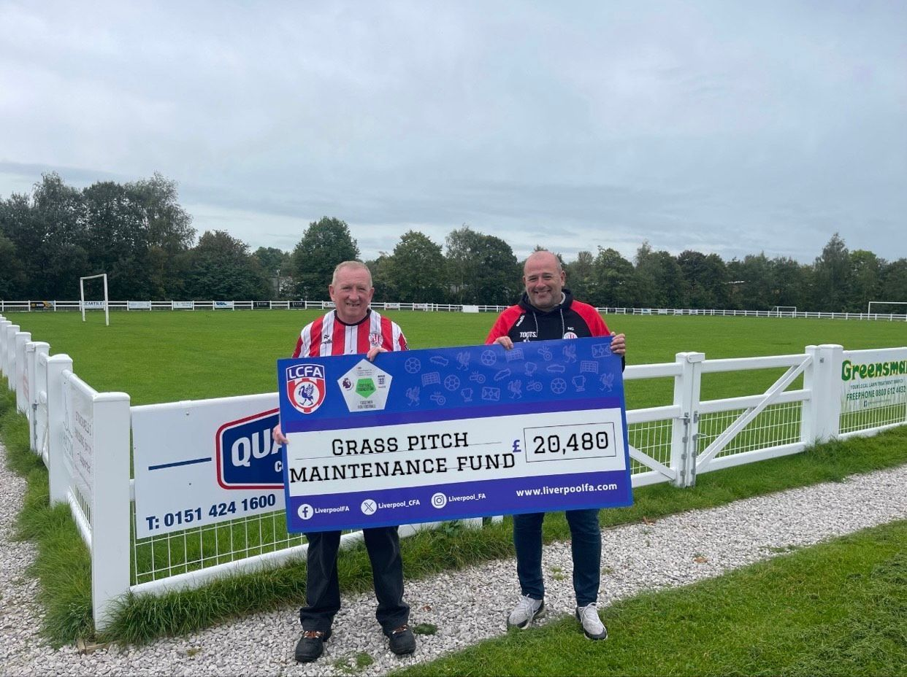
Facility Development

Slide 30
Facility Development
Aim | To develop a club home ground and provide facilities to allow the Club to grow. To provide facilities for club members and the community as a whole.
Objective | Achievement targets | Timescale | Responsibility | Cost
1. Discuss the facilities project idea with the County FA before beginning negotiations with the council/ land owner for a long term lease of land large enough to have a changing room/ pavilion and multiple grass pitches. | Negotiations underway with County FA & council. | Year ? | Chairman Secretary | N/A
2. Link team growth development plan with the formats (5v5, 7v7, 9v9,11v11) of the game to ensure correct layout of pitches confirming that they meet the needs of the Club Teams. (This can vary season to season). | Contact County FA/ FA Pitch Advisor for advice /guidance . | Year ? | Chairman Secretary Groundskeeper | N/A FREE
3. Manage and maintain those pitches to a high standard. | Enrol upon an on-line Level 1 Football Grounds Maintenance Course. | Year ? and annually | Chairman Secretary Groundskeeper | ?
4. Investigate the opportunity to develop a 3G FTP What is the Clubs legal Status? Incorporated/ unincorporated? | Discuss 3G project with County FA. Discuss with the County FA. | Years 3-5 | Committee | ?
Notes:
Things to consider:………. Does your club have it’s own Facility? If so what are your “Realistic” Plans, if not do you have potential to secure your own facility? If not what plans do you have should you be planning to grow the number of teams, where will they play? Do you have links with Schools to use their sites? Etc.

Slide 31
Facility Development
Aim | To develop a club home ground and provide facilities to allow the Club to grow. To provide facilities for club members and the community as a whole.
Objective | Achievement targets | Timescale | Responsibility | Cost
5. All facilities & goalposts are safe. Goalposts to be checked before each game and replaced when needed through applying to the Goalpost Programme at the Football Foundation. Risk assessments to be regularly carried out on the venue/facility. | On-going at ALL venues but when own facilities are up and running, to be completed before every match and training session. All facilities and goalposts to be safe and secure. | Weekly/ Annually | Committee, managers, Grounds person | N/A
5. Work with the County FA to continue to improve their grass pitches through our Pitch Improvement Programme. (this will enable more competitive games on the pitches) Complete a PitchPower Assessment on each of the clubs grass pitches in order to receive a report and potential funding. | Grass pitches maintained to a ‘good or higher’ standard. https://footballfoundation.org.uk/pitchpower/how-it-works | Year ? & Annually | Groundskeeper Groundskeeper/ Secretary/ Treasurer | Depending on PitchPower report FREE
6. Work with the County FA to access funding for pitch improvement (i.e. Maintenance machinery). | Attend workshops and Courses hosted by the County in order to find out what funding is available. | Year ? & Annually
7. Join the https://footballfoundation.hivelearning.com/ a Groundskeepers forum for advice and tips and questions you may have? | Groundskeeper to join. | Year ? | Groundskeeper | FREE
Notes:
Things to consider:………. Does your club have it’s own Facility? If so what are your “Realistic” Plans, if not do you have potential to secure your own facility? If not what plans do you have should you be planning to grow the number of teams, where will they play? Do you have links with Schools to use their sites? Etc.

