Slide 1
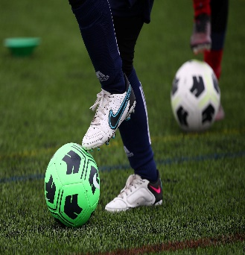
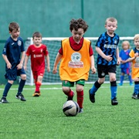

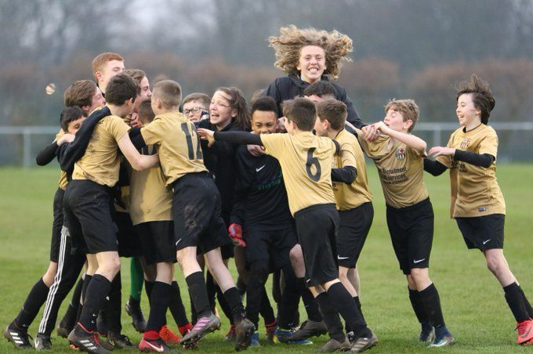
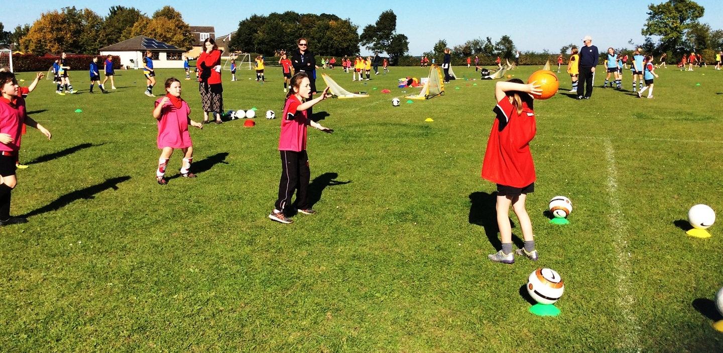
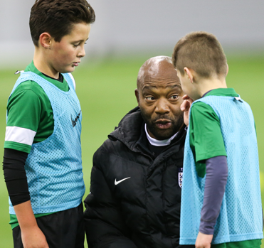
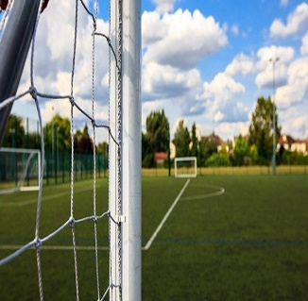
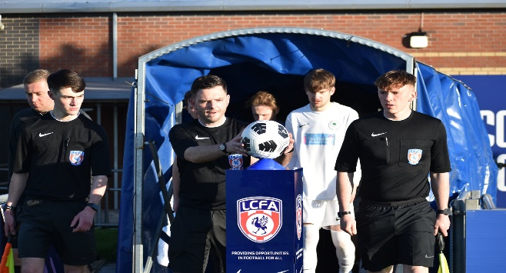
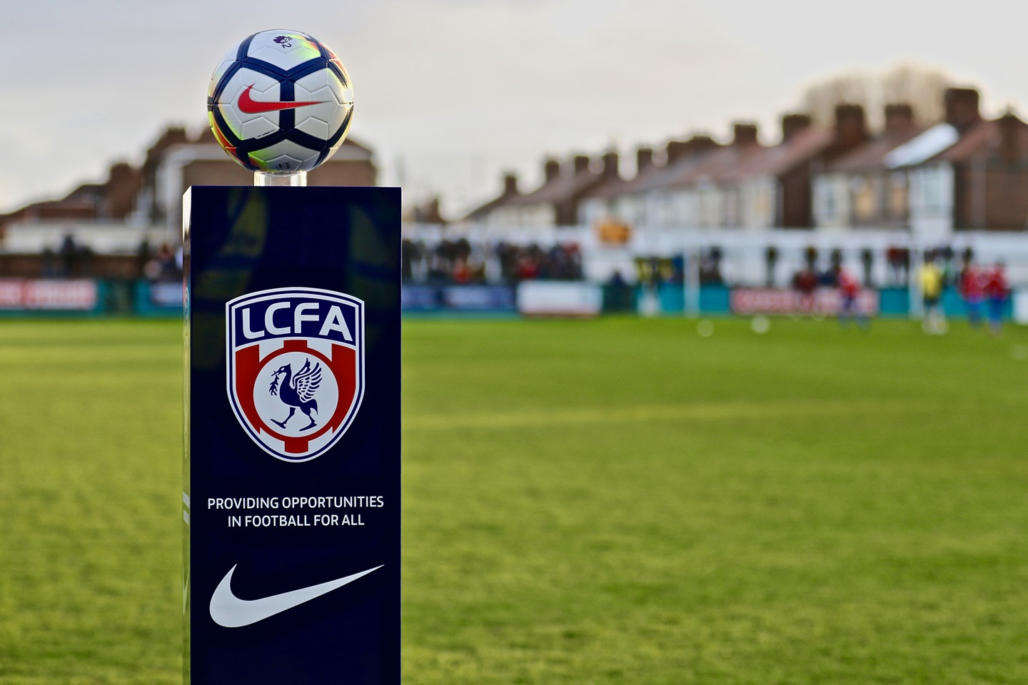
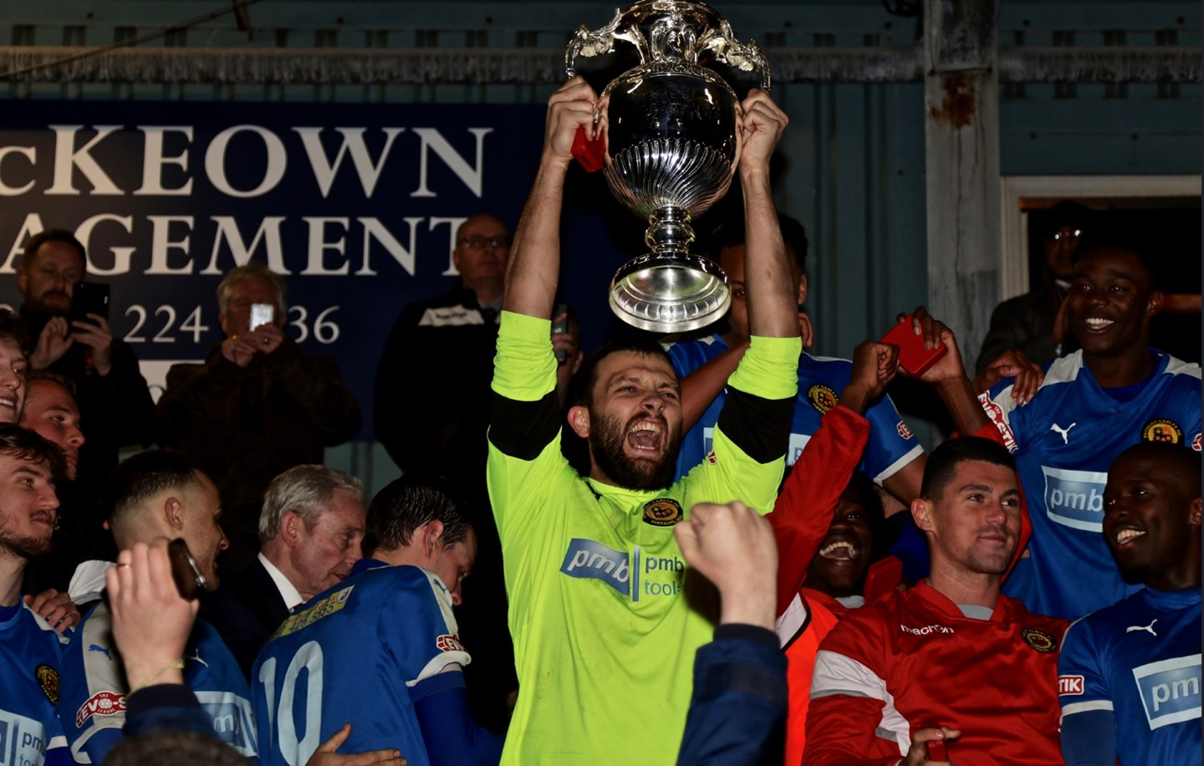

Insert Club Badge Here
Adult Club Season Planner
20xx-20xx

Slide 2

Season Planner – Adult Clubs
Task: | Description: | Timescale: | Person Responsible: | Cost: | Task Complete:
Administration: Liverpool FA Affiliation League Registration LCFA Cup Competition Registration League Cup Competition Registration Pitch Hire Sanction Friendly Fixtures Complete Player Registration League Match Details Complete England Football Validation | To: Liverpool FA To: (Insert League Name) To: (Insert Competition Name) To: (Insert Competition Name) To: (Insert Providers Name) To: Liverpool FA Via FA Club Portal Results & Paperwork/Online Reporting sent to League Ensure all criteria and qualifications are in place and up to date on Club Portal | Window opens April each Season Due (Insert Date set by League) Window opens April each Season Due (Insert Date) Due (Insert Date) 72 hours prior to fixture Due (Insert Date set by League) Due (Insert Date i.e. weekly - 6pm Monday Evening) November each season | Club Secretary Club Secretary Club Secretary Club Secretary Club Secretary Club Secretary Club Secretary Team Manager Club Secretary | £ (Insert Amount) £ (Insert Amount) £ (Insert Amount) £ (Insert Amount) £ (Insert Amount) £ (Insert Amount) £ (Insert Amount) N/A | Date Complete
Safeguarding: (Only applicable to Teams with Players Under the age of 18) Coach, Manager & First Aider(s) DBS Checked All Club Officials complete the FA Online Safeguarding For All Course Keep First Aider Qualification up to date. | All necessary People hold an in date and accepted FA DBS check at all times. Course available through the England Football Learning website | (Insert Day & Frequency) (Insert Day & Frequency) | Club Secretary Club Welfare Officer | £ (insert Amount) | Date Complete

Slide 3
Season Planner
Adult Clubs
Season Planner – Adult Clubs
Task: | Description: | Timescale: | Person Responsible: | Cost: | Task Complete:
Communication: Players (Match Details) Match Officials (Match Details) Send Opposition Medical Emergency Action Plan (MEAP) | Time and meeting point sent via WhatsApp/Text Message Time and meeting point sent via WhatsApp/Text Message MEAP to be sent via emailed/WhatsApp to opposition prior to each Home Game | (Insert Day & Frequency) (Insert Day & Frequency) (Insert Day & Frequency) |  | N/A N/A N/A
Meetings: League Meetings League Annual General Meeting (AGM) Club Committee Meetings | Attend each League meeting on behalf of Club. Attend League meeting on behalf of Club. Hold meetings for all Club Committee Members and other relevant Club Members | (Insert Date & Frequency) (Insert Date) (Insert Date & Frequency) | Club Secretary Club Secretary Club Secretary | N/A N/A N/A
Social Events: Fund Raising Night End of Season Presentation End of Season Trip Away/Party | (Insert Type of Event i.e. Race Night, Sportsman's Dinner etc) (Insert) (Insert Type of Event i.e. Trip Away, Day at the Races etc) | (Insert Date & Frequency) Due (Insert Date) Due (Insert Date) | Club Secretary Club Secretary Club Secretary | £ (Insert Amount) £ (Insert Amount) £ (Insert Amount)
General: Wash Strips. Replenish Medical Equipment. |  | (Insert Frequency) |  | £ (Insert Amount)

