Slide 1


Futsal League Coordinator | Hampshire FA
EMPLOYMENT APPLICATION PACK:
Futsal League Coordinator

Slide 2

Futsal League Coordinator | Hampshire FA
WHAT IS IN THIS PACK?
1 Job Advert & Description
2 Application Process
3 Full Role Profile & Person Specification
4 Supporting Information
  Hampshire FA Vision, Mission & Values
If you would like to discuss the role further or have any questions on the content of this pack, please contact Jordan Bradshaw using the details below:
E: Jordan.Bradshaw@HampshireFA.com
T: 01256 853 016

Slide 3
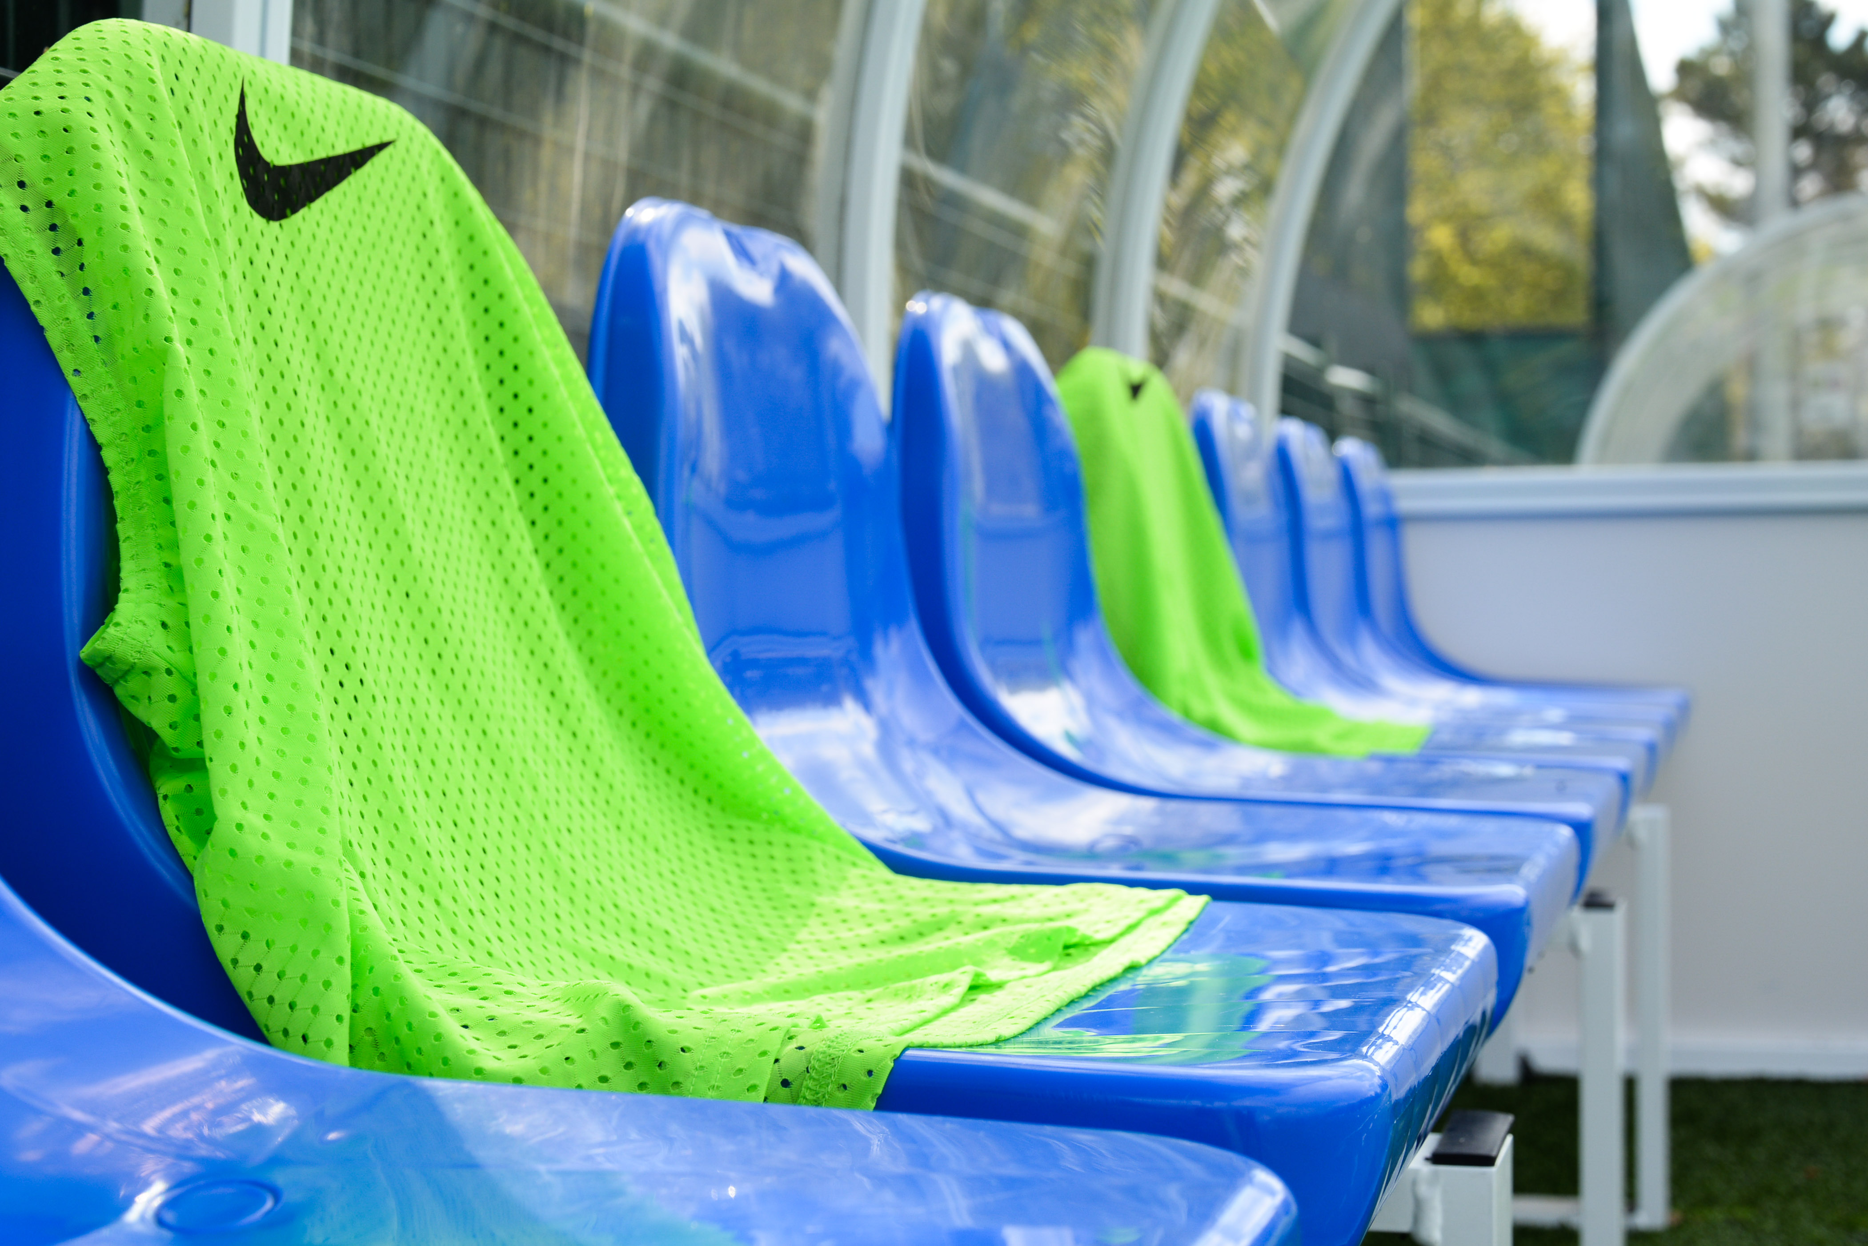
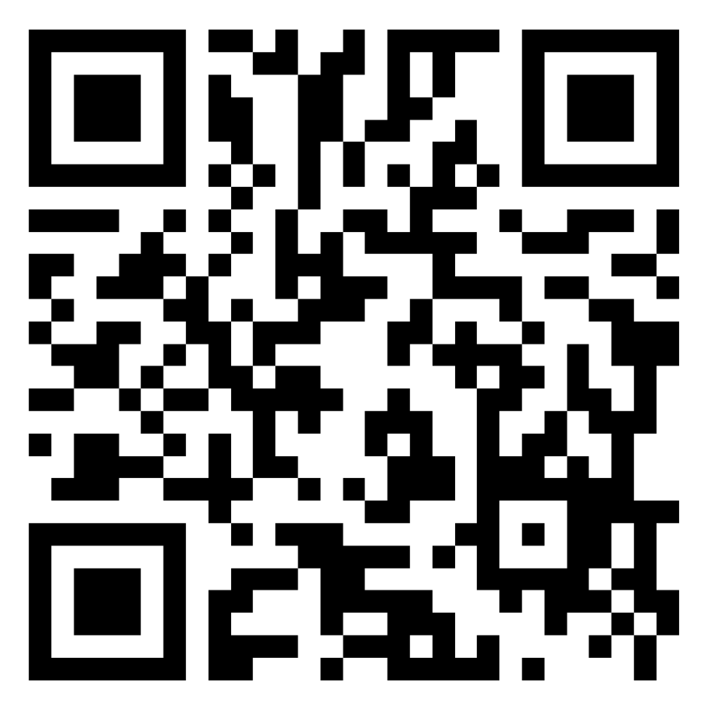
Futsal League Coordinator| Hampshire FA
Futsal League Coordinator
Salary: £20p/h Contract: June 2023 – September 2023
What is the role?
The Hampshire FA Male & Female Futsal League is a new midweek adult's league created to allow more both males and females to get involved in Futsal. The league requires one individual to support in coordinating the league fixtures, as well as being present at the fixtures to support with facilitating.
This is an exciting opportunity to be apart of the development of Futsal in Hampshire and support the development of players in an environment focused on fun. The league will run for 12 weeks, with a target to continue in the 23/24 season. The sessions will take place on Thursdays 19:00 to 21:00, with the female fixture taking place first, directly followed by the male fixture.
What will you do?
You will coordinate & arrange the players, teams and fixtures on the evening
You will coordinate both the male and female fixtures
You will ensure the facility is set up & manage equipment
You will facilitate the players through matches
You will take payments and track finance
What do you need?
FA DBS & FA safeguarding children qualification
FA First Aid in Football qualification
Minimum coaching level: Introduction to coaching football or equivalent
Applications by Friday 16th June 2023:
To apply, complete the online application form. Interview dates: Tuesday 20th June
Access the form by scanning this QR code with a smartphone:
Or via : https://forms.office.com/e/sFTjD2NYyr

Slide 4

Futsal League Coordinator | Hampshire FA
APPLICATION PROCESS
Please see the accompanying advert & job description, full role profile & person specification and supporting information. These should be used as a guide when completing the application form. The application form can be made available in alternative formats and should this be required please contact us to advise of your requirements.
Please complete the application form by clicking HERE:
If shortlisted, you will be invited to interview for the role. The exact format of the interview will be confirmed with notice of the interview and reasonable adjustments can be made to accommodate any needs you may have.
Hampshire FA have an understanding and commitment to equality, diversity and inclusion and would be grateful if you could complete an optional, anonymous equality monitoring form as part of your application. By completing this questionnaire, you are helping us to plan for the future and ensure we recruit from a diverse pool of applicants that are appropriate and relevant to the community we serve.
Please complete the equality monitoring form by clicking here.
Hampshire FA are committed to safeguarding children and adults at risk. Due to the nature of this role, the successful candidate will be required to undertake a Disclosure and Barring Service (DBS) check through the FA DBS process. The possession of a criminal record will not necessarily prevent an applicant from obtaining this post, as all cases are judged individually according to the nature of the role and information provided.
Key Dates:
Application Closing date – Friday 16th June
Interviews dates – Tuesday 20th June

Slide 5

Futsal League Coordinator | Hampshire FA
FULL ROLE PROFILE & PERSON SPECIFICATION
Hampshire FA are an equal opportunities employer and actively encourage people from diverse backgrounds to apply for all roles.
Job title | Futsal League Coordinator
Reports to | Female Recreational Football Development Officer
Job purpose(s) | You will coordinate & arrange the players, teams and fixtures on the evening You will coordinate both the male and female fixtures You will ensure the facility is set up & manage equipment You will facilitate the players through matches You will take payments and track finance
Location | Testlands Hub - Green Lane, Southampton SO16 9FQ
Working hours | Part Time, 2 hour per week – Thursday 7:00– 9:00pm
Role Type | Fixed term from June 2023 – September 2023 (Potential to continue in 2023/24 season, depending on league success)
Roles & Responsibilities:
Representing Hampshire FA | Actively deliver against Company Values and Behaviours and the Customer Charter Actively support the challenging of all forms of discrimination in football Utilise hub sites as a resource to deliver programmes and further Hampshire FA’s reputation as a facility provider
Retain & Grow Participation | Work with the Male Pathway Football Development Officer & Female Recreational Football Development Officer to retain and grow participation in the Male & Female Futsal League format.
Stakeholder Engagement | Deliver high quality, engaging service to ensure all participants enjoy football in a safe, fun environment. Engage with players & coaches to build relationships with all league stakeholders.
People | Engage with players & coaches to deliver a high quality product. Work with Male Pathway Football Development Officer & Female Recreational Football Development Officer to deliver high quality service
Safeguarding | Support maintenance of FA safeguarding 365 operating standards and ensure that the safeguarding of young and vulnerable people is prioritised at all times Carry out appropriate Safeguarding Risk Assessments for any activities delivered Ensure that all participants and their families are aware of how/encouraged to report any safeguarding concerns they might have
Equality, Diversity & Inclusion | Ensure that recreational male & female football is inclusive, diverse and reflective of local communities
Finance | Take payments and report finance sheet to Female Recreational Development Officer

Slide 6
Futsal League Coordinator | Hampshire FA
 | Skills | Knowledge/Experience
Essential (Required to fulfil role) | Ability to plan, set and achieve objectives to deadlines Ability to work independently and as part of a team Time management and prioritisation Problem-solving and decision-making Communication skills Skilled in football delivery | FA DBS Check FA Safeguarding FA First Aid Experience in facilitating sporting events, tournaments or fixtures
Non-Essential (Beneficial but can be accumulated once in the role) | Skilled in league delivery | Taking and recording payments Understanding of the game - Futsal
HFA Values | Expected Behaviours
PROGRESSIVE | Identifies the need for, and actions change in direction, practice, policy or procedure. Questions the way things are done and takes informed risks. Continuously seeks to improve efficiency and performance.
RESPECTFUL | Maintains people’s self-esteem when interacting with them. Avoids pre-judgement when listening to suggestions from others. Seizes the opportunity to apply Hampshire FA standards at all times.
INCLUSIVE | Openly collaborates with colleagues and partners in the game Provides equal opportunity to people of different backgrounds, experience and perspective Seeks out and embraces new ways of thinking and working.
DETERMINED | Works relentlessly to overcome roadblocks or obstacles to achieve the goal. Remains focused on seeing agreed goals through to completion taking pride in their work. Maintains motivation for their team and themselves.
EXCELLENT | Seeks to achieve the highest levels of performance at all times. Can be committed to achieve a standard that others consider impossible. Supports others to go further and achieve more.
Application Deadline: | Friday 16th June
Interviews to be held (format: Online): | Tuesday 20th June

Slide 7
Futsal League Coordinator | Hampshire FA
SUPPORTING INFORMATION
Hampshire FA Vision, Mission & Values
Vision
Using the power of football to build a better future for all communities in Hampshire.
Mission
Set strong foundations for all of Hampshire football to Recover stronger by enabling & supporting a bespoke Hampshire FA workforce.
Deliver an expanding network of Hub Sites, connected with & fully engaging their local communities.
Put Youth Engagement at the centre of all delivery & ensure young people are heard, safeguarded & empowered to influence the future.
Re-invigorate Equality, Diversity & Inclusion through new IAG/local engagement structure & governance standards.
Undertake a full business Culture review to embed inclusivity, safeguarding & quality community service throughout all we do.
Values
Progressive - Respect - Inclusion - Determined - Excellence

