Slide 1


Equal Game Ambassador | Hampshire FA
EMPLOYMENT APPLICATION PACK:
Equal Game Ambassador

Slide 2

Female Recreational Football Development Officer | Hampshire FA
WHAT IS IN THIS PACK?
1 Job Advert & Description
2 Application Process
3 Full Role Profile & Person Specification
4 Supporting Information
  Hampshire FA Vision, Mission & Values
If you would like to discuss the role further or have any questions on the content of this pack, please contact Hannah Humphreys using the details below:
E: Hannah.Humphreys@HampshireFA.com

Slide 3

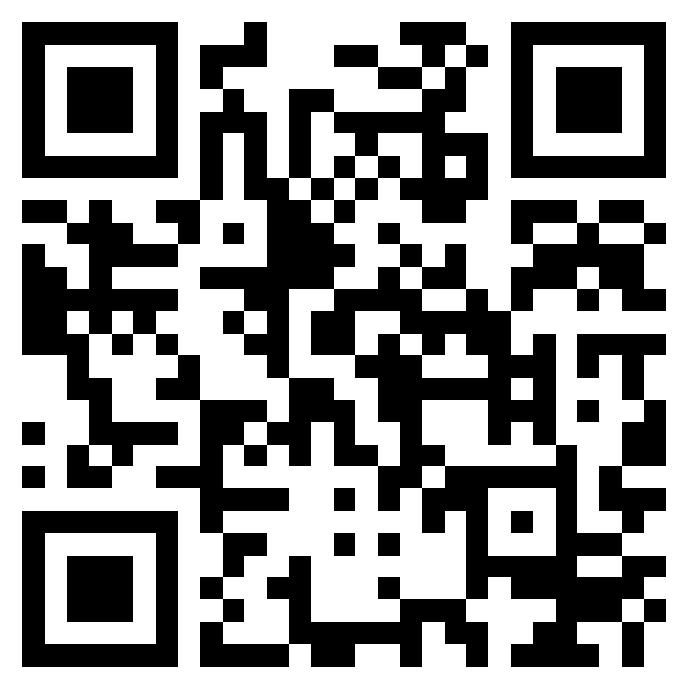
Equal Game Ambassador | Hampshire FA
Equal Game Ambassador (x2)
Salary: £25 ph Contract: Casual Contract. 50 hours per contract.
What is the role?
Hampshire FA are looking for enthusiastic and experienced individuals with a passion for grassroots football to join the team.
The successful candidates will be responsible for supporting grassroots football clubs to apply their learnings from the Equal Game Training and build their own Equal Game Action Plan; creating more accessible opportunities for women and girls.
Key Accountabilities:
You will engage with clubs following their completion of the ‘Equal Game Training’
Signpost and help clubs access relevant support
Support clubs to build and sustain relationships with local partners
Collaborate with County FA staff, national FA staff, and other grassroots football stakeholders
Maintain records of the support being provided to grassroots club
What we are looking for:
Someone with an understanding of the grassroots football network
The ability to build trust and develop effective working relationships with Club Committees
An advocate for female football with an understanding of the challenges and barriers that both players and volunteers can face.
Applications by Monday 24th October 2022:
To apply, complete the online application form. Interviews will take place on Monday 31st October
Access the form by scanning this QR code with a smartphone:
Or via : https://forms.office.com/r/XHe6etntiT

Slide 4

Equal Game Ambassador | Hampshire FA
APPLICATION PROCESS
Please see the accompanying advert & job description, full role profile & person specification and supporting information. These should be used as a guide when completing the application form. The application form can be made available in alternative formats and should this be required please contact us to advise of your requirements.
Please complete the application form by clicking here.
If shortlisted, you will be invited to interview for the role. The exact format of the interview will be confirmed with notice of the interview and reasonable adjustments can be made to accommodate any needs you may have.
Hampshire FA have an understanding and commitment to equality, diversity and inclusion and would be grateful if you could complete an optional, anonymous equality monitoring form as part of your application. By completing this questionnaire, you are helping us to plan for the future and ensure we recruit from a diverse pool of applicants that are appropriate and relevant to the community we serve.
Please complete the equality monitoring form by clicking here.
Hampshire FA are committed to safeguarding children and adults at risk. Due to the nature of this role, the successful candidate will be required to undertake a Disclosure and Barring Service (DBS) check through the FA DBS process. The possession of a criminal record will not necessarily prevent an applicant from obtaining this post, as all cases are judged individually according to the nature of the role and information provided.
Key Dates:
Application Closing date – Monday 24th October 2022
Interview date –Monday 31st October

Slide 5

Equal Game Ambassador | Hampshire FA
FULL ROLE PROFILE & PERSON SPECIFICATION
Hampshire FA are an equal opportunities employer and actively encourage people from diverse backgrounds to apply for all roles.
Job title | Equal Game Ambassador (x2)
Reports to | Female Pathway Football Development Officer
Job purpose(s) | Support grassroots football clubs to apply their learnings from the Equal Game Training and build their own Equal Game Action Plan; creating more accessible opportunities for women and girls.
Location | Winklebury Football Complex, Basingstoke, RG23 8BF (mix of office/remote working –including travel to Hampshire FA clubs )
Working hours | 50 hours per contract. Hours of work will vary and may include evenings and weekends
Contract type | Casual Worker
Salary | £25ph
Key Responsibilities:
Attend the ‘Train the Trainer’ course on Tuesday 6th December @ Berks & Bucks FA Work with County FA Leads to collaboratively deliver the local ‘Equal Game’ Training Work with England Football Accredited clubs following their completion of the ‘Equal Game Training’ to support in the creation of a bespoke female football game plan. This outlines new club-based opportunities for female players which may include new playing provisions, coaching development, volunteering roles, and creating safe environments. Support with engagement at every level of the club to maximise and sustain these opportunities for female players. Signpost and help clubs access relevant support including funding and coach development opportunities via the County FA, and FA Women & Girls Coach Development network. Support clubs to build and sustain relationships with relevant local partners such as charitable organisations, educational establishments, alongside other key partners to promote the new opportunities. Collaborate with County FA staff, national FA staff, FA Women & Girls Coach Mentors, FA Women & Girls Community Champions, external partners, and wider members of the grassroots delivery team workforce. Maintain records of the support being provided to grassroots clubs with the aim of providing clarity on work programmes, development opportunities and sharing of good practice.
 | Skills | Knowledge/Experience
Essential (Required to fulfil role) | Ability to build trust and develop effective working relationships within England Football Accredited Clubs. Ability to deliver practical support sessions to a range of club Volunteers. Understanding of how an England Football Accredited Club operates. An advocate for female football with an understanding of the challenges and barriers that both players and volunteers can face. Commitment to attend additional training provided as part of this programme. Flexible in approach with willingness to work evenings and weekends, as well as travel across the County. IT proficient- confident with setting up and actively taking part in online meetings. | Can demonstrate a history of success in developing female grassroots football opportunities and/or an experienced sports development professional. Experience of facilitating and engaging with volunteers. Experience of engaging with external partners and stakeholders.

Slide 6
Equal Game Ambassador | Hampshire FA
Non-Essential (Beneficial but can be accumulated once in the role) | Knowledge of The FA’s strategy for Women & Girls Football; Inspiring Positive Change. Knowledge of the England Football Accreditation Framework and the existing support and resources available to Accredited Clubs | Experience of volunteering within a grassroots football club as a Committee Member. Experience of mentoring others. Experience of accessing external funding
HFA Values | Expected Behaviours
PROGRESSIVE | Identifies the need for, and actions change in direction, practice, policy or procedure. Questions the way things are done and takes informed risks. Continuously seeks to improve efficiency and performance.
RESPECTFUL | Maintains people’s self-esteem when interacting with them. Avoids pre-judgement when listening to suggestions from others. Seizes the opportunity to apply Hampshire FA standards at all times.
INCLUSIVE | Openly collaborates with colleagues and partners in the game Provides equal opportunity to people of different backgrounds, experience and perspective Seeks out and embraces new ways of thinking and working.
DETERMINED | Works relentlessly to overcome roadblocks or obstacles to achieve the goal. Remains focused on seeing agreed goals through to completion taking pride in their work. Maintains motivation for their team and themselves.
EXCELLENT | Seeks to achieve the highest levels of performance at all times. Can be committed to achieve a standard that others consider impossible. Supports others to go further and achieve more.
Application Deadline: | Monday 24th October 2022
Interviews to be held: | Monday 31st October 2022

Slide 7
Equal Game Ambassador | Hampshire FA
SUPPORTING INFORMATION
Hampshire FA Vision, Mission & Values
Vision
Using the power of football to build a better future for all communities in Hampshire.
Mission
Set strong foundations for all of Hampshire football to Recover stronger by enabling & supporting a bespoke Hampshire FA workforce.
Deliver an expanding network of Hub Sites, connected with & fully engaging their local communities.
Put Youth Engagement at the centre of all delivery & ensure young people are heard, safeguarded & empowered to influence the future.
Re-invigorate Equality, Diversity & Inclusion through new IAG/local engagement structure & governance standards.
Undertake a full business Culture review to embed inclusivity, safeguarding & quality community service throughout all we do.
Values
Progressive - Respect - Inclusion - Determined - Excellence

