Slide 1
DBS (CRC) Integration

Slide 2
DBS Criminal Records Check (CRC) Integration
Benefits….
Fluid process, no confusion with GB home page
Minimise duplicate FANs
DBS’ accepted quicker, automatic update
See in WGS whether individuals have submitted their DBS, easy to track
Notes:
Introduction of the Aims of this session and the key items which will be covered during the WebEx/Face to Face meeting with your Club Welfare Officers

Slide 3
Club

Slide 4
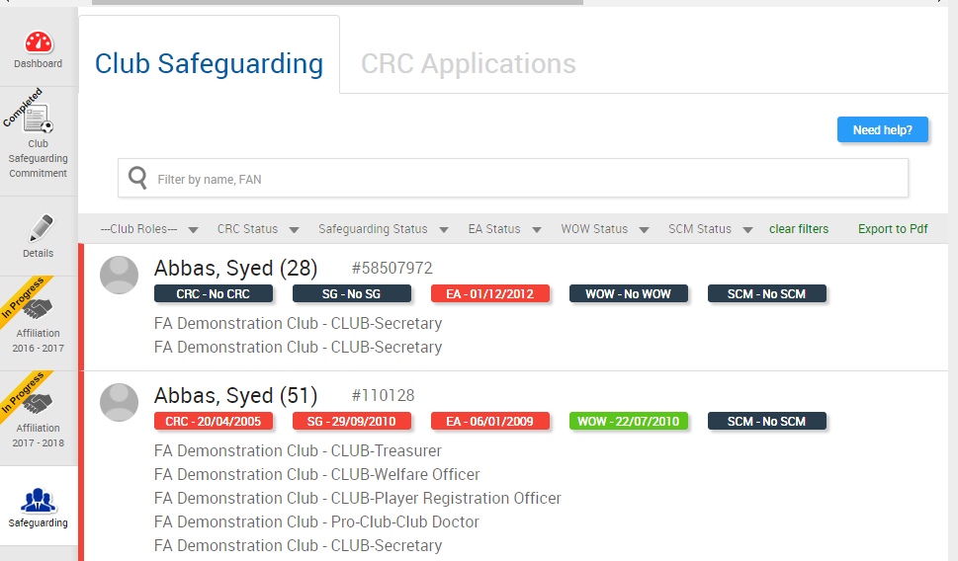
Club Safeguarding page – tab for DBS (CRC) Applications
Tab appears when CFA is tagged as processing CRC’s in WGS
Notes:
Reference new CRC Applications Tab which will now be live for Clubs, next to the Club Safeguarding Tab on the Safeguarding Tile in WGS

Slide 5
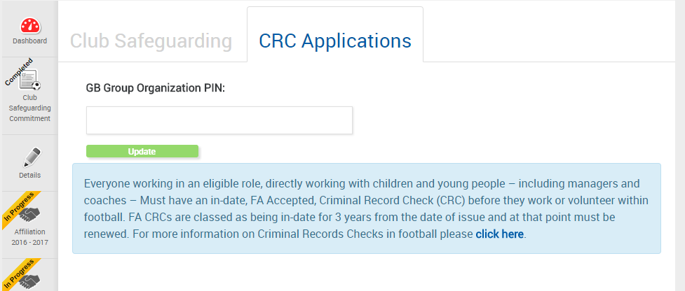
Club Safeguarding page – GB Group PIN
One off process – club stores PIN (then locked)
Notes:
On clicking here, for the first time only, the Club must add their GB Group PIN for that Club.
Make it clear again the message on the scenarios:- the three clubs with one pin, they all have 112233. Another scenario, three clubs with three different pins, 112233, 445566, 778899.
Key to make sure the PIN is that matching with GB Group

Slide 6
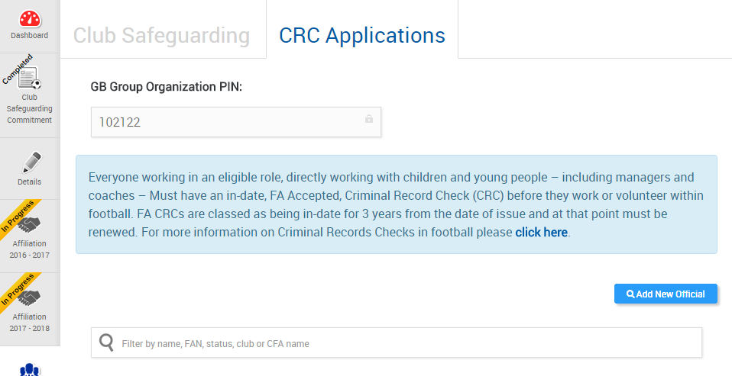
Club Safeguarding page – tab for DBS (CRC) Applications
Once entered, the GB Group Organisation PIN field is locked in Portal
Notes:
Once the PIN is added it is locked down. So please be diligent when adding this, and if required, check prior to entry to ensure it is not locked down with an incorrect PIN.

Slide 7
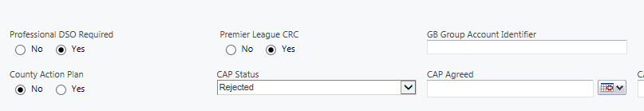
GB Group Account Identifier
Field is visible in CRM, and can be edited/corrected by County FA to allow for corrections
Notes:
Just a screen to show that the CFA can see this on CRM against the Club, so can monitor this if required.

Slide 8
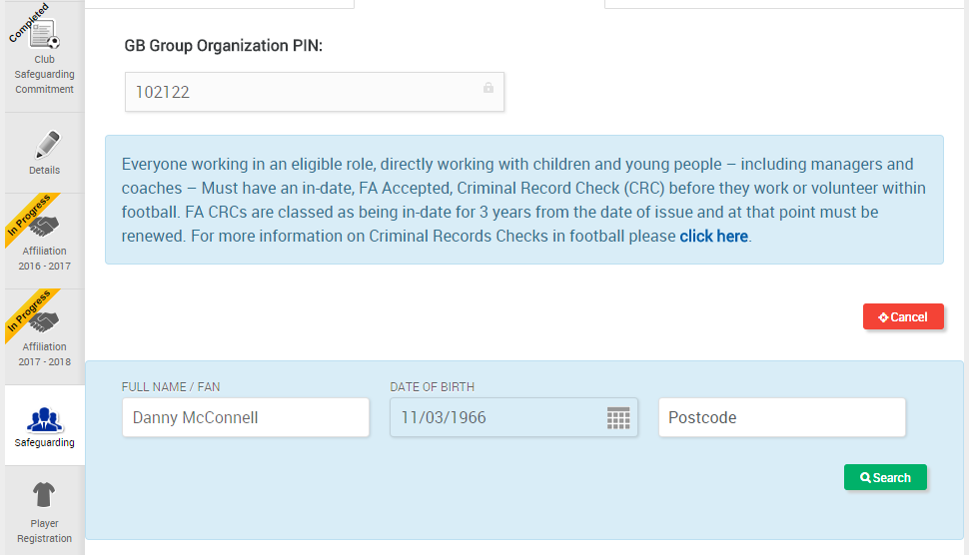
Club Safeguarding page – Add New Official
Clicking on the Add New Official expands to allow a club to search for an individual
Notes:
When adding anyone as a CRC Applicant, this is only for any NEW Individuals to the Club, where they do not have a current in date CRC.
Any new Coaches who have the required qualifications should be added as normal in the Team Officials Tab, assigning them to the correct team and role.
The reason we add anyone who does not meet the criteria here, is so we can track them and once the CRC is approved, they can then be assigned under the relevant team and role. This means rather than leaving them off WGS, we can look at the new Managers/Coaches from a Club view.

Slide 9
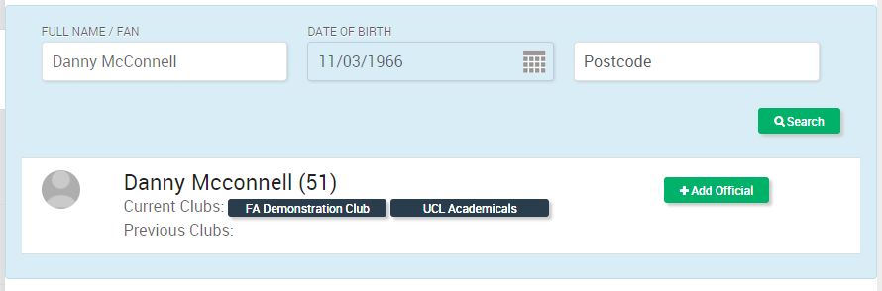
Club Safeguarding page – Search for Individual
Search returns individual (or more options to search) – same functionality as Player Registration
Notes:
When searching for an individual, you will need their FAN or First/Last Name and DOB. Postcode is optional, and doesn’t need to be completed as a requirement initially.
We would ask Clubs to be very diligent in their search, and if you know the individual has a FAN, but you cannot locate them, please speak to your CFA. This is in order to minimise the risk of Duplicate FANs and also ensure we have one person, with all of their qualifications etc on one FAN record.

Slide 10
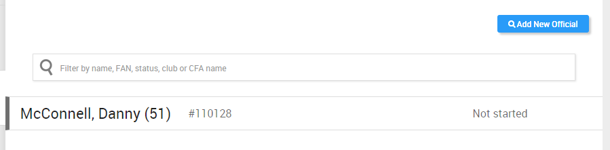
Club Safeguarding page – Search for Individual
Add Official creates the role of Club-CRC Applicant. Club may have multiple people with this role.
Notes:
Once added, the view ill show you their status, and show the multiple individuals if there are more than one, on this screen.

Slide 11
Applicant

Slide 12
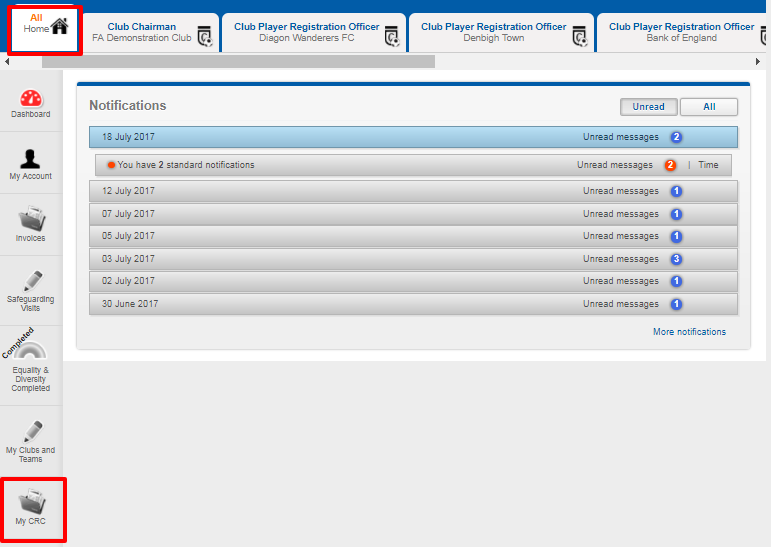
Individual – Login to Portal and has My CRC page
Page appears for Club-CRC Applicant, Club-Welfare Officer and all team officials requiring CRC
Notes:
This is the page the individual applicant will see, on their All (Home) page, they will see the My CRC Tile now appear. This is where they need to click to begin the process.

Slide 13
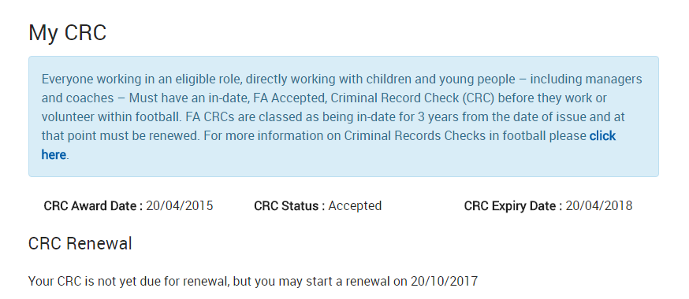
Individual – My CRC (DBS Check)
Renewal is only allowed within six months of CRC expiry (FA configuration)
Notes:
If renewal is not due, they will see the message on screen, which is that they cannot start their CRC until X date. This is only permitted within 6 months of expiry, allowing those closing in on their expiry date, to reapply for their CRC.

Slide 14
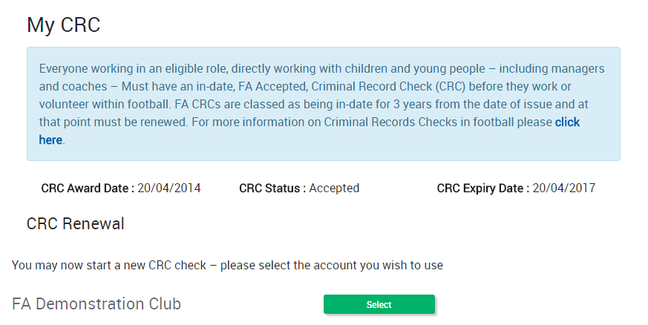
Individual – My CRC (DBS Check) initiation
Individual may be associated to more than one club. To start a CRC check, individual clicks Select
Notes:
If they can apply, as they are within 6 months. They will see a list of Clubs they have a role of Manager/Coach or Assistant Manager/Coach, or now the CRC applicant role.
If multiple, the individual can select which Club, as one may be closer to home to have the verification completed, or they may spend more time working with one Club than another, this is their choice.
Whichever Club they opt, must be the Club in which the verification is completed.

Slide 15
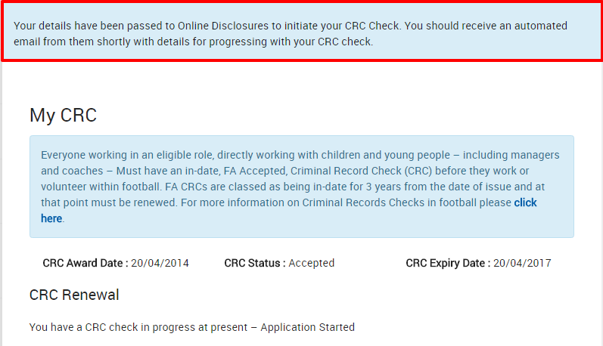
Individual – My CRC (DBS Check) - Initiation
Initiation sends message to GB Group, including Club PIN, individual FAN, name, date of birth and email address. CRC Renewal is shown as “Application Started”
Notes:
Once selected, they will see the screen above, and their details are passed to GB Group (Online Disclosures) who will initiate an auto email to the individual. So it is really important we ensure their FAN details are correct before doing this.

Slide 16
Club

Slide 17
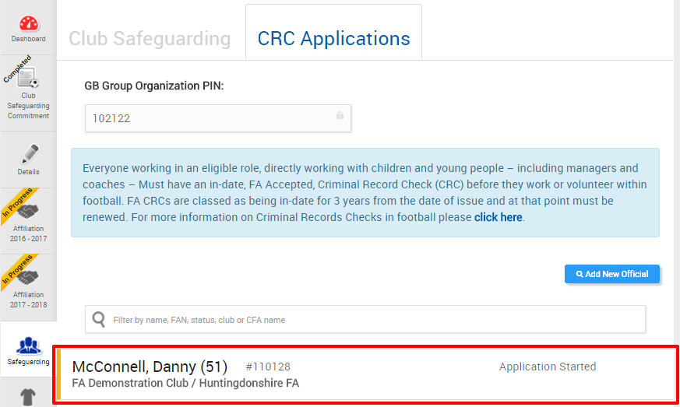
Club Safeguarding page – Visibility of Individual
Club can also see that the individual has started the CRC process in WGS
Notes:
Your visibility will then change on the CRC Application page to show, Application Started, rather than Not Started.

Slide 18
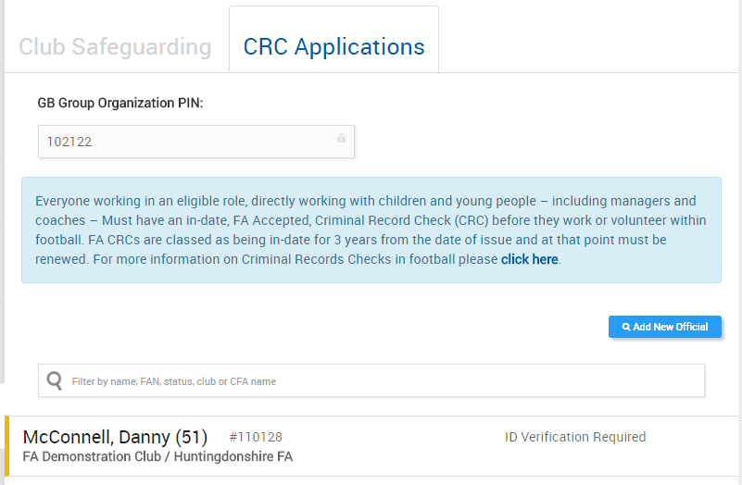
CRC In Progress – Status changes in Portal
Notes:
Once the individual has completed their part in GB Group, as they would have done previously, their documents will need to be verified and it will show “ID Verification Required”.
This is the time for the CWO to complete the checks as normal in the application on GB Groups site.

Slide 19
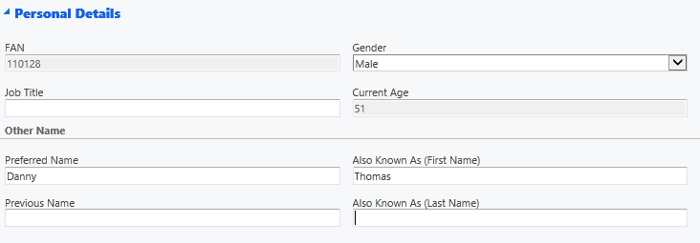
Auto-awarding – Known As name fields in CRM
First Name and Last Name may need to be added to Also Known As fields in CRM
Notes:
Very important if an individual is known as a different name, to that they were born with, their FAN may need to be updated by the County FA, to include the Preferred Name and Also Known As, which helps with matching the CRC Check to the individual.

Slide 20
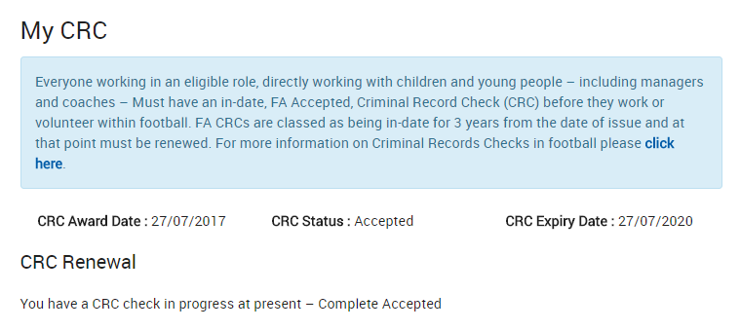
DBS (CRC) Check – CRC Award/Update
Disclosure Complete – Clear – CRC is automatically awarded
Status continues to be shown in Portal for 30 days
All other results still managed by GB Group
Notes:
If the disclosure is clear, it will automatically be awarded and assigned to the FAN if everything is in order, speeding up the process for both the Club and Individual.
We will show the status in Portal for 30 days for clarity.
Any other result will remain managed by GB Group, as is the current and normal process prior to WGS.

