Slide 1

Organisational Structure 2024/25
Last Update: 31/05/2024 | Updated by: Chris Smith

Slide 2

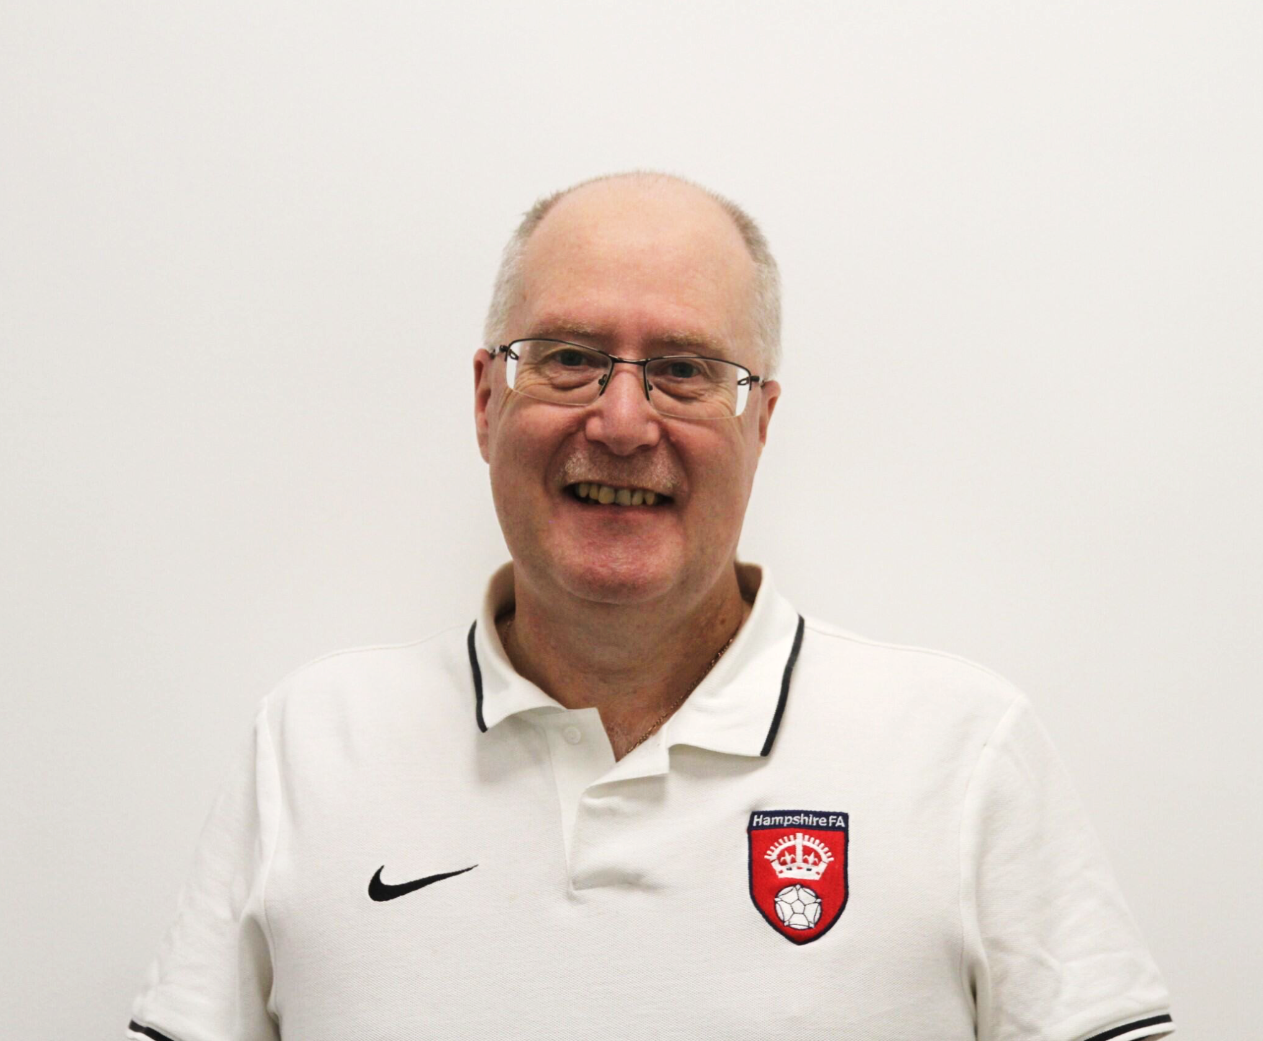

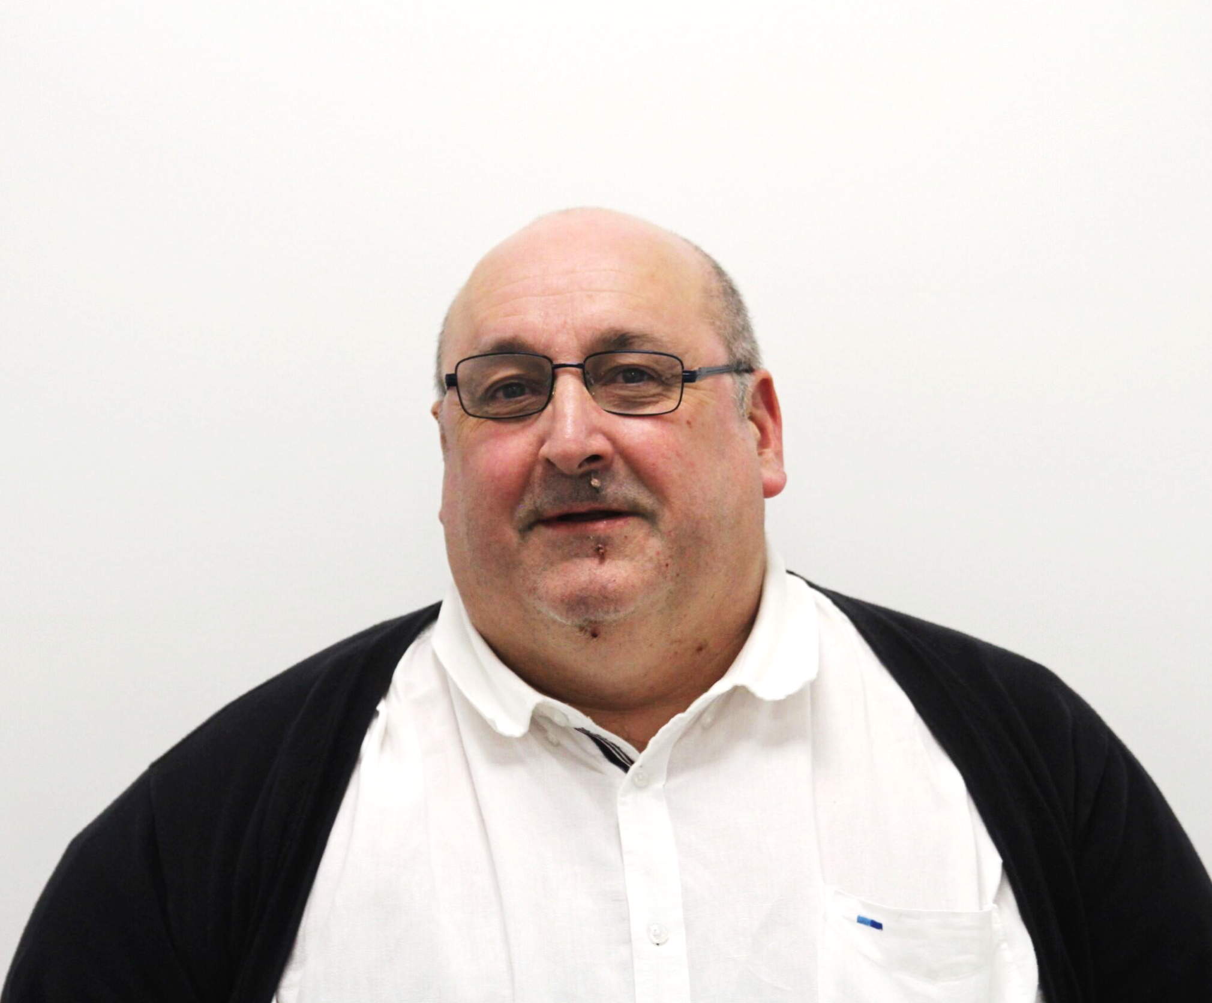
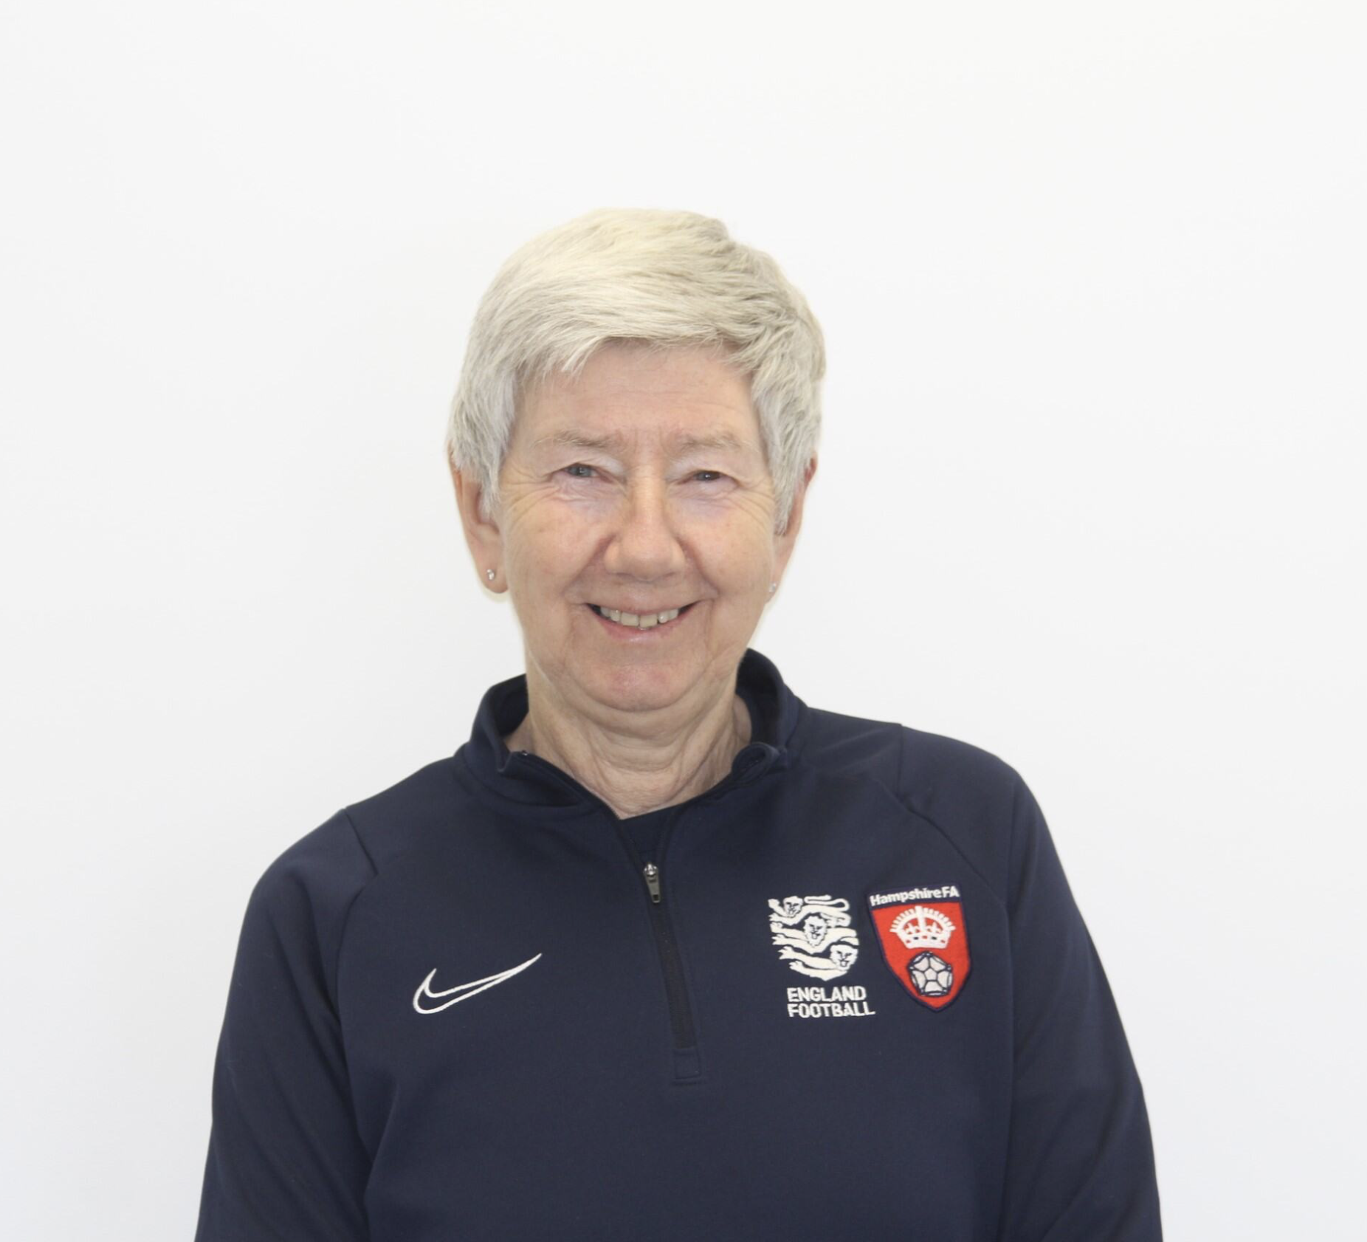
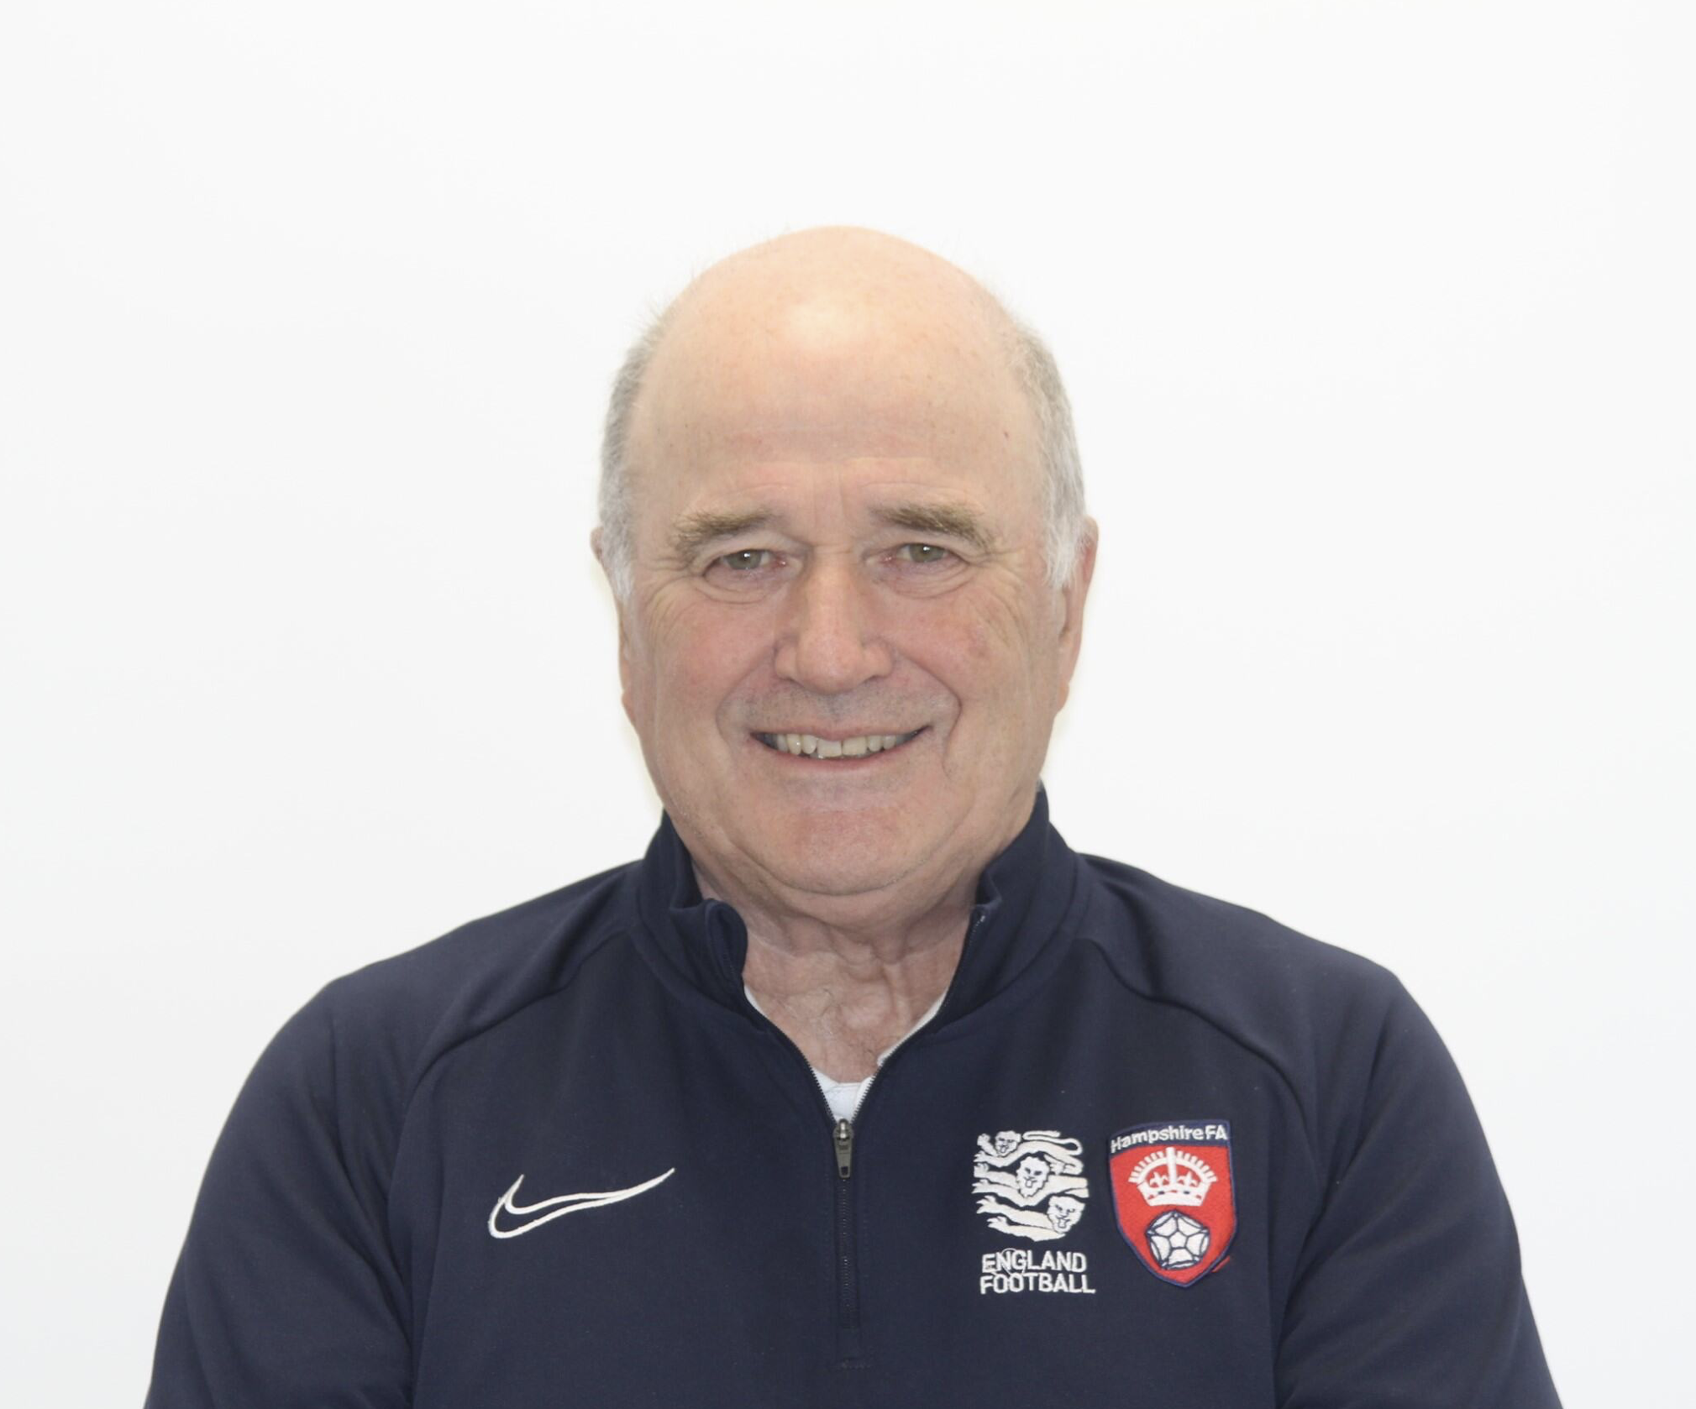
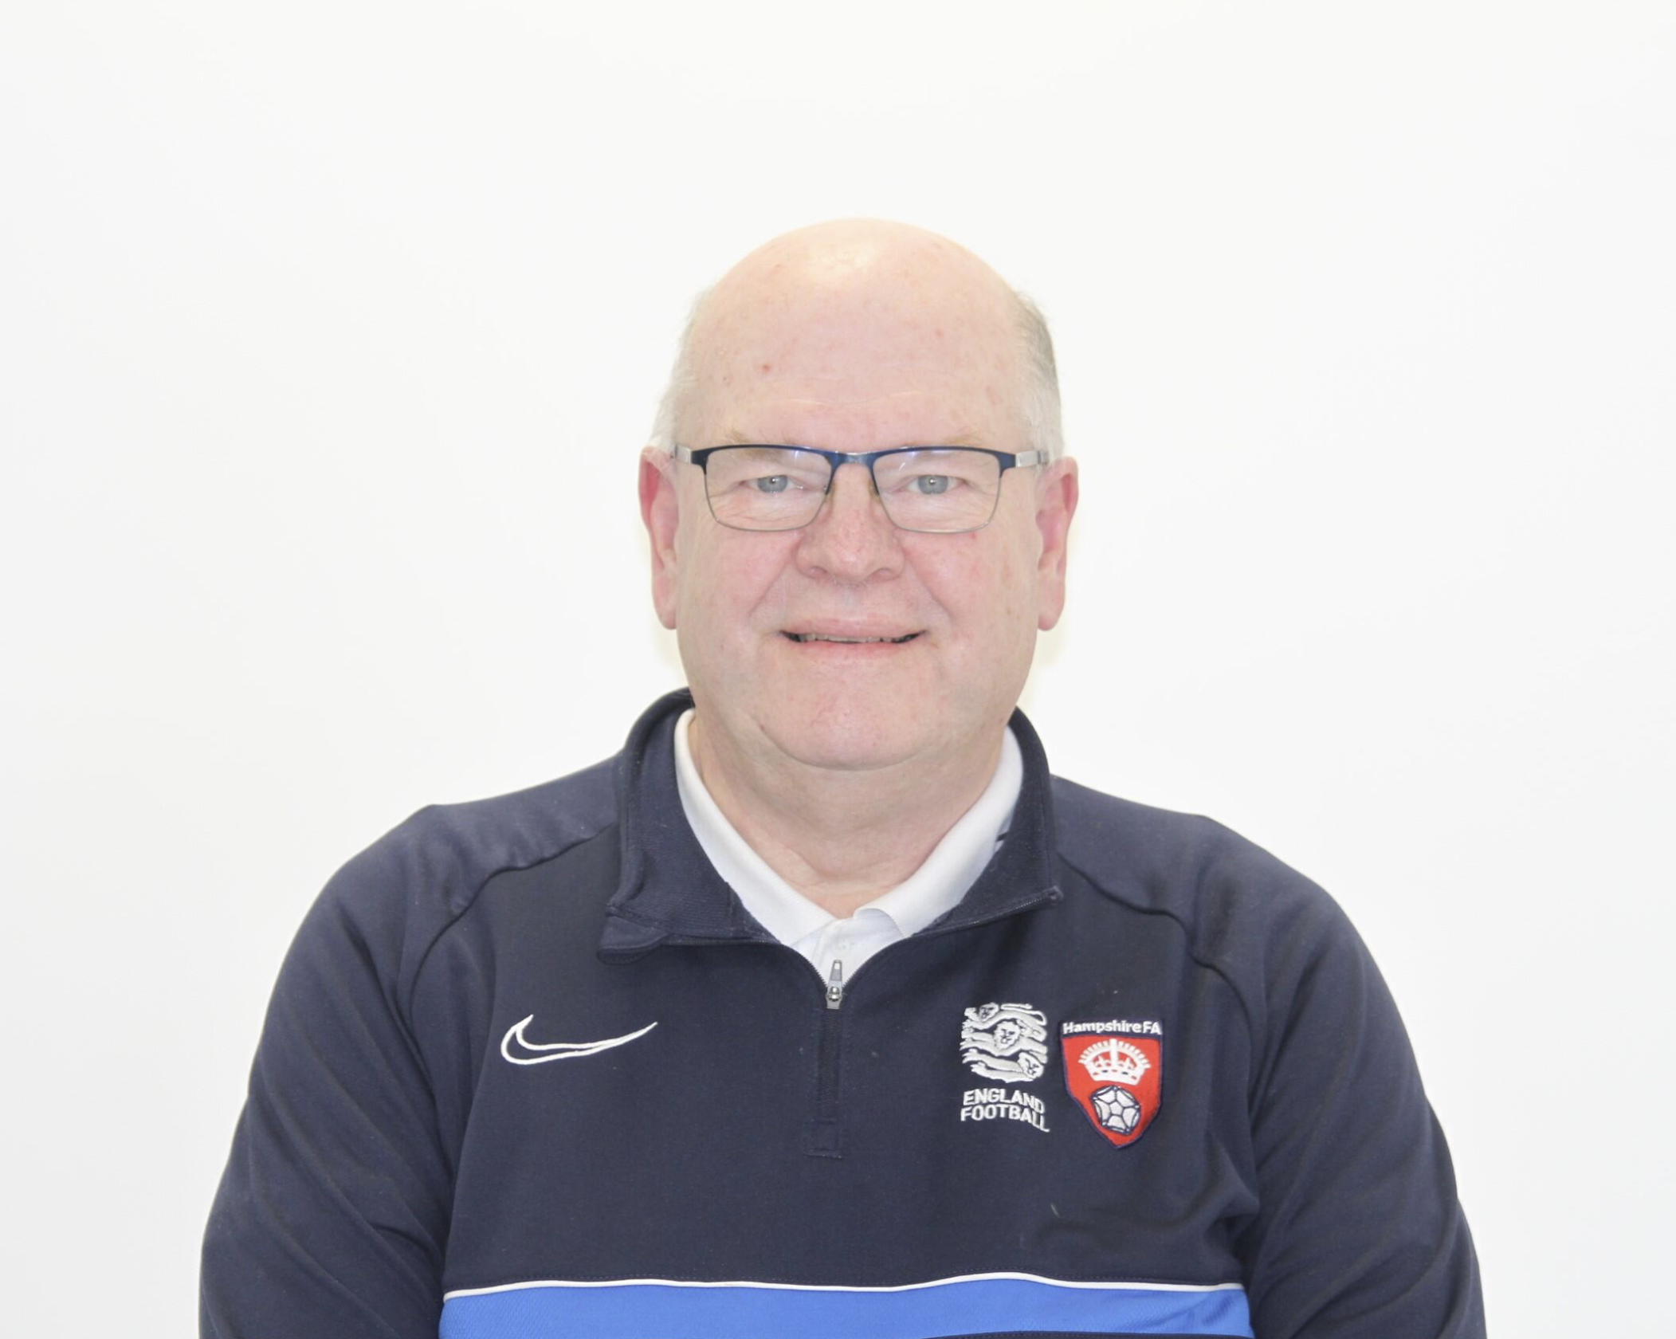
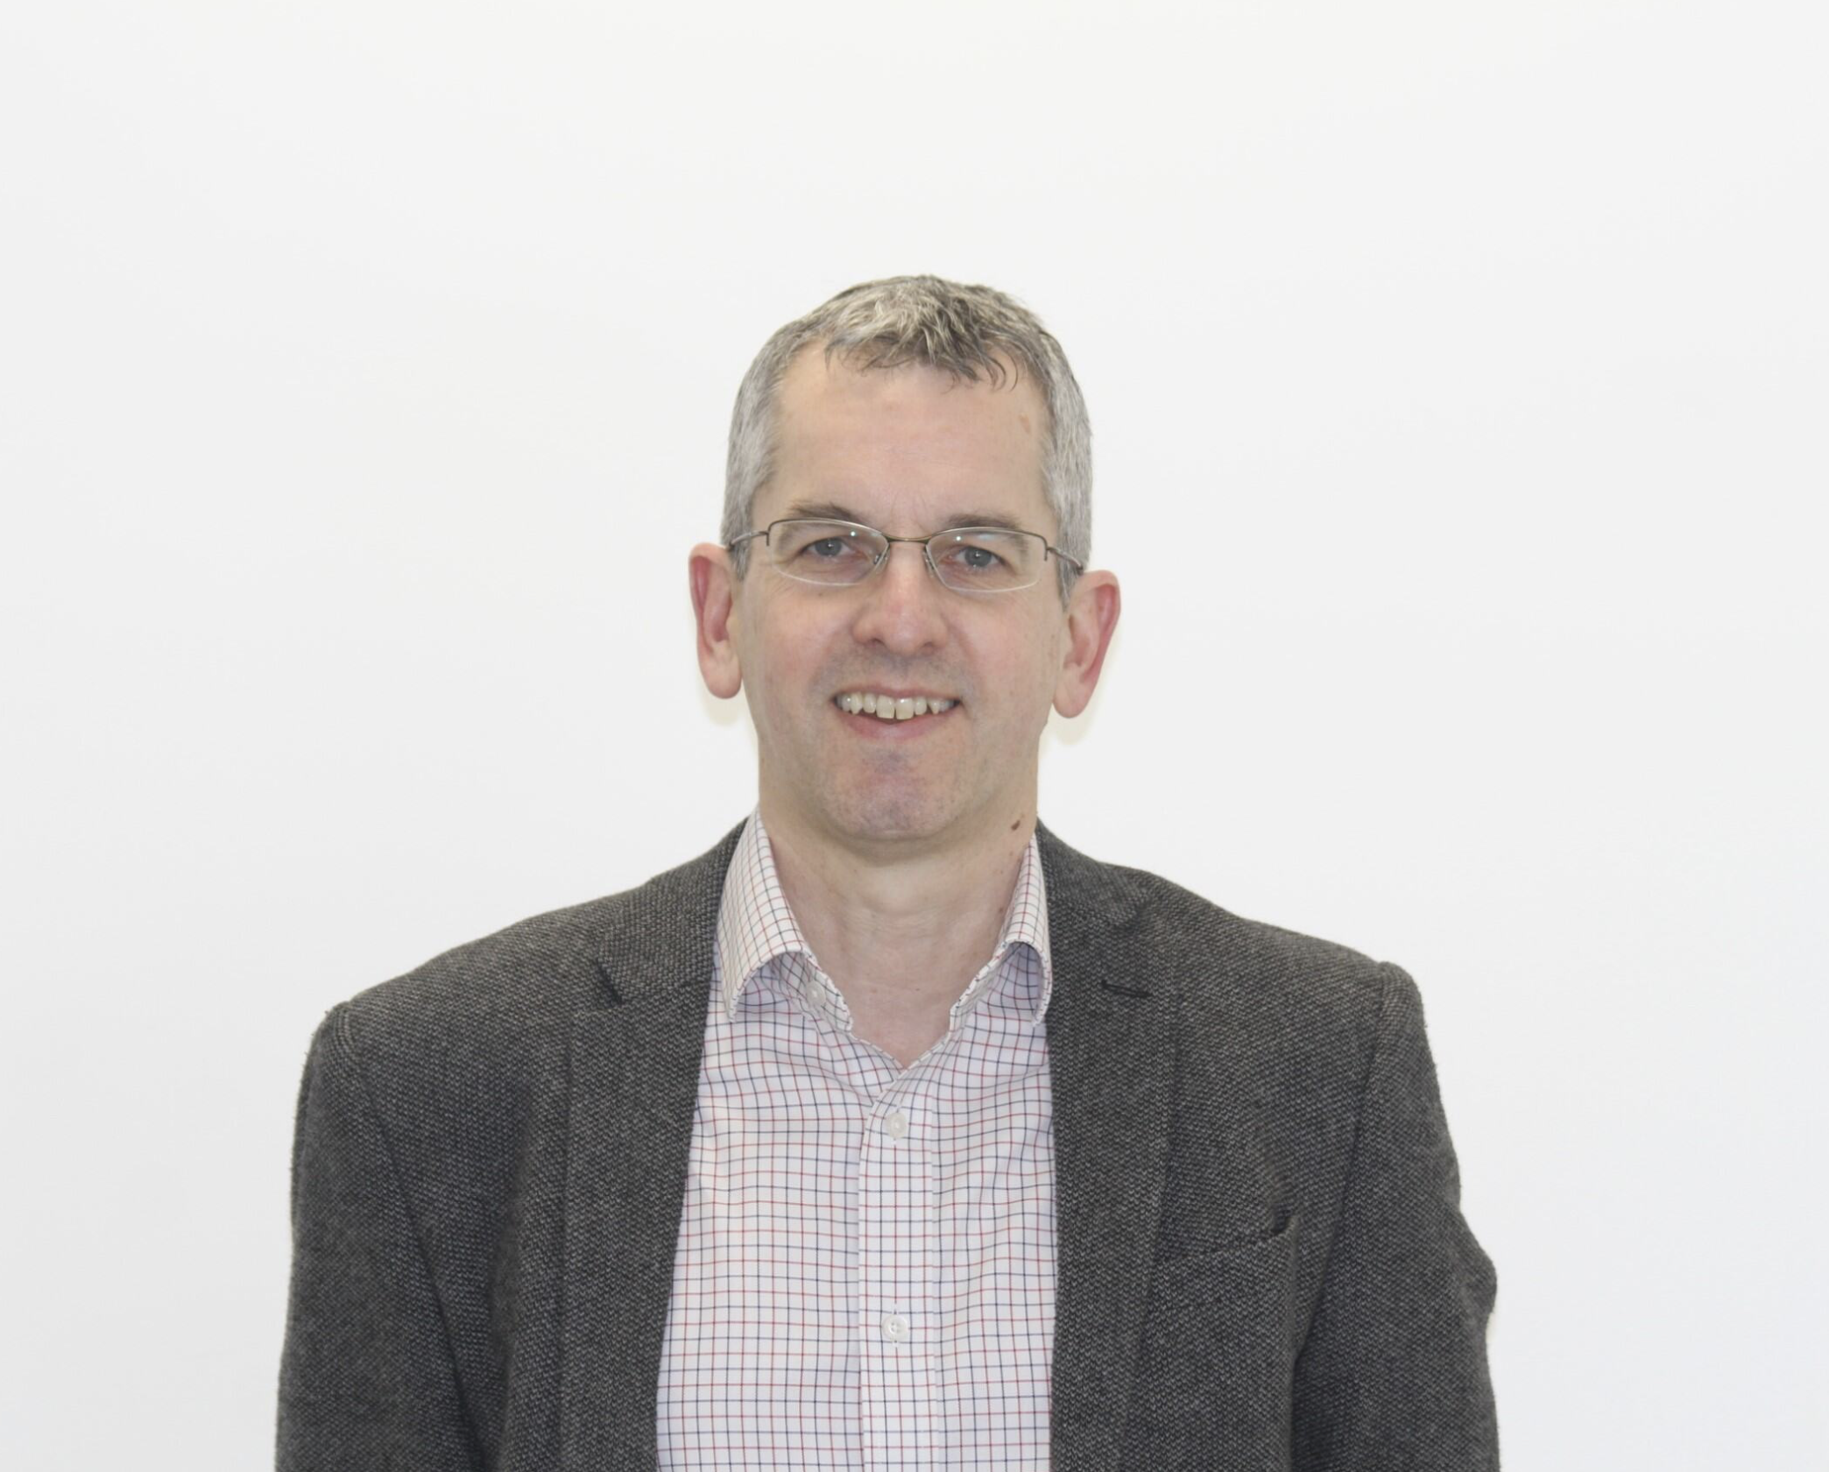
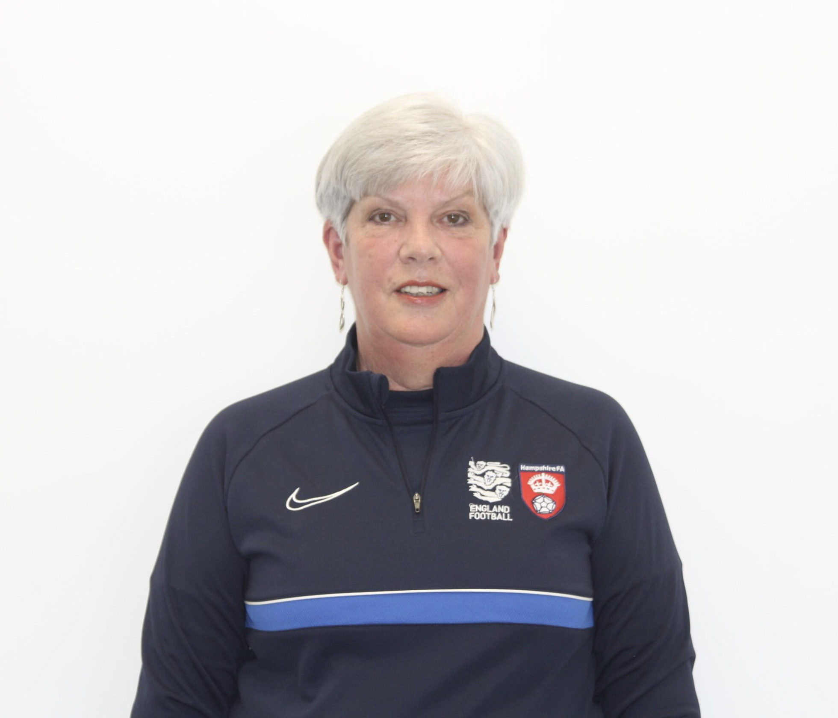
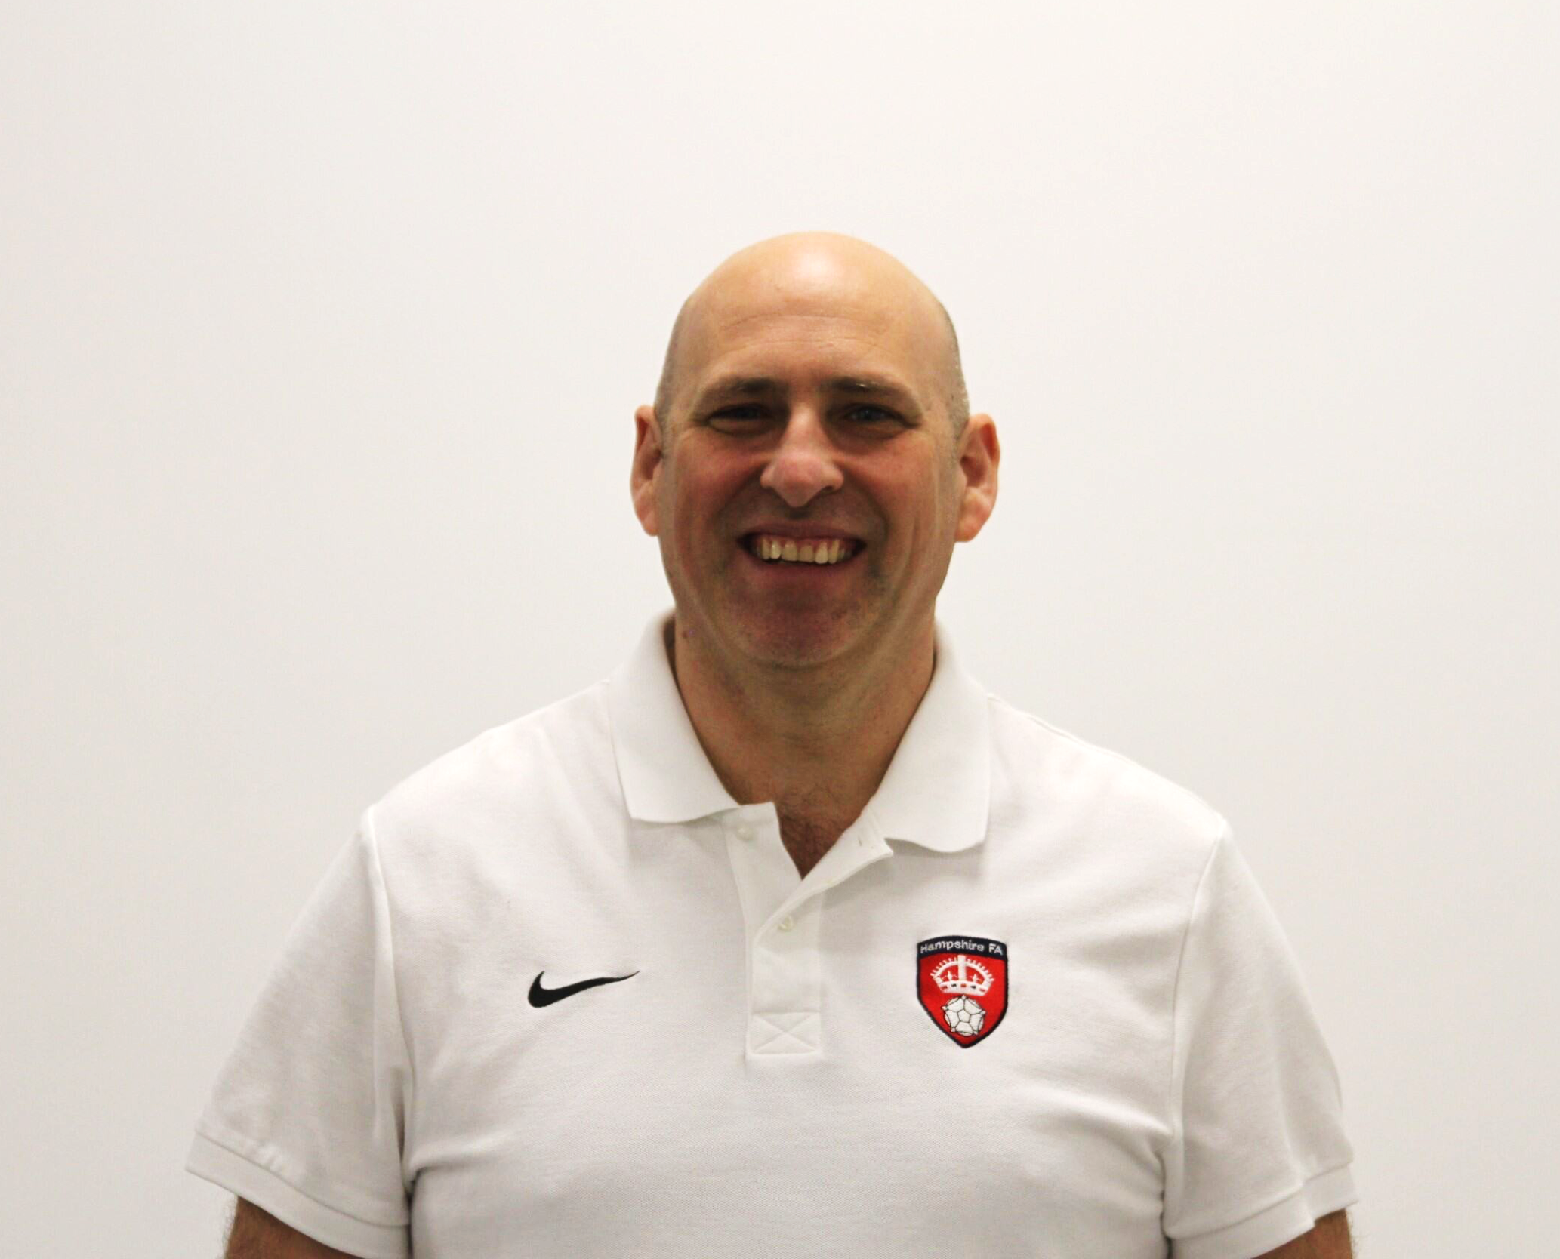

James Pearson
Chair
Re-elected 2023
Ian Walkom
Deputy Chair/ Safeguarding Champion
Re-elected 2023
Linda Hind
Football Director
Re-elected 2021
Vanessa Raynbird
Football Director
Re-elected 2022
Melanie Robinson
Independent Director/IAG Chair
Appointed 2024
Steve Yeomans
Finance Director
Re-elected 2023
Neil Cassar
CEO/FA Council Rep (Ex Officio)
Appointed 2006
David Bendall
Senior Independent Director
Re-elected 2023
Alex Marshall
Independent Director/Health & Wellbeing Champion
Appointed 2021
Leon Howgill
Independent Director
Appointed 2023
Lucy Wain
Independent Director
Appointed 2023
Nick Taplin
Football Director
Re-elected 2022
Organisational Structure 2024/25 | Hampshire FA
Board of Directors
Directors appointed to Board at AGM and elected or re-elected by football community representatives following the dissolution of council on 22 June 2019.
Directors appointed to Board via skills-based recruitment process consisting of application, shortlisting and interview.
Ex-Officio director role held by Hampshire FA Chief Operating Officer.

Slide 3
Neil Cassar
Chief Executive Officer
Chris Smith
Head of Strategy & Delivery
Departments:
Football Development
Equality, Diversity & Inclusion
HFA FE Academy
Darren Parker
Operations Manager (& Deputy Senior Safeguarding Lead)
Departments:
Football Operations
Finance
Discipline
Referee Development
Sacha Nicholas
Facility & Investment Manager
Melanie Gill
Senior Safeguarding Lead (HR & Wellbeing)
Departments:
Facility Development
Marketing & Communications
Pete Hussey
Head of Facilities Operations
Departments:
Safeguarding
Human Resources & Wellbeing
Departments:
Hub Sites x 4
Organisational Structure 2024/25 | Hampshire FA
Leadership Team

Slide 4
Chris Smith
Head of Strategy & Delivery
Pedro Viveiros
Football Development Manager
Hannah Humphreys
Female Pathway FDO
Alie Chartier
Community Engagement & Inclusion Officer
Joe Lea
Academy Head Coach
Jordan Bradshaw
Female Recreational FDO
Kel Crook
Male Pathway FDO
Glenn Brailey
Male Recreational FDO (& Disability Lead)
Nathan Watkins
Coach Apprentice
Jake Ashton
Coaching & Workforce FDO
James Ellis
PT Coach
Max Humphreys
Assistant FDO
Organisational Structure 2024/25 | Hampshire FA
Football Delivery

Slide 5
Darren Parker
Football Operations Manager (& Deputy Senior Safeguarding Lead)
Debbie Sowton
Discipline Manager
Georgina Frampton
Football Investigations Officer
Jon Fancy
Senior Operations Officer (Football Services)
Cai Povey
Senior Operations Officer (County Cups)
Rory Bentley
Discipline Support Administrator PT
Zac Osborne
Finance Administrator
Dec Helyer
Senior Operations Officer (Stakeholders)
Andy Moisey
Referee Development Manager
Cameron Davis
Referee Development Officer
Organisational Structure 2024/25 | Hampshire FA
Football Operations

Slide 6
Organisational Structure 2024/25 | Hampshire FA
Football Services
Sacha Nicholas
Facilities & Investment Manger
Charlotte Langley-Brown
Facility Development Officer
Issy Pearson
Business Development Lead
Denis Brzozowski
Marketing, Communications & PR Officer
Sam Burgess
Marketing & Communications Administrator
Melanie Gill
Senior Safeguarding Lead (HR & Wellbeing)
Shantell Woodward
Designated Safeguarding Officer
Jackie Binnington
Safeguarding Administrator
Michelle Saunders
Deputy Designated Safeguarding Officer

Slide 7
Pete Hussey
Head of Facilities Operations
STONEHAM LANE & WINKLEBURY
KING GEORGE V & FRONT LAWN
Lewis Wells
Duty Manager
Facility Assistants
Matt Hill
Facilities Operations Manager
Chris Cummings
Duty Manager
Mckenzie Moore
Trainee Duty Manager
10 x Zero Hour*
7 x Zero Hour**
Adam Lieu
Duty Manager
Matt Jenner
Duty Manager
Louie Stewart Abbot Williams
Full-Time
Sam Sturgess Hayden Mann
Apprentice
Facility Assistants
George Taylor Hashim Shafiq James Taylor
Full-Time
Maddy Mann
Apprentice
Organisational Structure 2024/25 | Hampshire FA
Hub Sites
Lauren Tarling
Trainee Duty Manager
*Zero Hour Staff at Stoneham Lane & Winklebury – Abigail Priest, Adee Chant, Ben O’Donnell, Billy Gammell, Callum Wiseman, George Cordall, Jackson Nichol, James Grainger, Tom Meadus and Tony Panteli
**Zero Hour Staff at King George V & Front Lawn - Adam Hayne, Bradley Horn, Charlie Mitchell, Izzy Collins, Joe Gargaro, Liam Seymour and Sam Fisher

