Slide 1


Female Recreational Football Development Officer | Hampshire FA
EMPLOYMENT APPLICATION PACK:
Female Recreational Football Development Officer

Slide 2

Female Recreational Football Development Officer | Hampshire FA
WHAT IS IN THIS PACK?
1 Job Advert & Description
2 Application Process
3 Full Role Profile & Person Specification
4 Supporting Information
  Hampshire FA Vision, Mission & Values
If you would like to discuss the role further or have any questions on the content of this pack, please contact Pedro Viveiros using the details below:
E: Pedro.Viveiros@HampshireFA.com
T: 01256 853 015

Slide 3
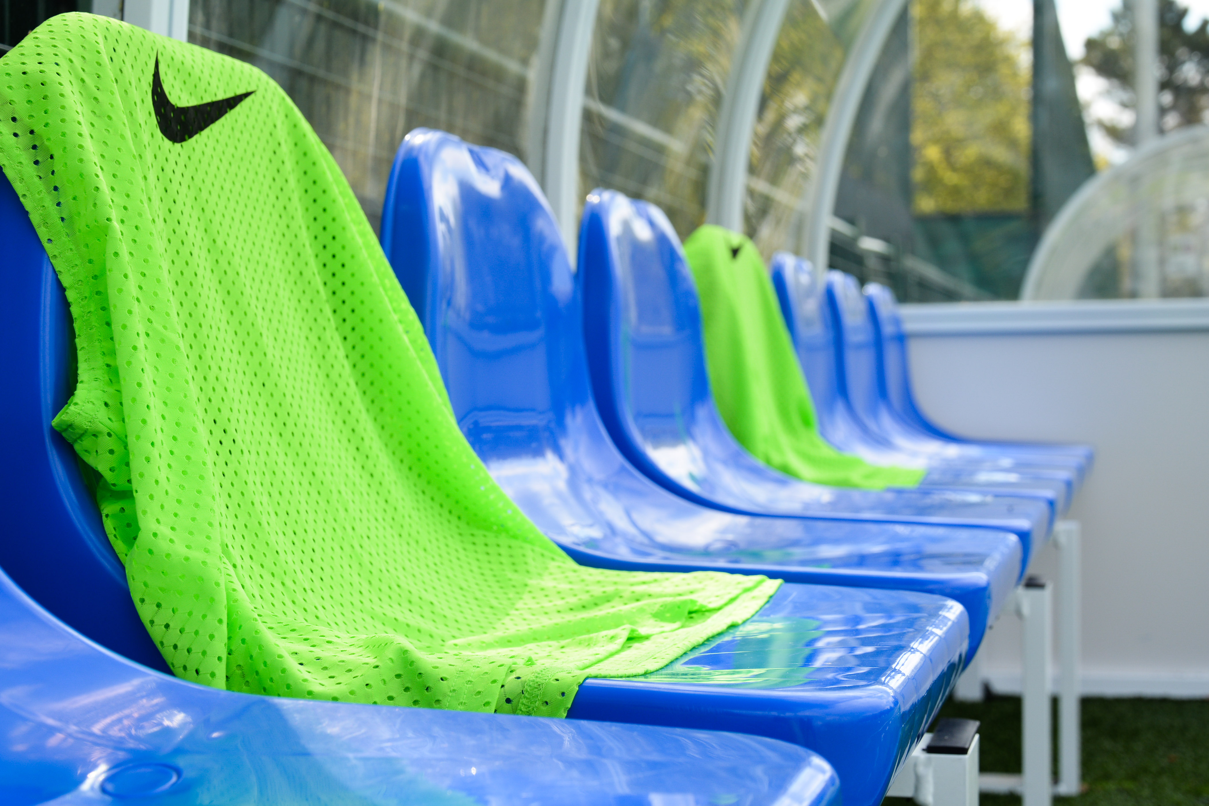
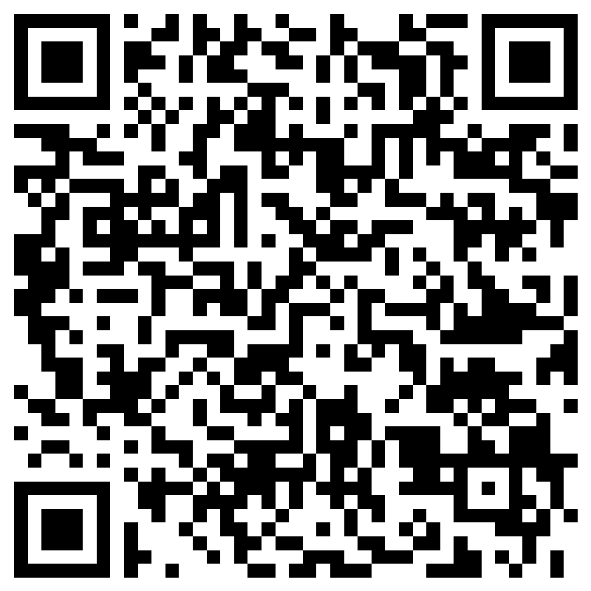
Female Recreational Football Development Officer | Hampshire FA
Female Recreational Football Development Officer
Salary: £26,000 per annum Contract: FT Oct 2022-Jul 2025
^{(subject to renewal)}
What is the role?
We are looking for someone to drive the development of all 16+ female recreational football in Hampshire. The successful candidate will look to retain existing participation in Southampton and grow new opportunities wider, throughout Hampshire, maximising the impact of the Lionesses’ recent success at UEFA Women’s Euro 2022!
What will you do?
You will lead the Southampton Host City Legacy Plan for the UEFA Womens Championship 2022
You will retain existing female recreational participation within the Southampton boundaries
You will upscale the provision in Southampton and replicate this in other areas of the county
You will maximise the legacy impact of UEFA Women’s Euro 2022
You will ensure recreational female football in Hampshire is safe, fun and inclusive
What do you need?
The ability to work collaboratively with a wide range of stakeholders
The ability to engage women in physical activity
The ability to connect and work within local communities
The determination to fail forwards - try > fail > learn > repeat
Applications by Tuesday 4th October 2022:
To apply, complete the online application form. Interviews will take place Monday 17th October.
Access the form by scanning this QR code with a smartphone:
Or via : https://forms.office.com/r/iCaXGaBiyx

Slide 4

Female Recreational Football Development Officer | Hampshire FA
APPLICATION PROCESS
Please see the accompanying advert & job description, full role profile & person specification and supporting information. These should be used as a guide when completing the application form. The application form can be made available in alternative formats and should this be required please contact us to advise of your requirements.
Please complete the application form by clicking here.
If shortlisted, you will be invited to interview for the role. The exact format of the interview will be confirmed with notice of the interview and reasonable adjustments can be made to accommodate any needs you may have.
Hampshire FA have an understanding and commitment to equality, diversity and inclusion and would be grateful if you could complete an optional, anonymous equality monitoring form as part of your application. By completing this questionnaire, you are helping us to plan for the future and ensure we recruit from a diverse pool of applicants that are appropriate and relevant to the community we serve.
Please complete the equality monitoring form by clicking here.
Hampshire FA are committed to safeguarding children and adults at risk. Due to the nature of this role, the successful candidate will be required to undertake a Disclosure and Barring Service (DBS) check through the FA DBS process. The possession of a criminal record will not necessarily prevent an applicant from obtaining this post, as all cases are judged individually according to the nature of the role and information provided.
Key Dates:
Application Closing date – Tuesday 4th October 2022
Interview date – Monday 17th October 2022 (in person @ Winklebury Football Complex, RG23 8BF)

Slide 5

Female Recreational Football Development Officer | Hampshire FA
FULL ROLE PROFILE & PERSON SPECIFICATION
Hampshire FA are an equal opportunities employer and actively encourage people from diverse backgrounds to apply for all roles.
Job title | Female Recreational Football Development Officer
Reports to | Participation Development Manager
Job purpose(s) | To lead on the development of adult women’s recreational football in Hampshire To lead the continuation of the UEFA Women’s EURO 2022 Legacy programme for Southampton To support delivery of The FA Grassroots Football, Inspiring Positive Change and Hampshire FA Business strategies To contribute to the effective implementation of The FA’s Safeguarding 365 Operating Standard for County FAs
Location | Winklebury Football Complex, Basingstoke, RG23 8BF (Hybrid Working Policy currently in operation providing mix of office/remote working - subject to ongoing review)
Working hours | 38.75 hours a week, occasional evening/weekend work required (Flexible options available - job share, part-time)
Contract type | Fixed term contract from Oct 2022 – 31st July 2025 (Further extension subject to funding renewal)
Salary | £26,000 per annum
Roles & Responsibilities:
Representing Hampshire FA | Actively deliver against Company Values and Behaviours and the Customer Charter Actively support the challenging of all forms of discrimination in football Utilise hub sites as a resource to deliver programmes and further Hampshire FA’s reputation as a facility provider Support delivery of set objectives through Hampshire FA Female Focus Group
Retain Participation | Lead the existing programme of female recreational football within Southampton Facilitate the movement of female players from recreational football into competitive football where appropriate Lead the retention of existing Find Your Feet Programme (including Recreational League provision and Futsal) Support retention of existing FA participation programmes (Squad & Just Play) Utilise the feedback from under-18s and adults at risk to enhance the experience, fun and safety in grassroots football
Grow Participation | Use national and local data, research and customer insight to increase participation in female recreational football Replicate existing recreational provision in Southampton to other areas of the county which have cold spots in participation Expand the Hampshire FA Play On League franchise to provide recreational football for open aged female players Provide or facilitate the development of other formats of football (e.g. walking football and futsal) that reflect changing participant behaviour and expectations Complete an annual analysis of female recreational football to map participation and identify gaps in provision Develop new playing opportunities for players with disabilities (utilising FA programmes inc. Just Play)
Equal Access for Girls in Leagues, Clubs & Schools | Work closely with Female Pathway FDO to aid local clubs and leagues to create strong foundations for inclusive participation Align recreational provision with clubs who require creating new teams to meet England Football Accreditation (EFA) Work with Facility Development Team to ensure ensure Local Football Facility Plans include female football priorities
Stakeholder Engagement | Work closely with key stakeholders to ensure local synergy and strategic alignment Promote activities by utilising the resources of Sport England’s This Girl Can campaign Utilise key national partners to support the plans, including but not limited to, Amnesty International UK, AOC Sport, BUCS, Cerebral Palsy Sport and The Wheelchair Football Association Provide The FA with quarterly monitoring and evaluation reports Provide regular updates to the Women’s Euro 2022 Host City Legacy Group on progress against plans for adult recreational football activities Lead the Southampton Legacy Project sub-group, ‘Women’s Recreational Football’, providing progress updates and performance reporting against Women’s Recreational Football Programme KPIs

Slide 6
Female Recreational Football Development Officer | Hampshire FA
People | Work with the Coaching & Workforce Football Development Officer to recruit, retain and develop female coaches Work with the Referee Development Team to recruit, retain and develop female match officials
Safeguarding | Support maintenance of FA safeguarding 365 operating standards and ensure that the safeguarding of young and vulnerable people is prioritised at all times Carry out appropriate Safeguarding Risk Assessments for any activities delivered Ensure that all participants and their families are aware of how/encouraged to report any safeguarding concerns they might have Listen to and consult with under-18s on their experiences of grassroots football as part of the Hampshire FA youth engagement strategy
Equality, Diversity & Inclusion | Ensure that recreational female football is inclusive, diverse and reflective of local communities Use national and local data, research and customer insight to diversify participation in female recreational football
Finance | Manage budget for area of Business Strategy and adhere to Hampshire FA finance protocols, processing payments and invoices as required Identify funding that will be of benefit to grassroots football and provide appropriate advice and support to applicants
 | Skills | Knowledge/Experience
Essential (Required to fulfil role) | Ability to work strategically with partner organisations Ability to plan, set and achieve objectives to deadlines IT skills, including the use of Microsoft Office applications Ability to work independently and as part of a team Time management and prioritisation Problem-solving and decision-making Communication and presentation skills Ability to use data to monitor and evaluate programmes Influencing skills to champion change | Passionate about Women & Girls football Knowledge and understanding of barriers faced by females in sports participation Educated to A Level or equivalent Practical experience of sports/football development/delivery Demonstrate a working knowledge of inclusion, equality, anti-discrimination and safeguarding Developing networks and relationships with a variety of stakeholders Provision of excellent customer service
Non-Essential (Beneficial but can be accumulated once in the role) | Skilled in creating, delivering and maintaining pathways which support the growth, transition and retention of players. Capability to create multiple reports, budgets and plans Budget management | Two years’ sports development experience Knowledge of the structure and partner organisations within football, nationally and within Hampshire Knowledge of The FA’s Grassroots Football and Inspiring Positive Change strategies Experience of project management Knowledge of The FA coaching qualification framework Experience of utilising mapping programmes to support strategic and logistical planning Knowledge and understanding of working with volunteers
HFA Values | Expected Behaviours
PROGRESSIVE | Identifies the need for, and actions change in direction, practice, policy or procedure. Questions the way things are done and takes informed risks. Continuously seeks to improve efficiency and performance.
RESPECTFUL | Maintains people’s self-esteem when interacting with them. Avoids pre-judgement when listening to suggestions from others. Seizes the opportunity to apply Hampshire FA standards at all times.
INCLUSIVE | Openly collaborates with colleagues and partners in the game Provides equal opportunity to people of different backgrounds, experience and perspective Seeks out and embraces new ways of thinking and working.
DETERMINED | Works relentlessly to overcome roadblocks or obstacles to achieve the goal. Remains focused on seeing agreed goals through to completion taking pride in their work. Maintains motivation for their team and themselves.
EXCELLENT | Seeks to achieve the highest levels of performance at all times. Can be committed to achieve a standard that others consider impossible. Supports others to go further and achieve more.
Application Deadline: | Tuesday 4th October 2022
Interviews to be held: | Monday 17th October 2022 (in Person @ Winklebury Football Complex, RG23 8BF)

Slide 7
Female Recreational Football Development Officer | Hampshire FA
SUPPORTING INFORMATION
Hampshire FA Vision, Mission & Values
Vision
Using the power of football to build a better future for all communities in Hampshire.
Mission
Set strong foundations for all of Hampshire football to Recover stronger by enabling & supporting a bespoke Hampshire FA workforce.
Deliver an expanding network of Hub Sites, connected with & fully engaging their local communities.
Put Youth Engagement at the centre of all delivery & ensure young people are heard, safeguarded & empowered to influence the future.
Re-invigorate Equality, Diversity & Inclusion through new IAG/local engagement structure & governance standards.
Undertake a full business Culture review to embed inclusivity, safeguarding & quality community service throughout all we do.
Values
Progressive - Respect - Inclusion - Determined - Excellence

