Slide 1
Considerations pre-workshop
Digital survey for players- With the aim of bringing key messages to life in your club:
Try to gather a cross-section of ages
Must be anonymous
Use an online platform, such as Microsoft Forms, Survey Monkey or Spond- Quick & easy to gather responses
Questions you could include:
Why do you play football?
What do you enjoy most about matchdays?
Is there anything you don’t like about matchdays?
How can the adults help you feel positive when playing the game?
What could they do that might upset you, or be unhelpful?

Slide 2
Considerations & Resources
Have you encouraged your parents/carers to complete the online ‘Safeguarding Awareness for Parents & Carers’?
Have you seen The FA’s Respect Code of Conduct for Spectators?
Have you considered how to implement this in your club?
Useful links/content to include (could be used before, during or after workshop):
FA Grassroots Guide – Downloadable resource (includes mobile version)
Costessey Sports - We Only Do Positive!
Costessey Sports Club - Play Your Role
How parents can help develop skilful players
The Boot Room- Search 'parents', then select resources
Some old FA Level 2 videos- Includes player interviews

Slide 3

#PlayYourPart
SPECTATORS
INSERT CLUB LOGO
@EssexCountyFA
*Add own social media info*
Notes:
Consider an arrival task/question to set things off positively

Slide 4
WHO WE ARE
Introduce club officials
Highlight vision, mission, values
Consider using headline figures (number of children/players that you support & number of volunteers)
@EssexCountyFA
*Add own social media info*
Notes:
Consider using more images/graphics than text. Easier to digest and brings content to life.

Slide 5
WHY ARE WE HERE TODAY?
To share what you can expect from our club
To share our expectations of spectators
Opportunities to connect & ask questions
Signpost to useful resources & learning
INSERT CLUB IMAGE
(eg-children playing)
@EssexCountyFA
*Add own social media info*
Notes:
Keep it short & sweet- Try to use imagery highlighting club identity

Slide 6
WHAT WE WILL DO
Provide a safe, fun & engaging environment for everyone
Set the standard and ensure that our club’s values are upheld
Clear communication- Players, parents, spectators, referees
Ensure that all players have the opportunity to reach their potential
@EssexCountyFA
*Add own social media info*
Notes:
Be clear, keep it simple and brief
Adapt as you see fit
Share examples to bring content to life
Try to include perspective from a few members

Slide 7
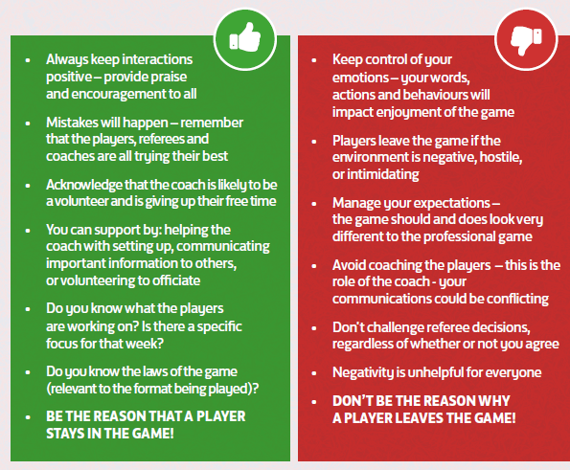
PLAY YOUR PART
As a spectator, you can play your part to ensure that everyone has a positive experience on and off the pitch.
Consider your interactions with the players, coaches and match officials.
@EssexCountyFA
*Add own social media info*
Notes:
Opportunities to break out into discussions in small groups

Slide 8
THE PLAYERS
What does negative behaviour look like from spectators?
How does this impact the players?
How can we ensure that matchdays are safe, fun and engaging?
@EssexCountyFA
*Add own social media info*
Notes:
An opportunity to share some of the videos mentioned in slide 2
Gathering information from the players, or having some players there could also help

Slide 9
Thank you!
@EssexCountyFA
*Add own social media info*
Notes:
Could include key contact details- CWO should be included

