Slide 1

#PlayYourPart
COACHES
INSERT CLUB LOGO
@EssexCoaches
*Add own social media info*
Notes:
Consider an arrival task/question to set things off positively, for example:
Why did you get involved in coaching?
What skills to you bring to coaching? (think about people skills, not about playing experience)
Discuss the qualities of a good coach- In your context (age/stage)
Over to you….What would you like to take away from today?

Slide 2
WHO WE ARE
Introduce club officials
Highlight mission, vision, values
Consider using headline figures (number of children/players that you support & number of volunteers)
@EssexCoaches
*Add own social media info*
Notes:
Consider using more images/graphics than text- Easier to digest and brings content to life
Try to keep text minimal

Slide 3
WHY ARE WE HERE?
To support our volunteer workforce
Consistent messages across the club
Opportunity to connect
Signpost to useful resources & learning
INSERT CLUB IMAGE
(eg-children playing)
@EssexCoaches
*Add own social media info*
Notes:
Keep it short & sweet
Try to use imagery highlighting club’s identity

Slide 4
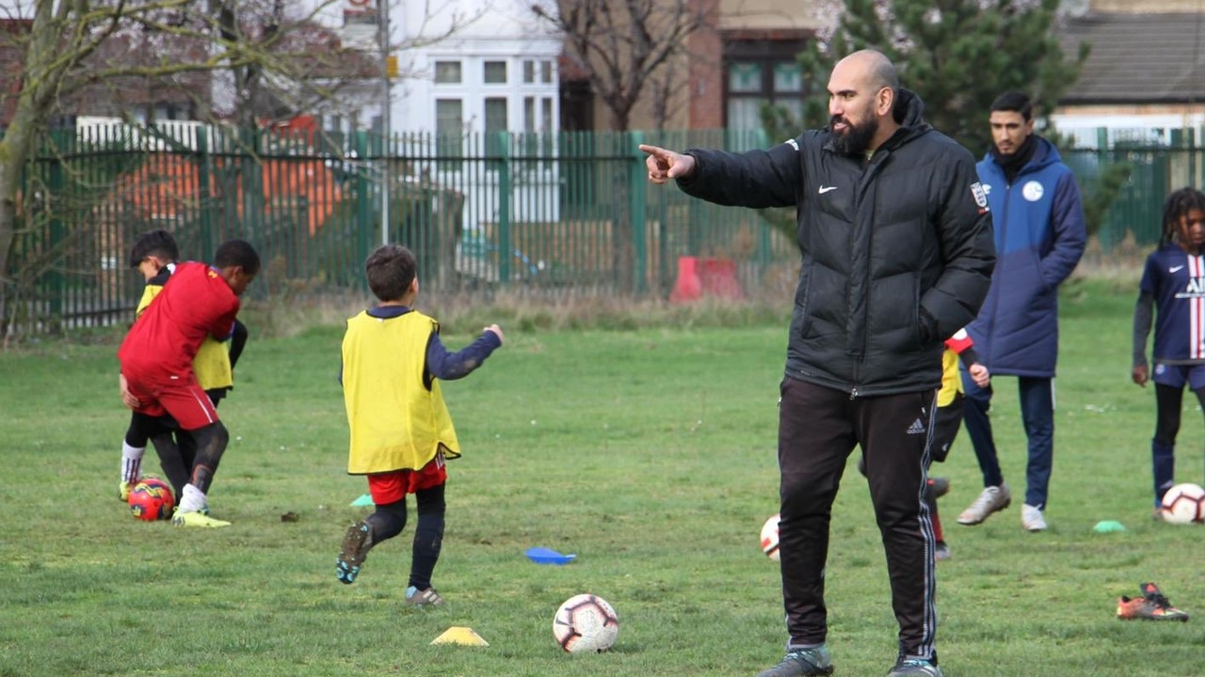
COACHING IN OUR CLUB
Good Practice:
Use a positive & enthusiastic manner at all times
90% of children perform better with positive encouragement.
Try to use games & activities that look like the game
Playing football is the best way to learn about the game.
Keep everyone busy- Aim for a minimum of 70% ball rolling time
Maximise playing time. More of them, less of us!
Get to know the people you coach- People first, players second
Building positive relationships will help you understand their individual needs.
Plan each football experience- Value the process of learning & development
Each training session & matchday is another opportunity to learn the game.
@EssexCoaches
*Add own social media info*
Notes:
Add your own, or select some to highlight/discuss
Be clear & share examples from different people
Make use of the experiences in the room

Slide 5
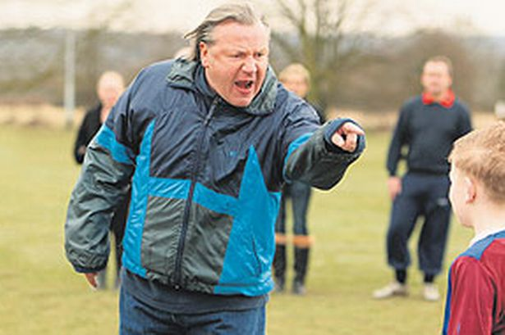
COACHING IN OUR CLUB
Try to avoid:
Lines, laps & lectures
Keep everyone busy, minimal queuing, plan football specific activities, and give the players a voice.
Negative comments or ‘punishments’
Coaching has moved on. Take your time, consider the impact of your interactions and seek support if unsure.
Focussing solely on the scoreline
This is often not a reflection of a team or individual’s performance
Rushing to the ‘adult game’
Formats of football have evolved, to provide a gradual introduction to the 11v11 game. If we support children to have a more rounded diet of football experiences (eg- playing in different positions & formats), they are more likely to reach their potential, and also stay in the game longer.
@EssexCoaches
*Add own social media info*
Notes:
The Youth Development Review took place 12 years ago- Available as a PDF via thefa.com
Add your own, or select some to highlight/discuss
Be clear & share examples from different people
Make use of the experiences in the room

Slide 6
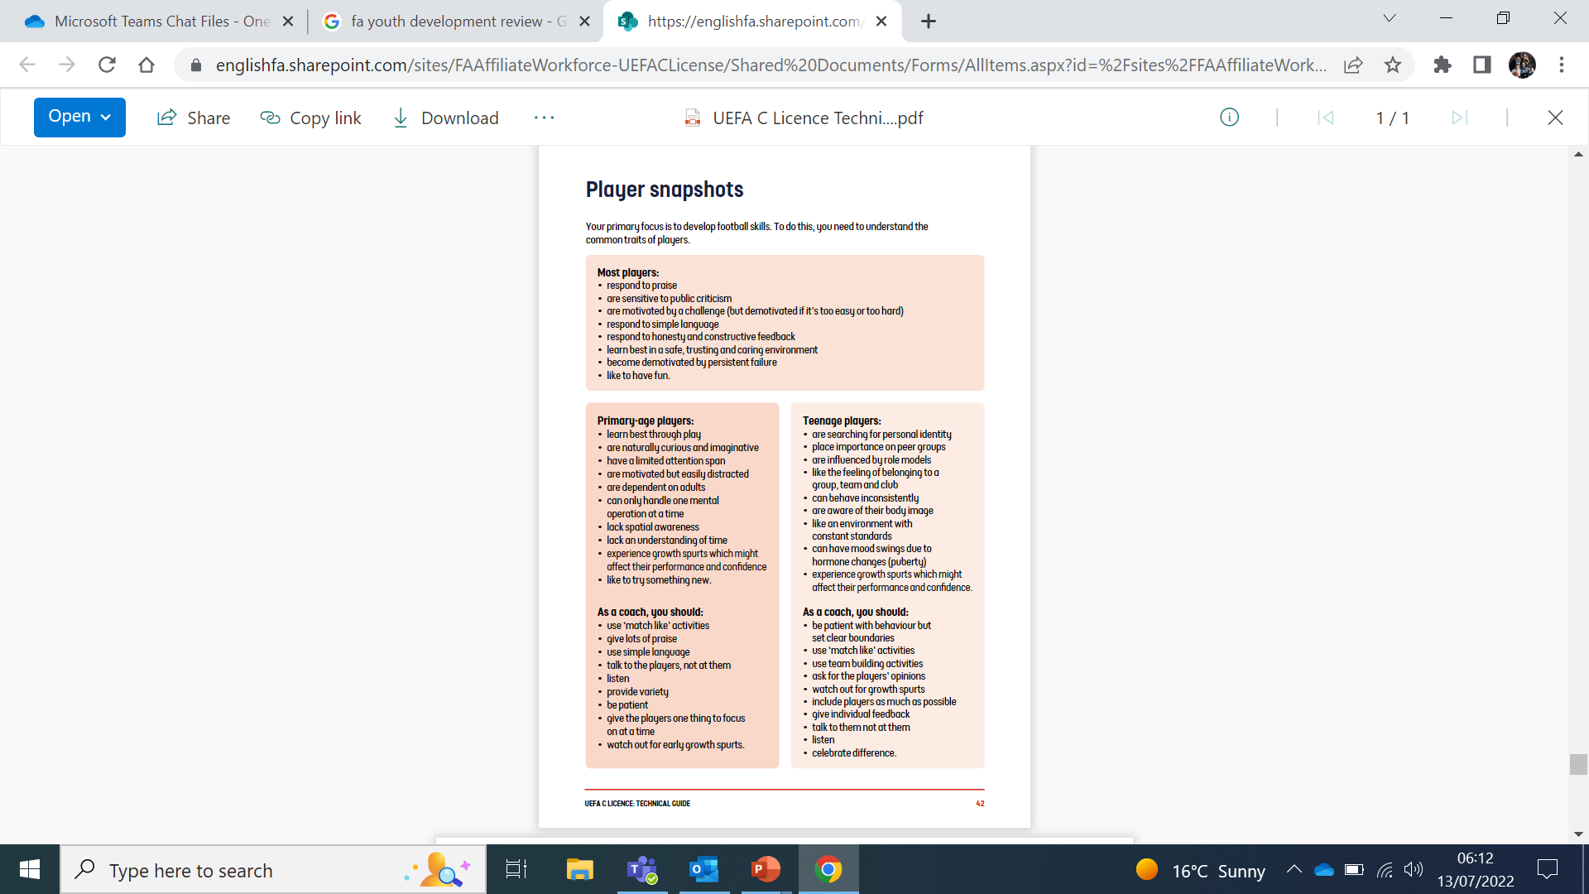
PLAYER SNAPSHOTS*
*Taken from ‘UEFA C Licence Technical Guide’
Your primary focus is to develop football skills. To do this, you need to understand the common traits of players.
Most players:
Respond to praise
Are sensitive to public criticism
Are motivated by a challenge
Respond to simple language
Respond to honesty & constructive feedback
Learn best in a safe, trusting and caring environment
Become demotivated by persistent failure
Like to have fun
Notes:
Optional page to include, print out, or share separately
Potential pre-workshop read, or arrival discussion

Slide 7





ENGLAND FOOTBALL LEARNING
@EssexCoaches
@EssexCoaches
*Add own social media info*
Notes:
Here’s one way to present the information. Links below if you’d prefer to share in a different way:
https://thebootroom.thefa.com/learning/qualifications/the-fa-playmaker
https://thebootroom.thefa.com/learning/qualifications/introduction-to-coaching-football
https://thebootroom.thefa.com/learning/qualifications/uefa-c-licence
https://thebootroom.thefa.com/learning/qualifications/safeguarding-children-course
https://thebootroom.thefa.com/learning/qualifications/introduction-to-first-aid-in-football

Slide 8
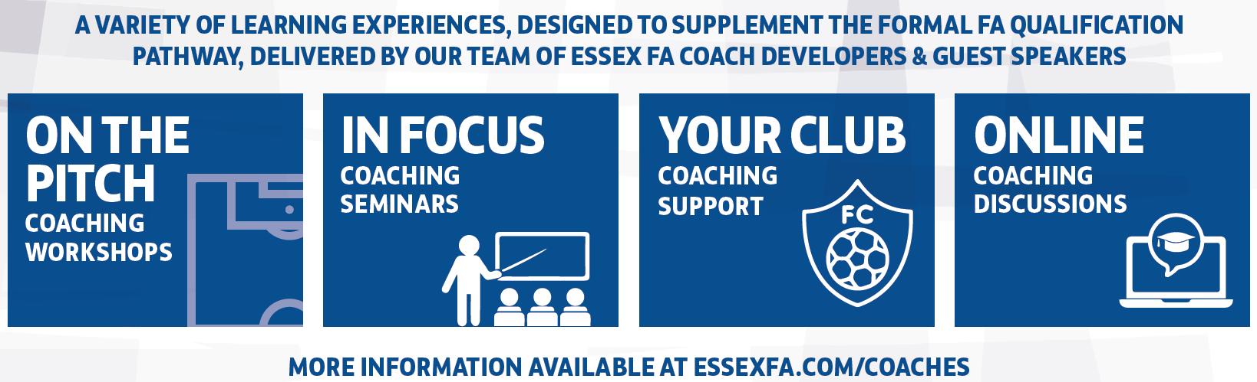
ESSEX FA COACH DEVELOPMENT PROGRAMME
@EssexCoaches
*Add own social media info*
Notes:
Add online discussions

Slide 9
Thank you!
@EssexCoaches
*Add own social media info*

