Slide 1

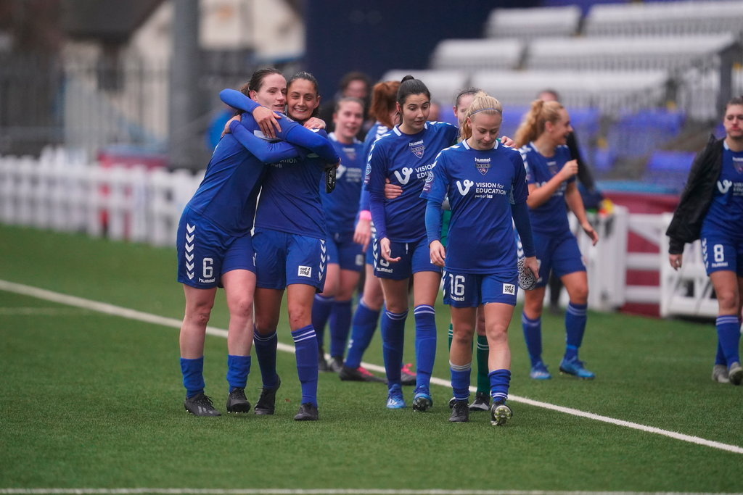




DURHAM COUNTY FOOTBALL ASSOCIATION
BUSINESS STRATEGY
2021-2024

Slide 2
Durham County FA VISION 2021-2024
This Strategy will be delivered in partnership with our Key Stakeholders;
To give Everyone, Everywhere within Durham County an Opportunity to Participate in FOOTBALL in a Safe, Inclusive and Accessible environment.

Slide 3
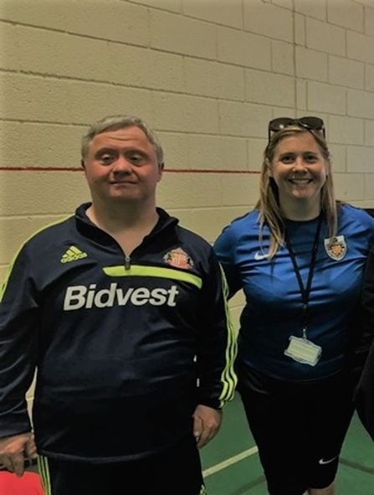
Durham County FA MISSION 2021-2024
To provide playing opportunities for ALL by reducing and removing barriers, simplifying our approach, be efficient with the services we deliver in order to provide the best possible experience.

Slide 4
Durham County FA VALUES
PRIDE – In what we do, why we do it and who we represent.
HONESTY – In our actions and our intentions
INTEGRITY – In our approach and consistent in our decisions
PROFESSIONAL – In our manner, on what we deliver and how we want to be perceived

Slide 5
Corporate Governance Structure
Board
Council
CEO
Senior Management Team
IAG
Youth Council
Football Services
Safeguarding Core Group
Investigations Team
Development
Referee Committee
Cup Competitions
Sanctions Committee
Discipline Committee
Football Board

Slide 6
County FA Structure
John Topping
CEO
Michael Bell
Designated Safeguarding Officer
David Cleary
Football Development Manager / DSSO
Andrea Fyall
Disability Participation FDO
Helen Edwards
Female Participation FDO
Andrew Brown
Male Participation (Youth) FDO
Richard Shuffleton
Football Development Officer
Daniel McElhone
Male Participation (Adult) FDO
Sebastian Stockbridge
Referee Development Officer
Kerry Topping
Football Services Manager
Christopher Hutchinson Facilities & Investment
Tracey Lavery Discipline & Affiliation Manager
Mark Smith County FA Leagues Officer
Eve Walker Football Services Administrator
Sophie Hughes Football Services Administrator (Safeguarding)
Bradley Fearnley Football Administrator (Fixed Term)
Thomas Wallace Football Administrator ( Fixed Term)

Slide 7










FOOTBALL TODAY IN DURHAM COUNTY FA
28 LEAGUES
12 Accredited Clubs
9 Adult
3 Youth
2 National Leagues
28 Disability Teams
50 FULL SIZE 3GS
37SMALL SIDED 3GS
3 NEW FOOTBALL HUBS
CONTAINING 10 FULL SIZE 3G PITCHES
721 CLUBS
ENGLAND ACCREDITED
243 Adult
32 Community
11 Development
136 Youth
2 Universities
91 Male Teams
24 Male Futsal Teams
17 Female Teams
9 Female Futsal Teams
650
COACHES REGISTERED ON COACH DEVELOPMENT PROGRAMME
2,810 Teams
  2431 Male
  299 Female
  28 Disability
  52 Futsal
  33 National League System
2 WSL Championship
26 Male College Teams
8 Female College Teams
44 Wildcat Centres
2 Regional Talent Centres

Slide 8
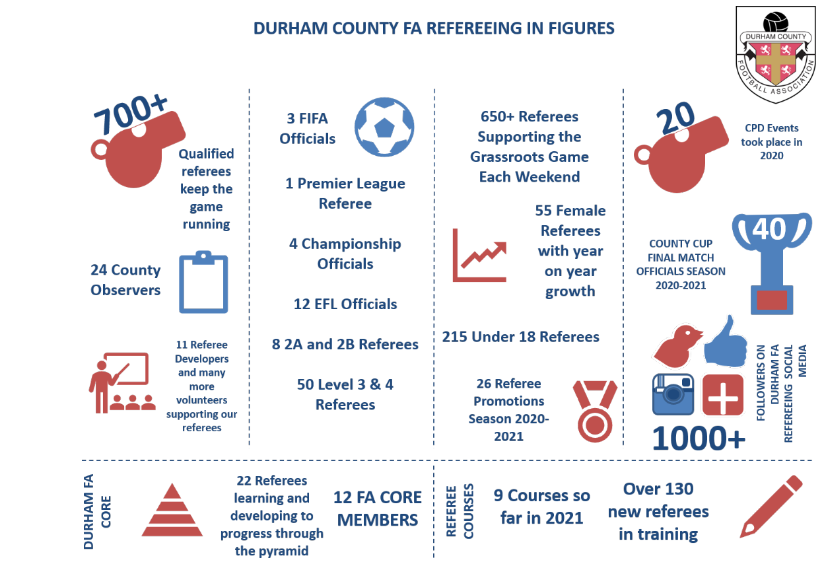
FOOTBALL TODAY IN DURHAM COUNTY FA

Slide 9
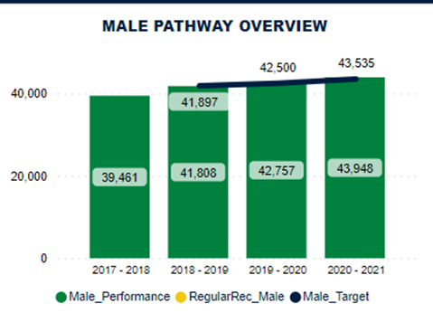
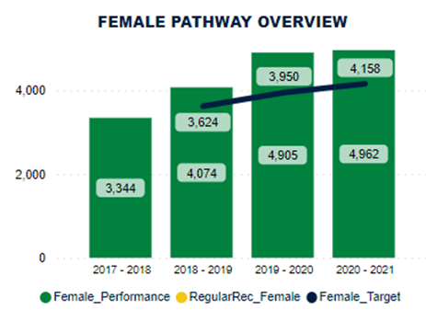
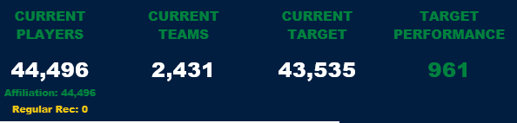
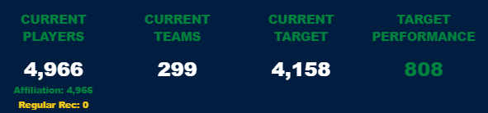
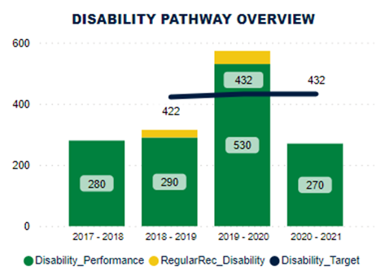
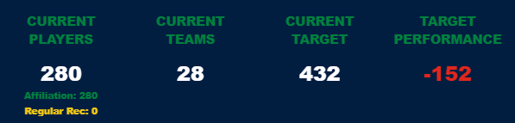
BUSINESS OVERVIEW 2018-2021
12.8% Increase since 2018
44% Increase since 2018
44 New Teams since 2018

Slide 10
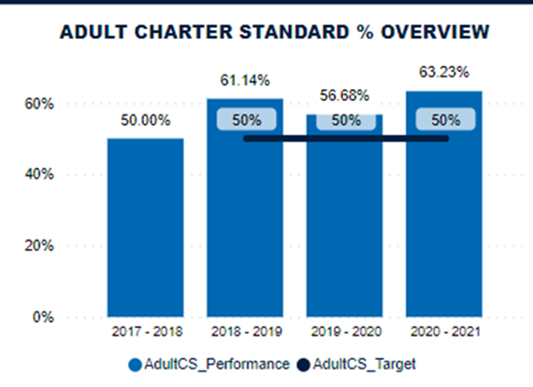
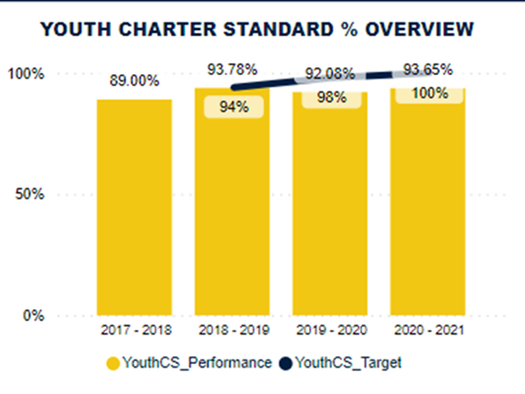
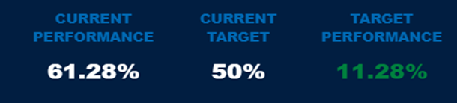
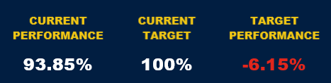
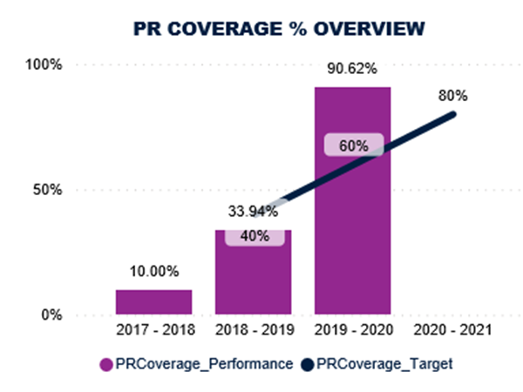
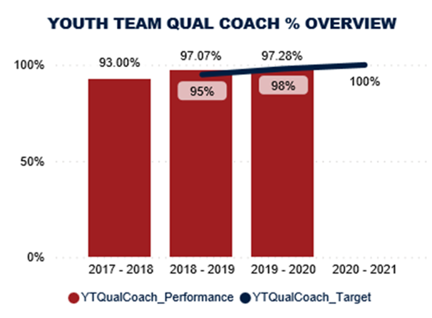
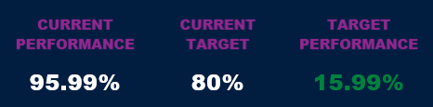
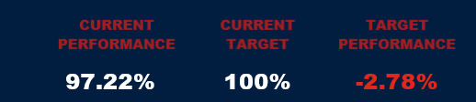
BUSINESS OVERVIEW 2018-21
11.28% Increase
6.15% Below Target
Operating at 15.99% ahead of target
2.78 % Below Target

Slide 11
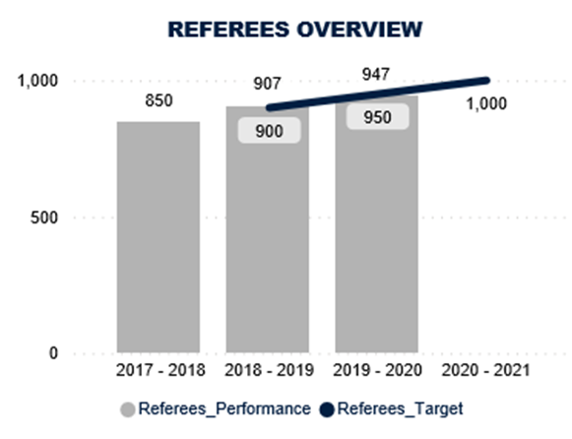
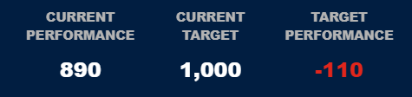
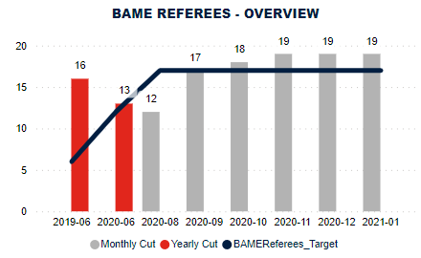
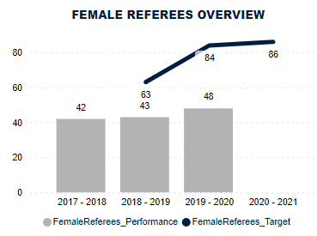
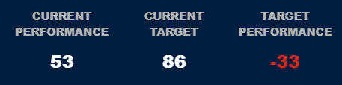
Business Overview 2018-21
Below target by 110
Below target by 33 however actually achieved once courses restarted
Increase by 2
BAME Target 17

Slide 12





BUSINESS OVERVIEW 2018-21
602 Coaches Registered to
Coach Development Programme
Safeguarding Operating Standards
Signed off March 2021
130 Grass Pitches Improved to Good or Higher
14 New Full Size 3G’s
72 Schools Supported
144 Teachers Supported

Slide 13
2018-2021 Analysis
Successes
Stopped the decline of adult football
Growth of Male and Female Participation.
Increase in Disability Teams prior pandemic
3 Brand New Hubs with 10 additional 3G’s + 2 additional
600+ coaches registered to our Coach Development Programme
Established Club Welfare Officer Network
SOS signed off May 2020/21
Commenced Code of Governance review
IAG firmly established
CFA have an Identified EDI Champion at Board level
Foundation refresh and Preliminary levels of Equality Standard targeted for completion by end 2021
Challenges
Durham County Council support for CFA hub
Lack of accessible 3G facilities
Continuance of subsidised insurance and other initiatives to financially support our members
Leagues still reluctant to change.
Lack of contact with new coaches moving through the coaching pathway.
To engage with the less proactive coaches (and clubs) as no requirement to attend CPD.
Huge reluctance for Just Play centres to use events engine
Referee’s re-engaging after COVID and ensuring that the appropriate support remains in place due to budget cuts
Player online registration system IT issues and loss of confidence from members
Club/League Welfare Officers in adult football ( Includes disability football)
Leagues to move to an appoint referees
Re-engaging with Disability Teams and Leagues
Disability Player Registration
Opportunities
To invest in CFA hub with financial help from FF
Use Power BI to monitor and analyse data so we can check and challenge our own programmes
Use findings from questionnaire & mapping exercise to fill the gaps in Male Pathway at U19’s, U21’s, O35’s
Provide clubs and coaches with variety of CPD at their Own Venues.
Work with Open Age Football to raise safeguarding awareness
To capitalise on the success of our higher level Referee’s – Michael Oliver , Rebecca Welch and Gary Beswick to help with recruitment and progression.
Take advantage of Womens’s Euro’s to promote recreational offer
Opportunity to create disability junior league
To demonstrate DCFA is a listening organisation that also acts appropriately in line with EDI principles
Work towards Equality Standard Preliminary level
FA Para Talent Football ID Workshops and Regional England Talent Days
Disability Awareness Training
Threats
CFA Hub impact on finances and move towards self sufficient/independence
Loss of Income from Coach Education & reduction in Funding from FA which will affect our contribution towards our ongoing programmes
Due to Growth in Open Age Football Awareness resulting in more referrals/complaints being received and lack of Staffing Resource
Pandemic has impacted disability community and there is a real risk that teams will not re-affiliate
The complexity of this season’s registration process and the safeguarding re-certification will mean referees will /may not re-register.

Slide 14
WHAT WE DID – WHAT WE FOUND
  In designing this strategy, we embarked on extensive research which includes insight from:
Durham FA Grassroots Survey
  56% Male Adult Players want more opportunity.
  63 % Adult Female Players want to participate more
  19% Referees want to participate more
  44% Club Officials want to participate less and think they’ll have too. 5% want to do less and they will.
  56% League Officials at Risk and want to participate less
  13% Helpers Volunteers want to participate less and will do.
  Every sector of our Volunteers from Players, Coaches, Referees, League & Club Officials and spectators want more interaction with the County FA
Youth Council Consultation
Coaching – Support for youth coaches after completing Introduction to Coaching Football.
Refereeing – Mentor Support for Youth Referees. Mentors at Central Venue Leagues. Female Only Referee Course.
Male Pathway – U19 to U23 Leagues to help transition into Adult Football.
Female Pathway - Small sided offer to keep girls playing after drop off at U13.
Disability Pathway – More opportunities for Youth Disability Football.
IAG Consultation
Agreed on 4 Thematic areas of work: Women & Girls, Disability, BAME, LGBT
Club Survey to ask about playing opportunities
  Overwhelmingly there is a need for Sunday provision for Male Mini Soccer.
  Coaches / Managers want to be part of DFA Forum.
  Coaches / Managers would like a ‘High Performance midweek League to challenge their better players / teams but concerned of too much play.
Coaches questionnaire
  Coaches Want Face to Face and predominantly to see practical sessions.
  Coaches would like to see events /workshops delivered at their own site with own club
  Coaches would like to see events delivered County wide.
  Female Coaches would like Female Only Events HOWEVER nearly all stipulated they would also attend mixed events.

Slide 15







WHAT WE WILL DO
    Continue to seek the views and opinions of our Key Stakeholders through questionnaires, surveys and forums
    Gather further evidence, thoughts and suggestions through dialogue with our Corporate Governance
Evaluate and Assess proposals
Manage expectations
Take action and deliver
Ensure Equality, Diversity and Inclusion are applied to all actions .
Promote our strategy amongst our Key Stakeholders.

Slide 16
We will deliver on our purpose and ambition through our 7 KEY STRATEGIC PRIORITIES
The Male, Female & Disability Player
Increase provision, regularity and quality playing experience
Create full player pathway for all.
Help with the transition from youth to adult football
Engage new players from diverse communities
Provide a Recreational Offer which reflects the needs and aspirations of our players
Establish our own County Leagues to provide Sunday as an alternative playing opportunity..
Retain and Build strong Club & League networks
Provide inclusive and accessible opportunities for all
Embed a broader set of playing opportunities at clubs to meet the needs of male, female and disability pathways
To support and guide clubs in operating as effective and efficient organisations.
To support leagues to deliver modern, safe and inclusive competitions to meet the needs of the game and maximise playing opportunities
Support Clubs and Leagues to fully understand the ‘New’ Accreditation, help with the application process and promote the benefits.
Provide a platform for all to enjoy the game in a safe environment
To continually achieve and deliver the FA Safeguarding Operating Standard with safeguarding principles embedded across grassroots football.
Continue to promote the key Respect principles to create a positive environment for all key stakeholders in the game.
To build on and deliver an engagement network with young people involved in all aspects of the grassroots football across the County to ensure they have a voice in their game.
Build and support the network of Club and League Welfare Officers across all affiliated members to continually embed safeguarding in the game.
To have achieved Foundation, Preliminary and Intermediate levels of the Equality Standard and be working on the achievement of the Advanced level.
DCFA to have Board, Council and Staff groups representative of the communities we serve
To improve the diversity of coaches, referees, officials and players involved in grassroots football within DCFA region to better reflect the diversity within our communities.
DCFA Inclusion and Advisory Group to maintain an influential role within the organisation with a clear, measurable Development Plan and dedicated Budget to enable an active contribution to the ongoing improvement of EDI across the organisation.
Safe, Fun, Inclusive Compliant environment
Supported Football Workforce
Recruit, Develop, Educate, Inspire
Provide consistent, continuous support through our ‘ On & Off’ the pitch Support Package so every member of the workforce feels valued..
Our Coach Development Programme will be easily accessible, evolve by seeking out the newest innovations and emerging trends.
Support Clubs and Leagues to develop their own recruitment policy which will provide sustainability within their relevant Committees.
Provide a support network for all referees with outstanding opportunities to develop and progress
Accessible, sustainable, quality pitches throughout the whole County
Our LFFP will ensure all priority projects deliver against the National Football Facility Strategy & Football Foundation performance framework
Continue working with priority sites as part of the FA Grass Pitch Improvement Strategy .
Ensure new and refurbished changing rooms & pavilions are fit for purpose .
Ensure all projects are aligned and delivered against FA National Game Strategy Targets and NFFS measurement framework
Accessible & Affordable Facilities
Supported through Wellbeing and Continued Personal Development
Being committed to improve each individuals Health and Wellbeing
Create a culture of learning by embedding the FA Training Ground into our Workforce programme.
Encourage our workforce to take responsibility for their own Personal Development
County FA Workforce
Build Meaningful and lasting relationships
Communicate, listen, and deliver
Establish a Community of practice: to provide a platform for discussion; to share knowledge and experience and to challenge thinking.
Collaborate with stakeholders to help grow and improve the game.
Use our website and social media channels to engage with our customers and promote our good work.

Slide 17
Our Strategic Priorities are underpinned by 5 key areas;
Governance
Workforce
Data & Insight
Durham County FA
Finance & Investment
Safeguarding

Slide 18
Good Governance
Code of Governance – A skills audit was carried out on Board members which identified the need for change as we have members with good football knowledge but lack in business knowledge. There is a need for independence and diversity amongst directors. The current Board have agreed to the change. We currently have a Safeguard Champion on the board and have recently added our IAG chair to represent Equality, Diversity & Inclusion. This Board will become our business board
Articles – The first step is to review our Articles and change them where required this is an ongoing process which we expect to have fully implemented by the AGM in 2022.
Recruitment of INEDs – Following the agreement of article changes it is our intention to add
independent and diverse members. We currently have one female member and seek to add a minimum of two more.
- Football Board – The changes to our main Board will result in a football board being created with
some of the current board and some independent members being added and they will deal with CFA
football issues and feed into the business board.
Council – The Council will be restructured to involve more Leagues and Clubs who represent a larger
independent and diverse group and become more involved in discussing and providing changes,
recommendations to the football board to debate. Our standing committees will be formed from
members of this group and we will also have involvement from the Youth council.

Slide 19
CFA Workforce
Following the reduction in FA funding we undertook a workforce review so that any losses would not have a big impact on the business. We made redundant the designated safeguard officer(DSO) on voluntary redundancy and promoted the Deputy DSO in his place, the discipline administrator and the one football development officer. Since then and the increase in the work surrounding safeguarding and the Equality standards we have re-employed the former DSO on a 12 month contract to ensure we reach the foundation and preliminary level of the standards and employed two administrators on 12 month contracts. As an Association we pride ourselves on providing the best service possible to our members and we will keep our staffing levels under review.
Staff Health & Wellbeing and Development – As a company we consider these two elements to be essential and have two members of staff (one male and one female) trained in health and wellbeing and they hold a staff meeting (without CEO and two line managers) where they have an open discussion. Staff are also encouraged to approach them with any personal issues they may have or need advice on.
Staff are encouraged to use the FA Training Ground site regarding their own development and to speak to their line manager regarding any training they need or wish to undertake.
Personal Development Reviews – these are led by the CEO for Senior Management Team and by the line managers for their team members.
One to Ones – CEO holds regular meetings with SMT and line managers hold monthly meetings with staff who report to them.

Slide 20
CFA Workforce
- People Development Plan central to everything we do.
- Culture that values the well being of all employees.
- Mental Heath First Aid lead in the organisation and promote EAP to employees.
- State of Play - Staff Survey Results presented to Board and SMT with action plans to improve.
- Flexible Working hours & environment to balance needs of individuals and organisation.
- Links between Directors / NEW committees / committee structure & Staff members
- Promote Training Ground as a key tool to support staff development.

Slide 21
Safe, Fun, Inclusive and Compliant Environment
Provide a platform for ALL to enjoy the game in a safe environment
Safeguarding & Youth Engagement
We Will:
Continue to roll out Validation Visits to Clubs. This provides an excellent opportunity to engage with our Key Stakeholders as well as Children and Young People Consultation.
Continue to monitor compliance with Safeguarding requirements for clubs, leagues, coaches and referee’s to ensure safeguards are in place.
Support Welfare Officers with CPD opportunities and a dedicated webpage which will be continually developed based on their feedback.
Facilitate and utilise feedback from children and young people across all programmes delivered by the County FA.
Equality, Diversity & Inclusion
We Will:
Appoint a Board Equality, Diversity and Inclusion Champion (also Chair of the Inclusion Advisory Group)
Achieved Foundation, Preliminary and Intermediate levels of the Equality Standard and we’ll be working on the achievement of the Advanced level.
Have a Board, Council and Staff groups representative of the communities we serve
Improve the diversity of coaches, referees, officials and players involved in grassroots football to better reflect the diversity within our communities.
Ensure our Inclusion and Advisory Group maintains an influential role within the organisation with a clear, measurable Development Plan and dedicated Budget to enable an active contribution to the ongoing improvement of EDI across the organisation.

Slide 22
Monthly
Project / Programmes updates to Staff and Board
Monitoring and Evaluation
Quarterly
Business Plan – Review
Board Updates – Company Secretary
Staff Updates – Company Secretary
Six Monthly Review
FA Review – Company Secretary / Chair
Staff Performance Management System
Staff PDR’s with annual appraisal
Annual Work Programme linked to Operational Plan
Internal Weekly, Monthly and Quarterly Review meetings against operational objectives

Slide 23




Data & Insight
DATA DRIVEN Power BI will help make effective decision making based on data analysis. This approach will enable our Business to examine and organise data with the goal of better serving our customers and prepare for opportunities.
TECHNLOGY Promote the benefits to our volunteers whilst continuing to upskill our Workforce to support the implementation of new technology across the game.
SURVEY Use the Consultation framework as a tool to receive feedback from all different sectors and act accordingly.
SMARTSHEETS Their implementation throughout the business will improve; collaboration amongst the workforce, monitor and evaluate performance and to be used to report findings to our Board.

Slide 24
Appendix : NGS Targets across next 3 seasons 21-24
Appendix 2. Referee Education & Development
Appendix 3. Coach Education & Development
Appendix 1. Registered Players
Measure | Baseline | 2021/22 Target | 2022/23 Target | 2023/24 Target
Registered Male Players | 35,145 | 35,145 | 35,145 | 35,145
Registered Female Players | 4444 | 4,888 | 5,333 | 5,777
Registered Disabled Players | 170 | 204 | 238 | 272
Measure | 1st March 2021 Baseline
1st March Baseline All Referees | 835
1st March Baseline All L5-L7 Referees | 685
Recruitment Measure Target 2021/22 | 209
Conversion Measure Target 2021/22 | 125
Retention measure target 2021/22 | 668
Progression measure target 2021/22 | 62
Measure | 1st March 2021 Baseline
Coach Education and Development
1st March Baseline Youth Teams | 2,055
1st March Baseline YTWAQ | 96.4%
2021/22 YTWAQC Target | 89%
2021/22 CPD Target | 411
2022/23 YTWAQC | 89.5%
2022/23 CPD Target | TBC
2023/24 YTWAQC Target | 90%
2023/24 CPD Target | TBC
Appendix 4. Secondary KPI’s
Measure | Baseline | 2021/22 Target | 2022/23 Target | 2023/24 Target
Weetabix Wildcats | 45 | 53 | TBC | TBC
Youth Clubs with Female Teams | 28% | 45% | 60% | 75%
Female Youth Competition | YES | YES | YES | YES
1000 clubs with a female | 14 | 9 | 18 | 30
England Football Accreditation – Adult Clubs | 62% | 60% | 65% | 70%
England Football Accreditation – Youth Clubs | 93% | 89% | 90% | 90%
Appendix 5. Quality Grass Pitches
Baseline | 2021/22 Target | 2022/23 Target | 2023/24 Target
103 | 130 | 155 | 201

Slide 25
End

