Slide 1
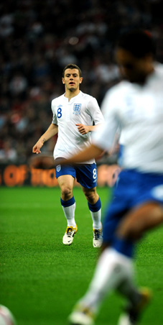
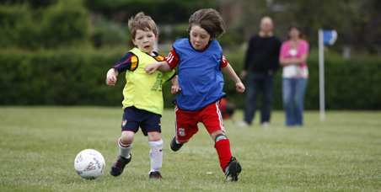
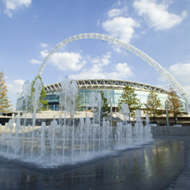
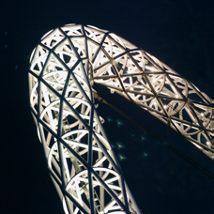
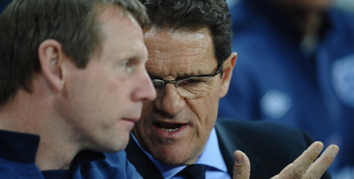
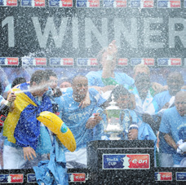
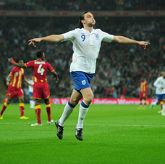
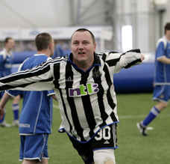
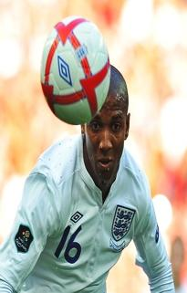
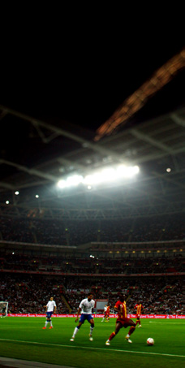
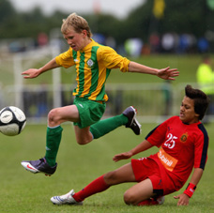
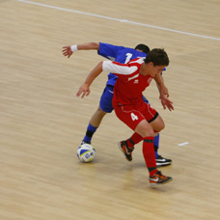
?????? FC Football Development Plan 2011-2015

Slide 2
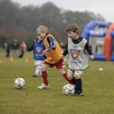
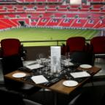
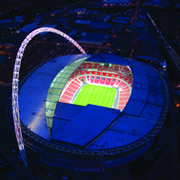
Contents
Our Vision
Growth and Retention
Raising Standards
Better Players
Running the Game
Workforce
Facilities
Promotion

Slide 3
Our Vision
Contents

Slide 4
Our History
Contents
Our Philosophy
Notes:
It’s a positive move for a club to have a philosophy (identity) which runs through the club and adopted by all teams within the club. This philosophy should be how the club believes children should develop, the environment which the children play, how the children should play (for example is it win at all costs long ball from back to front as quickly as possible or is it the players are children and should play in an environment free from pressure of making mistakes, mistakes will happen and learning will take place in a fun enjoyable environment) the philosophy will be clear to all and shared with everyone within the club. What is success??? Is it winning the league or maintaining a group of players that would normally have left the game??

Slide 5
Our Achievements
Contents
Club Growth!
Growth in Mini-Soccer, Youth, and open age football
Introduction and development of girls football
???? teams!
The People Factor!
Talent, enthusiastic and qualified volunteer workforce
Stable and progressive Executive Committee
Investment in young people to become coaches and referees

Slide 6
Our Achievements
Contents
Facility
?????
Recognition
???????
Notes:
Recognition is not just trophies but awards for the good work carried out by the club and it’s volunteers, these can be from the County FA, The FA, Local Authority etc.

Slide 7
Club Development Table
Contents
 | 12/13 |  |  | 13/14 |  |  | 14/15 |  |  | 15/16
No. of teams | ?? |  |  | ?? |  |  | ?? |  |  | ??
 | Male | Female | Disability | Male | Female | Disability | Male | Female | Disability | Male | Female | Disability
 | U7 U8, 8 U9 , 9 U10, 10 U11 U12 U13 U14 U14 U15 U16 U18 1st Team Over 35’s | U9 U11 U13 |  | U7 U8, 8 U9 , 9 U10, 10 U11 U12 U13 U14 U14 U15 U16 U18 U21’s 1st Team Over 35’s | U9 U11 U13 U15 | Adult | U7 U8, 8 U9 , 9 U10, 10 U11 U12 U13 U14 U14 U15 U16 U18 U21’s 1st Team Reserves Over 35’s | U9 U11 U13 U15 Senior | Adult | U7 U8, 8 U9 , 9 U10, 10 U11 U12 U13 U14 U14 U15 U16 U18 U21’s 1st Team Reserves Over 35’s | U9 U11 U13 U15 Senior | U12 Adult
Notes:
Clearly state the current ages groups you have, if you have multiple teams in 1 age group state them too, if a club has U18’s can they develop them to U21’s?? This will help the transition from youth to senior football for many players who are physically not ready for senior football.

Slide 8
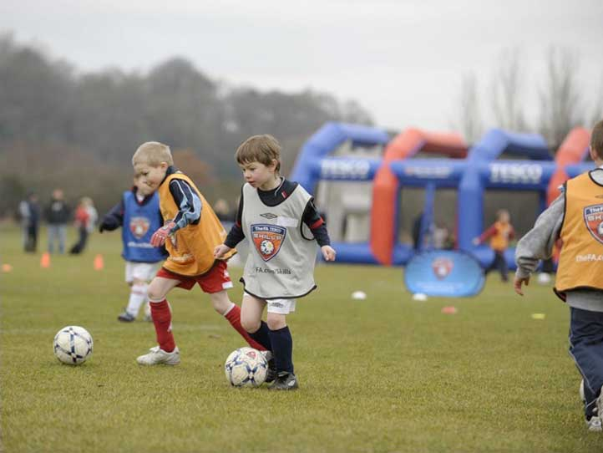
Growth and Retention

Slide 9
Growth and Retention
Contents
Aim | ??????
Objective | Achievement targets | Timescale | Responsibility | Cost
Notes:
Think a head to what teams you plan to set up over the duration of the plan, are you “back filling” each year and setting up at the younger age group or are there gaps in the age groups which you plan to fill? It’s important to add which age groups you plan to create and what format they will play. Also how you will go about setting the teams up, where will the players/volunteers come from? Are you using any schools? Etc.

Slide 10
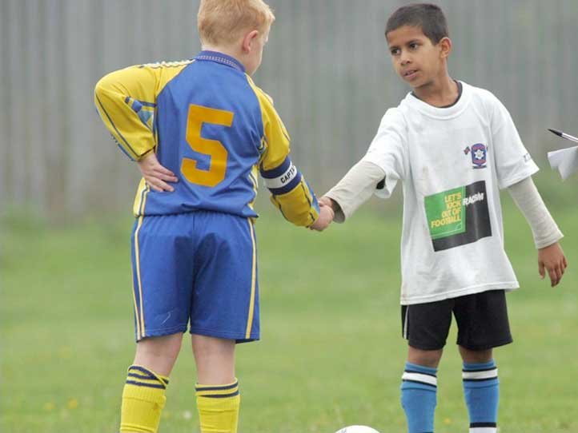
Raising Standards and Addressing Abusive Behaviour

Slide 11
Raising Standards and Addressing Abusive Behaviour
Contents
Aim | ??????
Objective | Achievement targets | Timescale | Responsibility | Cost
Notes:
How does your club plan to tackle poor standards and behaviour both on the pitch and touchline?? What ideas do you have to change the mindset of the adults?? Everyone involved in the game is entitled to an enjoyable environment free from abuse and intimidation, especially the young children.

Slide 12
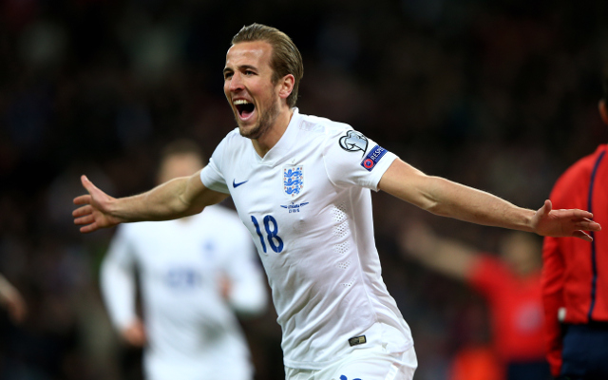
Better Players
Notes:
12

Slide 13
Better Players
Contents
Aim | ?????? ??????
Objective | Achievement targets | Timescale | Responsibility | Cost
Notes:
What methods/ideas do you have in mind to improve the players? E.g. club has a coach coordinator who spends a period of time with each age group and passes on new ideas to the coaches? If the club has multiple teams at 1 age group do they train together from time to time? Or for example does the U11’s spend a few weeks training with the U12’s?

Slide 14
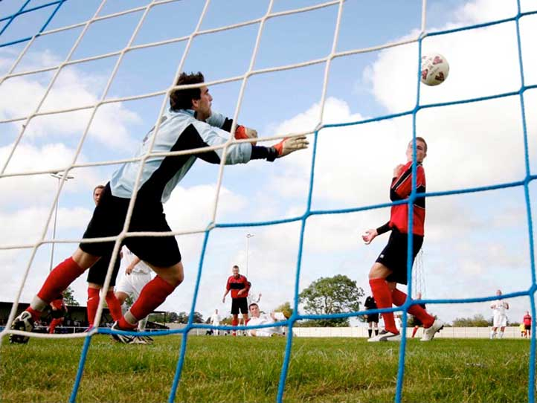
Running the Game

Slide 15
Running the Game
Contents
Aim | ?????? ??????
Objective | Achievement targets | Timescale | Responsibility | Cost
Notes:
What administration methods does the club plan to use to improve the running of the club? What’s the communication like between the teams. How easy is it to communicate with all the coaches? Etc.

Slide 16
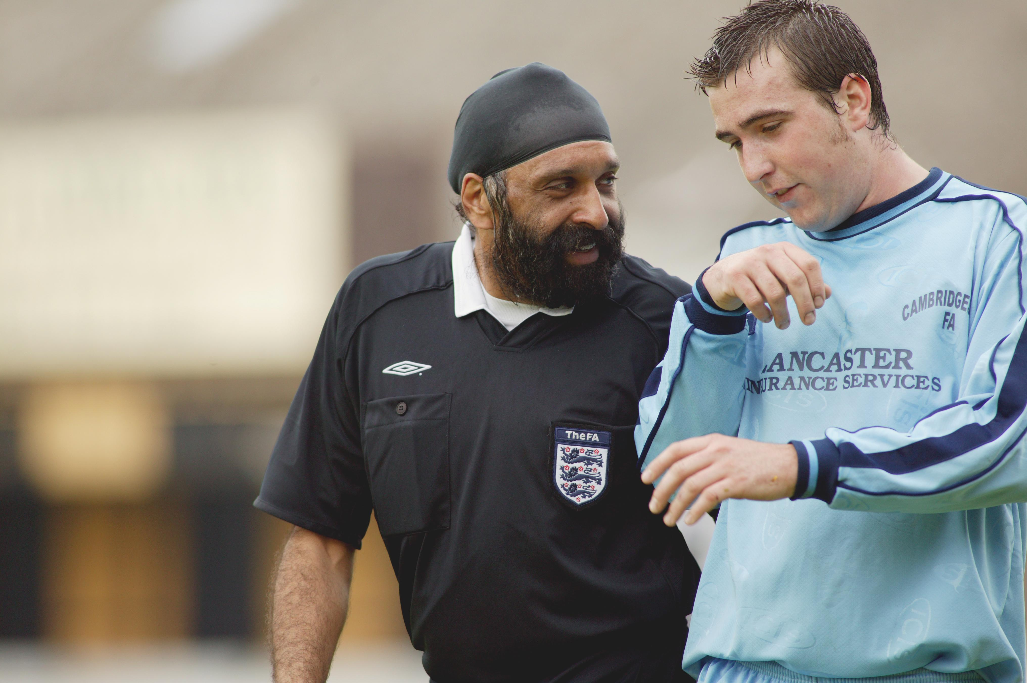
Workforce Development

Slide 17
Workforce Development
Contents
Aim | ??????
Objective | Achievement targets | Timescale | Responsibility | Cost
Notes:
Apart from coaches attending Level 1 and Level 2 courses, what other development do you have in mind for the coaches to continually development themselves in order to give the children the best possible experience and environment. Does the club host a Durham FA Coaches Association event which is free? Do they attend the Youth specific courses? (Youth Module 1 & 2) does the club have a buddy system for new coaches? Etc.

Slide 18
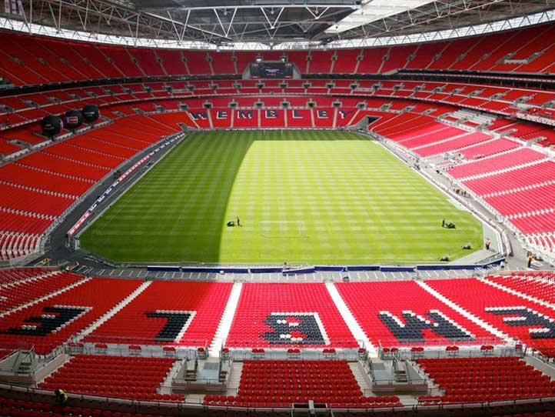
Facility Development

Slide 19
Facility Development
Contents
Aim | ??????
Objective | Achievement targets | Timescale | Responsibility | Cost
Notes:
Does your club have it’s own Facility? If so what are your “Realistic” Plans, if not do you have potential to secure your own facility? If not what plans do you have should you be planning to grow the number of teams, where will they play? Do you have links with Schools to use their sites? Etc.

Slide 20
Promotion

Slide 21
Promotion
Contents
Aim | ?????? ??????
Objective | Achievement targets | Timescale | Responsibility | Cost
Notes:
Does the club have a website? regular news letters? Social media? Social media policy and aware of the potential pit falls? How do you plan to promote your club in the community and attract potential volunteers/sponsors/players etc?

