Slide 1
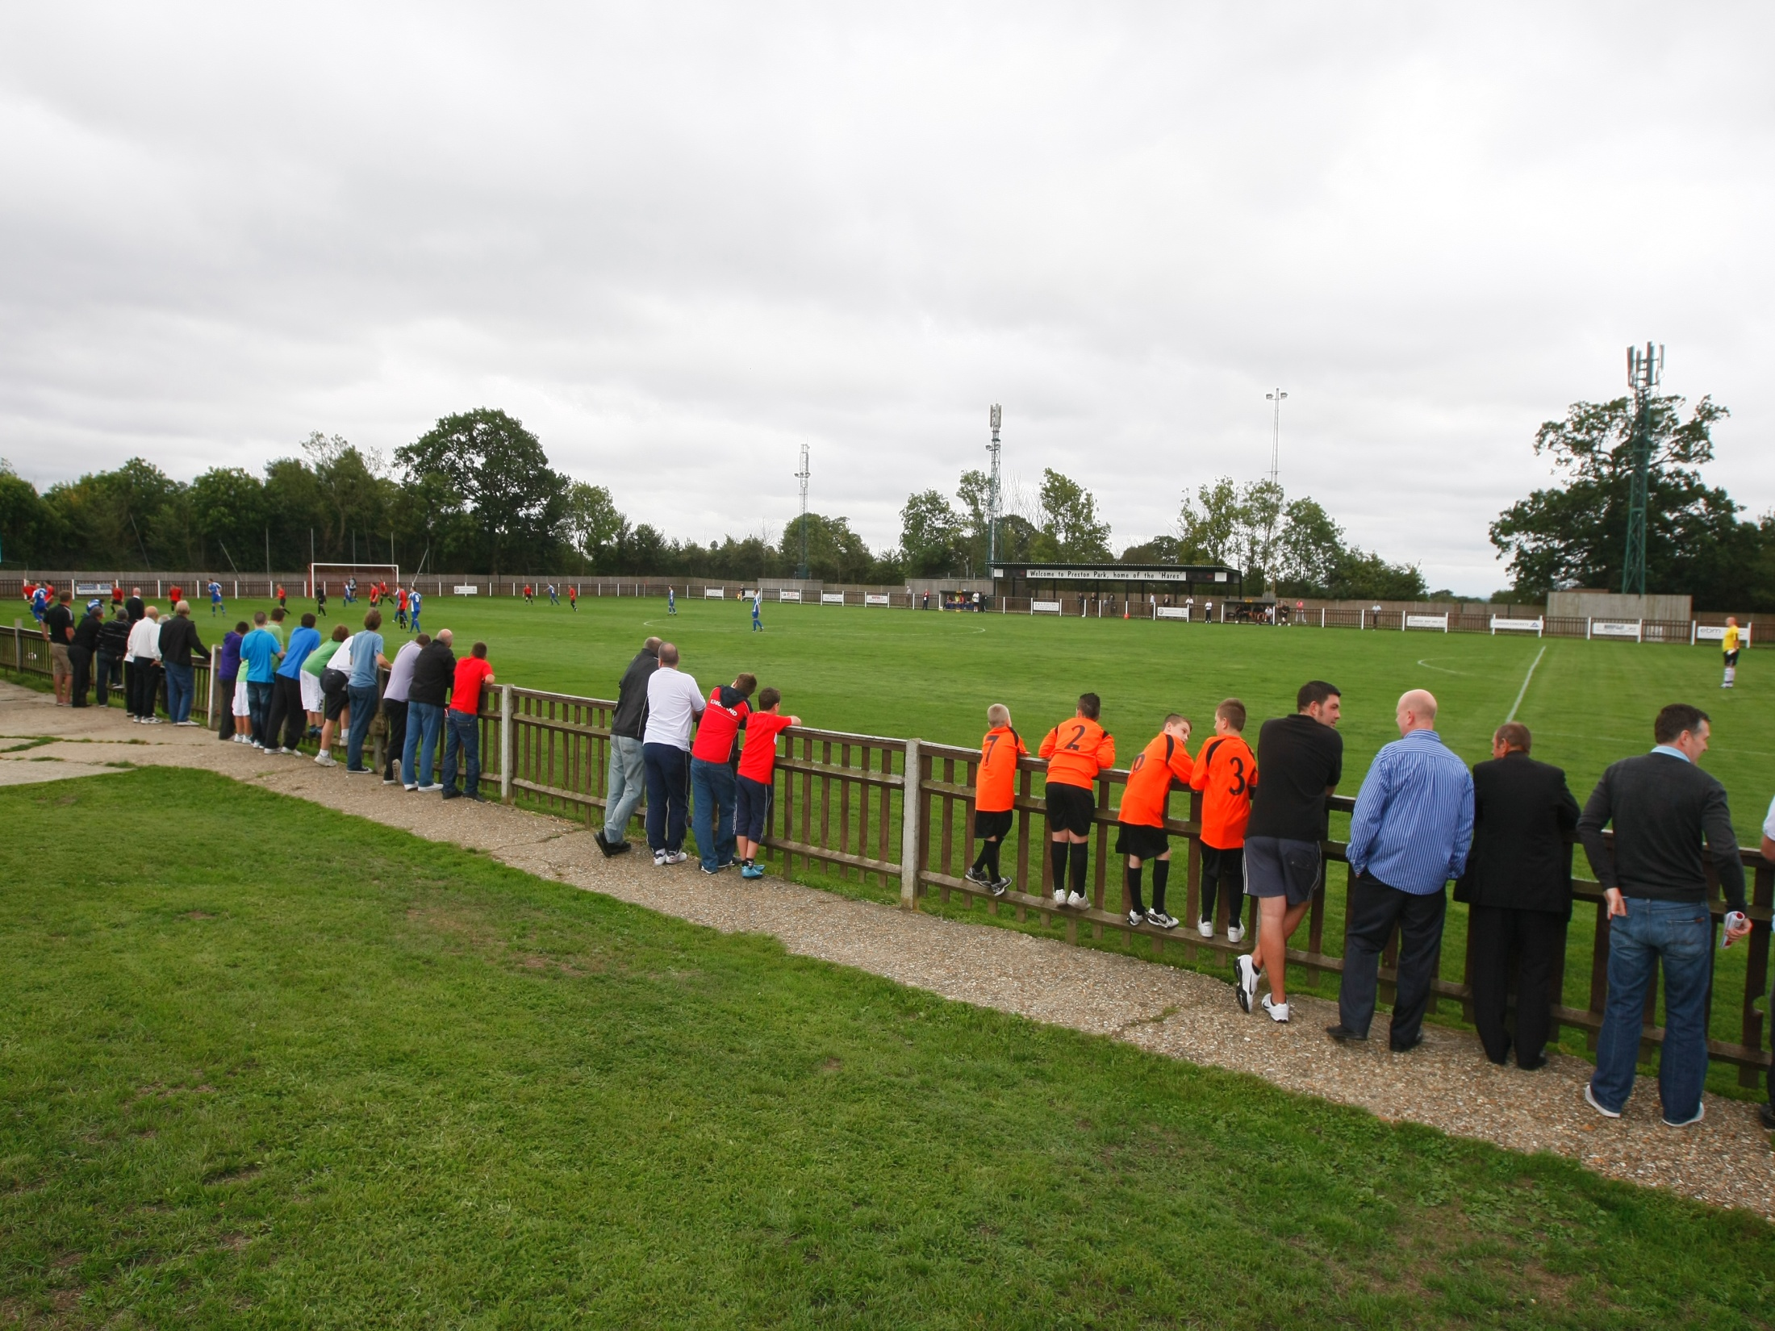
Setting up a Club Best Practice Guide

Slide 2
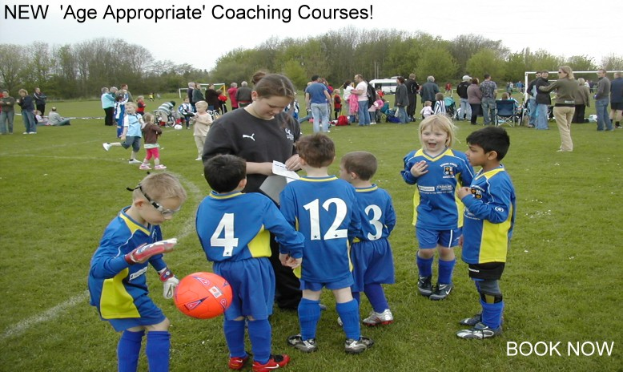
Setting up a Club Introduction
All clubs must affiliate to their respective County Football Association (Durham County FA)
Affiliation provides quality assurance, helping to protect players, clubs, officials and administrators throughout the game.
Contents
Setting up a Club – The easy to follow Flow Diagram
Yearly Timetable / Timeline
County FA Contacts
FA Youth Development Review
Useful Downloads
FA England Football Accreditation Programme
By following these simple guidelines you should be in a position to have your new club up and running in no time.

Slide 3
Setting up a Club Flow Diagram
Players
Do you have enough players to start a team? Do you have a Club Name? The name you select should be unique to the individual club; The Durham County FA will not permit a club to use the same or similar name as another club that is already affiliated as this may lead to confusion.
Volunteers
Do you have enough volunteers to cover club organisation and administration? For a committee you will need a minimum of a Chairman, Secretary, and Treasurer. If a Youth Club (U18’s and below) then a Welfare Officer must also be in place.
Bank Account
This will need to be in the clubs name and have a minimum of two signatories one of which must be the treasurer of the club.
Visit DCFA website www.DurhamFA.com for information on Club Rules, Codes of Conduct and Safeguarding/Welfare – use the downloads available to you.
All volunteers who have direct access to youth players must have an in date valid FA DBS Check.
Leagues
You will need to apply for a place in a league before you affiliate to a County FA.
Costs
Before you affiliate to the County FA, or league it is advisable that you create a list of costs that will help you budget for fees eg for affiliation and pitch hire that are paid out at the beginning of the season. The main income for clubs at the start is from subscriptions and membership fees.
Facility
Before applying to a league you may need to have a home ground, without this you may not be able to register in a league. This can be a local authority or school pitch, if you don’t have access to a privately owned one.

Slide 4
Setting up a Club Flow Diagram
Affiliation
Affiliation forms can be downloaded from the Durham County FA website (www.DurhamFA.com), or requested from the county offices from the Football Services Team. As part of your affiliation to the CFA you get public liability insurance plus Player Personal Insurance. If there is a County Cup competition for your age group you may want to enter it. Allocation of County Cups within the Open age bracket (*4 below) is dependent on what division your team plays in.
Kit & Equipment
Before the start of the season you will need to purchase suitable kit and equipment. The necessary equipment will include football playing strip, first aid kit, corner flags, balls and nets.
Funding & Fundraising
It will be important to raise funds quickly to cover the essential expenditure such as affiliation fees, league membership fee, pitch hire charges and kit. The treasurer will need to keep an accurate account of income and expenditure and feedback to the club committee at the General meeting. Funds can be raised by accessing numerous grants and funding schemes and for more information about those that are on the Durham County FA website Click Here.
Workforce Development
Essential information about volunteer recruitment can be found in the Safeguarding and Welfare page of the Durham County FA website Click Here. The club will then need to get volunteers qualified for their roles within the club please visit the FA Education Programme by Clicking Here.
Once you have established roles within your club and got yourselves up and running you should think about applying to become an FA Charter Standard Accredited Club. The FA Charter Standard Accreditation is about recognising and rewarding clubs who are organised and provide Best Practice environment for all of their members. For further information about The FA England Football Accreditation please Click Here.
FA England Football Accreditation

Slide 5
Setting up a Club Timeline / Time Table
Pre- Season
1. Players – Ensure that you have the right amount of players for your squad. Make sure all players are registered – Click Here for Club Membership Form
2. League – Ensure that you have a place in the correct age group of your preferred League
3. Affiliation - Complete and forward Affiliation Form and Club rules to the Governance Department of Durham County FA. This also then applies to the league when you register with them.
A downloadable template for Club Rules is available – Click Here
4. Facilities – Arrange pitches and training facilities.
5. Meetings – Ensure that you schedule regular club meetings to deal with club business and any issues that may arise.
6. Registration – Ensure that all players are registered with the appropriate league. Usually up to date passport type photographs are required.
7. Equipment – Purchase new equipment where necessary, ensuring that there is enough for all teams. Ensure that correct size footballs are used and you abide by specific League rules
Ball Sizes U7 to U10 = Size 3 U11 to U14 Size 4 U15+ = Size 5 8. Subscription and Fundraising – Set a subscription rate for players and members to ensure club running costs are met and ensure that accurate records are kept of all income and expenditure.
9. Delegation – Club Secretaries/ Team Managers should seek support from other members to spread the administration work load where necessary, though the Club Secretary will always retain overall control of club administration. ALL correspondence to the County FA should come through the Club Secretary 10. Respect - Getting everyone signed-up to their respective Code of Conduct.
Make everyone aware of the Respect Codes of Conduct relating to their age-group and get players, managers/coaches, welfare officer’s, club officials and Parent/Carers signed-up.

Slide 6
Setting up a Club Timeline / Time Table
Before Match Day
10. Confirm the Fixture according to the League rules – This should include the following; ‘Kick off’ time, kit colours, directions to ground, availability of the pitch and confirm Match Officials
Match Day
11. Pitch – Ensure that the pitch is correctly prepared with nets, flags, markings and access to changing facilities and toilets. Provide Designated Spectator Area’s.
12. Match Officials – If you are the home team (except in certain competitions) ensure that the Match Officials have been paid, get signed receipts to confirm payments.
13. Registration Cards – Ensure that these are exchanged and checked as per the League rules. 14. Match Result – Ensure that the result card is completed and sent as directed by the County/League/ Competition as stated in the rules. In some cases the home team may have to also phone in the result on the match day by a certain time.
Each League is different so please ensure that you read your League rules .
Post Season
15. Annual General Meeting – arrange AGM which includes presentation of accounts, review of season and preparation for Club Presentation Evening.
* Respect Leagues – All clubs registered with leagues who have signed up to The FA Respect Programme must adhere to;
Designated Spectator Area’s: i.e. the use of tape, roped stakes, marking cones or spray paint, to mark specific areas, all of these must be marked at least 2 meters away from the touchline.

Slide 7
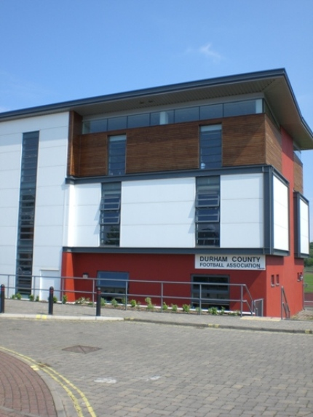
Setting up a Club Durham County FA Contact Details
Football Services Department Should you need any support regarding affiliating your team or club please contact the Football Services team. Football Services Contacts Tel: 0191 3872929 Fax: 0191 3872919 Email: Info@DurhamFA.com or Discipline@DurhamFA.com Website: www.DurhamFA.com
County FA Designated Safeguarding Officer The County FA employ a full time Welfare Officer to offer clubs and volunteers advice and guidance on all welfare and safeguarding issues. Daniel Taylor Tel: 0191 3872929 Email: Daniel.Taylor@DurhamFA.com
Referee Development Officer The County FA employ a full time Referee Development Officer to support the recruitment, retention and development of referees. Sebastian stockbridge Tel: 0191 3872929 Email: Sebastian.Stockbridge@durhamfa.com Football Development
The County FA employ Development Officers who will be pleased to advise Clubs regarding any Developmental issue, including FA Coaching Courses, Funding and Investment, FA Charter Standard Accreditation, Volunteer Development and a Specific Officer is also in place for Women and Girls and Disability Football.
Development Contacts:
Tel: 0191 3872928
Fax: 0191 3872919
Email: Development@DurhamFA.com
Website: www.DurhamFA.com
Office address Durham County Football Association,
Codeslaw,
Riverside South,
Chester-le-Street,
County Durham
DH3 3SJ

Slide 8
Setting up a Club Essential Downloads
Policies and Procedures
Club Safeguarding Children Policy Template
Safeguarding Policies and Procedures
Anti-Bullying Template
Advice and Support
Advice and Support for individuals receiving a disclosure
Advice and Support for those who have experienced abuse
Information for those against whom a complaint of poor practice has been made
Celebrating Football through photographs and video
Choosing a Club for your Child
Stay Safe, Have Fun
Changing Rooms and Showers Best Practice Guidance
Safe Recruitment
Appointing a Club Welfare Officer
Roles & Responsibilities of a Youth League Welfare Officer
Volunteer Reference Form
Selection of Volunteers
Trips and Tournaments
Club Membership and Consent form
Club Risk Assessment form
Sample Risk Assessment form for a minibus
Event Registration form – for photo’s and/or video
Events Specific Consent form
Emergency Procedures guidance form
Trips & Travel Tips
Safe Away cards
Social Networking sites/club websites/club communications with players/referees etc
Social networking, websites, mobile phone and email communications
Running a Website - Do’s and Don’ts
Responsible use of social networking sites
Communicating responsibly with Young Leaders, Coaches and Referees U18
Using Texts and Emails with U18s - Do’s and Don’ts
Guidance for parents/carers
Guidance for U18s

Slide 9
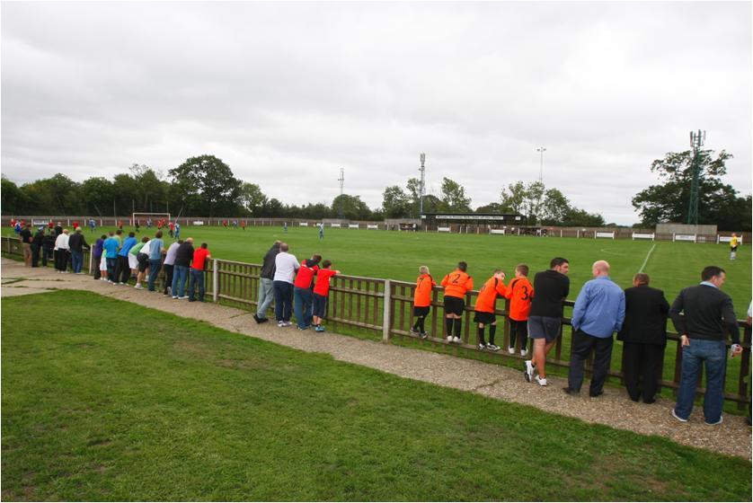
Setting up a Club FA England Football Accredited Club Programme
The FA England Football Accreditation is a best practice guide that sets standards of coaching, administration and safeguarding children for all clubs outside the Football League and Premier League.
As a benchmark for quality, it will improve the playing experience for all. It also recognises the club’s commitment to coaching, player and coach development and the raising of standards of behaviour in the game.
For further information about the FA England Football Accreditation please Click Here.

Slide 10
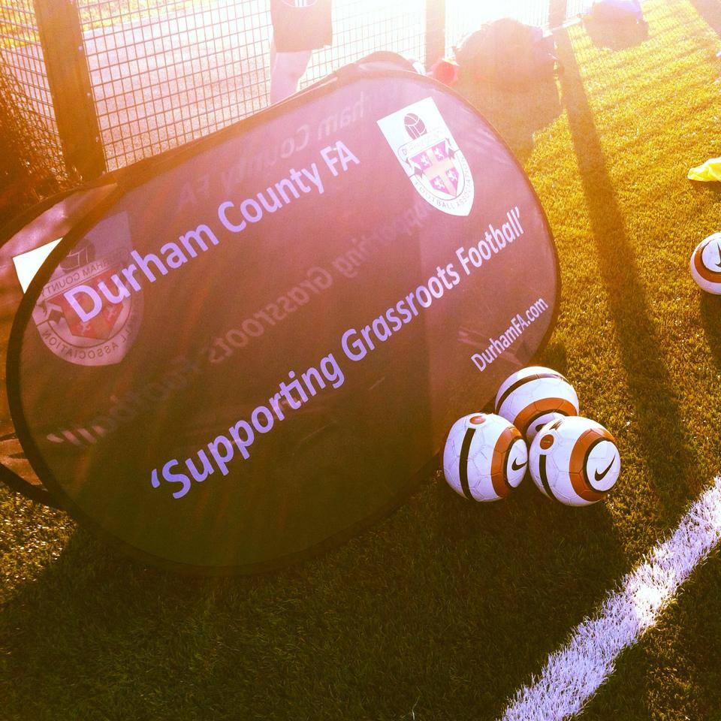
Durham County Football Association Ltd ‘Codeslaw’ Riverside South Chester-le-Street Co Durham DH3 3SJ Tel: 0191 3872928 Email: Development@DurhamFA.com Web: www.DurhamFA.com

