Slide 1
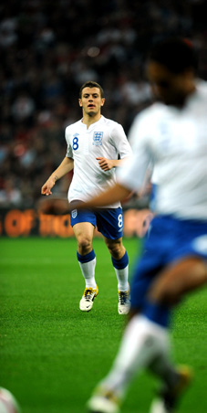
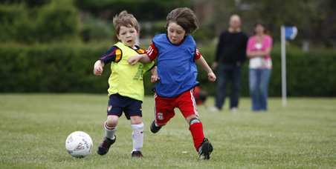
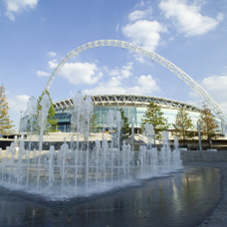
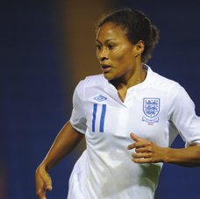
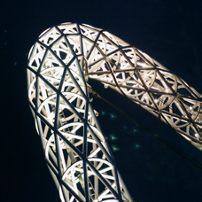
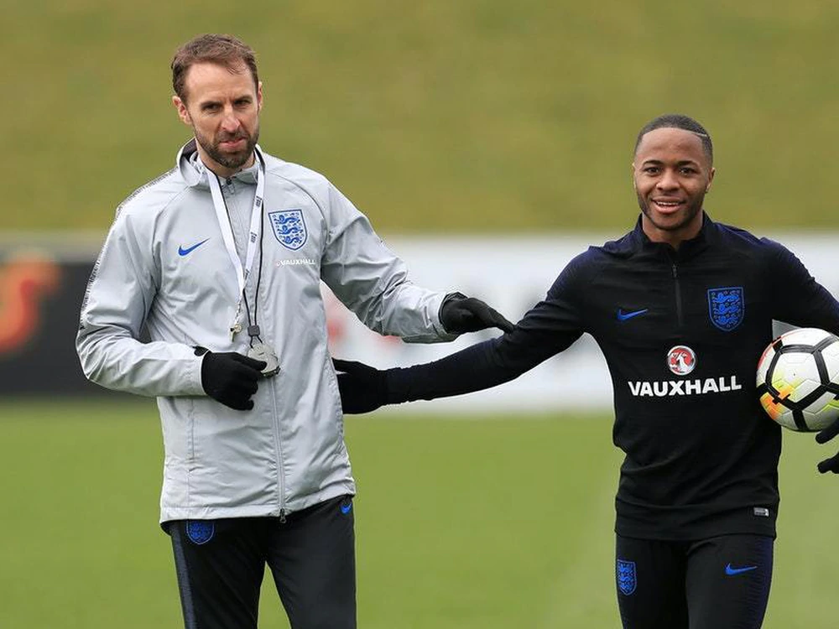
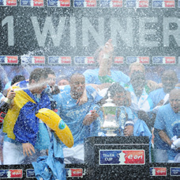
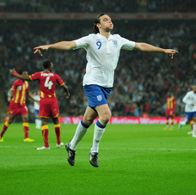
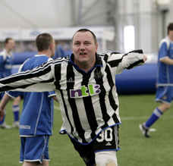
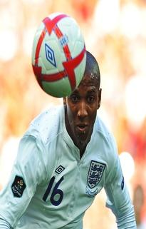
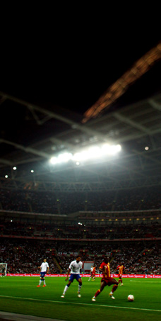
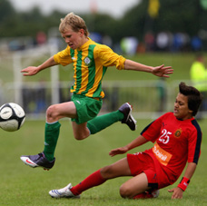
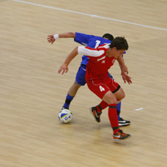
???? FC Football Development Plan Seasons 20?? - 20??

Slide 2
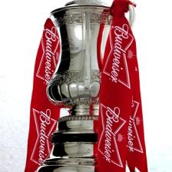
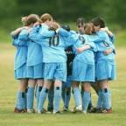
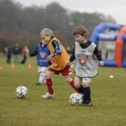
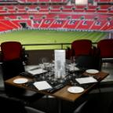
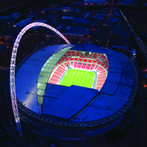
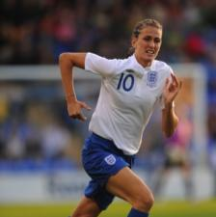
Contents
Our Vision
Growth and Retention
Raising Standards
Better Players
Running the Game
Workforce
Facilities
Promotion

Slide 3
Our Vision
Contents
Our vision is to build a Club that provides first class football training facilities and playing opportunities for current and future generations in the ????? and surrounding areas.
To provide quality, safe opportunities for young people of all ages in our community
To provide a safe and positive alternative place to go other than playing on the streets
To help people realise their potential, develop personal skills and confidence as well as promoting respect.
To introduce people to football regardless of age, ability, sex, religion and ethnic background
To improve the performance of players, coaches and volunteers within the Club through coaching, training and mentoring.

Slide 4
Our History – The Club was formed in ??? and achieved charter standard status in ???. Season 20??/?? sees the club affiliate ?? teams with Durham FA
Contents
Our Philosophy - ????? follows the FA England DNA playing philosophy which outlines an overarching vision for the English game.
We endeavor to put in place Specialist age-appropriate coaches for each team who concentrate on development, fun friends and family and promote respect and the Club values in everything we aim to achieve and do.
We promote equal playing time with a proviso that every player in a team will get 50% game time to allow everyone to develop.
????? have a coaching philosophy document available to everyone in the club which is attached to this application and available to view on the club website.
Notes:
It’s a positive move for a club to have a philosophy (identity) which runs through the club and adopted by all teams within the club. This philosophy should be how the club believes children should develop, the environment which the children play, how the children should play (for example is it win at all costs long ball from back to front as quickly as possible or is it the players are children and should play in an environment free from pressure of making mistakes, mistakes will happen and learning will take place in a fun enjoyable environment) the philosophy will be clear to all and shared with everyone within the club. What is success??? Is it winning the league or maintaining a group of players that would normally have left the game??

Slide 5
Our Achievements
Contents
Club Growth!
We have increased our numbers in mini soccer to now have multiple teams in ages U7s to U10s.
We are working closely with Durham FA to start women's and girls teams
We have increased teams numbers in last two seasons from ?? to ?? teams currently playing in the club.
The People Factor!
Talent, enthusiastic and qualified volunteer workforce
Stable and progressive Executive Committee
Investment in young people to become coaches and referees

Slide 6
Our Achievements
Contents
Facility
We currently Provide our members with first class training facilities which include 3g pitches at ?????.
We also have plans in place to secure land for multiple pitches and build a clubhouse with financial backing, fundraising ourselves and grants from various sources.
Recognition
We have charter standard status and retain this yearly via the health check.
Our Club is now being recognised and rewarded with increased numbers and a lot more applications to join us.
Notes:
Recognition is not just trophies but awards for the good work carried out by the club and it’s volunteers, these can be from the County FA, The FA, Local Authority etc.

Slide 7
Club Development Table (Example! Make it realistic of how your club will grow year by year)
Current |  |  | 20??/?? |  |  | 20??/20?? |  |  | 20??/20?? |  |  | 20??/20?? |  |  | 20??/20??
Number of Teams = ?? M=Male FM= Female Dis= Disability |  |  | ?? |  |  | ?? |  |  | ?? |  |  | ?? |  |  | ??
M | FM | Dis | M | FM | Dis | M | FM | Dis | M | FM | Dis | M | FM | Dis | M | FM | Dis
??xU8 ??xU9 ??x10 ??xU11 ??xU12 ??xU13 ??xU14 ??xU15 ??xU16 ??xU17 | 0 | 0 | 1xU7 1xU8 3xU9 2x10 2xU11 4xU12 1xU13 2xU14 1xU15 1xU16 1xU17 | 0 | 0 | 2xU7 1xU8 1xU9 3xU10 2xU11 2xU12 3xU13 1xU14 2xU15 1xU16 1xU17 1xU18 | 1xU9 | 0 | 2xU7 2xU8 1xU9 1x10 3xU11 2xU12 2xU13 3xU14 1xU15 2xU16 1xU17 1xU18 1xU19 | 1xU9 1xU11 | Junior | 2xU7 2xU8 2xU9 1x10 1xU11 3xU12 2xU13 2xU14 2xU15 2xU16 1xU17 1xU18 1xU19 1xU23 | 1xU9 1xU11 1xU13 | Junior | 2xU7 2xU8 2xU9 2Ux10 1xU11 1xU12 2xU13 2xU14 2xU15 2xU16 1xU17 1xU18 1xU19 1xU23 Adult | 1xU9 1xU11 1xU13 1xU15 | Junior x 2 Adult
Notes:
Clearly state the current ages groups you have, if you have multiple teams in 1 age group state them too, if a club has U18’s can they develop them to U23s?? This will help the transition from youth to senior football for many players who are physically not ready for senior football.

Slide 8
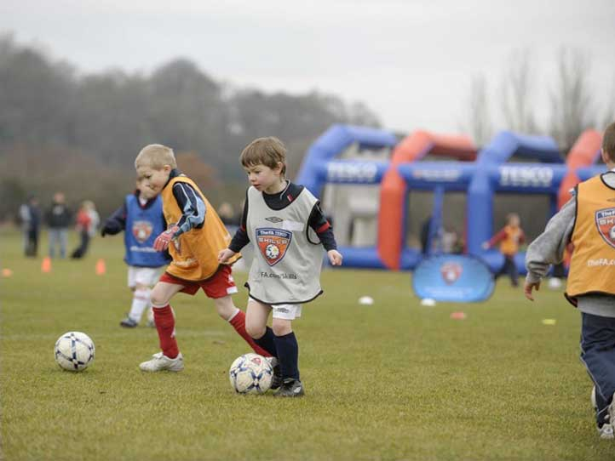
Growth and Retention

Slide 9
Growth and Retention
Contents
Aim | To provide opportunities for people of all ages and abilities to play football
Objective | Achievement targets | Timescale | Responsibility | Cost
1. Retain all existing teams Retain a good level of support to existing teams, Including Quarterly Team Manager and Coaches meetings to include a review of squad numbers | All existing teams retained | Year ? and annually after that. | Club Committee Head coach Team Managers | Normal running costs associated with those teams already in place.
2. Develop weekly introductory Coaching Sessions for 5-7 year old. New teams to be created from players attending these sessions. New Coaches to be identified from parents attending | ?? Kids attending 5-6 age group ?? Kids attending 6-7 age group | Next season and annually each season thereafter. | Club Committee Head coach Team Managers | Players pay £?? Per session
2. Back fill with ? new U7 teams each year through recruiting new players, coaches and managers. | ? new U 7s teams each year | Next season and annually each season thereafter. | Club Committee Head coach Team Managers | £300 per team
4. Develop a close link with Schools in the local area. Work with ? focus primary schools to recruit new players to squads where appropriate | Coaching sessions in the schools to promote the club | Year ? and annually | Head coach Championship sports (who have a link into schools) | Free
5. a) Develop ?? teams in each age group for mini soccer B) Develop an Under 15s & 16s team so w e have opportunities in every age group | U15S Boys team U16s boys team | Year ? and annual retention | Club Committee Head coach Team Managers (Appointment of a head of girls football) | £500 per team
Notes:
Think a head to what teams you plan to set up over the duration of the plan, are you “back filling” each year and setting up at the younger age group or are there gaps in the age groups which you plan to fill? It’s important to add which age groups you plan to create and what format they will play. Also how you will go about setting the teams up, where will the players/volunteers come from? Are you using any schools? Etc.

Slide 10
Growth and Retention
Contents
Aim | To provide opportunities for people of all ages and abilities to play football
Objective | Achievement targets | Timescale | Responsibility | Cost
6. Ensure all youth players have a realistic pathway to continue playing open age football. Develop a new second Senior Men's team and retain each year. Develop a new Senior Women’s team and retain each Year. | Multiple adults teams either in 11 aside or 5-a-side football. | Year ? | Club Committee Head coach Team Managers | £? for senior women's team
7. Develop a men's over 35s team to allow senior players to stay in the sport. | Over 35s team | Year ? | Club Committee Head coach Team Managers | £? for seniors team
8. To provide first class playing and social facilities to accommodate all the new members including children, adults, women's football and disability football. | Home ground with multiple pitches and club house facilities with social areas. | Year ? | Club Committee Head coach Team Managers
9. Set up a junior disability teams through making links with local disability organisations and schools Develop a new U??s disability team and retain each year | Junior disability team | Year ? | Club Committee Head coach Team Managers | £? for kit and equipment
10. Set up an adult disability team through making links with local disability organisations and support from the DFA Disability Development Officer to develop new adult disability team and retain each year | Adult disability team | Year ? | Club Committee Head coach Team Managers | £? for kit and equipment
Notes:
Think a head to what teams you plan to set up over the duration of the plan, are you “back filling” each year and setting up at the younger age group or are there gaps in the age groups which you plan to fill? It’s important to add which age groups you plan to create and what format they will play. Also how you will go about setting the teams up, where will the players/volunteers come from? Are you using any schools? Etc.

Slide 11
Growth and Retention
Contents
Aim | To provide opportunities for people of all ages and abilities to play football
Objective | Achievement targets | Timescale | Responsibility | Cost
11. Utilise FA Initiatives to recruit new players. For example the ‘Wild Cats’ programme aimed at recruit female players | Programme delivered. ? number of new players/teams join the Clubs | Year ? | Club Committee Head coach Team Managers | ?
12. Work with County FA Women’s & Girls Development Officer to develop a new girls and women's football teams each season targeting age ranges u8s to u 18s in first two years. Aim to create a Full Player Pathway for Female Football U8’s – Open Age. | A new girls/women’s football team each season as a minimum | Each season and annually there after. | Club Committee Head coach Team Managers (Appointment of a head of girls football) | £? per team
13. Offer recreational playing opportunities for members. Female sessions for player mams. Male sessions for players dads. Walking Football sessions for players grand parents. | Sessions available for parents to participate in whilst their child trains | Year ? | Club Committee Head coach Team Managers | attendees pay £?? Per session
Notes:
Think a head to what teams you plan to set up over the duration of the plan, are you “back filling” each year and setting up at the younger age group or are there gaps in the age groups which you plan to fill? It’s important to add which age groups you plan to create and what format they will play. Also how you will go about setting the teams up, where will the players/volunteers come from? Are you using any schools? Etc.

Slide 12
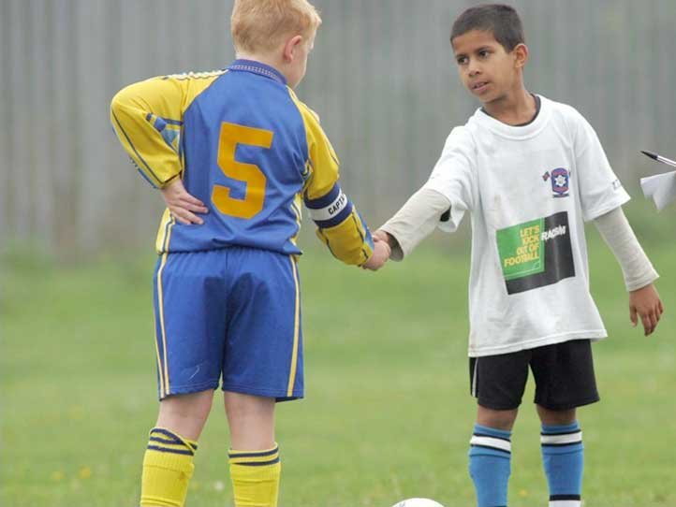
Raising Standards and Addressing Abusive Behaviour

Slide 13
Raising Standards and Addressing Abusive Behaviour
Contents
Aim | To ensure that all people can play football in a high quality, safe environment that is free from abuse
Objective | Achievement targets | Timescale | Responsibility | Cost
1. To Retain and achieve the FA community club standard and retain each year by completing the annual health check | FA Charter Standard Community accreditation achieved. | Year ? and annually | Secretary | ?
2. To follow all FA guidelines and procedures regarding Club Welfare and work with the county FA to ensure Club Welfare Officer receives up to date training and support. | All FA guidelines and procedures followed. | Year ? and annually thereafter | Club Welfare officer. | ?
3. To work with County FA to ensure Club Welfare Officers receive up to date training and support Club Welfare Officer to attend Welfare Officers workshop | Workshop attended . | Year ? | Club Welfare officers | ?
4. To increase the number of Welfare Officers the club has as teams and members increase | 1 Welfare Officer to 10 teams. | Year ? | Secretary Club Welfare officers | ?
5. Fully support the FA RESPECT PROGRAMME Through briefings and visibility of the respect logos and promotional material. | Regular agenda item on meetings. All teams to have respect captains armbands and logos on the sleeves. Respect barriers and posters to be used around the pitches and club house when built. | Year ? and annually thereafter | Secretary Club Welfare officers Team Managers | ?
Notes:
How does your club plan to tackle poor standards and behaviour both on the pitch and touchline?? What ideas do you have to change the mindset of the adults?? Everyone involved in the game is entitled to an enjoyable environment free from abuse and intimidation, especially the young children.

Slide 14
Raising Standards and Addressing Abusive Behaviour
Contents
Aim | To ensure that all people can play football in a high quality, safe environment that is free from abuse
Objective | Achievement targets | Timescale | Responsibility | Cost
6. Fully support the FA RESPECT programme through all the players and members . Every player, parent and coach to sign the ‘Code of Conduct’ and display latest versions in Clubhouse Zero tolerance of abuse towards referees Work with County FA | Reduce number of incidents of abuse towards referees and deal with all matters firmly and in line with FA recommended sanctions. | Year ? and annually | Club committee Team managers Parents Introduce respect Marshalls by year 2 | Nil
7. Attend County FA Club Support Workshops & Meetings. Request programme from CFA and nominate | Minimum of two workshops per year. | Year ? and annually | Club Committee | NIL
8. Organise a volunteer and player awards evening Set up an organising committee. Seek recognition for hard work of all volunteers | Annual volunteer and player awards evening 1 awards application per season. | Year ? and annually | Club Committee | £?
9. Organise a pre-season briefing for players and parents/carers at the start of each season detailing acceptable standards of behaviour. | One pre season meeting per year. | Year ? and annually | Club Committee | Nil
Notes:
How does your club plan to tackle poor standards and behaviour both on the pitch and touchline?? What ideas do you have to change the mindset of the adults?? Everyone involved in the game is entitled to an enjoyable environment free from abuse and intimidation, especially the young children.

Slide 15
Raising Standards and Addressing Abusive Behaviour
Contents
Aim | To ensure that all people can play football in a high quality, safe environment that is free from abuse
Objective | Achievement targets | Timescale | Responsibility | Cost
9. Any Volunteer looking to get involved with the Club (To work with children) must be passed on to the CWO and have an FA DBS check carried out by the FA and can not carry out any activity with the team until this has returned from the FA as accepted. | Every person involved with Teams have an up to date FA DBS Check. | Year ? and annually | ? | ?
10. Club Committee Members regularly visit training and games to ensure those involved are the correct Club Volunteers who have the necessary accreditations in place. |  | Year ? and annually | ? | ?
11. Club will set up a committee to deal with in house issues involving Parents & Coaches. | In house issues dealt with internally by Club Committee. | Year ? and annually | ? | ?
12. Managers & Coaches will be responsible for the behaviour of parents & spectators involved with their team. | Managers & Coaches to promote good behaviour inline with Clubs Codes of Conducts at training and matches throughout the season. | Year ? and annually | ? | ?
Notes:
How does your club plan to tackle poor standards and behaviour both on the pitch and touchline?? What ideas do you have to change the mindset of the adults?? Everyone involved in the game is entitled to an enjoyable environment free from abuse and intimidation, especially the young children.

Slide 16
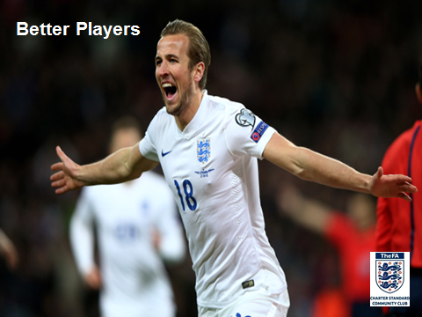
Better Players
Notes:
16

Slide 17
Better Players
Contents
Aim | To raise the standards of players within the club To support the development of coaches to create better players
Objective | Achievement targets | Timescale | Responsibility | Cost
1. Run weekly coaching sessions for all mini soccer players U7s to U10s. | ? kids currently being coached on a weekly basis in this age group. | Year ? and annually . | Cum Committee Team Managers Head of football | n/a
2. To identify older players in the Club from U17s up over as future young leaders. Also to sign post interested volunteers aged 14+ to the DFA Young leaders programme via the DFA. | Two per year. | Year ? and annually. | Head coach Committee Team Managers | £? per year
3. Run holiday coaching courses for 5-11s. | 5-11s engaged in holiday coaching Sessions. Over 11s also engaged in separate session. | Year ? and annually. | Head coach | n/a
4. Coaches to promote basics skill development training and coaching exercises to the parents/carers of players to increase practice time at home. | 2 meetings a year with parents. | Year ? then maintained annually. | Team managers Head of Football | N/A
Notes:
What methods/ideas do you have in mind to improve the players? E.g. club has a coach coordinator who spends a period of time with each age group and passes on new ideas to the coaches? If the club has multiple teams at 1 age group do they train together from time to time? Or for example does the U11’s spend a few weeks training with the U12’s?

Slide 18
Better Players
Contents
Aim | To raise the standards of players within the club To support the development of coaches to create better players
Objective | Achievement targets | Timescale | Responsibility | Cost
5. Run a transition festival in May each year to give players moving from 7 a side to 9/11 a side the experience of the wider format of the game. | 1 transition festival run in May each year for new U9s and U11s. | Year ? and annually. | Head coach Committee | Nil
6. Run 5 a side and 7 aside festivals across all age groups 12 - 17s to promote the benefits of small sided play supporting skill development at the end of each season. | 5 a side and 7 aside festivals to be organised for all age groups. | Year ? and annually. | Head coach Committee | Nil
7. To have multiple teams in each group which allows players the opportunity to play for a team that matches and pushes his/her ability and skill levels up. | Multiple teams in place from U7 to Under 12. Build from bottom up to continue this. | By the end of year ? to have multiple teams from U7 to U 18s plus adult first and reserve teams. | Committee Head coach | Nil
8 Increase the number of Level 2 Qualified Coaches in the Club to ?? | Number of coaches trained = ?? Each season. | Year ? and annually. | Committee head coach | £?? per Coach
Notes:
What methods/ideas do you have in mind to improve the players? E.g. club has a coach coordinator who spends a period of time with each age group and passes on new ideas to the coaches? If the club has multiple teams at 1 age group do they train together from time to time? Or for example does the U11’s spend a few weeks training with the U12’s?

Slide 19
Better Players
Contents
Aim | To raise the standards of players within the club To support the development of coaches to create better players
Objective | Achievement targets | Timescale | Responsibility | Cost
9. 25% of our coaches to have attained the FA goalkeeping level 1 certificate. | ?? Coaches trained per season. | Year ? and annually | Committee Head coach | £?
10. Increase number of Coaches attending Futsal Level 1 Training. | ?? Coaches trained per season.
11. To identify older players in the Club from U17s up over as future young leaders and attain the FA Certificate. Also to sign post interested volunteers aged 14+ to the DFA Young leaders programme via Tina reed at the FA. | ? Players identified per year | Year ? and annually | Head coach Committee Team Managers | £?
Notes:
What methods/ideas do you have in mind to improve the players? E.g. club has a coach coordinator who spends a period of time with each age group and passes on new ideas to the coaches? If the club has multiple teams at 1 age group do they train together from time to time? Or for example does the U11’s spend a few weeks training with the U12’s?

Slide 20
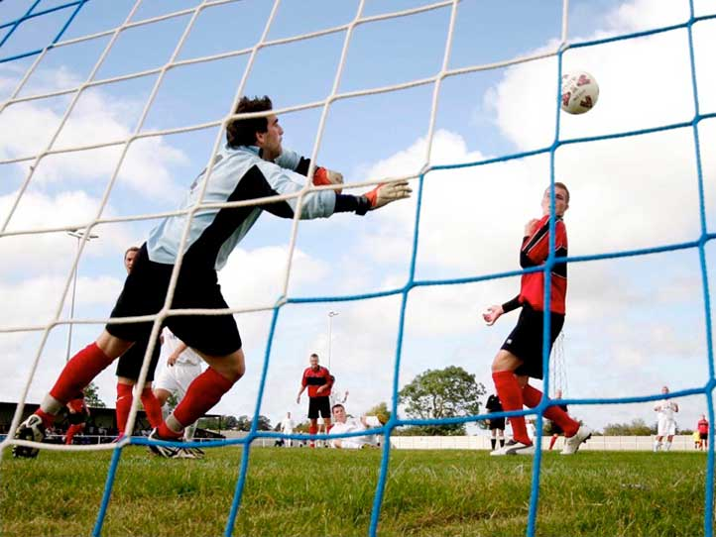
Running the Game

Slide 21
Running the Game
Contents
Aim | To ensure the club is managed and run effectively in accordance with FA guidelines To provide structure, management and leadership to successfully deliver a football development plan
Objective | Achievement targets | Timescale | Responsibility | Cost
1. Form a Football Development Committee to manage, monitor and deliver the Football Development Plan. Committee formed from representatives of junior, seniors, women and girls, disability and coaches as each section is developed. | Committee formed and meets on a regular basis. To be added to as club grows/develops. | Year ? and annually | Secretary, chairperson and head coach . | ?
2. All teams affiliated with CFA by 1st July every year and entered into the appropriate leagues. Secretary to submit paper work to CFA and maintain charter status. | All teams affiliated | Year ? an annually | Secretary | Affiliation costs only.
3. Keep all football records up to date with the County FA using the FA Whole Game System (WGS). | All records up to date | Year ? and ongoing process | Secretary | ?
4. Set up a coaches support group to offer help and guidance, Invite all coaches and Team Managers to a network meeting to discuss issues such as coaching methods and squad team numbers | Group established | Year ? and quarterly meetings thereafter | Football development committee, secretary and head coach. | ?
Notes:
What administration methods does the club plan to use to improve the running of the club? What’s the communication like between the teams. How easy is it to communicate with all the coaches? Etc.

Slide 22
Running the Game
Contents
Aim | To ensure the club is managed and run effectively in accordance with FA guidelines To provide structure, management and leadership to successfully deliver a football development plan
Objective | Achievement targets | Timescale | Responsibility | Cost
5. Improve communications between club and its team managers/coaches by having volunteers register including tel no and email address. | Managers/coaches register established and issued to all committee members. | Year ? and annually | Secretary, | ?
6. Improve communication between club and its members and parents with a fully updated contact list including telephone and email addresses. | Club Register established | Year ? an annually | Secretary | ?
7. To provide all new managers with guidance and support when joining the club in terms of coaching and admin. | All new managers supported by head coach for coaching and secretary for admin. Guidance documents given out. | Year ? and ongoing process | Secretary & head coach | ?
8. To make all club documents easily available for all members to assist in the smooth running of the club and have clear guidance on how the club is run. | All documents are available on the club website for download or reading. | Year ? and quarterly meetings thereafter | Football development committee, secretary and head coach. | ?
9. To maintain regular executive committee/ managers and parents meetings within the club. | Regular meetings held and documented | Year ? and annually | Secretary | ?
10. Create an Emergency Reserve Fund which will cover 6-12 Months of running costs in the event of unforeseen circumstances (i.e. COVID-19) Club to set % of annual income to set aside over ? of months/years. | ?% of annual income to be set aside to ensure committed outgoings such as facility hire contracts can be honoured. | By year ? | Club Committee & Treasurer
Notes:
What administration methods does the club plan to use to improve the running of the club? What’s the communication like between the teams. How easy is it to communicate with all the coaches? Etc.

Slide 23
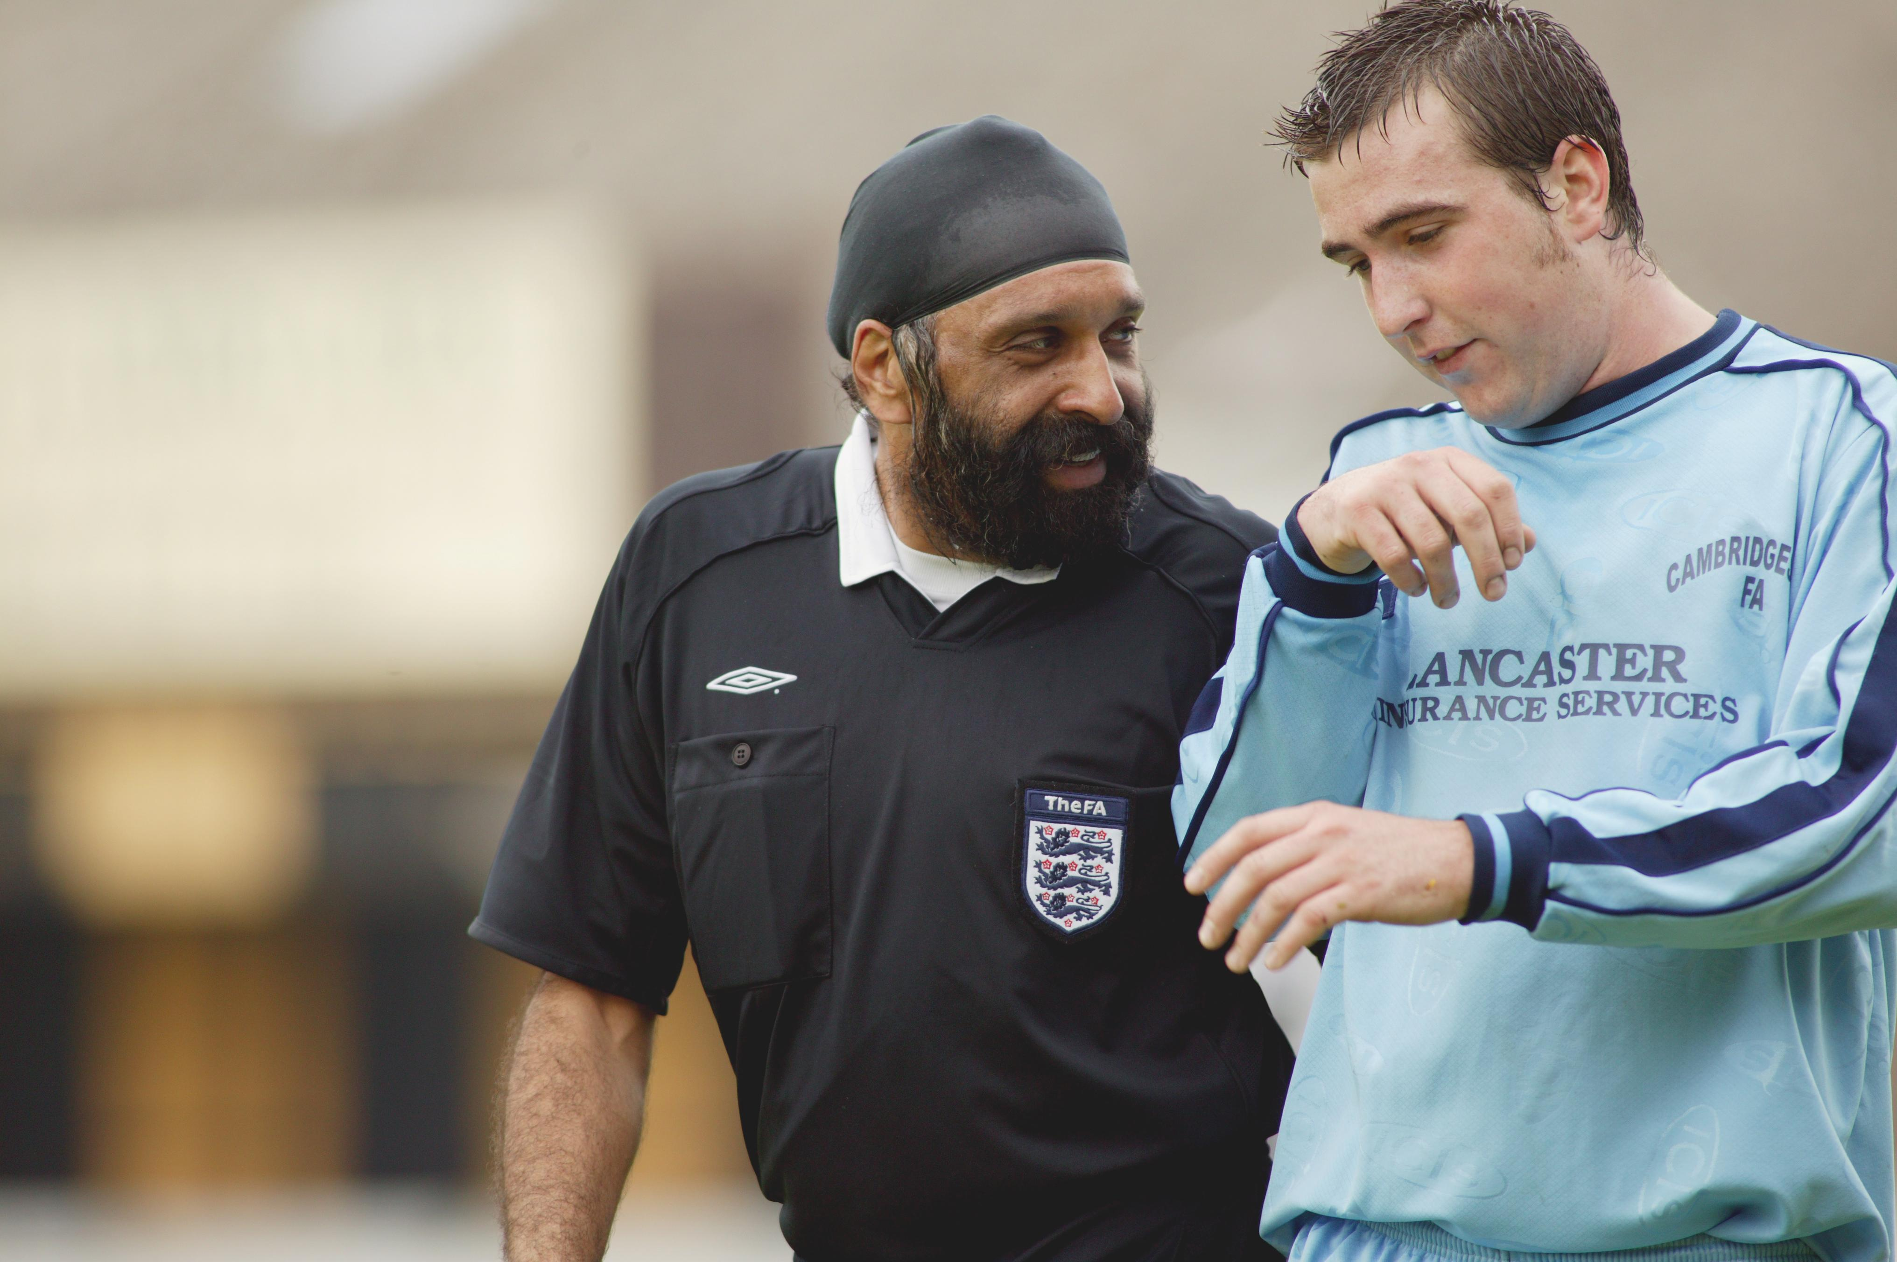
Workforce Development

Slide 24
Workforce Development
Contents
Aim | To create, develop and support an effective volunteer workforce within the club
Objective | Achievement targets | Timescale | Responsibility | Cost
1. Have a key contact person to support the recruitment and development of volunteers. Recruit and select a Volunteer Coordinator | Role currently carried out by club welfare officer but as we grow new role to be created. | Year ? | Management committee | ?
2. All Club coaches to hold a minimum of FA Level 1and FA DBS check. Volunteer Coordinator to maintain an up to date list and book new coaches onto County FA courses | All coaches either level 1 qualified or on booked courses. New coaches to be level 1 qualified within first 12 months. | Year ? and annually | Secretary, welfare officer and volunteer coordinator (when appointed) | Level 1 cost per coach. And CRC check £10
3. The Club uses The FA Football Workforce resource so that all coaches and volunteers have job descriptions with clear roles and responsibilities | All volunteers have job descriptions within the club. | Year ? and annually | Secretary, welfare officer and volunteer coordinator. | ?
4. Increase the number of Level 2 coaches Encourage enthusiastic Level 1 coaches to progress | ?? already level 2 qualified, ? further each year to be identified. | Year ? and annually | Head coach | Level 2 cost
5. Recruit new volunteers for all roles within teams and clubs, Find out parents backgrounds if possible and utilise their Skills within the Club. | ?? volunteers | Year ? and annually | Welfare officer, secretary, chairperson and volunteer coordinator (when appointed) | Dependant on role.
Notes:
Apart from coaches attending Level 1 and Level 2 courses, what other development do you have in mind for the coaches to continually development themselves in order to give the children the best possible experience and environment. Does the club host a Durham FA Coaches Association event which is free? Does the club have a buddy system for new coaches? Etc.

Slide 25
Workforce Development
Contents
Aim | To create, develop and support an effective volunteer workforce within the club
Objective | Achievement targets | Timescale | Responsibility | Cost
6. Ensure all existing coaches and appropriate volunteers have valid FA Emergency First Aid, Safeguarding Children qualifications and FA DBS Check. Identify expiry dates of existing coaches and volunteers’ qualifications | All coaches and volunteers qualifications up to date or booked on courses. | Year ? and annually | Welfare officer, secretary, chairperson and volunteer coordinator (when appointed) | Dependant on qualification.
7. All coaches to become part of DFA Coach Development Programme | All coaches either members or in process of applying. | Year ? and annually | Secretary, welfare officer and volunteer coordinator (when appointed) | ?
8. Increase the number of female level 1 coaches | ?? Female Coaches qualified each season. | Year ? and annually | Secretary, welfare officer, head coach and volunteer coordinator. | Level 1 cost x 2 annually
9. Develop new referees as club grows from older teams. | ?? referees | Year ? And annually | Secretary, welfare officer, head coach and volunteer coordinator. | Referee course cost
10. Hold Coach Development events in the club for its coaches in line with Durham FA and coaches association. | Improved levels of coaching for all coaches | Year 3 and annually | Secretary | ?
Notes:
Apart from coaches attending Level 1 and Level 2 courses, what other development do you have in mind for the coaches to continually development themselves in order to give the children the best possible experience and environment. Does the club host a Durham FA Coaches Association event which is free? Does the club have a buddy system for new coaches? Etc.

Slide 26
Workforce Development
Contents
Aim | To create, develop and support an effective volunteer workforce within the club
Objective | Achievement targets | Timescale | Responsibility | Cost
11. Implement a Coaching/Player Development Plan | Development Plan and Philosophy in place for all Coaches/Managers to follow. | Year ? and annually | ?? | ?
12. Club will sign up to the DFA Club Coach Support Programme by accessing either the Bronze, Silver, Gold or Platinum package. | Club accesses Coach Support specific to their Coaches. | Year ? and annually | ? | ?
13. Create a Succession Plan to identify suitable new Committee Members and future applicants for key roles. | Clear Role Descriptions in place. Progression route in place. Designated person in place to identify suitable new candidates | Year ? and annually | ? | ?
Notes:
Apart from coaches attending Level 1 and Level 2 courses, what other development do you have in mind for the coaches to continually development themselves in order to give the children the best possible experience and environment. Does the club host a Durham FA Coaches Association event which is free? Does the club have a buddy system for new coaches? Etc.

Slide 27
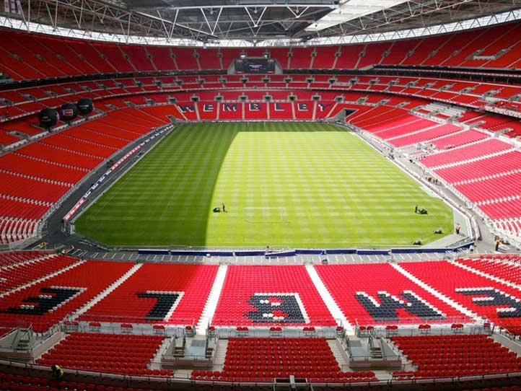
Facility Development

Slide 28
Facility Development
Contents
Aim | To develop a club home ground and provide facilities to allow the Club to grow. To provide facilities for club members and the community as a whole.
Objective | Achievement targets | Timescale | Responsibility | Cost
1. Begin negotiations with the council for the long term lease of land big enough to have a Club house on and multiple pitches. (Depends on Club circumstance and options available with Council) | Negotiations underway with council. | Year ? | Chairman Secretary | ?
2. Once lease obtained to begin development of the land to build Clubhouse and 3g pitch. Also improve existing pitches. Ground to include 5v5, 7v7, 9v9 and 11 aside pitches. (Depends on point 1) | Discussions underway with council and the FA. Funding being looked at and club already fundraising to achieve this. | Year ? | Chairman Secretary Work closely with the DFA Facility Development Officer | ?
3. Manage and maintain those facilities to a high standard | Facilities will be maintained to a high standard | Year ? and annually | Chairman Secretary Committee | Running costs
4. Form partnership with local schools in order to secure venues for winter training | Partnerships formed with local schools already and winter training based at schools such as ?????. | Year ? and annually | Committee | ?
5. All facilities & goalposts are safe. Goalposts to be checked before each game and replaced when needed through applying to the Goalpost Safety Programme at the Football Foundation. Risk assessments to be regularly carried out on the venue/facility. | Being carried out already at any venue but when own facilities up and running to be completed before every match and training session. All facilities and goalposts to be safe. | Year ? and annually | Committee, managers, Grounds person
Notes:
Does your club have it’s own Facility? If so what are your “Realistic” Plans, if not do you have potential to secure your own facility? If not what plans do you have should you be planning to grow the number of teams, where will they play? Do you have links with Schools to use their sites? Etc.

Slide 29
Facility Development
Contents
Aim | To develop a club home ground and provide facilities to allow the Club to grow. To provide facilities for club members and the community as a whole.
Objective | Achievement targets | Timescale | Responsibility | Cost
5. Work with the County FA to continue to improve their grass pitches through our Pitch Improvement Programme. (this will enable more competitive games on the pitches) | Grass pitches maintained to good/excellent standard. Designated person to have attended Groundsman training course. | Year ? & Annually
6. Work with the County to access funding for pitch improvement (i.e. Maintenance machinery) | Attend workshops and Courses hosted by the County in order to find out what funding is available | Year ? & Annually
Notes:
Does your club have it’s own Facility? If so what are your “Realistic” Plans, if not do you have potential to secure your own facility? If not what plans do you have should you be planning to grow the number of teams, where will they play? Do you have links with Schools to use their sites? Etc.

Slide 30
Promotion

Slide 31
Promotion
Contents
Aim | To actively promote and market all football opportunities available ● To increase the profile of the Club throughout the local community
Objective | Achievement targets | Timescale | Responsibility | Cost
1. To increase the awareness of football playing opportunities in the local community. To actively promote playing opportunities through posters in local community centres, schools and other community venues. | Full squads in all age groups Playing opportunities for those not in squads Posters displayed in community venues and schools | Year ? and annually | Secretary | £? a year for posters
2. Communicate with parents & hold an annual parents’ evening and annual Newsletter. Increase confidence with current members to spread the good work we do in the community for new members. | Improved communication with the parents. | Year ? and annually | Secretary | Nil newsletter to be sent electronically
3. Communicate with players, Develop a website & Team Manager & Club secretary, treasurer and welfare officer to hold all player contact details. | Improved communication with players. Website up and running | Year ? and annually | Secretary | ?
4. To advertise success To run an annual awards night and issue ongoing press releases to local media. Increase the general awareness of the football Club Develop a website to promote football Cub | Award nights being run now every year Website up and running Club promoted via posters in the area, social media and local press. Minimum of press releases every year. | Year ? and annually Year ? and being maintained Year ? and annually Year ? and annually | Committee members | Cost of trophies
Notes:
Does the club have a website? regular news letters? Social media? Social media policy and aware of the potential pit falls? How do you plan to promote your club in the community and attract potential volunteers/sponsors/players etc?

Slide 32
Promotion
Contents
Aim | To actively promote and market all football opportunities available To increase the profile of the Club throughout the local community
Objective | Achievement targets | Timescale | Responsibility | Cost
5. Increase confidence in the Cub with all its members and volunteers so that they spread the word of how successful we are therefore attracting new members and volunteers. | Increased confidence More members More volunteers | Year ? and maintained annually | Committee | ?
6. To advertise for volunteers & members. Promote opportunities through word of mouth, posters, leaflets and local /social media | Volunteers numbers increased in line with the increase of new Teams. Regular advertising done on club website, Durham FA website and social media. | Year ? and annually | Committee and managers | ?
7. Seek recognition of good football development work and recognise important role of Club volunteers . To apply for County FA Community Awards each season. | Make an application on an annual basis | Year ? and annually | Committee | ?
8. Build links with every school in the local area so that we can promote the Cub and offer facilities to the schools. Which in turn promotes the club in the community | Strong relationships with local schools | Year ? and annually | Secretary | ?
9. Keep up to date with Best Practice Guidance around Communication as the plan references new website and use of club social media. Link Here: http://www.thefa.com/football-rules-governance/safeguarding/best-practice-downloads
Notes:
Does the club have a website? regular news letters? Social media? Social media policy and aware of the potential pit falls? How do you plan to promote your club in the community and attract potential volunteers/sponsors/players etc?

