Slide 1
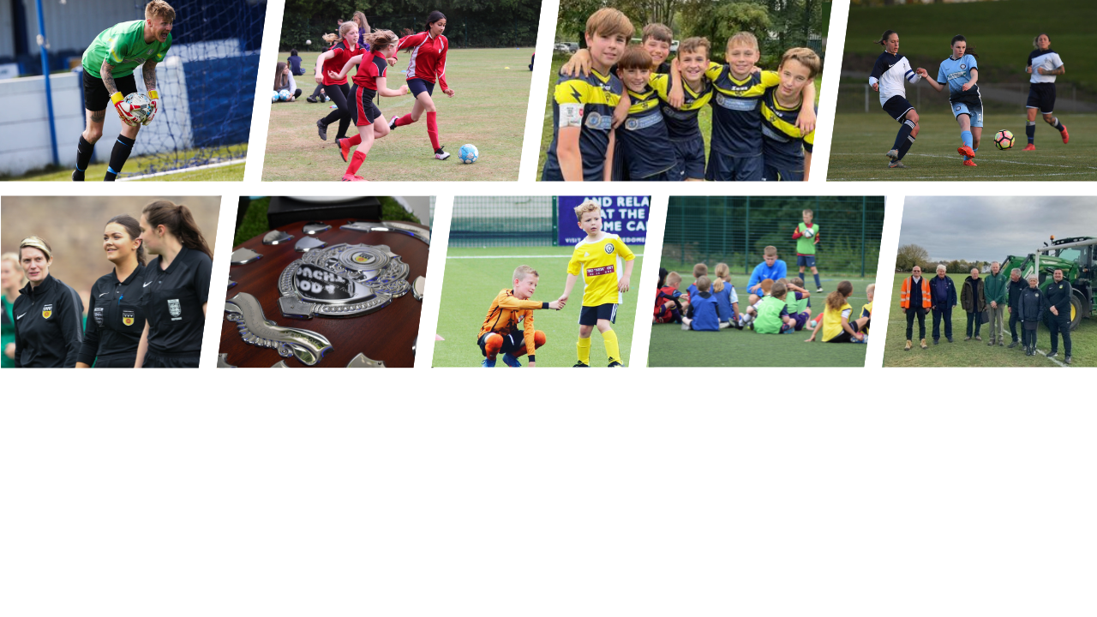

DERBYSHIRE FA – Council Report
Operational Update – May 2023

Slide 2
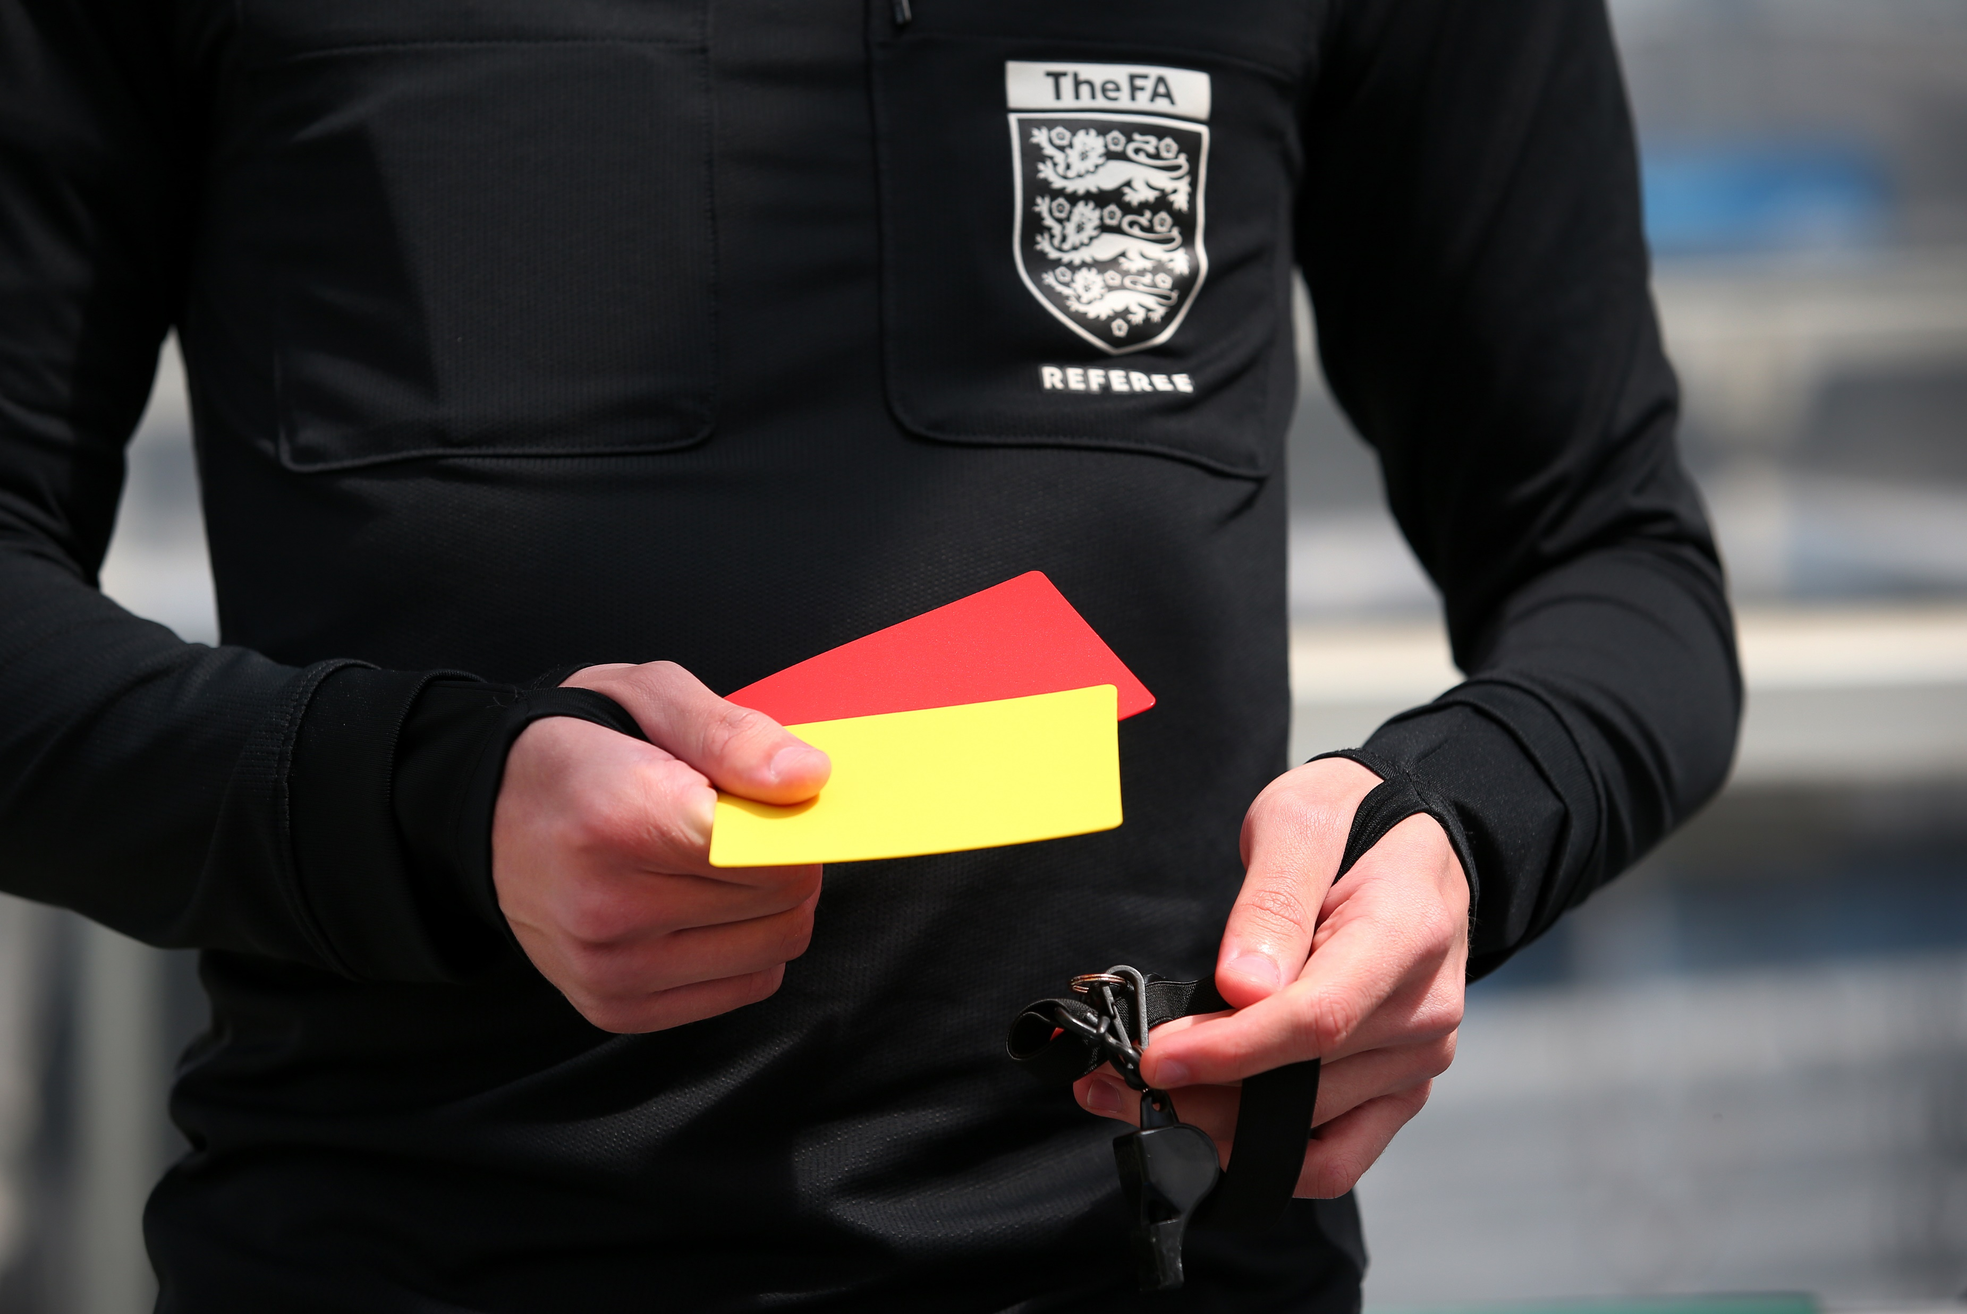
Discipline Update
Total Cases (including investigations with no further action taken) – 337​
​
Complete Cases – 267
Cases taken to hearing - 135
NFA – 131
Education Completed -​1
​
Cases Under Investigation
Open – 46
To Hear – 23​
​

Slide 3
County Cups - Winners
Senior Challenge Cup – Buxton FC
Divisional Cup North – Tintwistle Athletic
Divisional Cup South – Derby Singh Brothers
Junior Cup North – Shirebrook Soldiers
Junior Cup South – Mickleover RBL Reserves
Sunday Senior Cup – Brampton Victoria
Sunday Junior Cup – Newton George and Dragon Inn
Women’s Cup – Chesterfield FC Ladies
Women’s Plate – Wirksworth Colts Ladies

Slide 4
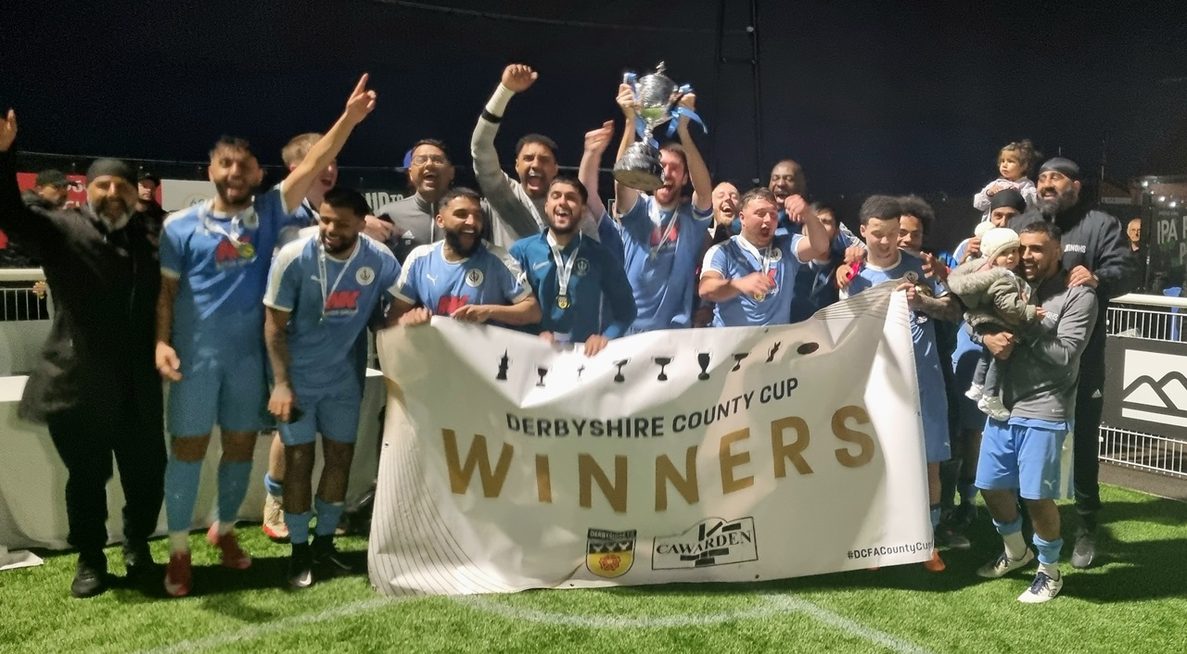
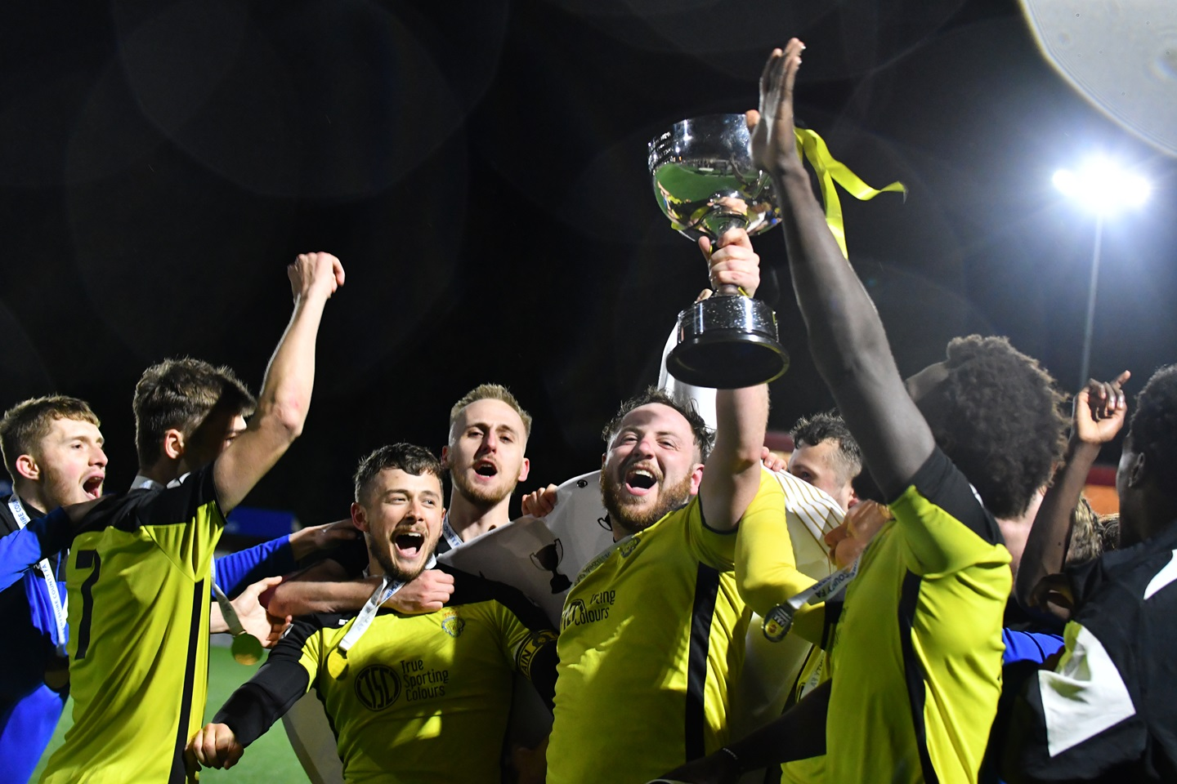
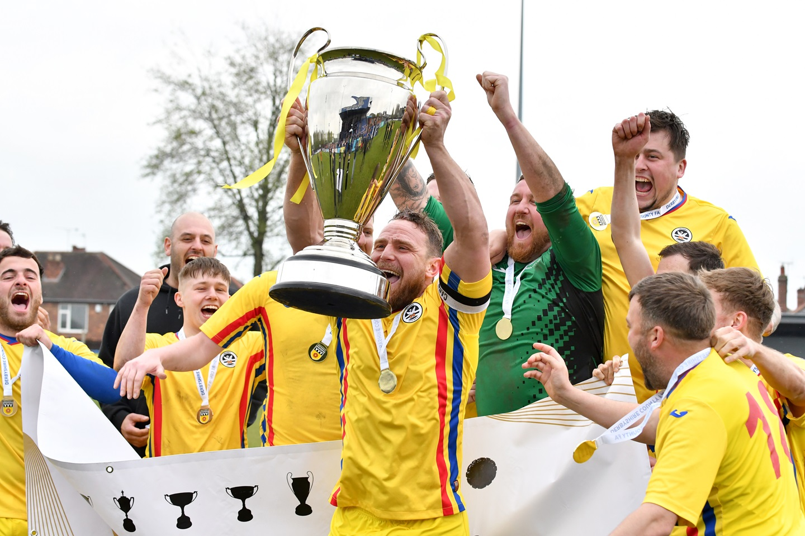
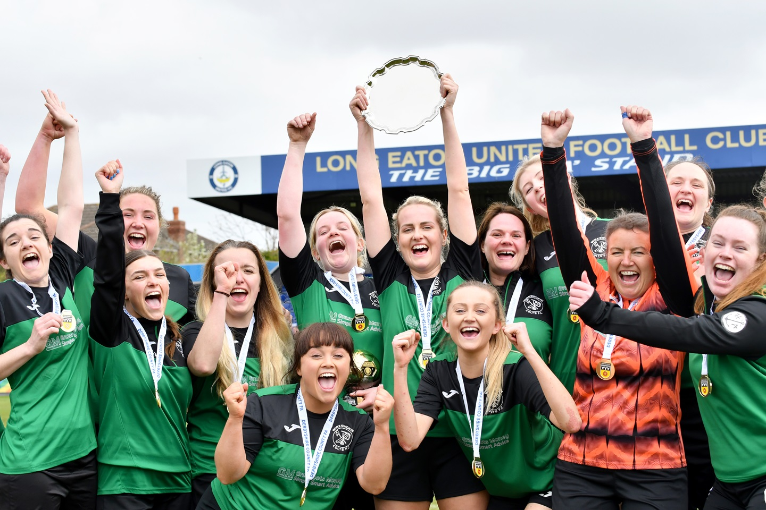
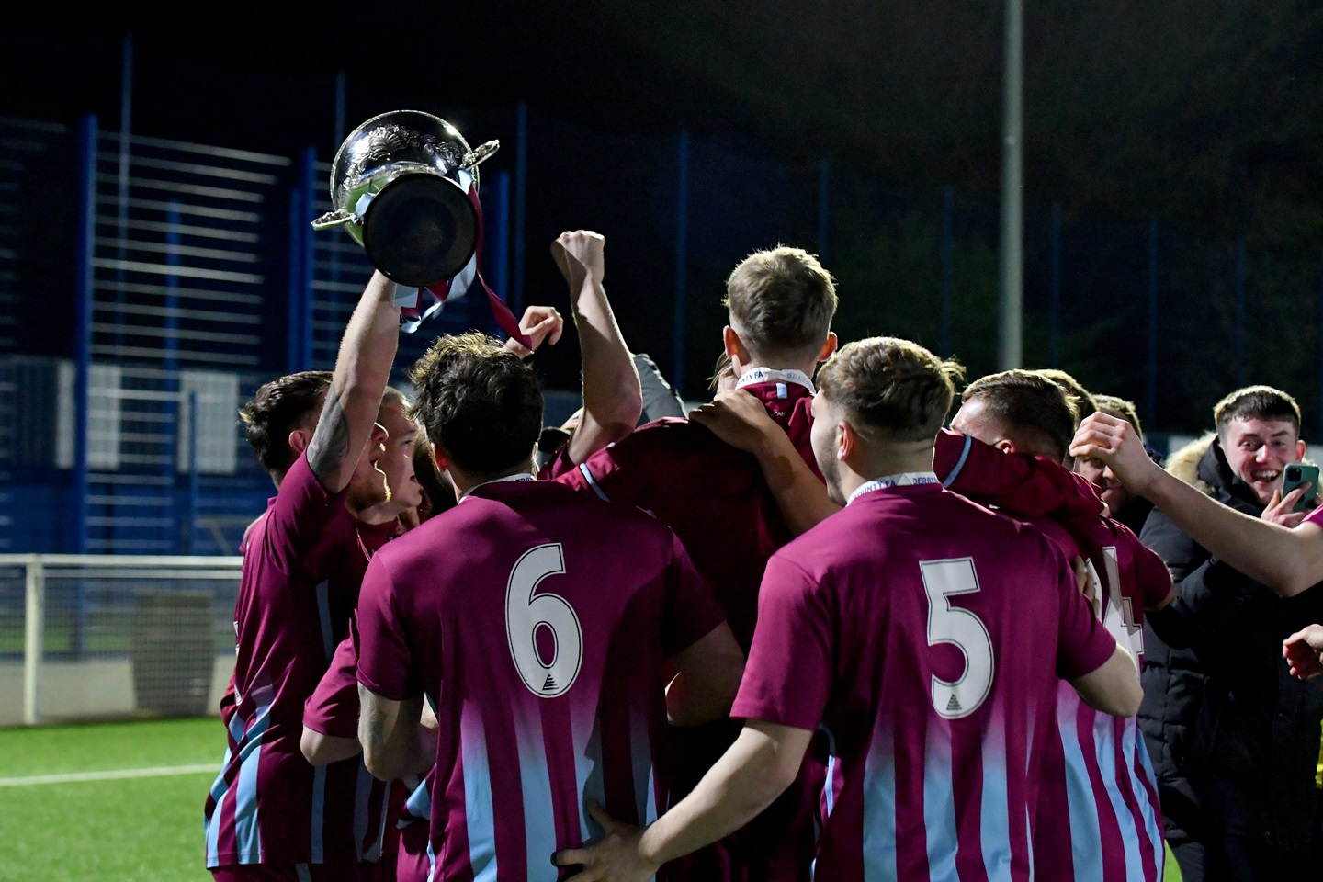
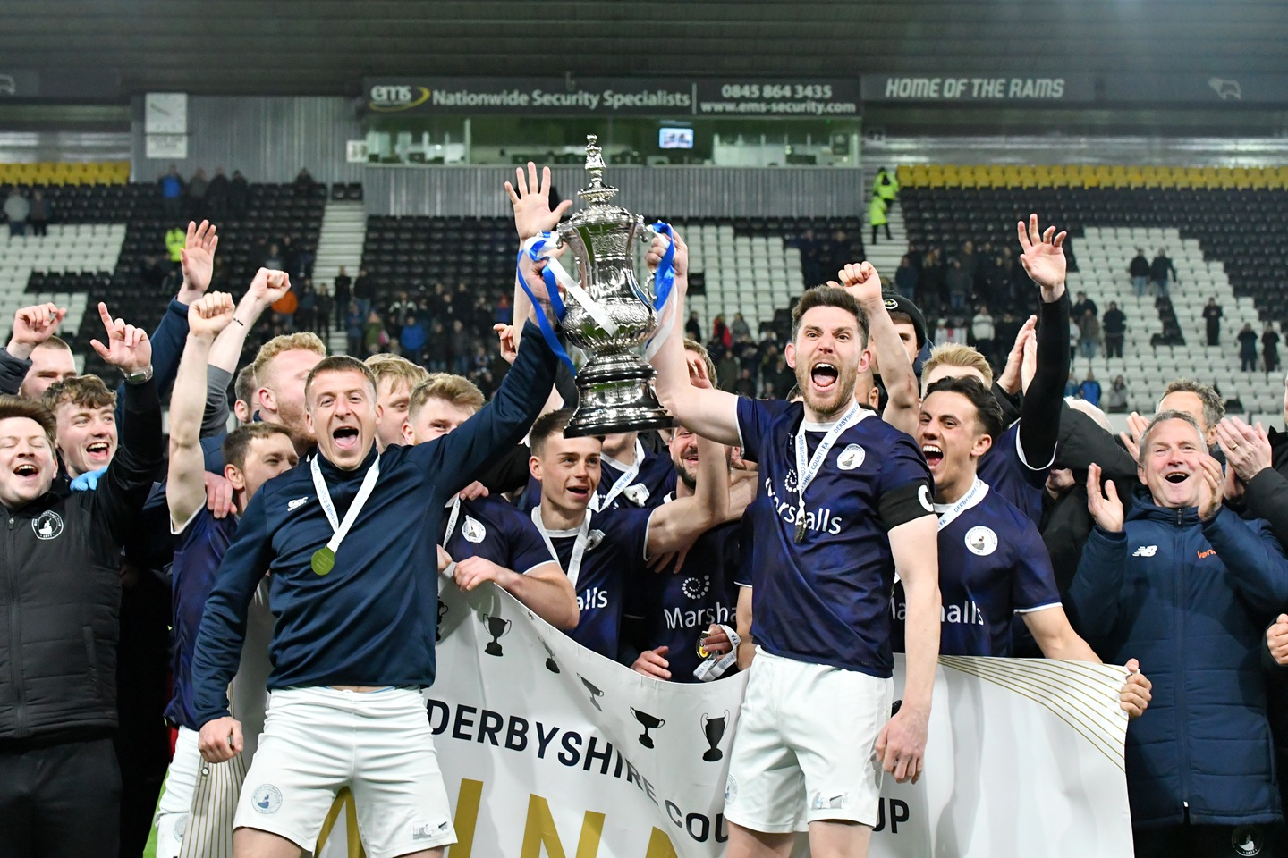
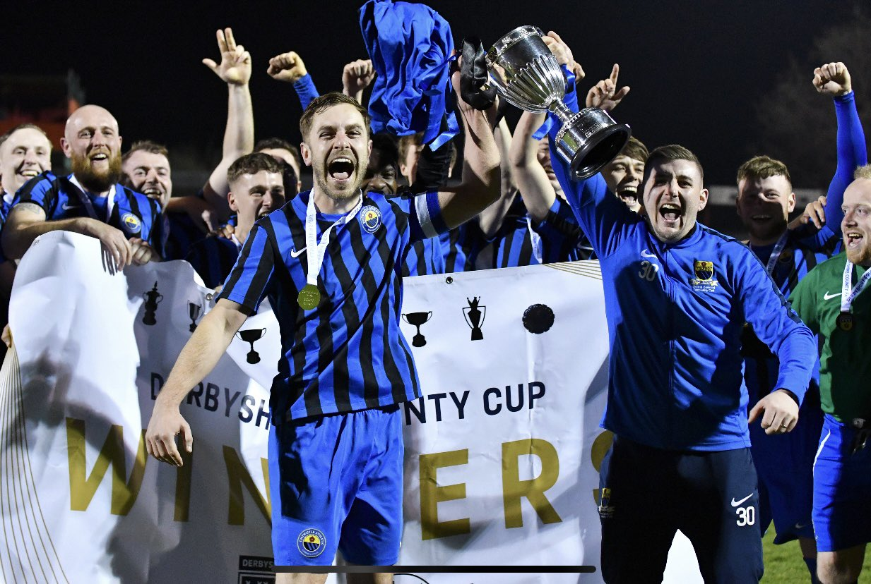
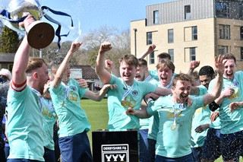
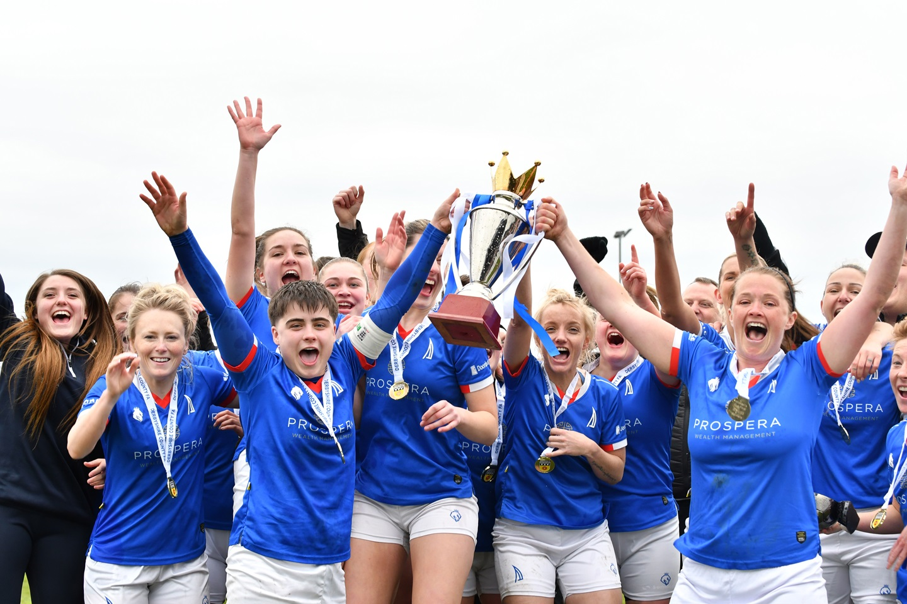

Slide 5
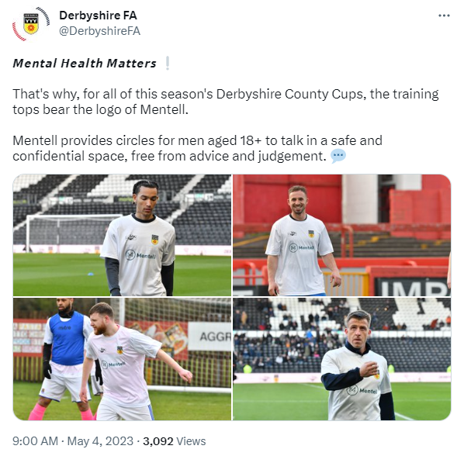
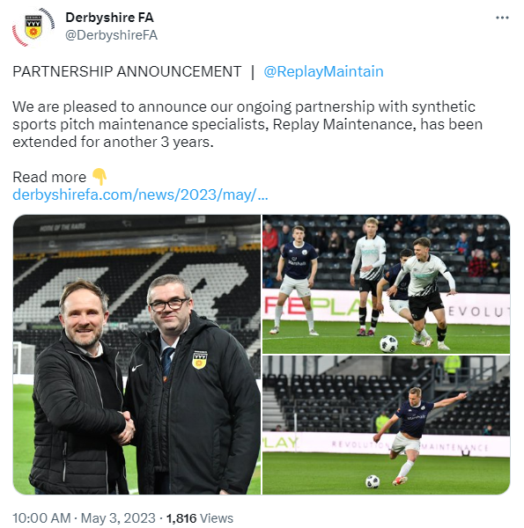
County Cups – Social Media

Slide 6
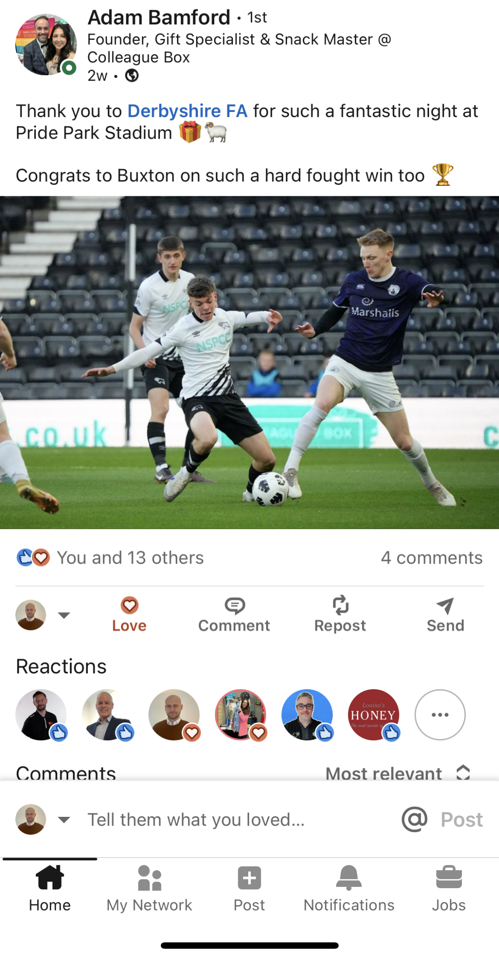
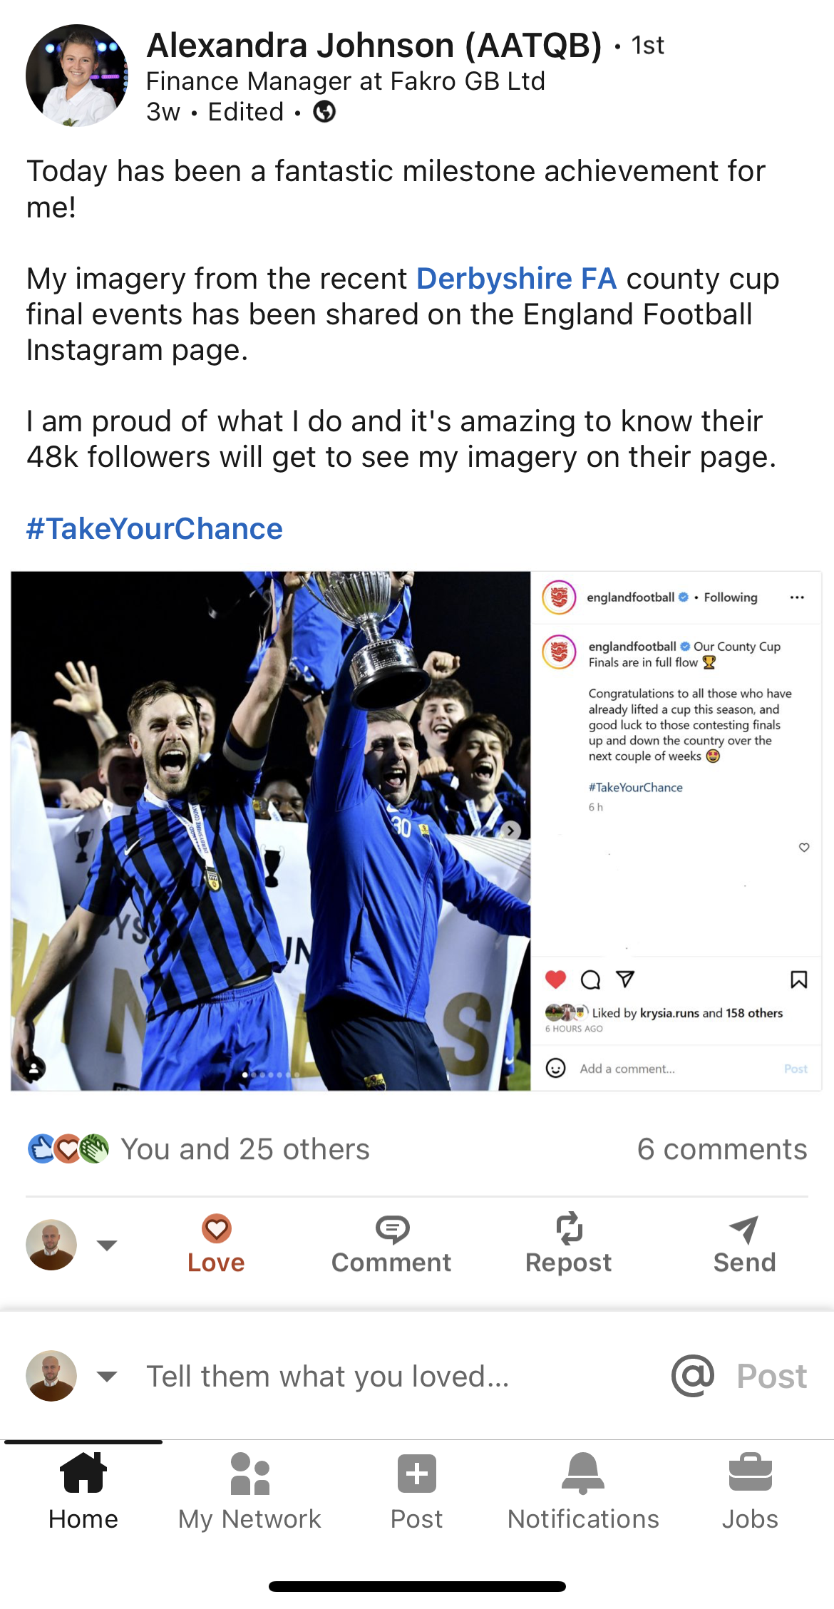
County Cups – Social Media

Slide 7

Freshdesk
July 2022 August 2022 September 2022
1574 tickets created 2154 tickets created 1874 tickets created 1500 tickets resolved 1707 tickets resolved 2085 tickets resolved
October 2022 November 2022 December 2022
1523 tickets created 1523 tickets created 1028 tickets created
1860 tickets resolved 1523 tickets created 1153 tickets created
January 2023 February 2023 March 2023
1311 tickets created 1240 tickets created 1576 tickets created 1199 tickets resolved 1209 tickets resolved 1553 tickets resolved
April 2023
1285 tickets created
1190 tickets resolved

Slide 8
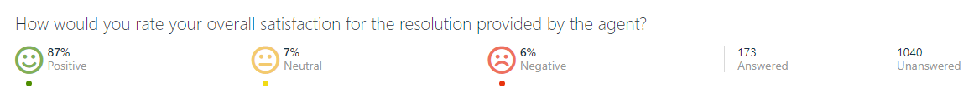
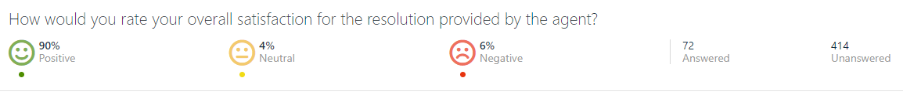
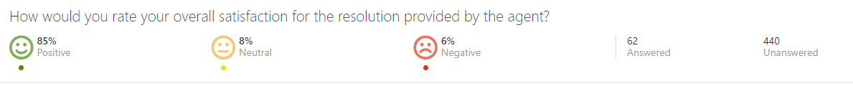
Freshdesk
Q1
Q2
Q3

Slide 9


Key stats on social media
1.34M impressions (amount of times a Tweet has been viewed)
857 mentions
133 new followers (10.3K in total)
231.9K people reached (193% increase)
16.1K page visits (159.9% increase)
263 new likes (107.1% increase)

Slide 10
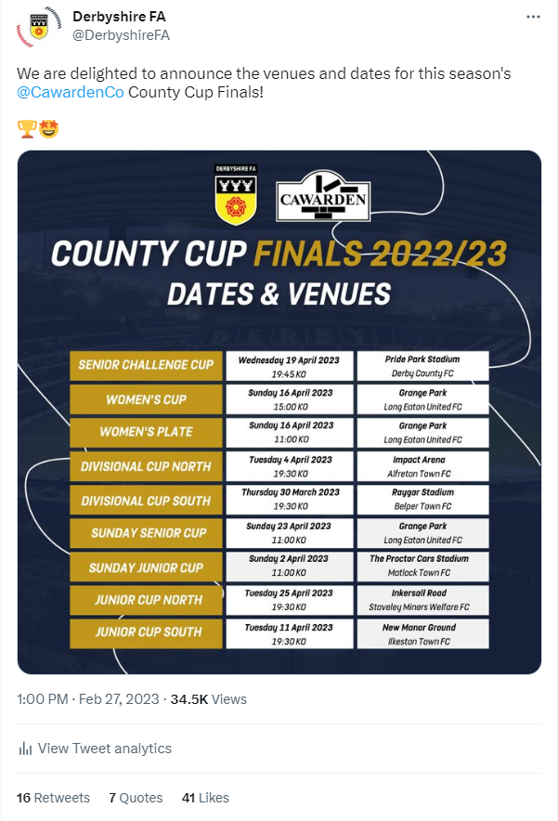
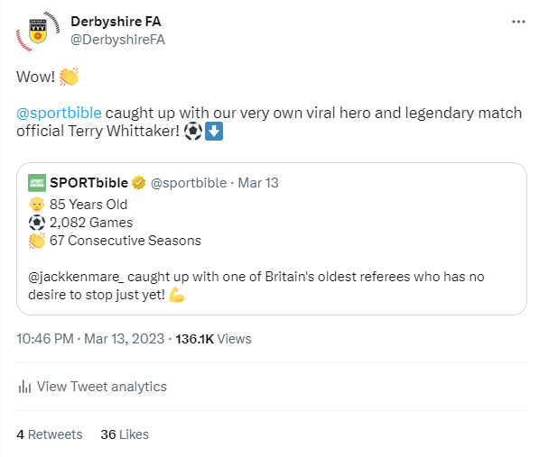
Top Posts

Slide 11
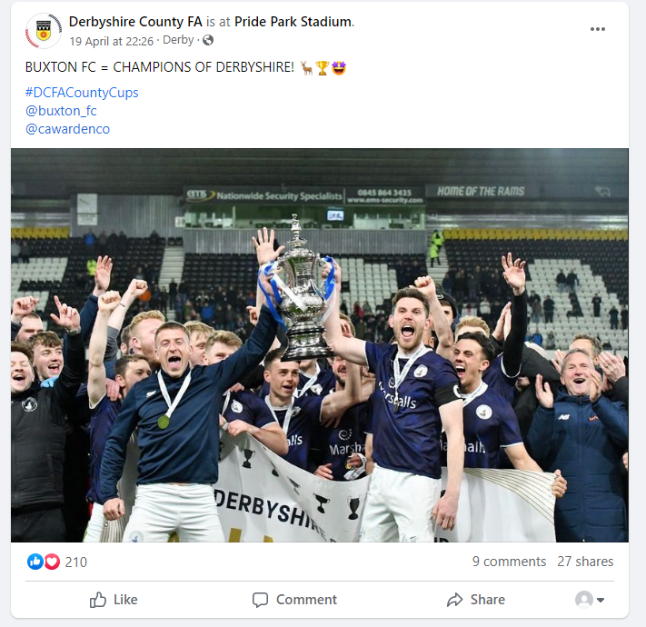
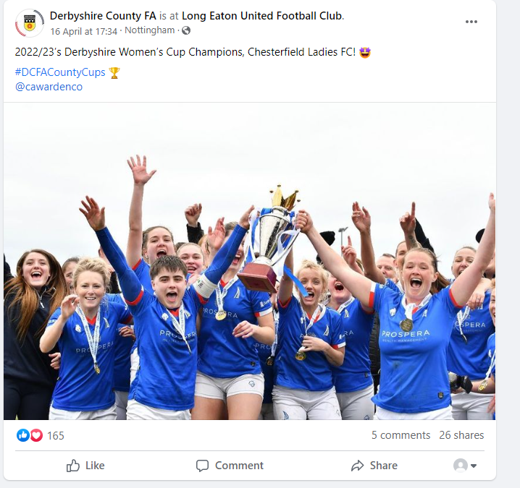
Top posts

Slide 12
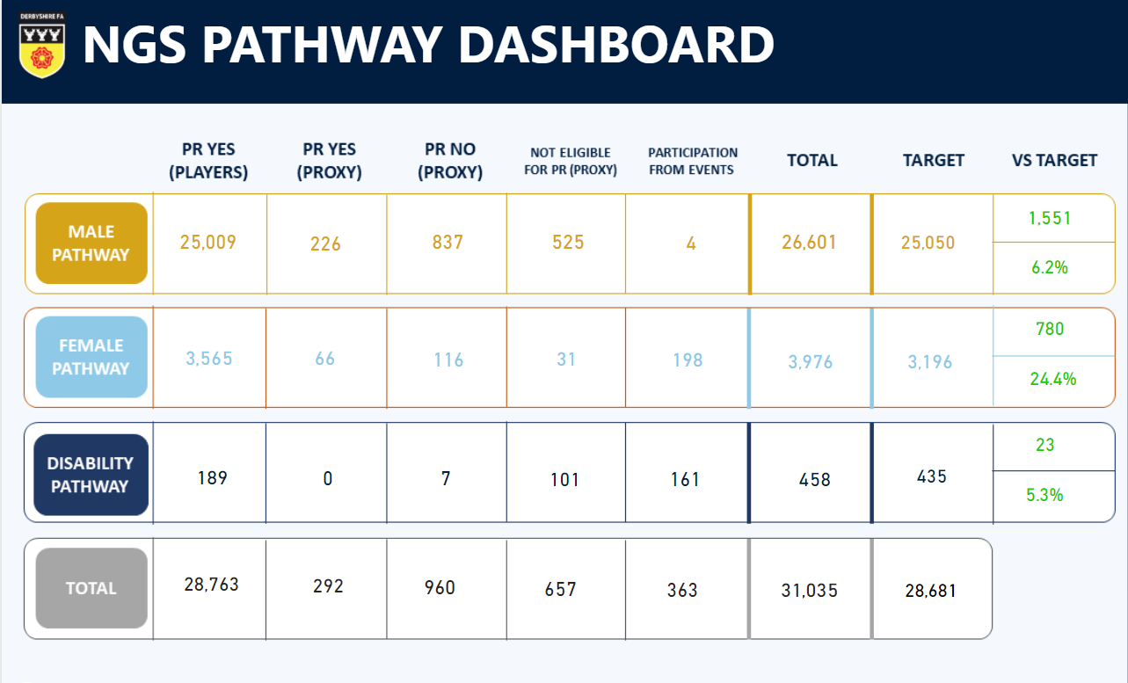
KPI – Player Pathway

Slide 13

KPI - Referees

Slide 14
Refereeing Update
36 Cup Final Referees appointed by a Panel of 4
Cup Final Evening ran with a Guest Speaker
FA Referee Course structure reviewed and will be changing for 2023/24
DCFA CORE Programme under review to change for next season
Referee Recognition Awards Promoted, pushed to get a nominee shortlisted for a National Award
RDO in the process of meeting all 3 Referee Associations ahead of the New Season with a offer of new referees from course attending an RA Meeting
Referee Development Day running in July with 6 guest speakers, 100 spaces of which 47 tickets have gone in 1 week!

Slide 15
Refereeing Update
Your Game Event attended, session delivered, and refereeing promoted to young people looking to get into football
Expression of Interest Form for new courses now live
Information Evenings running ahead of the courses being ran in 2023/24
DCFA WSL Assistant Referee, Georgia Ball appointed to FA Women's Cup Final

Slide 16
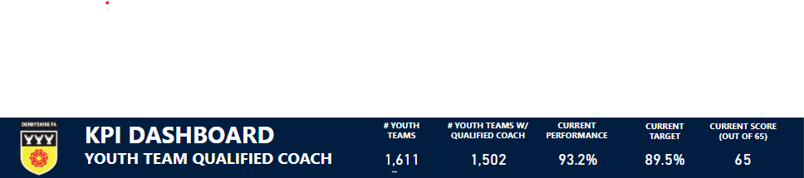
KPI - Coaching

Slide 17
Coach Development
Coaches Community very successful to date with over 20 events to have been delivered by the 30th June
Events at Glossop, Melbourne & Shirebrook in this quarter have been well attended and received.
Goalkeeping CPD taken further with Ross Atkins at Derby with next event scheduled for Early June.
Positive working relationships continue to be established with coach network and coach developers
EDI focused development group established and working closely with group of coaches from under-represented groups.
Two Stepping over the Sideline’s workshops delivered to Punjab United & AFC Chellaston. Pool of coaches from these workshops have emerged.
Furthermore, Female Coach Club has been launched with flagship event at Pride Park a resounding success. Next event scheduled for 27th June. Over 30 members have joined the FCC
Smashed through target barrier for each KPI with numbers still to be added .
Asked to present best practice on DCFA Coach Community at latest regional engagement day in May.

Slide 18
League Development
Relationships Strong with all leagues
England Football Accreditation awarded to Derwent Valley Junior League & development group set up with league to help and support the league on delivering against their league development plan.
Mediating discussions over potential merger for benefit of football in the county between MRA & Central Midlands Football League, we are now at a point of vote at next AGMS. Derbyshire FA hosted information evening that went down very well with clubs and over 80% indicated in favour of a joint venture.
Regular League Forums/Updates established with next one 21st May for ALL Leagues
Future of Youth football Project delivered successfully in conjunction with DJFL.
Discussions around girls provision ongoing with NDYFL & DVJL
Discussions around Under 21s League advancing with NDYFL

Slide 19
Club Development
All Clubs meeting in February well received and well attended
Regular online/in person support was delivered to clubs to see through EFA renewal process. As things stand 151/163 clubs have been successfully guided through renewals.
Ongoing support and engagement to clubs that wish to apply for accreditation for the first time.
High Peak Club development group explored to ensure that club & coach support is being delivered regularly to clubs in the north of the county
Coach development sessions delivered in Glossop in March
Follow up webinar and survey conducted in April – next event planned for June
Work ongoing to survey interested clubs with NDYFL for implementation of U21 League from next season
Post Season review to be conducted with all clubs at next meeting with opportunities for questions and answers in an open forum
Communication and on ground support being well received
Young people survey sent out to all clubs to find out views of young people at their club and help support any initiatives that encourage the importance of the voice of the child.

Slide 20
Youth Development
New Youth Development Board recruitment window saw eight young people selected to join
First meeting held online; views gathered on curriculum content for Youth Leadership Development sessions
Meeting face to face Thursday 8th June at DCFA offices
Equal Game Ambassador appointed
Michelle Jackson, former Doncaster Rovers Belles and England Player
Equal Game Workshops in the diary for 24th June at Chesterfield FC and 1st July at Belper Town FC
Part of FA Pilot for school to club transition in Derby City
Allenton United, Shardlow United and Hilton Harriers clubs identified and partnered with schools
Six weeks of delivery followed by two at club to encourage transition and boost club player numbers
Stepping over the sidelines workshop at the Pakistani Community Centre engaging with an underrepresented demographic
Women and Girls Development

Slide 21
Disability Update
Current Provision: 10 clubs - 20 sessions - 2 impairment specific (player pathway numbers ongoing, currently not representative)
Partnerships Created: Mencap - Steps - Umbrella - Help for Heroes - RBL - Move more - Mind
Awareness: World Autism Awareness Day – Shooters Showcase
New Project: Project B1 – Introduction to Blind Football
Upcoming: Para Talent ID Day – Para Football, Para Cycling, Para Triathlon, Boccia, Sitting Volleyball (7th June at Derby Arena)

Slide 22
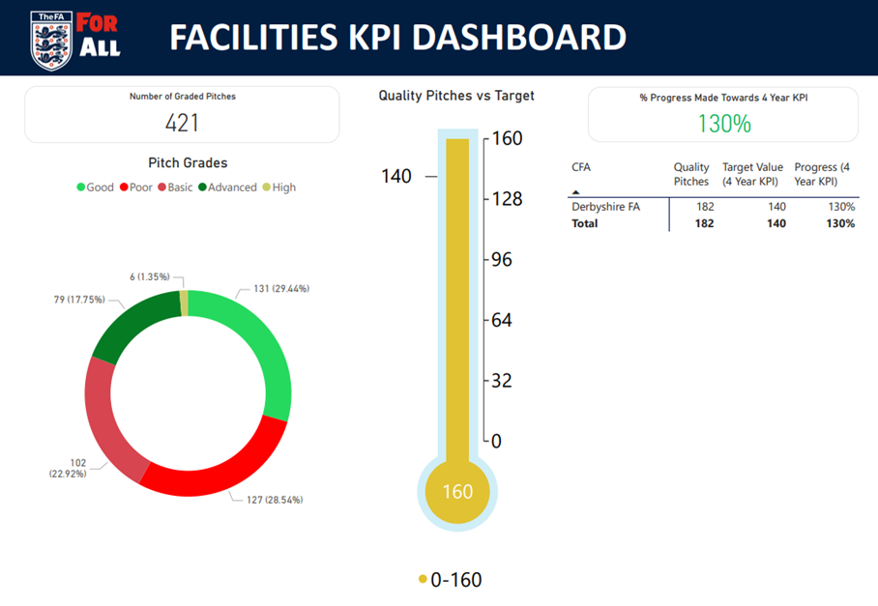
Grass Pitch Update
Ongoing – Pitch Power visits and assessments, partnership with support pitch advisors
Focus – Convert Pitch Power assessments to applying for Grass Pitch Maintenance Fund
Upcoming – Grass Pitch Improvement Workshop on 12th June at Ilkeston Town FC

Slide 23
Facility Projects Update
Cavendish Fields, Matlock(Derbyshire Dales) – Small Sided Refurb 3G Project. Feasibility, including the survey have been completed. The Cavendish Sports Fields Association are working hard to fundraise and submit funding applications to reach their target of £150k to put towards the project.
Chesterfield FC Community Trust (Chesterfield) – Full Size EG project. FF Funding application is waiting to be approved. We are just waiting on planning permission to be approved in May 2023.
Gresley Rovers FC (South Derbyshire) – Relocation Stadia 3G. Waiting on planning permission to be approved.

Slide 24
Facility Projects Update
Heanor Town FC (Amber Valley) – Stadia 3G Project. Feasibility and Surveys have been completed. Waiting for the tender process to be completed in June 2023.
Moorways Sports Village (Derby City) – Full Size 3G Refurb Project. Programme of use(1st draft was completed in April 2023. FF application will be submitted by October 2023.
Allestree Woodlands School(Derby City) – Full Size 3G Refurb Project. We are in the process of starting the Feasibility.
Rutland Sports Park (Erewash) – Full Size 3G Refurb Project. We are in the process of starting the feasibility

Slide 25
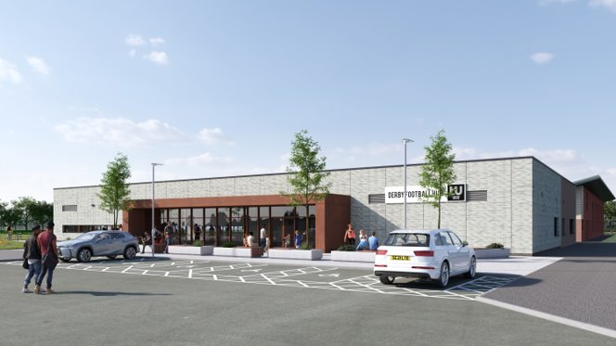
Facility Projects – The Racecourse
Construction started on 1st April 2023
3 New 3G Pitches and refurb to the existing 3G FTP should be completed by September 2023
All work on site including the pavilion, car parking and new access road should be completed by January 2024

Slide 26




Slide 27














★★ ★★★
.

Slide 28


























★★ ★★★
•
•
•
•
•
•
•
•
•
•
•

Slide 29





























•
•
•
•
•
•
•
•
•
We have sent this information out to all our 2* & 3* EFA Clubs.
So for the following clubs will be completing an application: -
Ashbourne Aztecs (Derbyshire Dales)
Aston Village (South Derbyshire)
Barlborough Juniors (Bolsover)
Heanor Town Juniors (Amber Valley)

