Slide 1
DERBYSHIRE FA
Council Update – March 2023

Slide 2
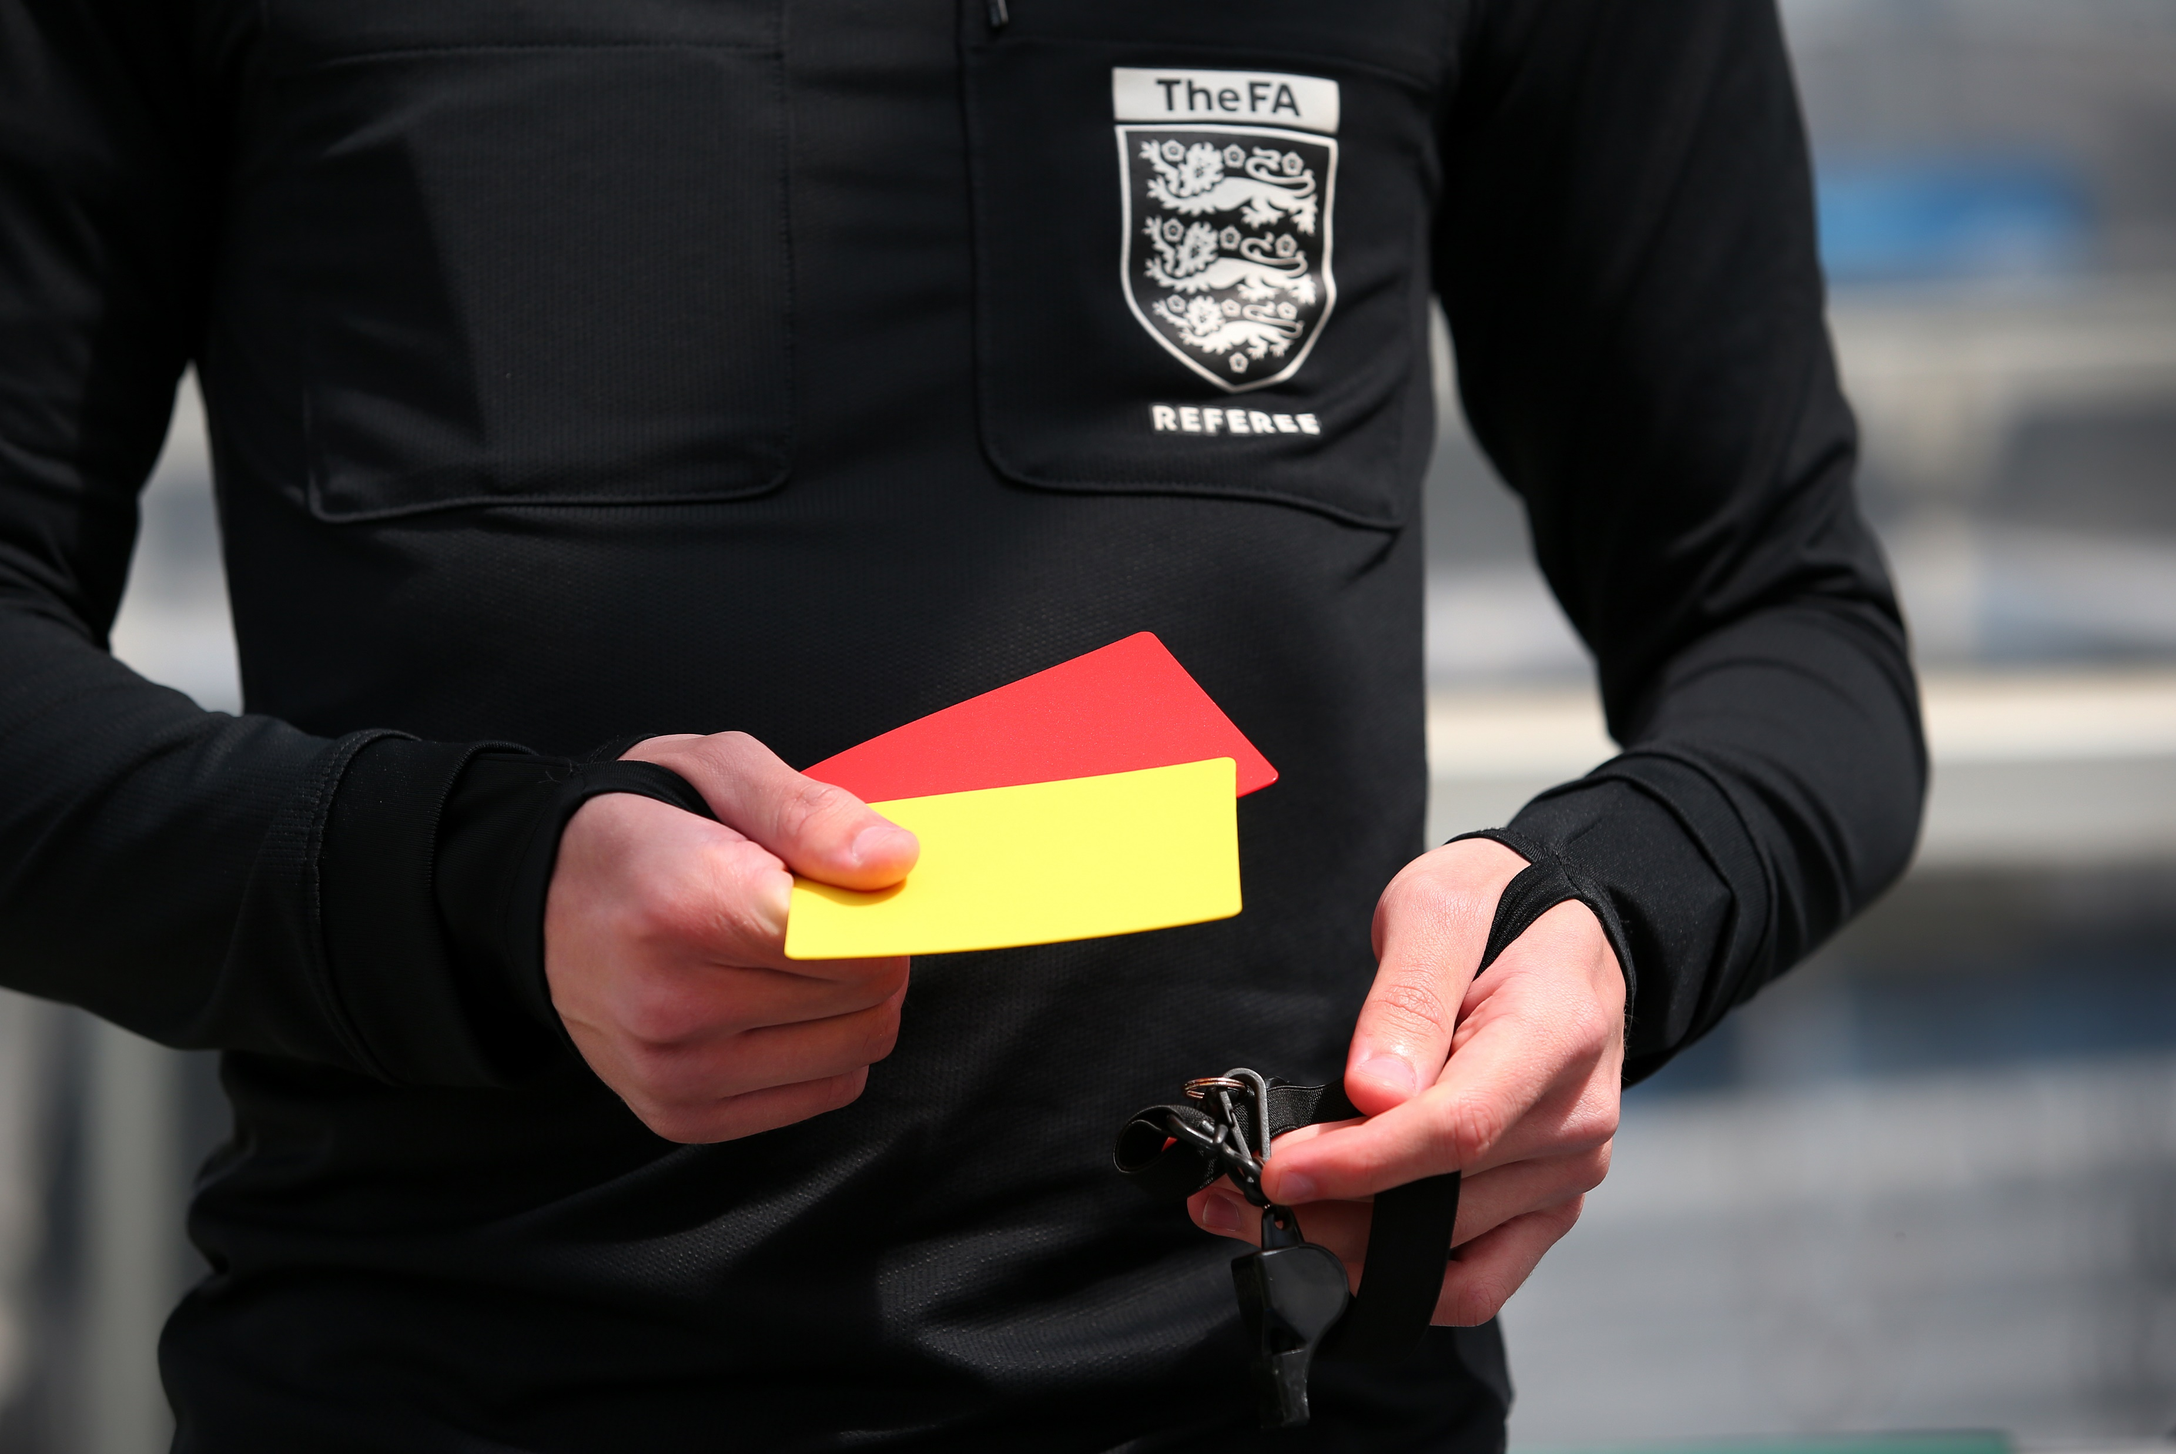
Discipline Update
Increased number of personal hearings requested, slowing down the time it takes to conclude cases
Specific to Q2
140 new cases in October, November, December – Reduced discipline in December due to inclement weather causing a number of postponements​
48 of the 140 cases have been NFA’d, primary reasons being allegations not being supported by the complainant during the investigation, resulting in having insufficient evidence
22 cases were linked to abandoned games
The average time for a case to be completed from notification date to closed date is 26.7 days

Slide 3
Offences against match officials (2018/19)

Slide 4
Offences against match officials (2021/22)

Slide 5
Offences against match officials (2022/23)
* As of 21/02/2023

Slide 6
Freshdesk – Ticket Numbers
July 2022 August 2022 September 2022
1574 tickets created 2154 tickets created 1874 tickets created 1500 tickets resolved 1707 tickets resolved 2085 tickets resolved
October 2022 November 2022 December 2022
1523 tickets created 1617 tickets created 1028 tickets created
1860 tickets resolved 1634 tickets resolved 1158 tickets resolved
January 2023
1202 tickets created
1126 tickets resolved

Slide 7
Freshdesk – Customer Satisfaction
Q1
Q2

Slide 8
Key stats on social media (Dec ‘22 – Jan ‘23)
Impressions increased by 96.7% in last 28 days
317k impressions (times a tweet has been viewed)
14.3k profile visits
307 mentions
47.9k people reached
70.1k post reach (78.4% increase)
3.2k page visits
Only 67 followers away from 4,000 followers
*Measuring from 1st December 2022 – 26th January 2023

Slide 9
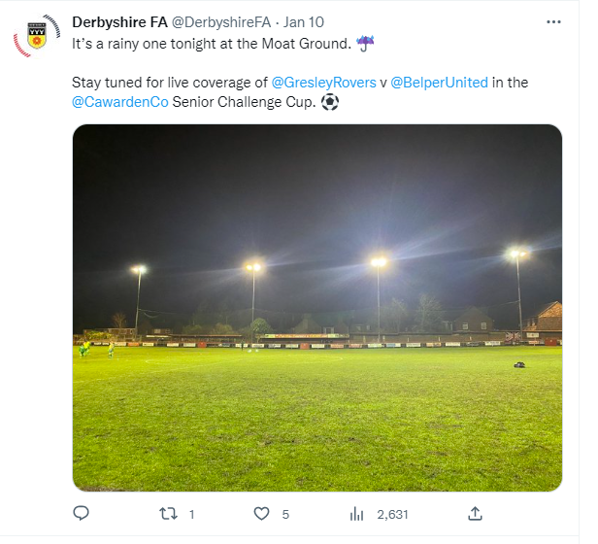
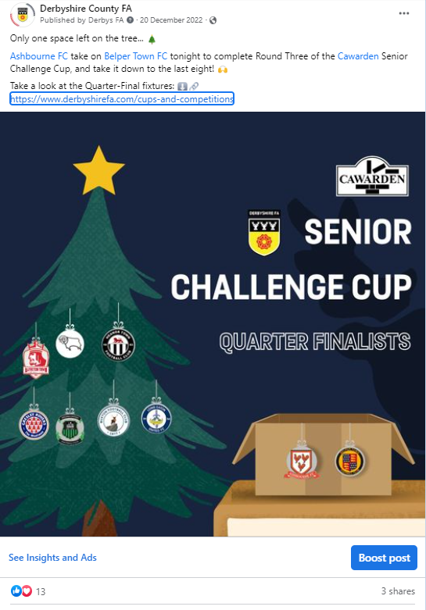
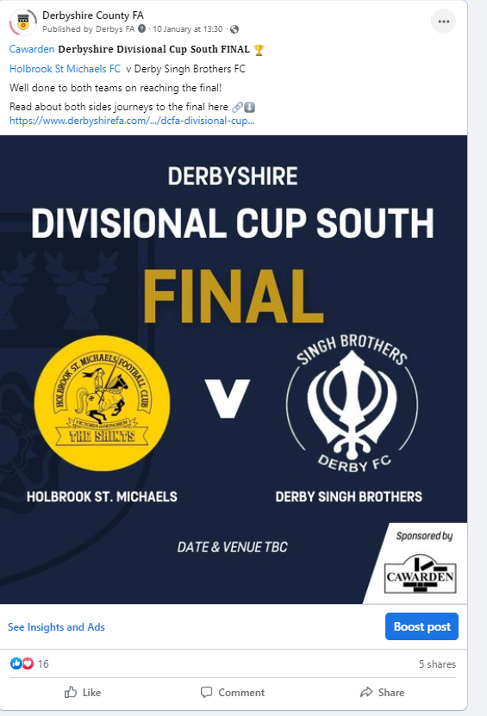
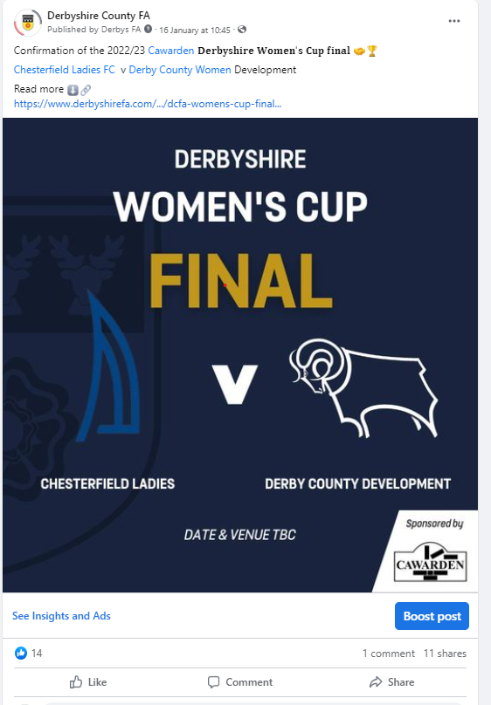
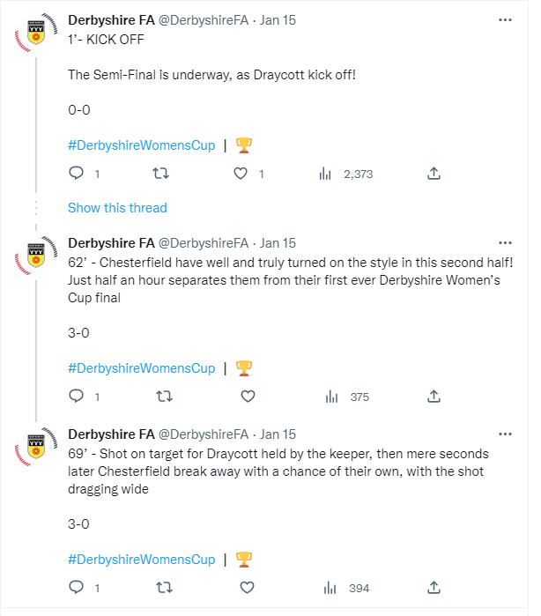
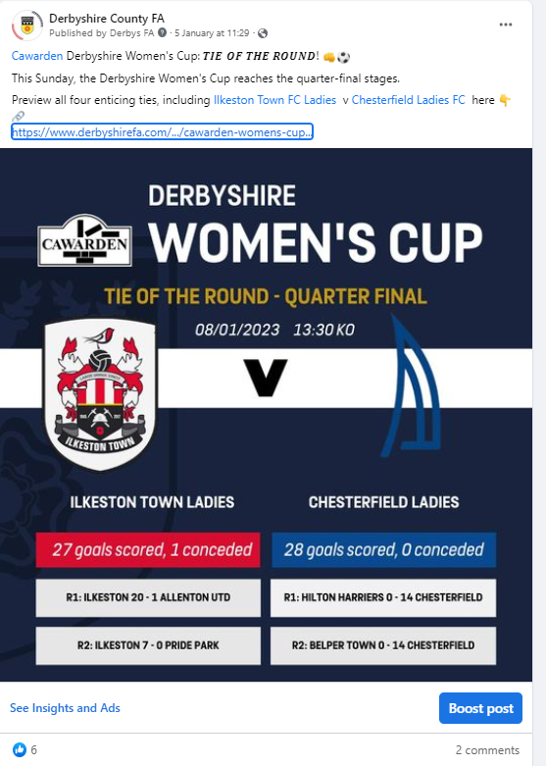
County Cups Coverage
The return of our County Cups has been well received, with lots of coverage going across our socials

Slide 10
County Cup Finals
Tuesday 21st March, Junior Cup South – To be confirmed
Thursday 30th March, Divisional South – Belper Town – 7:30pm KO
Sunday 2nd April Sunday Junior Cup – Matlock Town FC – 11am KO
Tuesday 4th April, Divisional North – Alfreton Town – 7:30pm KO
Sunday 16th April, Women’s Plate – Long Eaton United FC – 11am KO
Sunday 16th April, Women’s Cup – Long Eaton United FC -3pm KO
Wednesday 19th April, Senior Challenge Cup - Derby County FC – 7:45pm KO
Sunday 23rd April, Sunday Senior Cup – Long Eaton United – 11am KO
Tuesday 25th April – Junior North – Staveley Miners Welfare FC – 7:30pm KO

Slide 11
KPI – Player Pathway

Slide 12
KPI - Referees
Referee Course @ Belper Town FC on 1st March & 3rd March

Slide 13
KPI - Coaching
3x Registers still to be added to CPD INSTANCES - ON TRACK TO REACH/EXCEED TARGET

Slide 14
Facility Projects Update
Charles Hill Playing Fields – Amber Valley (Pavilion Project). FF approved their funding towards the project in January 2023. Work is due to on site in the Summer.
Moorways Sports Village 3G Project – Derby City. Meetings will be held in February with key partner clubs to this project. Programme of use to be finalised by May 2023. FF application will be submitted by October 2023.
Racecourse Strategic 3G Hub Project. FF approved their funding(£6million) in January 2023. Derby City Council to approve their funding contribution in February 2023. Work to start on site in April 2023 with the aim of completion by December 2023.

Slide 15
Coach Development
Coaches Community Tier 1 memberships Sold Out (30 x £50 memberships)
Individualised mentoring support offered through top tier has started to be rolled out with at least 8 coaches being visited for in site session observation by end of February
3 more successful CPD Events held since last update (Online Webinar, Melbourne SP & Ilkeston Town
Goalkeeping CPD introduced and piloted this month
Positive working relationships continue to be established with coach network and coach developers
Evidenced by EDI Targeted Coach CPD set up at racecourse in February in conjunction with Lee Brown & Chas Kehra (community champion)
Furthermore, Coaching in Female Game specific SPD rolled out at Ashbourne with help of UOD & Sam Griffiths
On track for KPIs with numbers still to be added.
Selected to be part of pilot with UK Coaching

Slide 16
League Development
Relationships Strong with all leagues
England Football Accreditation awarded to Derwent Valley Junior League
Mediating discussions over potential merger for benefit of football in the county between MRA & Central Midlands Football League (Next meeting 31st Jan)
Regular League Forums/Updates established
Working closely with DJFL and DGLL on initiatives such as Silent Support Weekend and Future of Youth Football Project which is hugely exciting to be a part of something potentially ground-breaking
On-site support for central venues becoming more frequent
MRA Workshop delivered 26/01/23 on Touchline Behaviour (well received)

Slide 17
Club Development
88 Clubs attended the all club meeting on 1st Feb
Workshop to be delivered on EFA Renewal/applications with 30th April deadline looming
Ongoing support and engagement to clubs that need renewal or to apply for first time
High Peak Club development group explored to ensure that club & coach support is being delivered regularly to clubs in the north of the county
Positive discussions with Josh Ratcliffe and Ben Mills about what this will look like
Work ongoing to survey interested clubs with NDYFL for implementation of U21 League from next season
Mid-season review to be conducted with all clubs at next meeting with opportunities for questions and answers in an open forum
Communication and on ground support being well received

Slide 18
Mental Health Workshops
Next Steps
Engagement with Clubs , Leagues & Referees
Mental Health Network Group
Develop Partnerships
The Football Mental Alliance

Slide 19
Future of Youth Football
What is it?
A range of different formats to identify the most appropriate for each age group e.g. 3v3, 4v4, 5v5
Camera equipment to observe games and look for technical actions e.g. amount of touches, kick in’s instead of throw in’s
One half = one observation (8 needed in total)
Evolution NOT Revolution
SATURDAY 4th March – 9am – 3pm
SATURDAY 11th March, 9am – 3pm
SATURDAY 18th March, 9am – 3pm
Focus Age Groups – U8, U9 & U10
SUNDAY 26th February, 9am – 4pm
SUNDAY 5th March, 9am – 4pm
SUNDAY 12th March, 9am – 4pm
SUNDAY 19th March, 9am – 4pm
Focus Age Groups – U7, U8, U9 & U10

