Slide 1
DERBYSHIRE FA
Council Report – September 2023

Slide 2
Discipline Update *up to 14th September 2023
Total Investigations | Total Charges Raised | Number of Abandoned Games | Total Serious Case Investigations | Average Time To Charge | Average Time To Complete
31 | 14 | 3 | 11 | 13.9 | 19.3

Slide 3
Discipline Update

Slide 4
Discipline Update
Changes for 2023/24
Automated updates to the original reporter
Leagues have been offered access to a dashboard to monitor cases within their own team concerning Derbyshire teams – 16 leagues have signed up
9 discrimination investigations
1 investigation for assault on club assistant referee
1 investigation for threatening a match official

Slide 5
Freshdesk
July 2022 August 2022 September 2022
1574 tickets created 2154 tickets created 1874 tickets created 1500 tickets resolved 1707 tickets resolved 2085 tickets resolved

Slide 6
Freshdesk
Q1

Slide 7
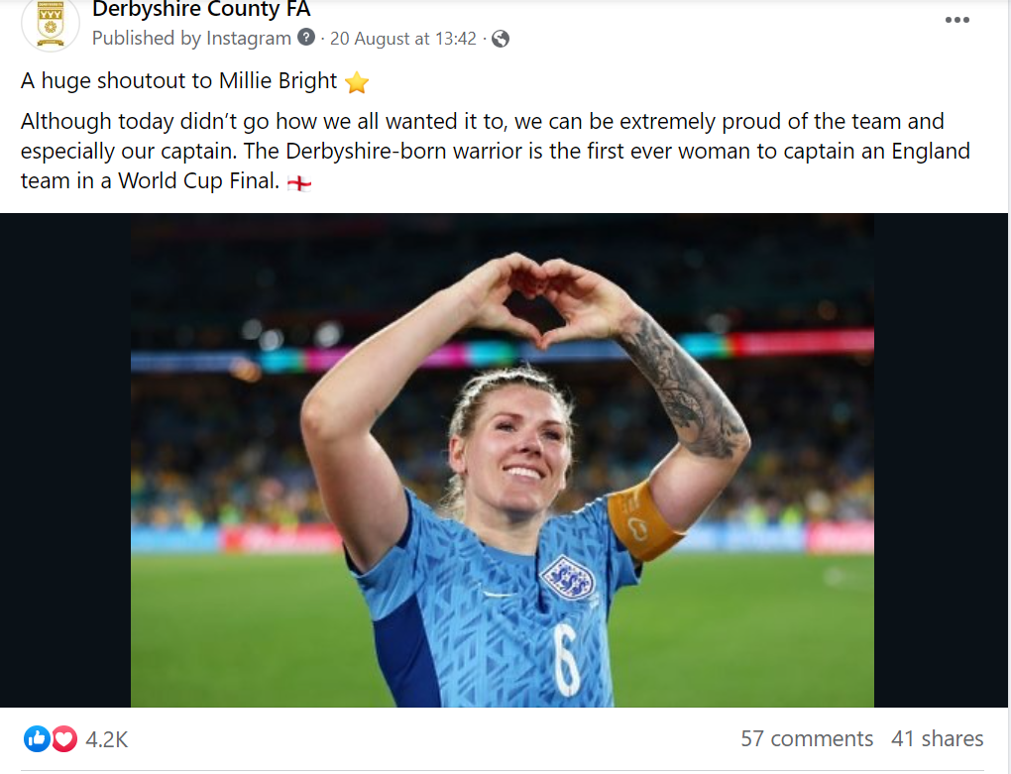
Top Posts – Instagram & Facebook

Slide 8
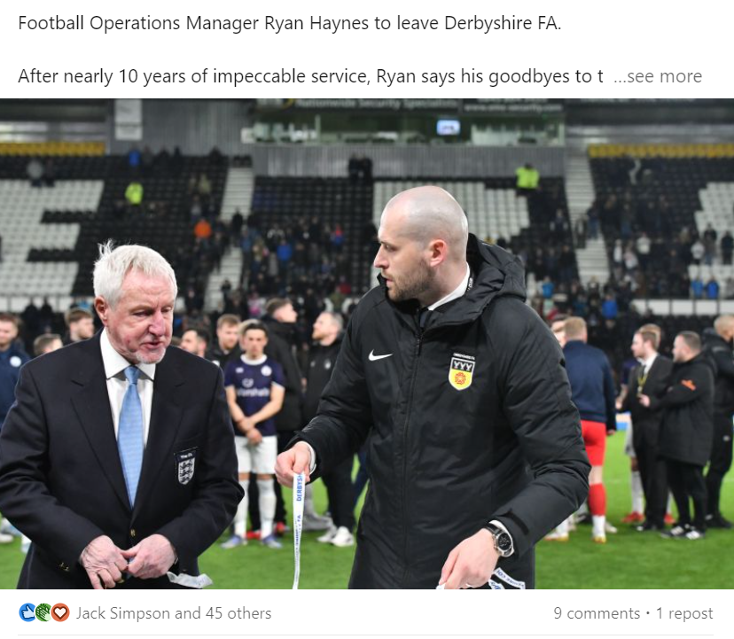
Top Posts – LinkedIn & Twitter

Slide 9
County Cups
Cup Competitions | Teams 22/23 | Teams 23/24 | Difference
Senior Challenge Cup | 24 | 25 | +1
Divisional Cup North | 18 | 23 | +5
Divisional Cup South | 17 | 23 | +6
Junior Cup North | 13 | 16 | +3
Junior Cup South | 10 | 15 | +5
Sunday Senior Cup | 38 | 40 | +2
Sunday Junior Cup | 44 | 81 | +37
Women's Cup | 17 | 27 | +9
Total | 181 | 250 | +69
Round 1 draws complete and communicated with clubs
1st games will be played 1st of October

Slide 10
KPI’s 2023/24

Slide 11
Coaching Update
Coaches Community relaunched for season 23/24 scheduled for 1st October with info webinar scheduled for 27th September to begin process of gathering sign ups.
UEFA C & B support provided throughout June-Sep. 'Introduction to UEFA C' Event held at UOD with 35 attendees.
Mentoring support provided to coaches at Swadlincote Town through Coaches Community Tier 1 programme
Female Coach Club relaunched for season 23/24 with hugely successful matchday observation event taken place for DCFW vs NUFC Women
Exciting partnership established and underway with ASC Cloud that will provide coaching support through FDF funding

Slide 12
League update
Successful pre-season league forum held with all leagues
Attended pre-season meetings for DJFL & Derby City League in person
Meeting set up with CSL to look at reinvesting funds through the member clubs
Plan in place to accelerate LESL accreditation application
On site support delivered to DJFL & DGLL whilst on-going construction takes place at Racecourse
Meet with the new committee of DVJL scheduled for the end of September and work on going with new proactive secretary.

Slide 13
Club update
List of adult clubs being compiled to target for accreditation – looking to increase adult accreditation percentage
Hilton, Swadlincote & GNEFC all targeted for Female coach events due to large female workforce and engagement with CPD
Mickleover 95 bespoke coaching programme underway with first event on 21st September.
Respect Talk being delivered to adult club Willington FC on 25th September

Slide 14
Refereeing Update
Female-Only Referee Course ran in Aug
64 referees in the Promotion Pathway in 2022/23
Referee Development Academy Working with Derby Uni Sports Science Dept
New Bursary for Historically Underrepresented Ethnic Background Referee Course
133 New Referees so far
Amy Fearn Awarded an MBE
495 retained referees so far in 23/24 (As of 18th Sept)
651 referees so far in 23/24 (As of 18th Sept)
12 Referee courses planned for the 2023/24
New Information Evenings ran in June/July, well attended (90 people approx. attended)

Slide 15
Recreational + Schools Football
Adult Snickers Protein JustPlay maintained at 20 sessions, meetings with Willows Sports Centre
Wildcats now at 39 sessions
SQUAD girls' sessions 9 active sessions
Shardlow United, Bakewell Town and Gresley Rovers attended SGP to film content for Wildcats Training
Continued support for providers through face to face, online and telephone meetings
Attended national meeting for recreational sessions at SGP
DSFA primary competitions set, secondary competitions currently open for entrants
Secondary school's competition for Boys U12,13,14,15,16,18 and Girls U12,14,16,18s
CC to become DSFA treasurer to ensure succession planning security around finances
Discussions on-going to have finals played at Moor Farm Training Ground with teams of three officials
Barclay's Girls School Football Partnership supported with new session kit grant opportunity

Slide 16
Female Football + Youth
Michelle Jackson working in role as Equal Game Ambassador helping Chesterfield Ladies, Tintwistle Athletic, Shardlow United, Tansley Juniors, Woodlands FC, Barlborough Juniors, Matlock Town, Gresley Rovers, Chesterfield FC, Hilton Harriers, and Bolsover District Council
Clubs supported to offer suitable female offer across their club
Heather Myronko appointed as Community Champion for female coach recruitment and retention (FA appointment)
Stepping over the sidelines organised for Gresley Rovers, Barlborough Juniors and Hilton Harriers
Meetings with DGLL to look at County Coverage
NDYFL girls division(s) not started due to lack of teams coming forwards
Meetings with potential stake holders to support High Peak league development, including private provider to support
CC to sit on Derby County FC female talent pathway advisory board
Women's World Cup Drawing competition received over 100 entries and was promoted by Millie Bright, England Captain
Youth Development Board strategically planning Youth Leadership curriculum and launch events for new facilities
Skye Bassett has joined SIAG

Slide 17
Disability Update
Competitive football – meeting held with EMPDL; outcome is to set up Derbyshire Pan-Disability Development League (option 1 – merge with existing league / option 2 – creation of new committee/league)
Recreational football – 215 players (5 clubs)
Derbyshire Disability Strategic Board created – representatives from Umbrella, Help for Heroes, Special Olympics, Chesterfield FC CT, Derby CC, Disability Direct
SEND School Festival – First festival in place to be delivered on 27th September at St Martins

Slide 18
Grass Pitch Update
Ongoing – Pitch Power visits and assessments, partnership with support pitch advisors
Number Update – 163 rated good/high/advanced
Current number of clubs accessing GPMF – 45
Number of new GMPF applications - 5
Improvements – Focus on pitches rated as poor/basic to improve, 4 pitches improved

