Slide 1


Laws of The Game – 2019-20
‘Sensible changes to make the game better’

Slide 2
Introduction
If you cannot hear us talking then please check your audio using the drop down box above or call in using :
Join by phone
Tap to call in from a mobile device (attendees only)
+44-203-478-5289 Call-in toll number (UK)
Meeting number (access code): 163 248 062

Slide 3
These changes came into effect on the 1st of June!

Slide 4
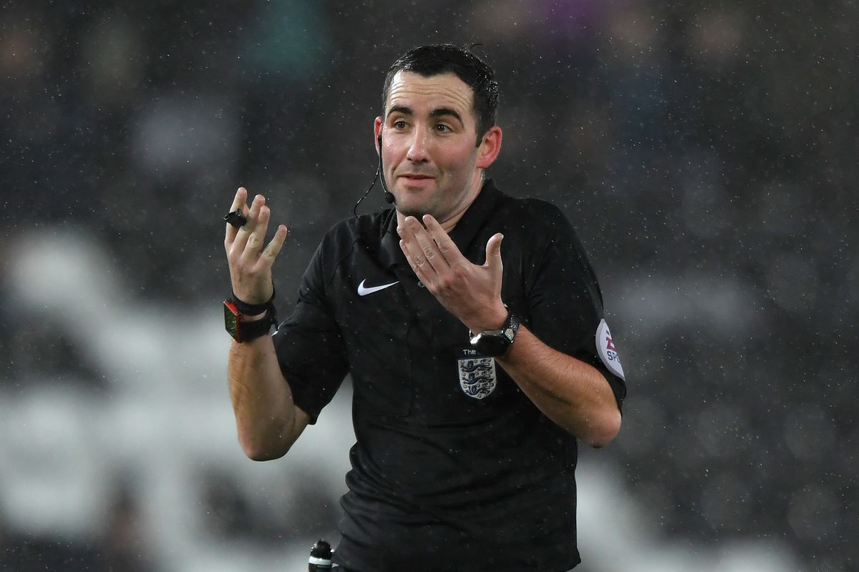
Changes for the 2019-20 Season…
Dropped Ball
Free Kicks & Quick Free Kicks
Goal Celebrations
Goal Kicks
Handball
Penalty Kicks
Substitutions
Team Officials
Kick Offs
Players Equipment
Medical Breaks

Slide 5
Dropped Ball…
There are no longer ‘contested’ drop ball restarts.
Play stopped inside the penalty area = Drop to the GK.
Play stopped outside the penalty area = Drop the ball to 1 player from the team that last touched the ball, where they last touched it.
All other players must be 4m (4.5 yards) away.

Slide 6
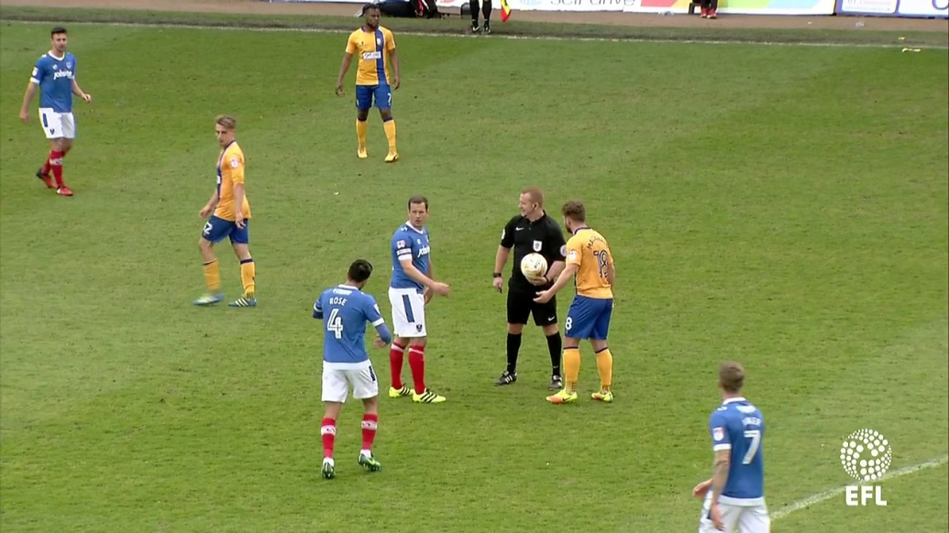
Dropped Ball continued…
If the ball touches the referee (or another match official) and goes into the goal, team possession changes or a promising attack starts, a dropped ball is awarded.

Slide 7
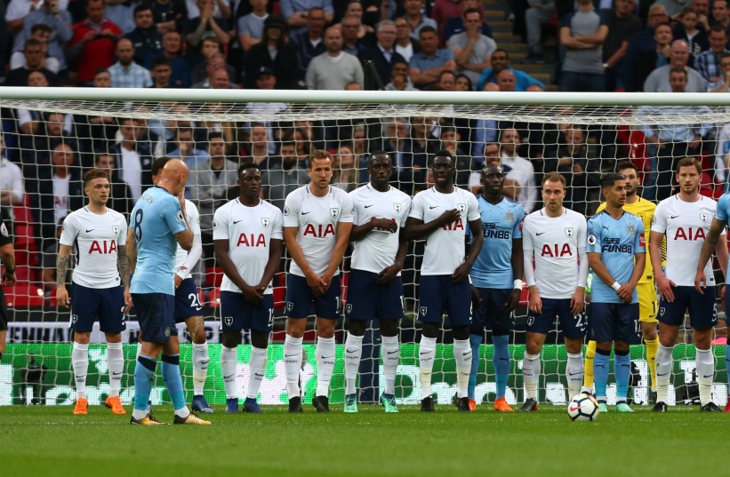
Free Kicks…
When there is a ‘wall’ of 3 or more defenders, the attackers are not allowed within 1m (1 yard) of the wall.
If the attacker is less than 1 yard when the kick is taken, an IDFK is awarded.
The ball does not need to leave to the penalty area when a free kick is taken.

Slide 8
Quick Free Kick – Yellow & Red Cards…
If the referee is about to issue a YC/RC but the non-offending team takes the free kick quickly and creates a goal-scoring opportunity…
the referee can delay the YC/RC until the next stoppage if the offending team was not distracted by the referee
For DOGSO this would result in a YC not a RC.

Slide 9
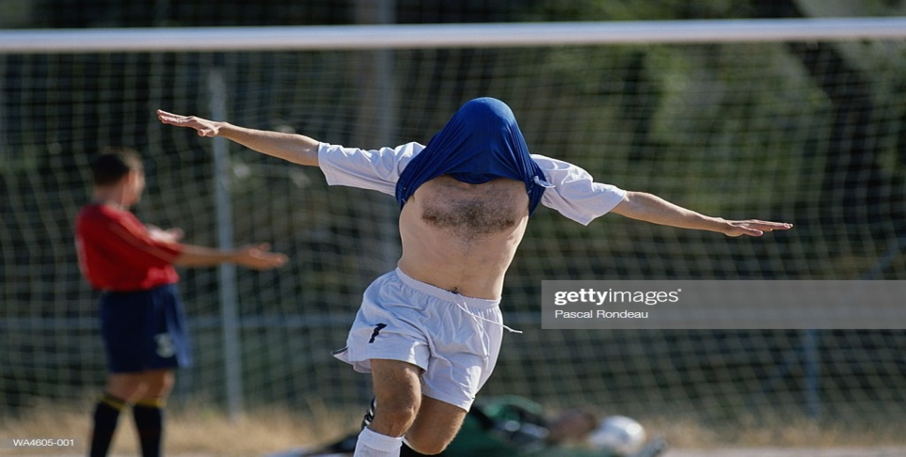
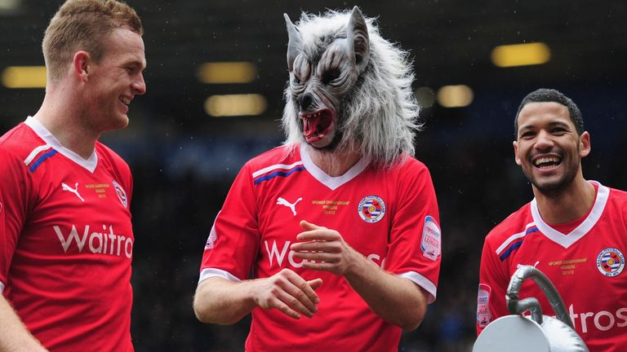
Goal Celebrations…
A yellow card must be shown for an illegal celebration regardless of whether or not the goal stands.

Slide 10
Goal Kick…
The ball does not need to leave the penalty area.
The ball is in play once it has been kicked and moves.
All opponents must remain outside the penalty area until the kick has been taken.

Slide 11
Handball…
Deliberate handball still remains an offence.
The following handball scenarios, even if accidental, will result in a free kick:
The ball goes into the goal after touching an attacking players hand/arm.
A player gains control/possession of the ball after it has touched their hand/arm and then scores, or creates a goal-scoring opportunity.
The ball touches a player’s hand/arm which has made their body unnaturally bigger.
The ball touches a player’s hand/arm when it is above their shoulder (unless the player has deliberately played the ball which then touches their hand/arm).

Slide 12
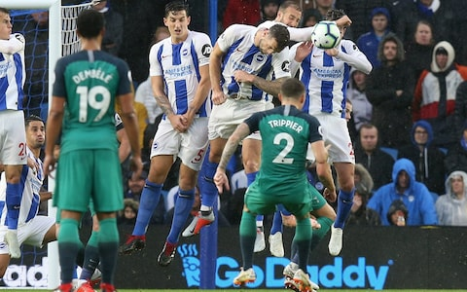
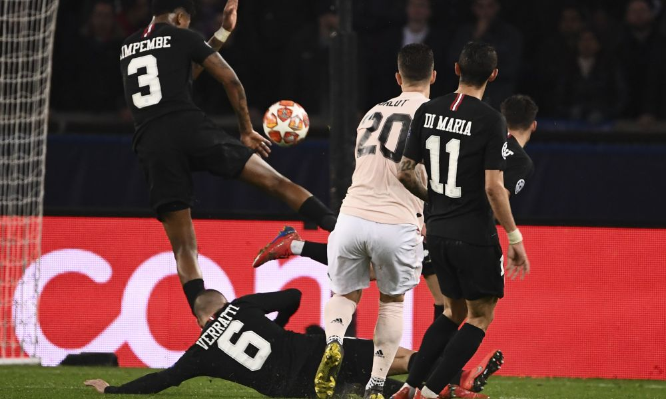
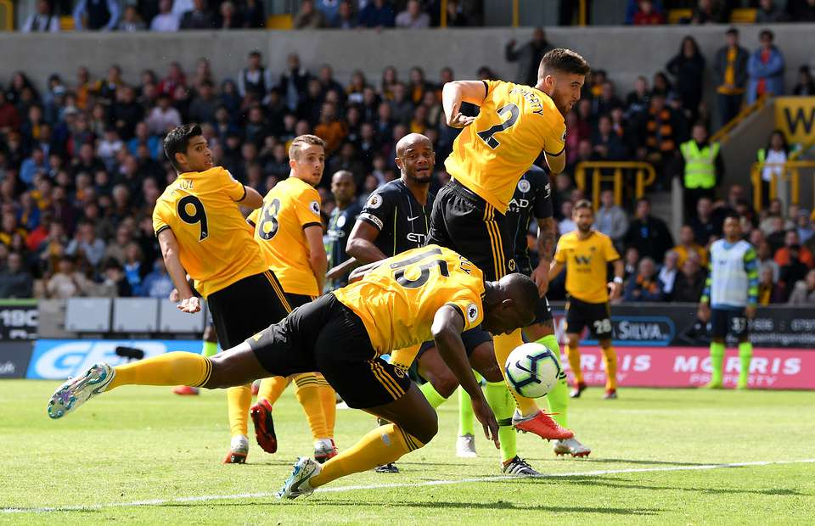
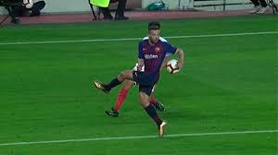
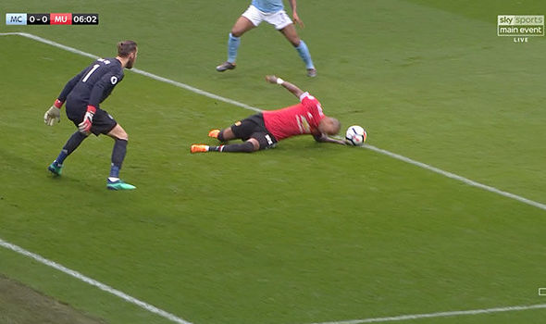

Slide 13
Handball continued 1…
The following will not usually be a free kick, unless they are one of the previous situations:
The ball touches a player’s hand/arm directly from their own head/body/foot or the head/body/foot of another player who is close/near.
The ball touches a player’s hand/arm which is close to their body and has not made their body unnaturally bigger.

Slide 14
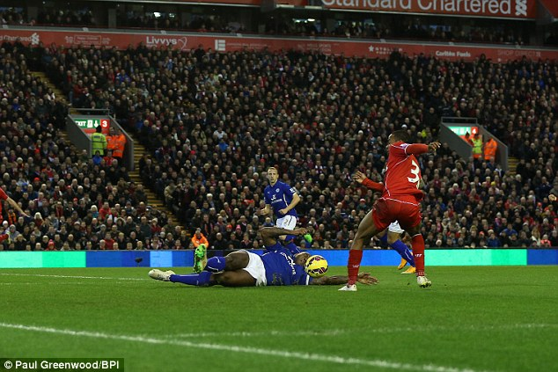

Slide 15
Handball continued 2…
The following will not usually be a free kick, unless they are one of the previous situations:
If a player is failing, and the ball touches their hand/arm when it is between their body and ground to support the body (but not extended to make their body bigger).
If the goalkeeper attempts to ‘clear’ (release into play) a throw-in or deliberate kick from a team-mate but he ‘clearance’ fails. The goalkeeper can then handle the ball.

Slide 16
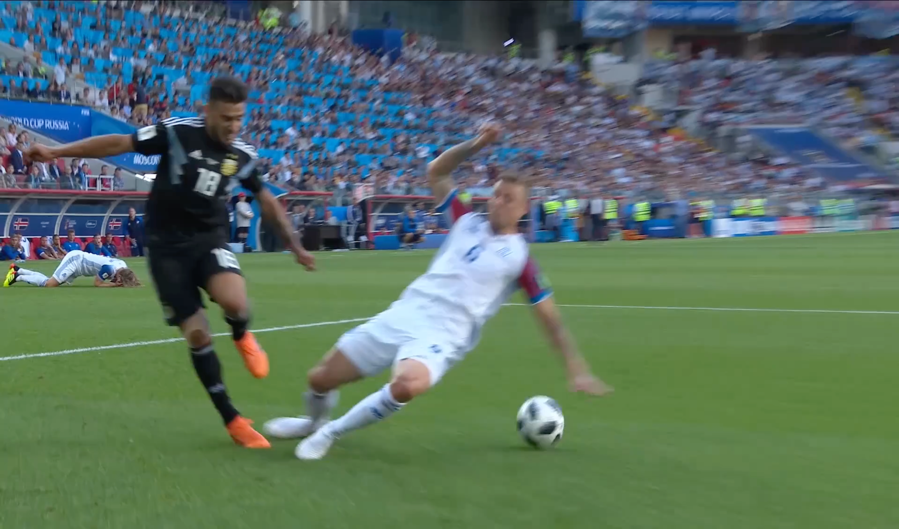
Offence if ball makes contact = hand/arm making body bigger
No offence if ball makes contact = hand/arm supporting body

Slide 17
Penalty Kick…
The team’s penalty taker can have (quick) treatment/assessment and then take the kick.
The goalkeeper must not be touching the goalposts/crossbar/nets; they must not be moving.
The goalkeeper must have at least part of one foot on/in line with the goal line when the kick is taken; cannot stand behind the line.

Slide 18
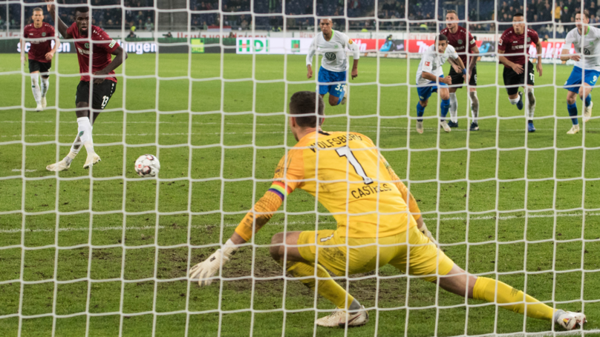
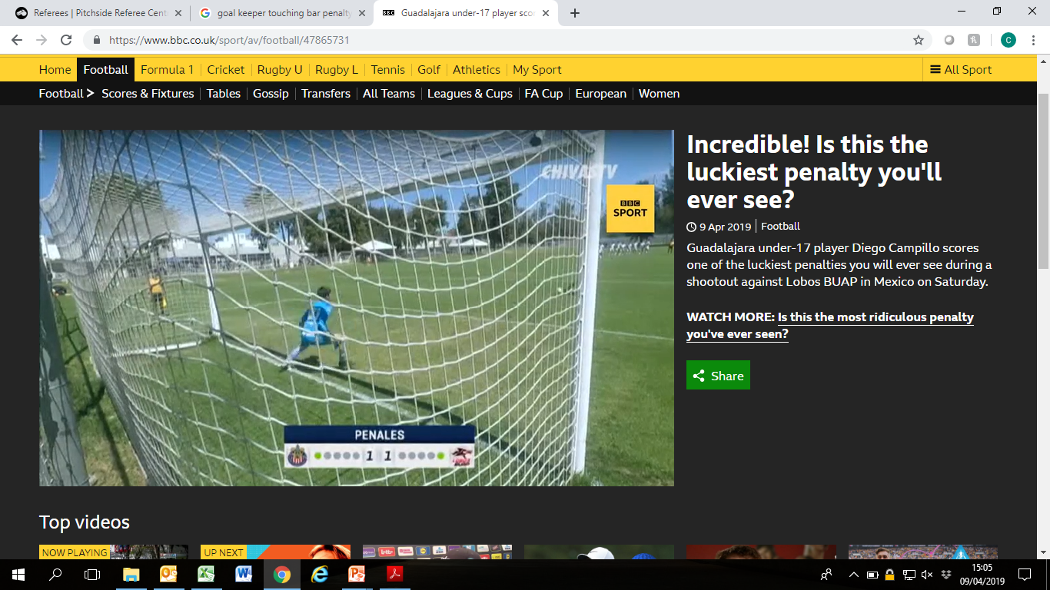

Slide 19
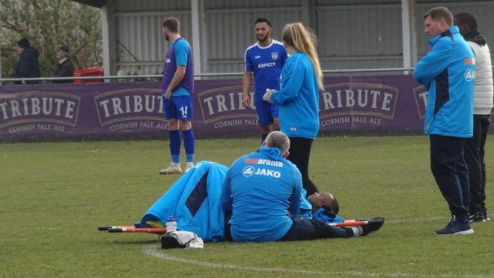
Substitutions…
A player who is being substituted must leave the field by the nearest point on the touchline/goal line (unless the referee indicates the player can leave quickly/ immediately at the halfway line or a different point because of safety, injury etc.)

Slide 20
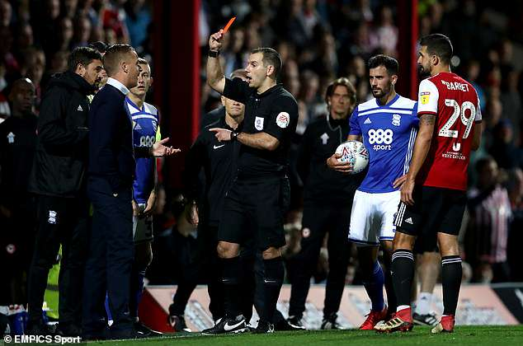
Team Officials…
A team official guilty of misconduct will be shown a Yellow Card or Red Card.
If the offender cannot be identified, the senior coach who is in the technical area at the time will receive the YC/RC.

Slide 21
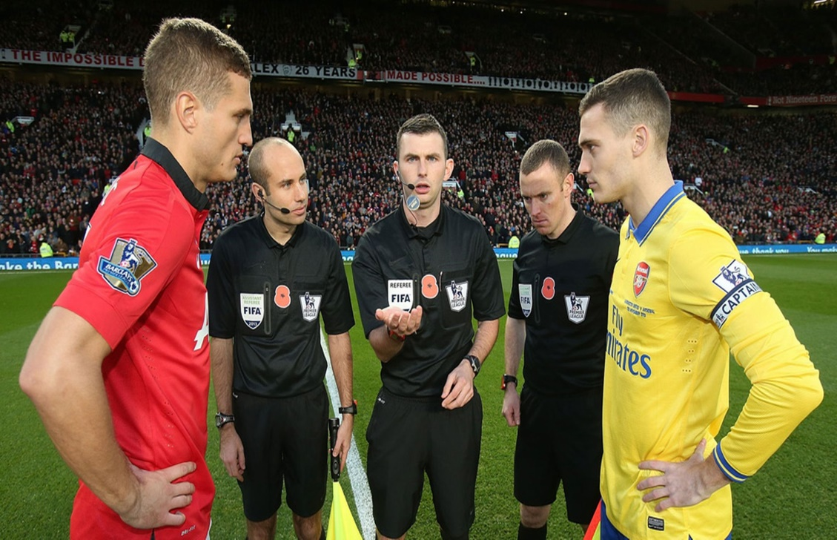
Kick Offs…
The team that wins the coin toss will decide whether they want to take the kick off or which goal to attack first.

Slide 22
Players Equipment…
Multi-coloured/patterned undershirts are now allowed if they are the same as the sleeve of the main shirt.

Slide 23
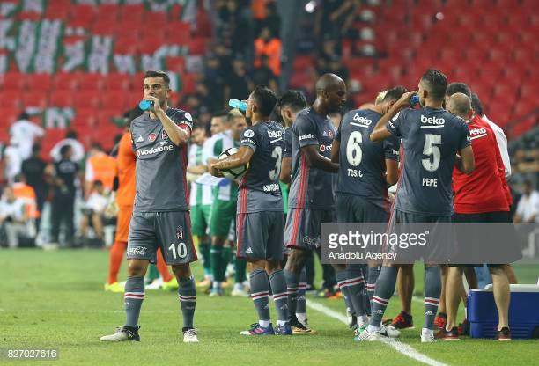
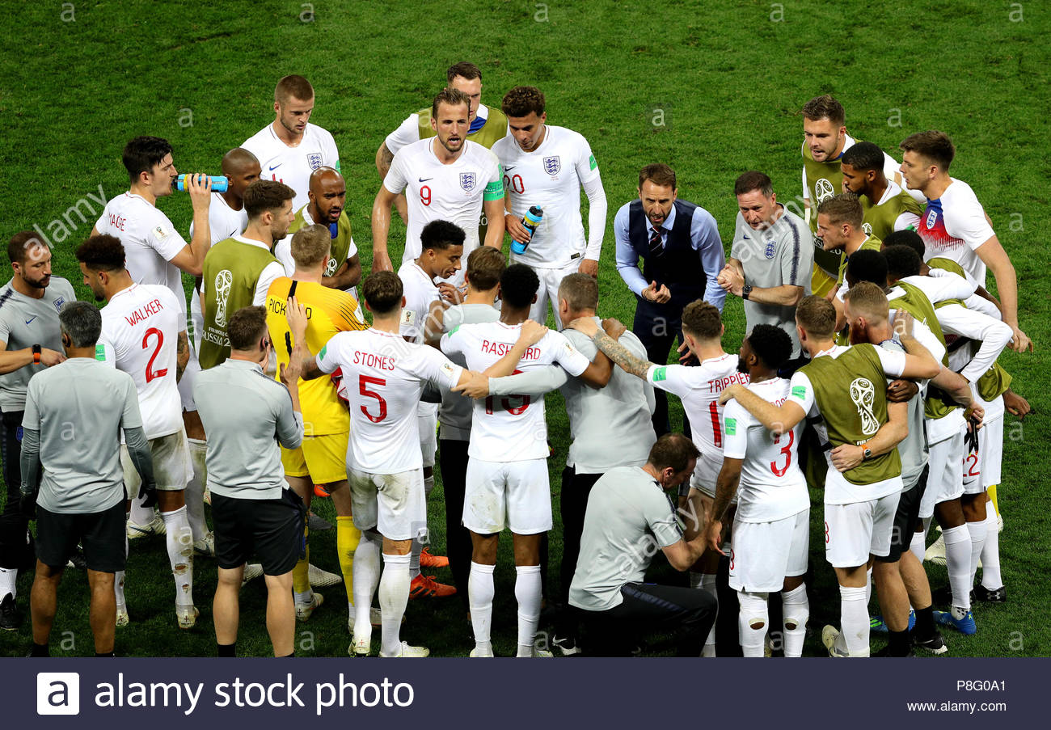
Medical Breaks
Cooling Breaks - Heat
90 seconds – 3 minutes.
Drinks Break – Half Time in Extra Time.
1 minute maximum.

Slide 24
These changes came into effect on the 1st of June!

