Slide 1
Female Football Study May 2020
Follow up to the Grassroots Football Survey Issued March 2020
Last data refresh:
5/1/2020 11:07:36 AM GMT Standard Time
Downloaded at:
5/1/2020 1:48:44 PM GMT Standard Time

Slide 2
Purpose
This report looks at 3 key areas highlighted within the Grassroots Football Survey Results 2019 (GRFS) where the County has scored low in comparison to other Band A CFA’s or All Counties as a whole.
Using a shorter discovery based survey we are able to isolate these areas through emotive responses to help us understand how we can best support participants over the coming months.
The survey was sent to all those who are involved within the female game from the Whole Game System. The format was text questions followed by three supplementary video questions to support greater insight.

Slide 3
What Did we Ask and Why?
To help create the narrative we needed to understand who was completing the survey, gender, age, role in football and length of time within the female game.
Tenure in the game is important, 34% of those completing the survey have been involved for 10+ years, the majority within a playing capacity. Female players feeling supported by the CFA is one of the areas covered where we score low in the GRFS
The following three questions requested a video response;
Do you feel that Birmingham County FA offers an adequate range of formats for females to participate in football? Highlighted as an area to address within the GRFS, this aims to prompt thought on what alternative formats participants would like to play
In your opinion what are the standard of facilities like that you mostly use? What do participants really think? Do they differ from the male game? What can we do to help?
Are you aware that Birmingham County FA has a dedicated Female Participation Officer? This is about relevance and awareness, NOT whether the individual is performing in their role. We fall almost 50% short of the national average around female players that feel supported by their CFA. How do we improve this?

Slide 4
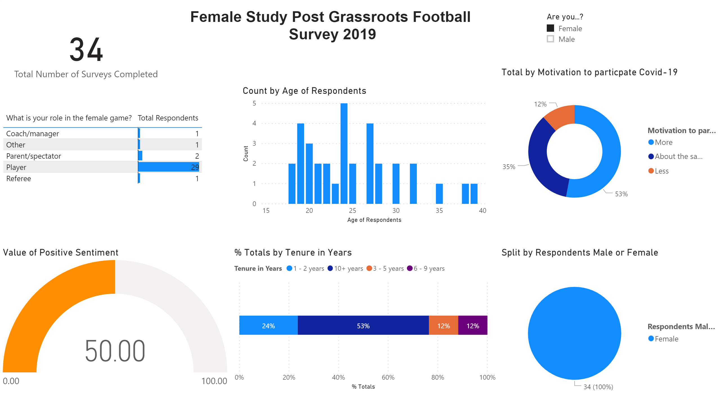
Data on female only respondents

Slide 5
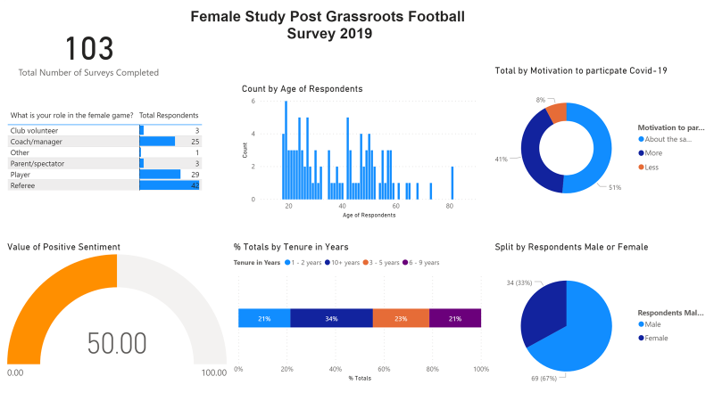
Aggregated data of all respondents

Slide 6
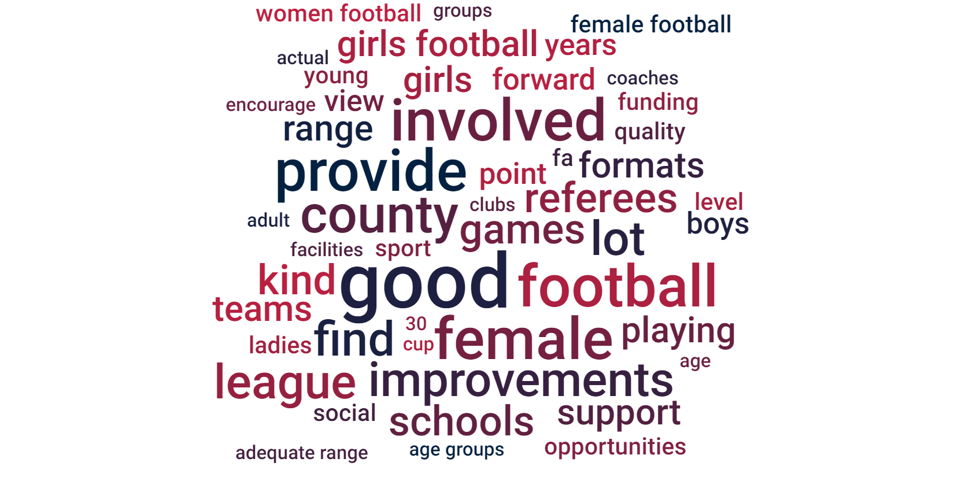
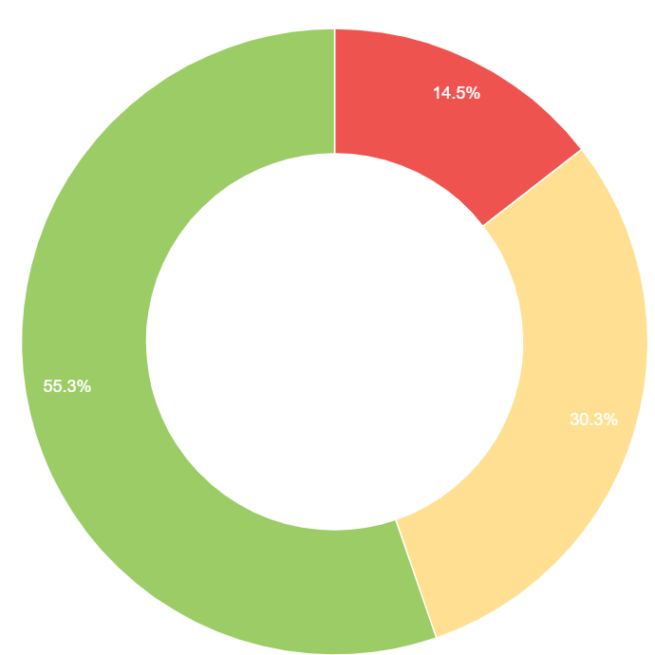
Using text analytics we can understand the key themes respondents discussed when asked about the range of formats Birmingham County FA offer for females
The key words create sentiment or feeling towards the question being asked, overall respondents feel that Birmingham County FA provide an adequate range of formats and opportunities for female participation

Slide 7
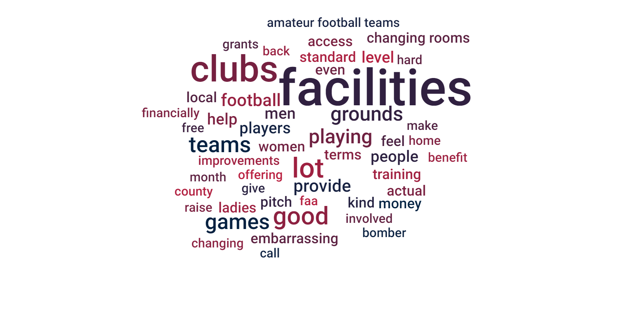
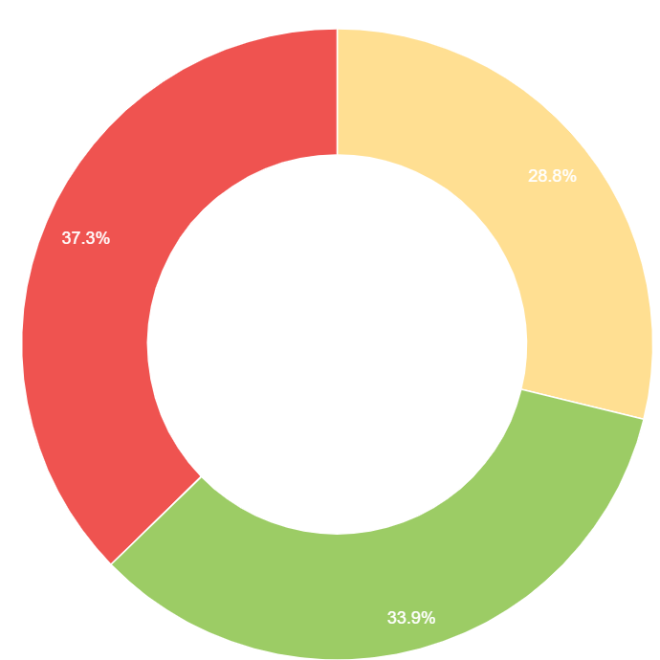
Using text analytics we can understand the key themes when respondents were asked about facilities used within the female game
Analysing the sentiment behind the words used show a negative feeling towards the standard of facilities used within the female game

Slide 8
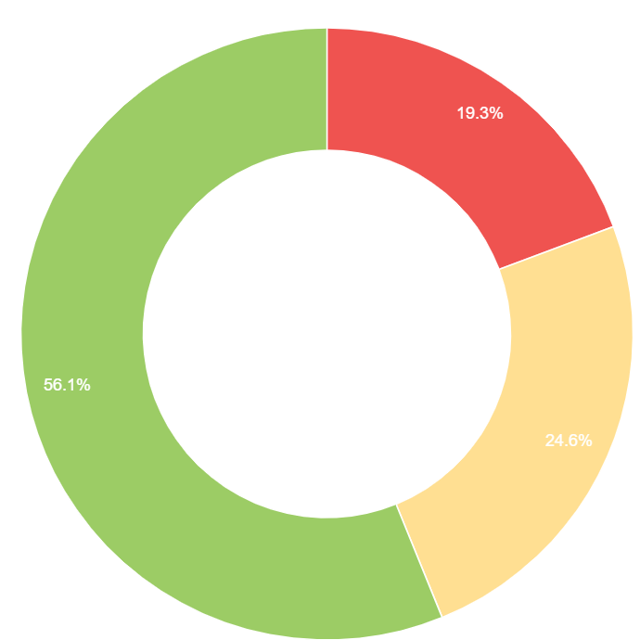
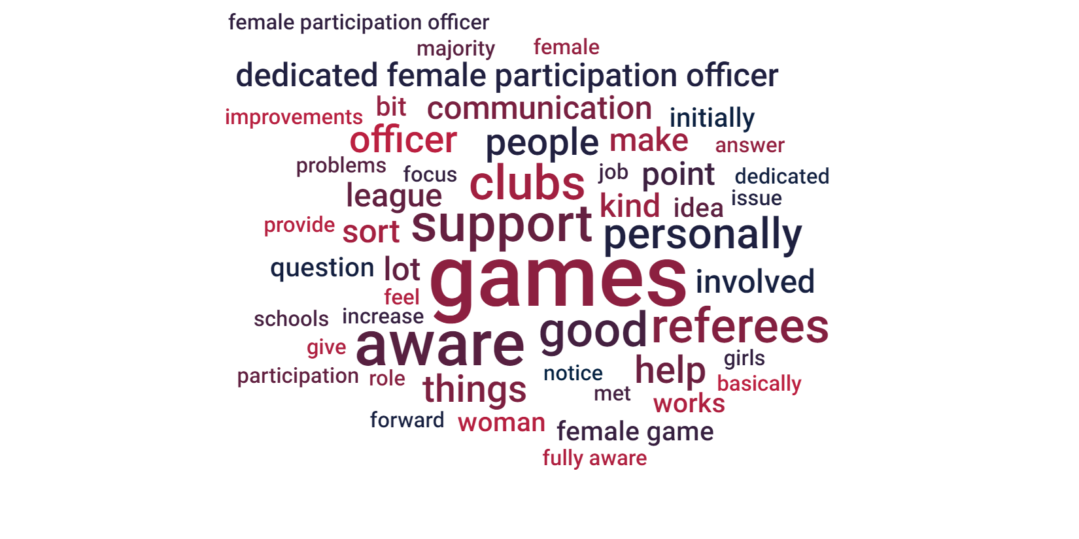
Using text analytics we can understand the key themes when respondents we asked if they were aware that the County FA had a specific Female Participation Officer
Strong positive sentiment when respondents were followed up with how this role could better support them

Slide 9
Video Responses
Please see below links to the video responses, just click to start
Question 1. Do you feel that Birmingham County FA offers an adequate range of formats for females to participate in football?
Question 2. In your opinion what are the standard of facilities like that you mostly use?
Question 3. Are you aware that Birmingham County FA has a dedicated Female Participation Officer? How could they best support you in your role?

Slide 10
Feedback Considerations
Access to social & recreational female football to supplement the positive league structure
Consider the feasibility of further over 30’s, Futsal & Walking Football provision
Better links with local schools to encourage female participation at an earlier age
Facility share scheme with larger well established male clubs
Poor facilities impact how players feel about football “embarrassing” is quoted
Player registration could further support awareness and direct engagement with the end user - what messages do we want to share?
Share more widely the work done by the Female FDO, using clubs & teams to create testimonials and good news stories

