Slide 1
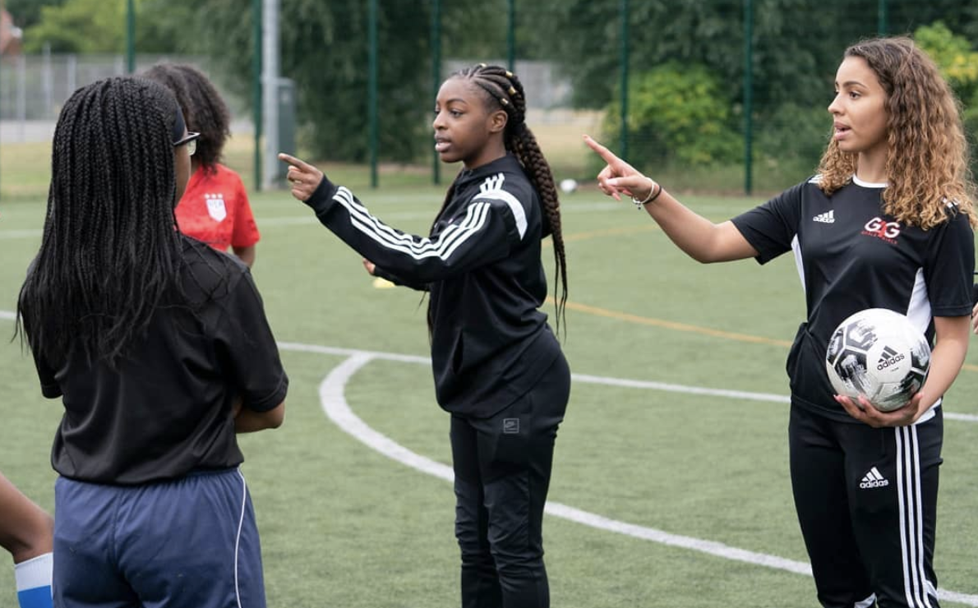


Slide 2

ABOUT
On June 8th, 2021, we proudly launched Save Today, Play Tomorrow the first of its kind sustainability programme in the UK that looks to empower grassroots football to support our ambitious goal of creating a low carbon greener game across the region
Why?
As a governing body, we recognise the need to take action now to ensure the beautiful game significantly reduces its environmental impact, whilst helping to educate those involved in football at all levels to make informed decisions that will shape how much future generations will be able to enjoy the game.
Notes:
Recap
It is worth remembering that this started as a conversation 2.5yrs ago around plastic waste in the game on our two-pitch site and how we could look at innovative ways to reduce & remove these levels and the impact that plastic and waste generated from within the game has on the environment – single use bottles – 11m a week? cones, shin pads, samba goals, shampoo bottles, strappings/medical waste, corner flags, boots, kit, printed programmes, etc
It quickly escalated into a maverick piece of work that had the potential to positively impact individual health, local community health and planetary health
I am sure you have all seen on the news the report by the independent Climate Change Committee predicting warming will hit the UK harder than first thought.
It warns of more severe heatwaves, especially in big cities, even poorer air quality and more intense rainfall, with an increased flood risk across most of the UK.
It says homes, infrastructure and services must be made resilient to floods, this will include football venues
Grassroots football already loses on average 5 weeks per season due to extreme weather conditions, with more than a third of those losing 2-3 months (Game Changers Report) things are set to get worse!
Taking action now means we are leading from the front in terms of sport & sustainability, opening opportunities for collaborative partnerships, commercial investment and how policy & legislation may be shaped and to safeguard the game for future generations

Slide 3


UN Sports for Climate Action Framework
In February 2021 we were accepted as participatory members of the UN’s Sport For Climate Action Framework, the first County FA to make this commitment
The activities under Sports for Climate Action have two overarching objectives:
(a) Achieving a clear trajectory for the global sports community to combat climate change, through commitments and partnerships in congress with verified standards, including measuring, reducing, and reporting greenhouse gas emissions in line with well below 2 degree scenario as set out in the Paris Agreement;
(b) Using sports as a unifying tool to drive climate awareness and action among global
citizens
Notes:
The UN Sport 4 Climate Action Framework - We now sit at the same table as The FA, Liverpool, Arsenal, Spurs, Southampton & Forest Green Rovers as part of this programme – and we have a voice and input
Also the IOC, Formula E, World Sailing and plethora of other world & national governing bodies
Sport 4 Climate Action has 2 clear objectives
1. To measure, reduce & report greenhouse gasses aligning to 1.5c commitment from the Paris Agreement
2. Use the power of sport as the vehicle to drive climate change awareness and behaviour change – this is our opportunity
The Framework has 5 guiding principles;
1. Undertake systematic efforts to promote greater environmental responsibility
2. Reduce overall climate impact
3. Educate for climate action
4. Promote sustainable and responsible consumption
5. Advocate for climate action through communication
From September we will be responsible for regular reporting our progress back to the UN on these 5 principles

Slide 4

UN Sustainable Development Goals (SDG’s)
Notes:
Some of you may have seen these before, these are the UN’s Sustainable Development Goals or SDG’s, adopted by member states in 2015
There are 17 goals, with 169 targets they recognize that ending poverty and other deprivations must go hand-in-hand with strategies that improve health and education, reduce inequality, and spur economic growth – all while tackling climate change and working to preserve our oceans and forests.

Slide 5




Sustainability Priority Areas
Good Health & Wellbeing
No Poverty
Quality Education
Gender Equality
Decent work & Economic Growth
Reduced Inequalities
Peace, Justice & Strong Institutions
Partnerships for the Goals
Quality Education
Good Health & Wellbeing
No Poverty
Gender Equality
Decent work & Economic Growth
Reduced Inequalities
Peace, Justice & Strong Institutions
Partnerships for the Goals
Affordable & Clean Energy
Industry, Innovation & Infrastructure
Sustainable Cities & Communities
Responsible Consumption & Production
Climate Action
Life Below Water
Life on Land
Partnership for the Goals
Climate Action
Life Below Water
Life on Land
Responsible Consumption & Production
Peace, Justice & Strong Institutions
Partnerships for the Goals
Notes:
The Save Today, Play Tomorrow workstreams align themselves with 4 of the SDG’s,but all 17 can and do sit across the headings
Over the coming slides I will talk through the 4 workstreams and some of the activations that are in place or due to go live shortly, there is still some refining of targets and metrics of success to be completed

Slide 6
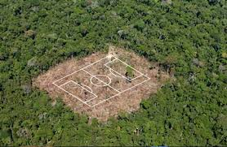
Birmingham County FA HQ
Zero to landfill partnered with Veolia
Carbon Trust Assessment completed
5 Qualified Mental Health Champions
2 public access hydration stations installed
2 EV charge points installed
Organic eco-friendly pitch care products used
£20K Club Innovation Fund launched 2019
£25K Green Innovation Fund Launches 2021
First ever Sustainability Pledge
Used WGS data over 6 seasons to create first Carbon Calculator for clubs
Notes:
Since our switch to Veolia we have collected over 11,000kg’s of waste from the BCFA HQ, 0% to landfill, 1,314kg’s diverted to create energy (heat & light for local homes) 9,852kg’s recycled.
Carbon Trust recommended simple fixes to create more efficient hot water, heating & lighting in the offices
External Hydration stations added for public use during match days & events
Grant funded EV chargers (£700 government scheme)
Innovation fund supported clubs with defibs, hydration stations, recycling bins etc
Green Fund – will support clubs solar panels, EV chargers, Mental Health Training, Carbon Literacy training, rain water harvesters & cycle racks
Sustainability Pledge partnered with award winning charity Pledgeball to create tangible commitments linked to football activity that educate carbon savings
Live calculator on BCFA website for clubs to look at indicative travel emissions, c.0.5 tonnes per season on top of the average persons 9.5 tonnes so for us that’s 35,000additional tonnes of CO2 created through football
Scale that up across the 11 million players reported to play and its 5.5 million tonnes of Co2 per season!

Slide 7
National Events
Notes:
We recognise that we can not change the game on our own, we will need the support of regional and national partners to leverage behaviour change events like this are perfectly placed to use football as a vehicle for positive climate action
The Great Big Green Week will take place 18 – 26 September 2021, and will be the largest event for climate and nature ever seen in the UK. Thousands of events will celebrate how communities are taking action to tackle climate change and protect green spaces
We have created a week long event for clubs to register and sign up to, details are TBC

Slide 8



Notes:
Health & Wellbeing
This is about creating opportunities for volunteers within clubs to become more aware of mental health issues, to make resources available and the opportunity to become qualified as MH champions
As a starter for 10, Mind & UK Coaching have an accredited course that we are actively promoting for £12pp, but I am also collaborating with Mind (Burton & Tamworth) to offer a bespoke football based MH training programme as a pilot scheme
Targets should be set to for year 1 & year 4, on how many MH champions have been qualified but these are still need some refinement
Point to note that for courses done outside of FA Education, we are not able to capture the data as yet on who has completed qualifications. The pilot programme will give us this but the UK coaching course does not

Slide 9


Notes:
Positive Education
Save Today, Play Tomorrow has a dedicated education hub section on the website where individuals can find out more about our plans and better understand the issues we face. We need to mindful that information shared here is non political & balanced, whilst driving conversations and debate
In addition the page has links to all of the Local Authorities and their Sustainability Plans plus,
Access to additional learning from the Carbon Literacy Project Course, having completed this in March I can recommend it to anyone who has an interest in learning more about climate change & impacts
Planet Super League were one of the first partners to come on board, for those who don’t know they are fan engagement sustainability start-up that engage with pro-clubs and their community trusts to recruit families to support their local club through meaningful carbon saving activities
They started with 12 clubs and for season 2 that has just finished they had 24 clubs plus us. From our region, WBA, AVFC, Burton Albion& Wolves were involved.
At the final count there were just short of 100 registered BCFA families taking part which is similar numbers to the pro clubs
Coverage on this was huge online with Sky Sports presenter David Garrido fronting a weekly Instagram TV show on the activities
For those interested Chesterfield won season 2!
Additionally I have included a directory that contains information on organisations who are subject matter experts as well as a resource section where visitors can download sports based climate change material, or understand further literature that can support their learning and education
Finally here, We have partnered with WM-Air based at the University of Birmingham to offer more scientific research into the effects of poor air quality on football, we know from the initial high level study that over 50% of our venues are in areas where levels of dangerous toxic PM2.5 exceed World Health Organisation recommendations. More work is going to be carried on this side looking at mapping venues to public transport, Exploration of impacts on athletic performance, and undertaking a health impact calculation study on populations from changing behaviours to more active means of travel. The Football Foundation have also expressed a recent interest in knowing more about STPT and the air quality initiative
Year 2 in this workstream will also see the introduction on “how to guides” for clubs around sustainable events, festivals & tournaments

Slide 10

Notes:
Climate Action
For the 21/22 season we have introduced the first ever sustainability pledge for clubs to sign when they affiliate, we have created a smart digital asset pack for clubs to use to share that they have signed the pledge and a certificate for the clubhouse/changing rooms
So far 34 clubs have registered with just over 100 teams involved, the target is 100 clubs c.400 teams
Signing the pledge will mean the club will make commitments based around 6 key sustainability elements
Travel
Waste
Energy
Water
Food
Community Engagement
We have linked our pledge with an online partner called Pledgeball who’s digital platform will be able to calculate carbon savings made by these clubs and produce a league table that will be hosted on our Climate Action webpage.
Pledgeball’s platform allows people to join at any point during the season to support their member club. For information Pledgeball have recently won FootballCan2041 a worldwide competition sponsored by Santander to find innovative solutions and projects to help create a better, more inclusive, diverse and sustainable game
To support more sustainable travel I have created a travel based interactive carbon calculator where clubs can look over the last 5 seasons to see what their estimated travel carbon emissions are. This is based on player data from WGS, coupled with home ground information and open source government data
Next here we have the circular economy for kit which is proving a bit of headache and may move to year 2 delivery,
This is about the waste created by clubs due to the purchasing of kit, particularly in the youth game. There are currently no models in place that help with keeping kit in circulation for longer, reusing and eventually recovering for recycling – Interestingly these schemes are quite common for school uniform. Initial conversations around a hand-back or subsidised purchasing model with Vesey were considered not viable for them as business. However I have sourced a small charity based in Exeter that run a donate/resale charity for grassroots rugby ploughing the money back into the local game. I am looking to pilot this with my own club initially before going wider.
Birmingham Energy Initiative - The purpose of the partnership is to provide football clubs from across the region an understanding of why climate action matters, how it is connected to football, and how clubs of all sizes and their communities can benefit by working together to achieve a common goal, related mainly around energy consumption but also being proactive about fuel poverty which it is estimated affects over 300,000 households across our region – it will also potentially impact football participation if households have a choice between football and basic human needs.
Lastly here we have Refill & Plastic FREE July, this goes back to the original idea of removing plastic from the game, Refill have an app with 30,000 venues included that offer free water refills, only 3 of those are football venues
We have added a further 6 recently through an online campaign and it is hoped more will come onboard following a more prolonged campaign during the next couple of months to remove single use bottles from the game – We even got local YouTube sensation Tekkerz kid to endorse the Press release and share a video with us!

Slide 11

Notes:
Example (interactive) Pledge

Slide 12

Notes:
Bio-Diversity otherwise known as Reconnecting Nature to football
This is about active communities, as we have seen through the pandemic football clubs became central hubs and lifelines whether through testing & vaccine centres or foodbanks clubs have the ability to positively impact their local surroundings
That said the canals & rivers trust are keen to work with us to help with clean-up, repair and planting projects across the 200km network they have in our region, we will look to pilot something small initially close to a venue or club and grow from there
This is also about clubs appreciating their own space, do they have wasteland or unused green area that could adopted by a local school as a nature reserve, could they create a rewilding space, a haven for wildlife, birds & insects?

Slide 13
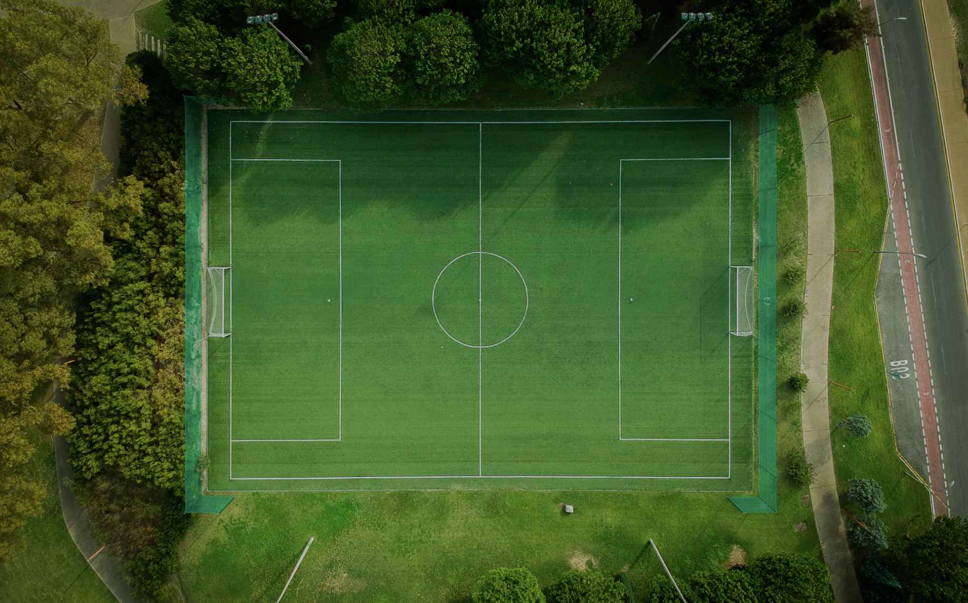

The Launch

Slide 14


The Launch
A full multi-media marketing campaign was created with easy to download and share digital assets across full suite of channels
126 organisations & individuals were identified as key players in the launch, these included current partners but most from outside of the County FA/FA network
Segmented audiences were created from the WGS database
Call to action messaging was created for each audience on how they can get involved
Use of Oporto to support media reach
Complete webpage rebuild including interactive tools
Partners were key to amplifying the messaging
Notes:
The Launch
Just after World Environment Day (5th June) across all media including 3 new social handles specific for Save Today, Play Tomorrow and its own brand & identity
New socials were decided to give the programme gravitas, & credibility in this space, capturing new audiences that might not have seen the launch via our busy football channels
Examples of the key players included FA staff, local & national media, the Mayors office, Local MP’s & sustainability organisations across the West Midlands
Call 2 action emails were sent to segmented audiences with different messages to players, club officials, coaches & match officials on how they can get involved
Created interactive webpages, which I think is again is also a first of its kind within the FA (I am claiming!)

Slide 15




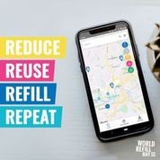



Our Partners
Notes:
These are the partners that have enabled to get to this position, there are more to come too as we build an effective alliance
BASIS – The regulatory body for sport & sustainability, very credible organisation we have been members for 2 years and they provide education, resources support & guidance – their course(s) are excellent
Planet Super League, Pledgeball, Birmingham Energy Initiative & Refill I have mentioned
Planet Earth games again are sport engagement charity who educate, influence and inspire people towards active, sustainable lifestyles. They are now global through the power of Zoom & Teams, and have British Olympian ambassadors working with them. The cover all sports except football and we are partnering with them for a month long campaign in August
UoB – This is the WM-Air Quality Team
Smol – The first real commercial brand that wanted to be connected to the programme, with not much football played recently, and not much kit to wash this has been a slow burner but it is hoped for the new season we can build some momentum through our digital engagement plan
None are what you would call out and out commercial partners but all offer us value

Slide 16


Coverage
BBC Sport webpage
Interview with CEO on 6.30pm Midlands Today
Interview with Richard on Radio WM
Discussion topic on the Price of Football Podcast
Richard Panel member on BASIS webinar
Mayor of West Midlands Office (visit being scheduled)
West Midlands Combined Authority WM2041 Team
BBC Bitesize Education Platform (Sept 21)
Nicola Richards (Conservative) MP West Brom shared her support
Sport Positive (Creators of the Premier League Sustainability Table 2019/2020)
Football For Future
Mental Health FA
Notes:
Since I have been involved at the County FA I have not seen a launch like this before, the coverage was phenomenal
This is just some examples of the coverage we have had had since the launch
The bottom 3 have a strong online following

Slide 17

Guess Who?
Morten Thorsby, 25 year old Norwegian midfielder currently playing for Sampdoria in Italy
He is a keen climate activist and in a recent interview is quoted to say
“I believe as athletes, we are part of society just like every one else. We have the platform and the ability to reach out to so many people in powerful ways. We really need to use this.”
Notes:
Morten Thorsby
Morten found his way on to the Save Today, Play Tomorrow Instagram site and liked a few of the posts over the first couple of days
I have since LinkedIn in with him and had a couple of exchanges around what we are trying to achieve, so it goes to show the reach of the programme launch

Slide 18
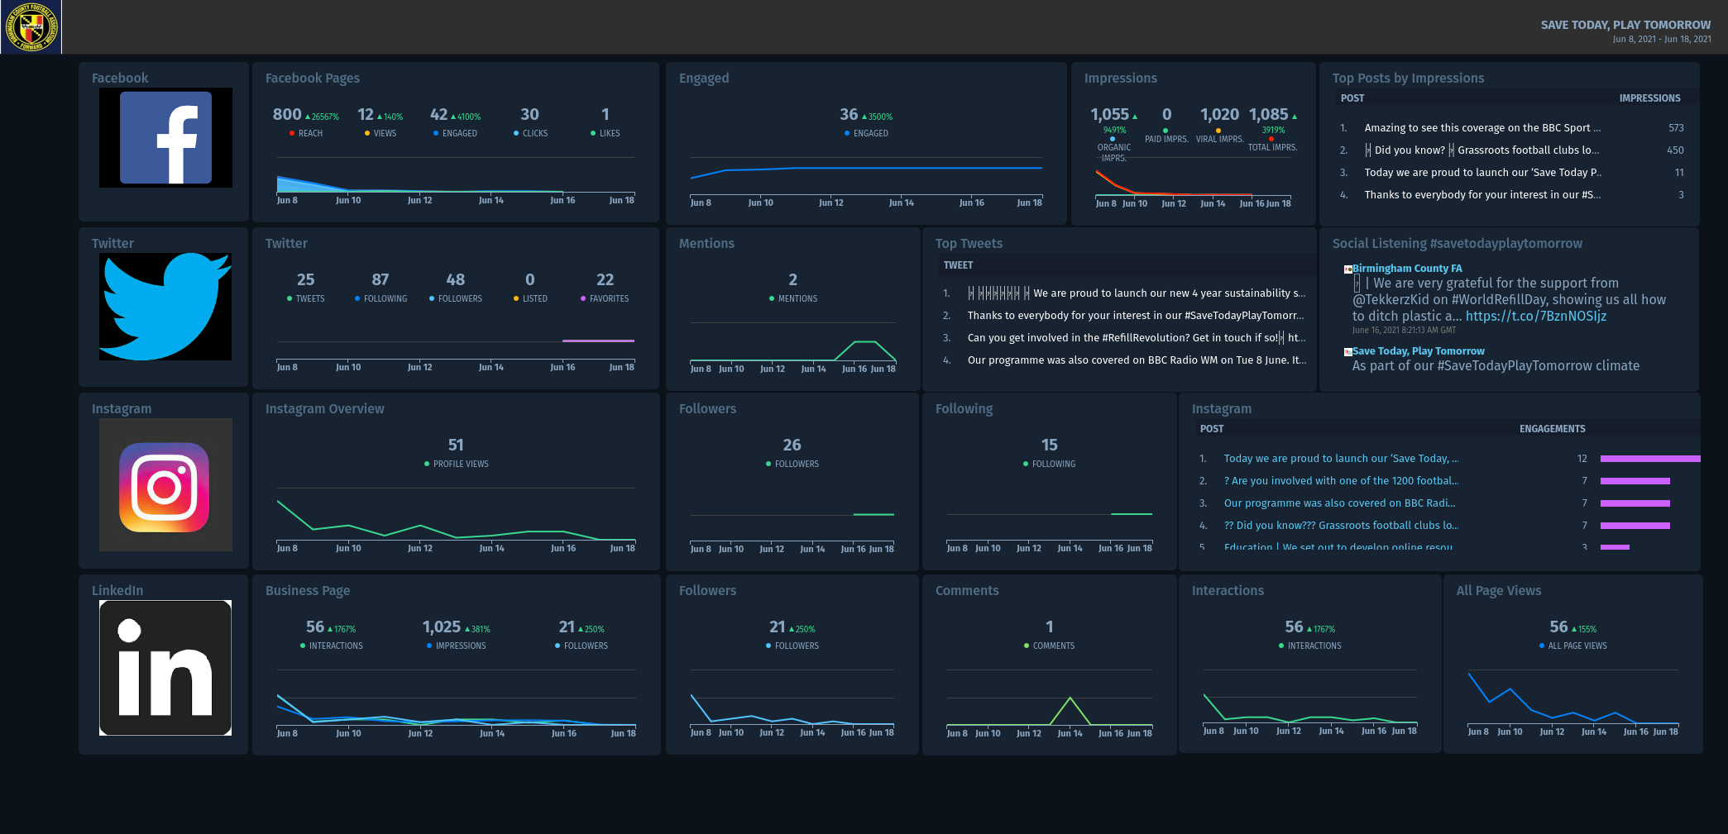
Data & Insight Socials
Notes:
All 3 of the new social platforms started fairly strongly and reach & engagement is growing daily, the key now will be to continue to drive engaging content that supports the delivery of what we are trying to achieve. Linkedin is opening new opportunities
Again website activity started sharply but we need to keep pushing people to the content on there and keep refreshing information

Slide 19
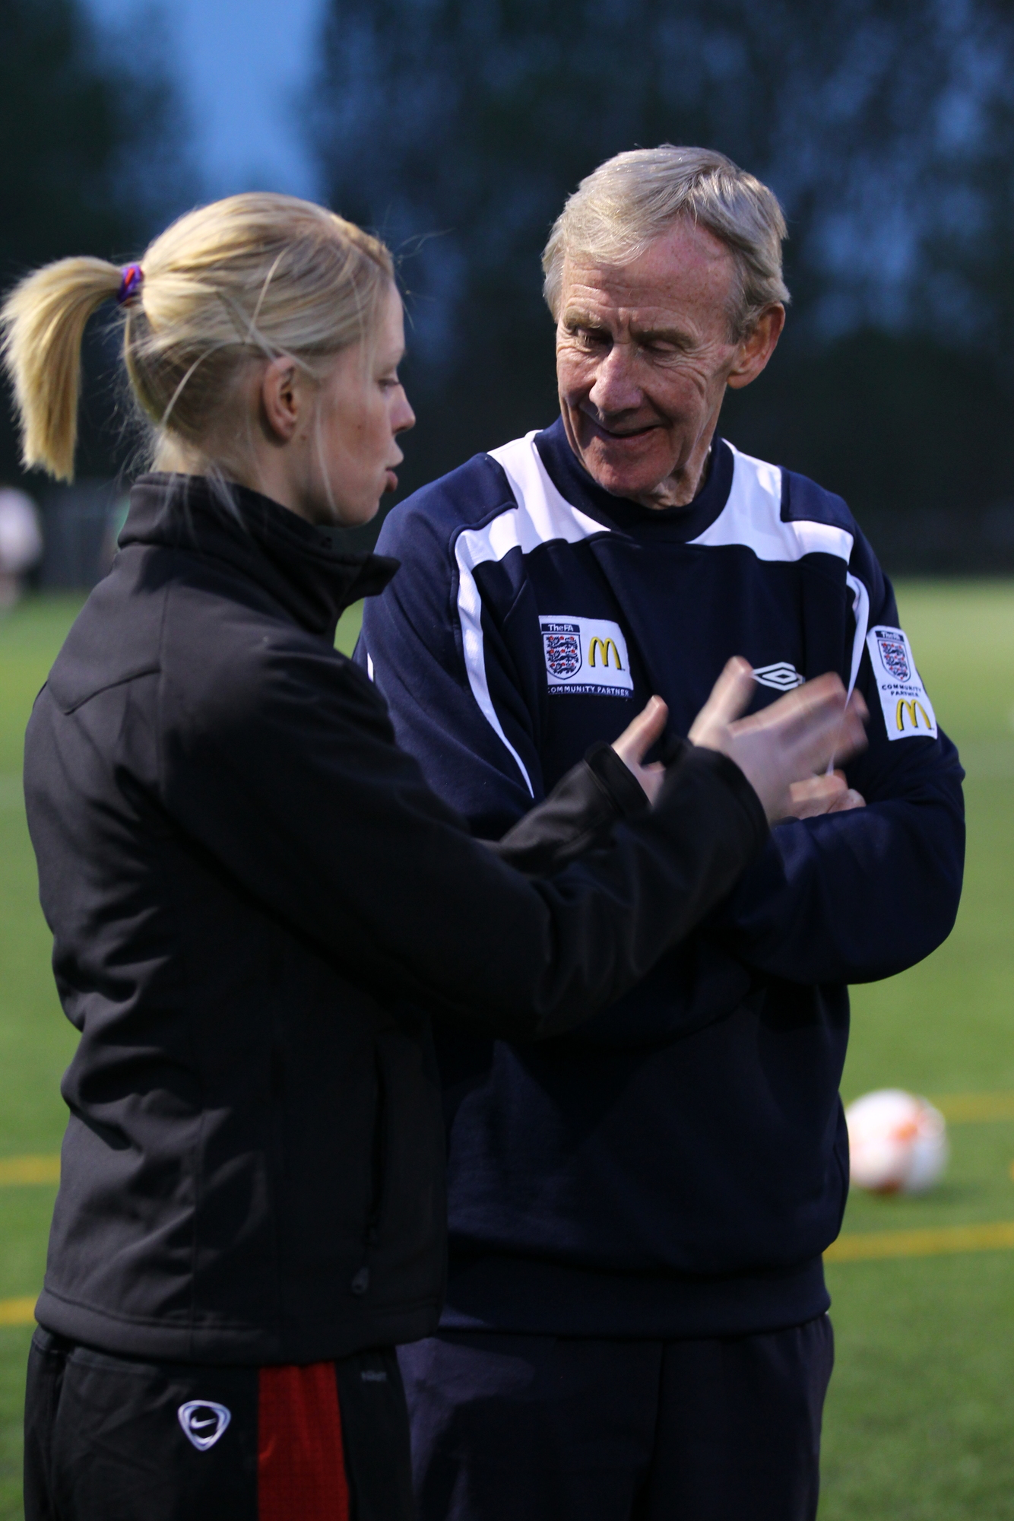
What Next?
Part of our S4CA commitment is around accurate reporting of scope 1 & 2 emissions, this will be annually from Sept
Understanding scope 3 emissions and what this means for football
Commit to reduce scope 1 & 2 by 45% no later than 2030, aligned with S4CA agreement
Understand and implement a way football can measure, avoid, reduce & offset GHG emissions
Consider our plans for COP26
Build our social audiences
Launch the Green Innovation Fund
Engage with new partners with the same values to support, promote, add value and potentially to finance – new money!
Notes:
STPT is our one, overarching big strategic ambition
Templates are being released and regular briefings are happening to help organisations implement this and their own ideas
Scope 3 are indirect emissions or as a result of activity for example travel to and from football
45% as an organisation
Use of green technology, investment & commercial sponsors
COP26 happens in Glasgow 1-12 Nov
Source influencers, create engaging content relevant to football/sport & sustainability – utilise our e-Sports competitions to magnify the messages, including RESPECT and discrimination
Expression of interest has been circulated to clubs need to decide a date to open the fund formally

Slide 20
Thank you & Questions

