Slide 1
SSE WILDCATS GIRLS FOOTBALL CENTRES
FROM THE FA 2018:
CFA Operating Guidance

Slide 2
CONTENTS
Page | Description
3 - 7 | Introduction : Purpose: Doubling female participation SSE Wildcats context & information
8 - 10 | CFA Responsibilities
11 | SSE Wildcats Deliverers key responsibilities
12 - 13 | The FA Responsibilities
14 | Timelines: Important dates
15 - 20 | Key Processes and Critical Success Factors
21 | Guidance on existing SSE Wildcats Centres
Note: | CFAs should read this Operating Guidance in conjunction with the SSE Wildcats Guidance for Applicants and The SSE Wildcats Pilot Debrief Report to enhance their planning and support to SSE Wildcats Centres for 2018.

Slide 3


SSE WILDCATS GIRLS FOOTBALL CENTRES FROM THE FA
INTRODUCTION

Slide 4
PURPOSE: DOUBLING FEMALE PARTICIPATION...
The FA has committed to doubling Women and Girls participation by 2020.
Key statistics show the need to provide a different offer to engage more girls in football:
The majority of girls prefer playing in female only teams
The earlier a girl starts playing football the more likely she is to have a long-term relationship with the sport.
The SSE Wildcats concept was introduced in 2017 to address the findings that only 3% of all mini-soccer teams cater exclusively for girls and as such only 41% of girls (compared to 95% of boys) under the age of 10 regularly play football.

Slide 5
SSE WILDCATS CENTRES
The Programme: The FA developed and piloted the SSE Wildcats Centres in 2017 to provide a different offer to engage girls in football.
Key Outcomes for 2018:
To deliver 800 new SSE Wildcats Centres in 2018.
To sustain our original 200 Centres.
CFA Role: The CFAs are requested to lead and manage the SSE Wildcats Centres delivery in their County FA area. The focus will be on deployment of these Centres in identified “hotspots” to encourage and sustain participation by linking the delivery network more effectively in order to support the doubling of female participation
Funding: Start-up funding will be provided by the FA for the SSE Wildcats Centres – for every approved new SSE Wildcats Centre the CFA will receive £1000 (£900 for the deliverer and £100 for the CFA towards administration) & 30 Nike footballs. An SLA will be provided between the FA and CFAs (as well as a template for CFAs to use with its Centres).
CFA Operating Guide: This guidance document outlines the key responsibilities of all partners and provides support information, processes and critical success factors from the pilots to support effective implementation and delivery.
Please also refer to “SSE Wildcats Centres: Guidance for Applicants” & the SSE Wildcats 2017 Debrief Report for further information

Slide 6
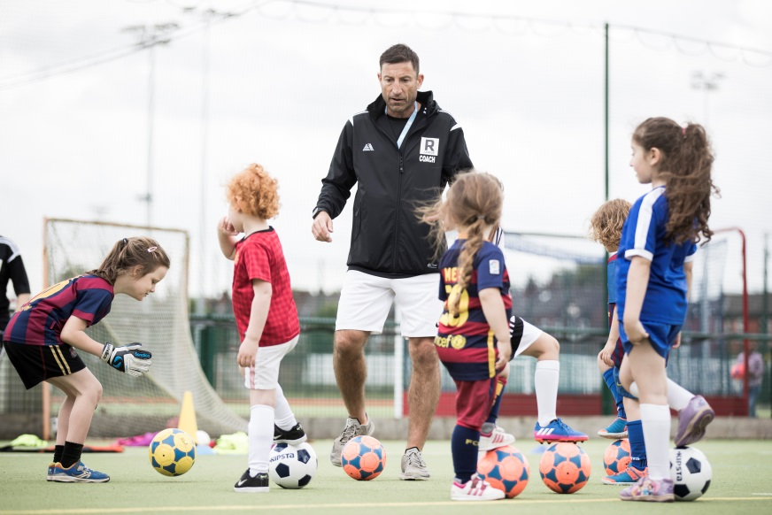
WHAT IS A SSE WILDCATS FOOTBALL CENTRE?
The aim is simple: Have fun, make friends, play football!
An SSE Wildcats Girls’ Football Centre is an opportunity for girls aged 5 – 11 to have fun, develop fundamental skills, try a variety of sessions and lay the foundations for a lifelong love of sport. The sessions are delivered on a weekly basis, either afterschool or at weekends.
By working in partnership with the
County FA, qualified coaches deliver
sessions locally, in a safe environment, to
provide girls with the opportunity to
experience football for the first time.
Having already established 200 SSE Wildcats Centres The FA and SSE are now
creating a further 800 Centres across England in 2018

Slide 7
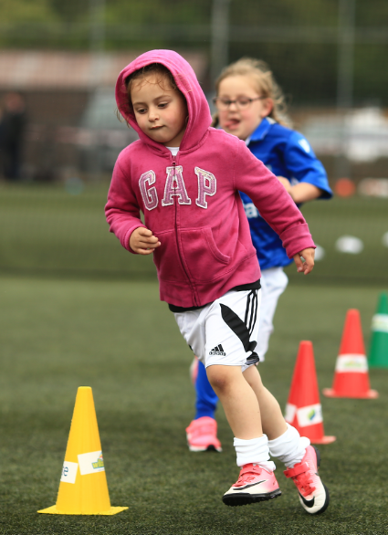
WHAT THE GIRLS (AND THEIR PARENTS & CARERS!) THINK
99% of Girls surveyed said that they “liked SSE Wildcats a lot”
Top 3 reasons for joining
SSE Wildcats:
I wanted to play football
I want to make new friends
I wanted to exercise
90% of parents & carers surveyed also “liked SSE Wildcats a lot”
85% of girls surveyed made new friends at SSE Wildcats!
“I like it because I like being a goal keeper and making friends” (Sophie, aged 5)
“I like the music games, I like stopping the ball in hoops, I love scoring goals, I like my friends, I love playing football at SSE Wildcats” (Naomi, aged 6)
“It’s a no pressure environment for the girls to have fun and improve their skills” (Gill, parent girl aged 10)

Slide 8
SSE WILDCATS CENTRES : CFA RESPONSIBILITIES
Responsibilities | Notes
Promote SSE Wildcats Centres and engage possible deliverers - encourage and support submission of applications - maximise quality and number of applications to meet local and national targets | Consider how you will support applicants in ensuring centres are inclusive
Contact 2017 SSE Wildcats Centres re process for continuing their delivery and help them develop possible new Centres if appropriate. Sign off any “refreshed” existing SSE Wildcats Centre applications within 5 working days where possible. | THE FA will contact existing deliverers directly re process on 2nd Nov.
Focus on “hotspots” to develop local delivery partnerships and enhance opportunities for girls in football | How will you manage strategic deployment into hotspots?
To make every effort to meet allocated target number of SSE Wildcats Centres allocated to the CFA Where possible ensure you have reserve applications. All reserve applications will need to be pending within the portal. | Reserve list in case of national shortfall against 800 target – eg if your allocation is 10 and you have 15 organisations that wish to apply, ask all to apply and approve best 10.
Support organisations with their applications : Brief re all criteria and accountabilities Share case studies and good practise re SSE Wildcats Inform re critical success factors for planning and delivery Ensure robust thought and planning for retention and sustainability. Link with local hotspot network to support recruitment & signposting for players | Don’t limit applications – generate as many as possible; then select best and approve; reserve and rank any extras

Slide 9
SSE WILDCATS CENTRES : CFA RESPONSIBILITIES
Responsibilities | Notes
Ensure relevant CFA staff attend training – FA webinars and national SSE Wildcats Centre training | Dates in SSE Wildcats Applicants Guide
Assess all applications against criteria. For example: Check all staff and volunteers – qualifications and safeguarding etc. H&S / safeguarding etc. – venue and organisation policies and documents Risk assessments | For all deliverers responsibilities and criteria please see the SSE Wildcats Applicants guidance pack Throughout process – CFAs check staff and update and re-check if any changes.
Approve target number of applications and establish a ranked reserve list | > Having ensured all criteria and standards met Note: Recommend that CFAs work with all organisations to get their applications in early and then check all staffing criteria are fulfilled as you receive applications to reduce workload at end of application process.
Communicate with all successful applicants and inform re next steps: Signed SLA to be returned to CFA FA training and dates (how to register) SSE Wildcats Centres - start preparing and recruiting immediately Info re Marcomms assets Info on funding / kit / national launch dates etc. Remind re management of registers and key documentation required | Template letter re comms to be provided by the FA SLA template to be provided by The FA for use by CFAs with SSE Wildcats Centres
Sign and return SSE Wildcats Centres SLA to The FA by 15th February

Slide 10
SSE WILDCATS CENTRES : CFA RESPONSIBILITIES
Responsibilities | Notes
Consider holding own induction for SSE Wildcats Centre leaders to support effective roll out and delivery . | The FA will provide a template presentation for CFAs to adapt and use.
Monitor and evaluate SSE Wildcats Centres regularly to ensure all delivery is taking place and support Centres where any issues arising In collaboration with the FA, to terminate any Centre where criteria is not being fulfilled. Power to halt delivery of and Centres sessions immediately where Safeguarding practise is not being followed and children may be at risk. | Use portal to track start of delivery and that registers uploaded. The FA to provide a monthly report on SSE Wildcats delivery. CFA to liaise with The FA Wildcats national team asap where urgent action has had to be taken.
Provide funds to centres – as agreed with FA (Two tranches) | Centres should receive 50% at the start of the programme and 50% half way through providing all registers have completed.
Carry out QA visits to centres (13% of approved centres). Meet Safeguarding Operating Standards criteria and review the Centres adherence to SSE Wildcats criteria | QA visits in addition to affiliated club visits. Support and advise deliverers on any issues and share other good practise.
To contribute to SSE Wildcats evaluation | The FA to lead and inform re contribution required
To share good practise and case studies | On HIVE sharing portal.
To market and promote SSE Wildcats through all channels

Slide 11
SSE WILDCATS CENTRES : DELIVERERS RESPONSIBILITIES
The CFAs is responsible for ensuring SSE Wildcats Centres fulfil all responsibilities
Main responsibilities:
Staffing: numbers, qualifications, Safeguarding and DBS, ratios
Recruiting players – hitting targets, inclusive practise
Completing registers and key paperwork
Enjoyable and participant centred sessions
Planning of retention and sustainability
Understanding football landscape and signposting next steps for players
.
Please refer to “SSE Wildcats Centres: Guidance for Applicants” document for more detailed information.

Slide 12
SSE WILDCATS CENTRES : FA RESPONSIBILITIES
Responsibilities | Notes
SSE Wildcats Project Owner and lead
Set national timelines
Set national targets and outcomes | Numbers; frequency; retained; sustained
Set criteria and expectations / key accountabilities for all partners | CFAs (Local lead) Deliverers – centres and Orgs.
M&E of all areas and Quality assurance process Set targets and process for monitoring delivery & centre visits – M&E/QA/ Safeguarding etc. | To include SSE Wildcats Centre criteria
Overview of national delivery and keeping project on track | Provide reports and track delivery
Power to terminate CFA / Centre SLA / programme | Centres in liaison with CFA
Allocation and tracking of funding to CFA - centres | Number of “centres” per CFA
Provide process and support resources – CFAs and Centres | Manual; promo assets; kit
Provide training for CFAs (Webinars and FDO networking) | Managing their SSE Wildcats centres locally; hotspots development. Use of Portal / Hive

Slide 13
SSE WILDCATS CENTRES : FA RESPONSIBILITIES
Responsibilities | Notes
Provide training for SSE Wildcats centre coaches (plus 1 x CFA Officer) | 2018 – range of dates provided at SGP
National promotion | 1 x launch – applications (Nov) 1 x Launch – participants (Mar/Apr)
Provide monthly reports – to individual CFAs Identify and share any good practise | Monthly reports to be provided to SRMs & national officers
Provide and manage portal for registers etc. and training for all stakeholders
Maintain key contacts and communication
Provide FAQ doc for CFAs and centres to support high quality delivery
Set branding criteria, implement and monitor adherence

Slide 14
SSE WILDCATS CENTRES : FA RESPONSIBILITIES
Responsibilities | Notes
Provide training for SSE Wildcats centre coaches (plus 1 x CFA Officer) | 2018 – range of dates provided at SGP
National promotion | 1 x launch – applications (Nov) 1 x Launch – participants (Mar/Apr)
Provide monthly reports – to individual CFAs Identify and share any good practise | Monthly reports to be provided to SRMs & national officers
Provide and manage portal for registers etc. and training for all stakeholders
Maintain key contacts and communication
Provide FAQ doc for CFAs and centres to support high quality delivery
Set branding criteria, implement and monitor adherence

Slide 15
TIMESCALES FOR SSE WILDCATS 2018
Action | Date
All paper work sent to CFAs | 1st November 2017
Application window opens | 1st December 2017
Application window closes | 8th January 2018
Deadline for approved list from CFA | 23rd January 2018
Successful Organisations notified | 1st February 2018
SSE Wildcats Training | February & March 2018
National, Regional & Local marketing | February & March 2018
SSE Wildcats start date | W/C 9th April 2018
FA Girls Football Week | 23rd -29th April 2018

Slide 16
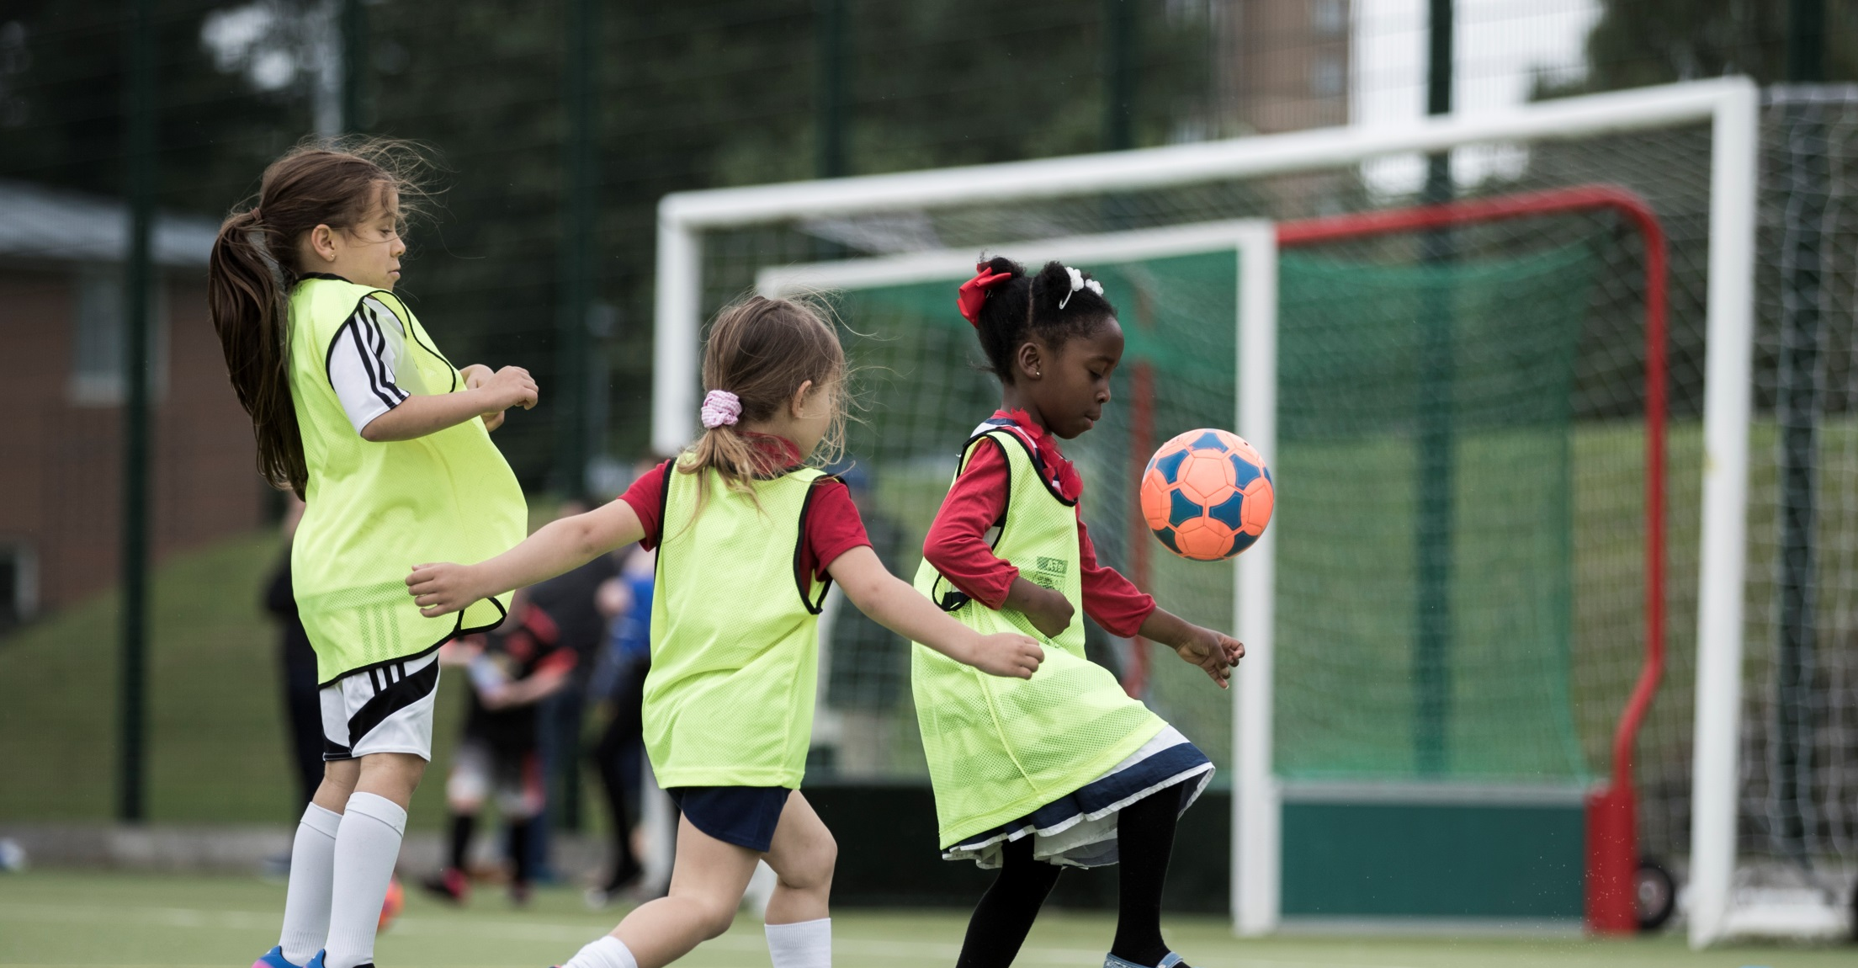

SSE WILDCATS CENTRES : KEY PROCESSES & CRITICAL SUCCESS FACTORS

Slide 17
Engaging with partners to ensure appropriate number & quality of applications to deliver SSE Wildcats Centres
Supporting SSE Wildcats centres to plan applications and meet criteria and responsibilities
Engage with key partners early to “commission” / enthuse re running SSE Wildcats (Nov) - prior to application window opening
Assess all applications as you go along to manage admin (especially staff checks) – develop approved list with reserves.
If a CFA is running SSE Wildcats Centres then final approval will come from The FA
Go through all criteria with them and assist in planning venues based in hotspots, ID staff to meet criteria, safeguarding, quals etc. Provide training dates in advance
Ensure you review with successful applicants the CSF to support SSE Wildcats centres in effective delivery: recruitment, doing the admin: registers, forms and QA visits.
Run own induction workshop
Plan with the end in mind – how will they sustain the SSE Wildcats centre?
How can you encourage development of opportunities for lower participant groups – considering, for example, disabled, BAME participation
Monitor and evaluate delivery: completion of registers and forms; numbers attending, QA, including safeguarding, visits

Slide 18
Supporting and working with SSE Wildcats Centres to plan effectively
Recruiting and engaging players
Planning with the outcome in mind
Please see tips and suggestions for effective engagement of players in “SSE Wildcats Guidance for Applicants”
It’s important that CFAs work with applicants to plan at the beginning how they will sustain the SSE Wildcats centre after the initial period
How will you support the 2017 SSE Wildcats Centres to keep activity going?
Some CFAs held their own SSE Wildcats induction – this helped in communicating key messages and developed relationships. You could also bring together existing SSE Wildcats Centres with new ones to share issues/ solutions and good practise

Slide 19

Supporting and working with SSE Wildcats Centres to plan effectively
What worked well in 2017:
Further information can be found in the SSE Wildcats Centres : Guidance for Applicants
Player Registers:
One of the key issues in 2017 was the completion of registers – please see the SSE Wildcats Guidance for Applicants for key processes.
One main solution to support this is for Centres to have a key person available to deal with this administration, especially for early sessions
Different organisations face different challenges in running SSE Wildcats Centres – how might you support them? See next slides for further detail.

Slide 20




The SSE Wildcats pilot was run by different types of partners, each of which have varied strengths and challenges – CFAs should consider the differing support organisations may require:
SSE Wildcats sessions were run by a wide variety of partners, such as Football Clubs, school affiliated centres, and community deliverers, and each type of partner boasts its own strengths and challenges
Football clubs
Community deliverers*
School affiliated clubs
Facilities
Coaches
Existing experience
Networks
Accesses untapped communities
Direct contact with the target audience
Facilities
Community links
Activity schedules
Parents’ trust
What defines success is coloured by the circumstance of each partner e.g.:
Football clubs will easily register 30 players
Community deliverers feel that registering 10 girls is also a big achievement
Strengths
May have conflict of interest with competitive girls teams
Lack experience, resources, and networks
Heavily rely on volunteers
Lack the technical football experience of a club
Challenges
With this in mind, it’s good to have a target but also to acknowledge the different difficulties partners may face in achieving that target

Slide 21






Time, effort, innovation and expertise put into marketing is key
Broadly, centres with the resources and expertise available to put a high level of thinking and investment into their marketing strategy saw correspondingly high participation.
Successful centres are using a broad range of marketing approaches
Partner with local organisations
Promote through own website
Targeted social media advertising
Use existing social media accounts
Advertise in local newspaper
Engage parents in promotion
Case Study
A Football Club experimented with Facebook advertising to promote the initiative.
They found the ROI much higher than using print advertising at £20 to reach 20,000 people
They were able to target the advertising to girls and parents of girls in the right area and age group
The centre attracted 45-50 registered players
“The ones being more proactive about marketing have definitely been rewarded with numbers.”
CFA

Slide 22
GUIDANCE ON EXISTING SSE WILDCATS CENTRES
Funding is not available for existing SSE Wildcats Centres
CFA should support and encourage all existing SSE Wildcats centres to continue their delivery and signpost them to refresh their centre profile on the portal i.e. update staff, confirm venue, day and time
If an existing SSE Wildcats centre wants to increase the number of clubs they run they can apply for funding to do so. For example, if Hunslet SSE Wildcats wish to run a new session, they firstly must refresh their existing profile and then follow the guidance to start a new application. Please note, they must continue to run their 2017 SSE Wildcats club to be eligible for funding to start a new club*.
*A new centre is in addition to existing SSE Wildcats Centres, it can be at the same venue, but it must be at a different time and have different girls attending.
SSE Wildcats Centres must therefore differentiate their Centres: e.g. Leeds North SSE Wildcats
Centre & Leeds South SSE Wildcats Centre

