Slide 1
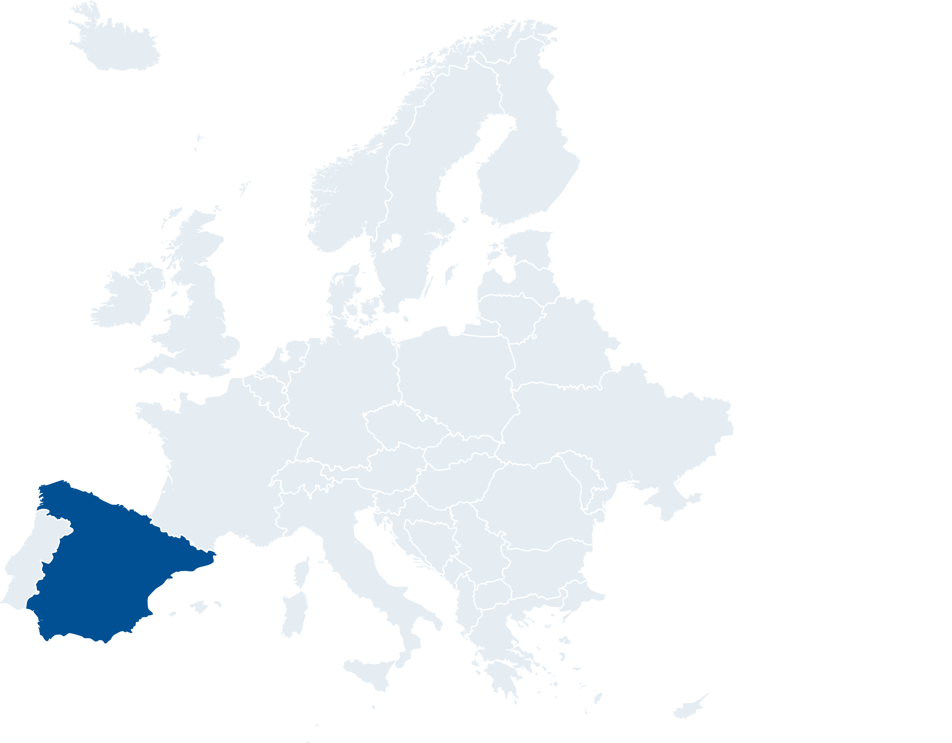

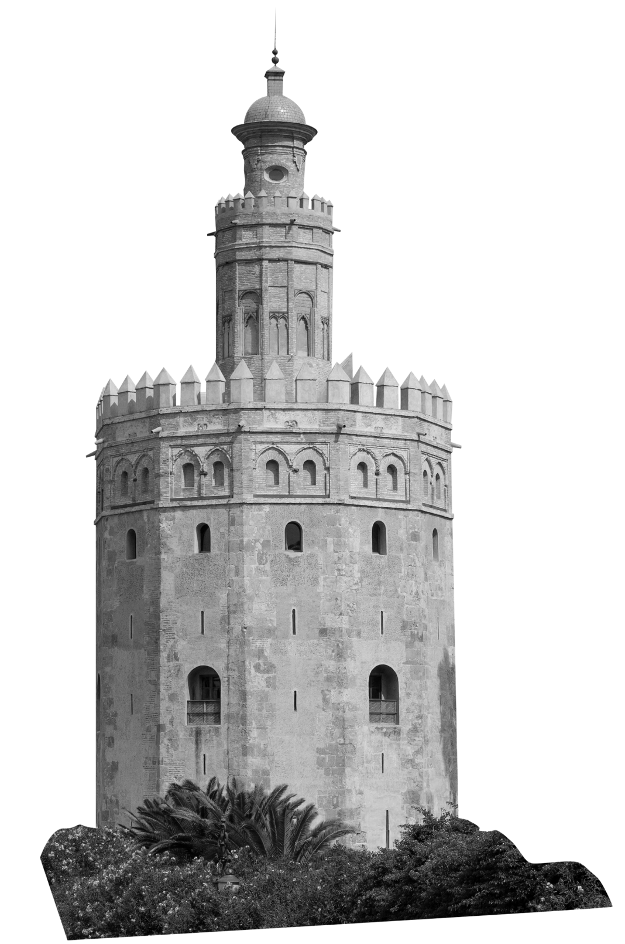





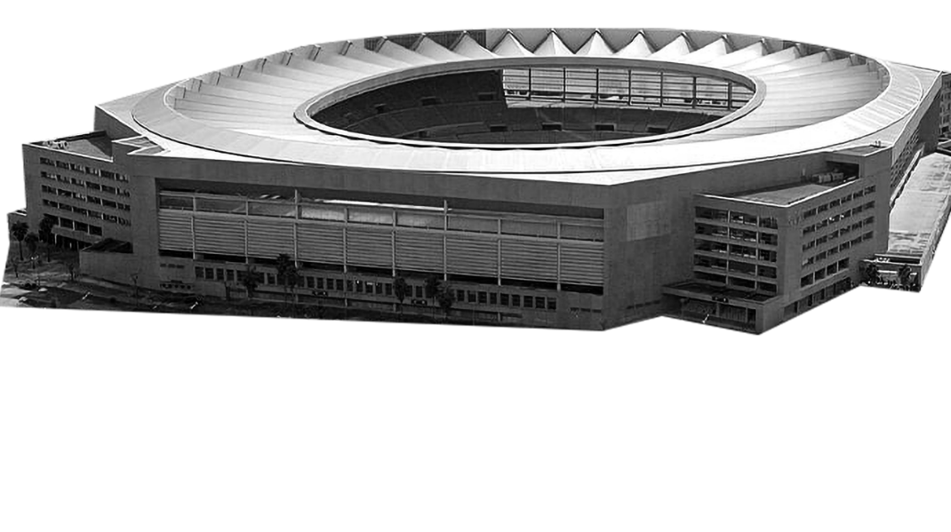
Welcome to..
SEVILLE
Continent: Europe
Country: Spain
Capital: Madrid
What country is Spain next to?
What is the official language in Spain?
Estadio La Cartuja
Toro del Oro
Notes:
Teacher Notes
Starter activity: Get students thinking about what country they are visiting.

Slide 2





Welcome to SEVILLE
You’ve made your railway journey to the city of Seville, in southern Spain. It is famous for being the birthplace of flamenco dancing, its many orange trees, and its architectural designs. It is one of the Group E hosts in UEFA EURO 2020.
What teams will be playing in this group?
Use the flags below to find out…
SPAIN
SWEDEN
GROUP E
POLAND
SLOVAKIA
Seville
Notes:
Teacher Notes
Brief introduction to Bilbao as a city.
Locate Spain and then Bilbao on the map.
Use the Bilbao Host City Guide to discuss the country in more detail (optional).

Slide 3
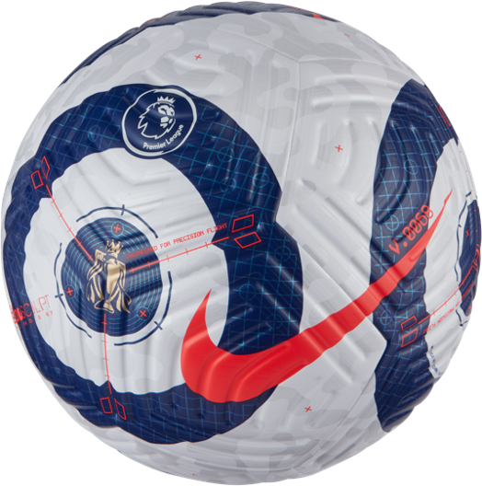
YOUR BIG QUESTION TO ANSWER IN SEVILLE IS:
What is a football made from and why?
You are going to use your knowledge of material properties to investigate what materials are best to make footballs.
Learning objectives:
To gain knowledge of how footballs are designed for different tournaments.
To investigate and compare two properties of footballs.
Notes:
Teacher Notes
The big question to answer is a key point of the lesson.

Slide 4
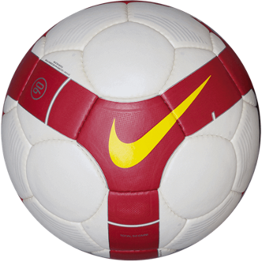
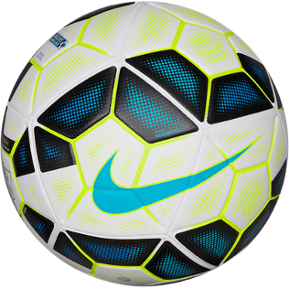
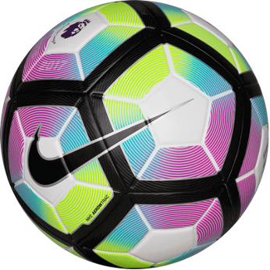
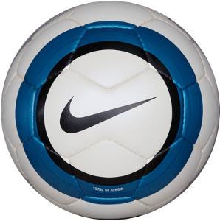
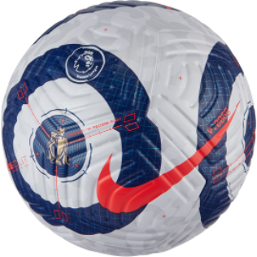
How footballs have changed
These are a selection of balls used in professional football.
In what ways can you see they’ve changed?
Complete the Activity Sheet to find out more about these designs.
1. Read the text. 2. Work out which ball the text is describing. 3. Draw a line to the ball.
Notes:
Teacher Notes
Discuss the images which show how ball design has changed over the past 15 or so years.
Q: How can you see they’ve changed?
A: Material, design, number of patches.
Q: Why do you think they changed?
A: Strength, elasticity, durability to water.
Q: Describe their shape.
Using the Professional Level Footballs Activity Sheet, ask pupils to read the information provided and match it to the images of balls shown.
Then share the next slides that take a closer look at the selected balls.
Further reading: https://www.premierleague.com/nike-ball-hub

Slide 5
Notes:
Teacher Notes
Pictures of ball development.
Slide to give a closer look at the selected balls.

Slide 6
Nike total 90 aerow 1
2004-2005
This ball used blue, black and white rings in it’s design to help players. It was made from 2mm Polyethylene. When it was used it was deemed to be the most accurate ball ever made.
Notes:
Teacher Notes
Slide used to follow up the Activity Sheet to discuss with students which footballs they identified correctly.

Slide 7
Nike total 90 omni
2008-2009
This ball has hand-sewn seams which gave the ball better aerodynamic qualities. The red, white and yellow colour scheme was designed to help players see the speed and direction of the spin of the ball.
Notes:
Teacher Notes
Slide used to follow up the Activity Sheet to discuss with students which footballs they identified correctly.

Slide 8
Nike ordem 2
2014-2015
This ball uses luminous yellow patterns to help with visibility. It was the first ball to have patches fuse-welded together. This ball had two colour schemes: One for winter and one for summer.
Notes:
Teacher Notes
Slide used to follow up the Activity Sheet to discuss with students which footballs they identified correctly.

Slide 9
Nike ordem 4
2016-2017
The rainbow design of this ball caught many eyes when on the pitch. It was made up of 12 main panels with black pentagons.
Notes:
Teacher Notes
Slide used to follow up the Activity Sheet to discuss with students which footballs they identified correctly.

Slide 10
Nike flight
2020-21
This ball has grooves cut into it’s surface which allows air to flow across it more efficiently. This means that it flies 30% truer. During it’s design phase it had 1700 hours of testing.
Notes:
Teacher Notes
Slide used to follow up the Activity Sheet to discuss with students which footballs they identified correctly.

Slide 11


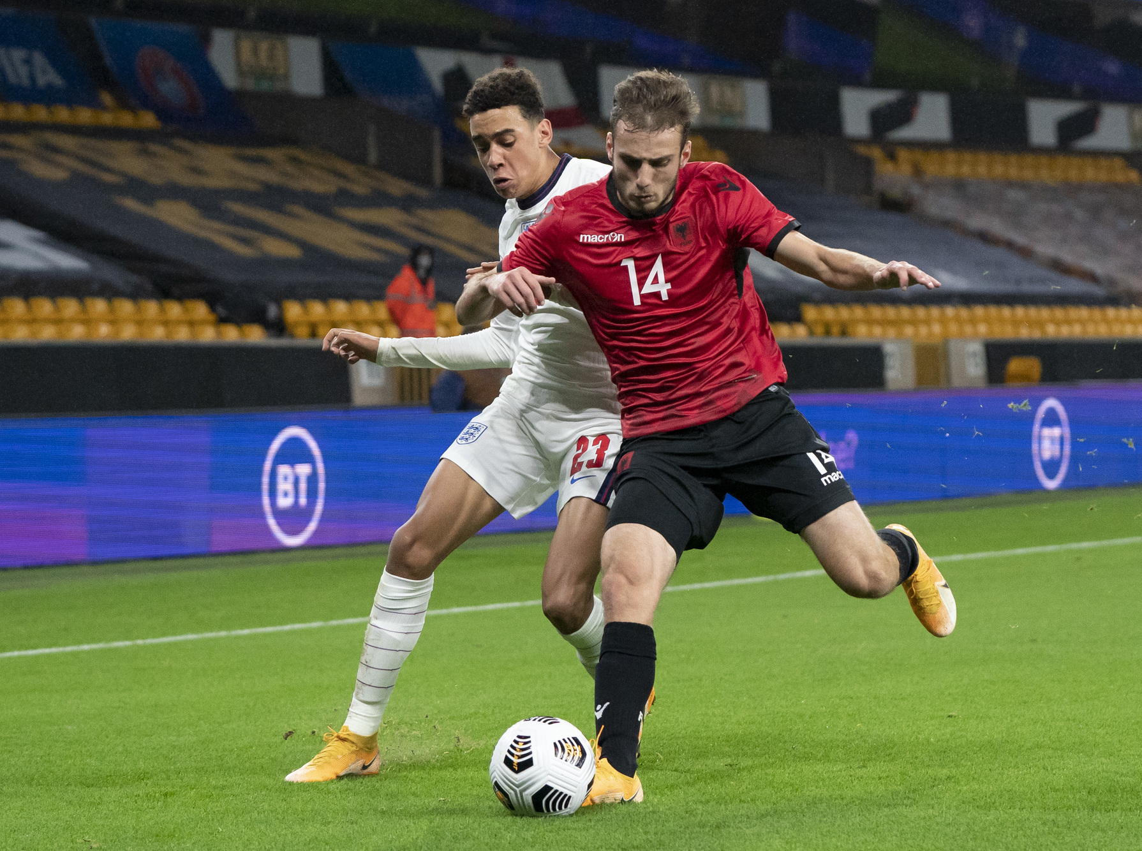
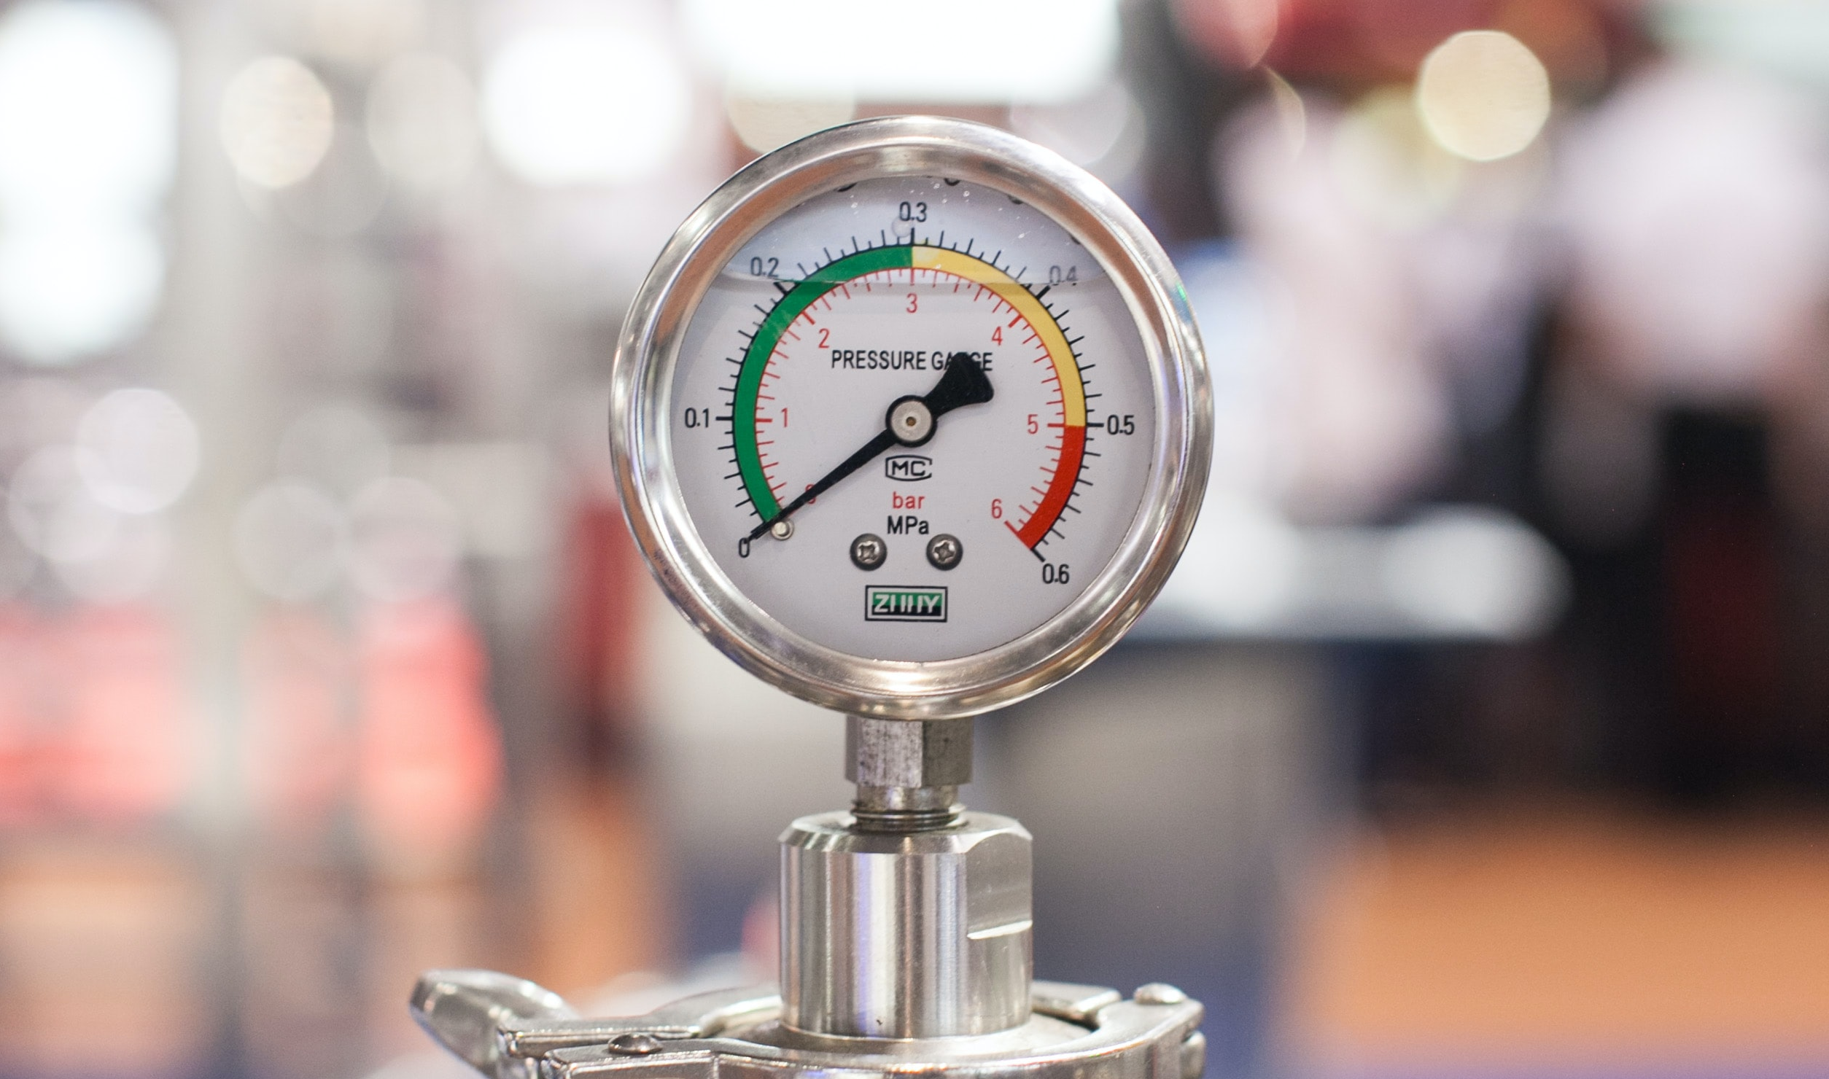
What properties are used to design a football?
Durability
    The ability to withstand wear, pressure, or damage.
Weight
How heavy an object is.
Size 5
Size 4
Size 3
Size 2
Size 1
Notes:
Teacher Notes
Question slide to start students off thinking about what properties need to be considered when designing a football.
Having a football in the classroom to look at would be really useful.
Images are used to help students think of properties: durability, weight and size.
The two properties we are going to investigate are durability and weight.

Slide 12



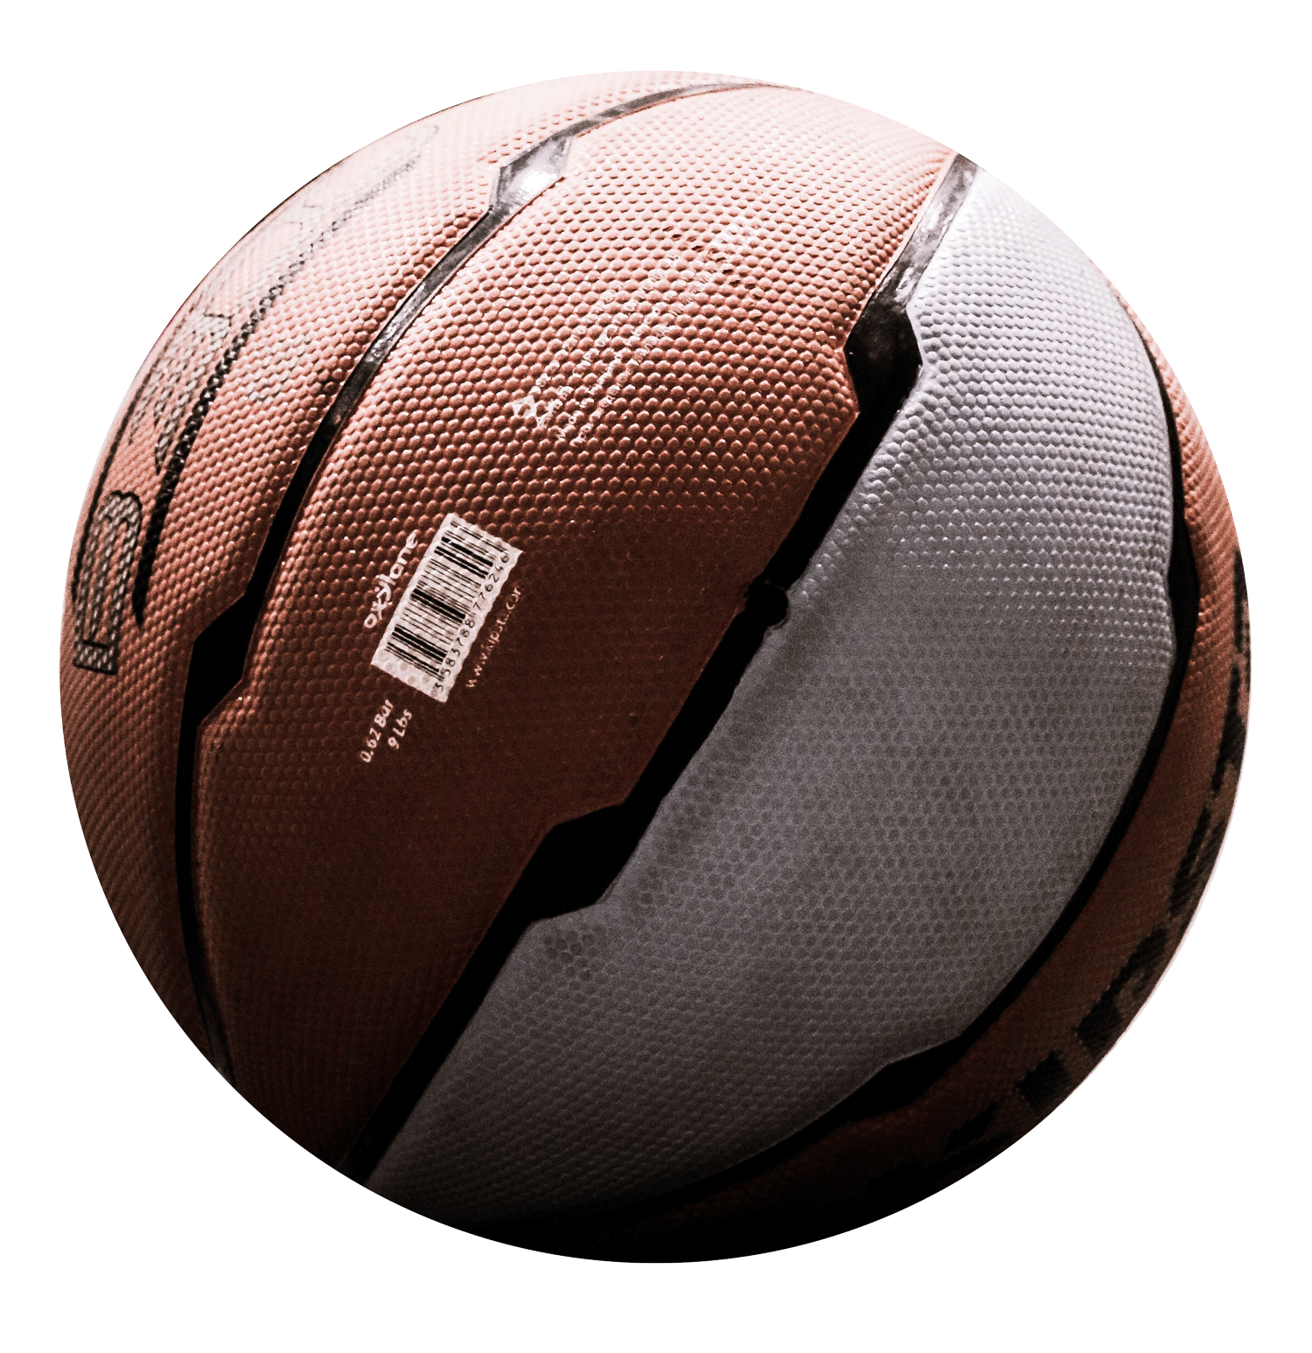
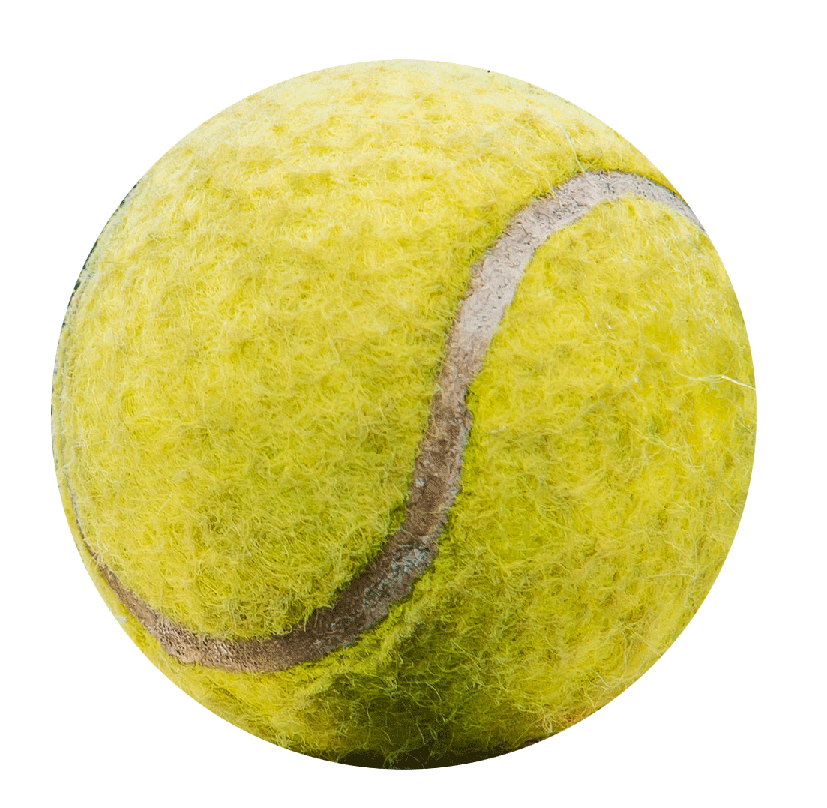
Practical task:
Comparing the properties of a football with other objects.
You are now going to test different objects against a football to investigate important properties.
Durability
Weight
Notes:
Teacher Notes
Intro to the properties investigation.
These are the objects that students will be testing the football against.
Outline expectations and behaviour of carrying out the practical work.
Hand out Compare the Properties Activity Sheet.

Slide 13
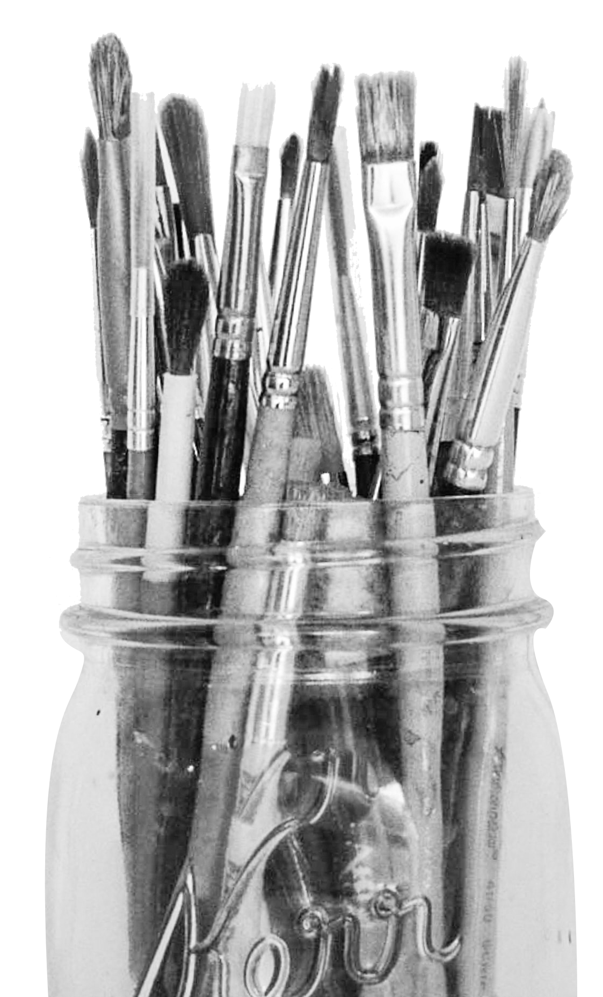
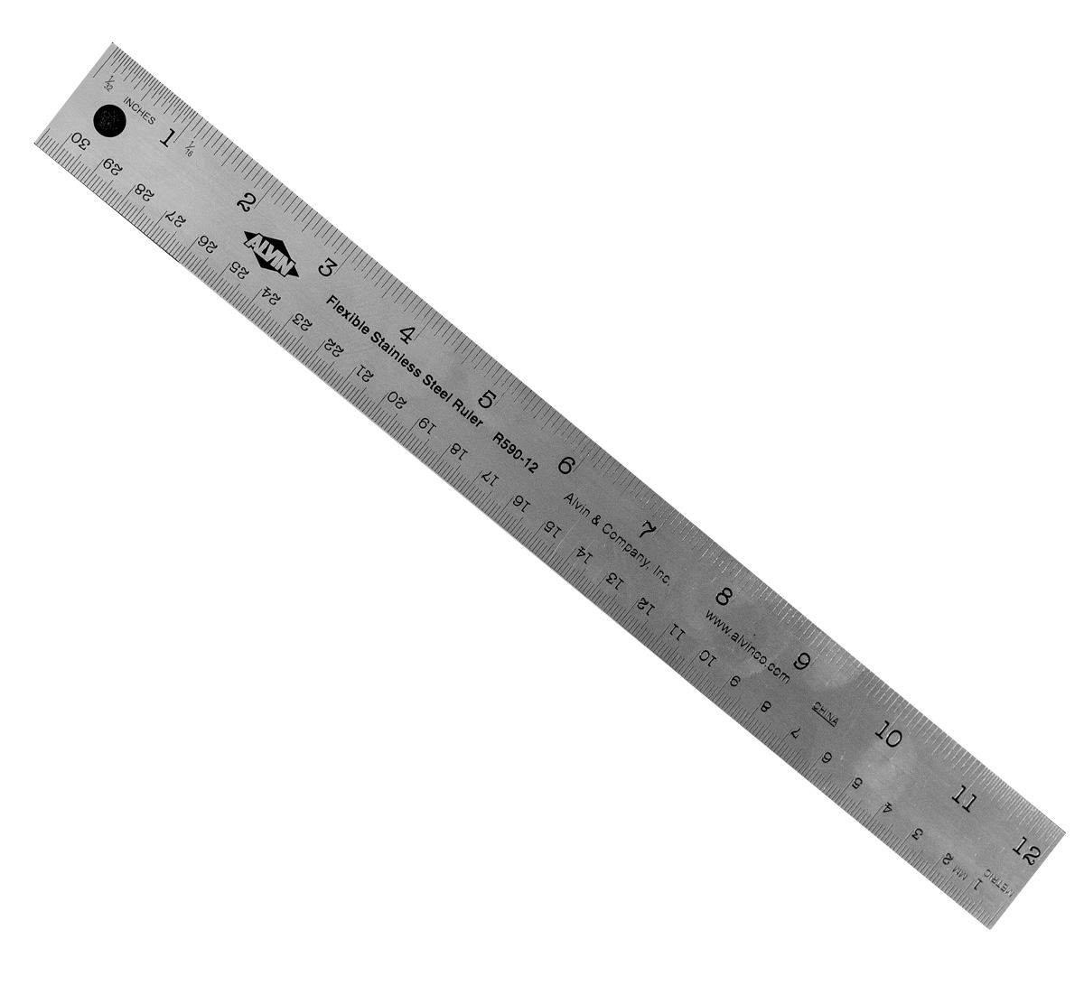
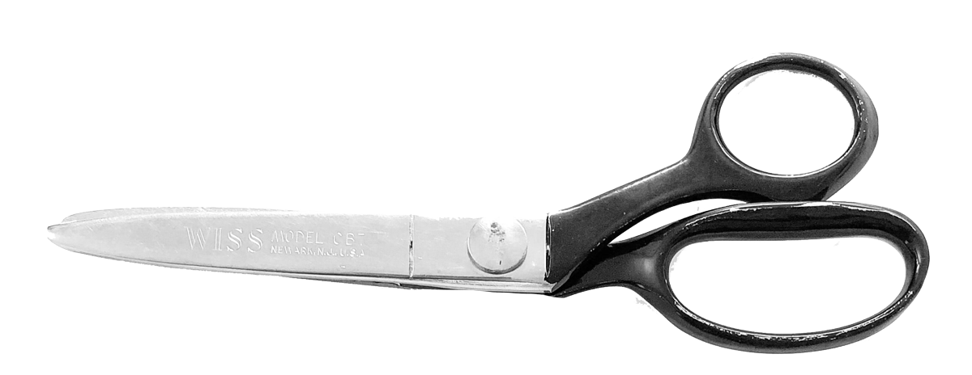
Design a match ball for your school
Name your ball
Using your knowledge of how different footballs are designed and engineered you are now going to design your own. You must:
Describe how your design is inspired by your school
Describe the properties of your ball
Design the look of your ball
Notes:
Teacher Notes
Task designed to consolidate pupils learning on footballs.
Suggest themes common with your school to assist pupils in their design. i.e. school logo/emblem, uniform design, local landmarks etc.

Slide 14


Let’s write home
Write a postcard home saying what you have learnt about material properties for making footballs.
Can you include:
What a football is made of.
Two different properties.
How footballs are designed for different tournaments.
Where are we going next?…..
Notes:
Teacher Notes
Students to consolidate their learning within this section.
Linking back to the big question.

