Slide 1
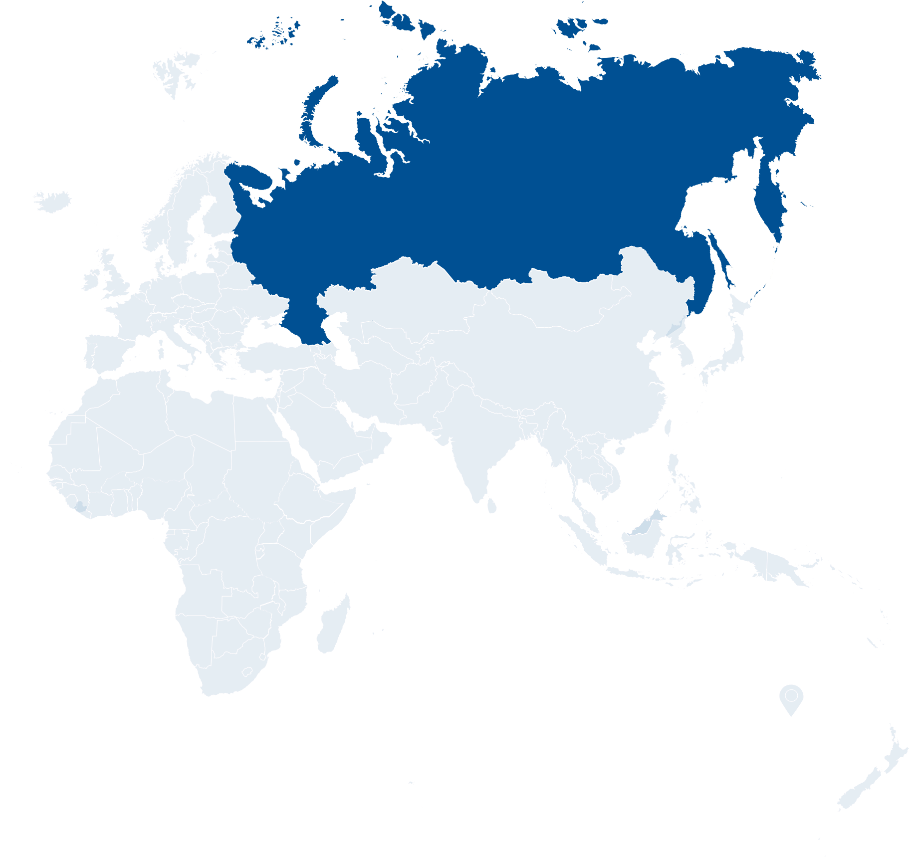
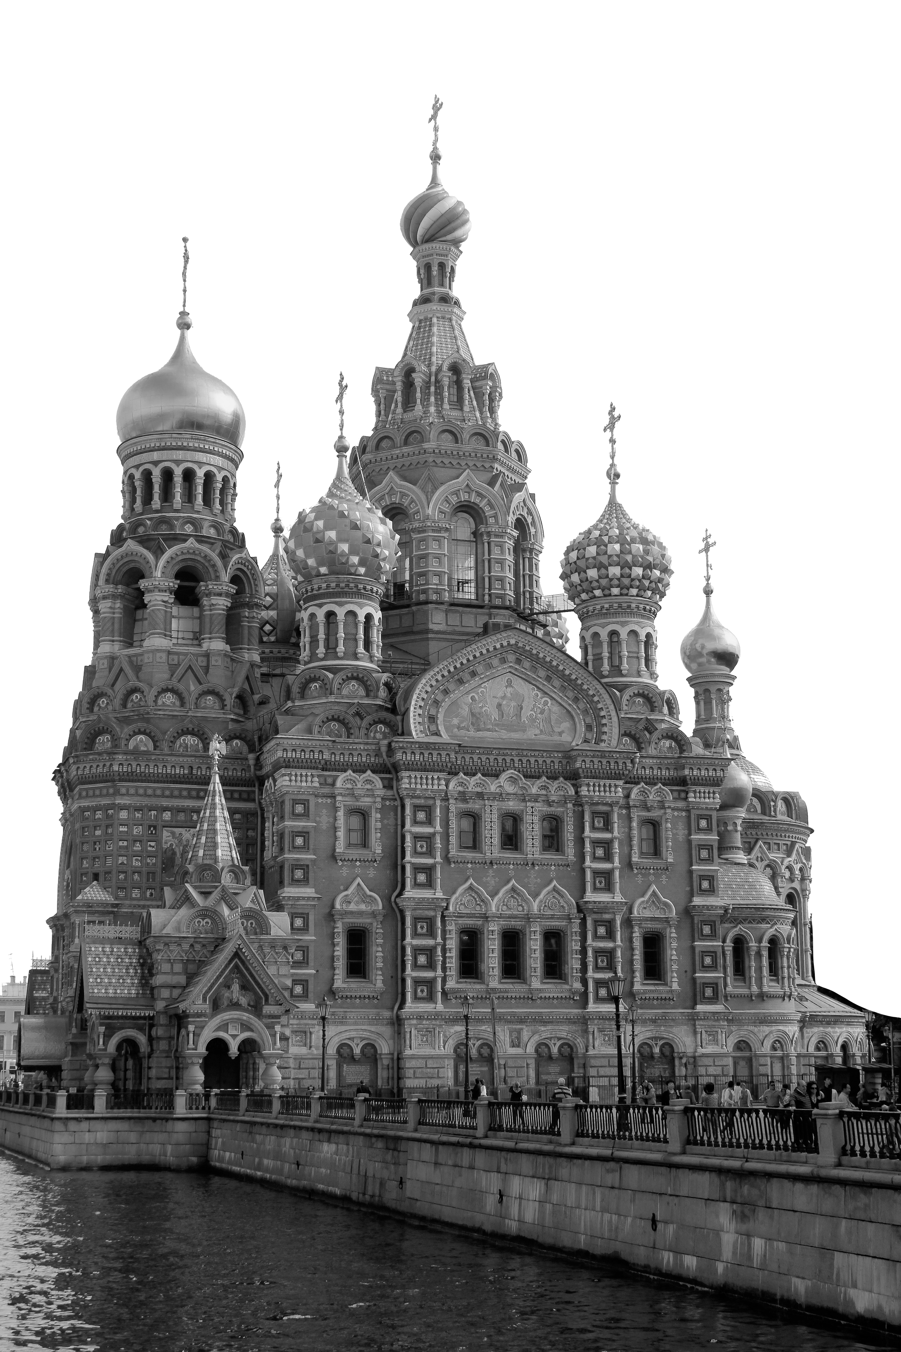
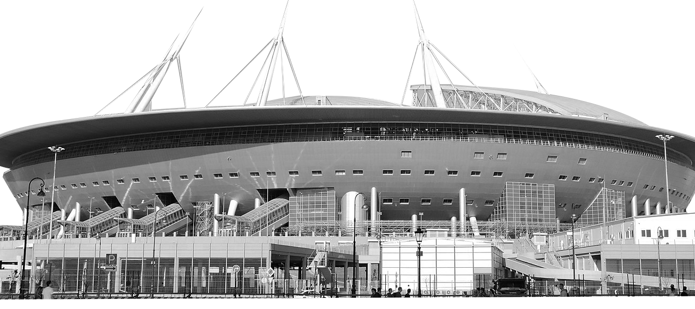
Welcome to..
St. petersburg
Continent: Europe
Country: Russia
Capital: Moscow
Church of the Saviour on Spilled Blood
What country is Russia next to?
What is the official language of Russia?
Krestovsky Stadium
Notes:
Teacher Notes
Starter activity: Get students thinking about what country they are visiting.

Slide 2
Welcome to st. petersburg
You’ve made your railway journey to the city of St. Petersburg in Russia, which is famous for its canals, palaces and churches. It is one of the hosts for both Group B and Group E in UEFA EURO 2020.
What teams will be playing in these groups?
Use the flags below to find out…
DENMARK
SPAIN
St. Petersburg
FINLAND
SWEDEN
GROUP B
GROUP E
BELGIUM
POLAND
RUSSIA
SLOVAKIA
Notes:
Teacher Notes
Brief introduction to St. Petersburg as a city.
Locate Russia and then St. Petersburg on the map.
Use the St. Petersburg Host City Guide to discuss the country in more detail (optional).

Slide 3
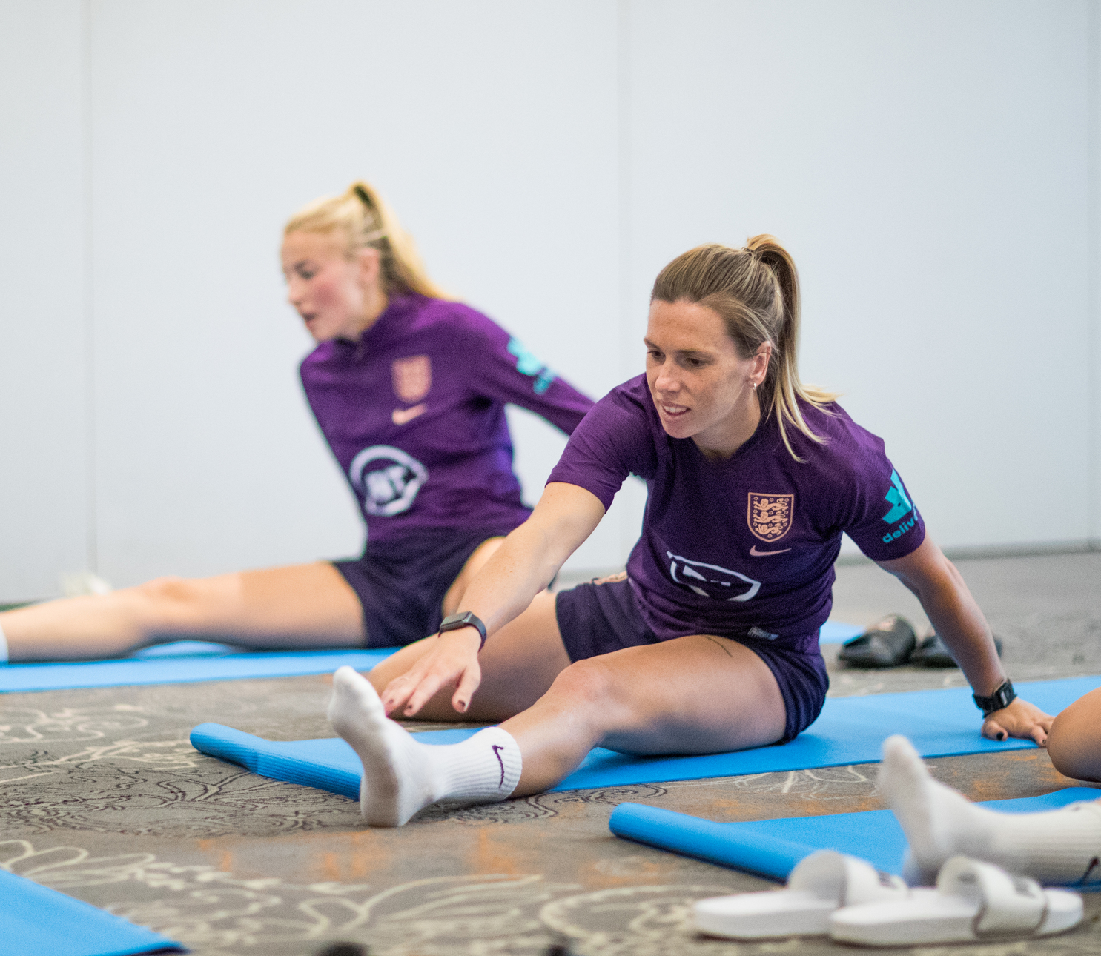
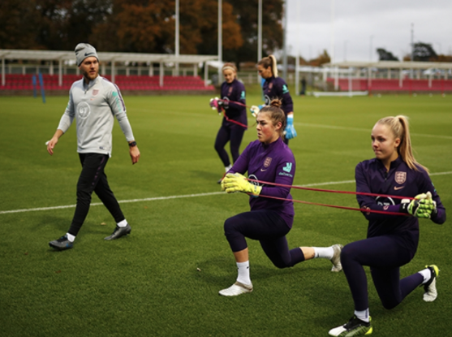
YOUR BIG QUESTON TO ANSWER IN ST. PETERSBURg IS:
What does it take to become an international footballer?
Learning objectives:
Recognise the four key aspects of a healthy lifestyle and their impact on the way bodies function.
Carry out a physical profile assessment.
Take measurements using a range of scientific equipment and record your data.
Notes:
Teacher Notes
The big question to answer is a key point of the lesson.

Slide 4
What does it take to become an international footballer?
Notes:
Teacher Notes
Discuss as a class.
Prompts if needed:
Fitness.
Skill at football (ability).
Attitude.
Resilience.
Individual/team player?
Health – physical, mental and emotional.
Understanding of dietary requirements.

Slide 5
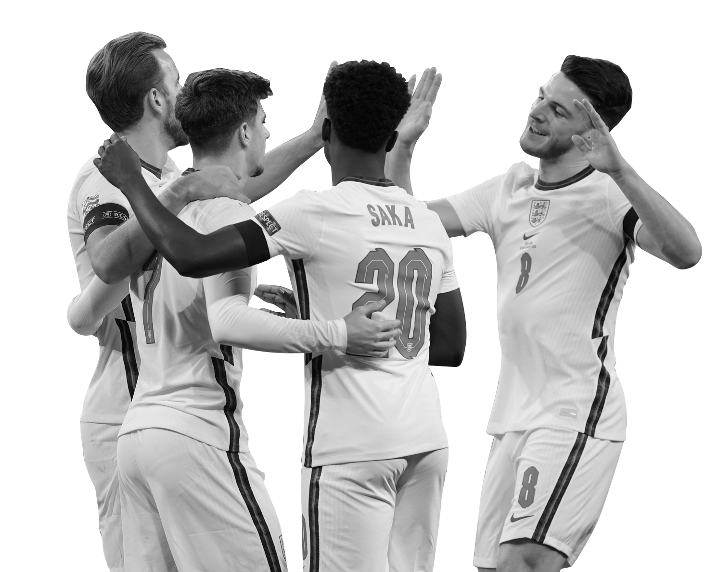
What did you come up with?
Here are some key factors:
High level of fitness.
Skill at football.
Positive “can do” attitude.
Resilience.
Good team player.
Good health - physical, mental and emotional.
Ambition.
Healthy lifestyle.
Notes:
Teacher Notes:
Display this list. Did pupils come up with similar ideas?

Slide 6
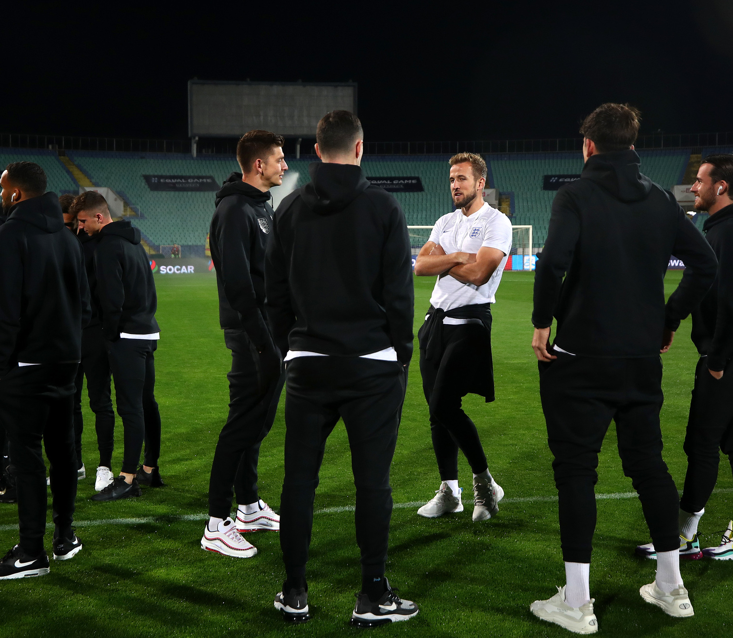
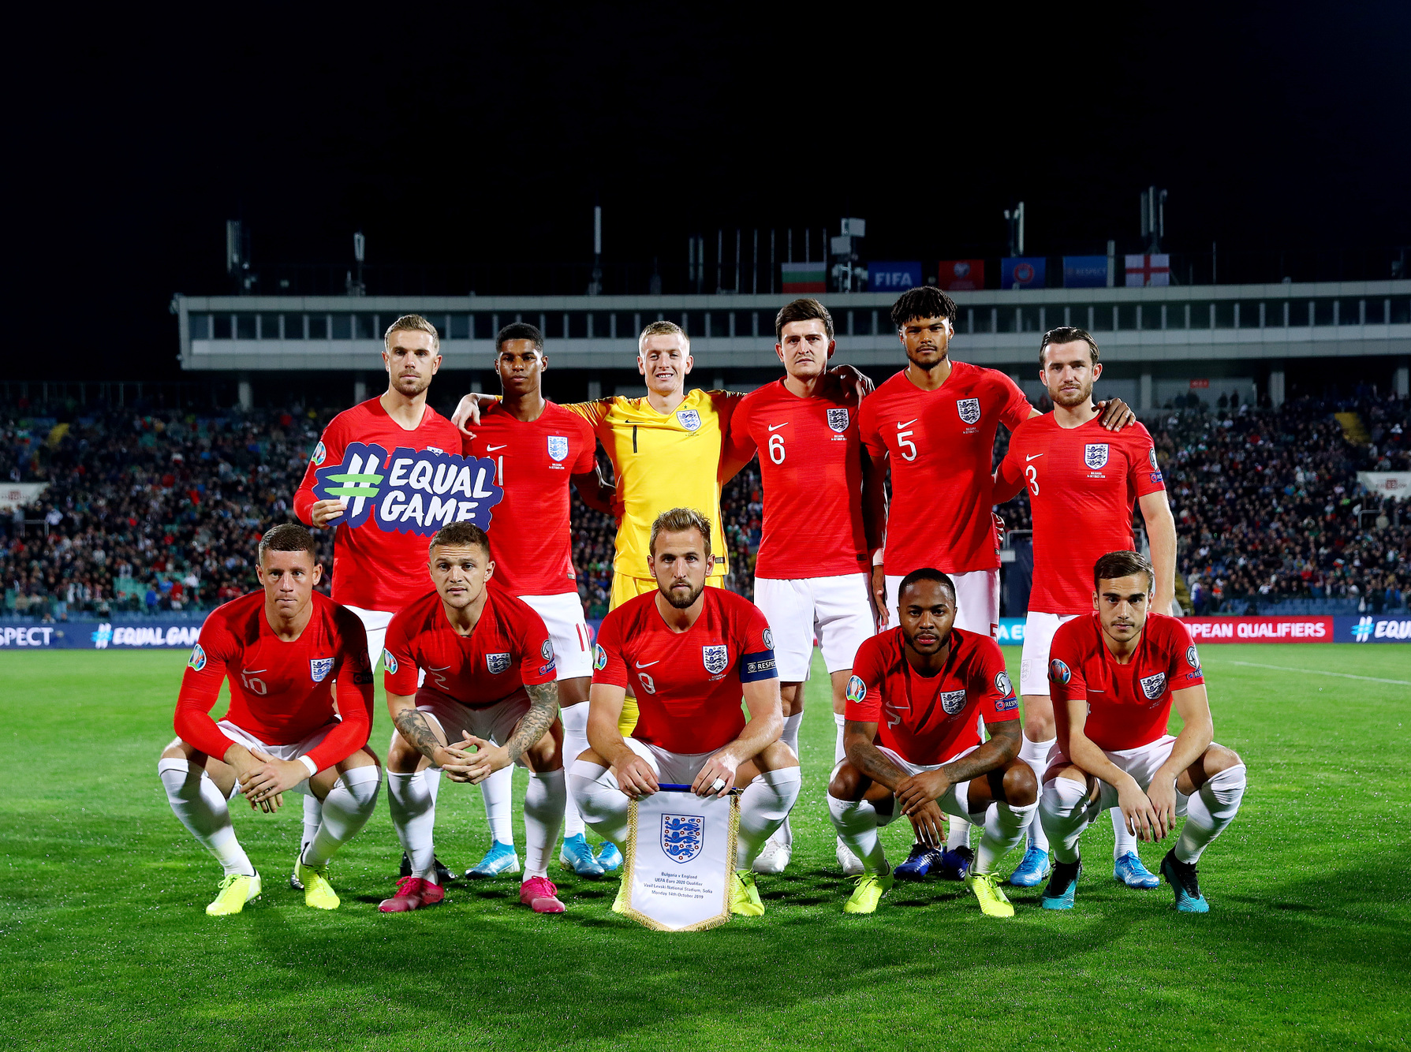
Impact of diet, exercise, drugs and lifestyle on your body
How is an individual’s approach to diet, exercise, drugs and lifestyle important in football?
Think, Pair, Share
Notes:
Teacher Notes
Working in pairs, ask pupils to think about how an individual’s approach to diet, exercise, drugs and lifestyle are important in football, and sport in general.
Gather pupils' ideas on sticky notes/paper to stick on a board/the wall and discuss as a class..
Ask pupils what sacrifices/commitments the players may have to make in order to become an international footballer. Do they have to eat a certain diet (links to Munich Challenge)? Do they train regularly? Should they be very careful about what medicines they take and make? Is it likely they have to make lifestyle choices that may mean missing out on certain activities like high risk sports where they could get injured?

Slide 7
FOUR KEY ASPECTS OF A HEALTHY LIFESTYLE
Balanced diet
and their impact on body function
Only take prescribed drugs (medicines)
Healthy
lifestyle
Regular exercise
Your body needs:
A balanced diet to grow and repair itself, including water and five portions of fruit and vegetables a day.
Regular exercise to keep your heart, lungs and muscles strong and healthy.
Avoid drugs that can alter the body’s function in a negative way or are not allowed in international football.
Sleep and rest so your body has time to recharge and recover from training or matches. This will help prevent injury.
Plenty of sleep
and rest
Notes:
Teacher Notes
Outline the four key aspects. Do they do any/all of these?

Slide 8
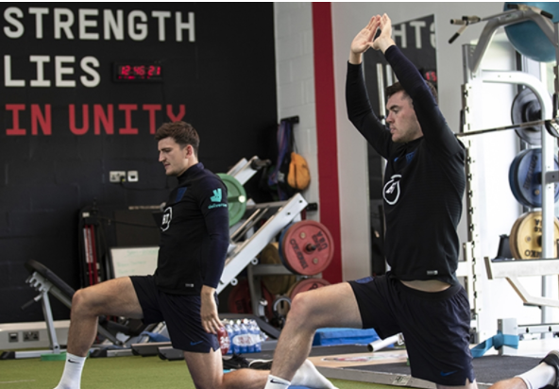
CHALLENGE ACTIVITY:
1. Long jump
This measures braking strength which is important as it allows a player's body to cope with constant change of directions.
2. Long lever bridge
This measures hamstring strength which is important as these muscles need to be able to cope with repetitive sprinting demands during a match.
Physical Profile
Click here for an example
3. 1km time trial
This measures repeat and recover capability which is needed for players to perform intense movement over and over again in a match without tiring and affecting performance.
Notes:
Teacher Notes
Link to clip showing how to do the physical profile: https://www.thefa.com/news/2020/apr/07/train-like-the-lions-martin-evans-12-week-plan-080420
See benchmark data for each exercise – please be aware younger children will not be expected to reach these are they are still growing. It just gives them an idea of what to aim for in the future.
Benchmark distance for active male = 1.85m female 1.5m.
Benchmark for an active person is 2 minutes.
Benchmark for active female is under 4 minutes and an active male is under 3 minutes 45 seconds.
Risk assess each activity for your group. Not all activities may be appropriate if pupils have medical conditions. If so these pupils can be involved by recording, timing, measuring out 1km distance to run etc.
Pupils can work in small groups and move around activities. Options: Alternate activity 1 and 2 in small groups and then do 1km run as a class or do each activity as a class in order.

Slide 9
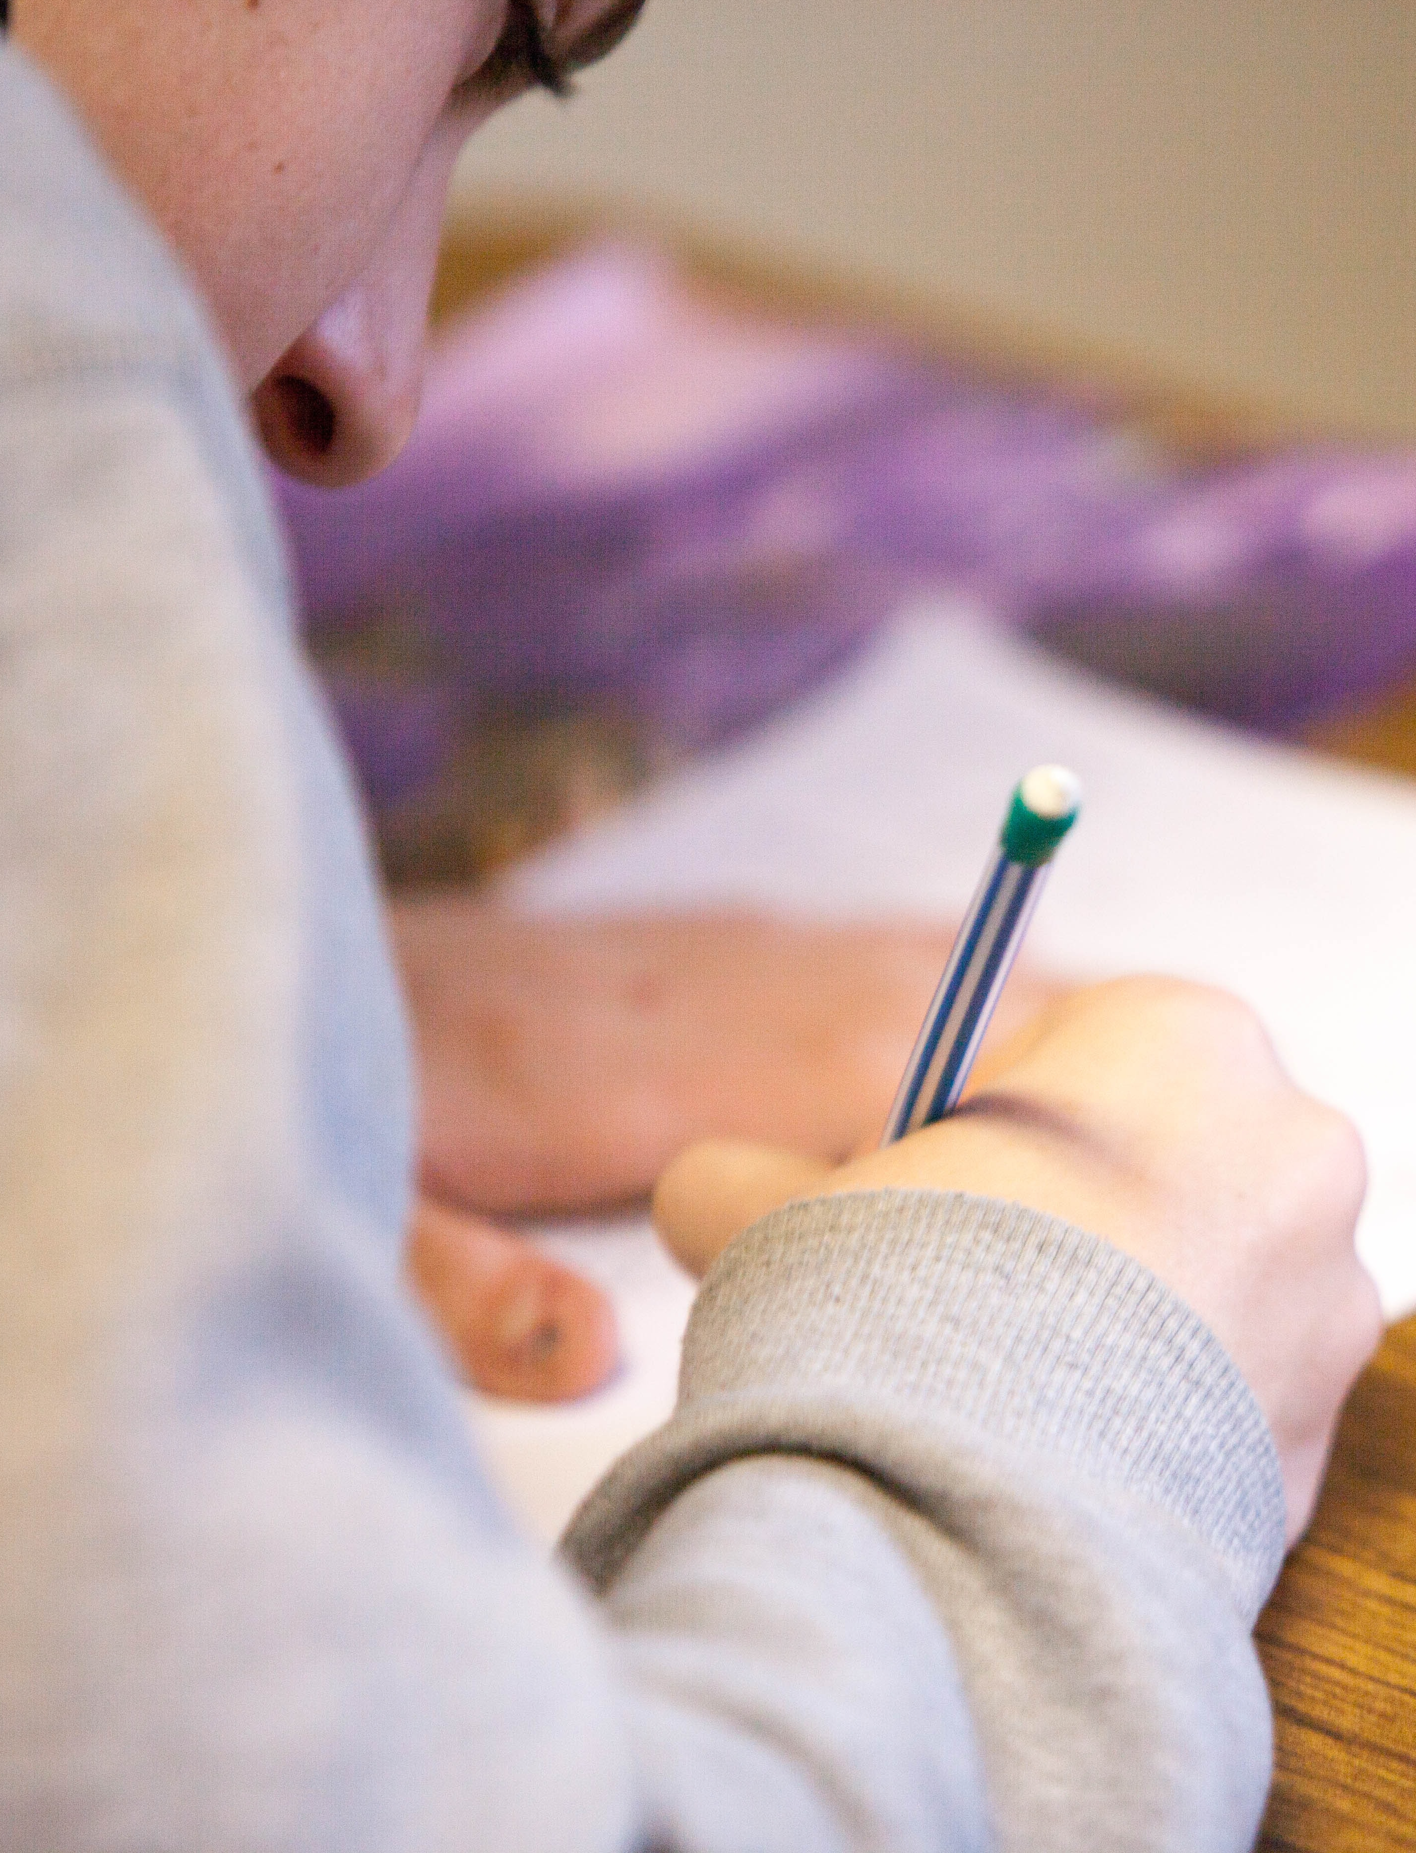
HOW WILL WE RECORD OUR RESULTS?
Task:
Make a list of the equipment will you need.
Design a table suitable to record your groups results in.
Remember to include the units in the table headings.
Notes:
Teacher Notes
Optional task here to focus on developing Upper KS2 Science skills section from national curriculum. See next slide for a table to provide to pupils if needed/if time is limited.

Slide 10
HOW DID YOU GET ON?
NAME | Long Jump (m) | Long level bridge (minutes) | 1Km run (minutes)
Notes:
Teacher Notes
Use this table to compile class results if you want to display them, or print off for pupils to record their times.
Here is link to extending this profiling past the introduction and for 12 weeks: https://www.thefa.com/news/2020/jun/23/train-like-the-pride-week-12-240620. Scroll down to see the clips explaining the exercises for each week.

Slide 11
EXTENSION:
How can you present the class results for girls and boys?
What sort of graphs could you use?
Can you calculate average results to compare the boys and girls results compared to the benchmark data?
Average = sum of all results ÷ number of results you have
Notes:
Teacher Notes
Example: 1km run
Pupils could work out average class time for 1km run for girls and boys and plot a bar graph comparing this to benchmark data. They could also add their own data onto the graph so they can see how they compare to the class average and benchmark.
Five bars in total:
Average girls.
Average boys.
Benchmark male.
Benchmark female.
Their own time.
They could discuss what they think would be the best order to plot bars in going across the x axis from left to right so they can best compare their, and the classes results, with the benchmarks.

Slide 12
LET’S WRITE HOME
Write a postcard home saying what you have learnt about what it takes to become an international footballer.
Can you include:
The four key aspects of a healthy lifestyle.
How each aspect helps to make an international footballer.
How to carry out a physical profile.
Where to next…..
Notes:
Teacher Notes
Students to consolidate their learning within this section.
Link back to the big question.

