Slide 1
School assembly
Notes:
N/A

Slide 2
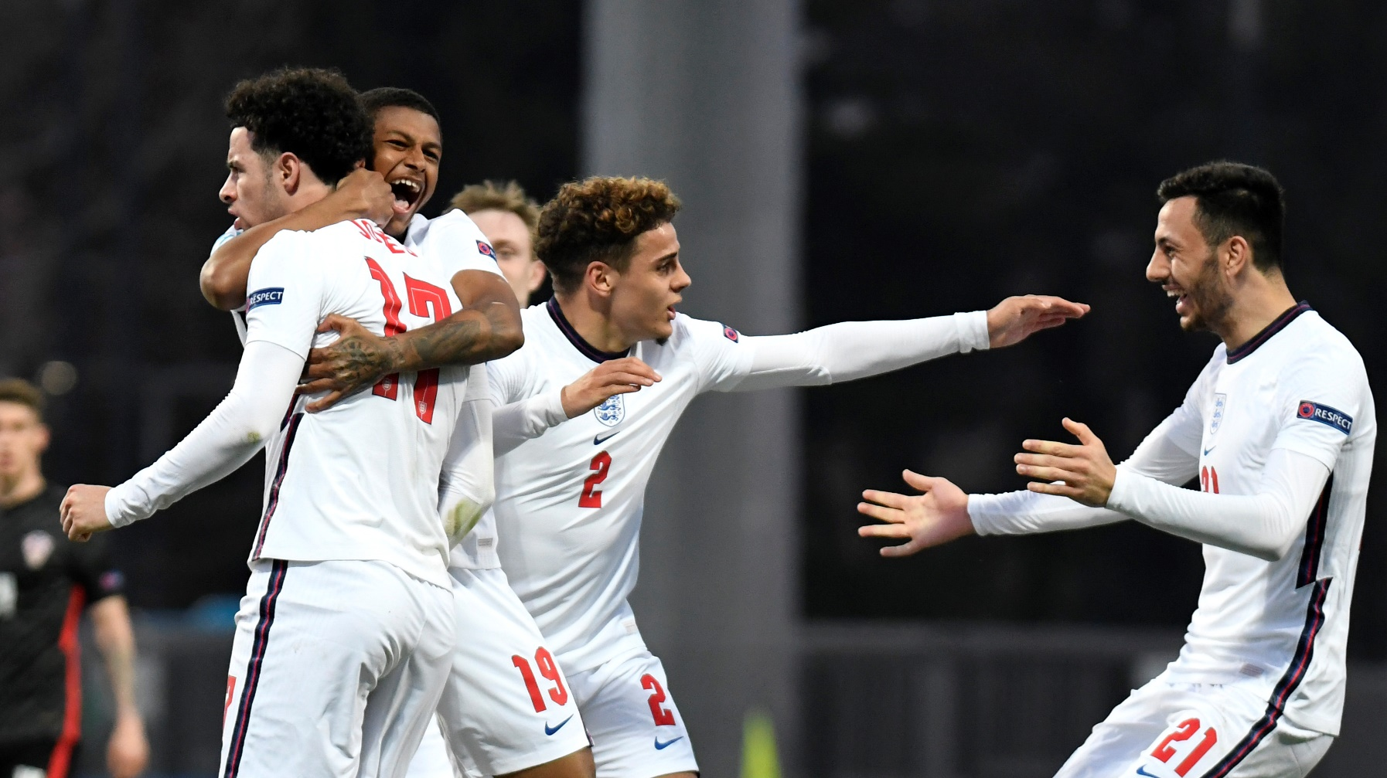
Celebrating a return to sport
A football tournament between 24 competing nations.
Teams play in pre-selected ‘groups’ which are drawn at random.
The teams in each group play each other in a round robin. The top two teams in each group then progress to the knock out stage.
Eventually only 2 teams will be left, and they will play in a final to win the UEFA EURO 2020 cup.
Notes:
Teacher notes
Ask if anyone knows of an exciting sporting tournament taking place this summer.
Answer: UEFA EURO 2020
Explain what the Euros are.
Play Euro’s promotional video.

Slide 3
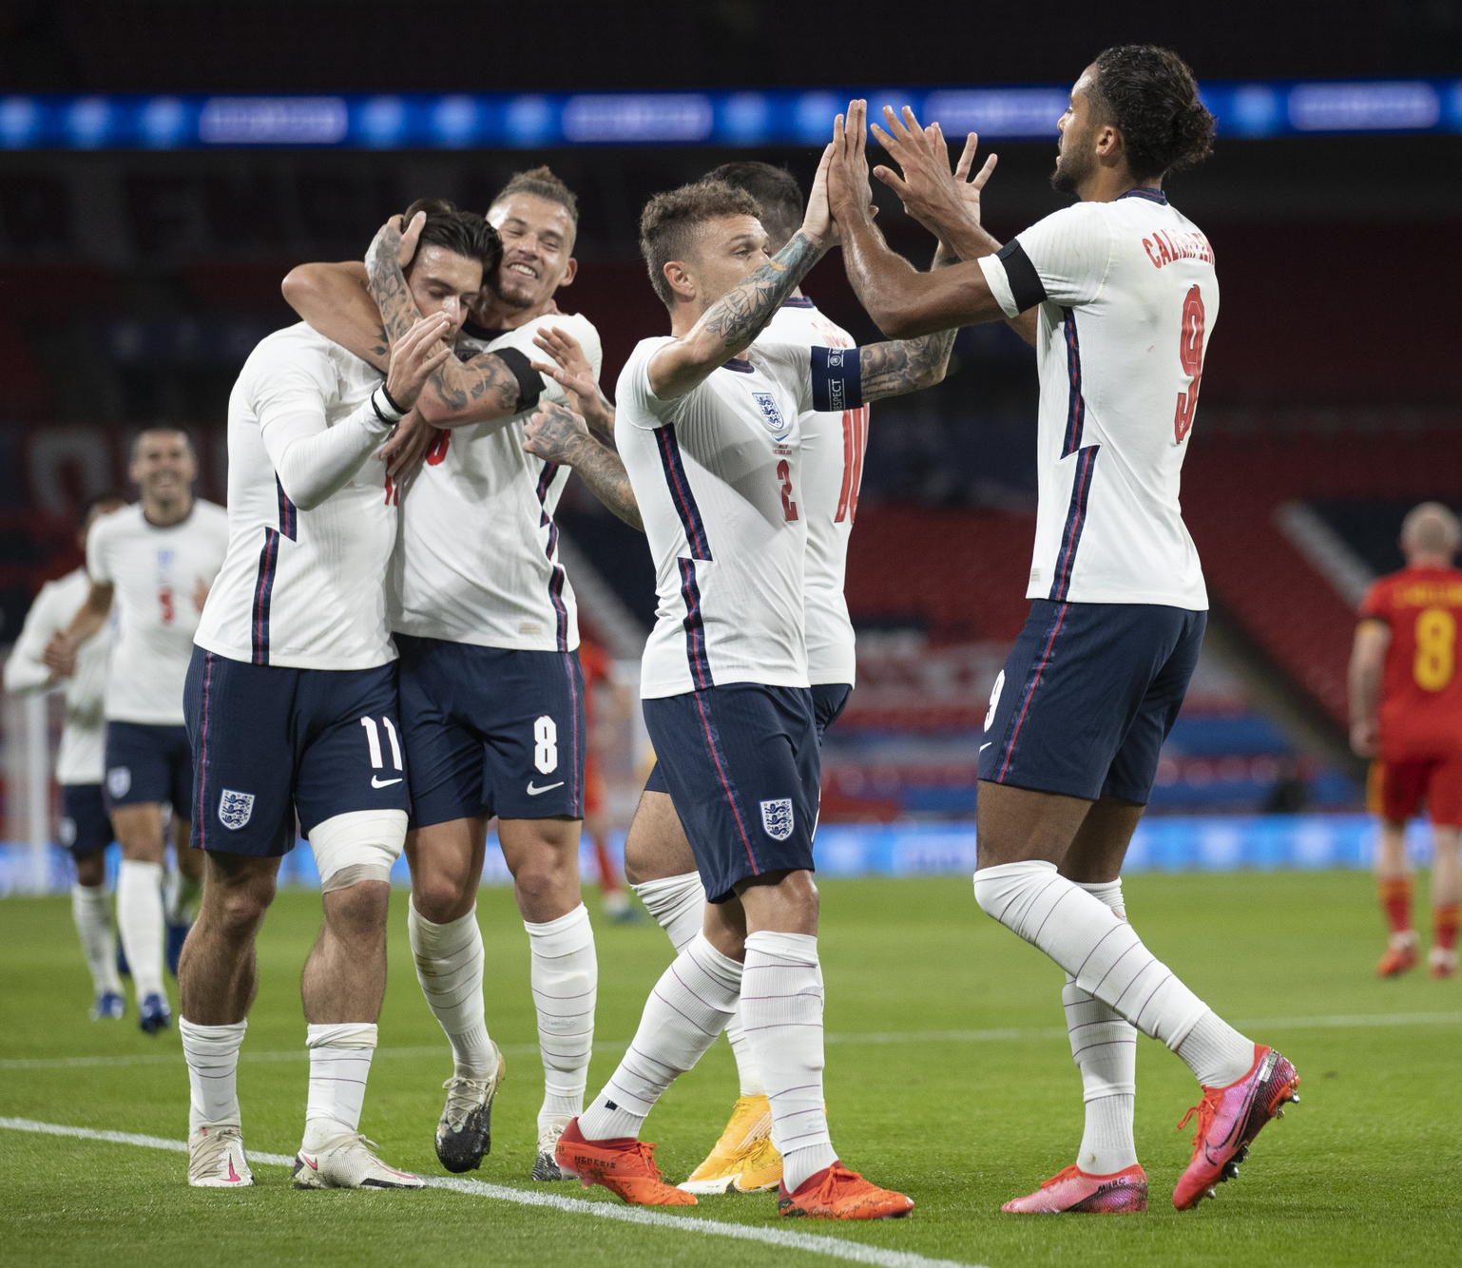
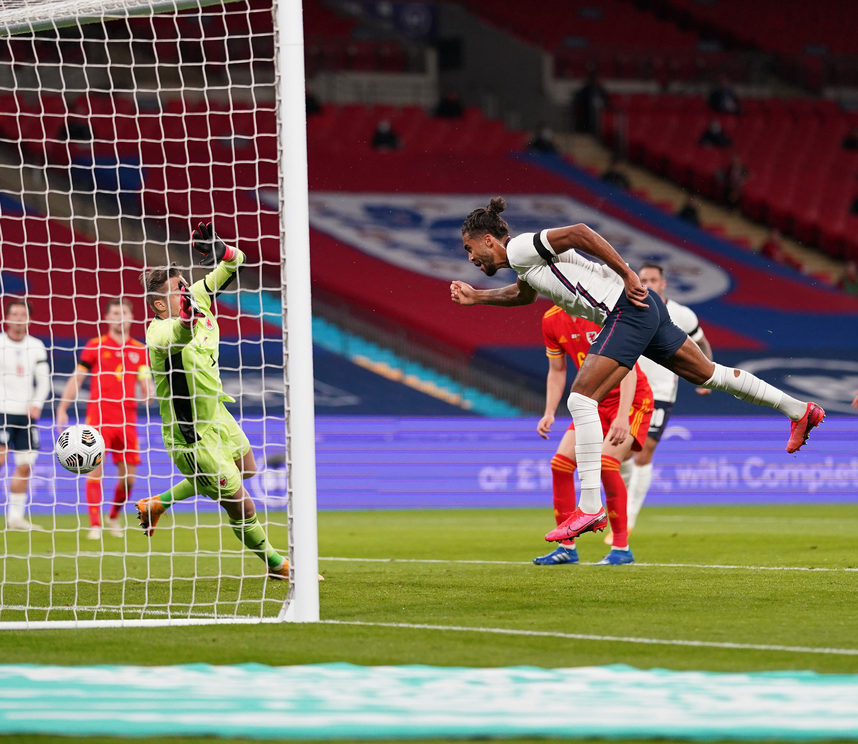
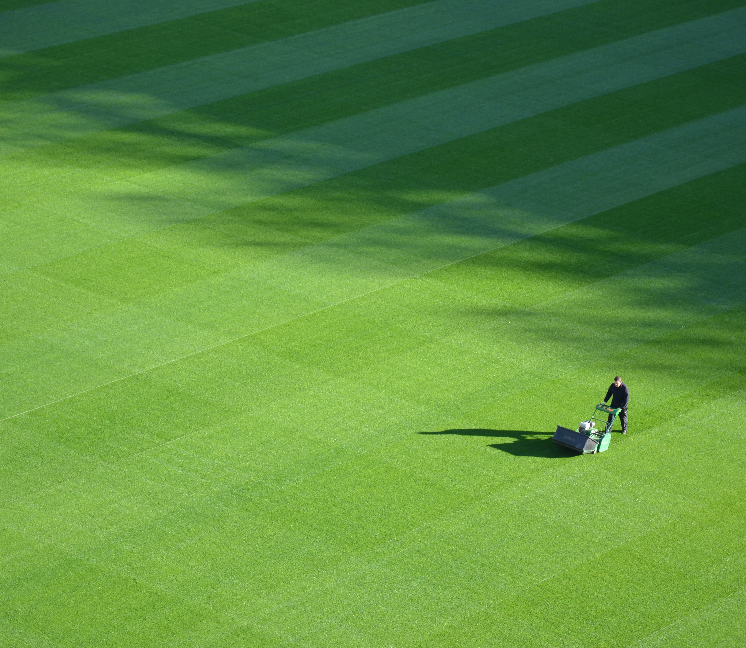
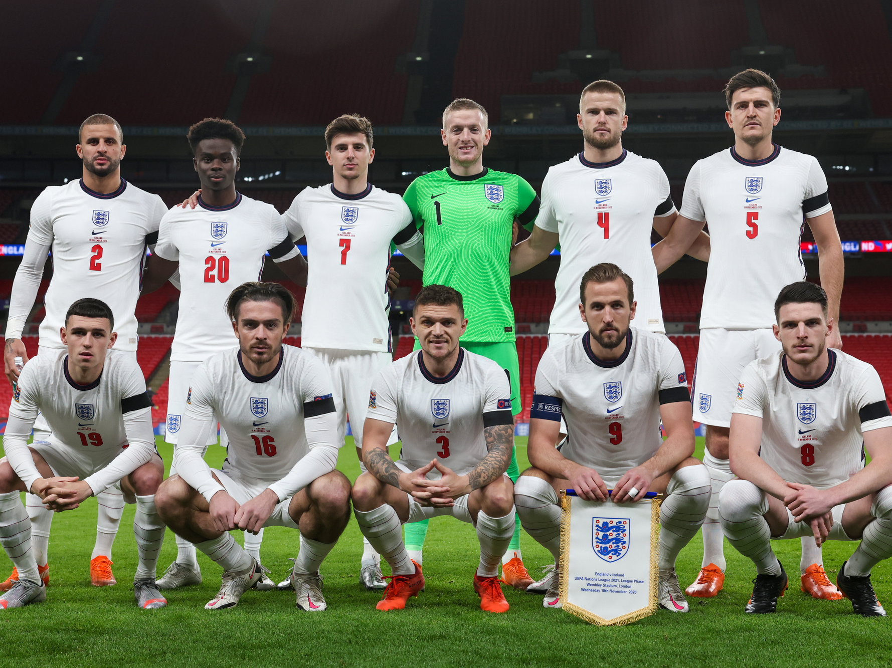
UEFA euro 2020
Matches start on 11th June 2021.
The final will be held on 11th July 2021 and will be hosted at Wembley Stadium in London.
In 2016, two billion people across the world watched the tournament.
The tournament takes place every four years and there have been 15 UEFA European Championship finals so far.
This year is the first time in the competition’s history that games are being held across different locations in Europe.
Notes:
Teacher notes
Discuss how many days there are to go until the tournament starts.

Slide 4
What is uefa euro 2020?
24 Nations
11 Host Cities
To qualify for UEFA EURO 2020 teams played in the European Qualifiers from March to November 2019.
To be selected as a host for the tournament, cities must submit a bid to UEFA who then choose the best applicants.
Austria
Belgium
Croatia
Czech
Republic
Denmark
England
Finland
Sweden
Netherlands
North
Macedonia
Poland
Portugal
Russia
Scotland
Slovakia
Switzerland
Ukraine
Wales
France
Germany
Hungary
Italy
Spain
Turkey
Notes:
Teacher Notes
24 nations are competing and the games will be played across 12 host cities.

Slide 5
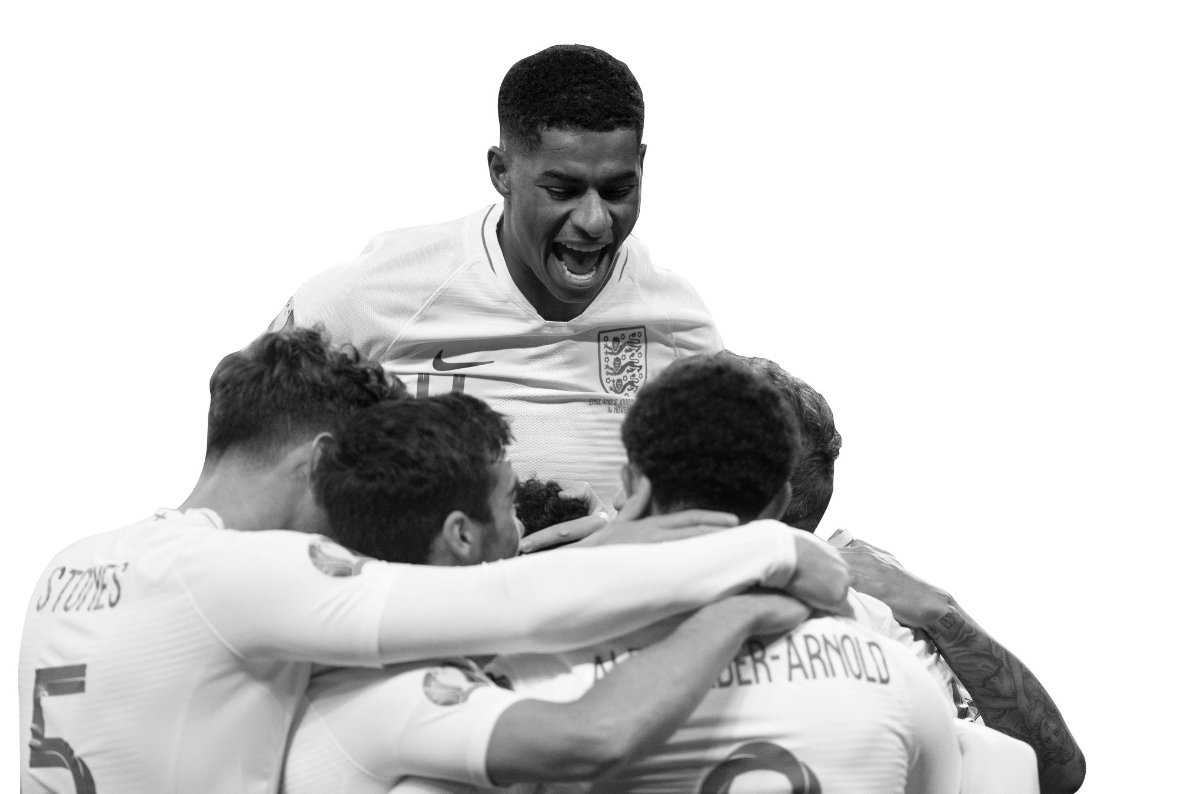
Why do we play team sports?
I feel happy
I can make new friends
I learn to work with others
I feel good about myself
I don’t worry about things as much
I learn to problem-solve
I have a lot of fun
Notes:
Teacher notes
Teacher to pose the question to the pupils: Why do we play team sports?
Outline skills/benefits of team sports:
Problem solving
Reduces stress and anxiety
Collaboration skills
Reduces stress and anxiety
Health and fitness
Improved mental health
Social skills

Slide 6
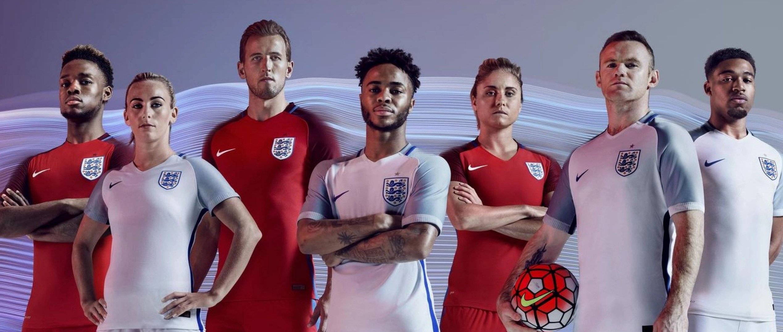
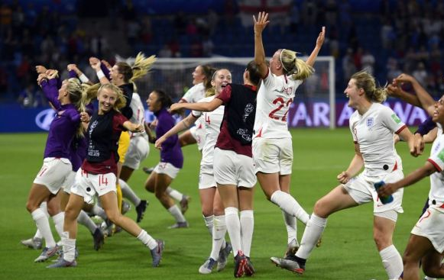
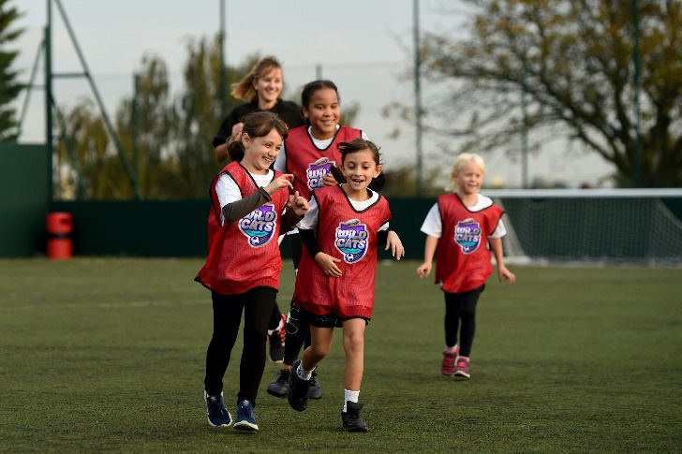
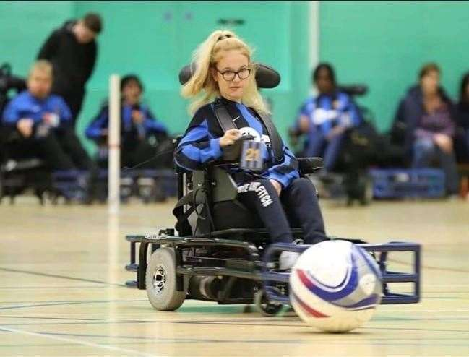
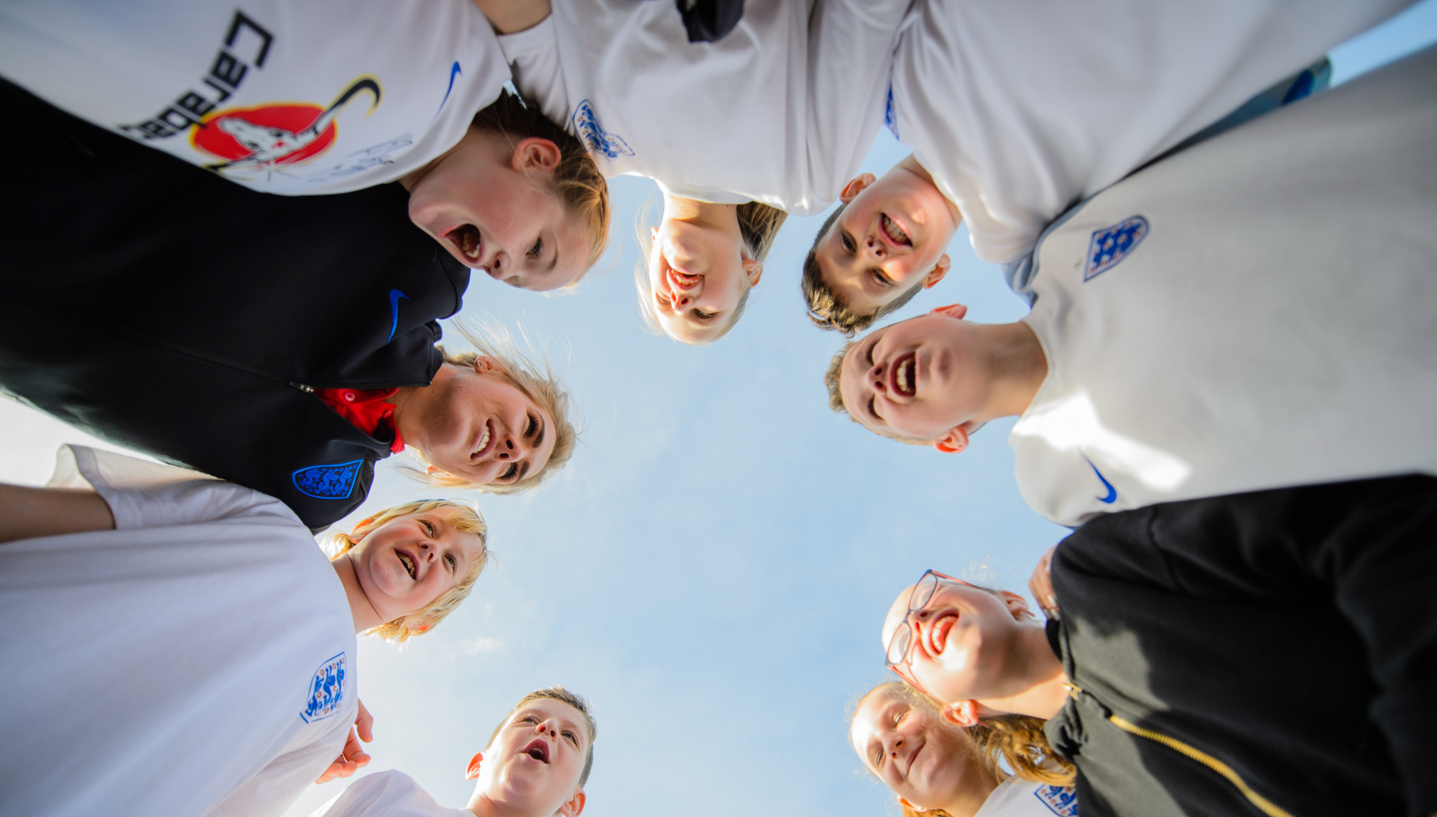
Game for all
Who plays football?
Notes:
Teacher notes
Explain to pupils that football is a game that anyone can play. EURO 2020 is a men’s tournament but the women’s tournament is next year.

Slide 7
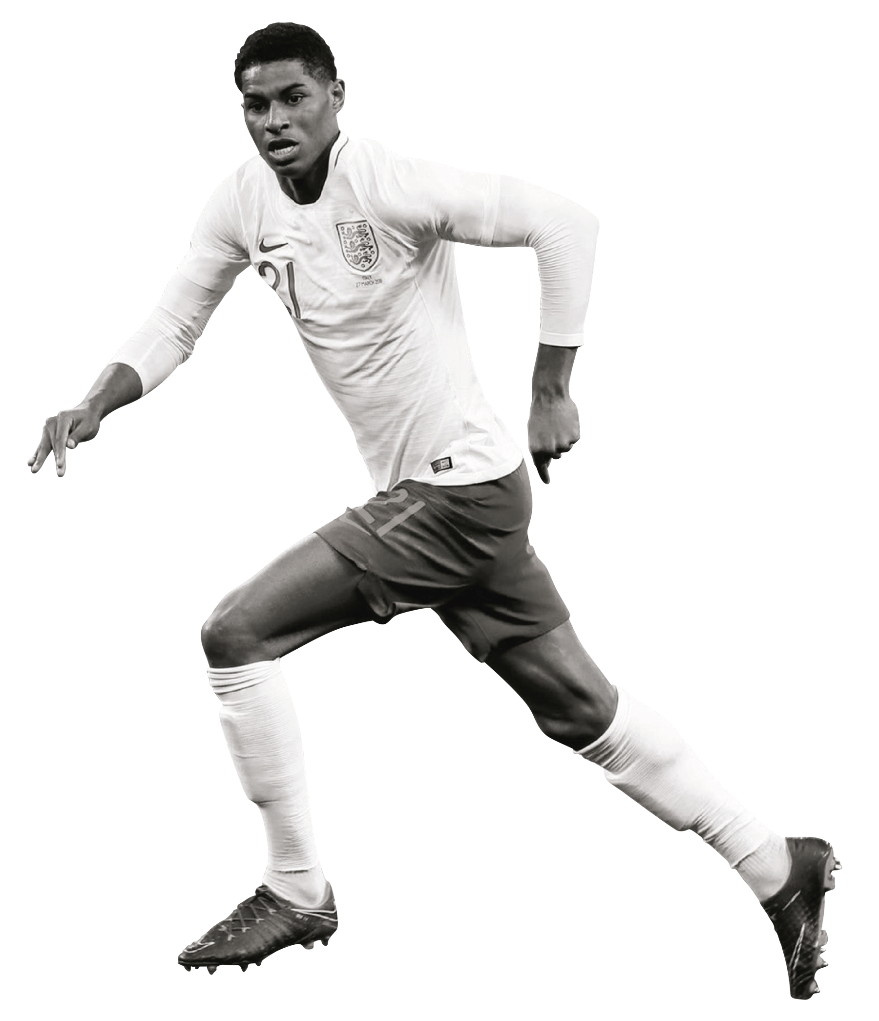
Game for all
Think about the following statements:
An hour of sport every day should be compulsory in schools.
Competitive sport should not be played in schools.
Penalty shoot-outs are an unfair way to win a match.
VAR (video assistant referee) is bad for football.
In football, the captain is always right.
Girls are not as good as boys at playing sports.
Notes:
Teacher Notes
Explain to students that football is a game that anyone can play.
Choose a statement from the grid.
Read out the statement to the audience
Ask for students' thoughts about each statement. Do they agree or disagree?
Discuss the statements chosen and challenge any misconceptions.
Reiterate football is a game for all - anyone can play and get involved.

Slide 8
Get involved!
Matches start on 11th June 2021 and will be shown on ITV and BBC.
There are 11 host cities across Europe, including London.
The final is being played at Wembley Stadium on 11th July.
The UEFA Women’s EURO matches are being held from 6th to 31st July 2022.
The women’s tournament is being held in England - 10 stadiums, from Old Trafford to Wembley will host games.

